Slide 1
Lecture 10
Chubby and Zookeeper

Slide 2
Implementing RSMs
Logical clock based ordering of requests
  Cannot serve requests if any one replica is down
Primary-backup replication
  Replace primary/backup upon failure
  Relies on always available view service
Paxos-based replicated service
  Available as long as majority in same partition

Slide 3
Case Studies (in brief)
Chubby (OSDI 2006)
ZooKeeper (USENIX ATC 2010)

Slide 4
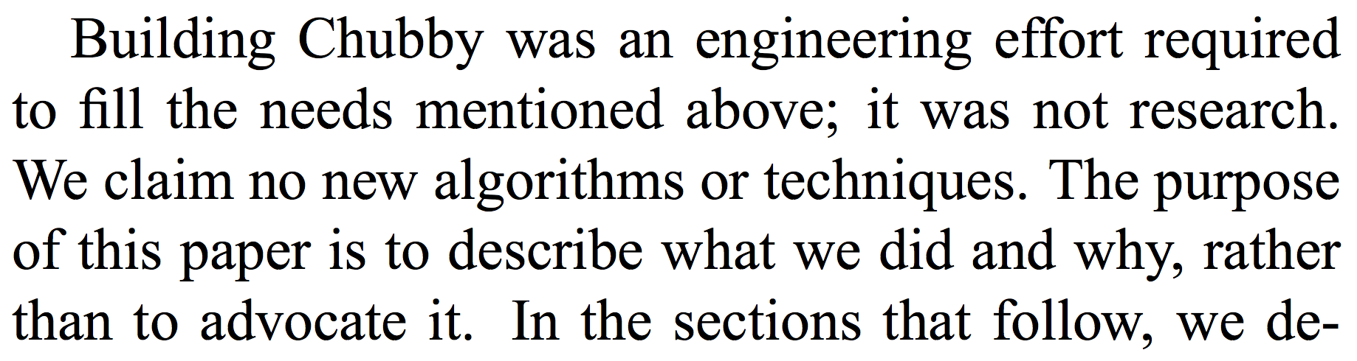
Chubby
Internal service within Google
Highly available coordination service

Slide 5
Chubby
Internal service within Google
Highly available coordination service
Two purposes:
  Lock service
  File system (for small files)

Slide 6
Example: GFS Chunkmaster
x = Open(“/ls/gfs-cell8/chunkmaster")
if (TryAcquire(x) == success) {
// I'm the chunkmaster, tell everyone
SetContents(x, my-address)
} else {
// I'm not the master, find out who is
chunkmaster = GetContents(x)
}
Notes:
There is an inherent election. Elected master has to renew lease. Replicas maintain a simple database. However, only master maintains control of this database (read/write). The others only copy updates from master.

Slide 7
Why this interface?
Why not a library that implements Paxos?
Developers do not know how to use Paxos
  They at least think they know how to use locks!
Need to export result of coordination outside of system
  Example: Clients need to discover GFS master

Slide 8
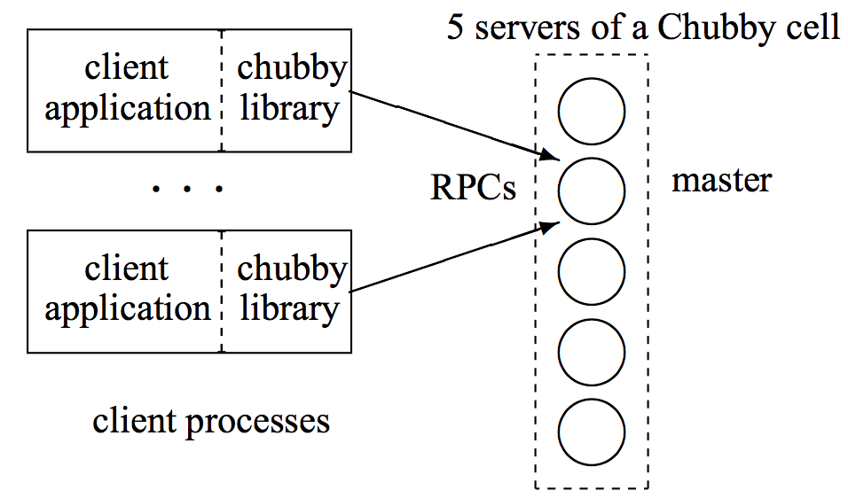
Chubby Design
Replicated service
using Paxos to
implement
fault-tolerant log
Notes:
Client sends write request to nearest replica. That replica returns Master’s address. From then on client directs requests to masters until it indicates it is no longer master. Writes propagated to replicas using consensus. Reads are handled without any consenusus (safe).

Slide 9
Chubby procedure
Client sends request to nearest replica.
Replica returns Chunkmaster’s address
Client directs requests to the Chunkmaster until it says it is no longer playing that role.
Writes propagated to replicas using consensus
Reads handled without consensus (Safe)

Slide 10

Chubby in Action
Modify file foo
?
Read file foo
Notes:
Needs consensus to modify.

Slide 11
Reads in Paxos-based RSM
For every key, every replica stores (value, version)
Return latest version out of majority of replicas
V1
Read file foo
V2
V1
V3
Read file foo
V2
Why do different replicas have different versions?
Gap between Accept and Learn
Notes:
Read does not need consensus.

Slide 12
Reads in Paxos-based RSM
How to ensure linearizability?
  A read must see the effect of all accepted writes
Get read accepted to one of the slots in replicated log
Every replica executes command in a slot only after executing commands in all prior slots

Slide 13
RSM with Paxos
Slots in log
Proposals / ballots
Notes:
Slots analogous to proposal number.

Slide 14
Reads in Paxos-based RSM
How to ensure linearizability?
  A read sees the effect of all accepted writes
Get read accepted to one of the slots in replicated log
Problem: Poor performance at scale

Slide 15
Reads/Writes in Chubby
One of the 5 replicas chosen as the master
Clients submit all reads and writes to master
How to handle master failure?
  Another replica must propose itself as master
  New master must first “catch up”
Master is performance bottleneck

Slide 16
Client sessions
A client requests a new session by contacting the master of a Chubby “cell”
It ends the session when it terminates or if it has been idle (no open handles or no calls for a minute).
Lease → session needs to be renewed before lease expires.
  Master can move it forward but not backward.

Slide 17
Event subscriptions
Clients may subscribe to a range of events (e.g., file contents modified or master failure).
Such events are delivered asynchronously via an up-call from the Chubby library.
  Delivered after the event has taken place

Slide 18
Scaling Chubby
Clients cache data they read
Reading from local cache violates linearizability
  How to fix this?
Master invalidates cached copies upon update
  Modification blocked until invalidations are sent
    Note that caches not updated (only invalidated) – this may be unnecessary.
  Reads proceed as usual (much more frequent than writes)
Master must store knowledge of client caches
What if master fails?
Notes:
Protocol ensures that a client either sees a consistent view of the Chubby state or gets an error.
Sever knows that every client has either ACKed the change in state, or its lease has expired; so once all relevant clients know, modification proceeds.
Clients need to have KeepAlives (at least ACK cache invalidation messages).

Slide 19
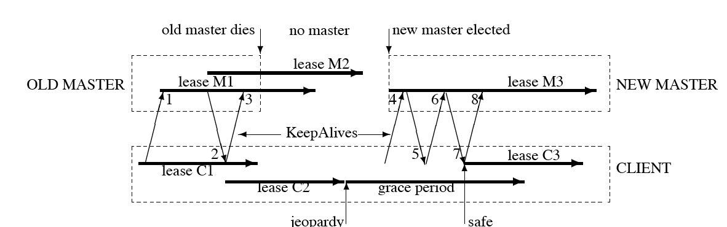
Grace period for leases
Grace period after lease expires
  If keepalive received within grace period, state updated
If grace period expires, the client assumes session has expired (Chubby cell inaccessible)
  Call returns with an error
Failed master discards state about sessions, handles and locks.
Notes:
Note that clients conservatively ask for lease extension before it expires. Lease M2 in response to message 1.
Jeopardy message sent to application by the Chubby library.
New Master initially has a conservative estimate M3 for the session the old master may have had. New lease after Message 7.
New master has to first reconstruct a conservative approximation of the in-memory state – read data from disc, obtaining state from clients and conservative settings. It picks a new epoch number for each client (old epoch numbers are rejected – e.g., 4).

Slide 20
Scaling Chubby with Proxies
Proxy
Proxy
Chubby
Notes:
Used to reduce read traffic and keep alive messages. But this could result in increased likelihood of failures (proxy and Chubby server can fail).

Slide 21
Handling client failures
What if a client acquires a lock and fails?
Client library exchanges keep-alives with master
Lock revoked upon client failure
Problem?
  Network partition not client failure
Chubby associates lock acquisitions with sequence numbers
  Can distinguish operations from previous lock holders

Slide 22
Discrepancy in Lock Validity
Lock service
Replica 1
Client2
Client1
Replica 2
Check with lock service
to confirm lock validity
Replica 3

Slide 23
ZooKeeper
Open source coordination service
Addresses need for polling in Chubby
  Example: If you cannot acquire lock, need to retry
Goal in ZooKeeper: Wait-free coordination

Slide 24
ZooKeeper: Watch mechanism
Clients can register to “watch” a file
  Watches are one-time triggers associated with a session (unregistered once triggered or when session closes)
  ZooKeeper notifies client when file is updated (trigger)
Example:
  Try to acquire a lock by creating a file with an ephemeral flag
  If file already exists, watch for updates
  Upon watch notification, try to re-acquire lock
Problem?
  Herd effect
    Many clients which get notification may vie for the lock

Slide 25
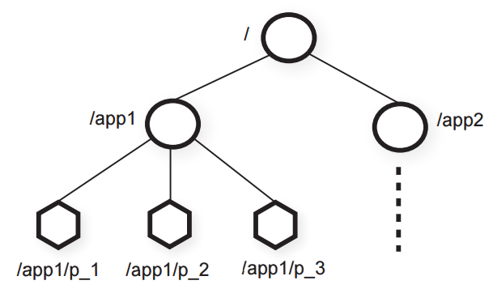
ZooKeeper: Hierarchy
Notes:
The data objects are organized as in a UNIX File system hierarchy. They are called znodes. Regular znodes (Clients manipulate directly). Ephemeral znodes (either deleted explicitly or system cleans up after the session that created these terminate).

Slide 26
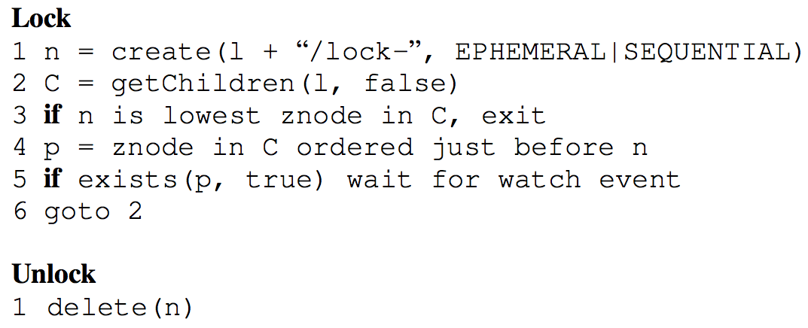
ZooKeeper: Sequencer
lock-1
lock-2
lock-3

Slide 27
Zookeper:Sequencer
The SEQUENTIAL flag orders the client’s attempt to acquire lock with respect to others.
If the znode created is lowest, get lock; else, wait for deletion of immediately prior znode.
Herd effect avoided by waking up only one process when lock is released or a lock request is abandoned.
Releasing lock: delete the proper znode.

Slide 28
Chubby vs. ZooKeeper
Difference between invalidation and watch?
Invalidation:
  Only library receives notification to update cache
Watch:
  Application receives notification
  Only app knows what it needs to do

