Slide 1
Summary: Top-Down Parsing
Backtracking Parsing
(“brute force”)
Top-Down Parsing
Recursive Descent Parsing
a func for a nonterminal
leverage call stack
Predictive Parsing
(lookahead)
LL(1) Parsing
use explicit stack
First and Follow sets
parsing table-driven
Common Issues:
left recursion
common prefix
Notes:
For recursive descent parsing, we solved it with EBNF (in particular, the option notation)

Slide 2
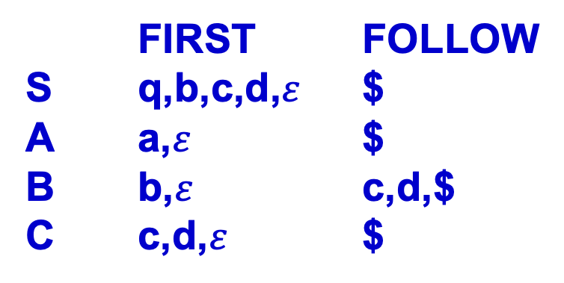
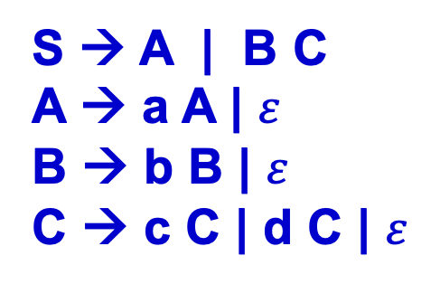
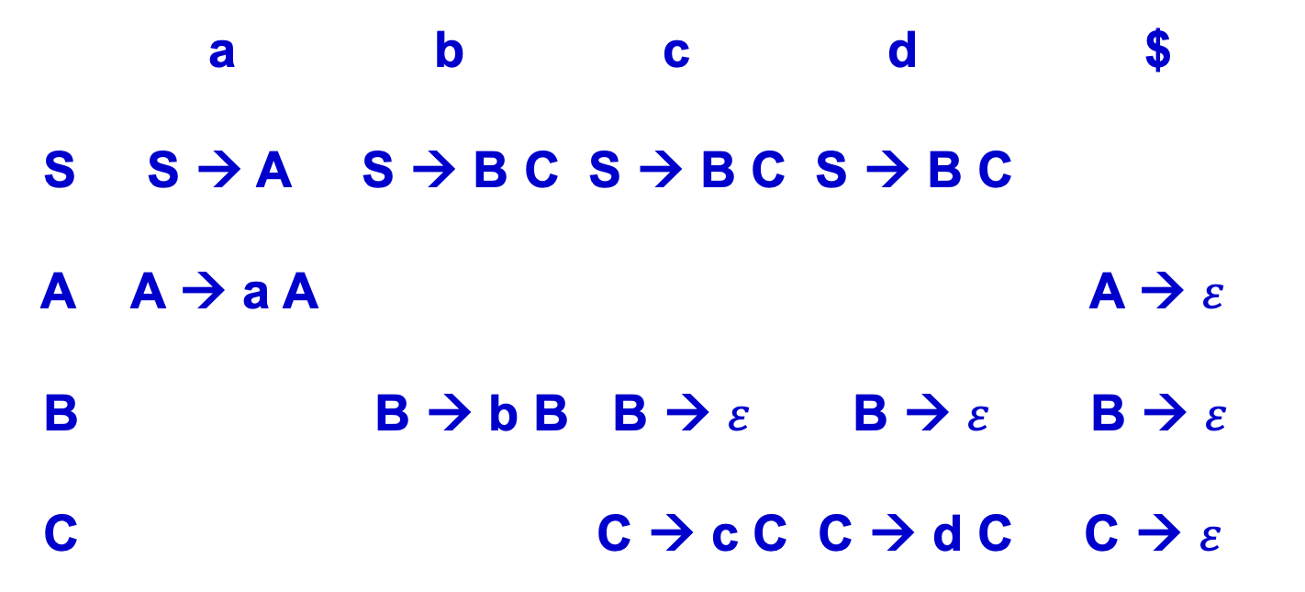
Example
a,
S → A
S → B C

Slide 3
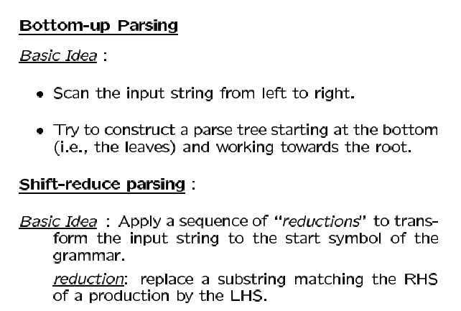

Slide 4
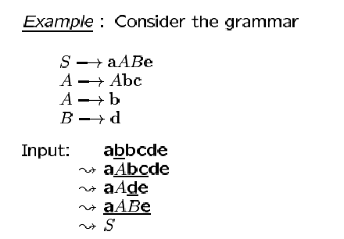
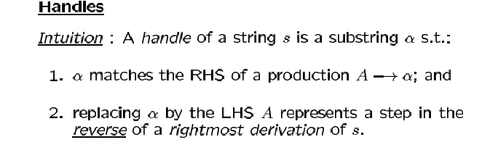

Slide 5
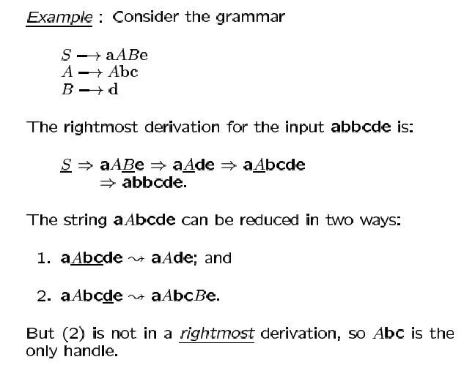
| b

Slide 6
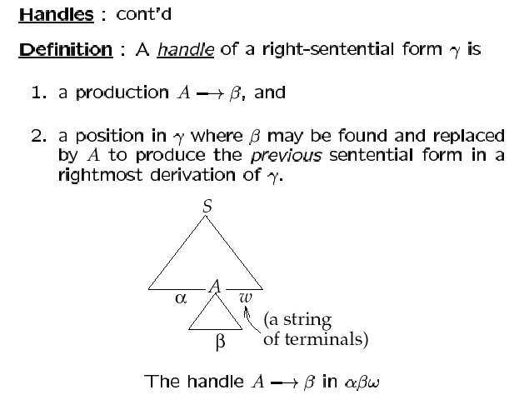

Slide 7
Shift Reduce Parsing
Stack
Tokens
$
abc$
$abc
$
Shifts
S → a b c
$S
$
Reduce

Slide 8
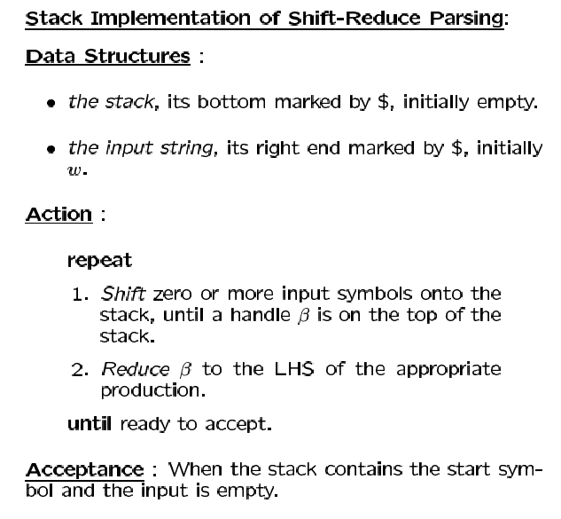

Slide 9
c
e
b
B
d
B
b
A
A
A
A
a
a
S
a
a
a
$
$
$
$
$
$

Slide 10
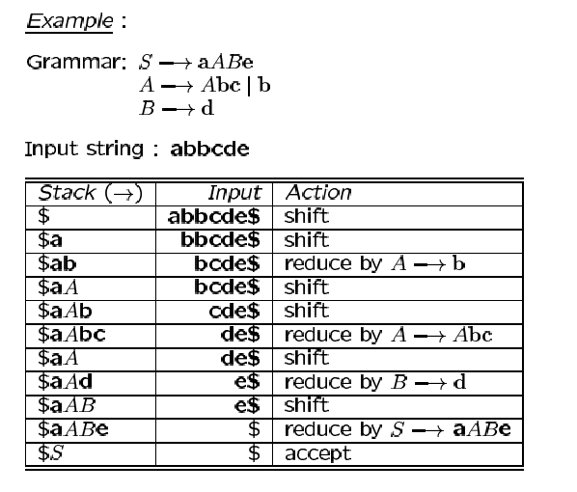

Slide 11
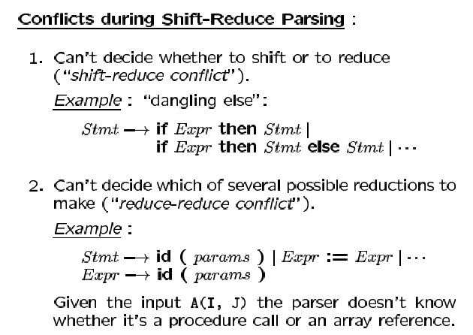

Slide 12
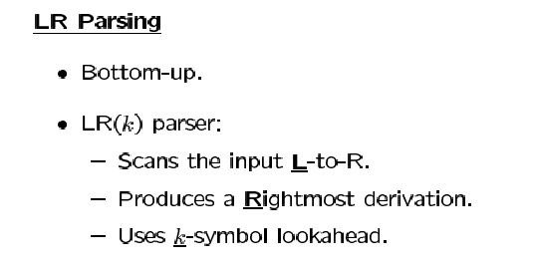

Slide 13
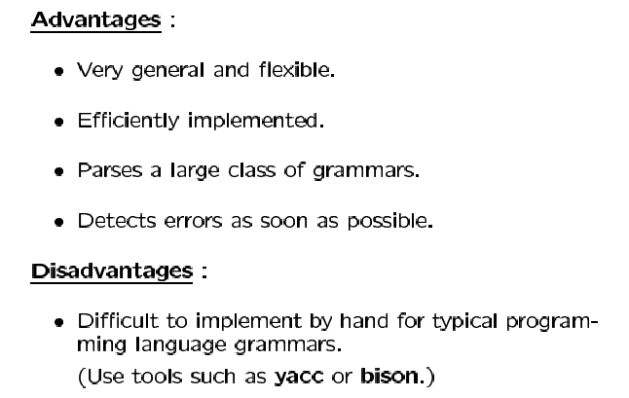

Slide 14
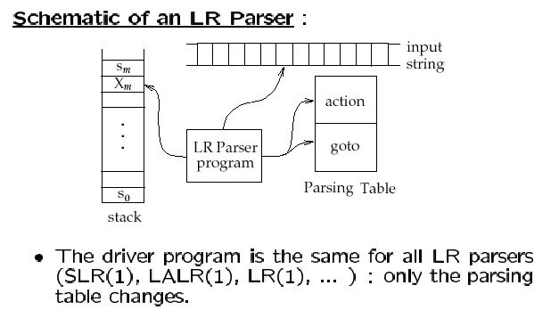

Slide 15
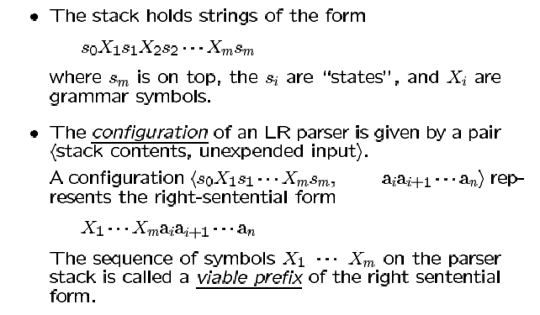

Slide 16
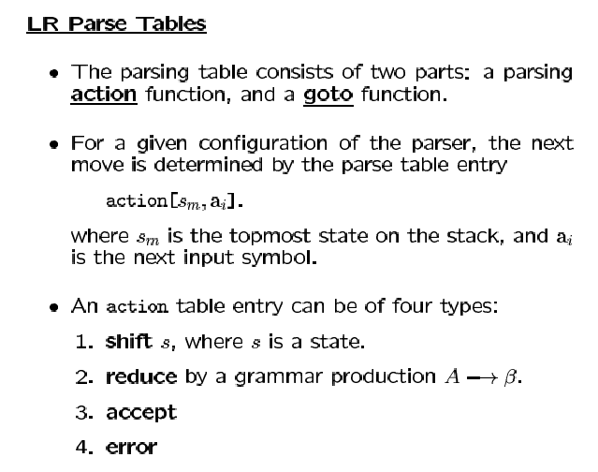

Slide 17
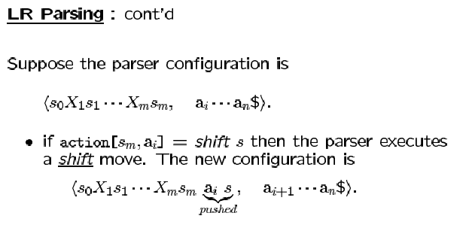

Slide 18
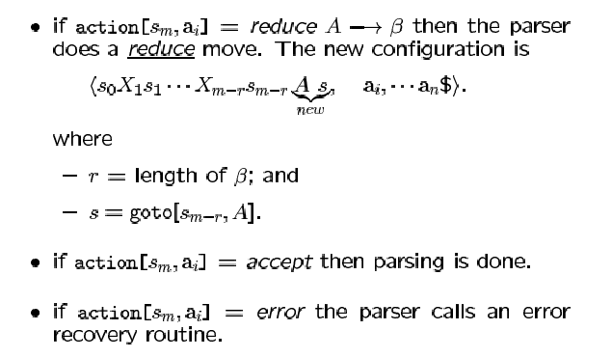

Slide 19
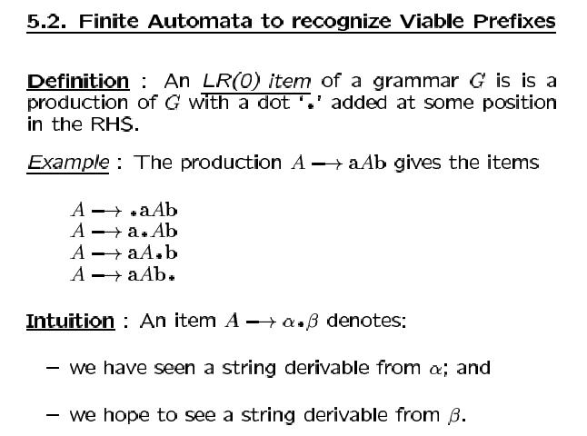

Slide 20
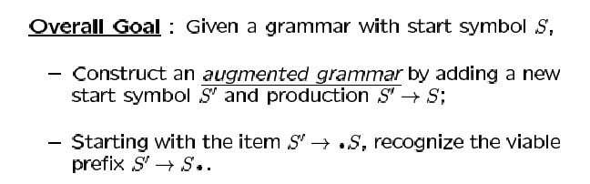

Slide 21
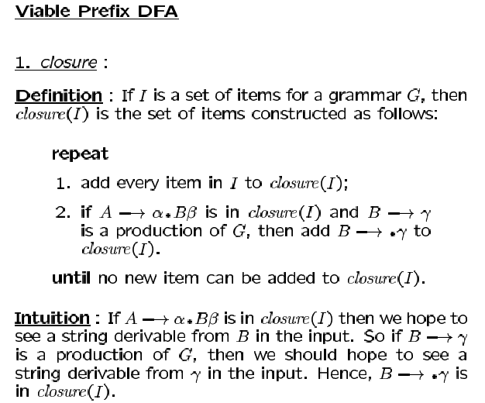

Slide 22
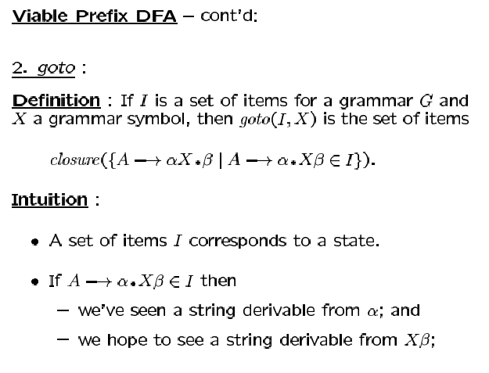

Slide 23
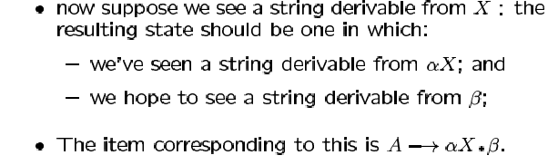

Slide 24
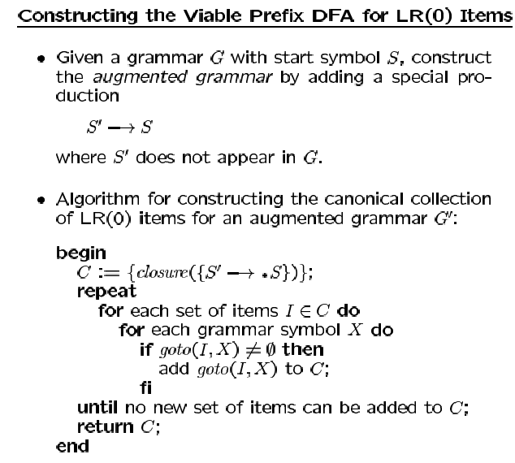

Slide 25
Example
Original Grammar
Augmented Grammar
E → E + T | T
T → id | ( E )
S’ → E
E → E + T | T
T → id | ( E )

Slide 26
S7
S8
S1
* E → E + . T
T → . id
T → . ( E )
* S’ → E .
* E → E . + T
T
* E → E + T .
+
E
(
S2
S0
* S’ → . E
E → . E + T
E → . T
T → . id
T → . ( E )
* E → T .
id
T
Augmented Grammar
S3
S’ → E
E → E + T | T
T → id | ( E )
* T → id .
id
(
id
T
Kernel items are
Marked with *
Rest of the items
added by closure
. Tells where we are
in the production
+
S4
* T → ( . E )
E → . E + T
E → . T
T → . id
T → . ( E )
S5
S6
* T → ( E . )
* E → E . + T
* T → ( E ) .
E
)
(

Slide 27
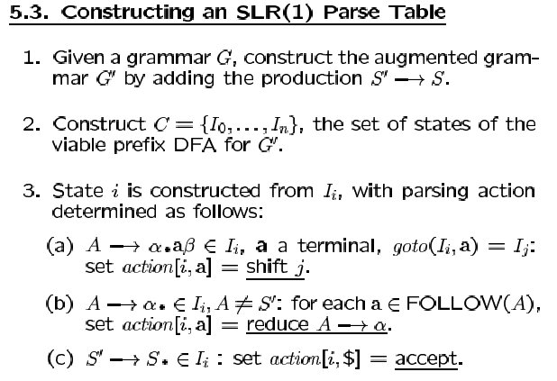

Slide 28
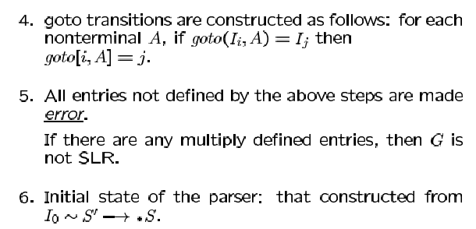

Slide 29
S7
S8
S1
* S’ → E .
* E → E . + T
* E → E + . T
T → . id
T → . ( E )
T
* E → E + T .
+
E
(
S2
S0
* S’ → . E
E → . E + T
E → . T
T → . id
T → . ( E )
* E → T .
id
T
Augmented Grammar
S3
S’ → E
E → E + T | T
T → id | ( E )
* T → id .
id
(
id
T
Kernel items are
Marked with *
Rest of the items
added by closure
. Tells where we are
in the production
+
S4
* T → ( . E )
E → . E + T
E → . T
T → . id
T → . ( E )
S5
S6
* T → ( E . )
* E → E . + T
* T → ( E ) .
E
)
(

Slide 30
ACTION
GOTO
 | + | Id | ( | ) | $ | E | T | S
S0 |  | S,S3 | S,S4 |  |  | S1 | S2
S1 | S,S7 |  |  |  | accept
S2 | R,#3 |  |  | R,#3 | R,#3
S3 | R,#4 |  |  | R,#4 | R,#4
S4 |  | S,S3 | S,S4 |  |  | S5 | S2
S5 | S,S7 |  |  | S,S6
S6 | R,#5 |  |  | R,#5 | R,#5
S7 |  | S,S3 | S,S4 |  |  |  | S8
S8 | R,#2 |  |  | R,#2 | R,#2
#1 S’ → E
#2 E → E + T
#3 E → T
#4 T → id
#5 T → ( E )
Follow(S’) → { $ }
Follow(E) → { +, ), $ }
Follow(T) → { +, ), $ }
S – SHIFT
R - REDUCE
S# - Next State
#n - Production Rule Number

Slide 31
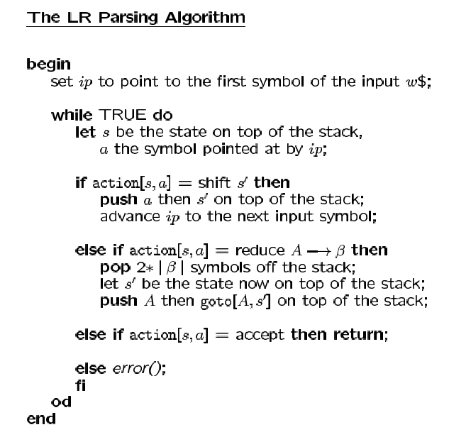

Slide 32
Stack Input Action
$ S0 id + id $ action[S0,id] = shift S3
$ S0 id S3 + id $ action[S3,+] = reduce T→id
GOTO[S0,T] = S2
$ S0 T S2 + id $ action[S2,+] = reduce E→T
GOTO[S0,E] = S1
$ S0 E S1 + id $ action[S1,+] = shift S7
$ S0 E S1 + S7 id $ action[S7,id] = shift S3
$ S0 E S1 + S7 id S3 $ action[S3,$] = reduce T→id
GOTO[S7,T] = S8
$ S0 E S1 + S7 T S8 $ action[S8,$] = reduce E→E+T GOTO[S0,E] = S1
$ S0 E S1 $ action[S1,$] = accept

Slide 33
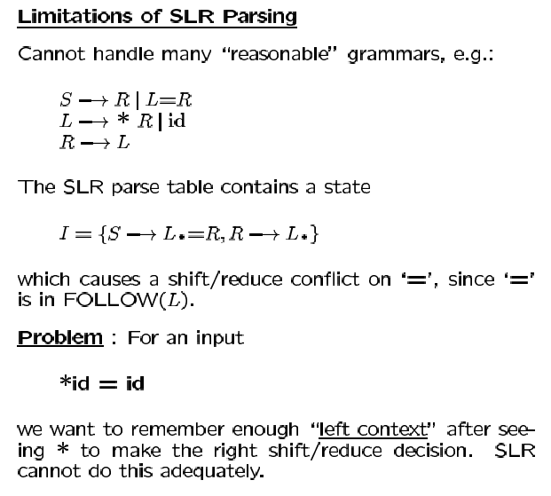

Slide 34
S → L = R
→ L = L
→ L = id
→ * R = id
→ * L = id
→ * id = id
S → L = R
→ L = L
→ L = id
→ id = id
Once having reduced id to L and then seeing =,
in the case on the left L is reduced to R
in the case on the right = is shifted to the stack.

Slide 35
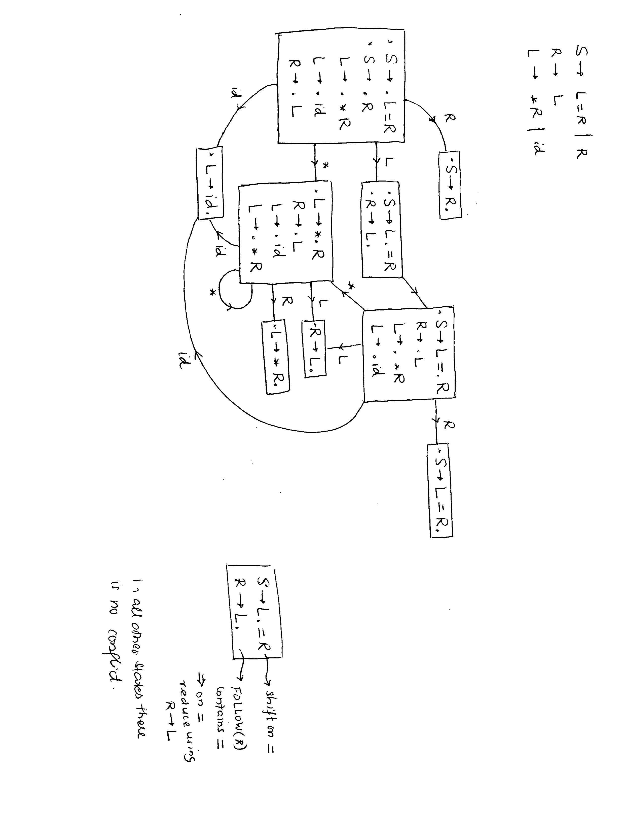
S → L = R | R
R → L
L → * R | id
S → L . = R Shift on =
R → L . Since = is in Follow(R)
so Reduce on =
=

Slide 36
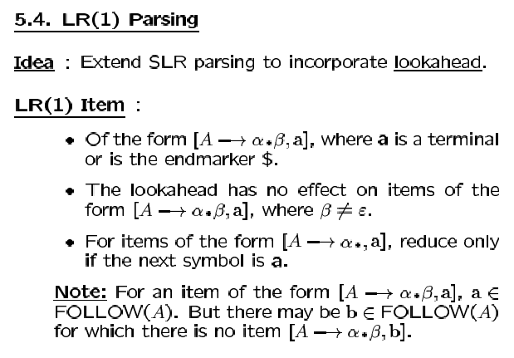

Slide 37
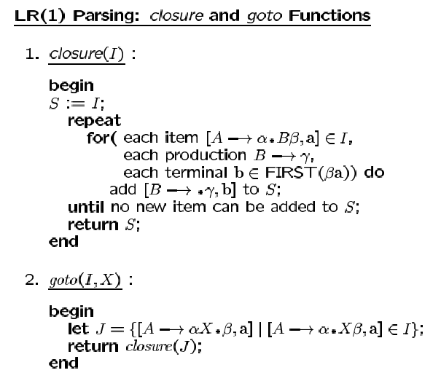

Slide 38
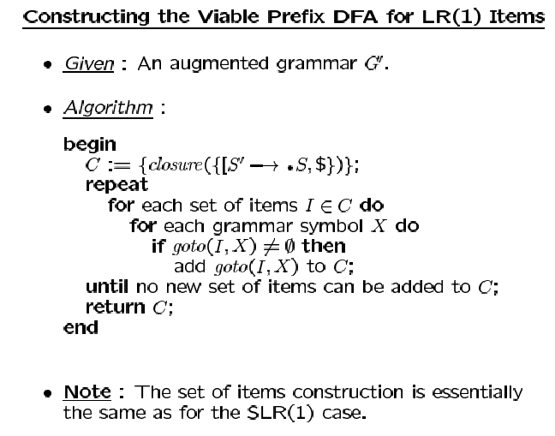

Slide 39
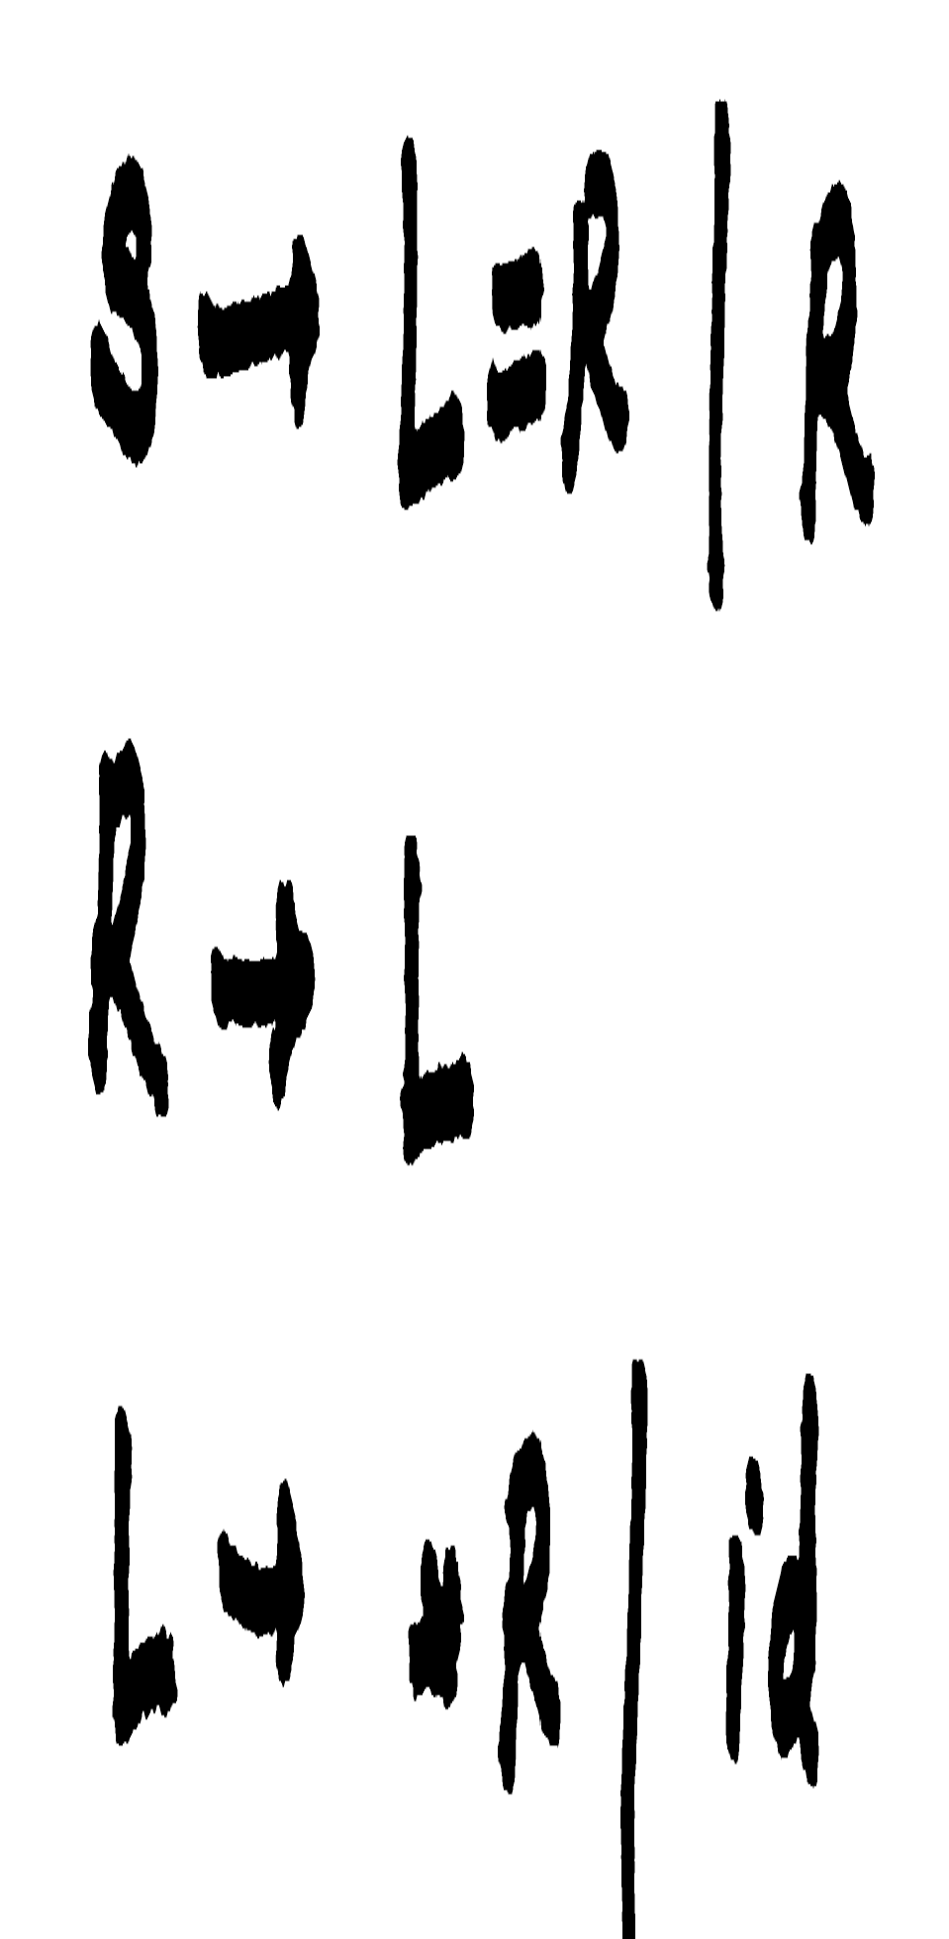
S8
S5
R
* S → L = R . , $
* S → L = . R, $
R → . L, $
L → . * R, $
L → . id, $
S1
S9
* R → L . , $
* S → R . , $
S12
L
* L → id . , $
L
* L → * R . , $
R
=
id
S2
S10
id
R
S0
L
* S → L . = R, $
* R → L . , $
*
* L → * . R, $
R → . L, $
L → . id, $
L → . * R, $
* S → . L = R, $
* S → . R, $
L → . * R, =/$
L → . id, =/$
R → . L, $
S6
* R → L . , =/$
*
* L → * . R, =/$
R → . L, =/$
L → . id, =/$
L → . * R, =/$
L
R
S11
* L → * R . , =/$
*
id
S3
S7
* L → id . , =/$
id
*
S4

Slide 40
ACTION
GOTO
 | * | = | id | $ | S | R | L
S0 | S,S3 |  | S,S4 |  |  | S1 | S2
S1 |  |  |  | accept
S2 |  | S,S5 |  | R,R→L
S3 | S,S3 |  | S,S4 |  |  | S7 | S6
S4 |  | R,L→id |  | R,L→id
S5 | S,S11 |  | S,S10 |  |  | S8 | S9
S6 |  | R,R→L |  | R,R→L
S7 |  | R,L→*R |  | R,L→*R
S8 |  |  |  | accept
S9 |  |  |  | R,R→L
S10 |  |  |  | R,L→id
S11 | S,S11 |  | S,S10 |  |  | S12 | S9
S12 |  |  |  | R,L→*R
S – SHIFT
R - REDUCE
S# - Next State
#n – Production Number

Slide 41
$ S0 * id = id $
$ S0 * S3 id = id $
$ S0 * S3 id S4 = id $
$ S0 * S3 L S6 = id $
$ S0 * S3 R S7 = id $
$ S0 L S2 = id $
$ S0 L S2 = S5 id $
$ S0 L S2 = S5 id S10 $
$ S0 L S2 = S5 L S9 $
$ S0 L S2 = S5 R S8 $
accept

Slide 42
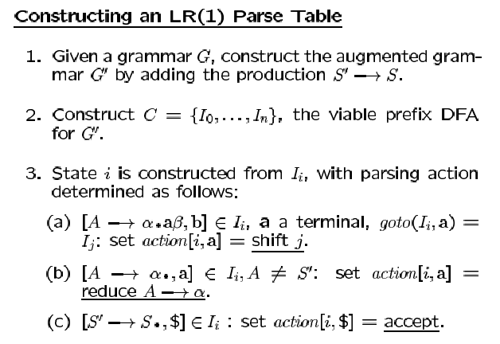

Slide 43
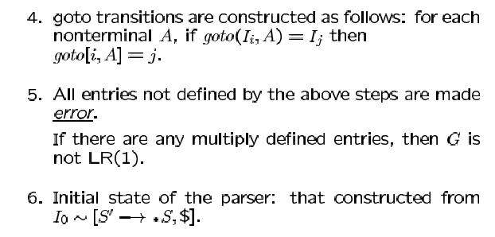

Slide 44
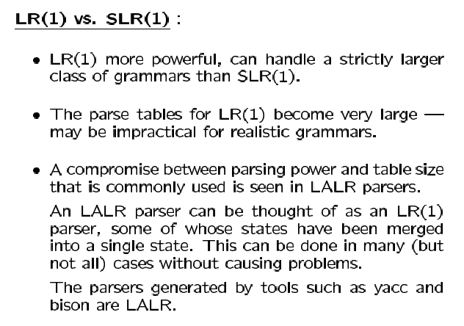

Slide 45

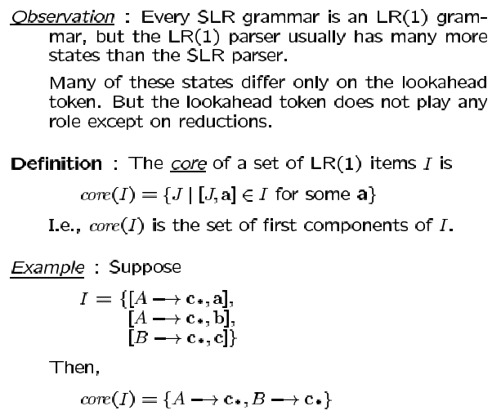

Slide 46
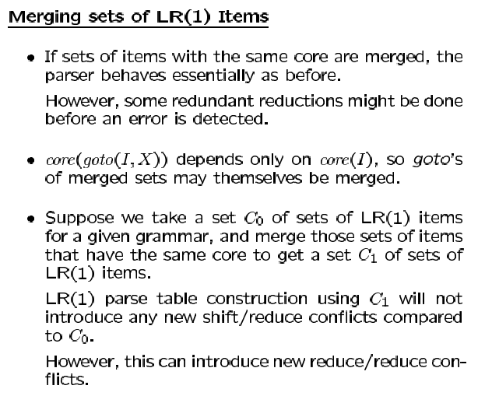

Slide 47
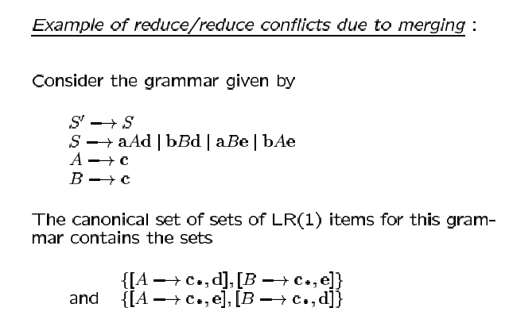

Slide 48
d
* S → a A . d, $
* S → a A d ., $
A
* S → a B . e, $
e
* S → a B e ., $
B
* S → a . A d, $
* S → a . B e, $
A → . c, d
B → . c, e
a
* A → c ., d
* B → c ., e
c
No Conflict
=> LR(1) Grammar
* S → . a A d, $
* S → . b B d, $
* S → . a B e, $
* S → . b A e, $
* A → c ., e
* B → c ., d
c
* S → b . B d, $
* S → b . A e, $
A → . c, e
B → . c, d
B
d
b
* S → b B . d, $
* S → b B d ., $
* S → b A . e, $
e
* S → b A e ., $
A

Slide 49
A → c . , d
B → c . , e
A → c . , d/e
B → c . , d/e
Merge
A → c . , e
B → c . , d
Contains
reduce-reduce conflict
→ not LALR(1)

Slide 50
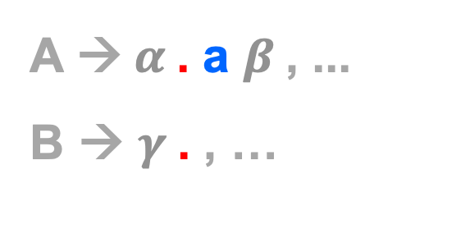
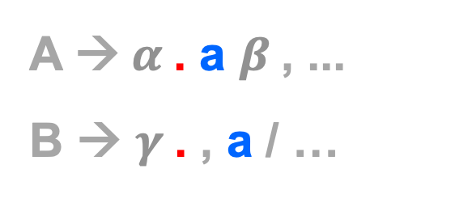

Merging of LR(1) states cannot introduce a
new shift-reduce conflict in LALR(1) parser
A →$α$. a $β$, ...
B → $γ$. , …
A →$α$. a $β$, ...
B → $γ$. , a / …
A →$α$. a $β$, ...
B → $γ$. , …
a
Conflict was already present
in an LR(1) state!

Slide 51
SAMPLE PROBLEMS

Slide 52
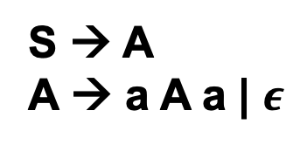
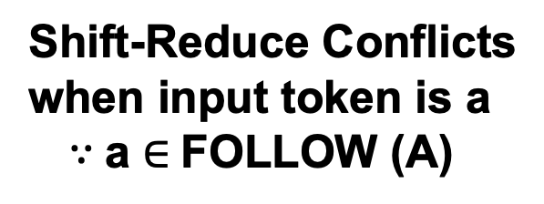
* S → A .
A
* S → . A
A → . a A a
A → .
* A → a A . a
a
A
a
* A → a . A a
A → . a A a
A → .
* A → a A a .
a

Slide 53
* S → A ., $
A
* S → . A, $
A → . a A a, $
A → . , $
a
* A → a A . a, $
* A → a A a ., $
a
A
* A → a . A a, $
A → . a A a, a
A → . , a
* A → a A . a, a
* A → a . A a, a
A → . a A a, a
A → . , a
A
a
a
* A → a A a ., a
a
Shift-Reduce Conflicts
when input token is a

Slide 54
S → C C
C → c C | d
C
* S → C C ., $
* S → C . C, $
C → . c C, $
C → . d, $
c
* C → c . C, $
C → . c C, $
C → . d, $
C
d
* S → . C C, $
C → . c C, c/d
C → . d, c/d
* C → d ., $
d
C
c
c
* C → c C ., $
d
* C → c . C, c/d
C → . c C, c/d
C → . d, c/d
C
* C → c C ., c/d
d
c
* C → d ., c/d

Slide 55
S → A
A → ( B ) | a
B → B A | A
(
A → ( . B )
B → . B A
B → . A
A → . ( B )
A → . a
S → A .
B
)
A → ( B . )
B → B . A
A → . ( B )
A → . a
A → ( B ) .
A
(
S → . A
A → . ( B )
A → . a
(
B → B A .
A
A
B → A .
a
a
a
A → a .
No Conflicts!

Slide 56
S → E
E → ( L ) | a
L → E L | E
* E → ( L ) .
)
* E → ( L . )
* S → E .
L
E
E
L
* E → ( . L )
L → . E L
L → . E
E → . ( L )
E → . a
* L → E . L
* L → E .
L → . E L
L → . E
E → . ( L )
E → . a
* L → E L .
* S → . E
E → . ( L )
E → . a
(
(
(
a
E
* E → a .
a
a

Slide 57
S → E
E → ( L ) | a
L → E L | E
* E → ( L ) . , $
E
)
* L → E . L , )
* L → E . , )
L → . E L , )
L → . E , )
E → . ( L ) , (/a/)
E → . a , (/a/)
* E → ( L . ) , $
L
* S → E . , $
* L → E L . , )
L
E
E
* E → ( . L ) , $
L → . E L , )
L → . E , )
E → . ( L ) , (/a/)
E → . a , (/a/)
a
* S → . E , $
E → . ( L ) , $
E → . a , $
(
(
E
(
a
* E → ( . L ) , (/a/)
L → . E L , )
L → . E , )
E → . ( L ) , (/a/)
E → . a , (/a/)
L
* E → ( L . ) , (/a/)
* E → a . , $
)
a
* E → ( L ) . , (/a/)
(
a
* E → a . , (/a/)

