Slide 1
A Field-Programmable
Pin-Constrained Digital Microfluidic Biochip
Dan Grissom and Philip Brisk
University of California, Riverside
Design Automation Conference
Austin, TX, USA, June 4, 2013

Slide 2
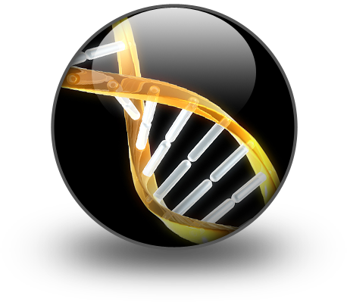
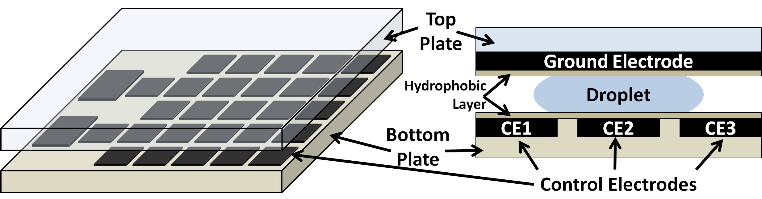
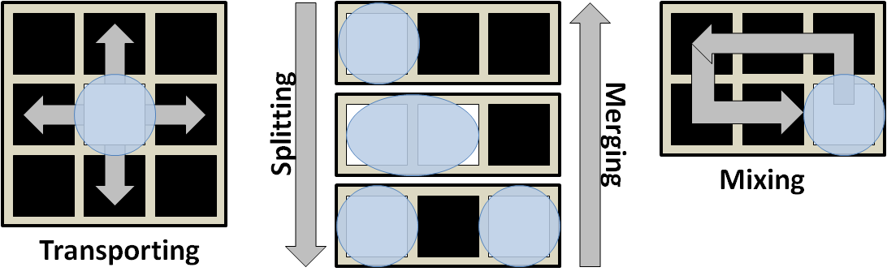
Digital Microfluidic Biochips (DMFB) 101
A Digital Microfluidic Biochip
Applications
Basic Microfluidic Operations

Slide 3
Direct Addressing Cost Problem
Problem:
  Direct-addressing wire-routing is expensive (m × n wires)
m
DA: 100 pins
Vs.
PC: ≤ 28 pins
n
Many PCB Layers
Few PCB Layers
Direct Addressing DMFB
Pin-Constrained DMFB

Slide 4
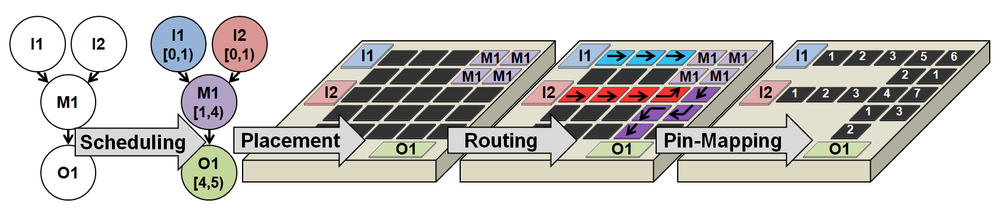
Pin-Constrained Flexibility Problem
Problem:
  Pin-constrained devices are application specific ( < m × n wires)
I1
1
2
3
5
6
2
1
I2
1
2
3
4
7
1
3
2
Direct-Addressing Synthesis
O1
Pin-Constrained
Mapping/Reduction
Application Specific!

Slide 5
Goal Statement
Goal: 1) Inexpensive, 2) general-purpose DMFBs
Why:
  Affordable/accessible to poor/remote communities
  Encourage new applications
Generally Programmable
Few PCB Layers
Best of BOTH Worlds!

Slide 6
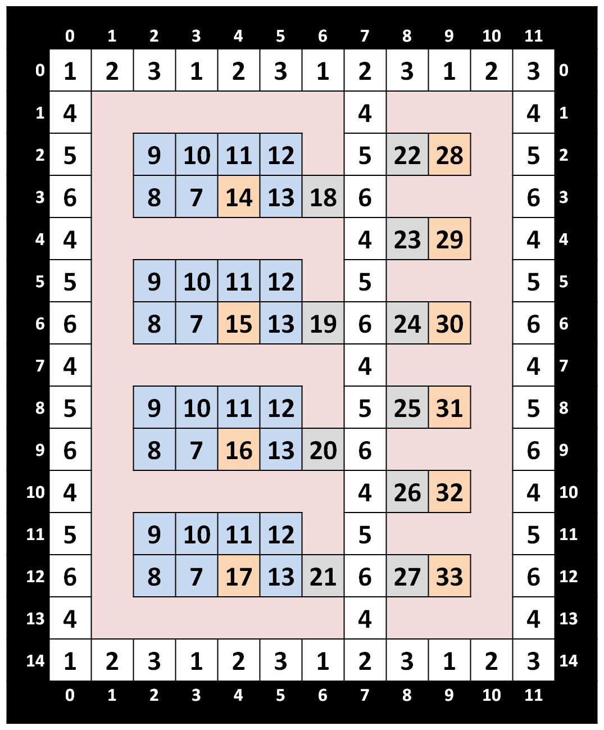
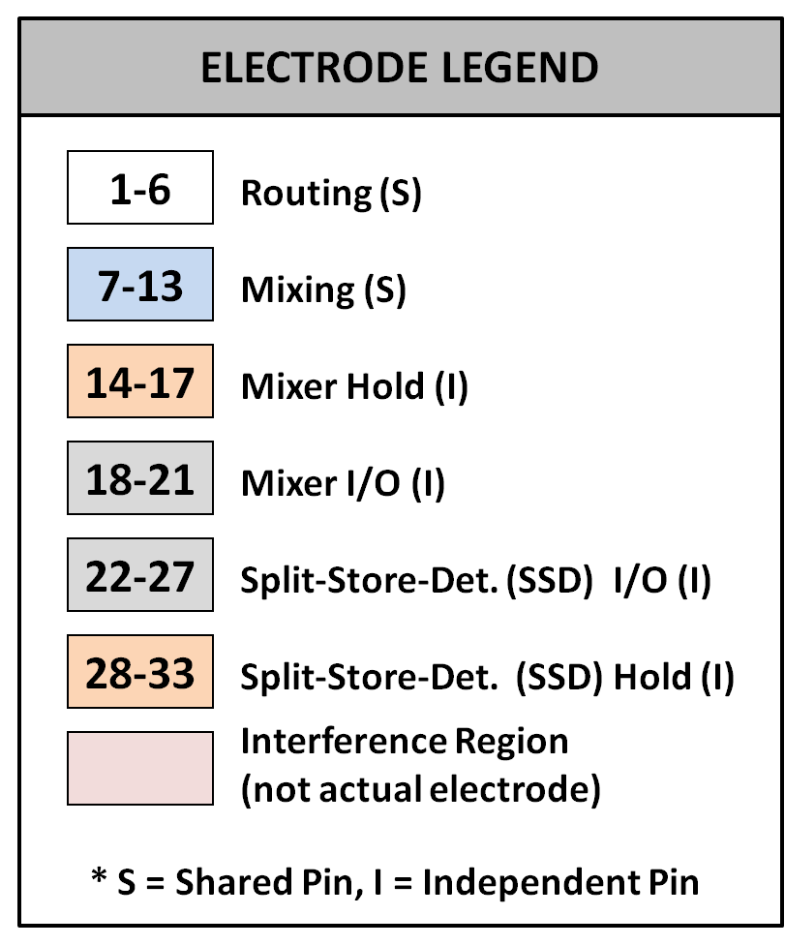
The Solution
Solution: Field-programmable, pin-constrained (FPPC) DMFB
  Mapped for basic operations instead of specific assays
  Flexibility & reduced pin-count (PCB layers)
 | DMFB Type
 | DA | FPPC
Dimensions | 12w × 15h
# Electrodes | 180 | 111
# Unique Pins | 180 | 33

Slide 7
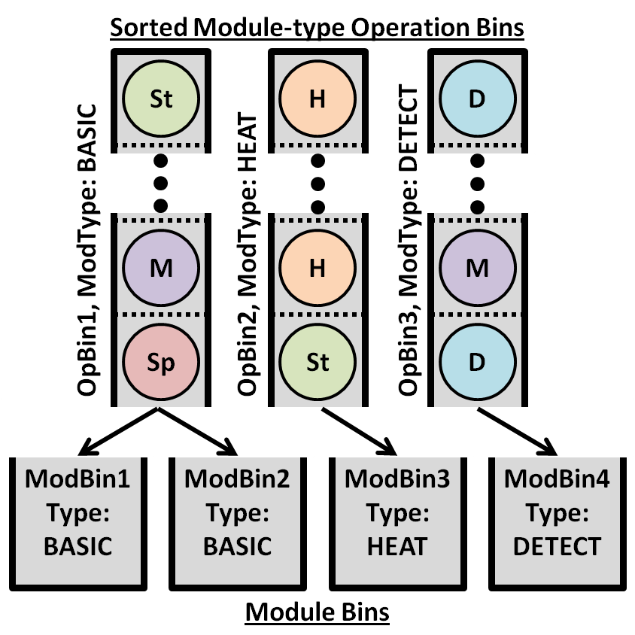
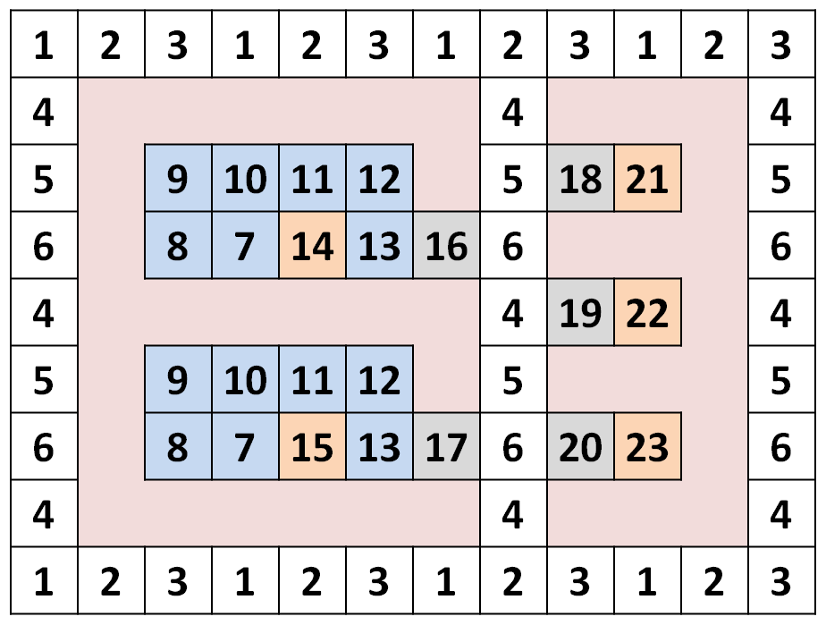
FPPC DMFB Features
Complete Synthesis
  List Scheduling onto discrete resources
    e.g. 4 mixers, 6 split/store/detect modules
    Other schedulers acceptable
  Simple, fast left-edge binding
I1
I1
[0,1)
I2
I2
[0,1)
M1
M1
[1,4)
Det1
Det1
[4,9)

Slide 8
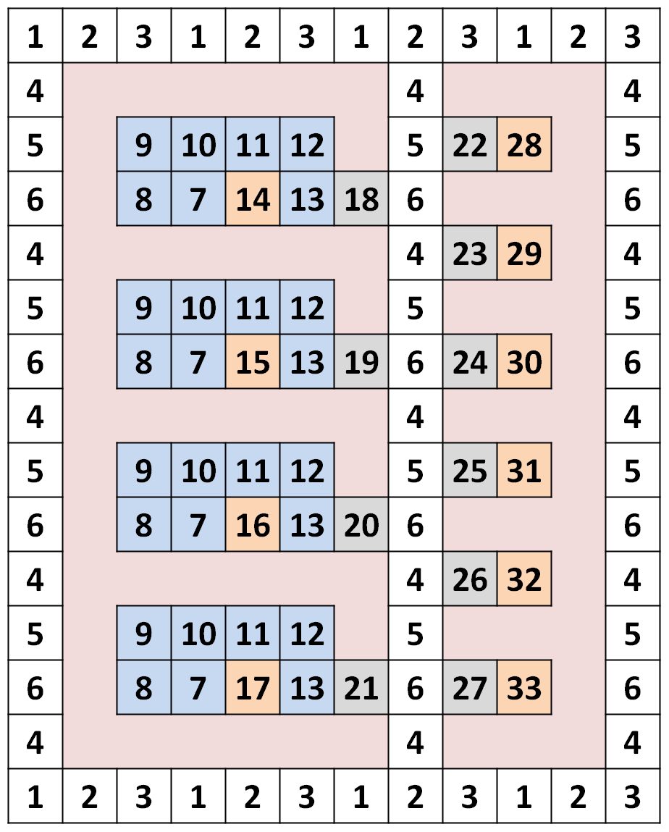
FPPC DMFB Features (cont’d)
Complete Synthesis (cont’d)
  Sequential router (I/O→Module, Module→Module, Module→I/O)
    Horizontal/vertical routing channels
    3-pins per channel
    Routing cycles (ms) << operation time-steps (s)
      No significant gains by parallel routing
    Well-defined module I/O
      See Paper/Poster
    Well-defined deadlock-resolution policies
      See Paper/Poster
Desired Motion
1
2
1
2
1
3
1
2
3
1
2-Phase Bus
3-Phase Bus
Vertical
Routing Channels
Horizontal Routing Channels

Slide 9
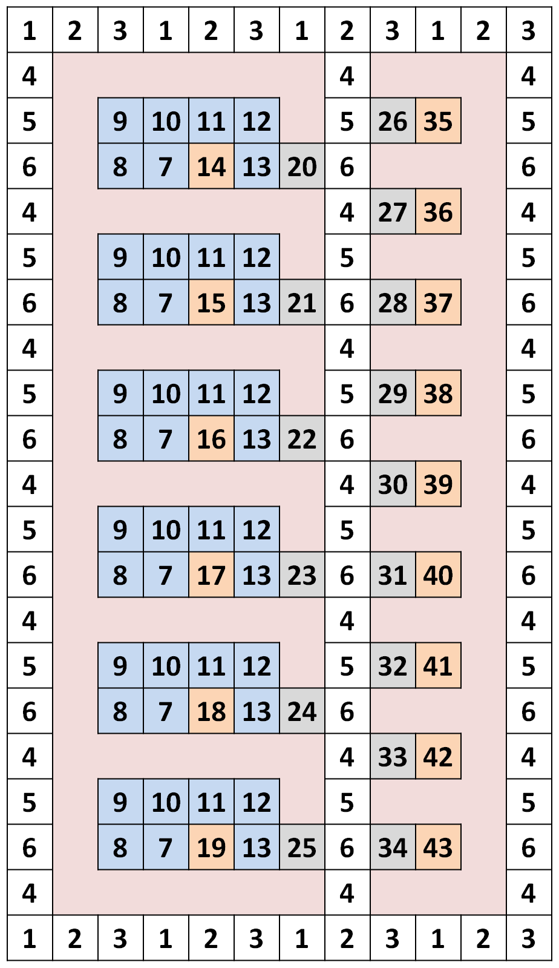
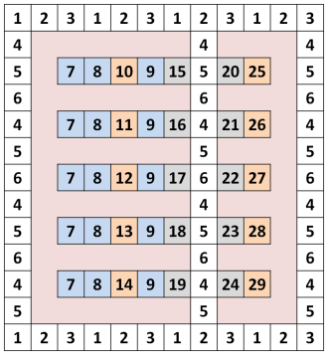
FPPC DMFB Features (cont’d)
Resizing without changing synthesis methods
  DMFB Elongation
  Module-Size Variation
Allows user to buy off-the-shelf DMFB with enough resources to run their assay.

Slide 10
Experimental Results
FPPC DMFB vs. Direct-Addressing DMFB ^{[1]}
Direct-Addressing DMFB (DA) vs. Field-Programmable Pin-Constrained DMFB (FP)
Benchmarks | Array Dim. |  | # Electrodes Used |  | # Pins |  | Routing Time (s) |  | Operations Time (s) |  | Total Time (s)
 | DA | FP | DA | FP | DA | FP | DA | FP | DA | FP | DA | FP
PCR | 15x19 | 12x21 | 285 | 153 | 285 | 43 | 0.7 | 2.1 | 11 | 11 | 11.7 | 13.1
In-Vitro 1 | 15x19 | 12x21 | 285 | 153 | 285 | 43 | 0.7 | 2.6 | 14 | 14 | 14.7 | 16.6
In-Vitro 2 | 15x19 | 12x21 | 285 | 153 | 285 | 43 | 1.2 | 3.8 | 18 | 18 | 19.2 | 21.8
In-Vitro 3 | 15x19 | 12x21 | 285 | 153 | 285 | 43 | 1.9 | 6.2 | 22 | 18 | 23.9 | 24.2
In-Vitro 4 | 15x19 | 12x21 | 285 | 153 | 285 | 43 | 1.8 | 8.8 | 24 | 19 | 25.8 | 27.8
In-Vitro 5 | 15x19 | 12x21 | 285 | 153 | 285 | 43 | 2.9 | 11.6 | 32 | 25 | 34.9 | 36.6
Protein Split 1 | 15x19 | 12x21 | 285 | 153 | 285 | 43 | 1.8 | 2.9 | 71 | 71 | 72.8 | 73.9
Protein Split 2 | 15x19 | 12x21 | 285 | 153 | 285 | 43 | 6.2 | 6.1 | 106 | 106 | 112.2 | 112.1
Protein Split 3 | 15x19 | 12x21 | 285 | 153 | 285 | 43 | 13.9 | 13.5 | 176 | 176 | 189.9 | 189.5
Protein Split 4 | 15x19 | 12x21 | 285 | 153 | 285 | 43 | 32.9 | 29.3 | 316 | 316 | 348.9 | 345.3
Protein Split 5 | 15x19 | 12x25 | 285 | 177 | 285 | 49 | 63.6 | 61.4 | 670 | 596 | 733.6 | 657.4
Protein Split 6 | 15x25 | 12x29 | 375 | 203 | 375 | 55 | 161.2 | 127.4 | 1156 | 1156 | 1317.2 | 1283.4
Protein Split 7 | 15x25 | 12x31 | 375 | 239 | 375 | 63 | 290.3 | 260.6 | 2353 | 2276 | 2643.3 | 2536.6
Avg. Normalized Improvement: ( > 1 is improvement) |  |  | 1.82 |  | 6.53 |  | 0.68 |  | 1.07 |  | 0.98
Negative Impact on Routing
Offset by
Positive Impact on Operation Time
Yields
Neutral Effect on Overall Assay Time
[1] D. Grissom and P. Brisk. Fast online synth. of generally prog. digital microfluidic biochips. CODES+ISSS 2012.

Slide 11
Experimental Results
FPPC DMFB vs. Direct-Addressing DMFB
Direct-Addressing DMFB (DA) vs. Field-Programmable Pin-Constrained DMFB (FP)
Benchmarks | Array Dim. |  | # Electrodes Used |  | # Pins |  | Routing Time (s) |  | Operations Time (s) |  | Total Time (s)
 | DA | FP | DA | FP | DA | FP | DA | FP | DA | FP | DA | FP
PCR | 15x19 | 12x21 | 285 | 153 | 285 | 43 | 0.7 | 2.1 | 11 | 11 | 11.7 | 13.1
In-Vitro 1 | 15x19 | 12x21 | 285 | 153 | 285 | 43 | 0.7 | 2.6 | 14 | 14 | 14.7 | 16.6
In-Vitro 2 | 15x19 | 12x21 | 285 | 153 | 285 | 43 | 1.2 | 3.8 | 18 | 18 | 19.2 | 21.8
In-Vitro 3 | 15x19 | 12x21 | 285 | 153 | 285 | 43 | 1.9 | 6.2 | 22 | 18 | 23.9 | 24.2
In-Vitro 4 | 15x19 | 12x21 | 285 | 153 | 285 | 43 | 1.8 | 8.8 | 24 | 19 | 25.8 | 27.8
In-Vitro 5 | 15x19 | 12x21 | 285 | 153 | 285 | 43 | 2.9 | 11.6 | 32 | 25 | 34.9 | 36.6
Protein Split 1 | 15x19 | 12x21 | 285 | 153 | 285 | 43 | 1.8 | 2.9 | 71 | 71 | 72.8 | 73.9
Protein Split 2 | 15x19 | 12x21 | 285 | 153 | 285 | 43 | 6.2 | 6.1 | 106 | 106 | 112.2 | 112.1
Protein Split 3 | 15x19 | 12x21 | 285 | 153 | 285 | 43 | 13.9 | 13.5 | 176 | 176 | 189.9 | 189.5
Protein Split 4 | 15x19 | 12x21 | 285 | 153 | 285 | 43 | 32.9 | 29.3 | 316 | 316 | 348.9 | 345.3
Protein Split 5 | 15x19 | 12x25 | 285 | 177 | 285 | 49 | 63.6 | 61.4 | 670 | 596 | 733.6 | 657.4
Protein Split 6 | 15x25 | 12x29 | 375 | 203 | 375 | 55 | 161.2 | 127.4 | 1156 | 1156 | 1317.2 | 1283.4
Protein Split 7 | 15x25 | 12x31 | 375 | 239 | 375 | 63 | 290.3 | 260.6 | 2353 | 2276 | 2643.3 | 2536.6
Avg. Normalized Improvement: ( > 1 is improvement) |  |  | 1.82 |  | 6.53 |  | 0.68 |  | 1.07 |  | 0.98
Neutral Effect Considered Positive
Because of
Electrode/Pin-Count Reduction

Slide 12
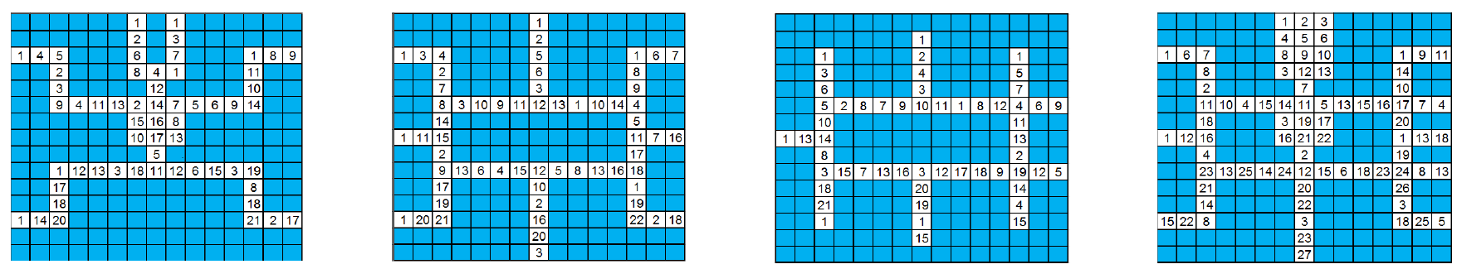
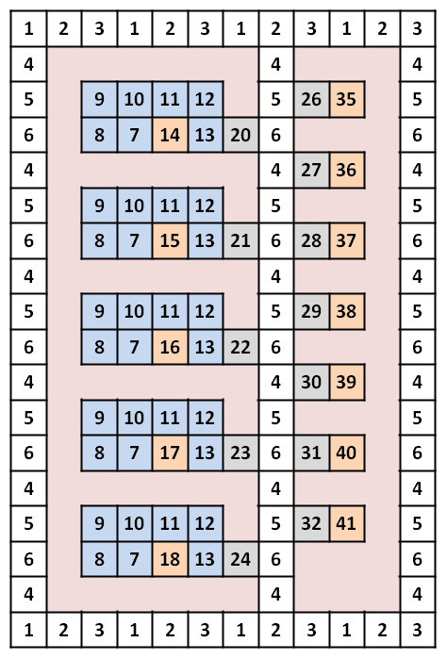
Pin-Constrained Comparison
Application-specific Pin-constrained Designs:
Pin Count
Xu [2] | Luo [3]
37 | 27
Multiplexed Immunoassay DMFB
PCR Assay
DMFB
Protein Dilution Assay DMFB
Multi-Functional DMFB
Smallest FPPC to perform Immuo/PCR/Protein:
Pin-usage for FPPC design on par with optimized PC DMFBs
FPPC can perform general assays vs. optimized PC DMFB’s 3 specific assays
Better schedulers could reduce size needed
Pin Count
37
12x18
[2] T. Xu and K. Chakrabarty. Broadcast electrode-addressing for pin-constrained multi-functional digital microfluidic biochips. DAC, 2008.
[3] Y. Luo and K. Chakrabarty. Design of pin-constrained general-purpose digital microfluidic biochips. DAC, 2012.

Slide 13
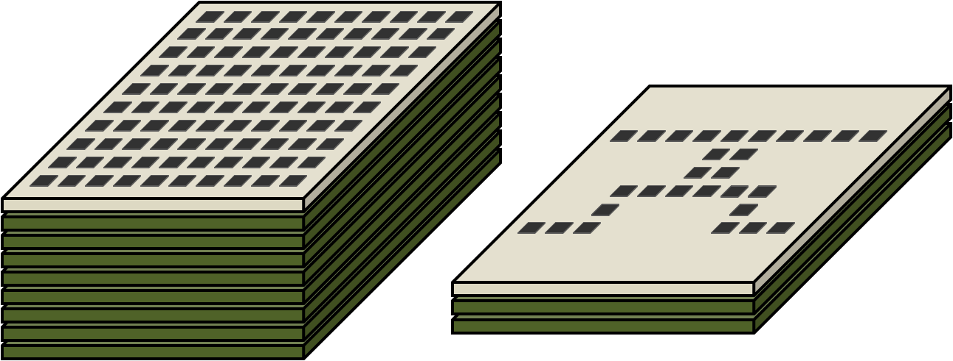

Conclusion
New DMFB design
  Pin-constrained to OPERATIONS
  Pin-constrained design → Inexpensive
  Field-programmable → Execute general assay s
Can buy an inexpensive, off-the-shelf device and run desired assay
  Design facilitates different DMFB and module sizes
Best of both worlds
  Similar assay times and flexibility to recent direct-addressing DMFBs
  Similar pin-counts to recent pin-constrained designs

Slide 14
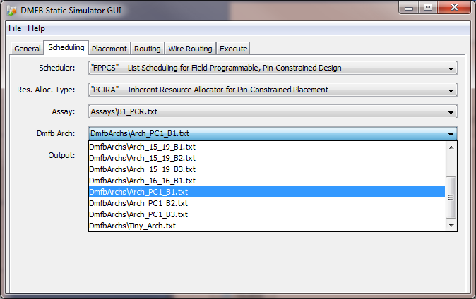
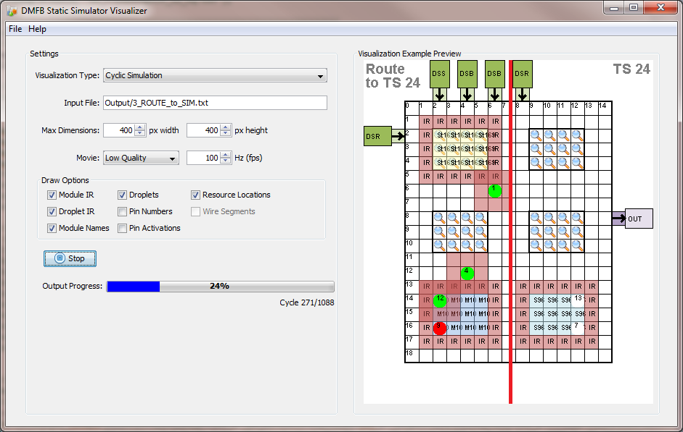
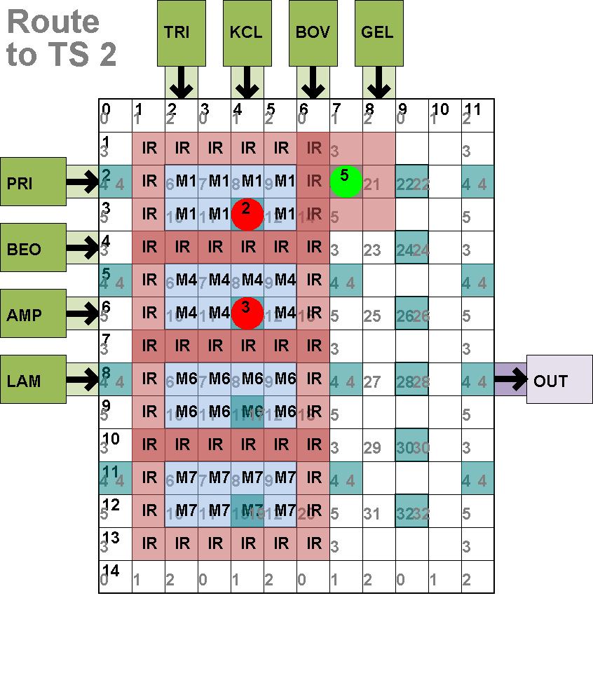
Thank You
http://microfluidics.cs.ucr.edu
DMFB simulator and high-quality visualizations
Open-source code and Windows binaries
Includes a number of synthesis methods including source code for DAC 2013
Great for research implementations, teaching (project course work), high-quality graphics (for papers and presentations) and more…

Slide 15
Thank You

