Slide 1
Exploring Speed and Energy Tradeoffs in Droplet Transport for Digital Microfluidic Biochips
Johnathan Fiske, *Dan Grissom, Philip Brisk
University of California, Riverside
19th Asia & South PacificDesign Automation Conference
Singapore, January 21, 2014

Slide 2
The Bottom Line
Microfluidics will replace traditional bench-top chemistry

Slide 3
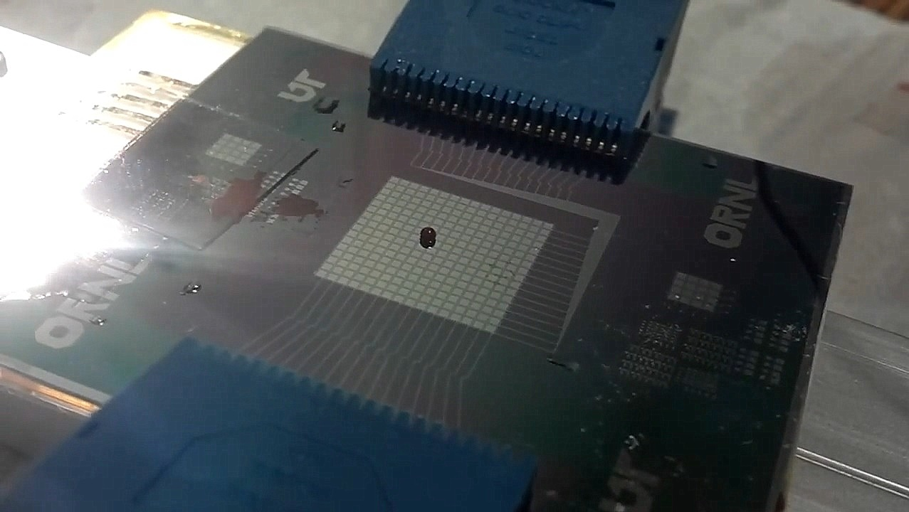
The Future of Chemistry
Microfluidics
“Digital”
Discrete Droplet Based
Miniaturization + Automation
of Biochemistry

Slide 4

Applications
Biochemical reactions and immunoassays
  Clinical pathology
Drug discovery and testing
  Rapid assay prototyping
Biochemical terror and hazard detection
DNA extraction & sequencing

Slide 5
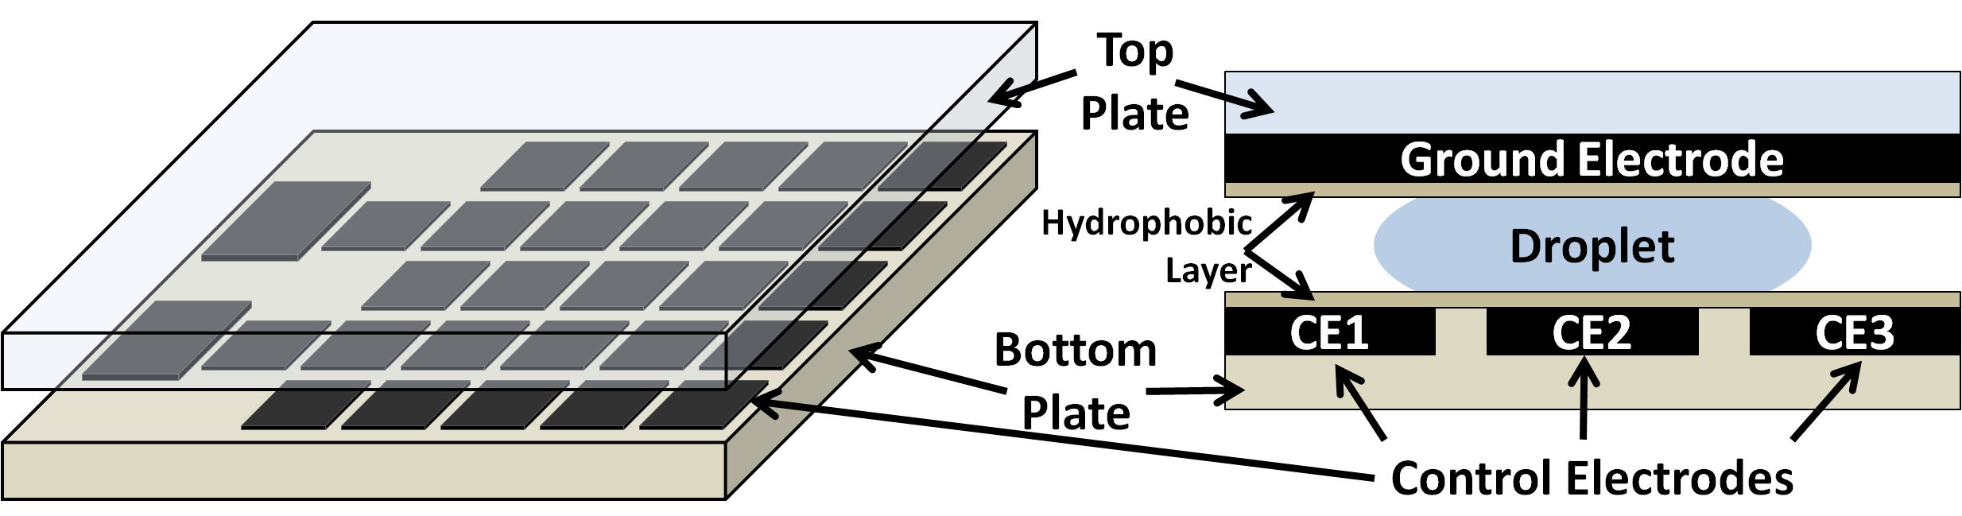
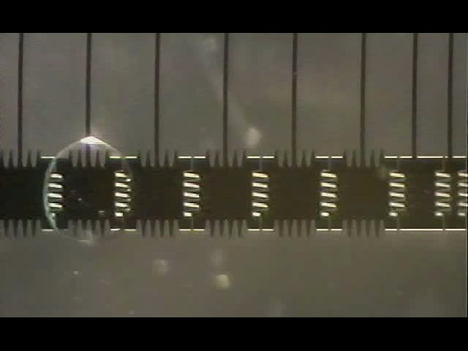
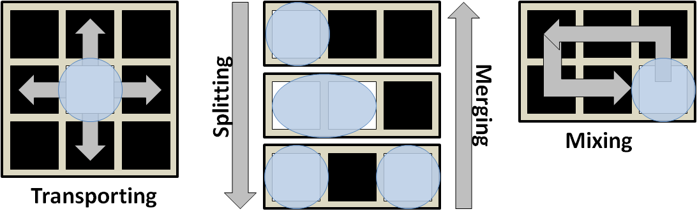
Digital Microfluidic Biochips (DMFB) 101
Top
Plate
Ground Electrode
Droplet
Hydrophobic
Layer
A Digital Microfluidic Biochip (DMFB)
Bottom
Plate
CE1
CE2
CE3
Control Electrodes
Basic Microfluidic Operations
http://microfluidics.ee.duke.edu/

Slide 6
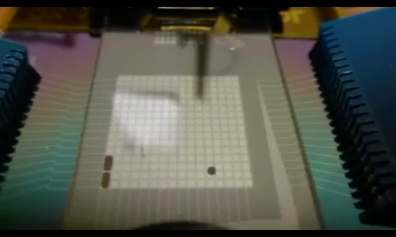
Digital Microfluidic Biochips (DMFB) 101
Droplet Actuation on a Prototype DMFB
at the University of Tennessee

Slide 7
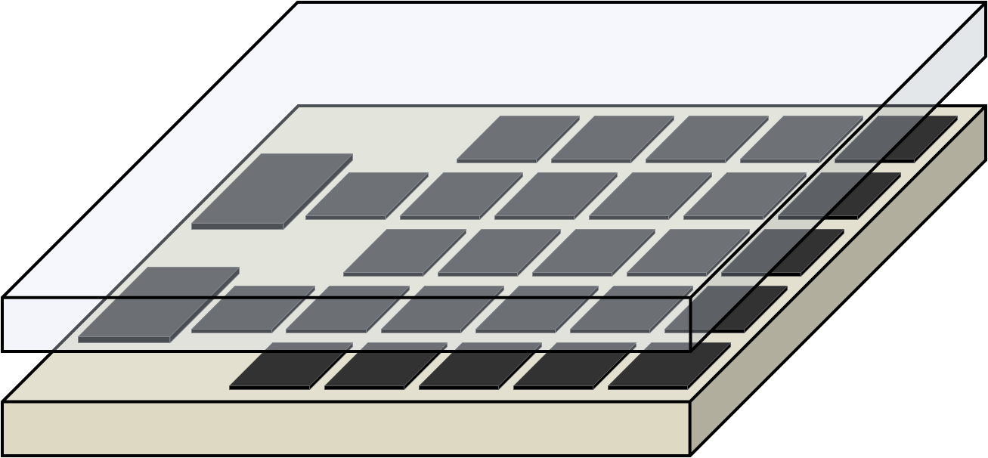
DMFB Mapping
How do I make a reaction run on a DMFB?

Slide 8
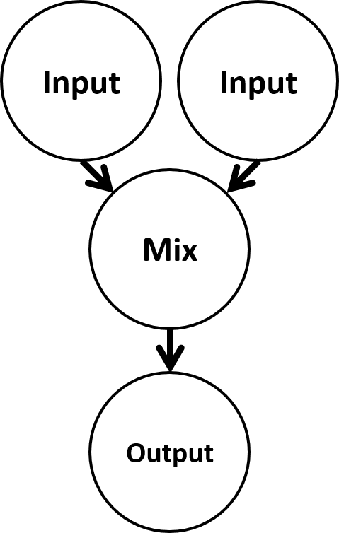
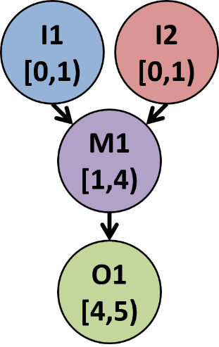
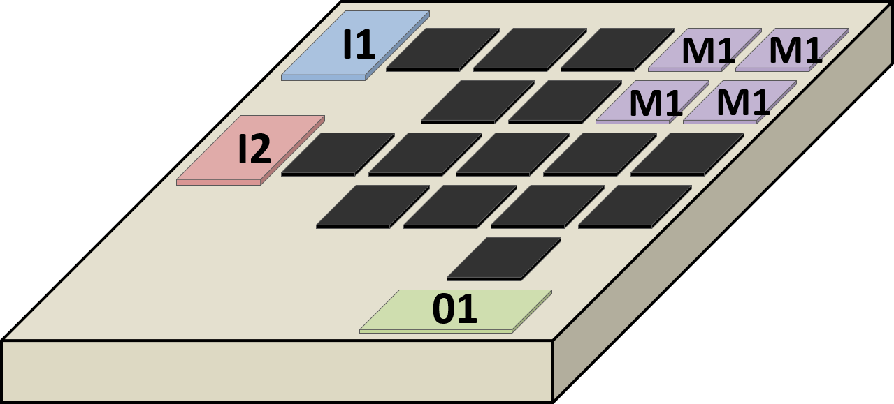
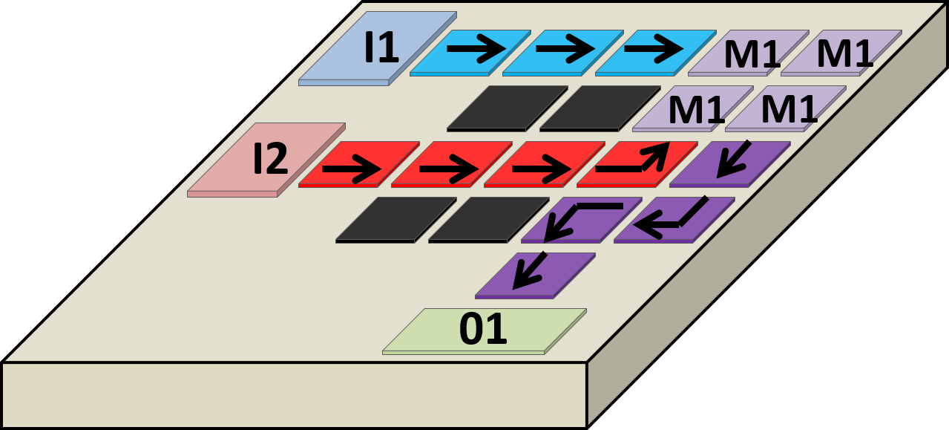


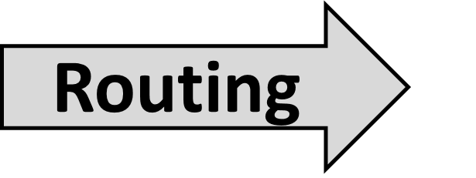
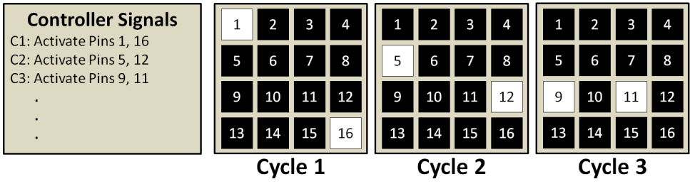
CAD Synthesis Flow
Synthesis: The process of mapping an application to hardware
  Similar to how applications are mapped to ICs
Electrode Sequence

Slide 9
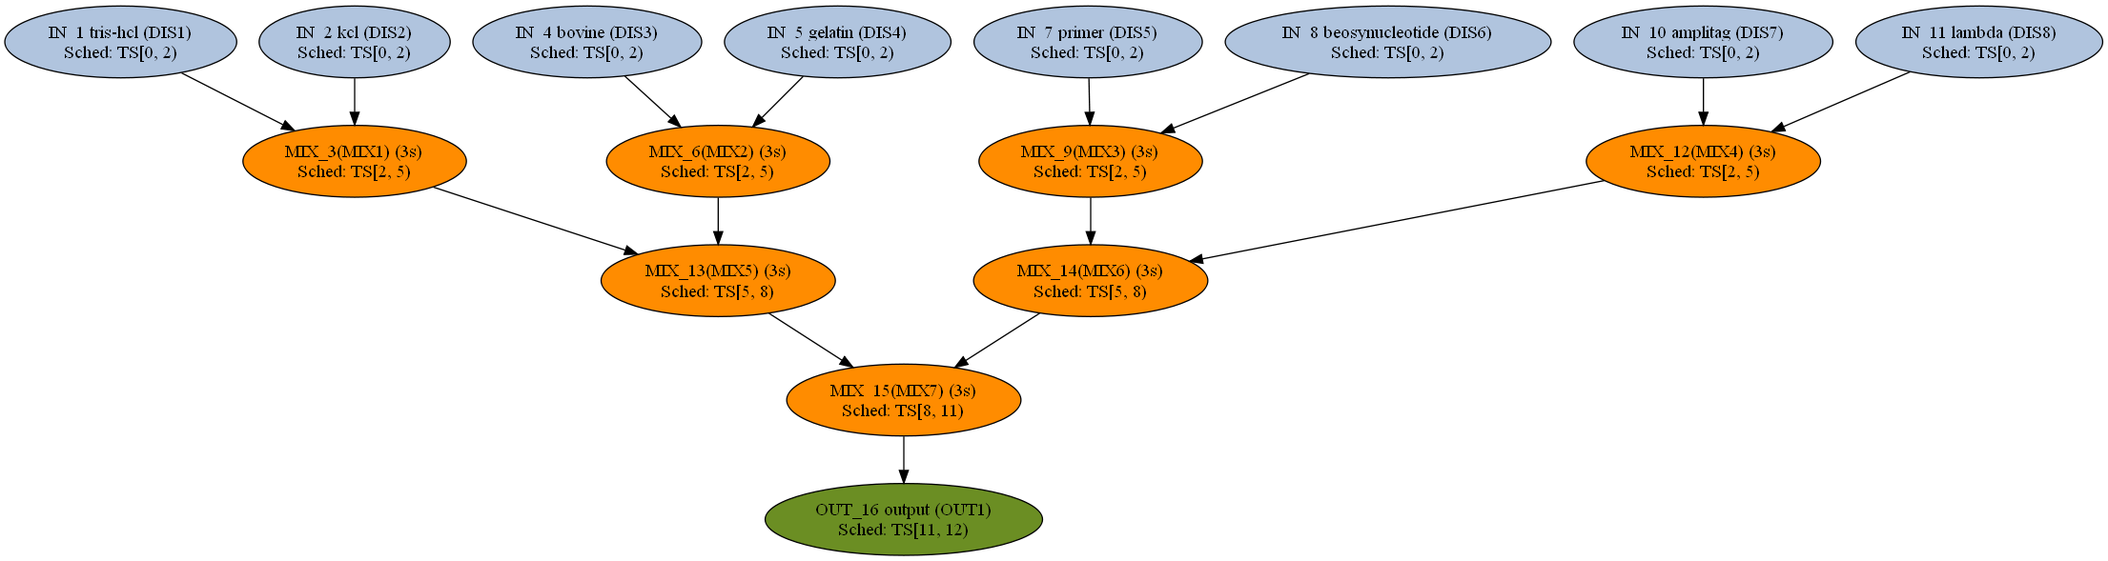
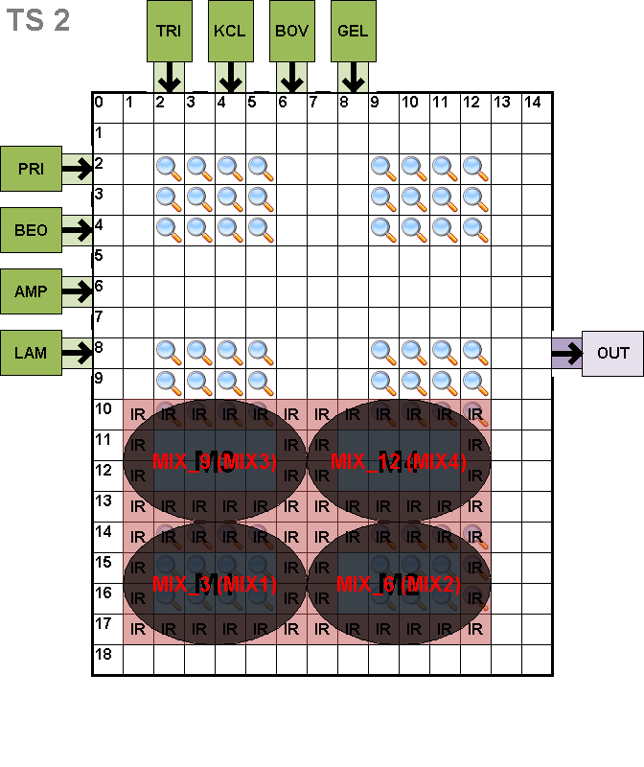
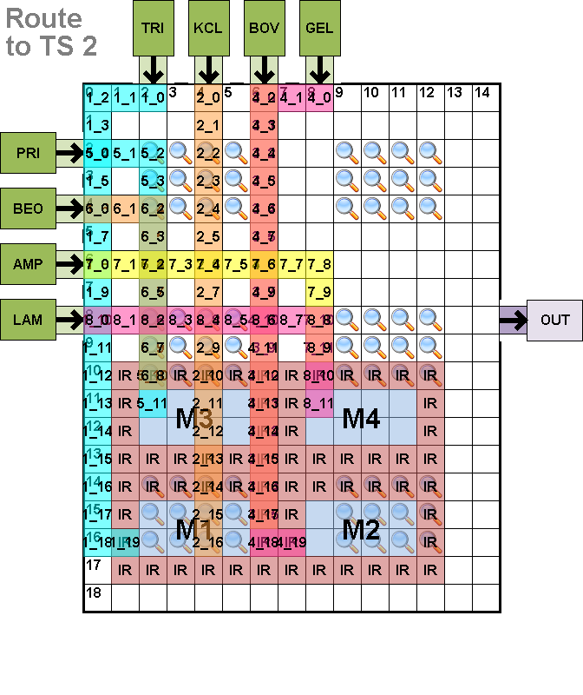
Synthesis Example
1.) Schedule
2.) Place
3.) Route

Slide 10
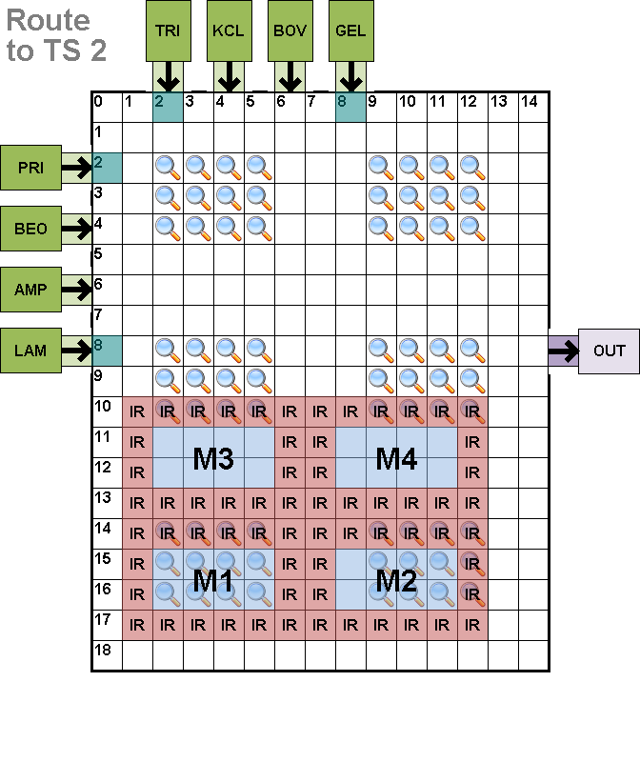
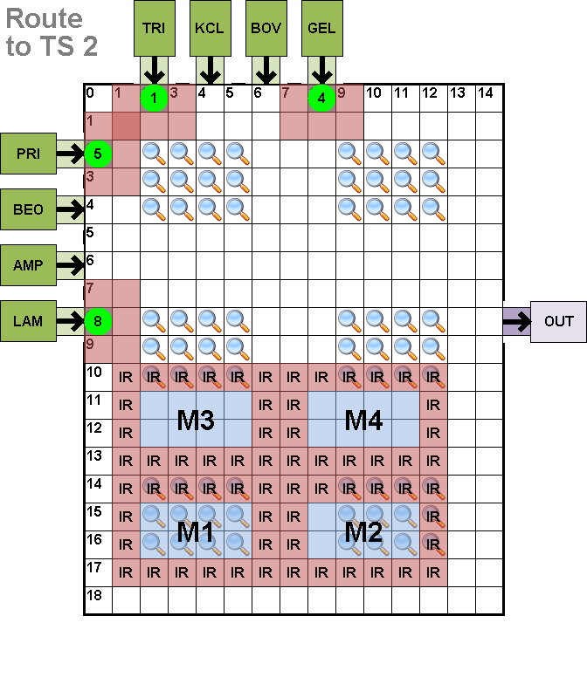
Compaction Example
Electrode Activations
Corresponding Droplet Motion

Slide 11
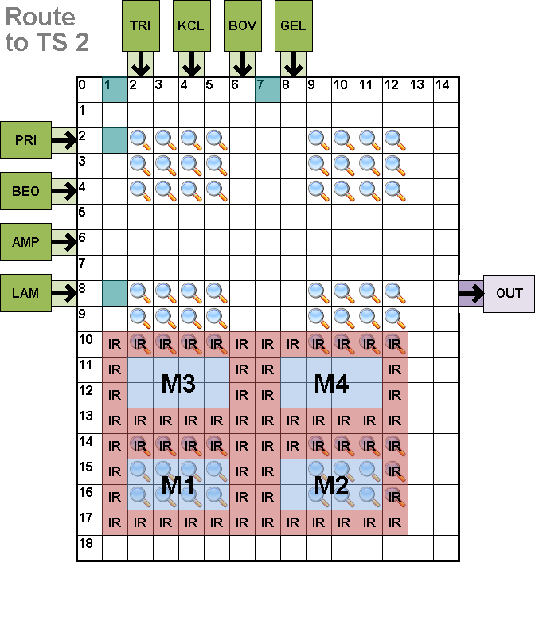
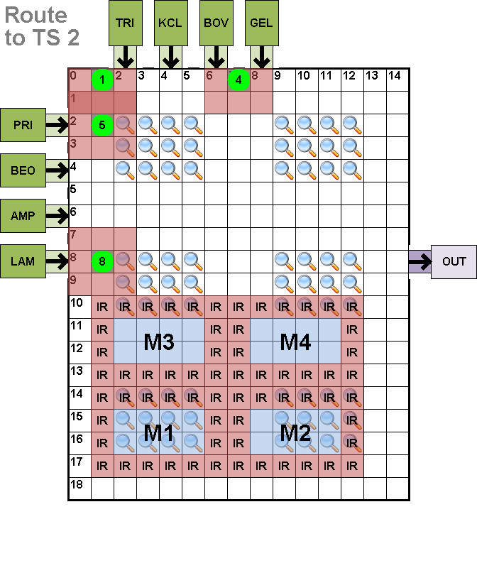
Compaction Example
Electrode Activations
Corresponding Droplet Motion

Slide 12
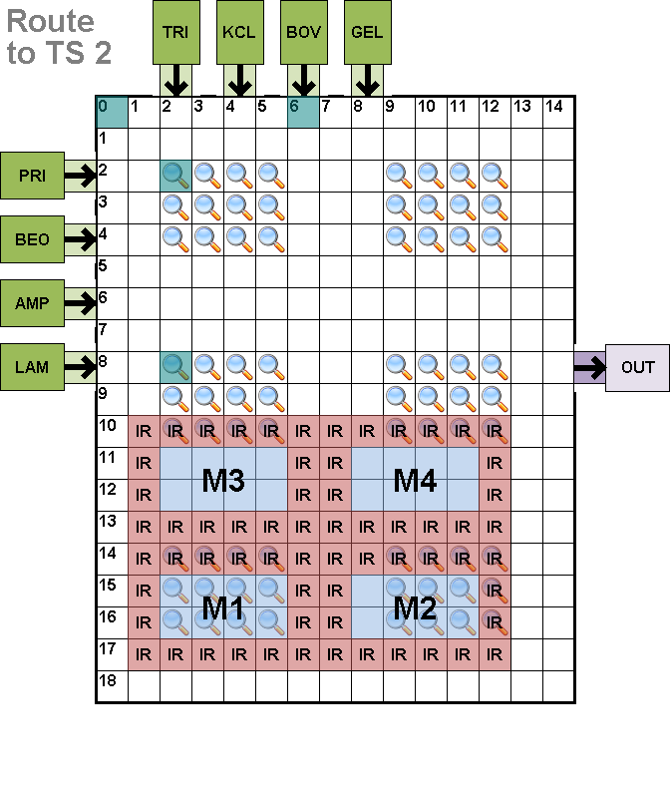
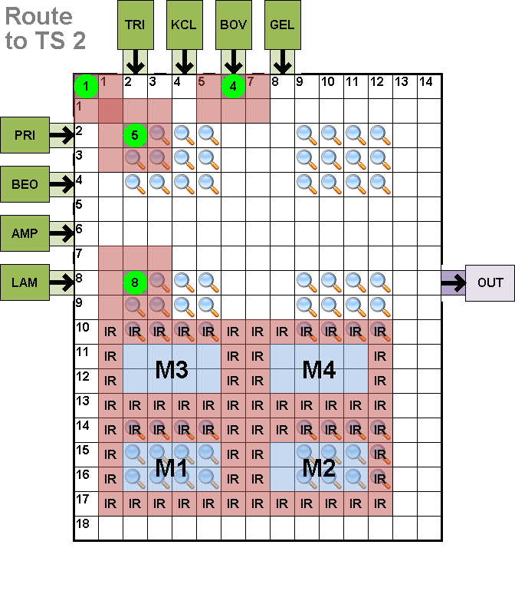
Compaction Example
Electrode Activations
Corresponding Droplet Motion

Slide 13
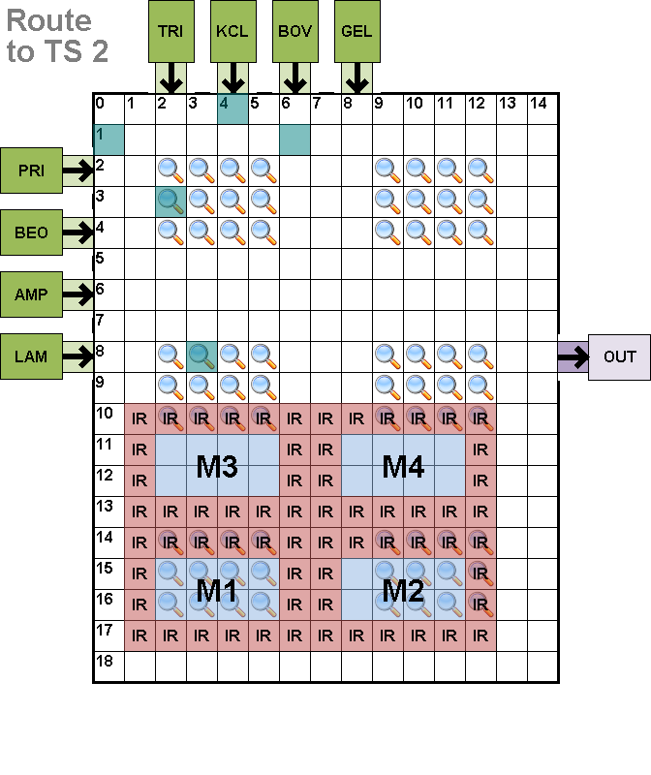
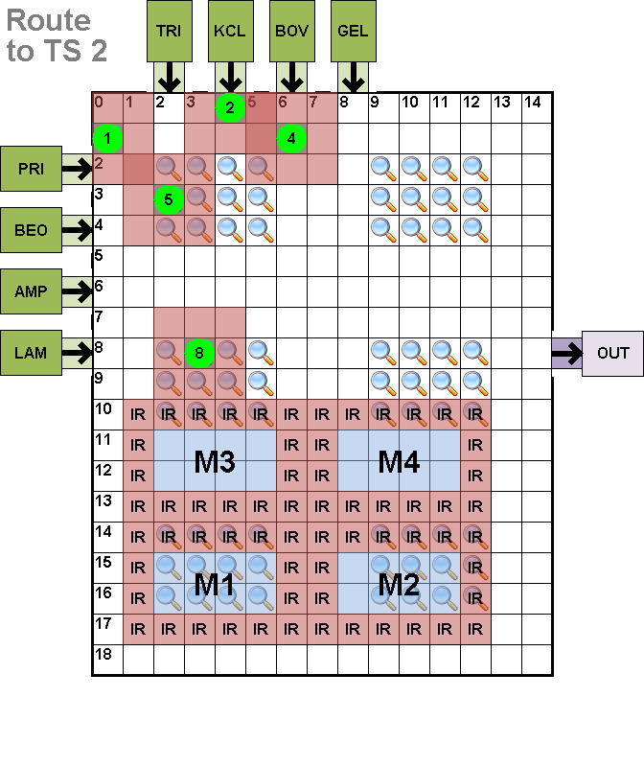
Compaction Example
Electrode Activations
Corresponding Droplet Motion

Slide 14
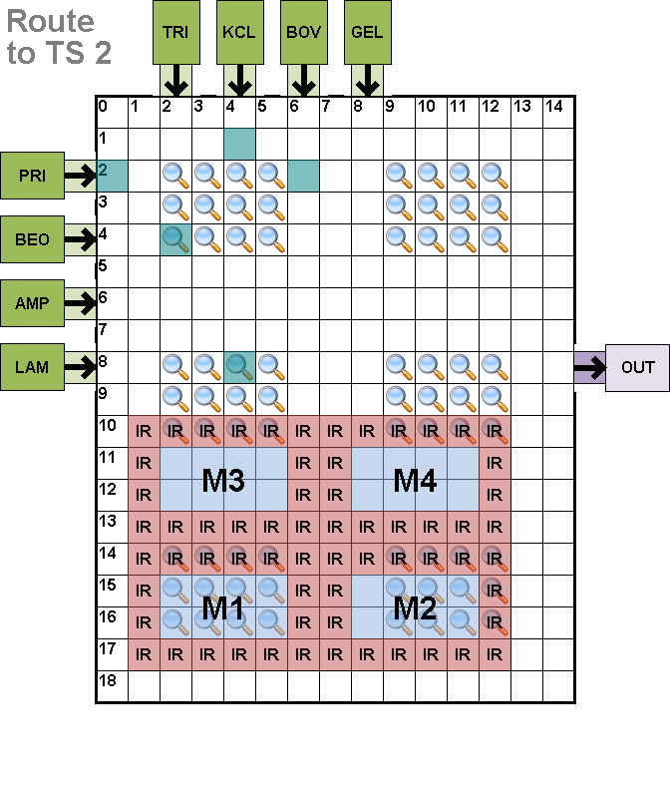
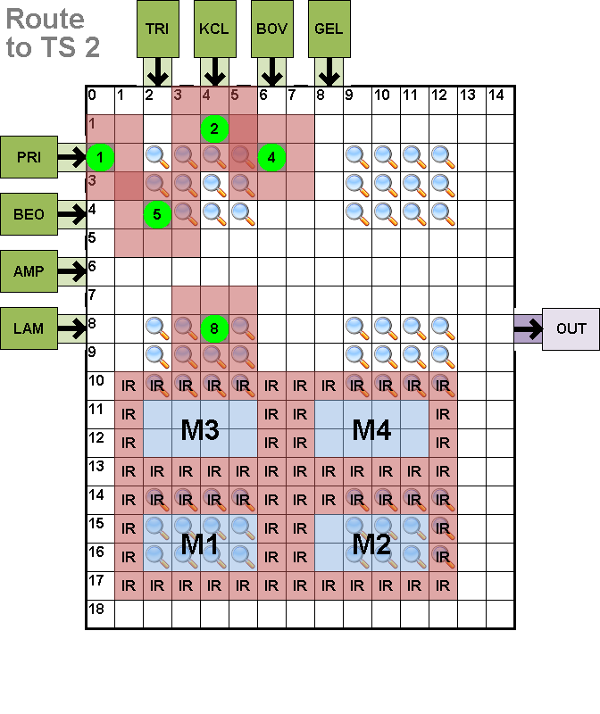
Compaction Example
Electrode Activations
Corresponding Droplet Motion

Slide 15
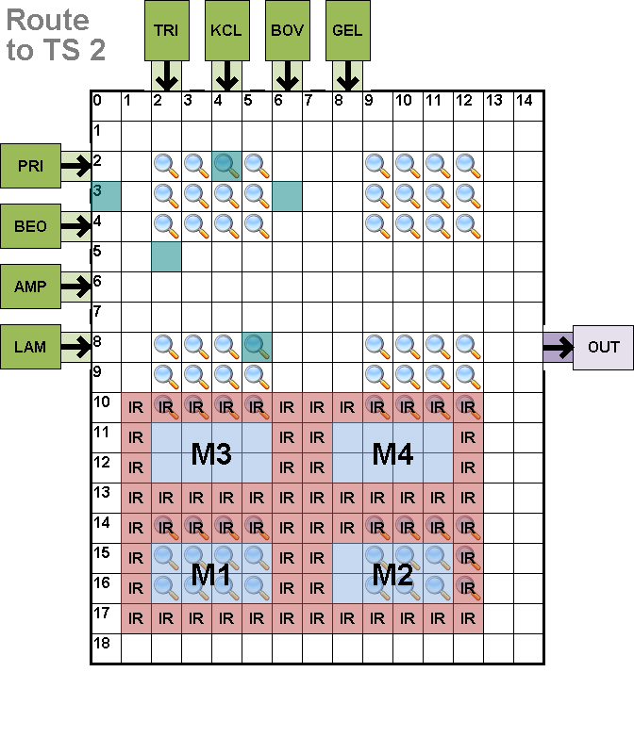
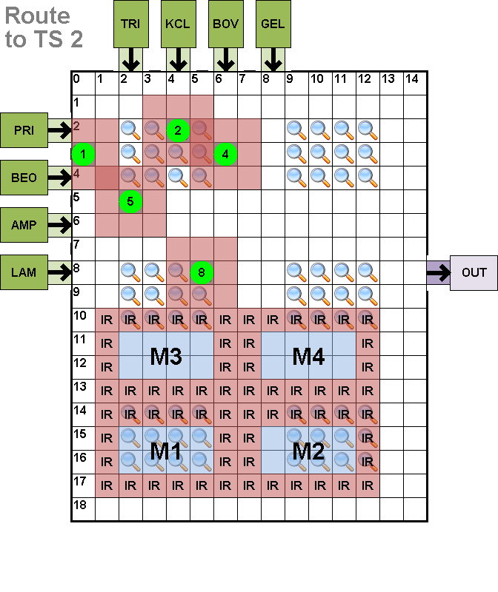
Compaction Example
Electrode Activations
Corresponding Droplet Motion

Slide 16
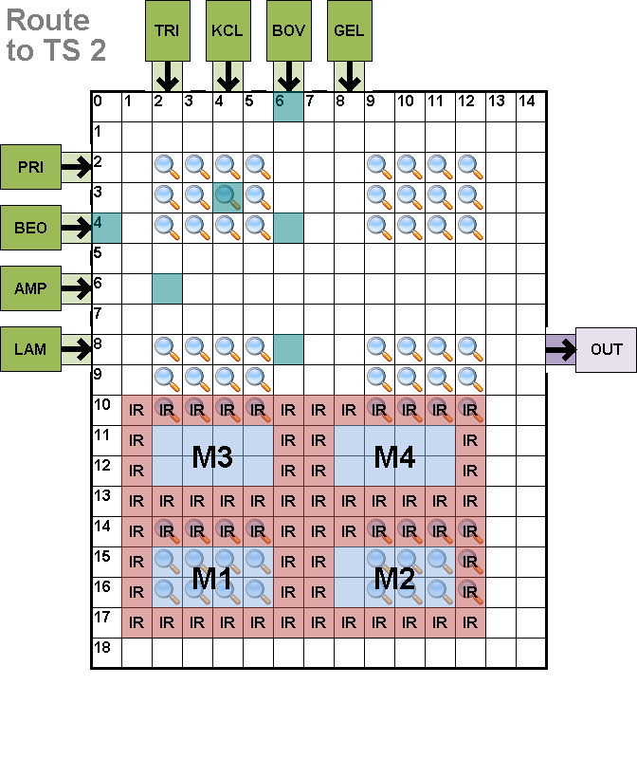
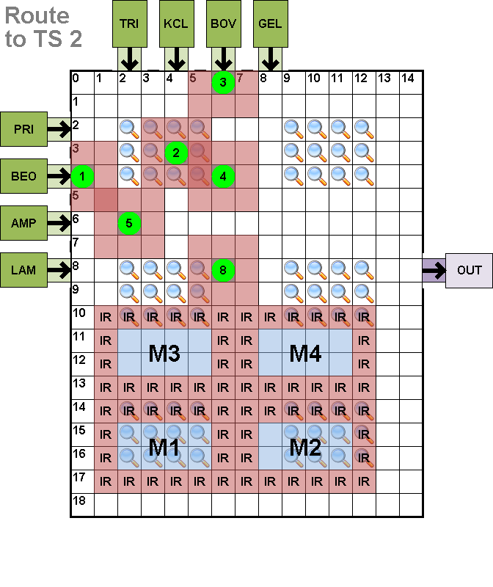
Compaction Example
Electrode Activations
Corresponding Droplet Motion

Slide 17
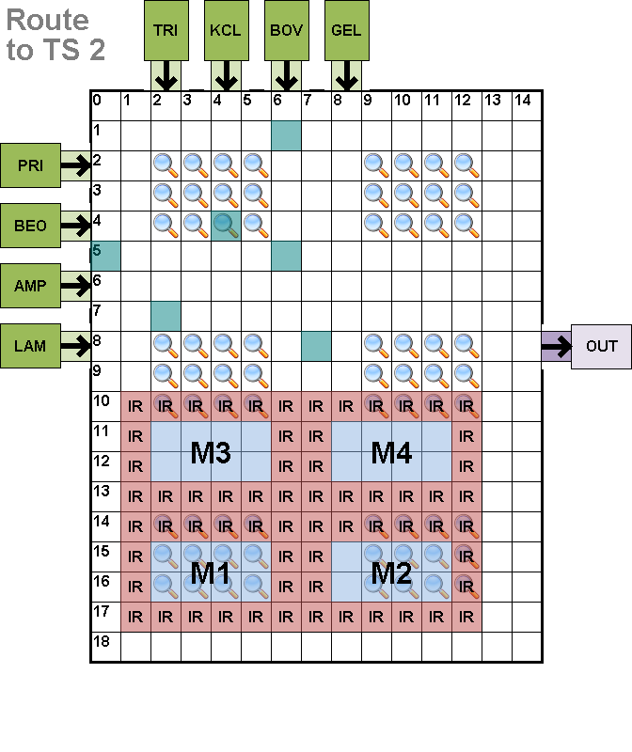
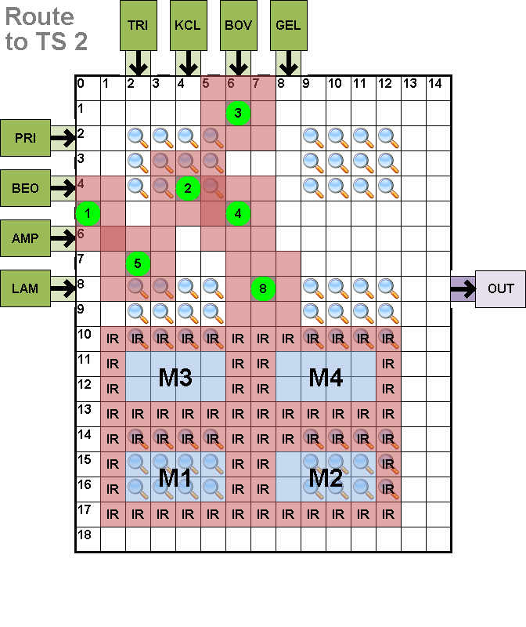
Compaction Example
Electrode Activations
Corresponding Droplet Motion

Slide 18
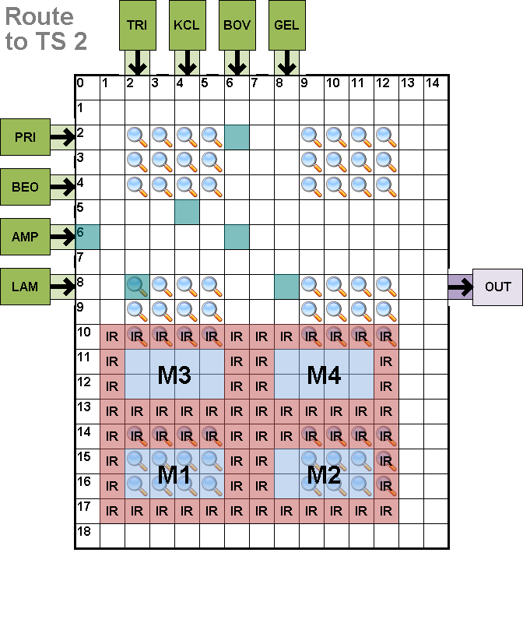
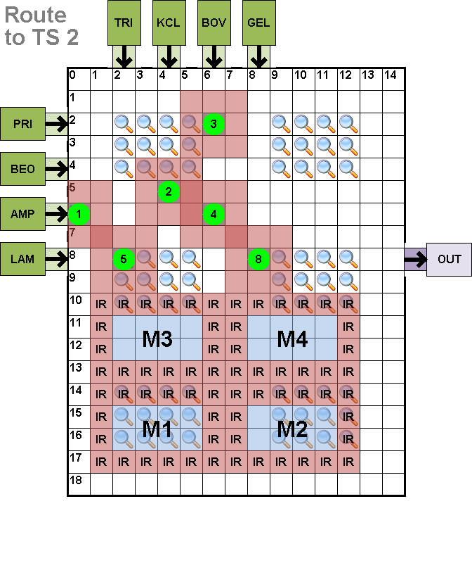
Compaction Example
Electrode Activations
Corresponding Droplet Motion

Slide 19
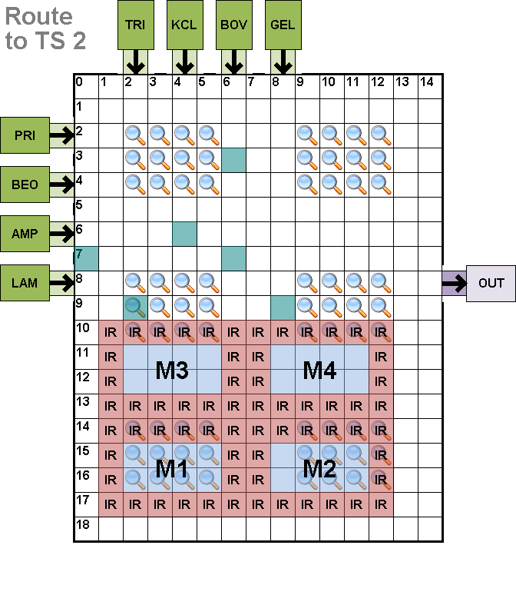
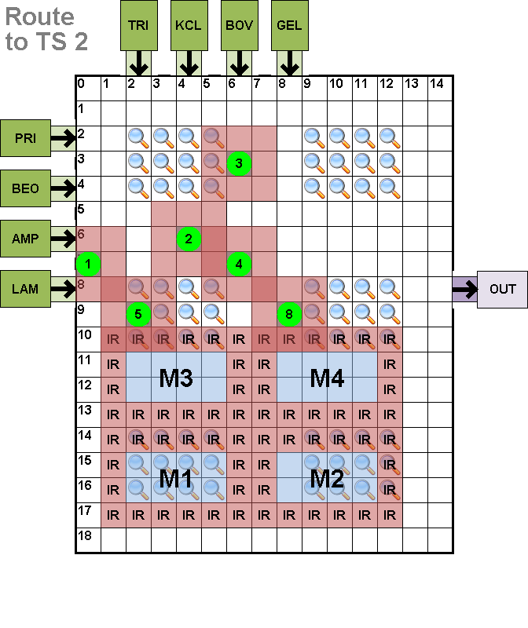
Compaction Example
Electrode Activations
Corresponding Droplet Motion

Slide 20
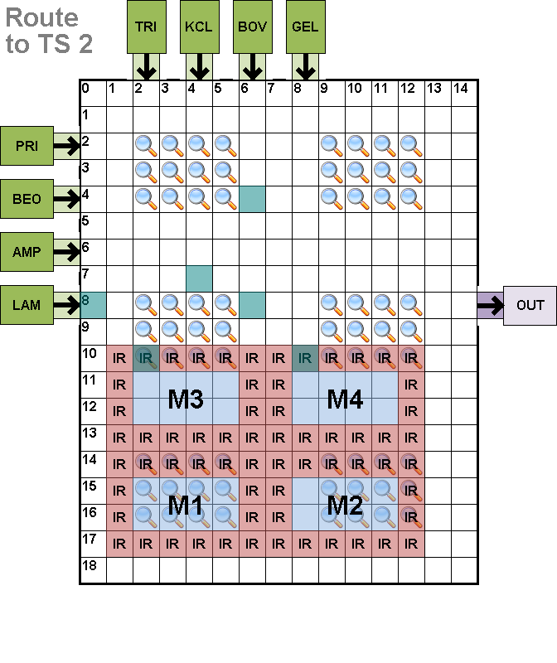
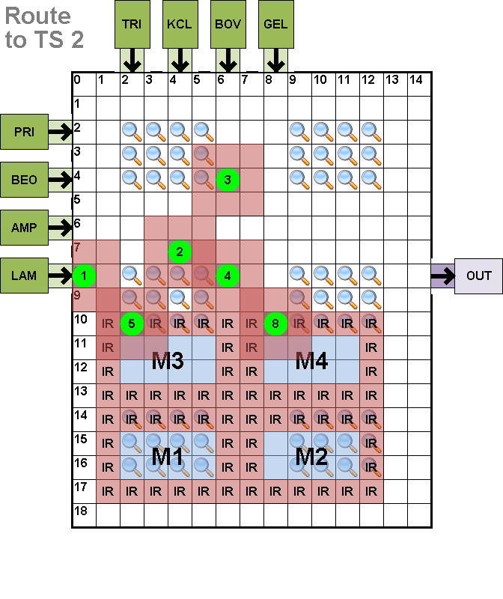
Compaction Example
Electrode Activations
Corresponding Droplet Motion

Slide 21
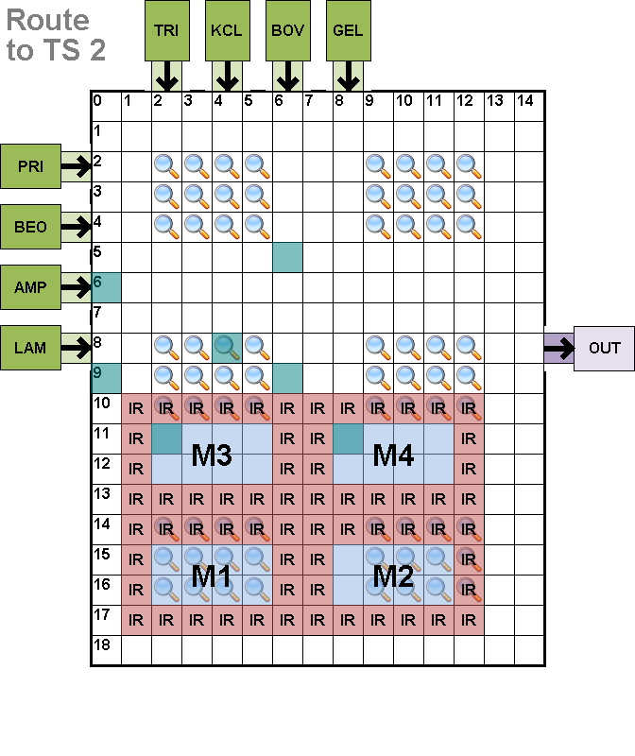
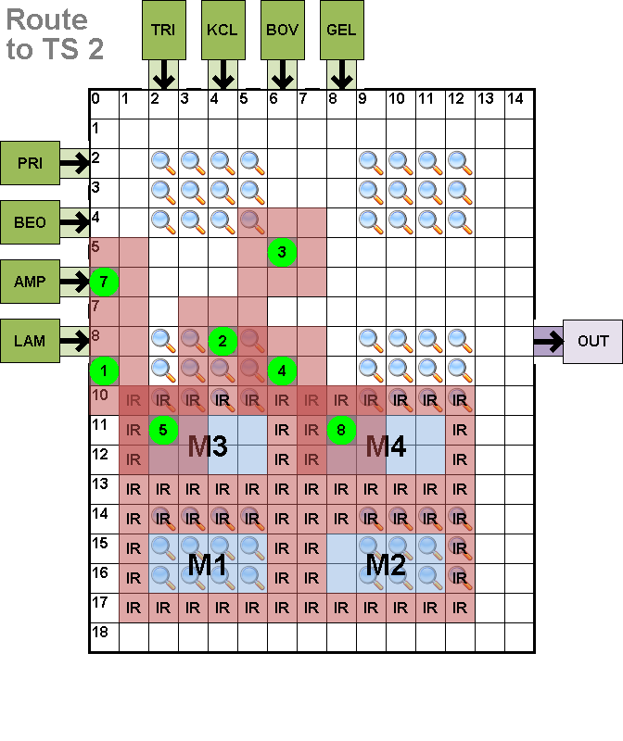
Compaction Example
Electrode Activations
Corresponding Droplet Motion

Slide 22
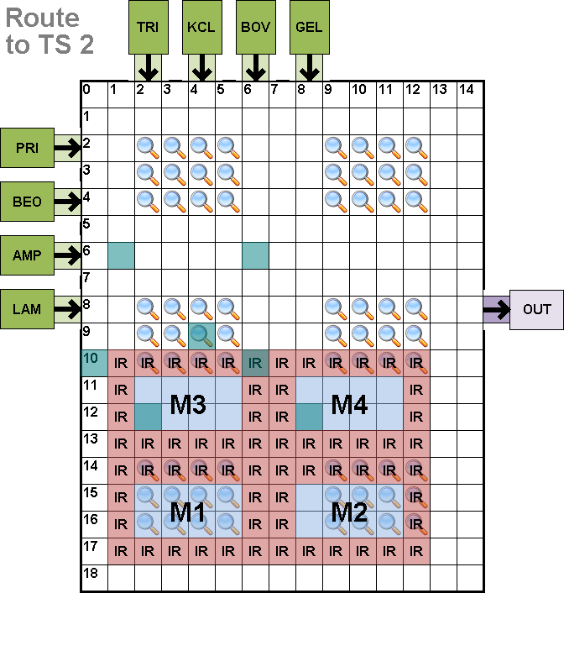
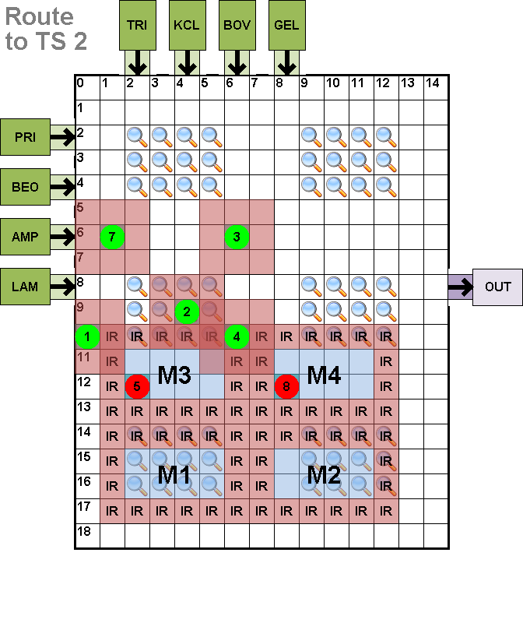
Compaction Example
Electrode Activations
Corresponding Droplet Motion

Slide 23
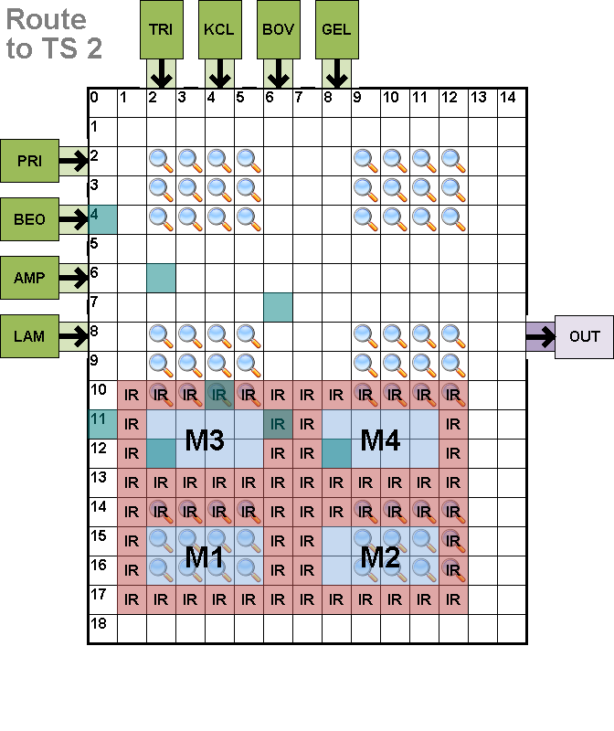
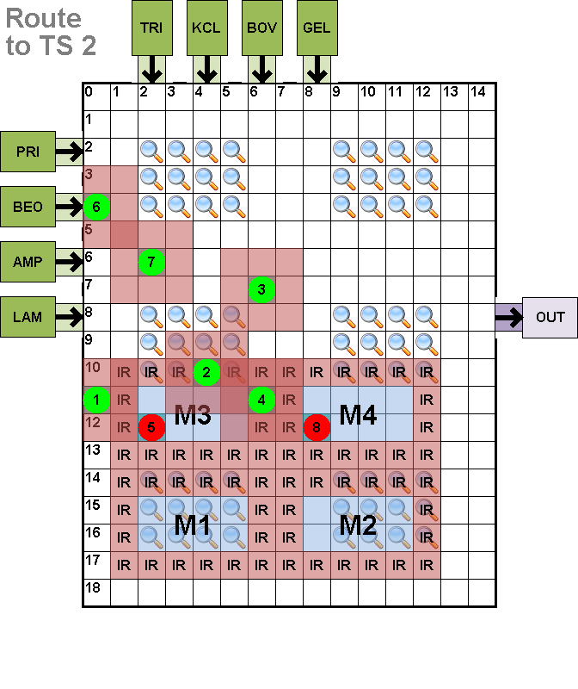
Compaction Example
Electrode Activations
Corresponding Droplet Motion

Slide 24
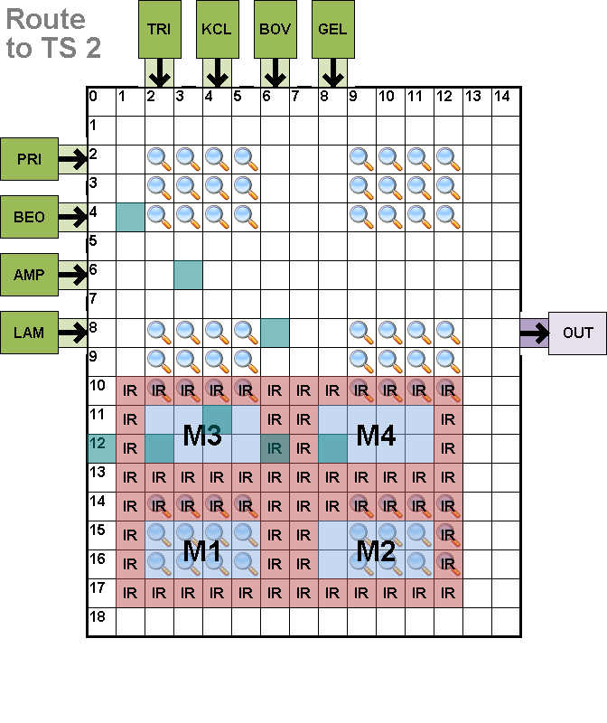
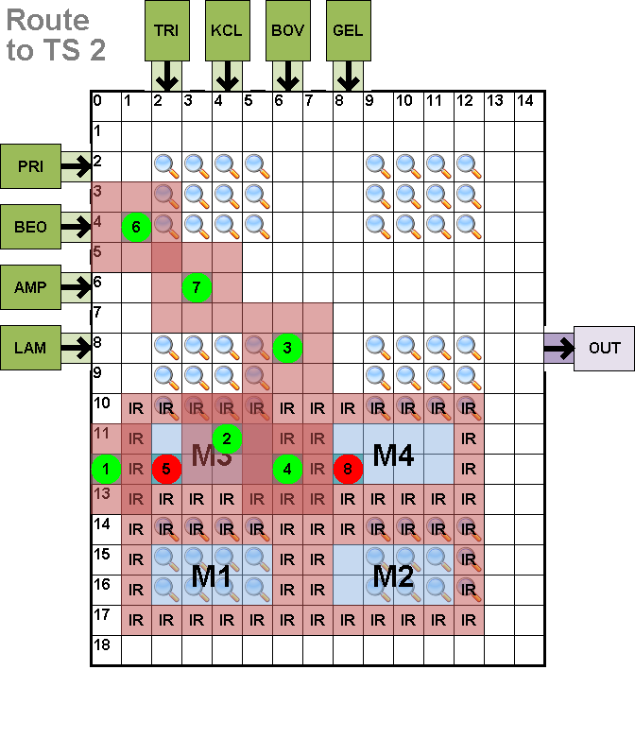
Compaction Example
Electrode Activations
Corresponding Droplet Motion

Slide 25
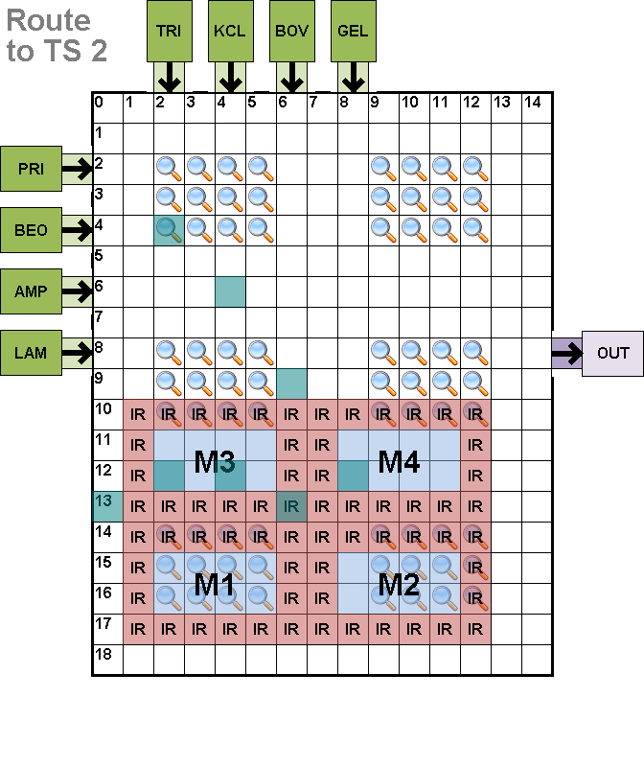
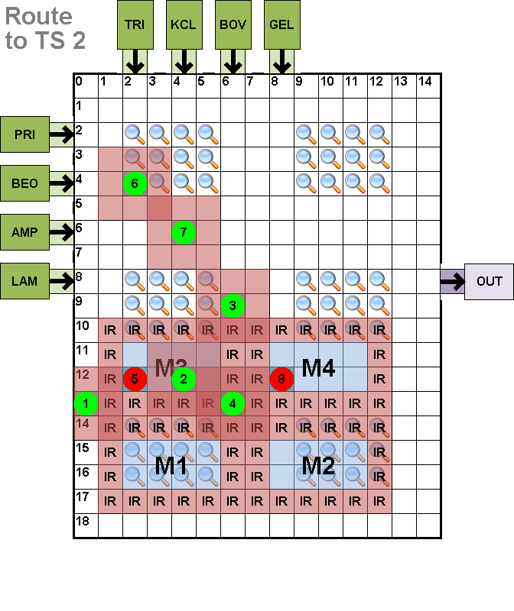
Compaction Example
Electrode Activations
Corresponding Droplet Motion

Slide 26
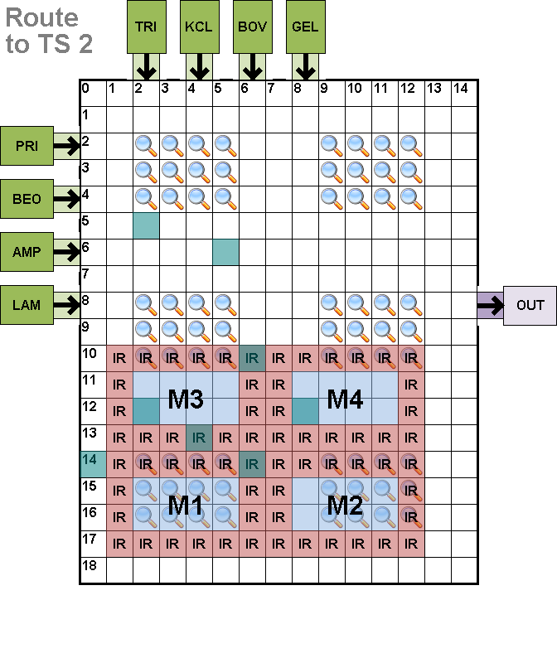
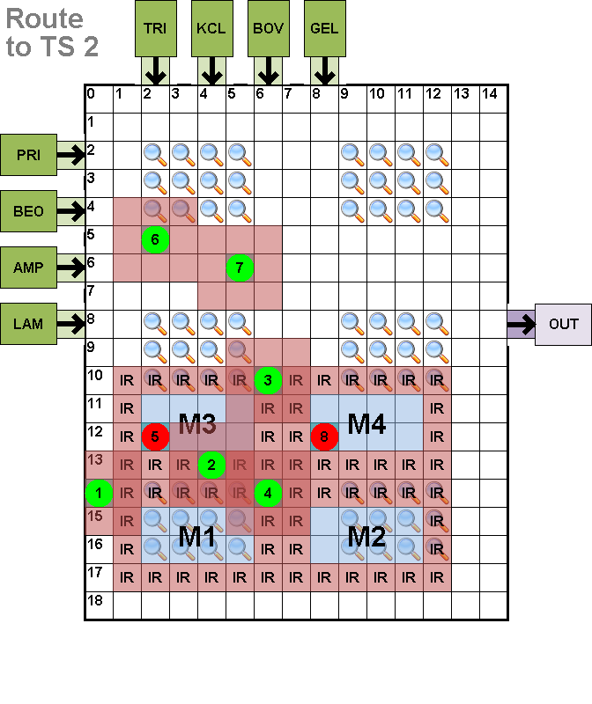
Compaction Example
Electrode Activations
Corresponding Droplet Motion

Slide 27
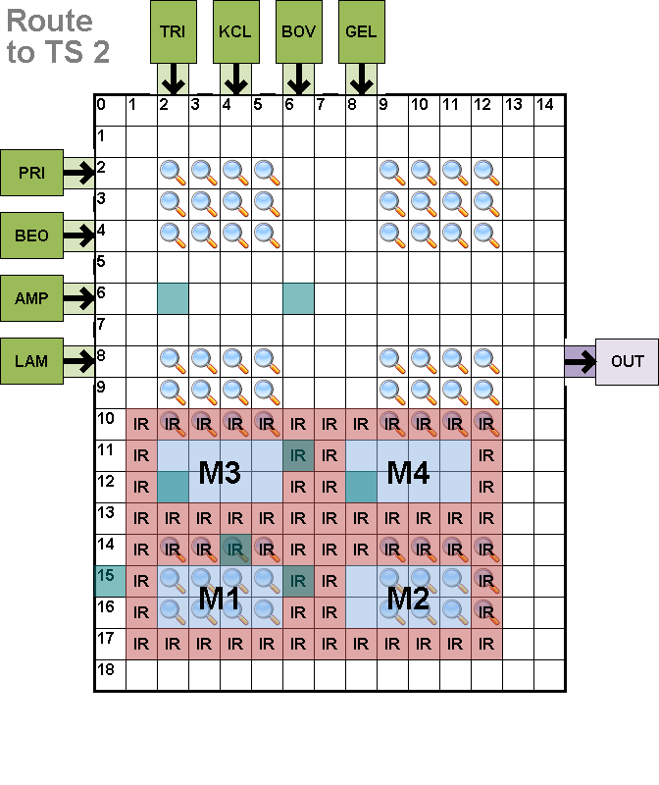

Compaction Example
Electrode Activations
Corresponding Droplet Motion

Slide 28


Compaction Example
Electrode Activations
Corresponding Droplet Motion

Slide 29


Compaction Example
Electrode Activations
Corresponding Droplet Motion

Slide 30


Compaction Example
Electrode Activations
Corresponding Droplet Motion

Slide 31


Compaction Example
Electrode Activations
Corresponding Droplet Motion

Slide 32


Compaction Example
Electrode Activations
Corresponding Droplet Motion

Slide 33


Compaction Example
Electrode Activations
Corresponding Droplet Motion

Slide 34


Compaction Example
Electrode Activations
Corresponding Droplet Motion

Slide 35


Compaction Example
Electrode Activations
Corresponding Droplet Motion

Slide 36


Compaction Example
Electrode Activations
Corresponding Droplet Motion

Slide 37


Compaction Example
Electrode Activations
Corresponding Droplet Motion

Slide 38


Compaction Example
Electrode Activations
Corresponding Droplet Motion

Slide 39


Compaction Example
Electrode Activations
Corresponding Droplet Motion

Slide 40



Discrete Perspective
Increase Voltage ➔ Increase Velocity
Compaction treated as discrete problem
  Single voltage used for all droplet movements
  All droplets move at same speed (requires halts)
Pollack, M. G., Shenderov, A. D., and Fair, R. B. 2002. Electrowetting-based actuation of droplets for integrated microfluidics. Lab-on-a-Chip 2, 2 (Mar. 2002), 96-101.
D2 WAITS

Slide 41

Continuous-Time Perspective
Voltages can be changed
  Abandons synchronous droplet movement
Reduce energy usage; maintain timing
Compaction treated as continuous problem
  Multiple voltages used for droplet movements
  Droplets move at different speeds (avoid halts)

Slide 42








Formal Problem Formation
Details In Paper

Slide 43



General Problem Formation
Droplet paths broken into segments
  Max-length contiguous subsequence in one direction
Droplet motion:
  Constant velocity/voltage along entire segment
  Only stops at beginning/end of segments
  Interference constraints at continuous-time positions
Static Constraints
Dynamic Constraints
Interference Regions (IR) Prevent Droplet Collisions

Slide 44
Algorithmic Description
Step 1: Route computation
  Roy’s maze-based droplet router (greedy)
    Computes routes that could overlap
  Never re-visit/re-compute routes

Slide 45


Algorithmic Description
Step 2: Time-constrained, energy-aware compaction
  Given timing constraint $T_{c}$
  For each droplet path:
    Compute initial path velocity $vel=\frac{pathLength}{Tc}$
      Minimum Voltage for velocity derived from graph
Least-squares-fit equation
Noh, J. H., Noh, J., Kreit, E., Heikenfeld, J., and Rack, P. D. 2012. Toward active-matrix lab-on-a-chip: programmable electrofluidic control enabled by arrayed oxide thin film transistors. Lab-on-a-Chip 12, 2 (Jan. 2012), 353-360.

Slide 46


Algorithmic Description
Step 2: Compaction (continued)
  Compute all segment timings from
  initial velocities
  For each droplet path $P_{d}$
    For each electrode position $e_{di}$ in $P_{d}$
      Compare against each previously compacted path
        If no interference along segment:
          Accept segment
        If interference along segment:
          Speedup current droplet along its segment
          Adjust remaining segments to conserve energy
          Re-compute path timings for that droplet
(0,8]
(7,14]
(8,13]
(0,7]
Example Coming!

Slide 47
Simple Example
d1
(0,8]
D2
s2
(7,14]
(8,13]
(0,7]
s1
D1
d2
Compact D1.

Slide 48
Simple Example
d1
 |  |  |  |  |  |  |  | 13
 |  |  |  |  |  |  |  | 12
 |  |  |  |  |  |  |  | 11
 |  |  |  |  |  |  |  | 10
 |  |  |  |  |  |  |  | 9
 |  |  |  |  |  |  |  | 8
 |  | 1 | 2 | 3 | 4 | 5 | 6 | 7
(0,8]
D2
s2
(7,14]
(8,13]
(0,7]
Numbers on electrodes indicate the time the droplet arrives at the electrode.
s1
Segment 1: 1 electrode/s
Segment 2: 1 electrode/s
D1
d2
No previous paths; D1 routes with no problems.

Slide 49
Simple Example
d1
 |  |  |  |  |  |  |  | 13
 |  |  |  |  |  |  |  | 12
 |  |  |  |  |  |  |  | 11
 |  |  |  |  |  |  |  | 10
 |  |  |  |  |  |  |  | 9
 |  |  |  |  |  |  |  | 8
 |  | 1 | 2 | 3 | 4 | 5 | 6 | 7
D2
s2
Numbers on electrodes indicate the time the droplet arrives at the electrode.
s1
Segment 1: 1 electrode/s
Segment 2: 1 electrode/s
Segment 3: 1 electrodes/s
D1
d2
Now compact D2 against all previous droplet paths (D1).

Slide 50
Simple Example
d1
 |  |  |  |  |  |  |  | 13
 |  |  |  |  |  | 1 |  | 12
 |  |  |  |  |  |  |  | 11
 |  |  |  |  |  |  |  | 10
 |  |  |  |  |  |  |  | 9
 |  |  |  |  |  |  |  | 8
 |  | 1 | 2 | 3 | 4 | 5 | 6 | 7
s2
D2
Numbers on electrodes indicate the time the droplet arrives at the electrode.
s1
D1
Segment 1: 1 electrode/s
Segment 2: 1 electrode/s
Segment 3: 1 electrodes/s
d2
Now compact D2 against all previous droplet paths (D1).

Slide 51
Simple Example
d1
 |  |  |  |  |  |  |  | 13
 |  |  |  |  |  | 1 |  | 12
 |  |  |  |  |  | 2 |  | 11
 |  |  |  |  |  |  |  | 10
 |  |  |  |  |  |  |  | 9
 |  |  |  |  |  |  |  | 8
 |  | 1 | 2 | 3 | 4 | 5 | 6 | 7
s2
D2
Numbers on electrodes indicate the time the droplet arrives at the electrode.
s1
D1
Segment 1: 1 electrode/s
Segment 2: 1 electrode/s
Segment 3: 1 electrodes/s
d2
Now compact D2 against all previous droplet paths (D1).

Slide 52
Simple Example
d1
 |  |  |  |  |  |  |  | 13
 |  |  |  |  |  | 1 |  | 12
 |  |  |  |  |  | 2 |  | 11
 |  |  |  |  |  | 3 |  | 10
 |  |  |  |  |  |  |  | 9
 |  |  |  |  |  |  |  | 8
 |  | 1 | 2 | 3 | 4 | 5 | 6 | 7
s2
D2
Numbers on electrodes indicate the time the droplet arrives at the electrode.
s1
D1
Segment 1: 1 electrode/s
Segment 2: 1 electrode/s
Segment 3: 1 electrodes/s
d2
Now compact D2 against all previous droplet paths (D1).

Slide 53
Simple Example
d1
 |  |  |  |  |  |  |  | 13
 |  |  |  |  |  | 1 |  | 12
 |  |  |  |  |  | 2 |  | 11
 |  |  |  |  |  | 3 |  | 10
 |  |  |  |  |  | 4 |  | 9
 |  |  |  |  |  |  |  | 8
 |  | 1 | 2 | 3 | 4 | 5 | 6 | 7
s2
Numbers on electrodes indicate the time the droplet arrives at the electrode.
D2
s1
D1
Segment 1: 1 electrode/s
Segment 2: 1 electrode/s
Segment 3: 1 electrodes/s
d2
Now compact D2 against all previous droplet paths (D1).

Slide 54
Simple Example
d1
 |  |  |  |  |  |  |  | 13
 |  |  |  |  |  | 1 |  | 12
 |  |  |  |  |  | 2 |  | 11
 |  |  |  |  |  | 3 |  | 10
 |  |  |  |  |  | 4 |  | 9
 |  |  |  |  |  | 5 |  | 8
 |  | 1 | 2 | 3 | 4 | 5/6 | 6 | 7
s2
Numbers on electrodes indicate the time the droplet arrives at the electrode.
D2
s1
D1
Segment 1: 1 electrode/s
Segment 2: 1 electrode/s
Segment 3: 1 electrodes/s
d2
While compacting D2, detected interference at time 5 between D1 and D2.

Slide 55
Simple Example
d1
 |  |  |  |  |  |  |  | 13
 |  |  |  |  |  |  |  | 12
 |  |  |  |  |  |  |  | 11
 |  |  |  |  |  |  |  | 10
 |  |  |  |  |  |  |  | 9
 |  |  |  |  |  |  |  | 8
 |  | 1 | 2 | 3 | 4 | 5 | 6 | 7
D2
s2
Numbers on electrodes indicate the time the droplet arrives at the electrode.
s1
Segment 1: 1 electrode/s
Segment 2: 1 electrode/s
Segment 3: 2.5 electrodes/s
D1
d2
Increases D2’s velocity/voltage (2.5x) and restart compaction for D2.

Slide 56
Simple Example
d1
 |  |  |  |  |  |  |  | 13
 |  |  |  |  |  | .4 |  | 12
 |  |  |  |  |  | .8 |  | 11
 |  |  |  |  |  | 1.2 |  | 10
 |  |  |  |  |  |  |  | 9
 |  |  |  |  |  |  |  | 8
 |  | 1 | 2 | 3 | 4 | 5 | 6 | 7
s2
D2
Numbers on electrodes indicate the time the droplet arrives at the electrode.
s1
D1
Segment 1: 1 electrode/s
Segment 2: 1 electrode/s
Segment 3: 2.5 electrodes/s
d2
Re-compact D2 at 2.5x speed against all previous droplet paths (D1).

Slide 57
Simple Example
d1
 |  |  |  |  |  |  |  | 13
 |  |  |  |  |  | .4 |  | 12
 |  |  |  |  |  | .8 |  | 11
 |  |  |  |  |  | 1.2 |  | 10
 |  |  |  |  |  | 1.6 |  | 9
 |  |  |  |  |  | 5 |  | 8
 |  | 1 | 2 | 3 | 4 | 5 | 6 | 7
s2
Numbers on electrodes indicate the time the droplet arrives at the electrode.
D2
s1
D1
Segment 1: 1 electrode/s
Segment 2: 1 electrode/s
Segment 3: 2.5 electrodes/s
d2
Re-compact D2 at 2.5x speed against all previous droplet paths (D1).

Slide 58
Simple Example
d1
 |  |  |  |  |  |  |  | 13
 |  |  |  |  |  | .4 |  | 12
 |  |  |  |  |  | .6 |  | 11
 |  |  |  |  |  | 1.2 |  | 10
 |  |  |  |  |  | 1.6 |  | 9
 |  |  |  |  |  | 2 |  | 8
 |  | 1 | 2 | 3 | 4 | 5 / 2.4 | 6 | 7
 |  |  |  |  |  | 2.8
 |  |  |  |  |  | 3.2
s2
Numbers on electrodes indicate the time the droplet arrives at the electrode.
s1
D1
Segment 1: 1 electrode/s
Segment 2: 1 electrode/s
Segment 3: 2.5 electrodes/s
d2
D2
D2 reached end of segment.

Slide 59
Simple Example
d1
 |  |  |  |  |  |  |  | 13
 |  |  |  |  |  | .4 |  | 12
 |  |  |  |  |  | .6 |  | 11
 |  |  |  |  |  | 1.2 |  | 10
 |  |  |  |  |  | 1.6 |  | 9
 |  |  |  |  |  | 2 |  | 8
 |  | 1 | 2 | 3 | 4 | 5 / 2.4 | 6 | 7
 |  |  |  |  |  | 2.8
 |  |  |  |  |  | 3.2
s2
Numbers on electrodes indicate the time the droplet arrives at the electrode.
s1
D1
Segment 1: 1 electrode/s
Segment 2: 1 electrode/s
Segment 3: 2.5 electrodes/s
Segment 4: 0.46 electrodes/s
d2
D2
D2 does not need to get there before D1; save energy and slow D2 down to 0.46 electrodes/sec.

Slide 60
Simple Example
d1
 |  |  |  |  |  |  |  | 13
 |  |  |  |  |  | .4 |  | 12
 |  |  |  |  |  | .6 |  | 11
 |  |  |  |  |  | 1.2 |  | 10
 |  |  |  |  |  | 1.6 |  | 9
 |  |  |  |  |  | 2 |  | 8
 |  | 1 | 2 | 3 | 4 | 5 / 2.4 | 6 | 7
 |  |  |  |  |  | 2.8
 |  |  |  |  | 5.3 | 3.2
s2
Numbers on electrodes indicate the time the droplet arrives at the electrode.
s1
D1
Segment 1: 1 electrode/s
Segment 2: 1 electrode/s
Segment 3: 2.5 electrodes/s
Segment 4: 0.46 electrodes/s
d2
D2
D2 does not need to get there before D1; save energy and slow D2 down to 0.46 electrodes/sec.

Slide 61
Simple Example
d1
 |  |  |  |  |  |  |  | 13
 |  |  |  |  |  | .4 |  | 12
 |  |  |  |  |  | .6 |  | 11
 |  |  |  |  |  | 1.2 |  | 10
 |  |  |  |  |  | 1.6 |  | 9
 |  |  |  |  |  | 2 |  | 8
 |  | 1 | 2 | 3 | 4 | 5 / 2.4 | 6 | 7
 |  |  |  |  |  | 2.8
 |  |  |  |  | 5.3 | 3.2
s2
Numbers on electrodes indicate the time the droplet arrives at the electrode.
s1
D1
Segment 1: 1 electrode/s
Segment 2: 1 electrode/s
Segment 3: 2.5 electrodes/s
Segment 4: 0.46 electrodes/s
d2
D2
D2 does not need to get there before D1; save energy and slow D2 down to 0.46 electrodes/sec.

Slide 62
Simple Example
d1
 |  |  |  |  |  |  |  | 13
 |  |  |  |  |  | .4 |  | 12
 |  |  |  |  |  | .6 |  | 11
 |  |  |  |  |  | 1.2 |  | 10
 |  |  |  |  |  | 1.6 |  | 9
 |  |  |  |  |  | 2 |  | 8
 |  | 1 | 2 | 3 | 4 | 5 / 2.4 | 6 | 7
 |  |  |  |  |  | 2.8
 |  |  |  | 7.4 | 5.3 | 3.2
s2
Numbers on electrodes indicate the time the droplet arrives at the electrode.
s1
D1
Segment 1: 1 electrode/s
Segment 2: 1 electrode/s
Segment 3: 2.5 electrodes/s
Segment 4: 0.46 electrodes/s
d2
D2
D2 does not need to get there before D1; save energy and slow D2 down to 0.46 electrodes/sec.

Slide 63
Simple Example
d1
 |  |  |  |  |  |  |  | 13
 |  |  |  |  |  | .4 |  | 12
 |  |  |  |  |  | .6 |  | 11
 |  |  |  |  |  | 1.2 |  | 10
 |  |  |  |  |  | 1.6 |  | 9
 |  |  |  |  |  | 2 |  | 8
 |  | 1 | 2 | 3 | 4 | 5 / 2.4 | 6 | 7
 |  |  |  |  |  | 2.8
 |  |  |  | 7.4 | 5.3 | 3.2
s2
Numbers on electrodes indicate the time the droplet arrives at the electrode.
s1
D1
Segment 1: 1 electrode/s
Segment 2: 1 electrode/s
Segment 3: 2.5 electrodes/s
Segment 4: 0.46 electrodes/s
d2
D2
D2 does not need to get there before D1; save energy and slow D2 down to 0.46 electrodes/sec.

Slide 64
Simple Example
d1
 |  |  |  |  |  |  |  | 13
 |  |  |  |  |  | .4 |  | 12
 |  |  |  |  |  | .6 |  | 11
 |  |  |  |  |  | 1.2 |  | 10
 |  |  |  |  |  | 1.6 |  | 9
 |  |  |  |  |  | 2 |  | 8
 |  | 1 | 2 | 3 | 4 | 5 / 2.4 | 6 | 7
 |  |  |  |  |  | 2.8
 |  |  | 9.5 | 7.4 | 5.3 | 3.2
s2
Numbers on electrodes indicate the time the droplet arrives at the electrode.
D1
s1
Segment 1: 1 electrode/s
Segment 2: 1 electrode/s
Segment 3: 2.5 electrodes/s
Segment 4: 0.46 electrodes/s
d2
D2
D2 does not need to get there before D1; save energy and slow D2 down to 0.46 electrodes/sec.

Slide 65
Simple Example
d1
 |  |  |  |  |  |  |  | 13
 |  |  |  |  |  | .4 |  | 12
 |  |  |  |  |  | .6 |  | 11
 |  |  |  |  |  | 1.2 |  | 10
 |  |  |  |  |  | 1.6 |  | 9
 |  |  |  |  |  | 2 |  | 8
 |  | 1 | 2 | 3 | 4 | 5 / 2.4 | 6 | 7
 |  |  |  |  |  | 2.8
 |  |  | 9.5 | 7.4 | 5.3 | 3.2
s2
Numbers on electrodes indicate the time the droplet arrives at the electrode.
D1
s1
Segment 1: 1 electrode/s
Segment 2: 1 electrode/s
Segment 3: 2.5 electrodes/s
Segment 4: 0.46 electrodes/s
d2
D2
D2 does not need to get there before D1; save energy and slow D2 down to 0.46 electrodes/sec.

Slide 66
Simple Example
d1
 |  |  |  |  |  |  |  | 13
 |  |  |  |  |  | .4 |  | 12
 |  |  |  |  |  | .6 |  | 11
 |  |  |  |  |  | 1.2 |  | 10
 |  |  |  |  |  | 1.6 |  | 9
 |  |  |  |  |  | 2 |  | 8
 |  | 1 | 2 | 3 | 4 | 5 / 2.4 | 6 | 7
 |  |  |  |  |  | 2.8
 |  | 11.6 | 9.5 | 7.4 | 5.3 | 3.2
s2
D1
Numbers on electrodes indicate the time the droplet arrives at the electrode.
s1
Segment 1: 1 electrode/s
Segment 2: 1 electrode/s
Segment 3: 2.5 electrodes/s
Segment 4: 0.46 electrodes/s
d2
D2
D2 does not need to get there before D1; save energy and slow D2 down to 0.46 electrodes/sec.

Slide 67
Simple Example
d1
 |  |  |  |  |  |  |  | 13
 |  |  |  |  |  | .4 |  | 12
 |  |  |  |  |  | .6 |  | 11
 |  |  |  |  |  | 1.2 |  | 10
 |  |  |  |  |  | 1.6 |  | 9
 |  |  |  |  |  | 2 |  | 8
 |  | 1 | 2 | 3 | 4 | 5 / 2.4 | 6 | 7
 |  |  |  |  |  | 2.8
 |  | 11.6 | 9.5 | 7.4 | 5.3 | 3.2
s2
D1
Numbers on electrodes indicate the time the droplet arrives at the electrode.
s1
Segment 1: 1 electrode/s
Segment 2: 1 electrode/s
Segment 3: 2.5 electrodes/s
Segment 4: 0.46 electrodes/s
d2
D2
D2 does not need to get there before D1; save energy and slow D2 down to 0.46 electrodes/sec.

Slide 68
Simple Example
d1
 |  |  |  |  |  |  |  | 13
 |  |  |  |  |  | .4 |  | 12
 |  |  |  |  |  | .6 |  | 11
 |  |  |  |  |  | 1.2 |  | 10
 |  |  |  |  |  | 1.6 |  | 9
 |  |  |  |  |  | 2 |  | 8
 |  | 1 | 2 | 3 | 4 | 5 / 2.4 | 6 | 7
 |  |  |  |  |  | 2.8
 |  | 11.6 | 9.5 | 7.4 | 5.3 | 3.2
s2
D1
Numbers on electrodes indicate the time the droplet arrives at the electrode.
s1
Segment 1: 1 electrode/s
Segment 2: 1 electrode/s
Segment 3: 2.5 electrodes/s
Segment 4: 0.46 electrodes/s
d2
D2
D2 does not need to get there before D1; save energy and slow D2 down to 0.46 electrodes/sec.

Slide 69
Simple Example
d1
 |  |  |  |  |  |  |  | 13
 |  |  |  |  |  | .4 |  | 12
 |  |  |  |  |  | .6 |  | 11
 |  |  |  |  |  | 1.2 |  | 10
 |  |  |  |  |  | 1.6 |  | 9
 |  |  |  |  |  | 2 |  | 8
 |  | 1 | 2 | 3 | 4 | 5 / 2.4 | 6 | 7
 |  |  |  |  |  | 2.8
 |  | 11.6 | 9.5 | 7.4 | 5.3 | 3.2
s2
D1
Numbers on electrodes indicate the time the droplet arrives at the electrode.
s1
Segment 1: 1 electrode/s
Segment 2: 1 electrode/s
Segment 3: 2.5 electrodes/s
Segment 4: 0.46 electrodes/s
D2
d1
D2 does not need to get there before D1; save energy and slow D2 down to 0.46 electrodes/sec.

Slide 70
Simple Example
D1
d1
 |  |  |  |  |  |  |  | 13
 |  |  |  |  |  | .4 |  | 12
 |  |  |  |  |  | .6 |  | 11
 |  |  |  |  |  | 1.2 |  | 10
 |  |  |  |  |  | 1.6 |  | 9
 |  |  |  |  |  | 2 |  | 8
 |  | 1 | 2 | 3 | 4 | 5 / 2.4 | 6 | 7
 |  |  |  |  |  | 2.8
 |  | 11.6 | 9.5 | 7.4 | 5.3 | 3.2
s2
Numbers on electrodes indicate the time the droplet arrives at the electrode.
s1
Segment 1: 1 electrode/s
Segment 2: 1 electrode/s
Segment 3: 2.5 electrodes/s
Segment 4: 0.46 electrodes/s
D2
d1
D2 compacted against D2 with no interference.

Slide 71
Simulation Details
DMFB modeled after University of Tennessee’s active matrix design¹
  Electrode resistance = 1GΩ
  Electrode pitch (dimension) = 2.54mm
  Voltage_{min} = 13V, Voltage_{max} = 70V
  Voltage/velocity relationship:
¹ Noh, J. H., Noh, J., Kreit, E., Heikenfeld, J., and Rack, P. D. 2012. Toward active-matrix lab-on-a-chip: programmable electrofluidic control enabled by arrayed oxide thin film transistors. Lab-on-a-Chip 12, 2 (Jan. 2012), 353-360.

Slide 72
Simulation Details
Benchmarks
  PCR, In-Vitro Diagnostics, Protein, ProteinSplit assays (common benchmarks)
Base Routing Flow²
  Step 1: Roy maze router (same as proposed)
  Step 2: Constant voltage
    Add stalls at beginning of routes to avoid interference
Setup
  Schedules and placements same for both route compactors
² Grissom, D., and Brisk, P. Fast online synthesis of generally programmable digital microfluidic biochips. In Proceedings of the ACM/IEEE International Conference on Hardware Software Codesign and System Synthesis (Tampere, Finland, October 07 - 12, 2012). CODES-ISSS '12, 413-422.

Slide 73

Results: Energy Savings
Routing
Sub-problem #
Base flow performed at 30V, 50V and 70V
  Time constraints for continuous-time compaction derived from these runs
Energy savings vary greatly between sub-problems
  Due to amount and complexity of droplets being routed

Slide 74

Results: Energy Savings
Higher voltages ➔ Better energy usage across platforms
More V for less time can lead to energy savings
30V sees greatest savings because slower paths provide more opportunities for route speedups

Slide 75

Results: Energy Savings
Energy Decreasing
Energy Increasing
Threshold exists where Increasing Voltage ➔ Decreases Energy becomes not true
Threshold depends on device characteristics
Large savings can be incurred by decreasing voltage on halts
  Wait for 0.5s:
    @ 30V ➔ 450 V²s/GΩ
    @ 70V ➔ 2450 V²s/GΩ

Slide 76

Conclusion
First model for continuous-time domain droplet routing (compaction)
  Varying voltage ➔ varying velocity
Multiple speeds allow for energy savings
  Higher voltages can have better energy usage
  Continuous-time domain droplet compaction can achieve energy savings across range of voltage
Tradeoffs may vary based on characteristics of DMFB
Base flow performed at 30V, 50V and 70V
  Time constraints derived from these runs
More savings seen when compared to lower-voltage base cases

Slide 77


Thank You
http://microfluidics.cs.ucr.edu/

