Slide 1
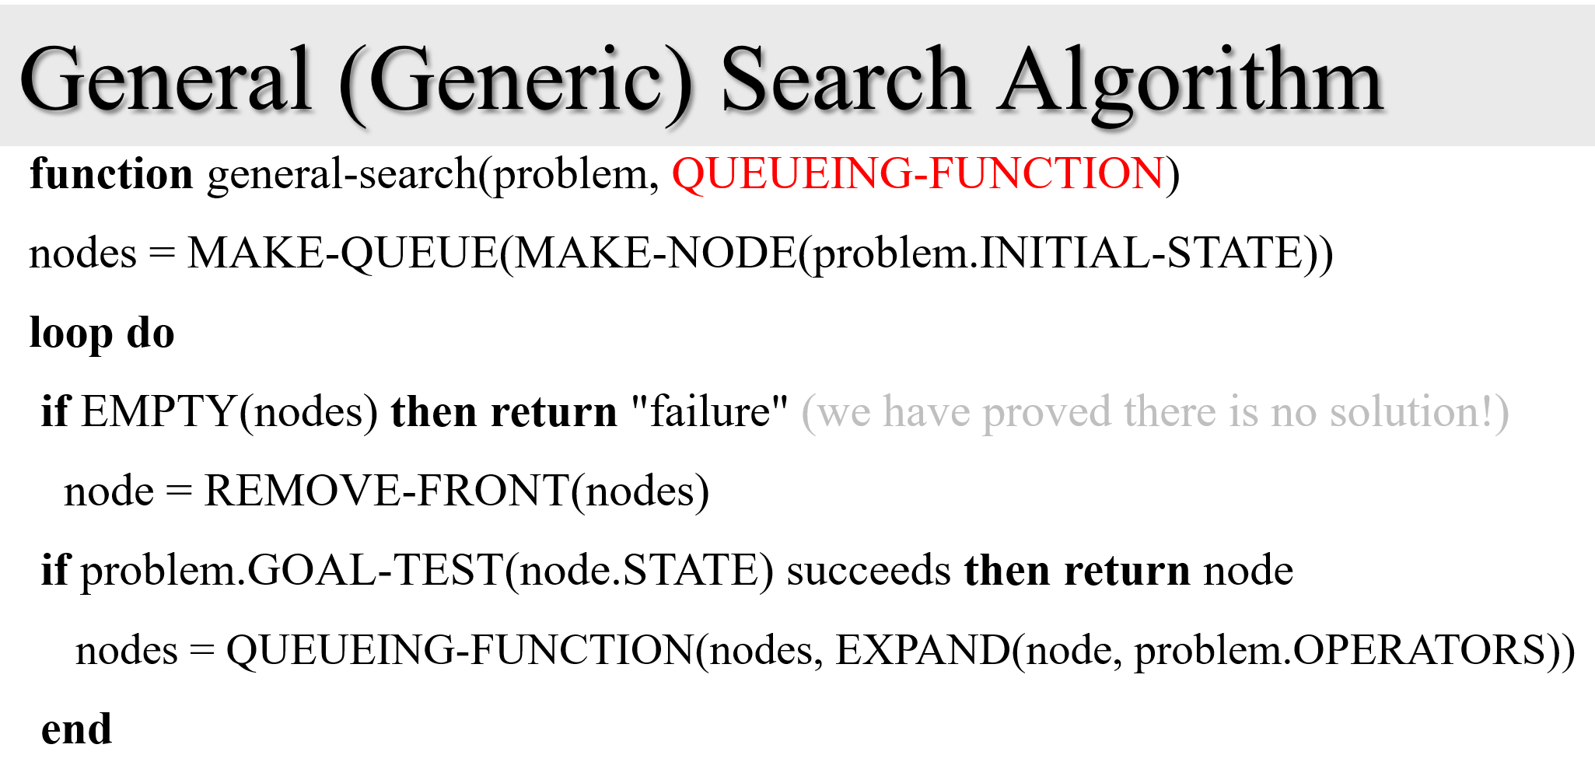
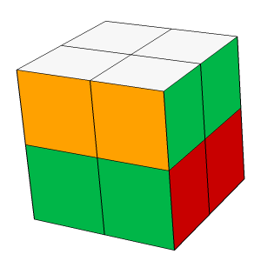
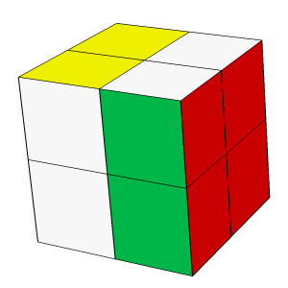
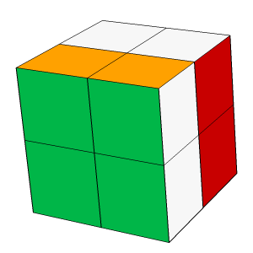
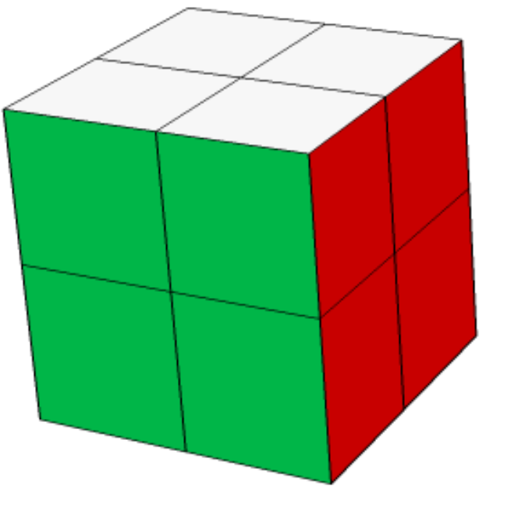
Review
The ways that search can end
How can the algorithm terminate?
We find a solution!
We go to pull the head of nodes, but it is empty.
Unofficial: We let it run for a week, then we pulled the plug.
Unofficial: We get an out-of-memory error.
nodes
nodes
..find a solution!
….pull the head of nodes, but it is empty.

Slide 2
How many solutions?
How many solutions can a search have?
It can have anything between zero and infinity.
If there is more than one, we typically want optimality, the cheapest solution in terms of G(n) cost.
Lets talk about the zero solution case..
1
1
G(n) = 1
1
1
1
1
1
1
1
1
1
1
1
1
G(n) = 3

Slide 3
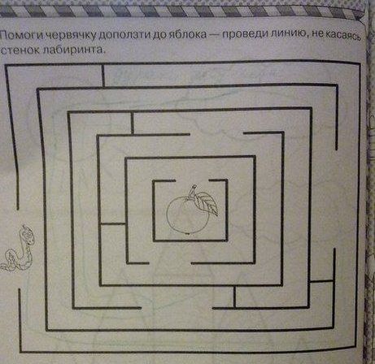
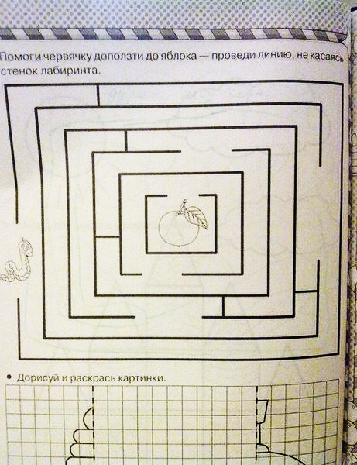
This is a child's maze puzzle that seems amiable to search
::
::

Slide 4
The number of solutions can be from zero to infinity
How can we have zero solutions?
This is a child's maze puzzle that does not have a solution.
I assume it was created by accident.
To prove it is unsolvable, I can trace a fully closed bounding box around the target.
What would happen if we search for a solution on such a problem?

Slide 5
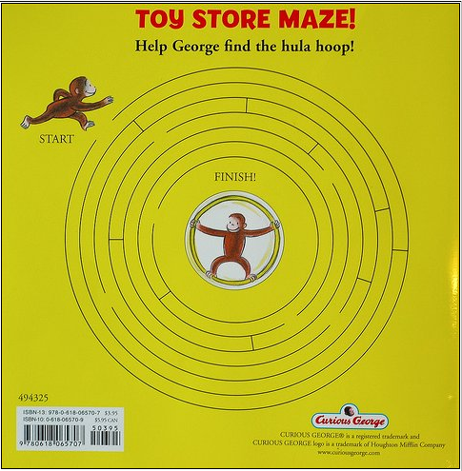
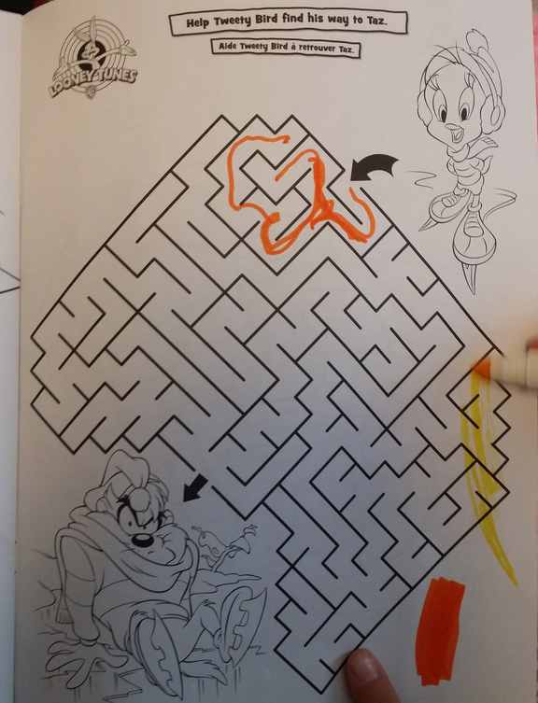
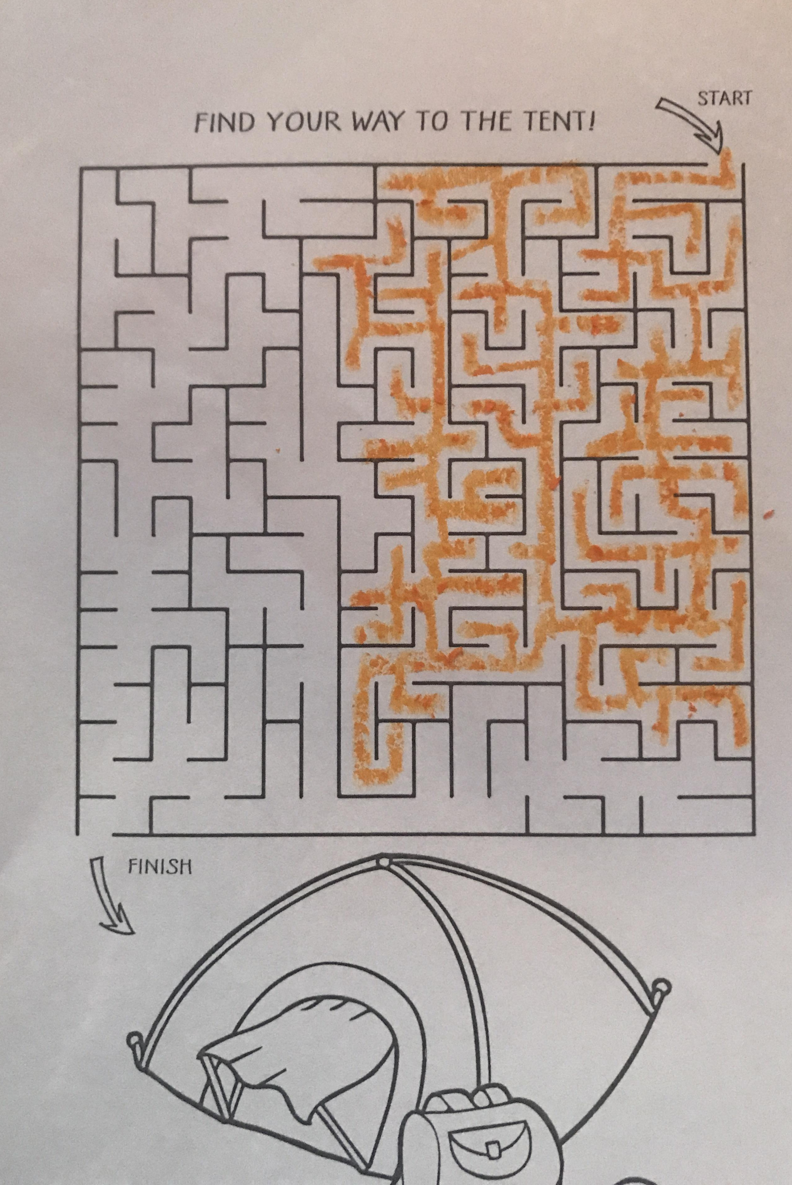
More examples

Slide 6
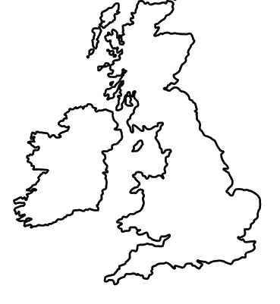
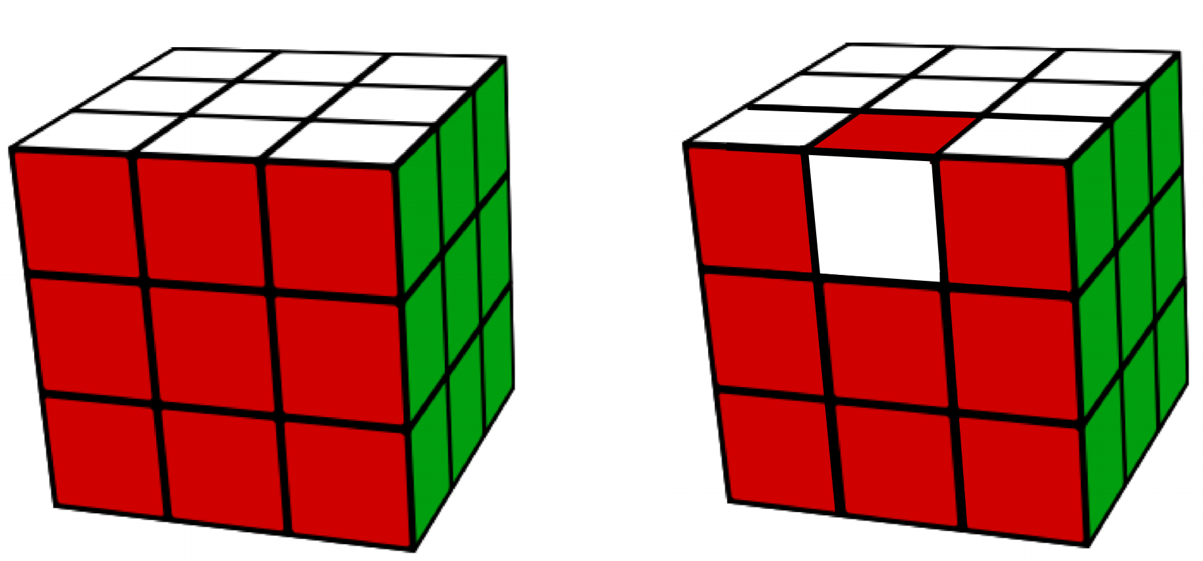
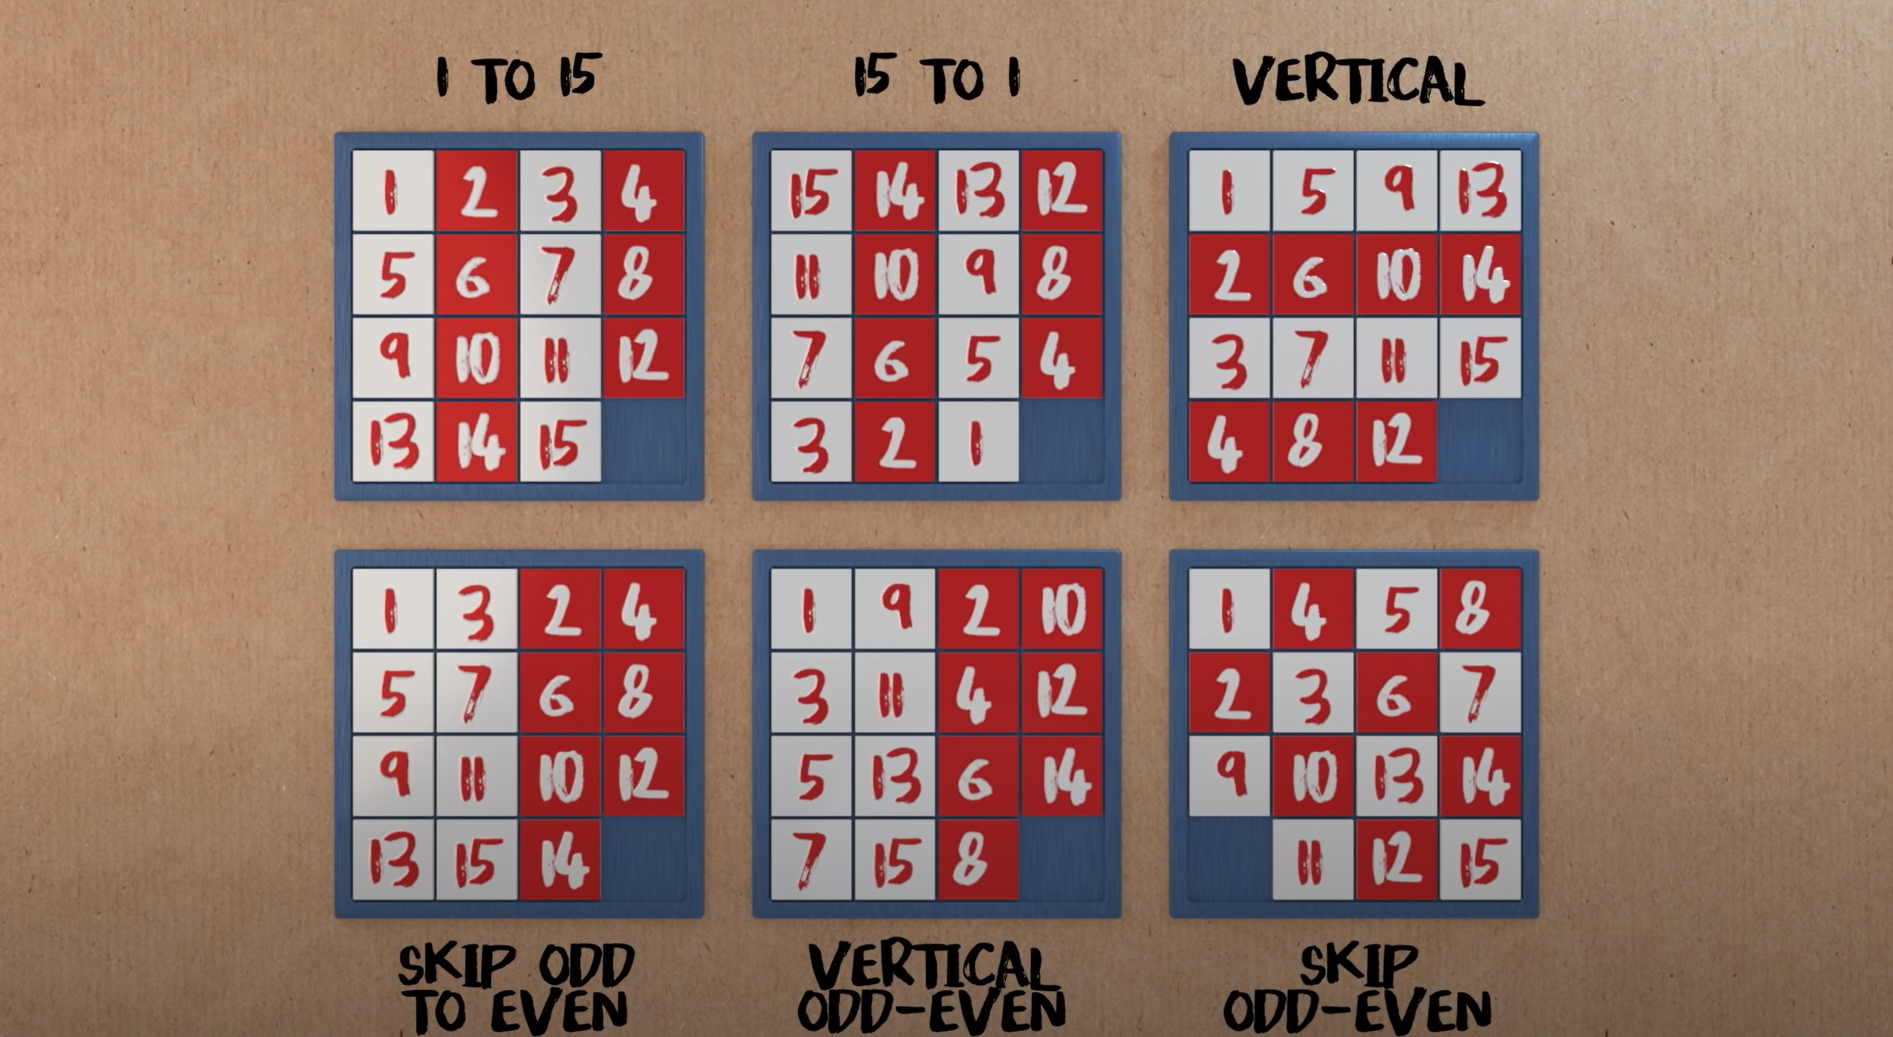
Examples of Unsolvable Problems
You cannot drive from Dublin… .. to London.
You cannot change this Rubik cube... … to this Rubik cube.
You cannot change this 15-puzzle... … to this 15-puzzle.
You cannot change this 3-puzzle... … to this 3-puzzle.
Can you drive from Sweden to Denmark?
1
2
2
1
3
3

Slide 7
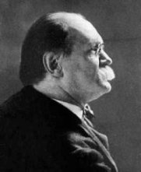
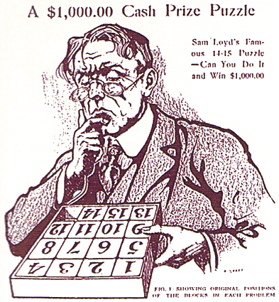
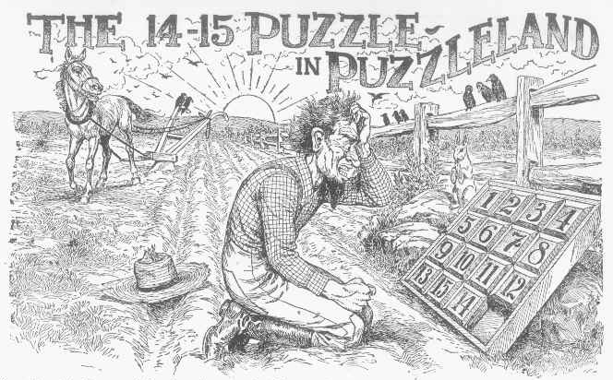
An example of a problem with zero solutions.
In 1878, Sam Loyd offered a $1000 prize for a solution to this version of the 15-puzzle…
1
2
3
4
1
2
3
4
5
6
7
8
?
5
6
7
8
9
10
11
12
9
10
11
12
13
14
15
13
15
14

Slide 9
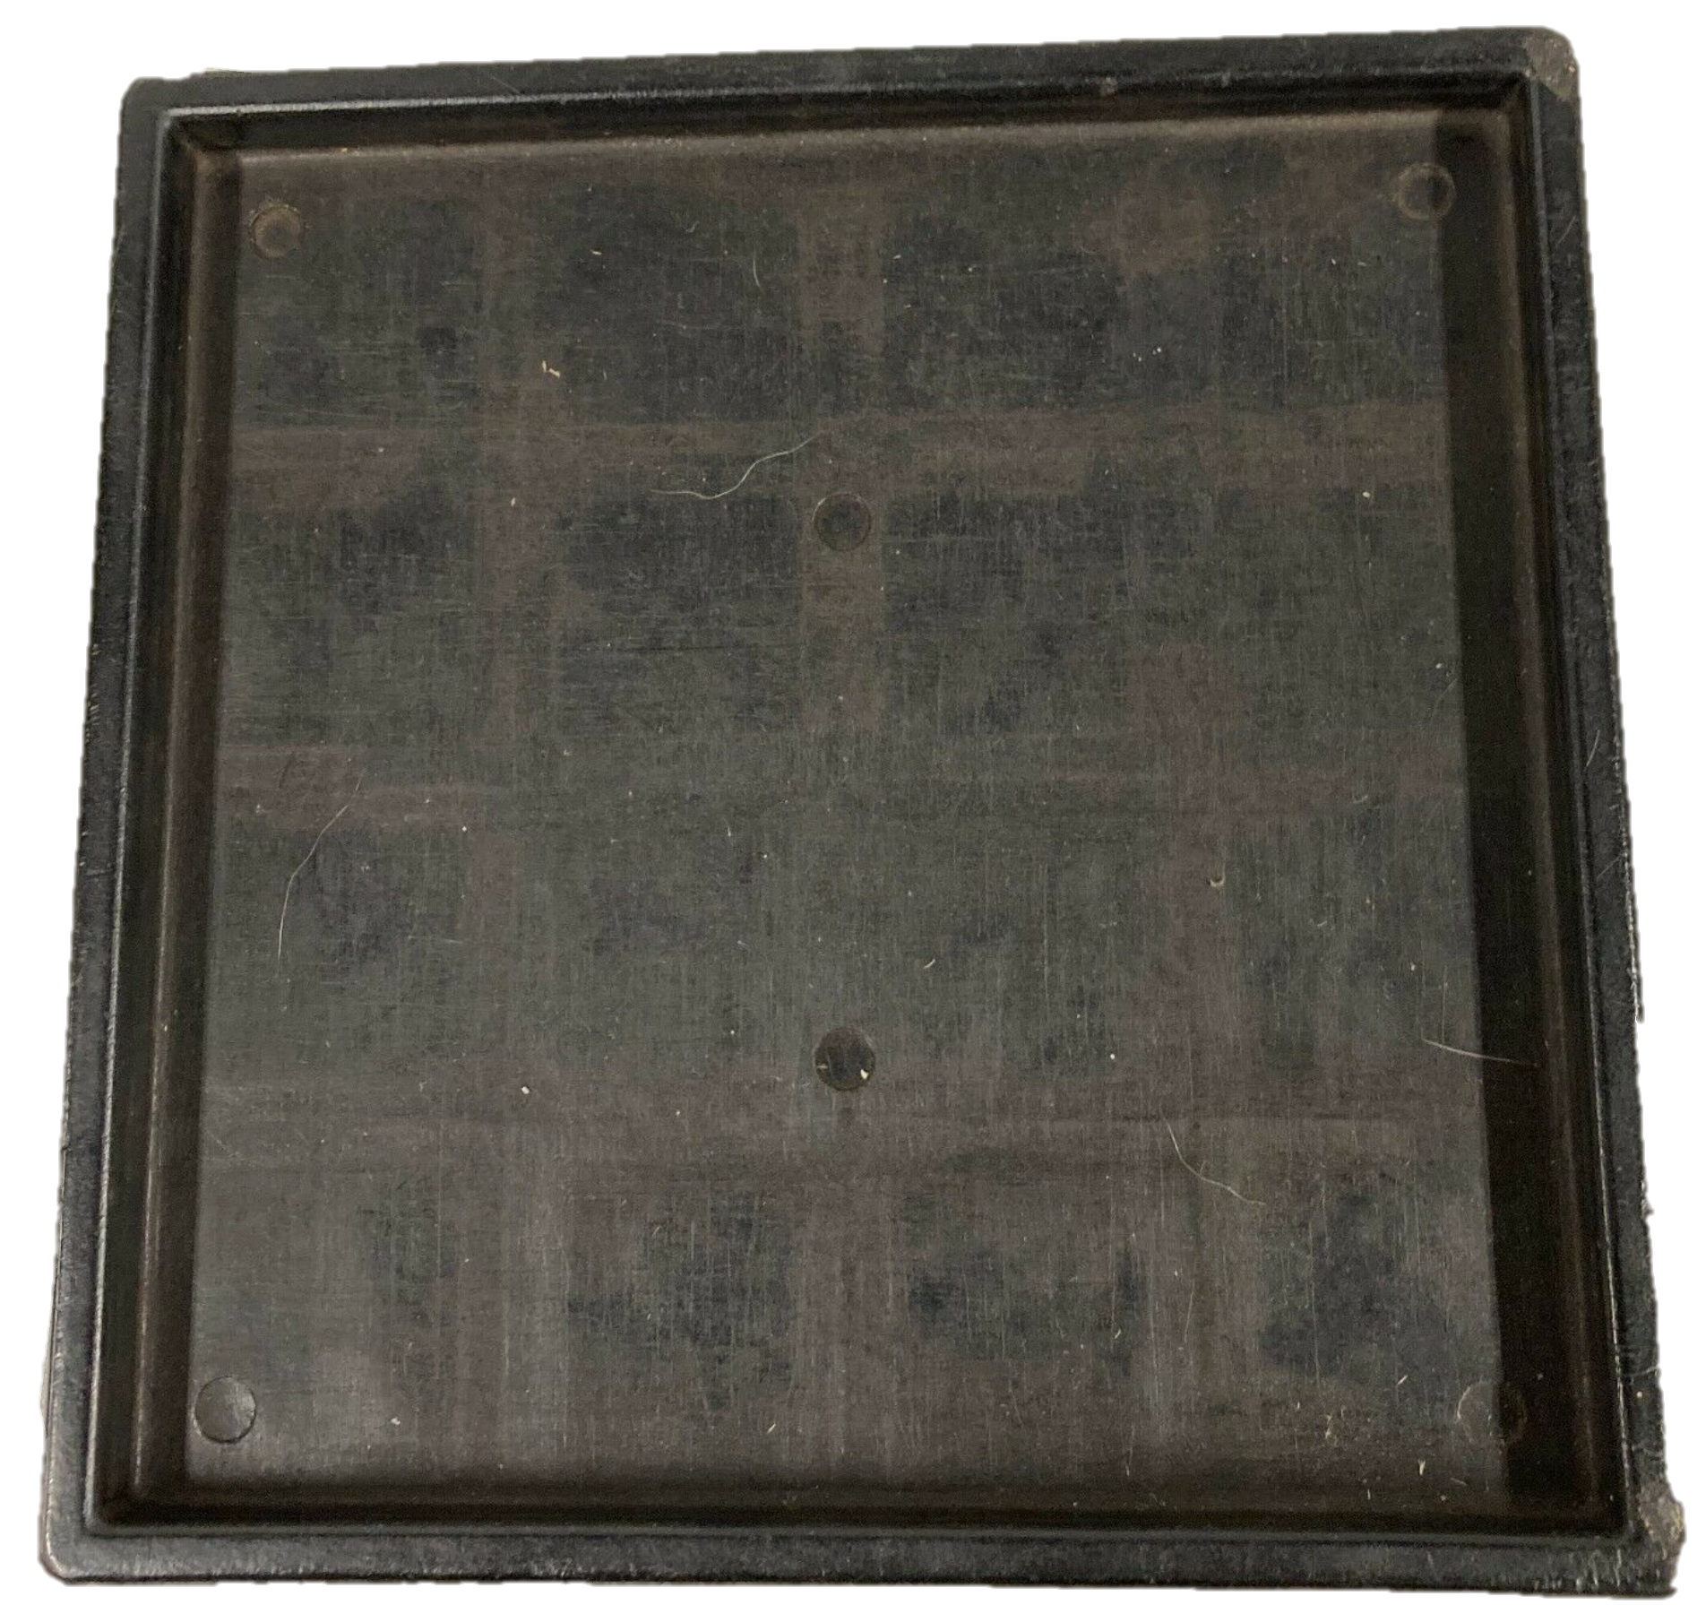
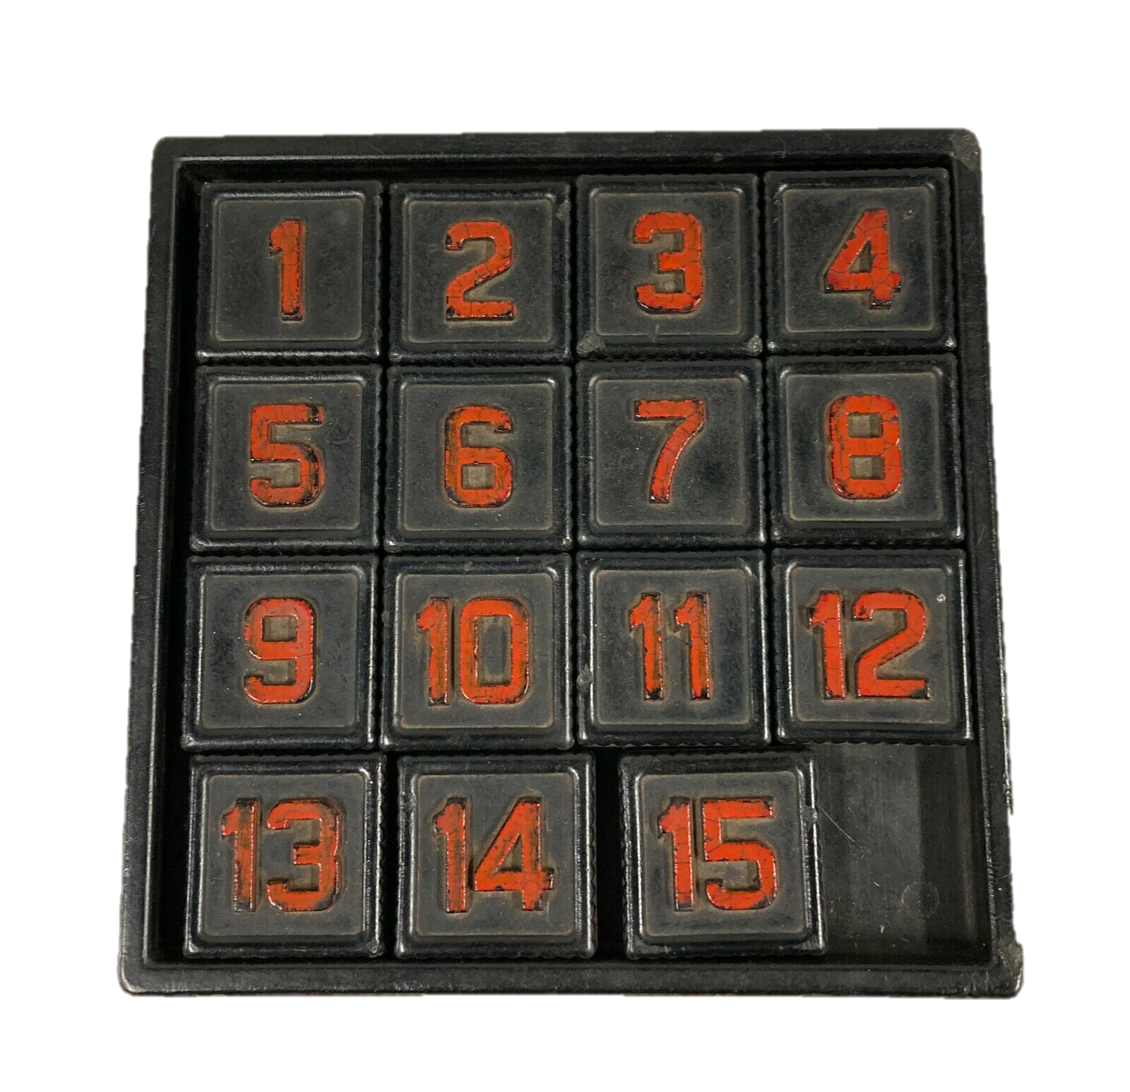
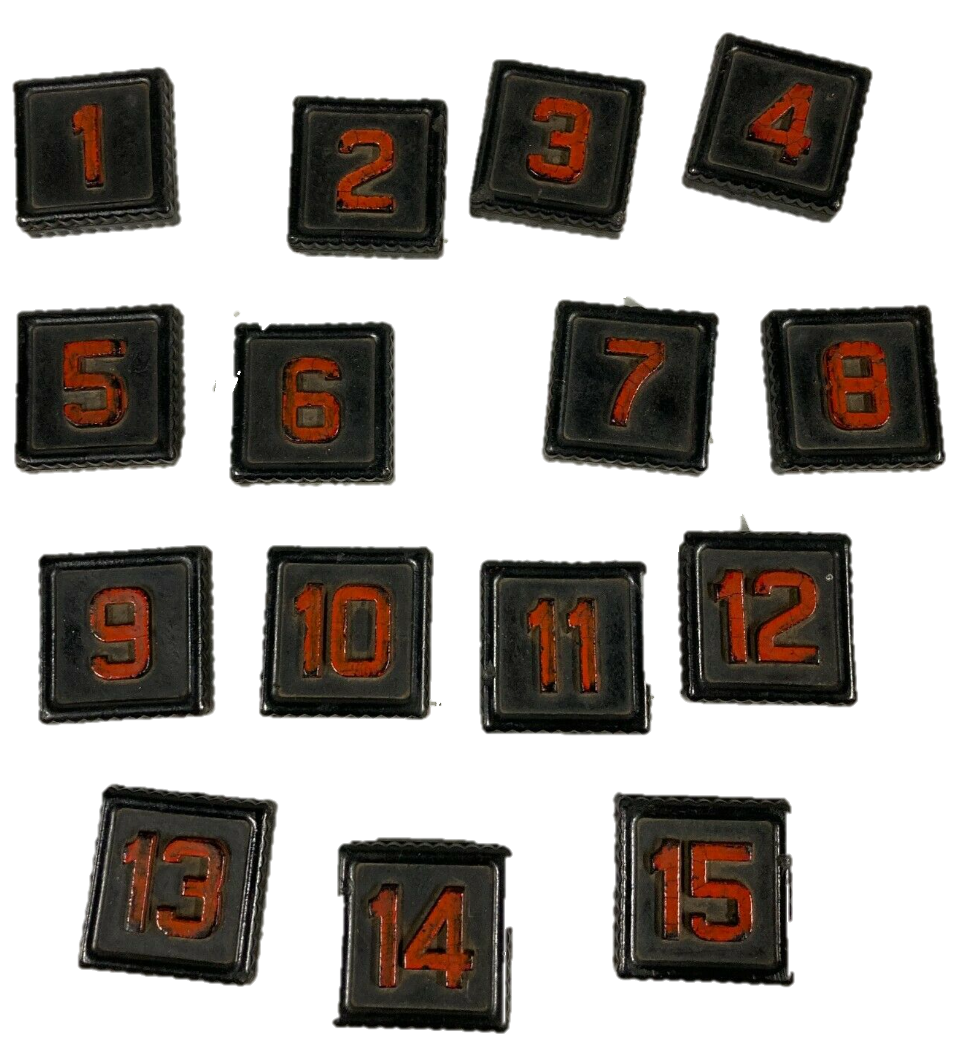
Parity A
Parity B

Slide 10
Why is it impossible to go from this, to this?
Let's see on a smaller example.
It is also impossible to go from this, to this.
2
1
1
2
3
3

Slide 11
Imagine we break a 3-puzzle apart.
How many ways can we reassemble it?
Working top to bottom, left to right..
There are four choices for the first cell, (‘1’, ‘2’, ’3’ or ‘B’)
There are three choices for the next cell
There are two choices for the next cell
There is one “choice” for the last cell
4 * 3 * 2 * 1 = 4! = 24
More generally, for the N-puzzle, there are (N+1)! arrangements.
2
1
2
3
B
2
2
1
B
3

Slide 12
The 3-puzzle is small enough that we can show a full search tree.
Repeated states are shown in gray.
1
22
3
1
2
1
2
3
2
3
Note that of the 24 states we can reach by breaking the puzzle apart and assembling it, only 12, exactly half of them, are reachable from the classic initial state.
1
1
2
1
2
2
3
2
3
3
1
3
3
1
1
1
2
2
2
2
3
2
3
1
3
3
1
1
2
2
3
2
3
2
1
3
1
3
3
1
2
2
3
2
1
2
1
3
1
3
3
1
2
3
3
2
1
2
1
2
1
2
3
3
As an aside. You can now see why the Diameter of the 3-puzzle is six
1
2
1

Slide 13
2
1
Note the difference
1
22
3
3
2
1
2
1
3
1
3
Note that of the 24 states we can reach by breaking the puzzle apart and assembling it, only 12, exactly half of them, are reachable from this initial state.
2
2
1
2
1
1
3
1
3
3
2
3
3
2
2
2
1
1
1
1
3
1
3
2
3
3
2
2
1
1
3
1
3
1
2
3
2
3
3
2
1
1
3
1
2
1
2
3
2
3
3
2
1
3
3
1
2
1
2
1
2
1
3
3
2
1
2

Slide 14
2
1
Note that that two trees are completely disjoint
So we can never go from any arrangement on the red tree, to any arrangement on the blue tree.
3
2
1
2
1
3
1
3
2
2
1
2
1
1
3
1
3
3
2
3
3
2
2
Parity B
2
1
1
1
1
3
1
3
2
3
3
2
2
1
1
3
1
3
1
2
3
2
1
22
3
3
2
1
1
3
3
1
2
1
2
3
2
1
2
1
2
3
3
2
1
3
3
3
2
3
1
2
1
2
1
2
1
1
2
1
2
2
1
3
3
3
2
3
3
1
3
2
1
2
3
1
1
Parity A
1
2
2
2
2
3
2
3
1
3
3
1
1
2
2
3
So now you can see that our earlier claim was true.
2
3
2
1
3
1
3
3
1
2
2
3
2
1
2
1
3
1
It is also impossible to go from this, to this.
1
2
2
1
3
3
1
2
3
3
2
1
2
1
2
1
3
3
2
3
3
1
2
1

Slide 15
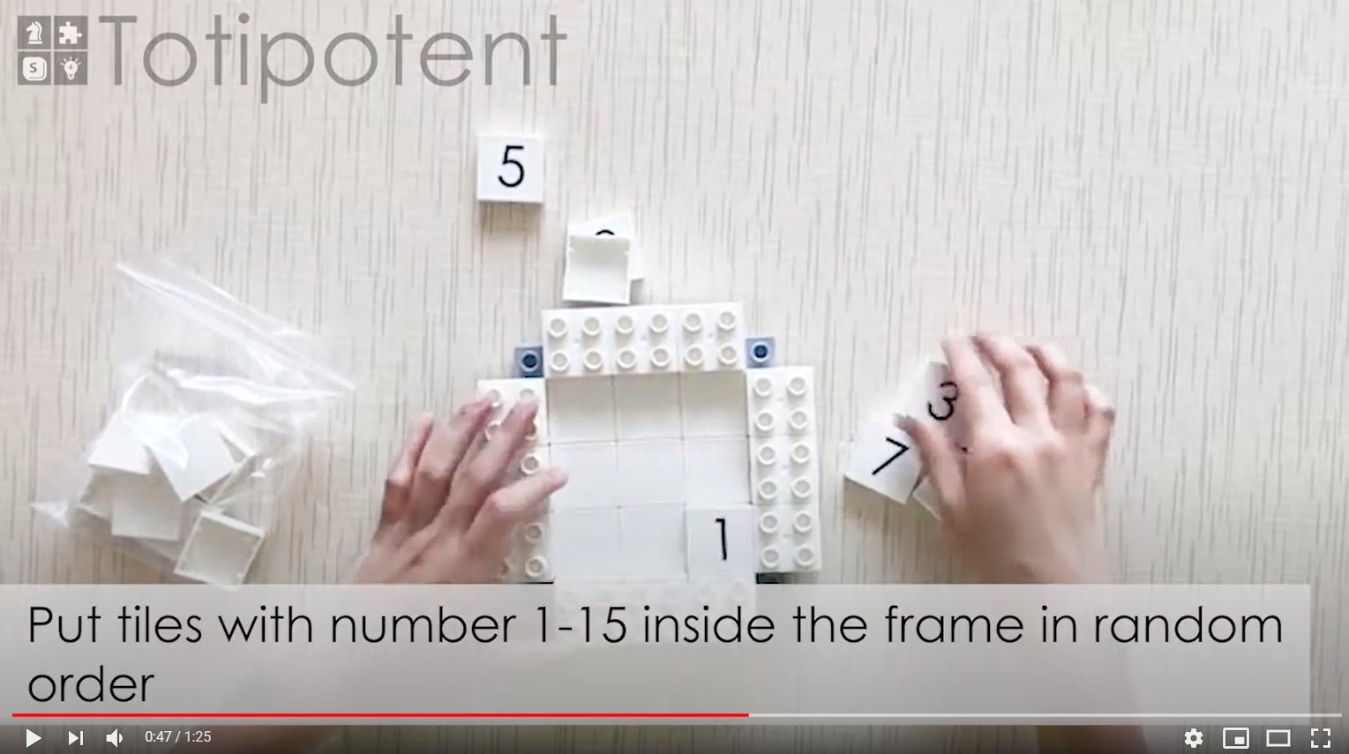
This is a video advertisement for an educational toy that includes a “make-your-own” eight puzzle. However, the instructions say put the numbers in, in random order.
We now know that if you do that, you only have a 50% chance of having a solvable puzzle.
https://www.youtube.com/watch?v=BcEKual8-cc&ab_channel=DoerStem

Slide 16
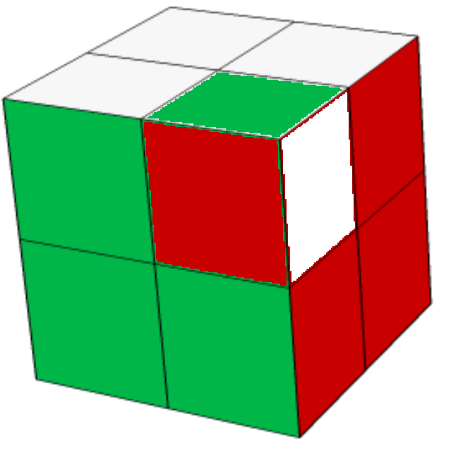
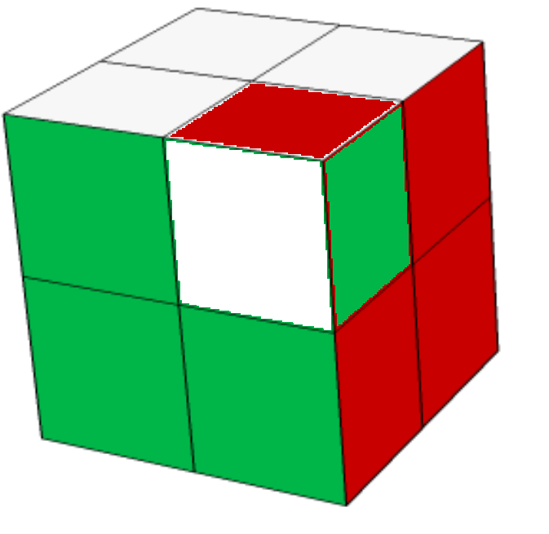
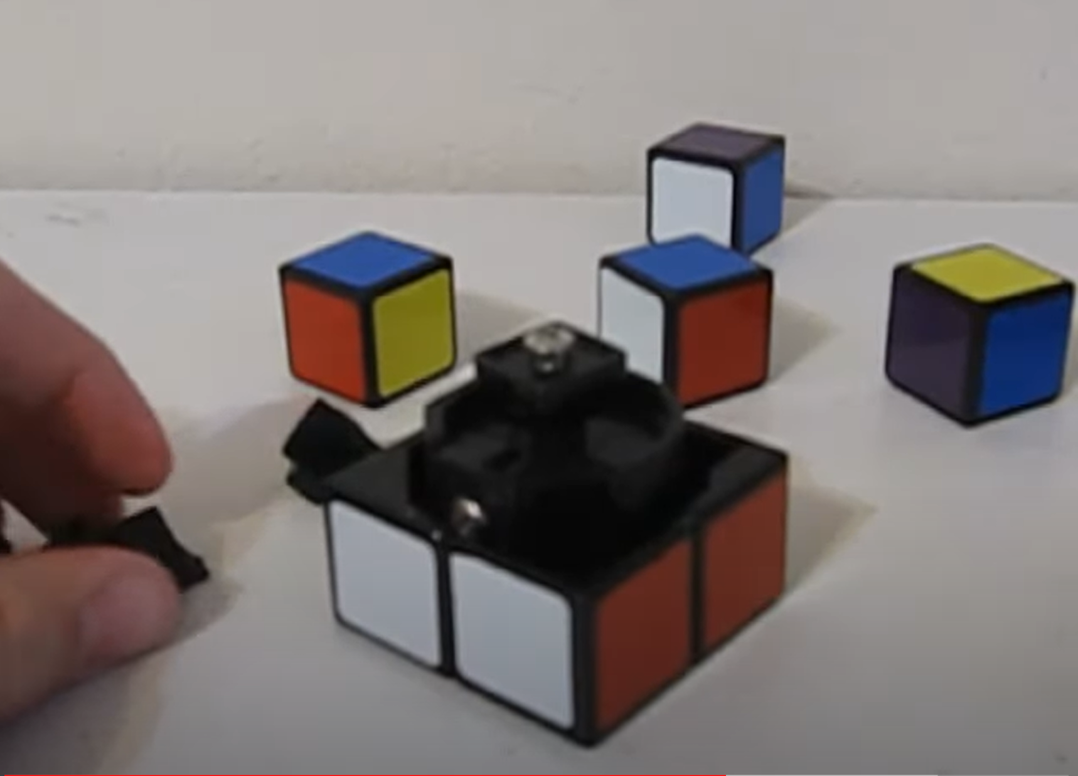
2*2*2 Cube
Tree with 3,674,160 states
Tree with 3,674,160 states
Tree with 3,674,160 states
Note that the three trees are completely disjoint, just like our 3-puzzle example.
To get the root of each tree, consider a solved cube, remove one corner piece, and replace it all permutations (twists)
All trees are of depth 11 (1/2 turn metric)

Slide 17
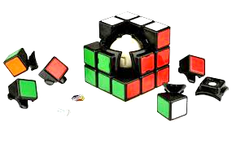
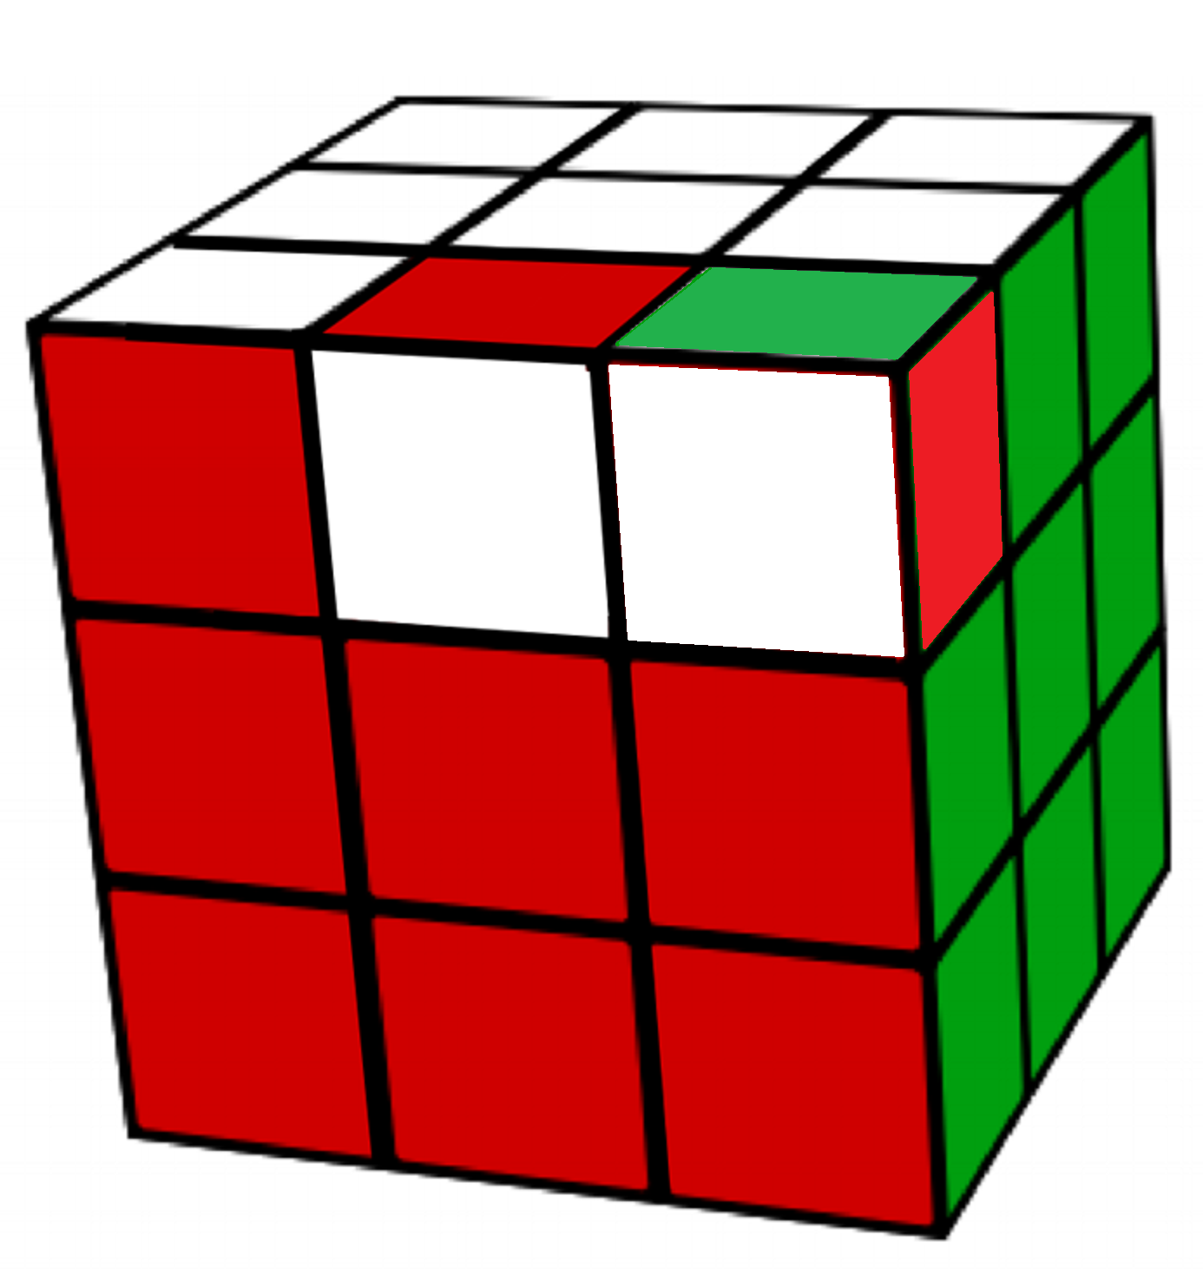
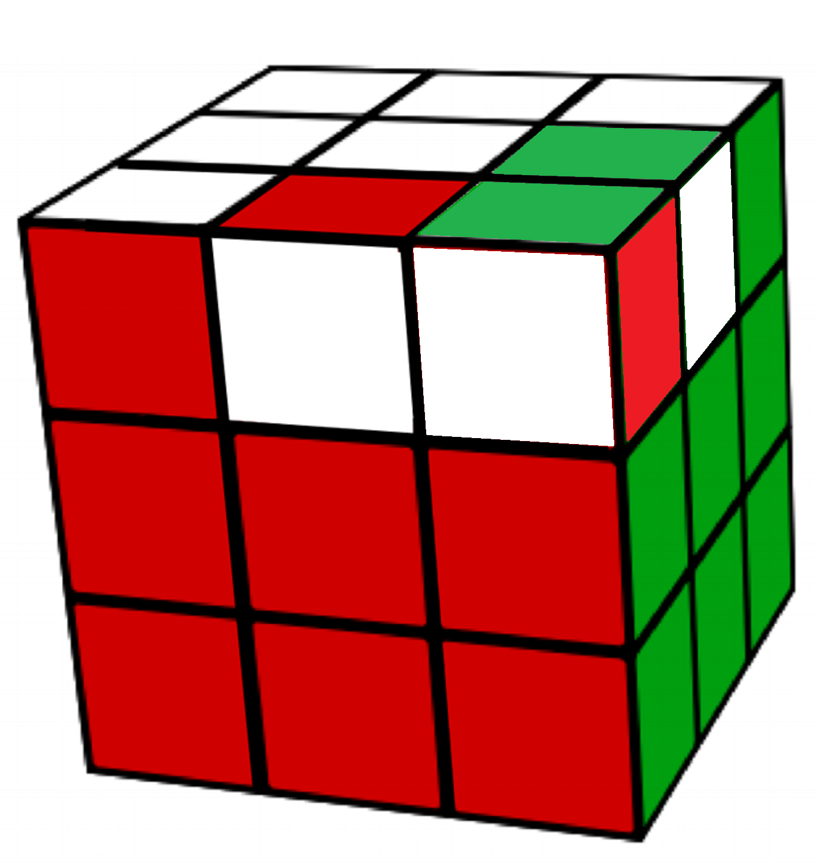
3*3*3 Rubik Cube
Tree with 43,252,003,274,489,856,000 states
Tree with 43,252,003,274,489,856,000 states
Tree with 43,252,003,274,489,856,000 states
Tree with 43,252,003,274,489,856,000 states
Tree with 43,252,003,274,489,856,000 states
There are twelve trees, which are completely disjoint (only some are shown above)
To get the root of each tree, consider a solve cube. Now remove two edge pieces and one corner piece, and replace them in all permutations. There are two ways to insert an edge piece, and three ways to insert a corner piece, so two times two times three = twelve.
All trees are of depth 20 (1/2 turn metric)

Slide 18
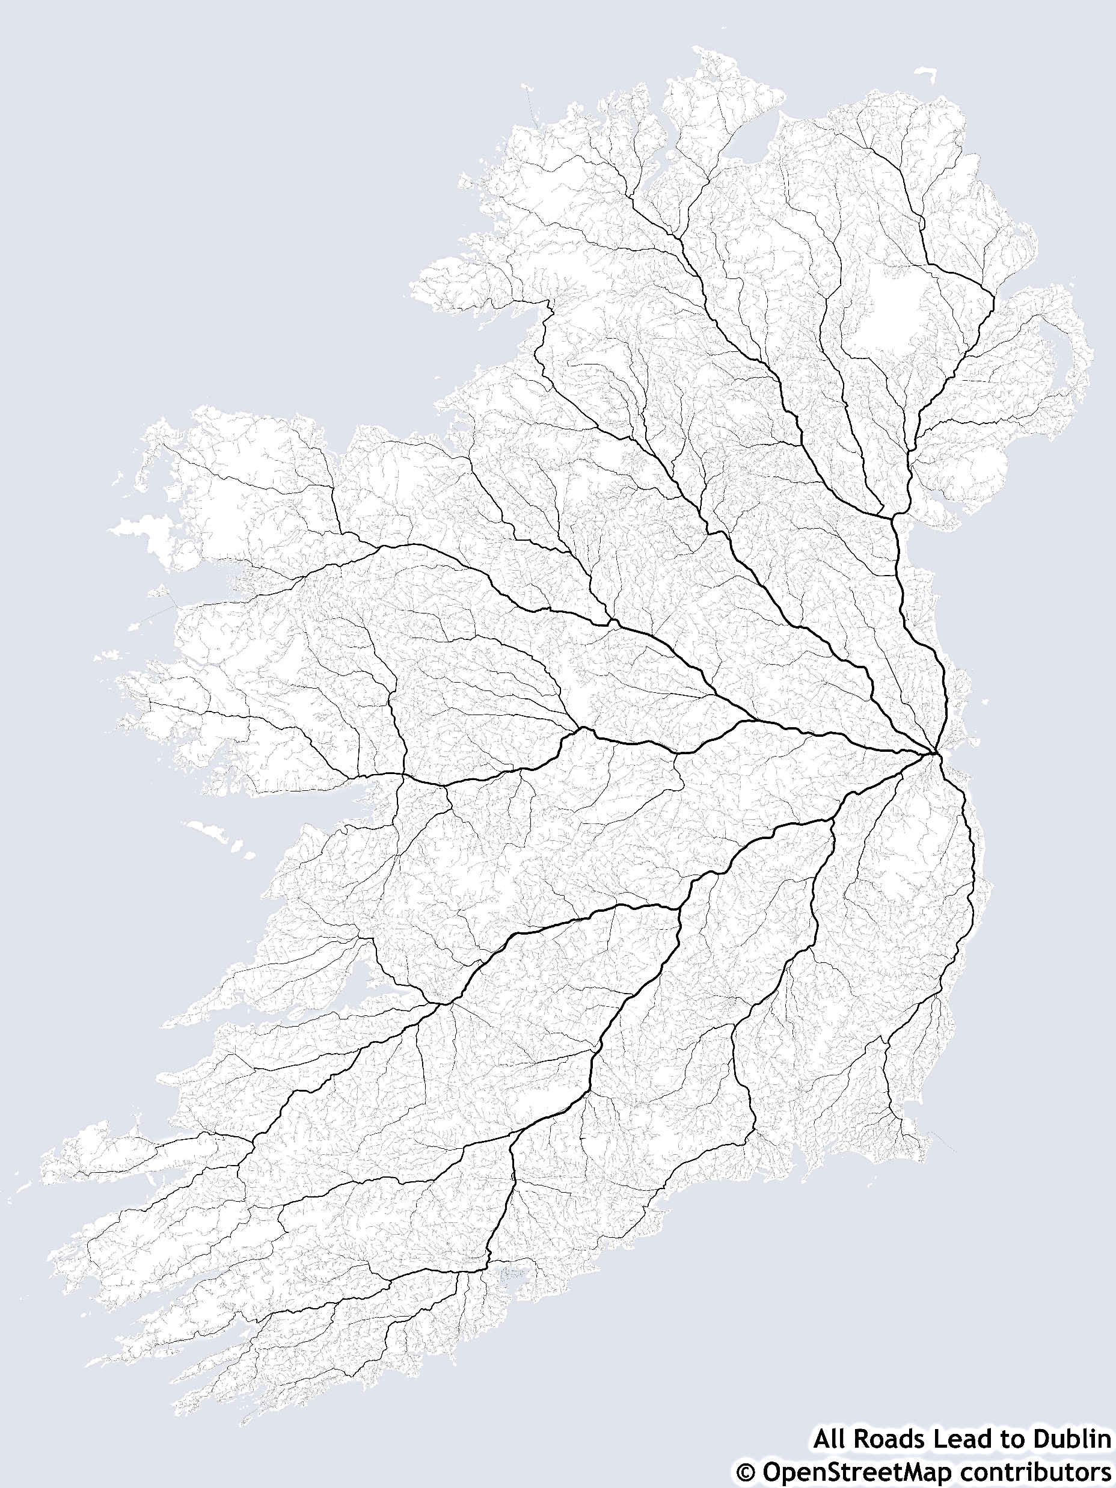
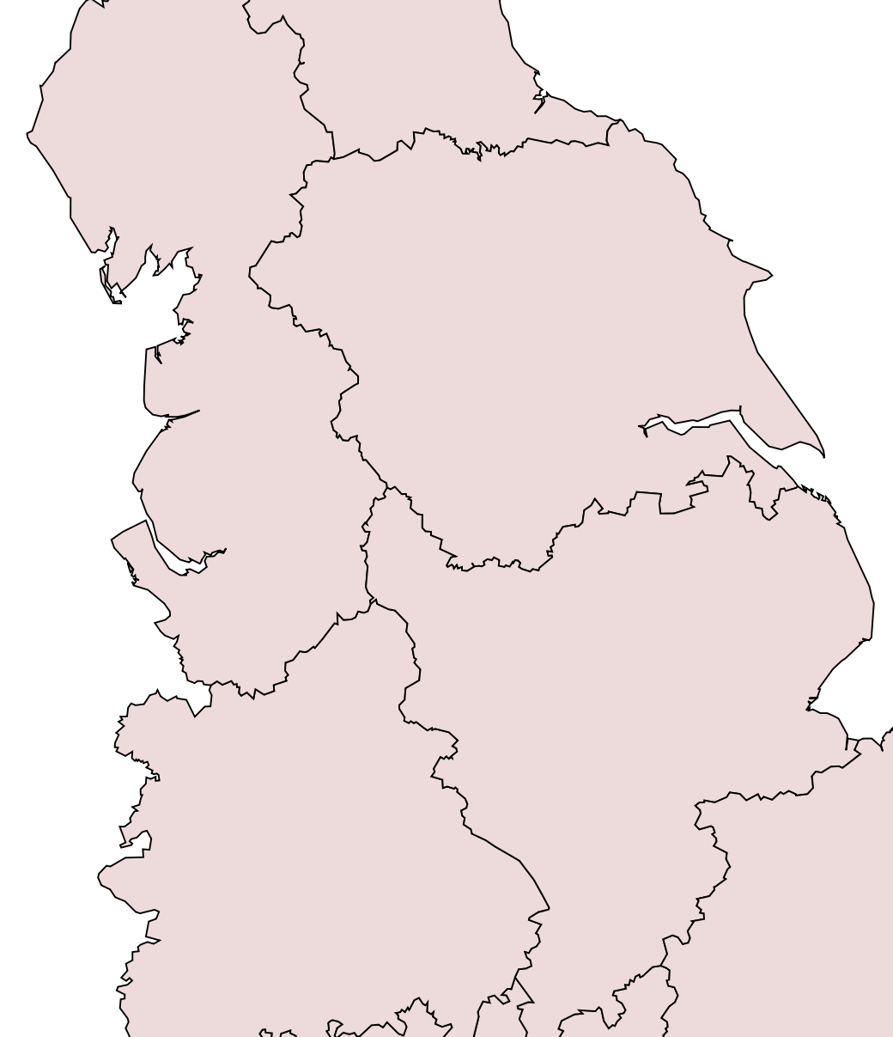
You cannot drive from Dublin to London.
We could prove this with the same technique we used for the 3-puzzle, exhaustive search. Starting from Dublin, expand every reachable node. If we never encounter London, we have proved this claim...
Dublin
..of course, that would take some time. If we were smart, we would simply note that there is a sea in between, and no bridge.
London

Slide 19
3
1
2
What would happen if we tried to solve this puzzle using A*. Here solve means get to this goal state.
A* would solve it in milliseconds.
2
1
3
nodes
1
1
2
1
3
2
3
3
2
nodes
1
1
2
3
2
3
nodes
1
3
2

Slide 20
3
1
2
What would happen if we tried to solve this puzzle using A*. Here solve means get to this goal state.
A* would solve it in milliseconds.
What would happen if we tried to solve this puzzle using A*. Here solve means get to this goal state.
A* would return “Failure” in milliseconds. In a sense, failure is an unfair term. We have successfully proved that no solution exists by an exhaustive search.
2
1
3
2
1
1
2
3
3
nodes
3
3
1
2
1
2
nodes
3
1
2
nodes

Slide 21
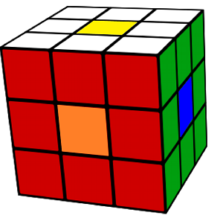
3
1
2
What would happen if we tried to solve this puzzle using A*. Here solve means get to this goal state.
A* would solve it in milliseconds.
What would happen if we tried to solve this puzzle using A*. Here solve means get to this goal state.
A* would return “Failure” in milliseconds. In a sense, failure is an unfair term. We have successfully proved that no solution exists by an exhaustive search.
What would happen if we tried to solve this puzzle using A*. Here solve means get to this goal state.
A* would solve it in under a second (surprisingly, this particular example takes just three moves).
What would happen if we tried to solve this puzzle using A*. Here solve means get to this goal state.
In principle, A* would return “Failure”. However, suppose that it takes one microsecond to test one state, then it will take 1,371,512 years to return “Failure”. So for all practical purposes, it runs forever, and are never sure if it is just about to return a solution.
2
1
3
2
1
1
2
3
3
43252003274489856000 microseconds in years = 1371512.026 years

Slide 22

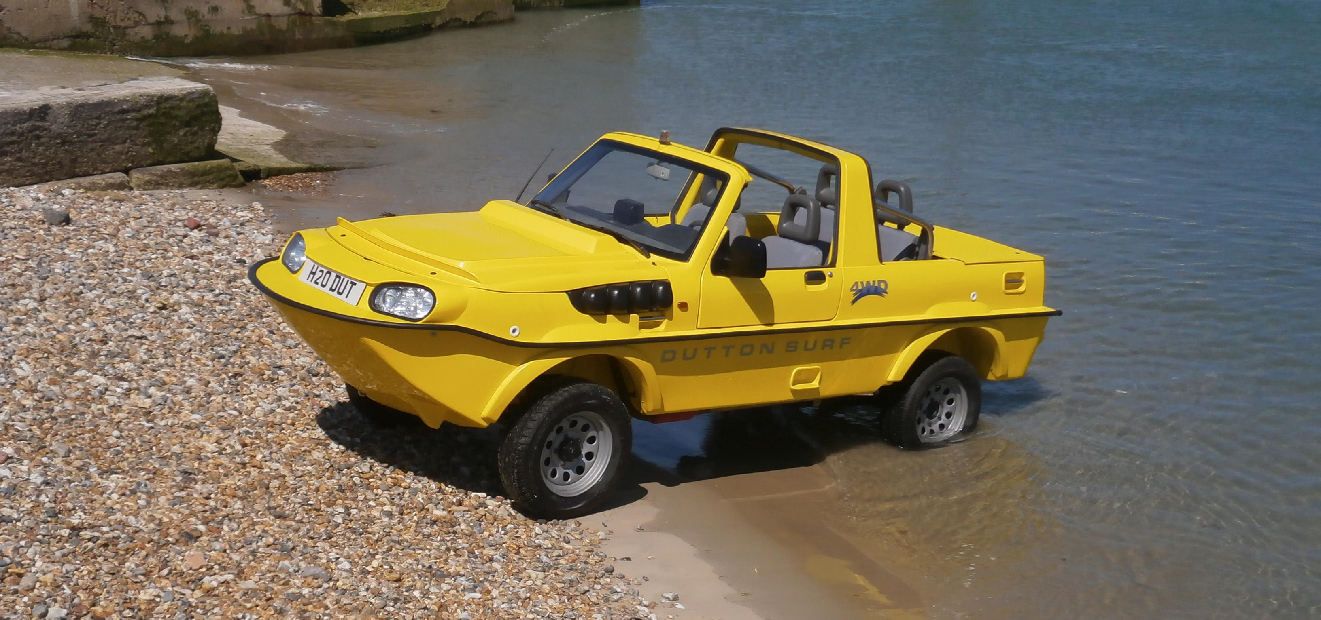
Can you make an unsolvable problem solvable?
Sometimes, yes
To solve the driving from Dublin to London problem, you could..
Add a new operator, take the ferry! (Google now does this)
Build a bridge between England and Ireland.
To solve the wrong-parity 3-puzzle problem you could..
Add a new operator, pull out and swap two tiles!
Build a “bridge” between the two parities
Lift out of the puzzle
2
2
2
1
1
2
3
Sometimes, you can add operators.
For example, for route finding, police and fire services has at least one operator that most folks don’t have, they can drive the wrong way down a one-way street.
B
3
3
B
1
2
2
2
1
1
2
Amphibious cars allow extra operators
B
B
3
B
B
3
Bridge: Add a new blank slot

Slide 23
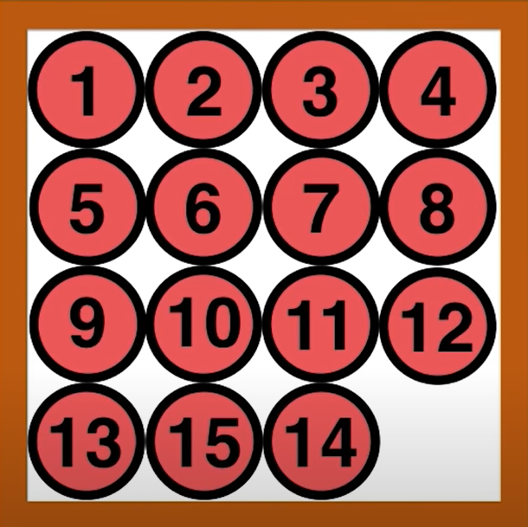
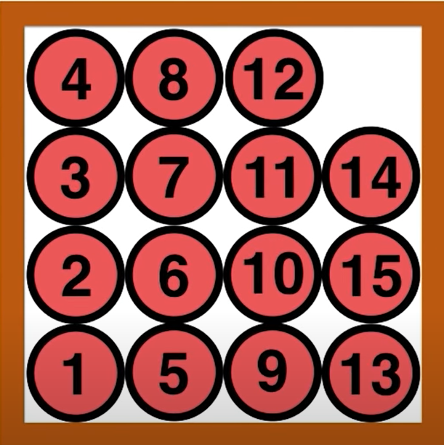
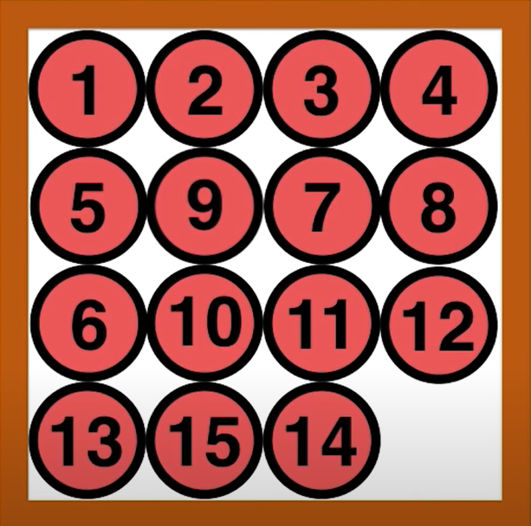
Sometimes you can find a 15-puzzle with round tiles.
This allows you too solve the unsolvable arrangement in one of two different ways, by adding two new operators.
New operator 1: Rotate the entire puzzle 90 degrees
New operator 2: Rotate 9 and 6 by 180 degrees
To be clear, you should do one, not both of the new operators.
Unsolvable
Solvable!
Rotate the entire puzzle 90 degrees
Rotate the individual tiles negative 90 degrees
Unsolvable
Rotate the 9 and 6
Solvable!

Slide 24
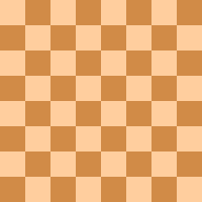
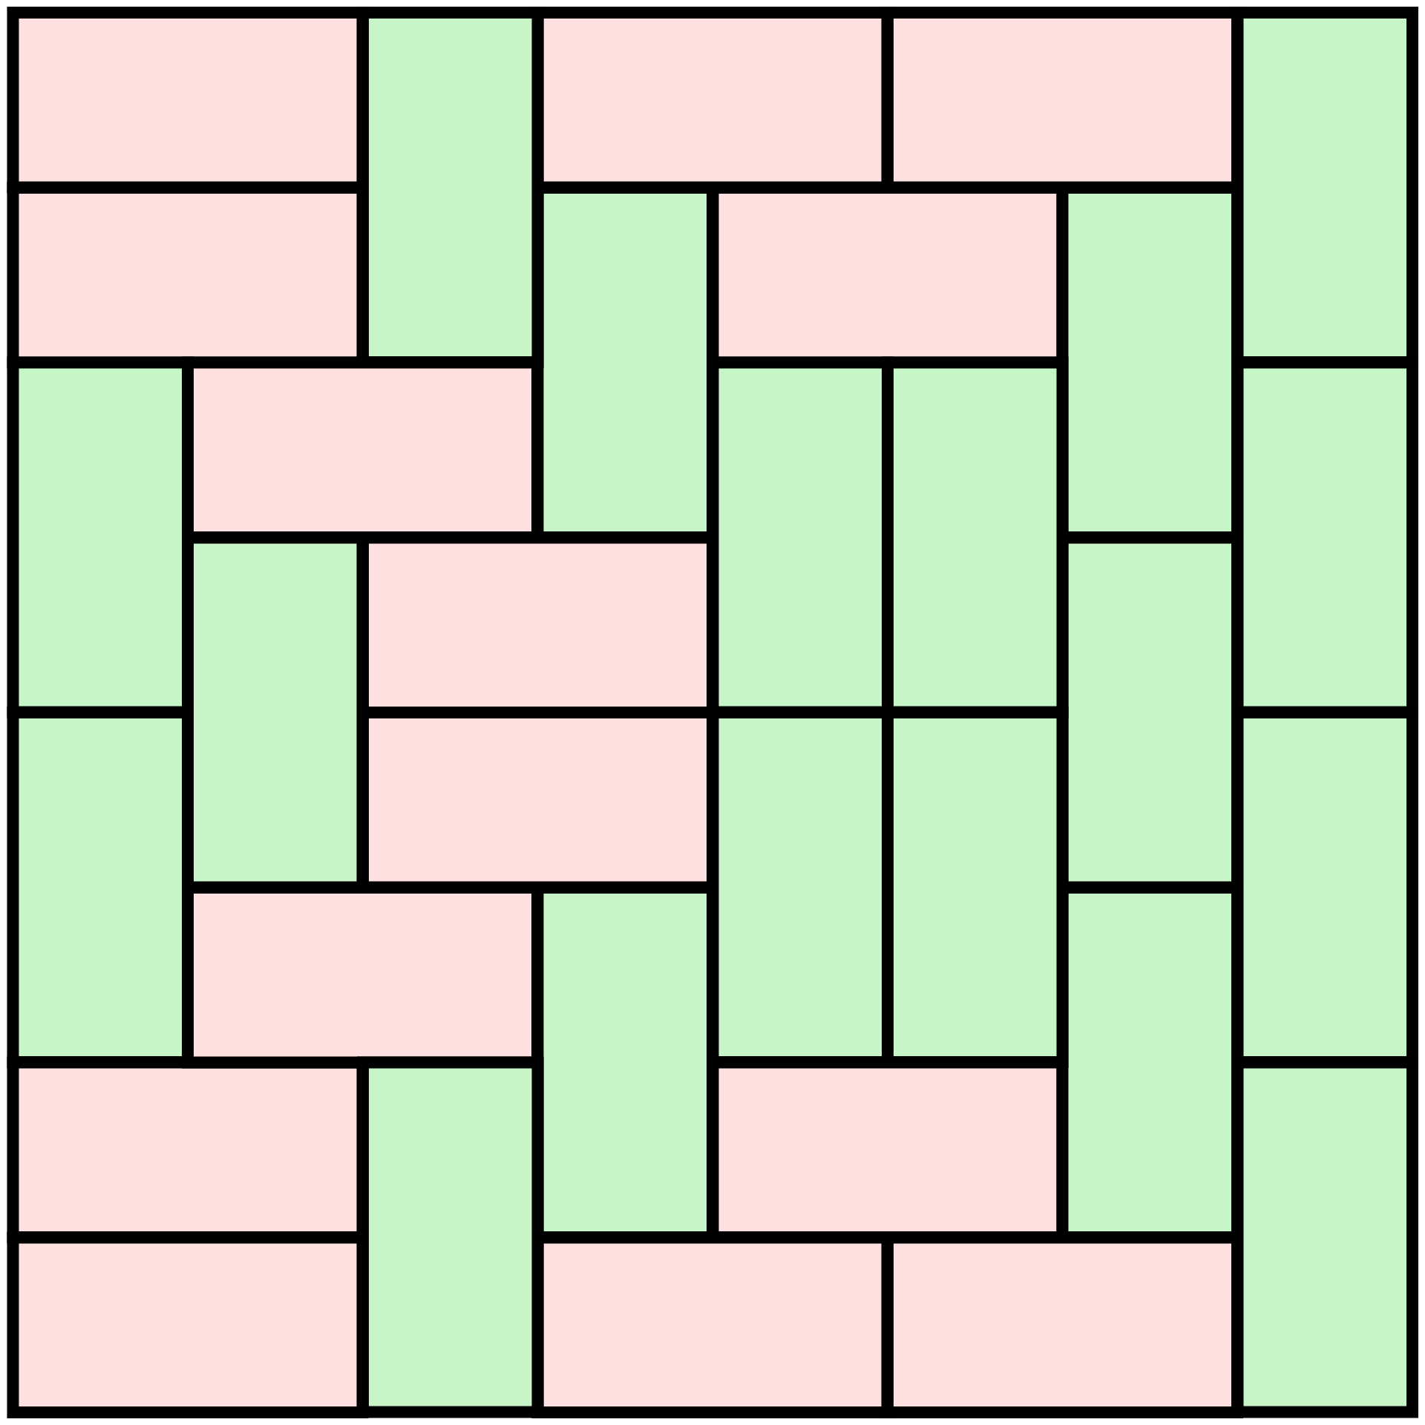
Given a standard chessboard.
And a set of 1 by 2 tiles
Can you tile the chessboard, completely covering every square?
Yes! Here are two solutions, there are a total of 12,988,816 different solutions

Slide 25
Given a mutilated chessboard, with two diagonally opposite squares missing.
And a set of 1 by 2 tiles
Can you tile the mutilated chessboard, completely covering every square?

Slide 26
Given a mutilated chessboard, with two diagonally opposite squares missing.
And a set of 1 by 2 tiles
Can you tile the mutilated chessboard, completely covering every square?
Hmm. Not clear.
We could search for a solution..

Slide 27
What are the branching factor and depth?
Depth: Any solution will have exactly 31 tiles, so the depth is just 31.
Branching factor is huge!
The first tile, in horizontal orientation can go in (6*7 ) + (2*6) = 56 places.
The first tile, in vertical orientation can go in (6*7 ) + (2*6) = 56 places.
So, the first branch has 112 possibilities. This number goes down as we add more tiles.
If we think carefully, we can possibly exploit some symmetries to reduce BF.
If we think carefully, we can prune some possibilities.
For example, if our tile placement creates enclosed region, and the number of available squares in that region is an odd number, we can stop expanding any children of that node (example below).
Because we know the depth is exactly 31, we can use depth-limited search, so memory will not be an issue.
Time will be an issue. However, if we exploiting some of the tricks mentioned above, I think this could be solved in weeks to years of CPU time. And distributed across many machines, just hours.
If we are clever, we would not expand this node, can you see why?

Slide 28
Ideas worth trying (a sort of guessing “island driven search”)
I might try something like this; “pre-tile” a large chunk of the chessboard by hand, and start my search from there.
This would drastically reduce both of the…
Depth: Any solution from here will take 16 more tiles, so depth is 16.
Branching factor is
The first tile, in horizontal orientation can go in 24 places.
The first tile, in vertical orientation can go in 32 places.
So, the first branch has 56 possibilities. This number goes down as we add more tiles.
Important disclaimer
If I do find a solution from this starting point, it is a real valid solution.
But if I don’t find a solution, it does not mean a solution does not exist.
To see why, imagine that the only solution happens to include the pink tile shown below…

Slide 29
However, if we are smart, we don’t need search!
Note the following two facts:
Every tile we put on the board, always covers one white and one black square
The two corners we removed are both white.
So, the problem is impossible!
So, for our last move, we have to place the tile such that it covers two black squares, but ‘2’ above notes that every tile we put on the board, always covers one white and one black square.
Lesson learned: There are problems we could solve with search, but there may be a clever insight to solve it with no search.

Slide 30
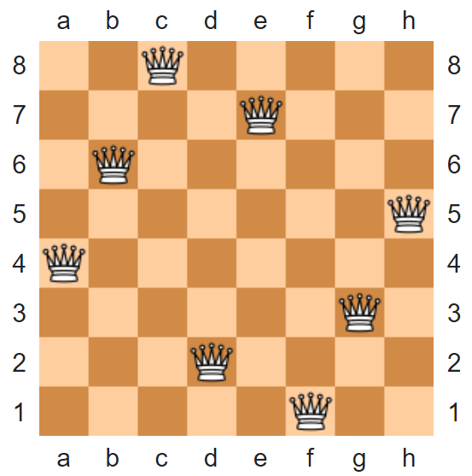
Failure in search can be a positive thing!
Sometimes a search failure is what we are looking for, because it proves something does not exist.
For example, we know that is possible to put eight queens on a chessboard, such that non attack each other.
However, I think that you can put at most fourteen bishops on a chessboard, such that non attack each other.
How can I prove that?
To prove that, all I have to do is:
Do a search with fourteen bishops, and find at least one solution
Do a search with fifteen bishops, and wait till the algorithm reports failure.
QED

Slide 31
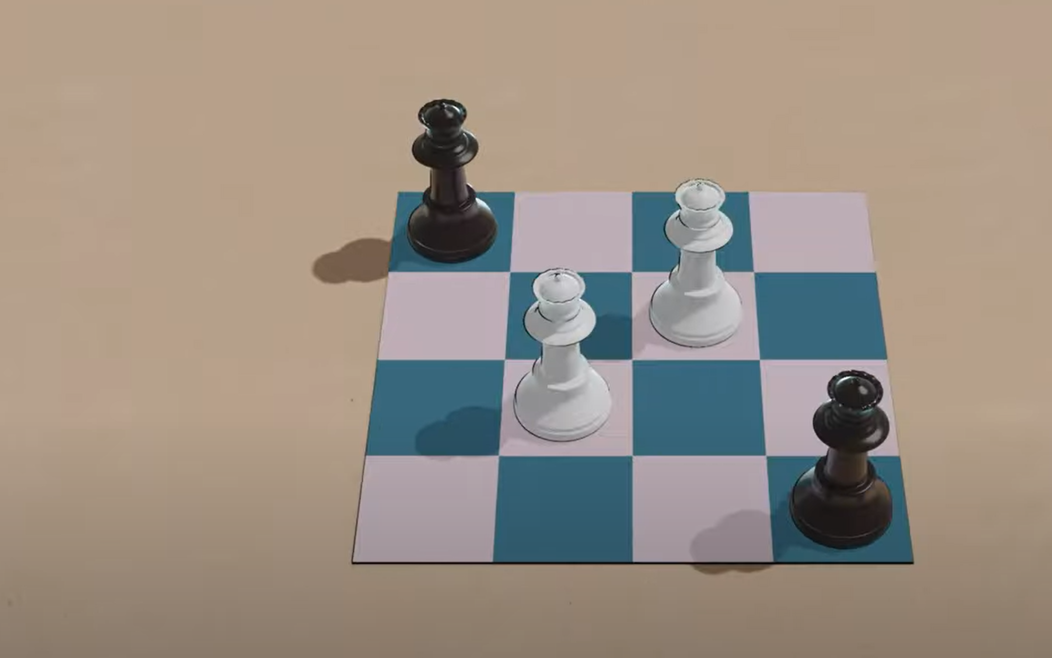
Let's finish with an example of an unsolved problem
Peaceable Queens are sets of queens, an equal number of black and white, that can be place on a NxN chessboard, such that there are no cross-color attacks.
For example, for the 4x4 board, K can be 2

Slide 32
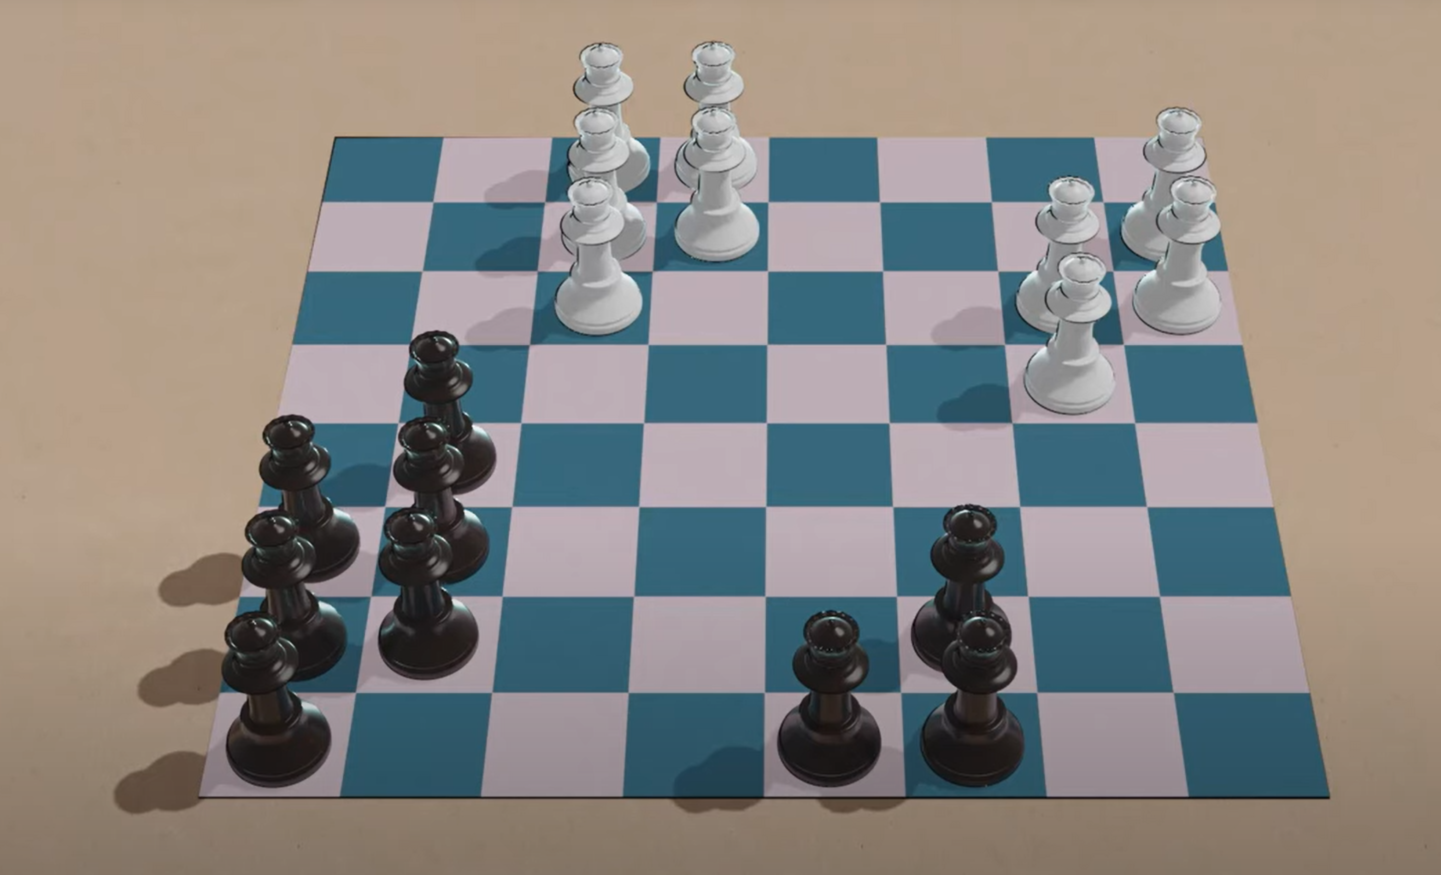
On a regular 8x8 chessboard, you can do K = 9

Slide 33
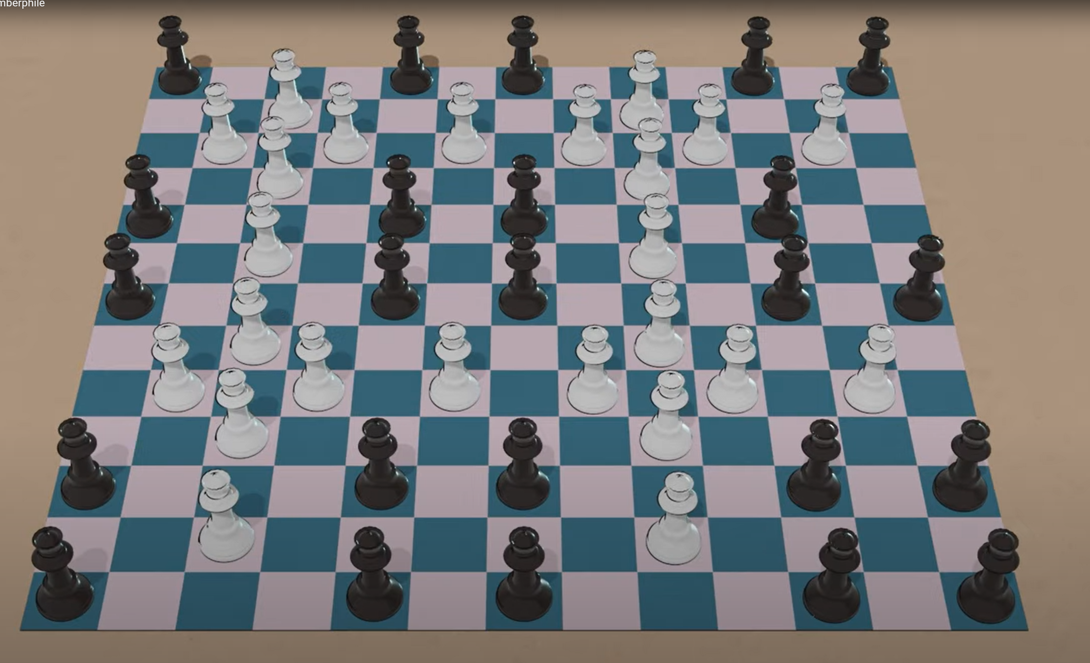
On a 13x13 chessboard, you can do K = 24

Slide 34
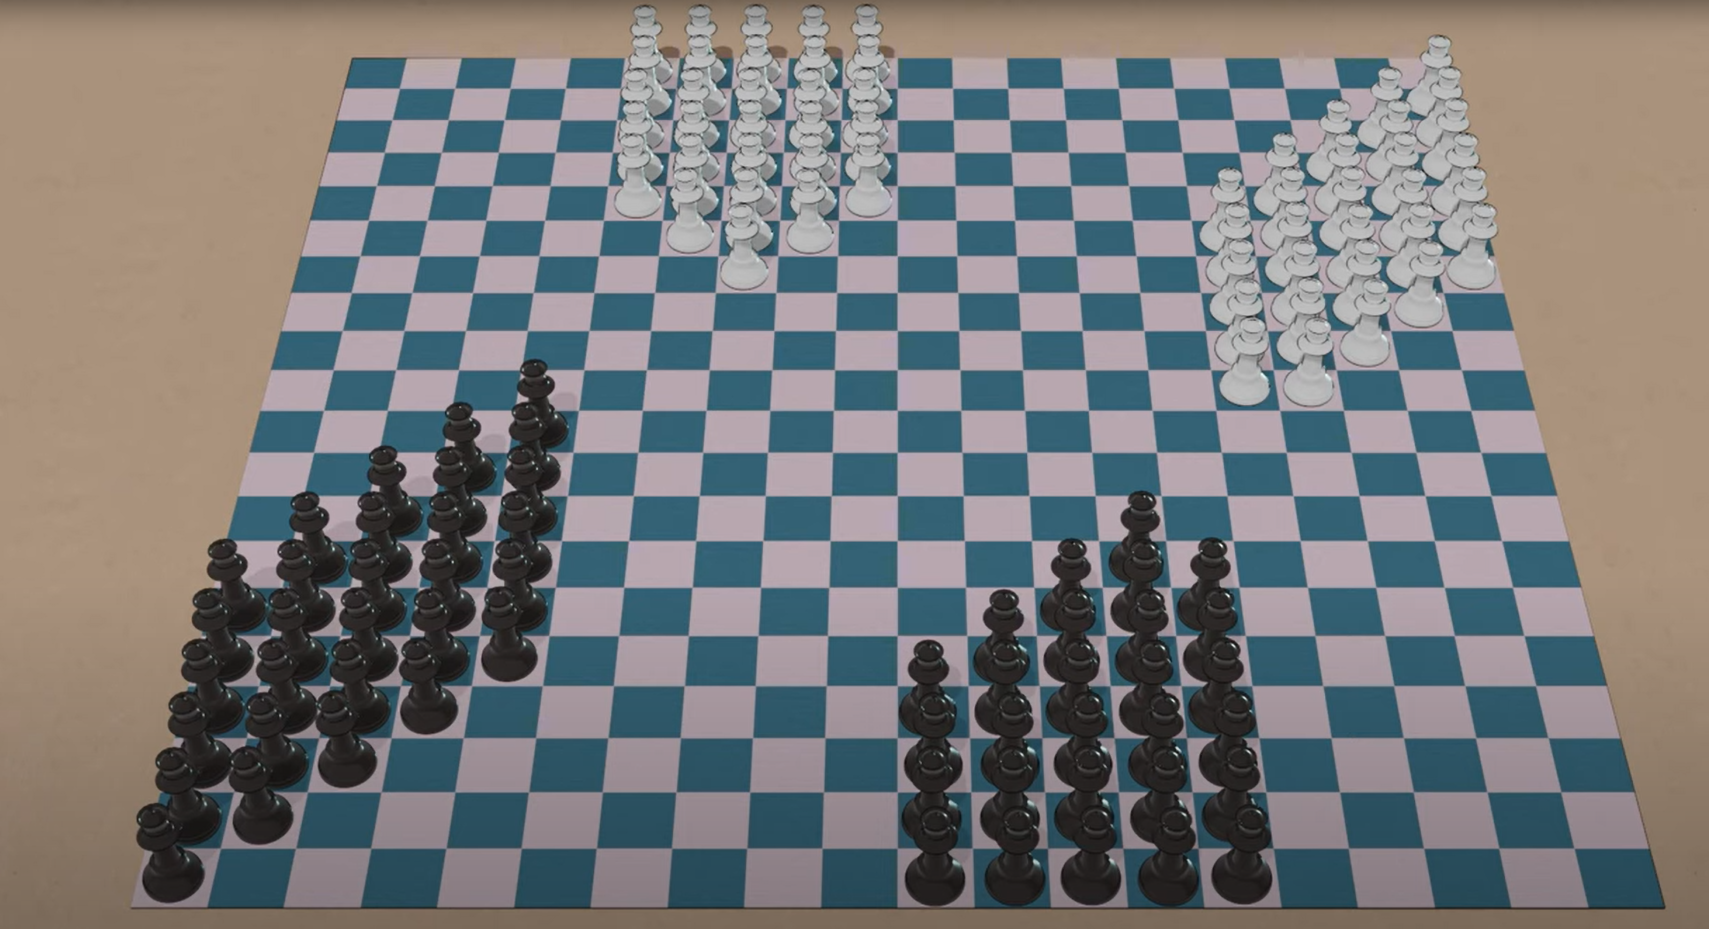
On a 20x20 chessboard, you can do K = 58
Can you do K= fifty-nine?
As of today, no one knows.

Slide 35
Review
A search problem can have between zero and infinity solutions.
Searching the full problem space, and not finding an answer, is logically equivalent to proving that no solution exists.
Sometimes, human common sense will tell us a problem cannot be solved, but sometimes we are not sure.
Sometimes (although it is rare) you can add an operator that makes an unsolvable problem solvable.
Can you drive from Dublin to London?
On a 20x20 chessboard, can you K= 59 peaceable queens?
Amphibious cars allow extra operators

