Slide 1
PIM is a two-player game:
12 marbles are arranged in a line.
Players take turns to remove marbles from the right end (i.e. you must remove the marbles with the lowest number(s) )
Players can remove 1, 2 or 3 marbles
The winner is the person who takes the last marble.
12
11
10
9
8
7
6
5
4
3
2
1

Slide 2
Sample Game
12
11
10
9
8
7
6
5
4
3
2
1
Initial state
12
11
10
9
8
7
6
5
4
3
Max takes 2
12
11
10
9
8
7
6
5
4
Min takes 1
12
11
10
9
8
7
Max takes 3
12
11
10
9
Min takes 2
12
11
10
Max takes 1
12
11
10
Min takes 3, including the last marble. Min wins!

Slide 3
Let us practice our skills
What is the branching factor of PIM?
When asked that question in the real world, often an estimate or an upper/lower bound is enough. For example, if I ask you for the branching factor for 8-puzzle, it would suffice to say “four is an upper bound, because you can sometimes do 4 things, sometimes less than 4 things, but you can never do 5 or more things.”
What is the depth of PIM?
Here, I would expect you to be able to give me the deepest and shallowest tree. For example, for tic-tac-toe we could easily see that deepest = 9, and shallowest = 5.
(let’s do in class) Is PIM a solved game?

Slide 4
Solving NIM (PIM was so you could not Google it)
A solved game is a game whose outcome (win, lose or draw) can be correctly predicted from any position, assuming that both players play perfectly.
One way to solve NIM would be to simply run minimax to the full depth of the three. The value passed up the initial state is our answer.
As it happens, the tree is small enough to do this. However, suppose we play NIM with 1000 marbles...
It is sometimes possible to solve a game without building the full tree.

Slide 5
Let us start by looking at simpler version, 4-marble NIM.
Let us assume that is Max’s turn.
It is easy to solve this!
If Max takes 1, then Min can take 3, and win!
If Max takes 2, then Min can take 2, and win!
If Max takes 3, then Min can take 2, and win!
So no matter what Max does, Min can win. This game is solved, it is win for Min
It is Max’s turn
12
11
10
9

Slide 6
Let us look at 8-marble NIM.
Again assume that is Max’s turn. It is easy to solve this!
All Min has to do is try to get to the 4-marble case, because he knows that he can will that.
If Max takes 1, then Min can take 3, and get to the 4-marble case!
If Max takes 2, then Min can take 2, and get to the 4-marble case!
If Max takes 3, then Min can take 2, and get to the 4-marble case!
12
11
10
9
8
7
6
5

Slide 7
Finally, let us look at 12-marble NIM.
Let us assume that is Max’s turn.
It is easy to solve this!
If Max takes 1, then Min can take 3, and win!
If Max takes 2, then Min can take 2, and win!
If Max takes 3, then Min can take 2, and win!
So no matter what Max does, Min can win. This game is solved, it is win for Min
12
11
10
9
8
7
6
5
4
3
2
1

Slide 8
Comments
You have seen a trick for solving NIM. If the number of marbles is a multiple of 4, it is a win for Min.
(to think about) Can you solve 25-marble NIM?
Checkers was solved by a combination of some tree search, and some “tricks” (it still took a few hundred CPU years).
Maybe there is a trick to solve GO or Chess, but I highly doubt it. I would be stunned if they are solved this century.

Slide 9
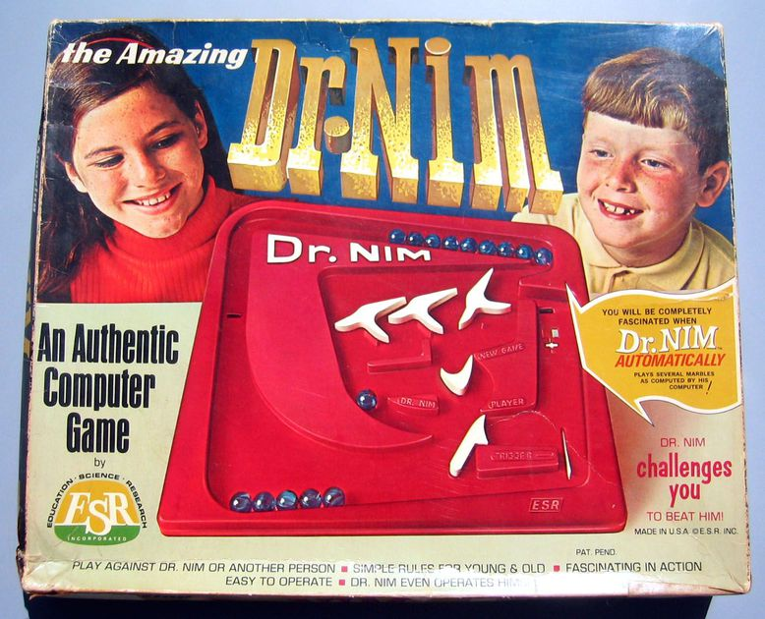
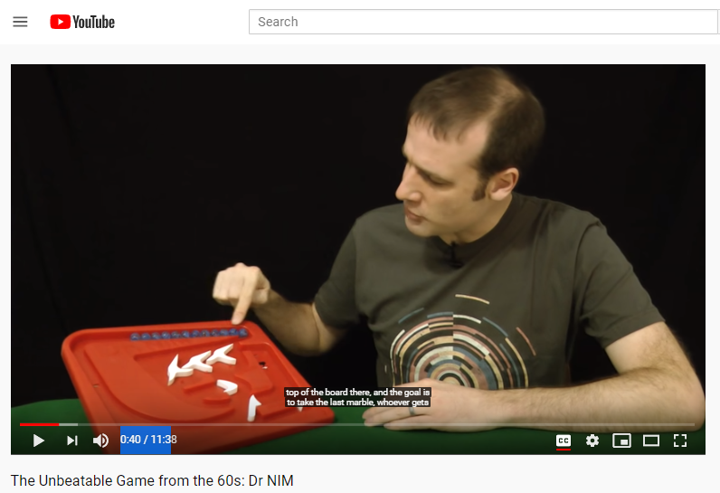
In the 1960s there was a computer (mechanical, but still a computer) that could play a perfect game of NIM.
The link below has a nice explanation of it
https://www.youtube.com/watch?v=9KABcmczPdg

Slide 10
NIM, as we have seen it, is a very boring game (like Tic-Tac-Toe)
There are many variations.
In one variation, there are multiple piles (say 3), you still take 1, 2 or 3 marbles, but they must be all of the same color.
The multiple pile version is a lot more interesting for humans, but still solved, using generalizations of our trick.
What is the branching factor and tree depth of the 3-color/12-length NIM?
12
11
10
9
8
12
11
10
9
8
7
6
5
4
3
12
11
10
9
8
7
6

