Slide 1
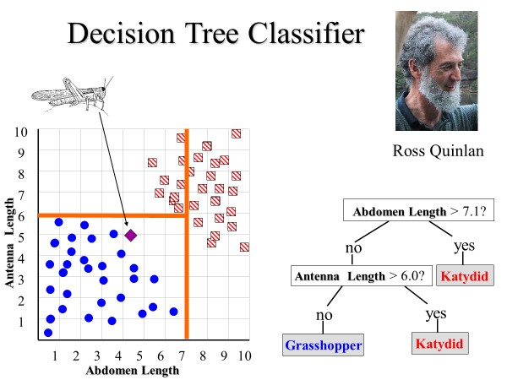
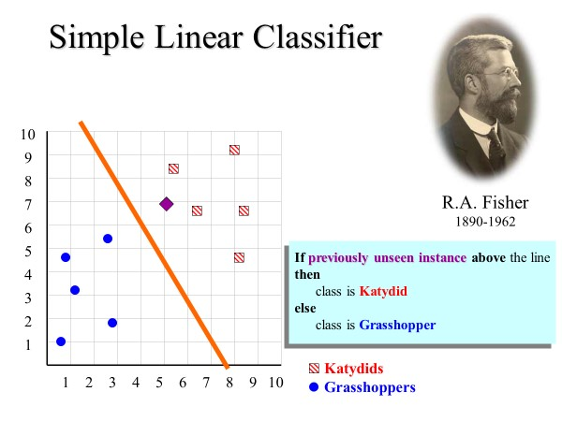
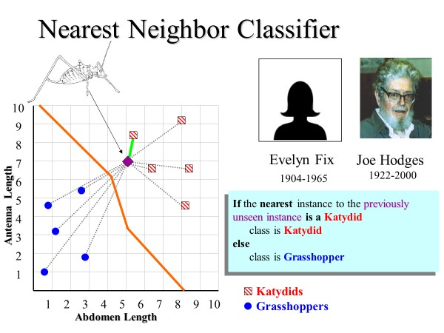
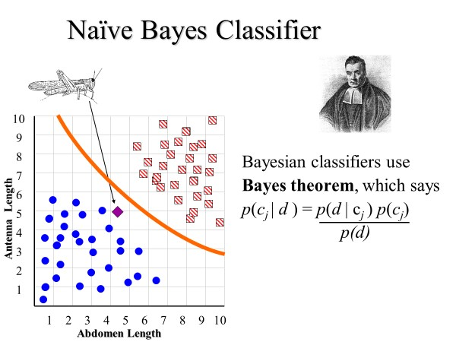
We understand classification algorithms in terms of the expressiveness or representational power of their decision boundaries.
However, just because your can represent the correct decision boundary does not mean you can learn the correct decision boundary.

Slide 2
Consider the following two-class problem.
There are one-hundred features, one thousand instances.
  For class 1, exactly 51 of those features are 1’s, but a random 51, different for each instance
  For class 2, exactly 50 of those features are 1’s, but a random 50, different for each instance
Note that once I tell you the rule, you could easily classify any instance by hand
Class | Feature 1 | Feature 2 | Feature 3 |  | Feature 100
1 | 0 | 0 | 1 |  | 0
1 | 1 | 1 | 0 |  | 1
2 | 0 | 1 | 0 |  | 0
1 | 1 | 1 | 1 |  | 1
2 | 1 | 0 | 1 |  | 0
1 | 0 | 1 | 0 |  | 1

Slide 3
Let us build a decision tree by hand for this problem
Here I am showing just one path to a terminal node
Note that this is a very deep and dense tree, but I can in principle build it by hand, and it will have 100% accuracy.
Can we learn this tree?
Is Feature 1 = ‘1’
yes
no
Is Feature 2 = ‘1’
yes
no
Is Feature 3 = ‘1’
yes
no
Is Feature 51 = ‘1’
yes
no
This is Class 1!
This is Class 2!

Slide 4
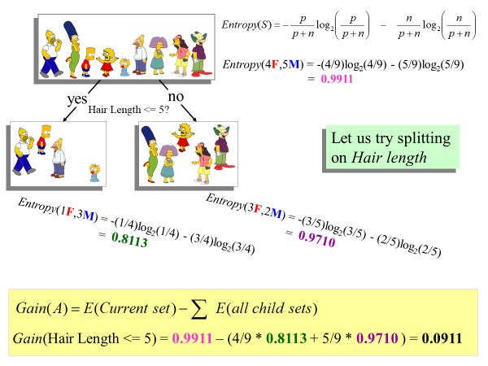
Entropy(500 “1”,500 “0”) = -(500/1000)log₂(500/1000) - (500/1000)log₂(500/1000)
= 1
Is Feature 1 = ‘1’
yes
no
Is Feature 2 = ‘1’
Is Feature 2 = ‘1’
Entropy(250 “1”,250 “0”) = -(250/500)log₂(250/500) - (250/500)log₂(250/500) = 1
Entropy(250 “1”,250 “0”) = -(250/500)log₂(250/500) - (250/500)log₂(250/500) = 1
Gain(Feature 1 = ‘1’) = 1 – (500/1000 * 1 + 500/1000 * 1 ) = 0

Slide 5
Can nearest neighbor solve this problem?
Two exemplars could differ in only one place but be in different classes!
Two exemplars could differ everywhere but be the same class!
The only way nearest neighbor can do well, is if you have basically one of every possible example
But that means you need at least 1267650600228229401496703205376 training instances!
Class | Feature 1 | Feature 2 | Feature 3 |  | Feature 100
1 | 0 | 0 | 1 |  | 0
1 | 1 | 1 | 0 |  | 1
2 | 0 | 1 | 0 |  | 0
1 | 1 | 1 | 1 |  | 1
2 | 1 | 0 | 1 |  | 0
1 | 0 | 1 | 0 |  | 1

Slide 6
Take Home Message
The ability to represent a solution, does not mean you can learn a solution. Recall that multi-layer neural nets could representation any decision boundaries in the 1970s, but could only learn them well in the 2010s
There are problems that humans can learn to solve (once they see the pattern) that no current algorithm can learn to solve.
Feature generation is useful. Here, if we made a new feature that was just the some of all the ‘true’ variables, we could learn the answer with little data and basically any algorithm.

Slide 7
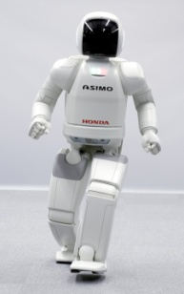
Resources Allocation for AI
An autonomous robot has finite computational resources.
It has to deal with gait, navigation, image processing, planning etc.
Notice that not all these sub-problems need to be solved with the same precision at all times.
If we understand and exploit this, we can do better.
In the next 20 min we will see a simple concrete example of this (not the full general case).
I have another reason to show you this work…

Slide 8
Giving a conference talk
I have another reason to show you this work…
I want to show you how to present your work at a conference
  A conference talk is NOT your paper presented out loud
  A conference talk is an advertisement for your paper
I also want to show you want a nice paper/research contribution can look like.
A very simple idea, well motivated, well evaluated and well explained.

Slide 9
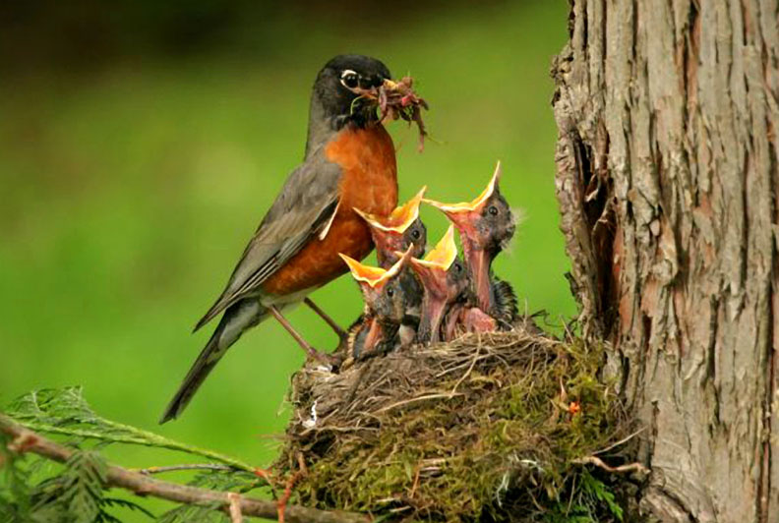
Polishing the Right Apple: Anytime Classification Also Benefits Data Streams with Constant Arrival Times
Jin Shieh and Eamonn Keogh
University of California - Riverside

Slide 10
Important Note
This talk has no equations or code
I am just giving you the intuition and motivation
Full details are in the paper

Slide 11
Assumptions
For some classification problems, the Nearest Neighbor (NN) algorithm is the best thing to use
Empirically, NN is still state-of-the-art for time series data.
Some datatypes have a good distance measure, but no explicit features (compression based distance measures, normalized Google distance) So you can only use NN.
It is simple!

Slide 12
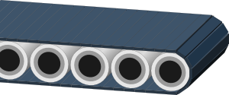
Problem Setup
Objects to be classified arrive (fall off the conveyer belt) at regular intervals. Lets say once a minute for now

Slide 13
Problem Setup
To classify the object, we scan it across our dataset, and record the nearest neighbor
Dataset
Fish
Fowl
Fish
::
Fish
Fowl

Slide 14
Problem Setup
Here, the nearest neighbor was a Fish, so we classify this object as Fish.
Dataset
Fish
Fowl
Fish
::
Fish
Fowl

Slide 15
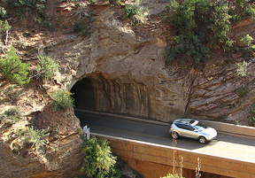
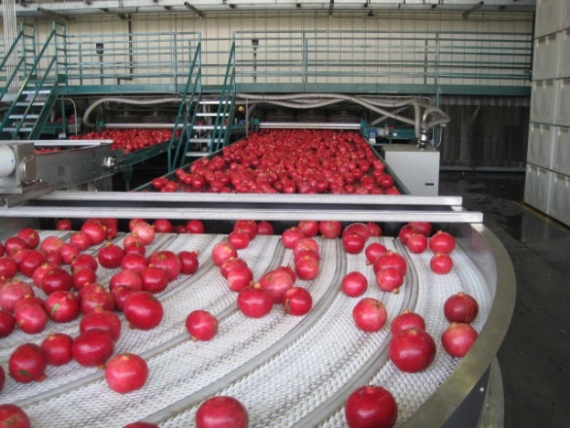
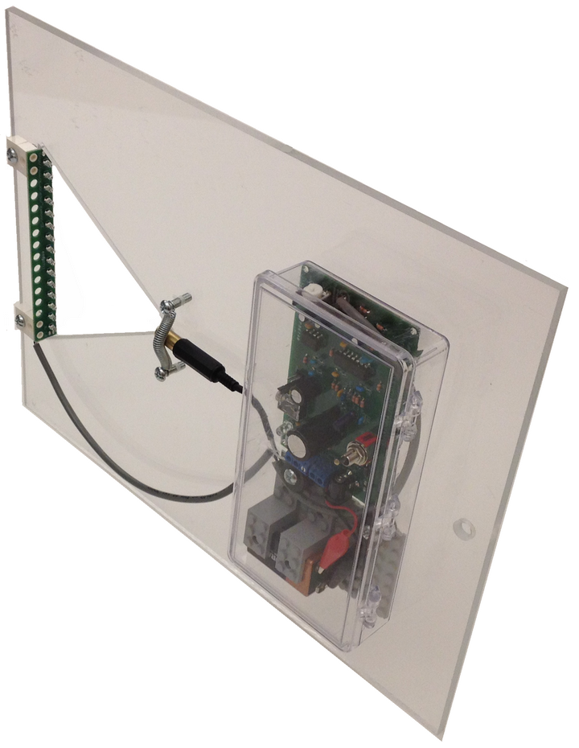

This is a realistic model for some problems
0
0.5
1
1.5
2
2.5
3
3.5
4
x 10
4
4.5

Slide 16
Problem Setup
Assume it takes us 50 seconds to scan our dataset to find the nearest neighbor.
Given the arrival rate is every 60 seconds, we are fine
Dataset
Fish
Fowl
Fish
::
Fish
Fowl

Slide 17
Problem Setup
Suppose however that the arrival rate is every ten seconds?
Simple solution. We just look at the first 1/5 of our dataset
Dataset
Fish
Fowl
Fish
::
::
Fish
Never visited
Fowl

Slide 18
Problem with the Simple Solution
In general, the nearest neighbor algorithm works better with more data, there is a lost opportunity here.
Dataset
Fish
Fowl
Fish
::
::
Fish
Never visited
Fowl

Slide 19


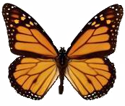




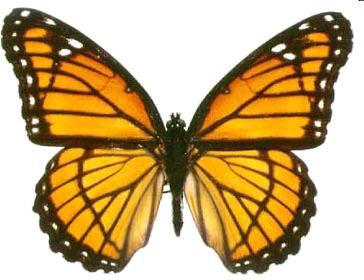

Observation: Some things are easer to classify than other
Consider a 3-class problem
{Monarch, Viceroy, Blue Morpho}
Bluish butterflies are easy to classify, we should spend more time on the red/black unknown butterflies
Monarch
Viceroy
Blue Morpho
Monarch
Blue Morpho
::
Monarch
Viceroy
Monarch
Blue Morpho
Viceroy
Monarch
Blue Morpho

Slide 20

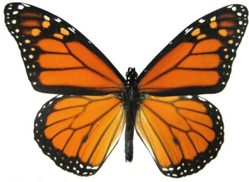
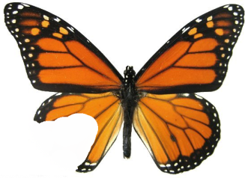
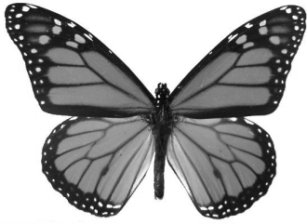
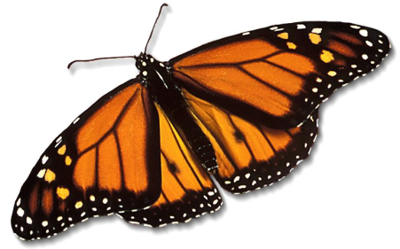
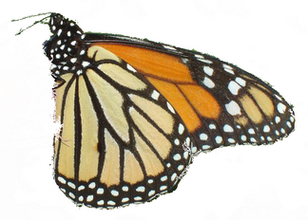
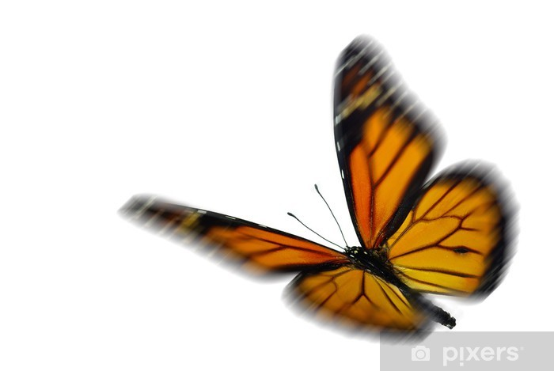
Observation: Some things are easer to classify than other
Even with a 2-class problem
{Monarch, Viceroy}
Some objects are still easer than others to classify
Monarch
Viceroy
Viceroy
Monarch
Viceroy
::
Monarch
Viceroy
Monarch
Monarch

Slide 21
Our solution
Instead of classifying a single item at a time, we maintain a small buffer, say of size 4, of objects to be classified.
Every ten seconds we are given one more object, and we must we evict one object.
We spend more time on the hard to classify objects
Dataset
Fish
Fowl
Fish
Fish
Fowl
Fowl
Fish
Fish
Fowl

Slide 22
Our solution
Some objects may get evicted after only seeing a tiny fraction of the data. These are the easy to classify objects
Dataset
Fish
Fowl
Fish
Fish
Fowl
Fowl
Some objects may get all the way through the dataset, then be evicted. These are the hard to classify objects
Fish
Fish
Fowl

Slide 23
Our solution
How do we know which objects to spend the most time on?
Dataset
Fish
Fowl
Fish
Fish
Fowl
Fowl
Fish
Fish
Fowl

Slide 24
Manser, M.B., and G. Avey. 2000. The effect of pup vocalisations on food allocation in a cooperative mammal, the meerkat.
How do we know which objects to spend the most time on?
Dataset
Fish
Fowl
Fish
Fish
Fowl
Fowl
Fish
Fish
Fowl

Slide 25
We can have the objects signal their “need” by telling us how close they are to their current best-so-far nearest neighbor.
Since an entering item has infinite need, it gets immediate attention…
Dataset
inf
Fish
Fowl
12.1
Fish
11.2
Fish
Fowl
Fowl
9.7
Fish
Fish
Fowl

Slide 26
Once we have pushed the new item down far enough such that it is not longer the neediest item, we turn our attention the new neediest item.
Every ten seconds, just before a new item arrives, we evict the object with the smallest need.
Dataset
Fish
Fowl
12.1
10.1
Fish
11.2
Fish
Fowl
Fowl
9.7
Fish
Fish
Fowl

Slide 27
Is it possible that an item could stay in the buffer forever?
No. Our cost function includes not just how needy an item is, but how long it has been in the buffer. All objects get evicted eventually.
Dataset
0.0001
Fish
Fowl
10.1
Fish
11.2
Fish
Fowl
Fowl
9.7
Fish
Fish
Fowl

Slide 28
How big does the buffer need to be?
No theoretical results (yet).
But there are fast diminishing returns. Once it is of size 8 or so, making it any larger does not help.
Dataset
0.0001
Fish
Fowl
10.1
Fish
11.2
Fish
Fowl
Fowl
9.7
Fish
Fish
Fowl

Slide 29
The Obvious Strawman
Round Robin
All objects move down the buffer together…
Dataset
Fish
Fowl
Fish
Fish
Fowl
Fowl
Fish
Fish
Fowl

Slide 30
The Obvious Strawman
Round Robin
All objects move down the buffer together…
Dataset
Fish
Fowl
Fish
Fish
Fowl
Fowl
Fish
Fish
Fowl

Slide 31
Our method works for any stream arrival model…
Constant arriving stream
  Constant arriving stream
  Exponentially arriving stream
Exponentially arriving stream

Slide 32
Empirical Results I
Gun Dataset
RoundRobin
0.91
0.86
0.81
Accuracy
0.76
0.71
1
0.9
0.8
0.7
0.6
0.5
0.4
0.3
0.2
0.1
Interarrival Time
(
r
)
=
|
D
|
r
Objects are arriving very quickly
Objects are arriving slowly
Objects are arriving faster

Slide 33
Empirical Results I
Gun Dataset
RoundRobin
BsfDistance
0.91
0.86
0.81
Accuracy
0.76
0.71
1
0.9
0.8
0.7
0.6
0.5
0.4
0.3
0.2
0.1
Interarrival Time
(
r
)
=
|
D
|
r
Objects are arriving very quickly
Objects are arriving slowly
Objects are arriving faster

Slide 34
Empirical Results II
Two Pattern Dataset
RoundRobin
0.98
0.88
0.78
Accuracy
0.68
1
0.9
0.8
0.7
0.6
0.5
0.4
0.3
0.2
0.1
Exponentially Distributed Interarrival Time
(
r
)
Objects are arriving very quickly
Objects are arriving slowly
Objects are arriving faster

Slide 35
Empirical Results II
Objects are arriving very quickly
Objects are arriving slowly
Objects are arriving faster

Slide 36
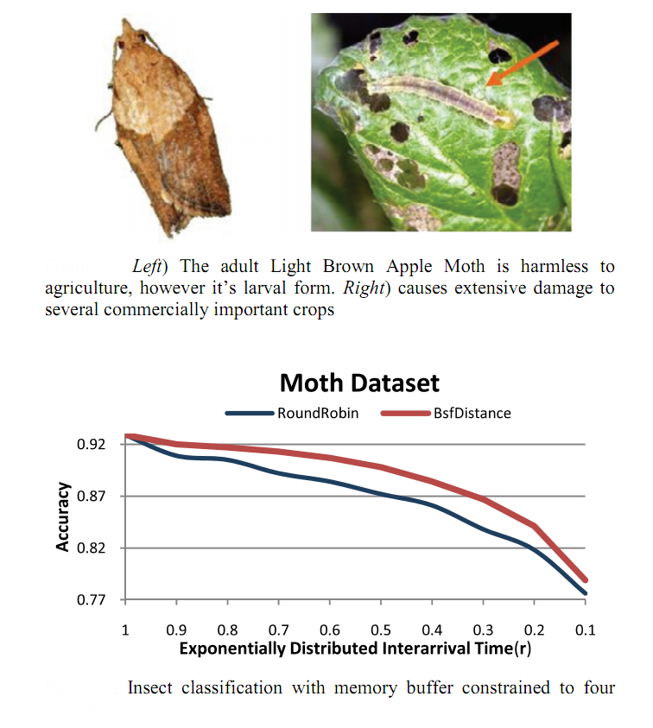
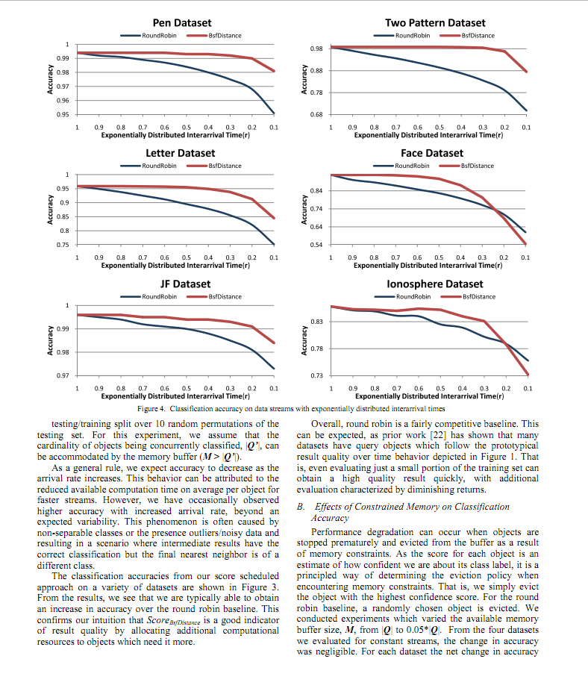
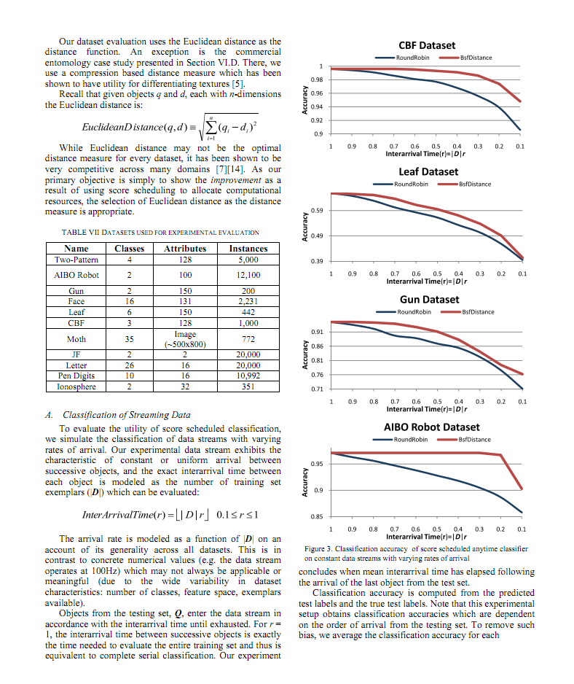
Empirical Results III

Slide 37
Polishing the Right Apple: Anytime Classification Also Benefits Data Streams with Constant Arrival Times
Questions?
Jin Shieh and Eamonn Keogh
University of California - Riverside

Slide 38
Debrief
For an AI system, we will always have finite resources. If we reason carefully about how to spend them, we can do better.
--
While subjective, I recommend this style of presentation of conference talks
  A conference talk is NOT your paper presented out loud
  A conference talk is an advertisement for your paper
I also want to show you want a nice paper/research contribution can look like.
A very simple idea, well motivated, well evaluated and well explained.

