Slide 1
Winding up Search
You now know almost everything you need to know about search!
Set up the problem space, keeping BF and depth low if possible.
If you can’t create a heuristic, use iterative deepening search.
If you can create a heuristic, use A* (or iterative deepening A*)
(obviously, you have seen a few other tricks, bi-directional search, deep-limited search in the rare cases you know the exact depth etc.)
It really is the case that 90% of the knowledge you need is generic, and independent of the problem.
However, sometimes there are a few “tricks” you could do, that depend on the particular problem.
Lets look at a few problems to get a flavor of this.

Slide 2
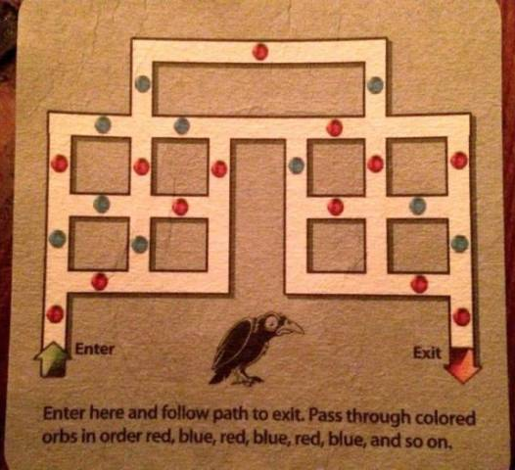
Here is a puzzle I found on a t-shirt
The task, is to go from start to finish, alternating the colors of the “orbs” you pass…

Slide 3
.. So this partial solution is not legal, since I have passed two blues in a row…

Slide 4
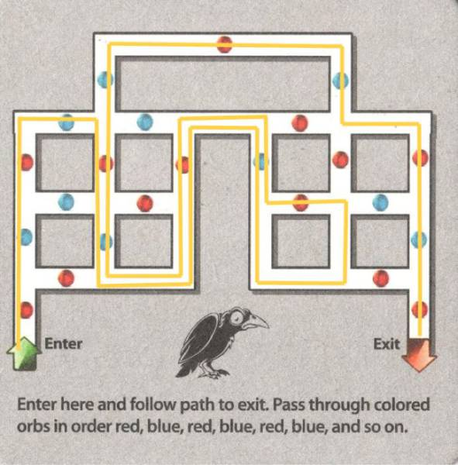
Here is a solution (I am not sure if it is unique)

Slide 5
To Think About
Assume we are to solve this with blind search..
How would you represent the states and the operators?
What is the branching factor?
What is the diameter? Can you get it exactly, or at least upper and/or lower bounds?
Which blind search algorithm would you use?

Slide 6
The states should be the intersections. It is only there that we have a choice.
Here choices are operators.
For each state we need to know..
F
H
I
M
C
E
G
J
L
N
B
D
K
O
Possible operators allowed
For example:
From C, we can get to B, E or F
From A, we can get to B
A
P

Slide 7
We also need to know the parity for each operator.
That is to say, we need to know the last color visited.
For example:
For node F
If C was parent, last color was Blue
If H was parent, last color was Blue
If M was parent, last color was Blue
If E was parent, last color was Red
F
H
I
M
C
E
G
J
L
N
B
D
K
O
A
P

Slide 8
For node F
If C was parent, last color was Blue
If H was parent, last color was Blue
If M was parent, last color was Blue
If E was parent, last color was Red
Given the above, we can list the legal operators
Expand_State_F
IF last color was Blue
legal operators = { E }
ELSE
legal operators = { C, M , H}
END
F
H
I
M
C
E
G
J
L
N
B
D
K
O
A
P

Slide 9
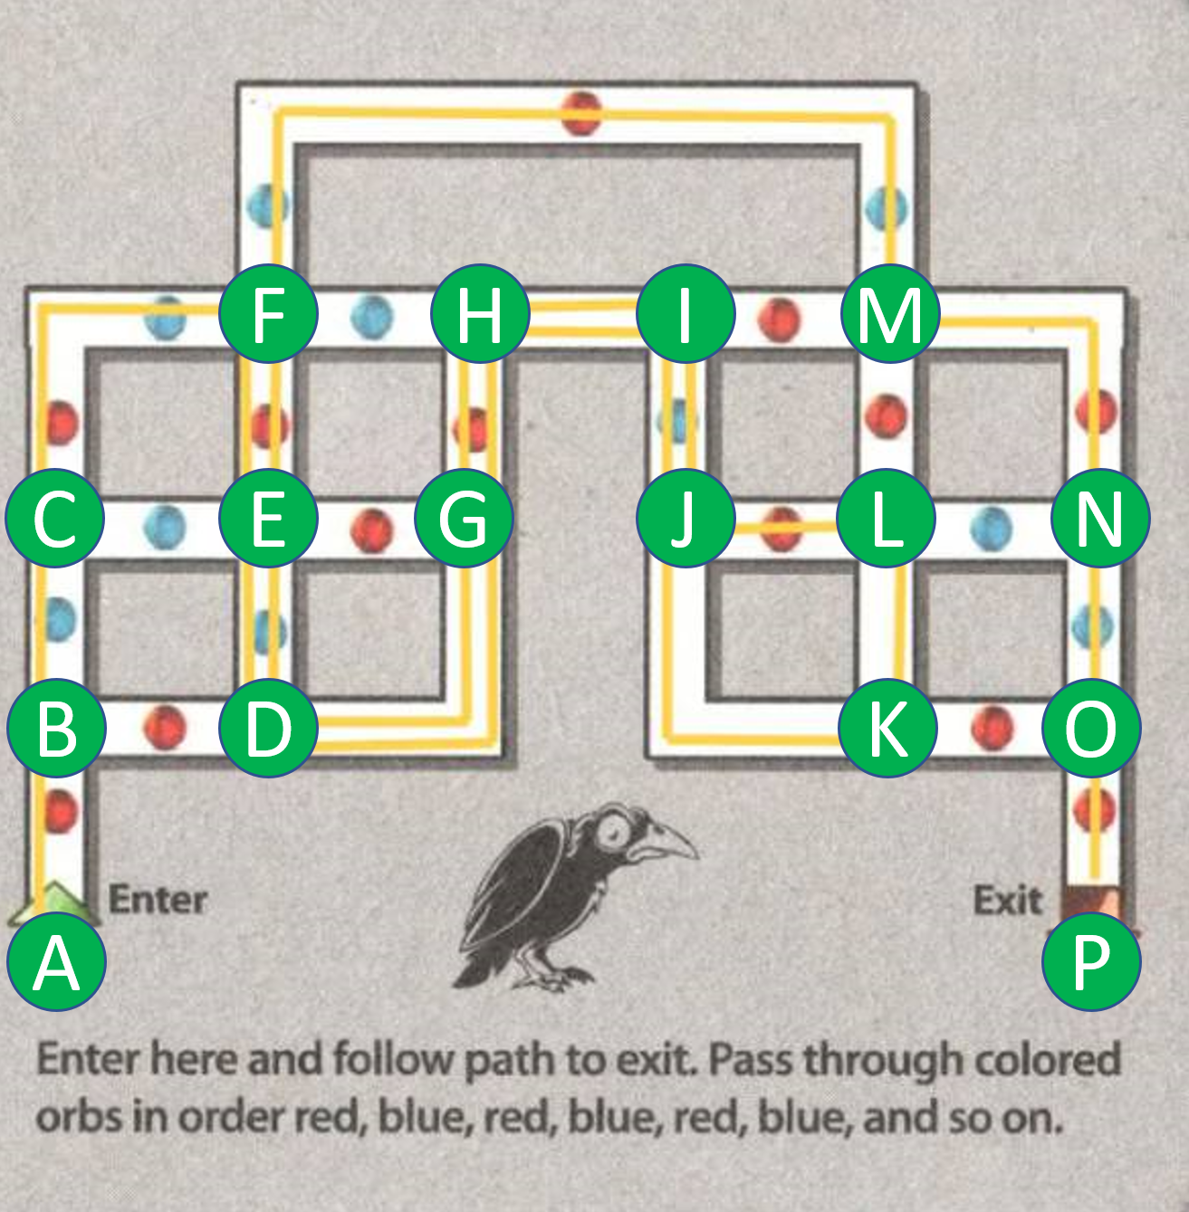
What can we say about the branching factor?
The are some four-way intersections, but you can never go back (because the last color you saw, would be seen again).
So the branching factor is at most three for the four-way intersections, and there are four of them.
The are some three-way intersections, but again you can never go back.
So the branching factor is at most two for the three-way intersections, and there are twelve of them¹.
So, an estimate for the branching factor is
b = (12/16 * 2) + (4/16*3) = 2.25.
This is actually an upper bound.
A
Start
B
C
D
E
F
B
N
L
O
P
Goal!
¹Really should say, at most 12, because A has only one choice

Slide 10
What can we say about the depth?
Lets do a lower bound.
If I take away all the colors, then I can solve this with ten moves: A, B, C, F , H, I, M, L, N, O, P
So 10 is a lower bound.
Lets do an upper bound.
If we count the number of intersections, we might guess 16. However, with a little introspection, we can see that:
We might have to visit some intersections twice, each time from a different parent, and each time going a different way.
We never have to visit an intersection twice from the same direction!
So an upper bound is d = (16 * 2) = 32.
A
Start
B
C
D
E
F
B
N
L
O
P
Goal!

Slide 11
Which algorithm should we use?
How many nodes do we have to check?
Assume we take one nanosecond to test each state we pop off NODES.
Assume the worst case
We have b = 2.25 and d = 32. (2.25³²) nanosecond = 3.1 minutes
Assume the best case
We have b = 2.25 and d = 10 (2.25¹⁰) nanosecond = 3.3 microseconds
Assume the actual depth is half way between best and worst case
We have b = 2.25 and d = 24 (2.25²⁴) nanosecond = 0.28 seconds
It probably does not matter what algorithm we use. We are not likely to run out of space or time. Likewise, I would not bother to optimize my code to much.
However, this assumes we solving the puzzle once. The similar “google maps” problem needs to be solved millions of times a day, so for that problem, we would optimize the code very carefully.

Slide 12
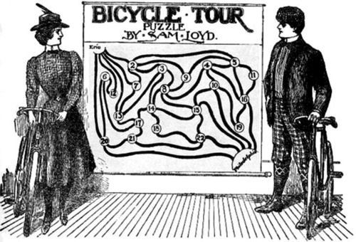
The map shows twenty-three prominent cities of the State of Pennsylvania connected by bicycle routes of more or less artistic design. The problem is a very simple one: merely start on your summer outing and go from Philadelphia to Erie, passing through every one of the cities but once and without going over any road twice. That is all there is to it. The cities are numbered so as to enable solvers to describe their routes by a sequence of figures. In this trip the usual practice of getting there by the “shortest route possible, etc.,” will be dispensed with. Just get there without minding the cyclometer, and get an answer by giving the sequence of towns passed through.
Notes:
Such of our puzzalists as completed the cross-state run, report that the only possible route by which all of the towns can be visited but once is to take them in the following sequence, according to the designated numbers: Philadelphia to 15, 22, 18, 14. 3, 8, 4, 10, 19. 16, 11, 5, 9. 2, 7, 13, 17, 21, 20, 6, 12 and then to Erie, which completes the trip after having visited the twenty-two towns.

Slide 13
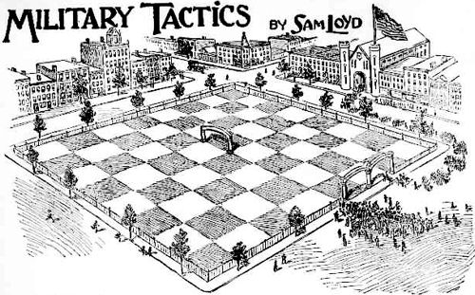
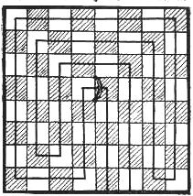
2
1
Show how a military division could enter at gate 1 march across all of the sixty-four squares and leave gate 2, after passing under the triumphal arch
Notes:
That lesson in military tactics, wherein a military division was to enter the park at one gate, go through the sixty four-squares and out at the other gate after passing under the triumphal arch in the center of the field, was sufficiently difficult to amuse and interest our young puzzlists, who found that there was but one way to perform the feat in fifteen moves, as shown, although there are a thousand and one routes which call for just on extra turn.
Show how a military division could enter at gate No. 1, march across all of the sixty-four squares and leave by the other gate, after passing under the triumphal arch

Slide 14
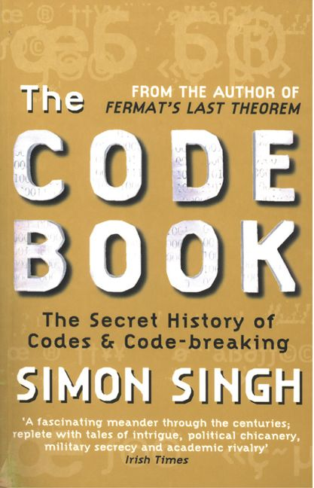
Search for Codebreaking
Lets briefly consider search in the context of codebreaking
We will consider three kinds of codes, in order of complexity
Cesar Shift Cipher
Substitution Cipher
Enigma Machine

Slide 15
Background
Our enemies Alice and Bob want to be able to pass messages to each securely, but through a channel we might be able to intercept.
They have an algorithm or device that can take a plain text message like..
THE QUICK BROWN FOX JUMPS OVER THE LAZY DOG
And convert it to cyphertext like
QEB NRFZH YOLTK CLU GRJMP LSBO QEB IXWV ALD
Of course, they can take a cyphertext and run the same algorithm to undo the encoding back to plaintext.
They assume that the world might know their algorithm. But the algorithm is parameterized by some settings (key) and only they know it.

Slide 16
Search Space for the Cesar Shift Cipher
Write the alphabet out twice.
Circular shift the bottom alphabet by some number between 1 and 25
Plain | A | B | C | D | E | F | G | H | I | J | K | L | M | N | O | P | Q | R | S | T | U | V | W | X | Y | Z
Cipher | X | Y | Z | A | B | C | D | E | F | G | H | I | J | K | L | M | N | O | P | Q | R | S | T | U | V | W
Shift by 3
Plaintext: THE QUICK BROWN FOX JUMPS OVER THE LAZY DOG
Ciphertext: QEB NRFZH YOLTK CLU GRJMP LSBO QEB IXWV ALD
The search space is just 25, easy to brute force.

Slide 17
Evaluation Function for Ciphers
If we are trying to brute force a code, how do we know when we have succeeded? For the moment, lets just use our eyes.
Suppose we have the Ciphertext QEB.
Let's try Shift by 1
That translates to RFC
Let's try Shift by 2
Plain | A | B | C | D | E | F | G | H | I | J | K | L | M | N | O | P | Q | R | S | T | U | V | W | X | Y | Z
Cipher | Z | A | B | C | D | E | F | G | H | I | J | K | L | M | N | O | P | Q | R | S | T | U | V | W | X | Y
1
2
3
10
11
12
25

Slide 18
Evaluation Function for Ciphers
If we are trying to brute force a code, how do we know when we have succeeded?
Suppose we have the Ciphertext QEB.
Let's try Shift by 1
That translates to RFC
Let's try Shift by 2
That translates to SGD
Plain | A | B | C | D | E | F | G | H | I | J | K | L | M | N | O | P | Q | R | S | T | U | V | W | X | Y | Z
Cipher | Z | A | B | C | D | E | F | G | H | I | J | K | L | M | N | O | P | Q | R | S | T | U | V | W | X | Y
Plain | A | B | C | D | E | F | G | H | I | J | K | L | M | N | O | P | Q | R | S | T | U | V | W | X | Y | Z
Cipher | Y | Z | A | B | C | D | E | F | G | H | I | J | K | L | M | N | O | P | Q | R | S | T | U | V | W | X
1
2
3
10
11
12
25

Slide 19
Evaluation Function for Ciphers
If we are trying to brute force a code, how do we know when we have succeeded?
Suppose we have the Ciphertext QEB.
Let's try Shift by 1
That translates to RFC
Let's try Shift by 2
That translates to SGD
Let's try Shift by 3
That translates to THE
Plain | A | B | C | D | E | F | G | H | I | J | K | L | M | N | O | P | Q | R | S | T | U | V | W | X | Y | Z
Cipher | Z | A | B | C | D | E | F | G | H | I | J | K | L | M | N | O | P | Q | R | S | T | U | V | W | X | Y
Plain | A | B | C | D | E | F | G | H | I | J | K | L | M | N | O | P | Q | R | S | T | U | V | W | X | Y | Z
Cipher | Y | Z | A | B | C | D | E | F | G | H | I | J | K | L | M | N | O | P | Q | R | S | T | U | V | W | X
Plain | A | B | C | D | E | F | G | H | I | J | K | L | M | N | O | P | Q | R | S | T | U | V | W | X | Y | Z
Cipher | X | Y | Z | A | B | C | D | E | F | G | H | I | J | K | L | M | N | O | P | Q | R | S | T | U | V | W
1
2
3
10
11
12
25

Slide 20
How do we know if the decoding is correct?
In the last example, human eyes looked at all possible 25 decodings to find the right one. That does not scale.
We can create an evaluation function to score the decoding’s.
The function takes in a tentative decoding, and returns a value, smaller is better, that reflects how likely that sentence is a valid English sentence.
We could use this evaluation function in generic search algorithm, enqueuing nodes in order of h(ALD NMFZH POLTK CLU GMJRY LSBO VXWI QEB)
Score tentative decoding
How do these evaluation functions work?
ALD NMFZH POLTK CLU GMJRY LSBO VXWI QEB
2343
Score tentative decoding
ZHE DUICK BROWN HOX JUMPS OVER ZHE LAZY QOG
12

Slide 21
Search Space for the Substitution Cipher
Write the alphabet out twice.
Randomly permute the bottom alphabet
Plain | A | B | C | D | E | F | G | H | I | J | K | L | M | N | O | P | Q | R | S | T | U | V | W | X | Y | Z
Cipher | D | Y | B | A | Z | M | X | K | F | G | W | I | J | E | L | C | N | O | R | V | P | S | T | U | Q | H
Plaintext: THE
Ciphertext: VKZ
The search space is 26! = 403,291,461,126,605,635,584,000,000
This is a huge search space. However, this is solvable because we have a very good heuristic..

Slide 22
The Search Tree for Substitution Cipher
QEB NRFZH YOLTK CLU GRJMP LSBO QEB IXWV ALD
Substitute A for A, B for A, C for A,…, Z for A.
It is 26 deep, and each node has 26 choices at the first level, then 25, then 24…
As we make our last “choice”, there is only one possibility left, we have changed all the other letters.
Substitute A for B, B for B, C for B,…, Z for B.
Substitute A for C, B for C, C for C,…, Z for C.
There are 26! leaf nodes, one of them corresponds to the plaintext, the goal state.
All the other nodes are gibberish.
h(THE QUICK BROWN FOX JUMPS OVER THE LAZY DOG) = 0
With such a huge search space, how can we solve this?
(next slide)
ALD NMFZH POLTK CLU GMJRY LSBO VXWI QEB
THE QUICK BROWN FOX JUMPS OVER THE LAZY DOG

Slide 23
The Search Tree for Substitution Cipher
QEB NRFZH YOLTK CLU GRJMP LSBO QEB IXWV ALD
Substitute A for A, B for A, C for A,…, Z for A.
If we look at internal nodes, we can see if we are making progress.
We might have gotten one or two words.
We might have gotten common bigrams th/he/in/en/nt/re/er
We might have gotten common trigrams the/ing/hat/his
We can encode this intuition in an evaluation function and do a greedy search.
Substitute A for B, B for B, C for B,…, Z for B.
Substitute A for C, B for C, C for C,…, Z for C.
QHB NRFZH YOOTK COU GRJMP LSWR QHB IXWV SDE
QHB NRFZH YOOTK COU GRJMP LSER QHB IXWV DOG
Which of these two nodes would you expand?

Slide 24
The Search Tree for Substitution Cipher
QEB NRFZH YOLTK CLU GRJMP LSBO QEB IXWV ALD
Substitute A for E, B for E, C for E,…, Z for E.
To make the most of heuristic, we can reorder the search.
We count the frequency of the letters in the ciphertext, and start with the most frequent letters. This will give us a strong heuristic, early in the tree.
 |  |  | Letter | Frequency
 |  |  | E | 12.02
 |  |  | T | 9.10
 |  |  | A | 8.12
 |  |  | O | 7.68
 |  |  | I | 7.31
 |  |  | N | 6.95
 |  |  | S | 6.28
 |  |  | R | 6.02
 |  |  | H | 5.92
 |  |  | D | 4.32
 |  |  | L | 3.98
 |  |  | U | 2.88
 |  |  | C | 2.71
 |  |  | M | 2.61
 |  |  | F | 2.30
 |  |  | Y | 2.11
 |  |  | W | 2.09
 |  |  | G | 2.03
 |  |  | P | 1.82
 |  |  | B | 1.49
 |  |  | V | 1.11
 |  |  | K | 0.69
 |  |  | X | 0.17
 |  |  | Q | 0.11
 |  |  | J | 0.10
 |  |  | Z | 0.07
In fact, this method is so efficient, that for long messages, people have been doing this by hand for centuries.
The substitution cipher is not a strong code.

Slide 25
The Fundamental Weakness of the Substitution Cipher
The problem with the substitution cipher is that each letter gets transposed to the same letter everywhere.
Consider the following coded message..
Ol miol mit ktas soyt? Ol miol pwlm yafmalb? Eawuim of a safrlort, Fg tleaht ykgd ktasomb Ghtf bgwk tbtl, Sggq wh mg mit lqotl afr ltt

Slide 26
The Fundamental Weakness of the Substitution Cipher
The problem with the substitution cipher is that each letter gets transposed to the same letter everywhere.
Consider the following coded message..
Ol miol mit ktas soyt? Ol miol pwlm yafmalb? Eawuim of a safrlort, Fg tleaht ykgd ktasomb Ghtf bgwk tbtl, Sggq wh mg mit lqotl afr ltt
We notice that the word “mit” appears twice.
The most common three letter words are the, and, for, are, but, not, you, all, any, can,..
So, it might be that “mit” is “the”, meaning that: m → t, i → h, t → e
Lets make that substitution in the first sentence
Ol miol mit ktas soyt? Becomes… Ol thol the ktas soyt?

Slide 27
The Fundamental Weakness of the Substitution Cipher
The problem with the substitution cipher is that each letter gets transposed to the same letter everywhere.
Consider the following coded message..
Ol miol mit ktas soyt? Ol miol pwlm yafmalb? Eawuim of a safrlort, Fg tleaht ykgd ktasomb Ghtf bgwk tbtl, Sggq wh mg mit lqotl afr ltt
We notice that the word “mit” appears twice.
The most common three letter words are the, and, for, are, but, not, you, all, any, can,..
So, it might be that “mit” is “the”, meaning that: m → t, i → h, t → e
Lets make that substitution in the first sentence
Ol miol mit ktas soyt? Becomes… Ol thol the ktas soyt?
What words begin with “th” and have two letters? There are a few, “thus”, “this”… (it can't be “then”, “that”)
If we assume “thus”, we get: Us thus the ktas soyt?
If we assume “this”, we get: Is this the ktas soyt?
With this little work, we may already have 5 letters correctly decoded!
Thus, to have a good cipher, we need a system in which a letter does not always map onto the same letter…

Slide 28
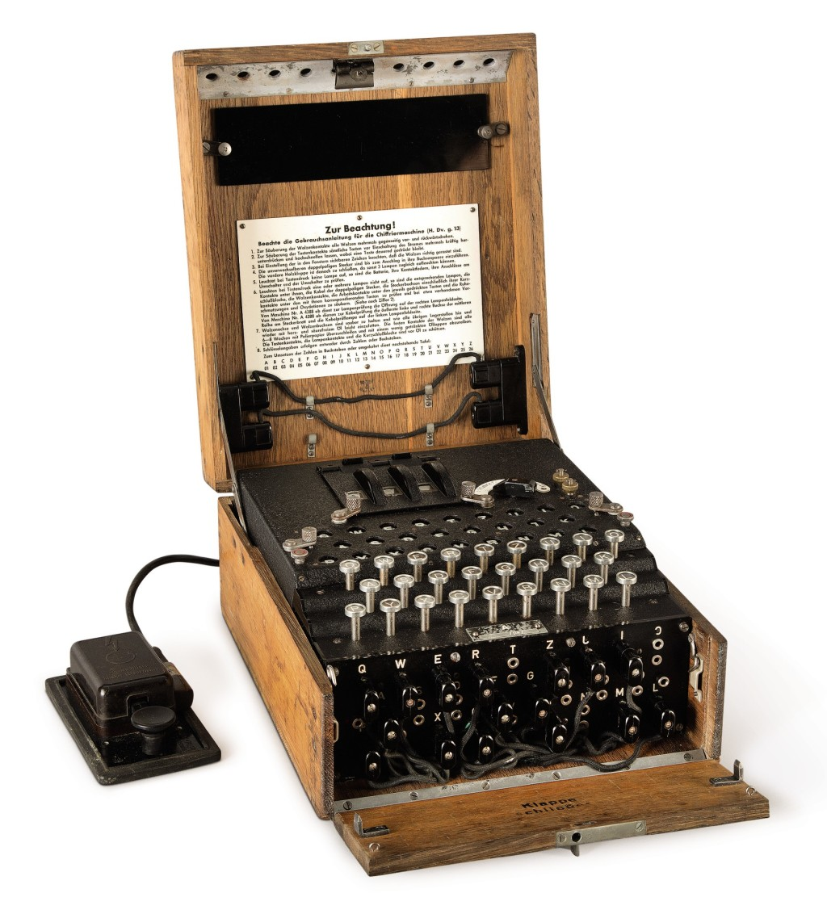
The Enigma Machine
Each day the machine was initialized with settings (key) known only to the sender and receiver.
The sender typed the message on the keyboard, and a different letter would light up. That illuminated letter was the ciphertext.
If the sender typed Eamonn, it might transpose to….
DCVESV
Note that the two ‘N’s map to different letters!
Note also that one a ‘V’ maps to a ‘M’, but the other ‘V’ to ‘N’.
The receiver can take the ciphertext, and, so long as his machine was in the same settings, simply type it into his machine, the ciphertext would transpose back to the plaintext in the lighted keyboard.
Note that this defeats our evaluation function, finding repeated snippets

Slide 29
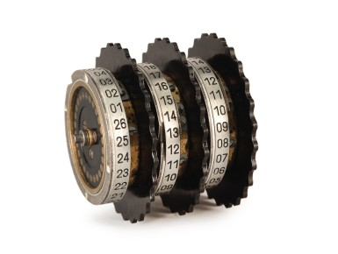
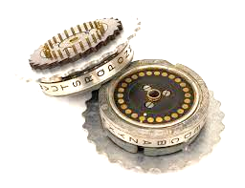
Search Space for the Enigma Machine
From a set of five rotors, pick the left, center and right rotor: 5 * 4 * 3 = 60
For each of the rotors, pick the starting number: 26 * 26 * 26 = 17,576
Connect 10 wires on the plugboard 26!/(6!*10!*2¹⁰) = 150,738,274,937,250
So the total search space is the product of these numbers, which is: 158,962,555,217,826,360,000
https://www.youtube.com/watch?v=G2_Q9FoD-oQ&t=4s

Slide 30
Evaluation Function for the Enigma Machine
The search space is massive, but it is actually 40 million times smaller than the substitution cypher.
The difference is that the substitution cypher allows an evaluation function that can measure partial progress. The offers some weak information to guide the greedy search.
The “different letter each time” property of the Enigma machine does not seem to offer any information to guide the greedy search.
What we need is a genius…
Score tentative decoding
ALD NMFZH POLTK CLU GMJRY LSBO VXWI QEB

Slide 31
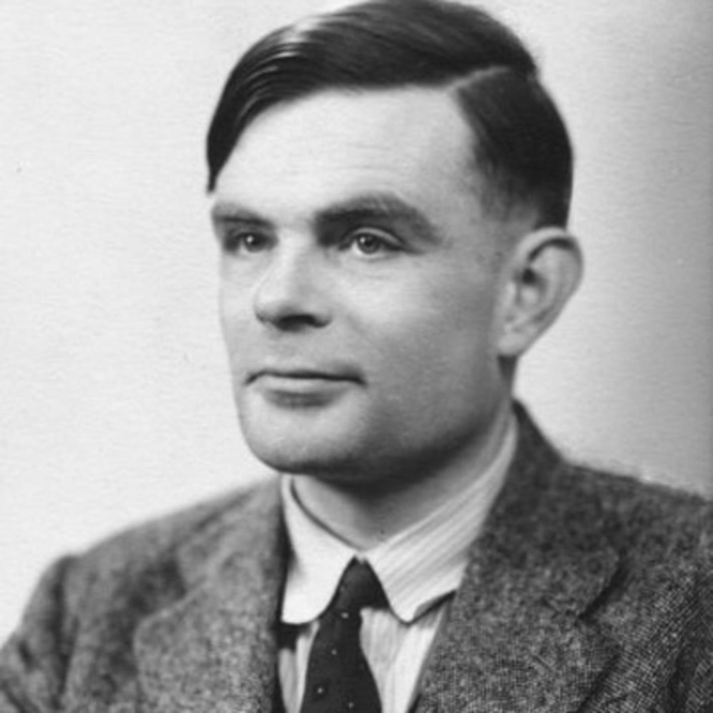
Evaluation Function for the Enigma Machine
The search space is massive, but it is actually 40 million times smaller than the substitution cypher.
The difference is that the substitution cypher allows an evaluation function that can measure partial progress. The offers some weak information to guide the greedy search.
The “different letter each time” property of the Enigma machine does not seem to offer any information to guide the greedy search.
What we need is a genius…
Fortunately, we have one
Score tentative decoding
ALD NMFZH POLTK CLU GMJRY LSBO VXWI QEB

Slide 32
Heuristics for the Enigma Machine
Enigma had the property that no letter could ever be transposed to itself. This is exploitable.
Suppose you guessed a phase that might be in the original text, say you guess it contained the word Wetterbericht
Suppose you have a ciphertext…
HKJLGGUJLLDHK HDPMNCTPBLKQD DJEBDUSWRPEAS…
WetterberichT Wetterbericht Wetterbericht…

Slide 33
Heuristics for the Enigma Machine
Enigma had the property that no letter could ever be transposed to itself. This is exploitable.
Suppose you guessed a phase that might be in the original text, say you guess it contained the word Wetterbericht
Suppose you have a ciphertext
HKJLGGUJLLDHK HDPMNCTPBLKQD DJEBDUSWRPEAS…
WetterberichT Wetterbericht Wetterbericht…

Slide 34
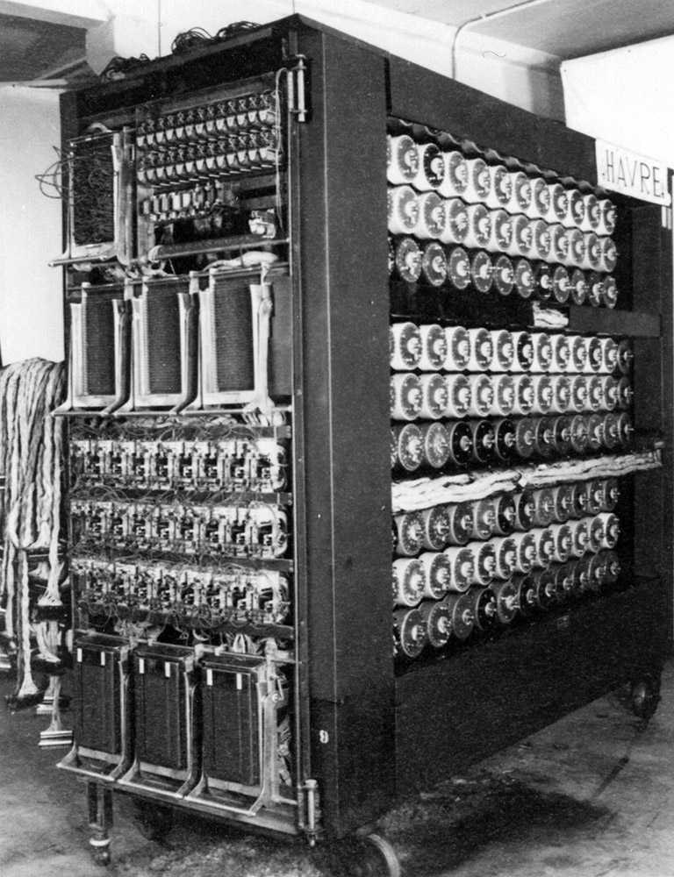
The Bombe
This was the device used to do search over the code space.
It was electromechanical, and too slow to do brute force search over the full search space.
However, with the heuristic in the previous page (and some others) it was fast enough to crack the codes, every day.
The Imitation Game (2014)

Slide 35
Recommend viewing for the Enigma Machine
Historical context
https://www.youtube.com/watch?v=k9mNRbx6LOM
Explicit mention of a search tree for Enigma
https://youtu.be/k9mNRbx6LOM?t=1634
Flaw in the Enigma Code
https://www.youtube.com/watch?v=V4V2bpZlqx8
Using the “a letter cannot map to itself” to crack Enigma
https://www.youtube.com/watch?v=bRT5YKez8m4
How to compute the size of the search space
https://www.youtube.com/watch?v=G2_Q9FoD-oQ
Dramatization of the Turing’s flash of insight
https://www.youtube.com/watch?v=mwFWMM9APLs

Slide 36
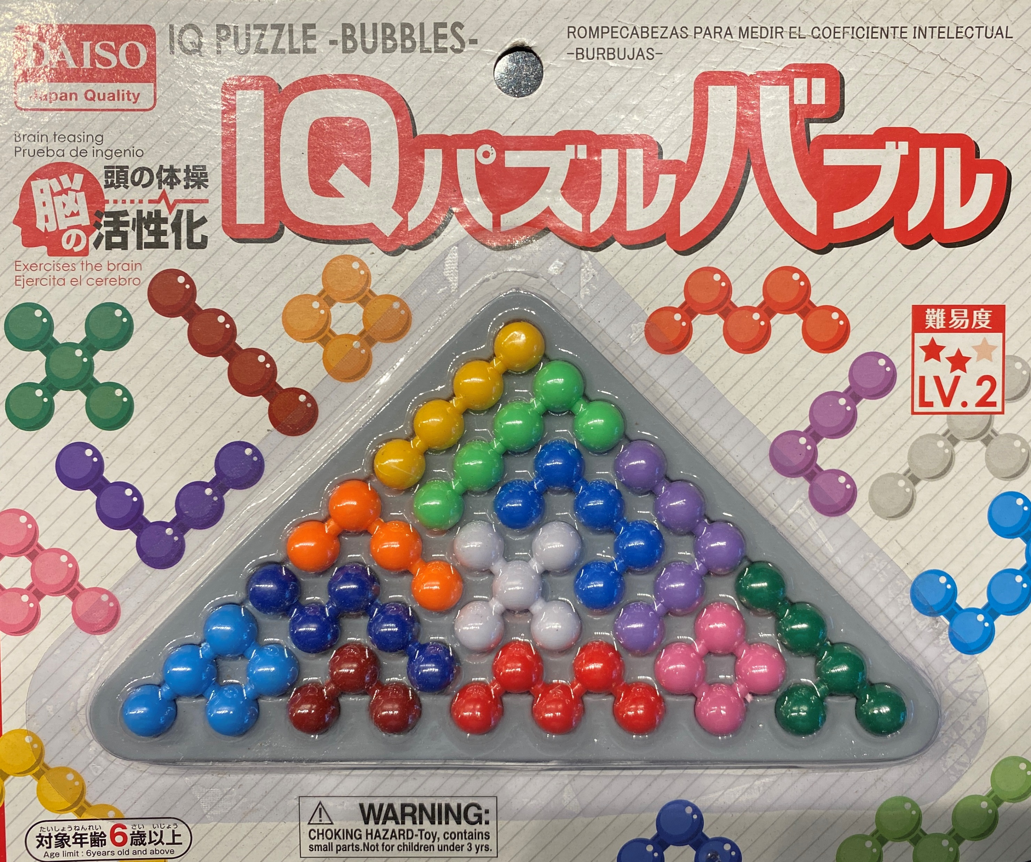
Let us investigate using search to solve this puzzle

Slide 37
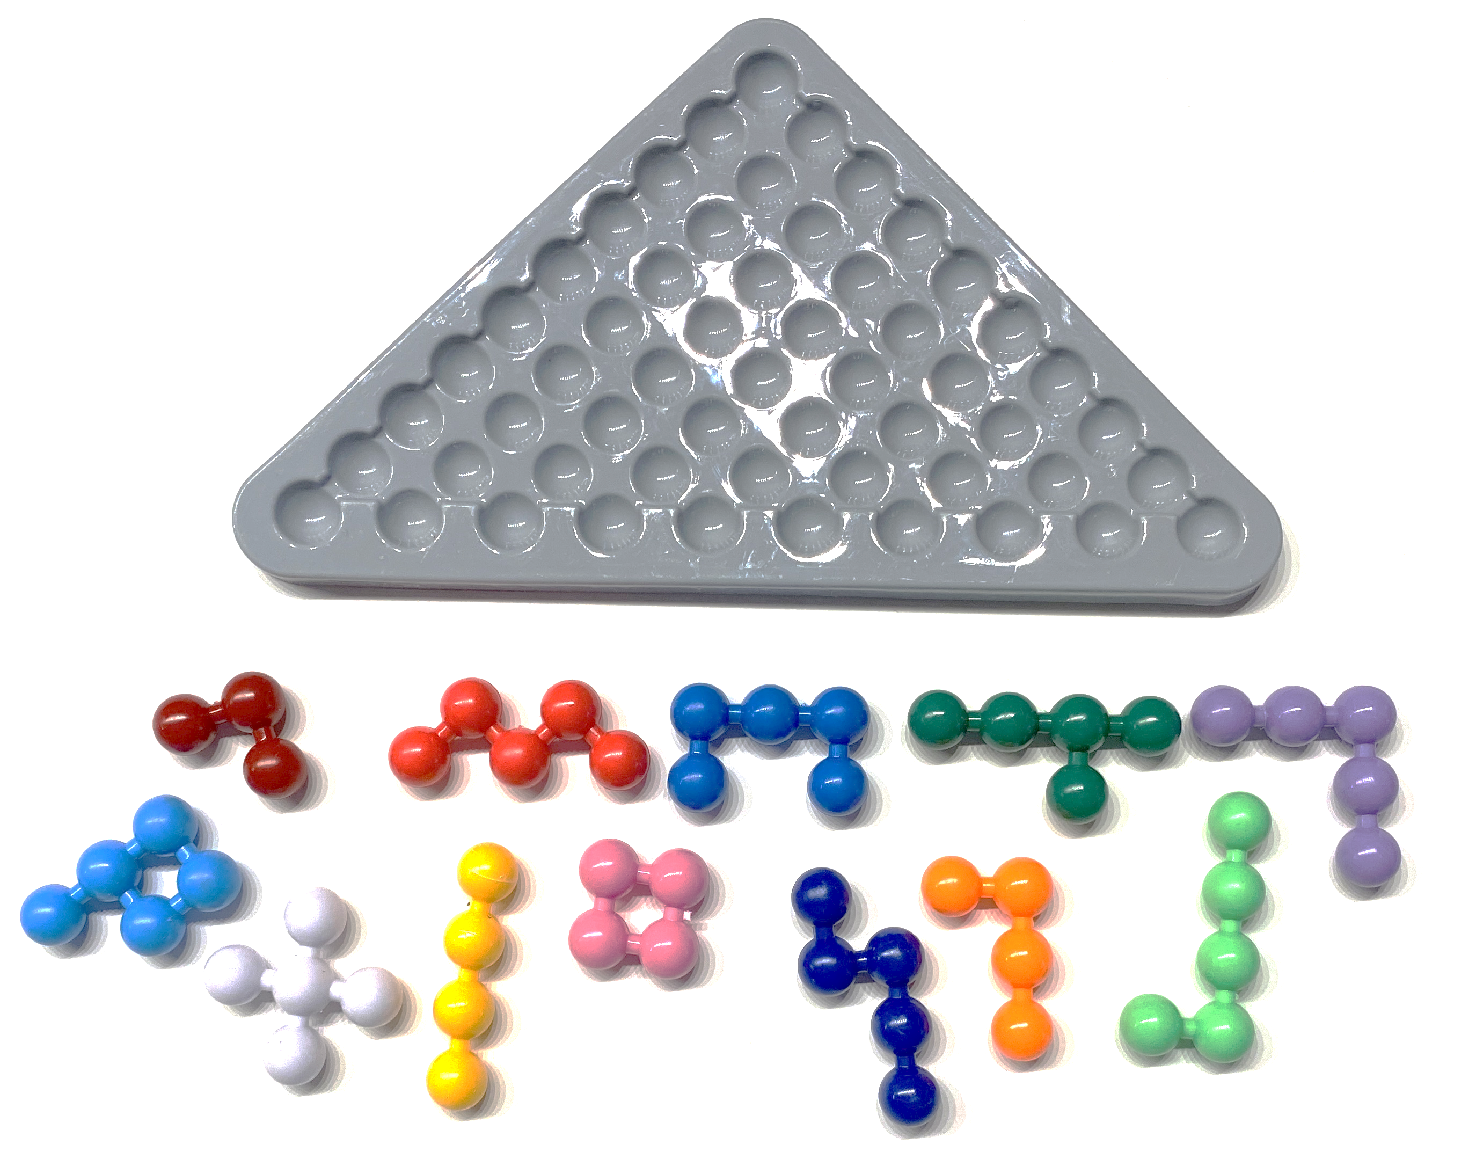
The object of the puzzle is simply to place all the pieces onto the gray template.

Slide 38
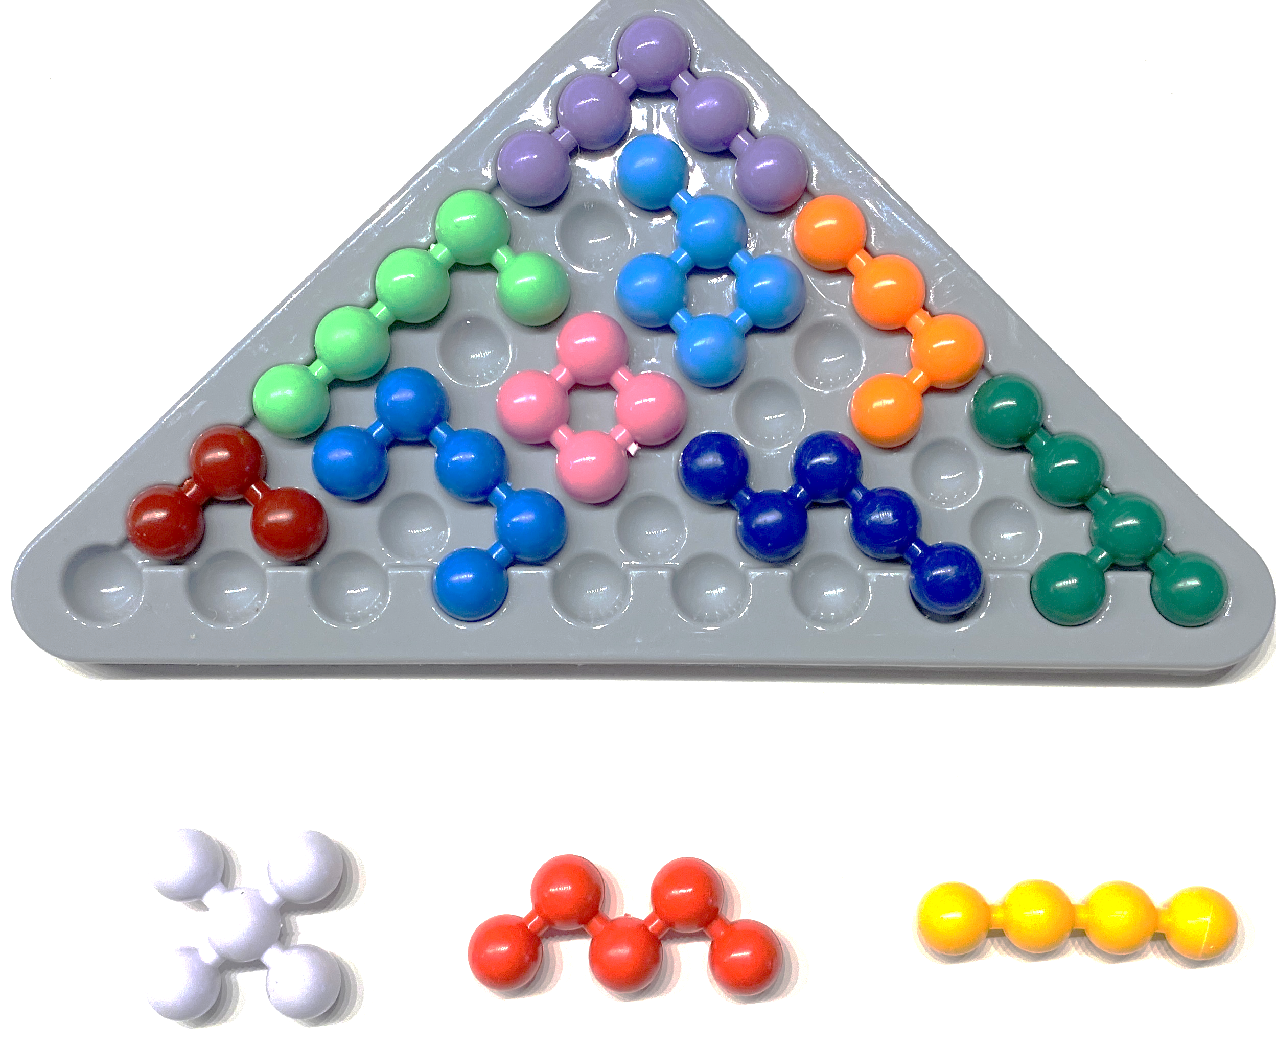
If you try it randomly, you quickly arrive at a situation where you cannot continue.
It is a surprisingly hard puzzle.

Slide 39
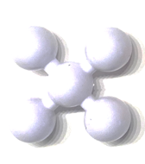
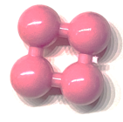
An observation that may be useful
Some pieces (white, pink) can only be arranged in one way (one orientation).
One piece (yellow) can be arranged in two ways.
Some pieces (dark-red, purple) can be arranged in four ways.
All remaining pieces can be arranged in eight ways, four different rotations times two possible flips.
rotate
rotate
flip

Slide 40
If we count the number of dimples in the gray template, and the number of balls included among all the pieces, they are both 55.
This means that we must use up all the pieces.
This also means that the depth of the tree is exactly 12.
So, we can use depth-limited search, memory will not be an issue.

Slide 41
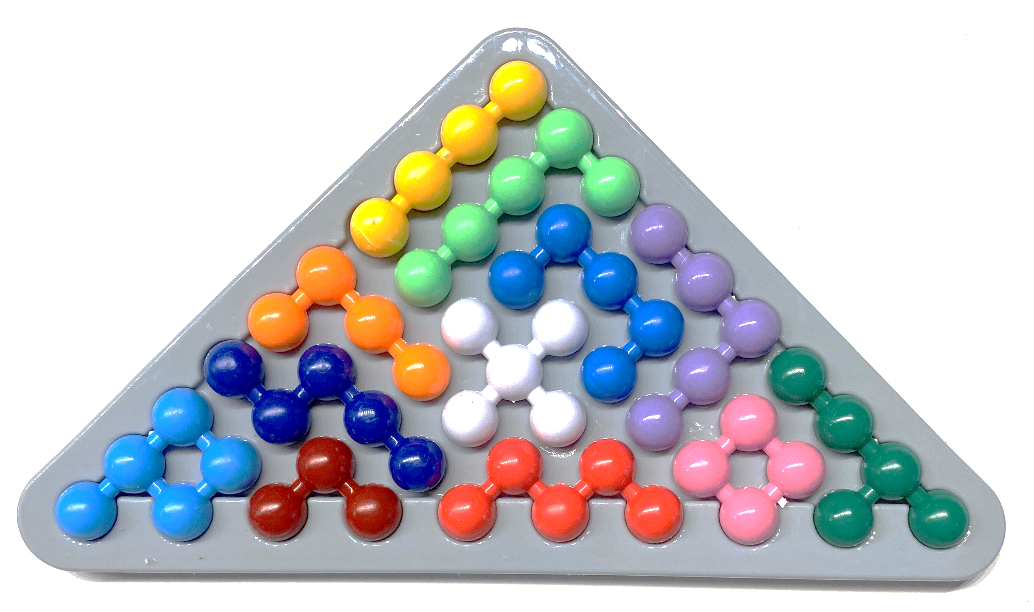
It is clear that the order in which you place the pieces does not matter. If that is not clear, imagine a video of you removing the pieces one by one from the finished puzzle, now play that video backwards…
This is helpful, as it will reduce our branching factor.
We can just list the parts in any order, say alphabetical by color..
Blue
Cyan
Green
etc.
.. And insert them in that order. But see later…
Empty
Empty
Everyway to insert Blue piece
This would be an inconceivably large branching factor
Everyway to insert blue
Everyway to insert red piece
Everyway to insert orange piece
Everyway to insert Cyan piece

Slide 42
1
Let us get a rough idea of the branching factor, which will give use a rough idea of the size of the search space.
To do this, we need to consider how many ways we can insert various pieces.
Let us take a random piece, lets use yellow.
Let us paint one end a darker color.
We could put the dark end in fifty-five different places.
For example, as shown to the right, we could put it in ten spots in the upper right diagonal.
However, some of this arrangements are illegal.
This means that the number of dimples in the gray template (fifty-five) includes all the legal possibilities, plus some illegal ones, so it is an upper bound.
So, this suggests that we can use the number of dimples remaining as an upper bound.
(but see next slide)
2
3
4
5
6
7
8
9
10
1
2
3
4
5
6
7
8
9
10
illegal

Slide 43
1
The yellow part has two orientations.
So, we would need to multiple our upper bound of fifty-five by two.
2
3
4
5
6
7
8
9
10

Slide 44
1
The yellow part has two orientations.
So, we would need to multiple our upper bound of fifty-five by two.
Some parts have eight orientations (the asymmetric pieces).
We can rotate them in four directions.
We can flip them to either of two sides
Four times two is eight.
So, for asymmetric pieces would need to multiple our upper bound of fifty-five by eight.
2
3
4
5
6
7
8
9
10
rotate
flip

Slide 45
We can now compute a very weak upper bound.
If we assumed that all parts are asymmetric then we have:
55 dimples times 8 arrangements (four orientations, two sides) which is 440.
We have 12 pieces.
So we have an upper bound of 440¹² or 5.2 *10³¹
That is a scarily large number.
If this had been a reasonably small number, say a billion, we could have stopped there.
However, because it is so huge, I would want to see a tighter upper bound before I started coding….

Slide 46
Two observations to help compute a tighter upper bound
I had assumed that the 55 dimples are available to all pieces. However, as we descend the search tree, we use up some of these slots. For example, in the right figure there are only 23 slots left.
I had assumed that we should multiple the number of dimples left by eight, because some of the parts have eight arrangements. However, recall that a few of the parts have only one arrangement (white and pink). This has two implications
We don’t need to multiple the number of dimples available by eight for white and pink.
We should insert white and pink first in our search tree! This one idea will make search hundreds of times faster!
rotate
flip

Slide 47
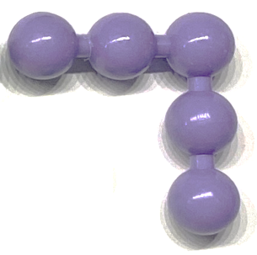
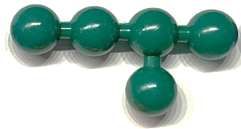
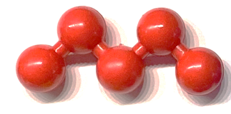
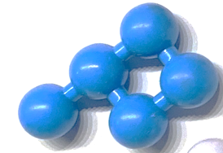
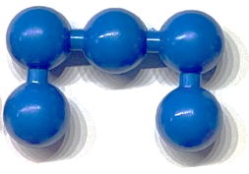
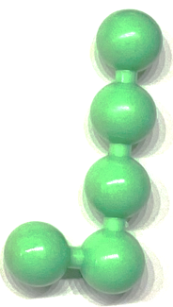
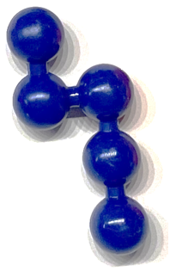
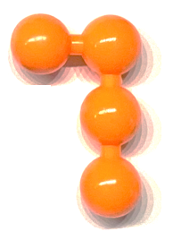
Slots Remaining |  | Now insert color… | It can be inserted in this many ways
55 |  | White 5 | 7 + 6 + 5 + 4 + 3 + 2 + 1 = 28 | Hand counted
50 |  | Pink 4 | (8 + 7 + 6 + 5 + 4 + 3 + 2 + 1) - 5 = 31 | It could go in 36 places if white was not there (hand counted), but white has to block at least 5 slots
46 |  | Yellow 4 | 2 * 46 = 92 | 46 slots are left, yellow can be inserted in at most 46 time two places (two orientations)
42 |  | Purple 5 | 4 * 42 = 168 | Purple can be inserted in at most 42 times four places (four orientations)
37 |  | Dark-red 3 | 4 * 37 = 148 | Dark-red can be inserted in at most 37 times four places (four orientations)
34 |  | Dark-Green 5 | 8 * 34 = 272 | Dark-green can be inserted in at most 34 times eight places (four orientations, two sides)
29 |  | Red 5 | 8 * 29 = 232 | Red can be inserted in at most 29 times eight places (four orientations, two sides)
24 |  | Light-Blue 5 | 8 * 24= 192 | Light-blue can be inserted in at most 24 times eight places (four orientations, two sides)
19 |  | Medium Blue 5 | 8 * 19 = 152 | Medium-blue can be inserted in at most 19 times eight places (four orientations, two sides)
14 |  | Light-Green 5 | 8 * 14 = 112 | Light Green can be inserted in at most 14 times eight places (four orientations, two sides)
9 |  | Dark Blue 5 | 8 * 9 = 72 | Dark Blue can be inserted in at most 9 times eight places (four orientations, two sides)
4 |  | Orange 4 | 1 | Special case, there is only one way Orange could fit
28*31*92*168*148*272*232*192*152*112*72*1 = 2.94 * 10²² This upper bound is about a billion times smaller than the first upper bound! However, it is still a huge number. With a little more work, we could make it tighter…

Slide 48
Useful Optimizations I
Suppose we are searching, and we create a node by adding the pink part as shown.
Note that this creates at least one cell that is an island. That is, a single cell is surrounded by pieces or by the puzzles edge.
It is clear that this state can never give rise to a solution, as all the remaining parts have at least two balls in a row.
So, we can mark it as NULL, and not expand it. This may help to prune a large fraction of states.

Slide 49
Useful Optimizations II
There is an even stronger pruning rule.
When we add the Dark Blue piece as shown on the left, we create an island of size two.
However, none of the pieces will fit into an island of this size.
So, we can mark it as NULL, and not expand it. This may help to prune a large fraction of states

Slide 50
Useful Optimizations III
The “islands of size one or two” rule seems to be very effective at pruning once you have about six pieces on the board. Most of the following placements (not exhaustive) are terminal nodes with this test. And the pruning rule gets even more effective as you get deeper.
Most subtrees below level six will be very very very sparse. This is very good news.

Slide 51
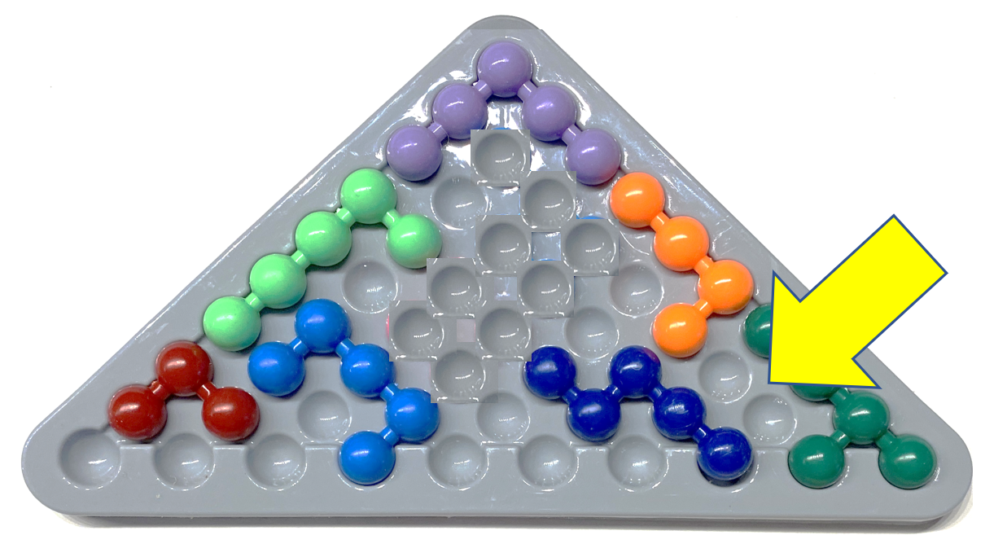
Review
When you first get a problem, roughly understanding size of the problem space is usually the first step.
If it is relatively small (in the millions or billions) like the raven puzzle, you can probably just brute force it.
If it is relatively large, trillions or worse, then:
See if you can come up with a pruning rule, to avoid expanding fruitless nodes.
See if you can come up with a heuristic that scores promising nodes, even a weak heuristic can sometimes make a huge difference to greedy search.
See if you can change the order of the search, to reduce the branching factor, and to get good heuristic information early in the search.
HKJLGGUJLLDHK
WetterberichZ
THA QUICK ZROWN
AWS UJHTC VNBMQ
Which of these two nodes should you expand first?
Expand most frequent letters first
First white, then pink, then yellow….

Slide 52
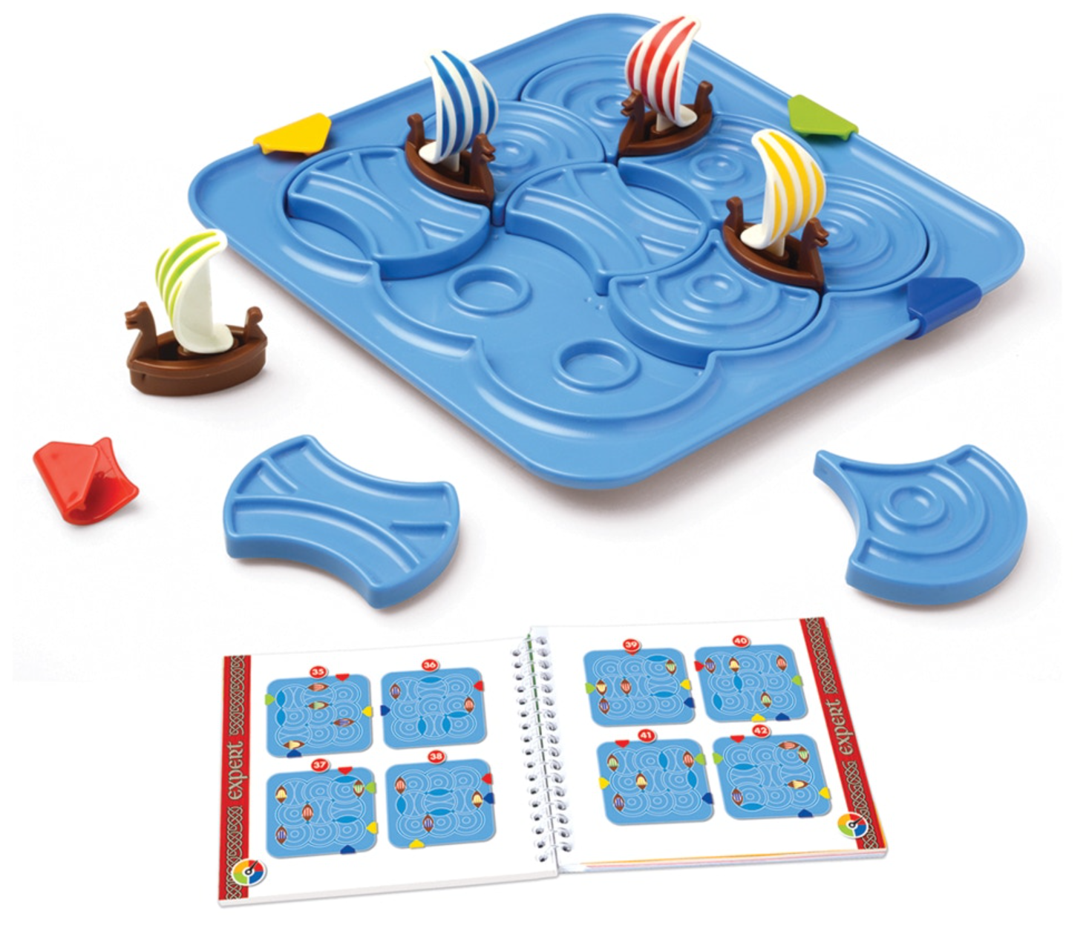
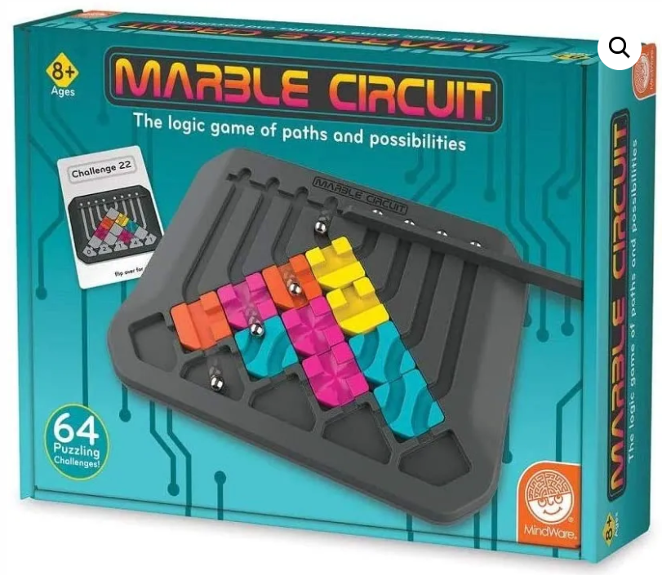
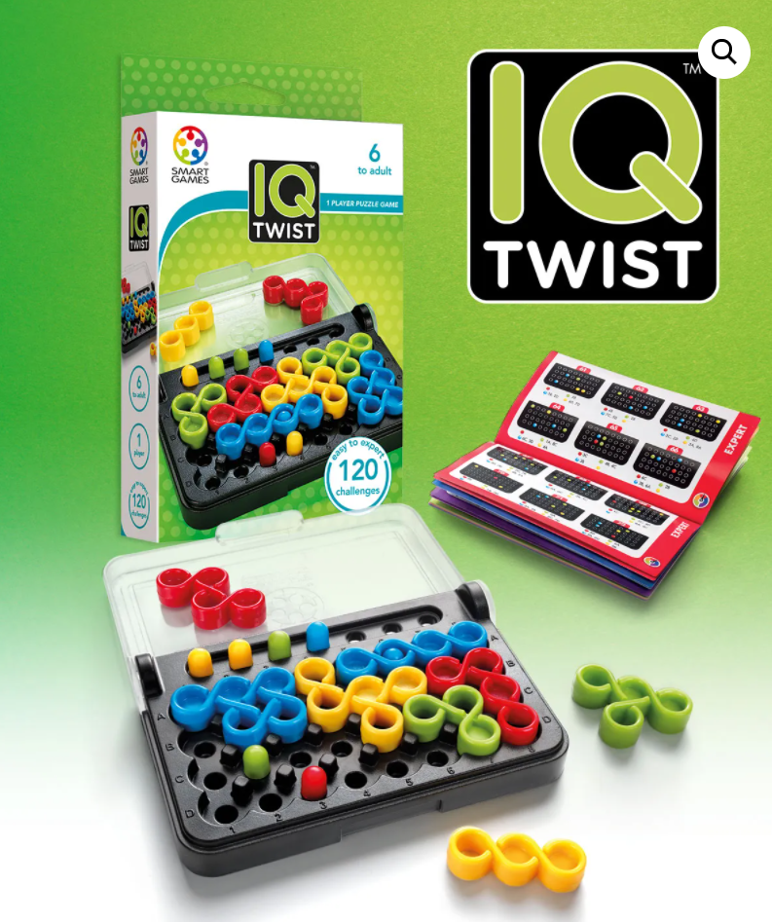
https://www.thetoyfactory.us/
Vikings Brainstorm

Slide 53
Ol miol mit ktas soyt? Ol miol pwlm yafmalb? Eawuim of a safrlort, Fg tleaht ykgd ktasomb Ghtf bgwk tbtl, Sggq wh mg mit lqotl afr ltt
Is this the real life? Is this just fantasy? Caught in a landside, No escape from reality Open your eyes, Look up to the skies and see

