Slide 1
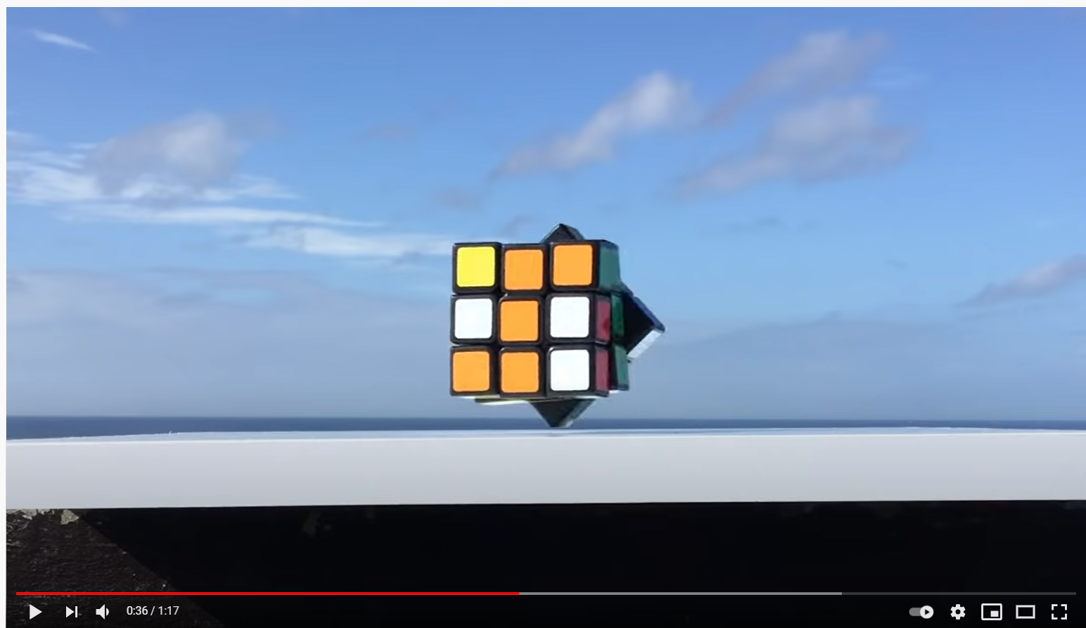
Look at this video (again)
https://www.youtube.com/watch?v=2vG-YtRmBSw&
When I saw it, I realize that the cube was NOT using A-star to solve itself. How did I know that?
Hint: You should be able to answer this question without doing any heavy math or algorithm tracing. If it takes you more than 10 seconds to see the answer, you are overthinking it.
Answer:
In the beginning, we see the human make nine moves to scramble the cube.
We know that A-star is optimal. That means A-star would solve this in at most nine moves
However, the cube takes at least 62 moves*
*Sometimes, we count a 180 degree turn as two (90 degree) moves.

Slide 2
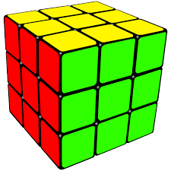
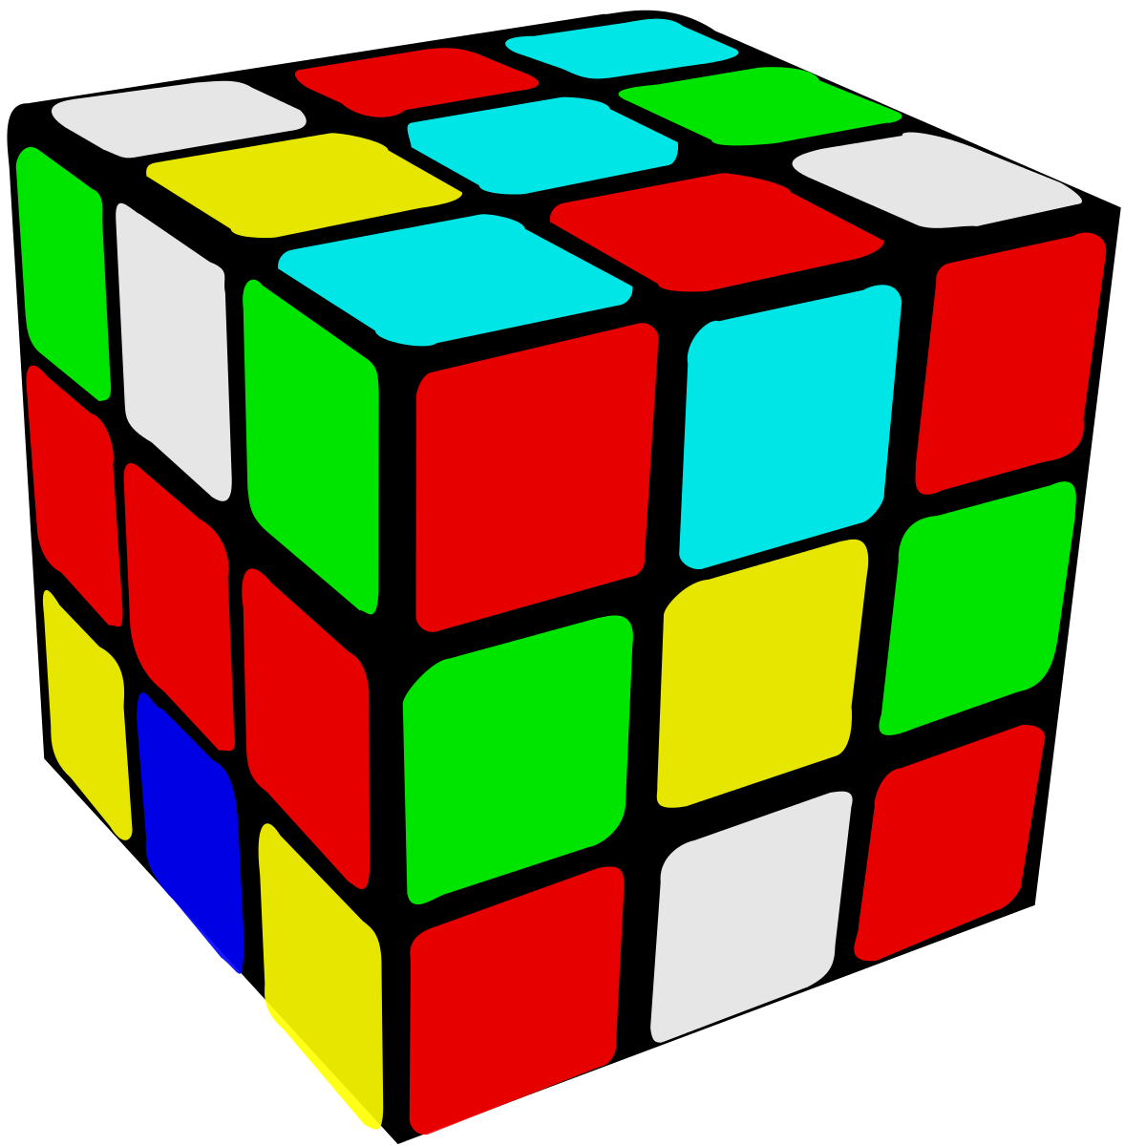
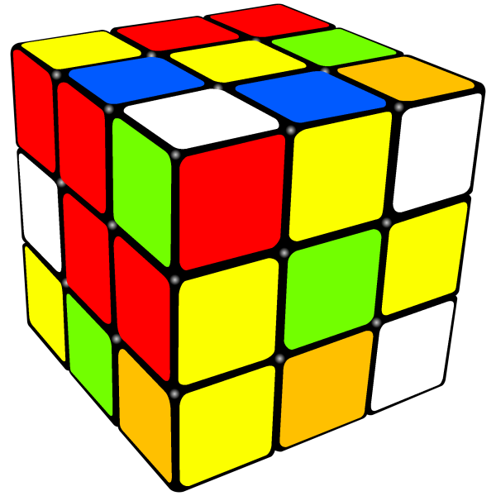
I have invented a new game, called 2cube. I take two standard 3x3 Rubik cubes, A and B, and I scramble them anyway I want. The game is to take cube A, and transform it to cube B, using the normal legal moves.
    What is the diameter of 2cube? Actually, I don’t know! However, question ii and iii are answerable.
    What is a lower bound of the diameter of 2cube?
    What is an upper bound of the diameter of 2cube?
Hint: You should be able to answer this question without doing any heavy math. If it takes you more than 10 seconds to see the answer, you are overthinking it.
A
B
A
B
Diameter?
A
B

Slide 3
I have invented a new game, called 2drive. Starting from my house, I take two friends, Alice and Bob, and I individually drive them to a location up to 20 miles away, and I make them get out of my car. I live right next to a straight road that is 1,000 miles long.
The challenge is for Alice to walk to Bob
      What is the diameter of 2drive? Actually, I don’t know! It depends on the location of my house! But I can answer ii and iii
      What is a lower bound of the diameter of 2drive?
      What is an upper bound of the diameter of 2drive?

Slide 4
I have invented a new game, called 2drive. Starting from my house, I take two friends, Alice and Bob, and I individually drive them to a location up to 20 miles away, and I make them get out of my car. I live right next to a straight road that is 1,000 miles long.
The challenge is for Alice to walk to Bob
      What is the diameter of 2drive? Actually, I don’t know! It depends on the location of my house! But I can answer ii and iii
      What is a lower bound of the diameter of 2drive?
      What is an upper bound of the diameter of 2drive?
Suppose I live in the middle of a long straight freeway…
Suppose I live on the beach on square island, at one corner…
My house
Alice
Bob
Bob
20 miles
20 miles
My house
20 miles
..then I can clearly make Alice walk 40 miles (but no longer than that)
So, the upper bound is 40.
Alice
Here the worst I can do is to leave Alice at my house (drive her zero miles), and drive Bob 20 miles. So, the lower bound is 20 miles.

Slide 5
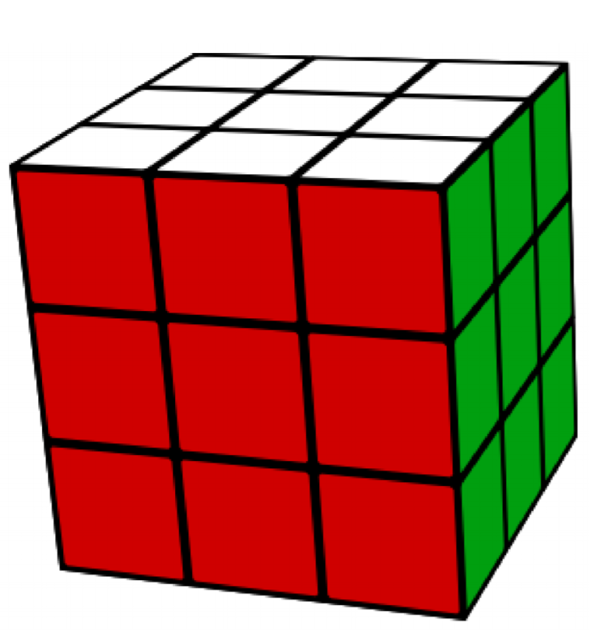
    What is a lower bound of the diameter of 2cube?
A
B
    It is clearly 20.
    Suppose A does zero scrambling
    Suppose B does scrambles all the way to the max diameter of a single Rubik cube, which we know to be dept 20.
    If the above is the case, then 2cube takes at least 20 moves to solve, so we have a lower bound.
Depth 20

Slide 6
    What is an upper bound of the diameter of 2cube?
    It is clearly 40.
    I know that for each cube individually, the dimeter of the classic Rubik cube problem is 20.
    So in the worse case I can follow the blue arrow, solve A to the classic configuration, then move to the scramble of B
    So at-most(20) + at-most(20) = at-most(40).
    This is an upper bound, because there might be a “shortcut” that does not need to go thru the solved cube (the red arrow). It is clear that such shortcuts sometimes exist. But because I don’t know if they always have to exist, I can only report an upper bound.
A
B
Depth 20

Slide 7
    What is the real diameter of 2cube?
    I don’t know, I am pretty sure it is just 20
    If you can make a contribution to the problem, I will give you extra credit ;-)

Slide 8
It is important to understand the question been asked.
Suppose I ask..
Last week, we played 2drive, what is the minimum number of miles Alice walked?
The answer is zero.
  I might have driven both Alice and Bob zero miles, or I might have driven the 7 miles to the same spot!
Recall that the diameter is the cheapest solution to the worst possible instance of a problem.
Above I (implicitly) asked what is the cheapest solution to the best possible instance of a problem.

