Slide 1
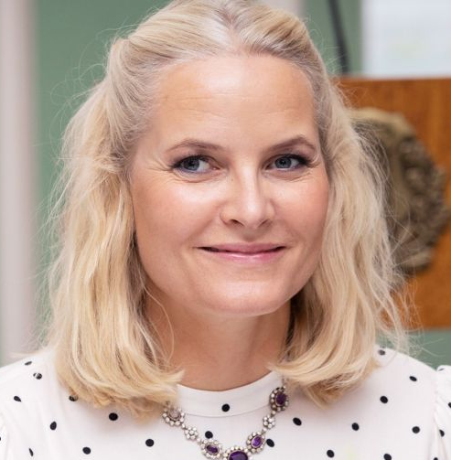


Motivation for Clustering
I get a call from my boss, asking me to pick up a Cambodian professor from the airport.
Before I can get any more details, my phone dies.
I know almost nothing about Cambodia, I have never met (to my knowledge) a Cambodian.
In the baggage claim area, there are only three people, which one should I approach?

Slide 2
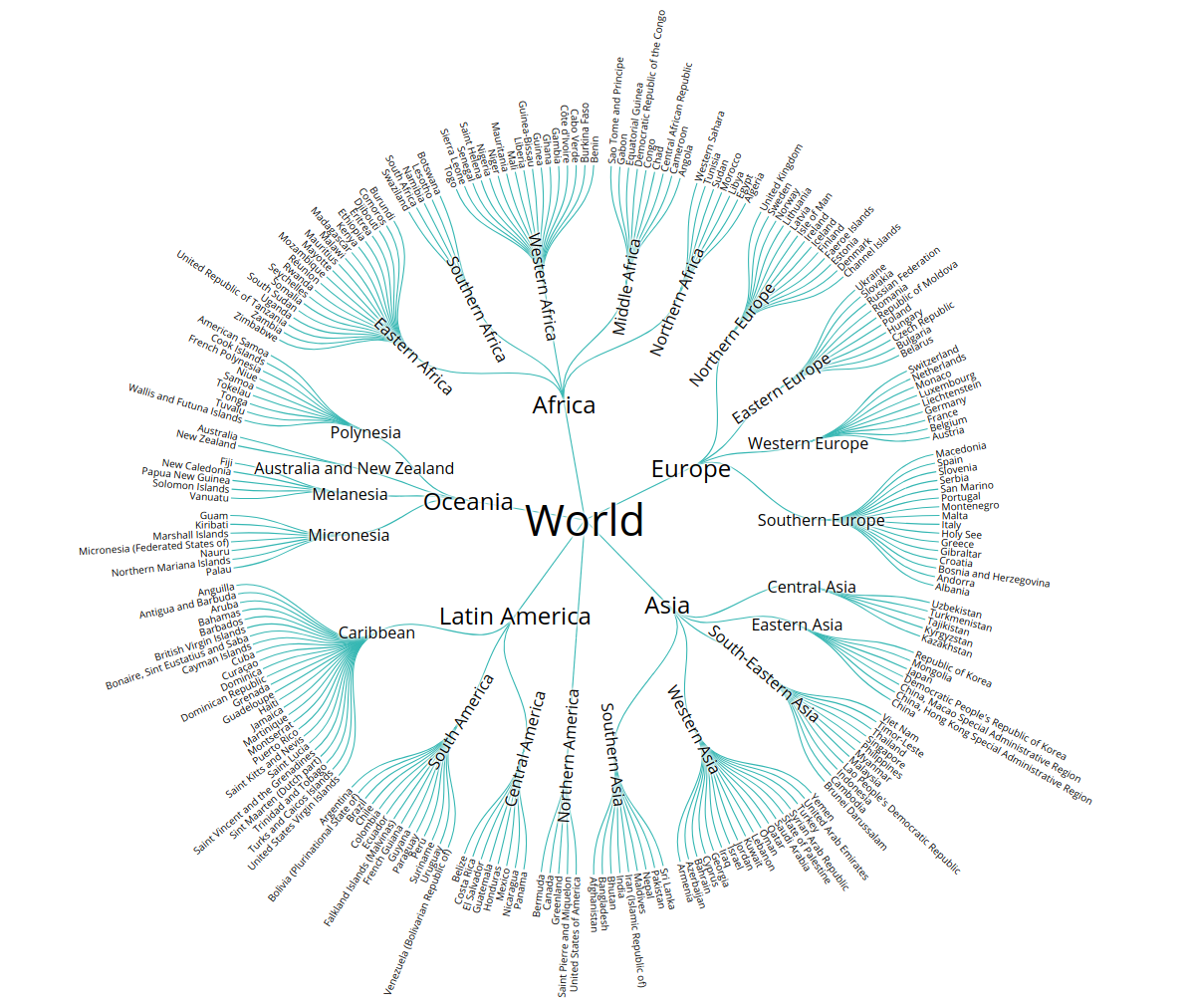
Over my life, I have implicitly built a “clustering” of all countries.
Because of physical/political geography, this clustering has a tree structure.
The root is planet Earth.
The major subtrees tend to be continents.
The next level down are regions, sometimes split by rivers or deserts.
The next level down are countries.
The next level down are counties/states.
The next level down…
Note:
I know some subtrees very well, mostly Europe and North America.
Other subtrees, such as Africa, Middle East, Asia, I know superficially.
Yet other subtrees, Caribbean, middle East etc., I know almost nothing about.

Slide 3
I know Cambodian is in the same subtree as Thailand
I know several Thai people
The lady in the middle looks like my Thai friends.

Slide 4
What religion is mostly likely for a person from Oman?
What religion is mostly likely for a person from Andorra?
Of course, hierarchical thinking can lead you astray..
What language do they speak in Paraguay?
I don’t know, but snice it is the South American
Subtree, and most of those counties speak Spanish
I will (correctly) guess Spanish.
What language do they speak in Guyana?
I don’t know, but snice it is the South American
Subtree, and most of those counties speak Spanish
I will guess Spanish. However, English is its official and most spoken language.

Slide 5
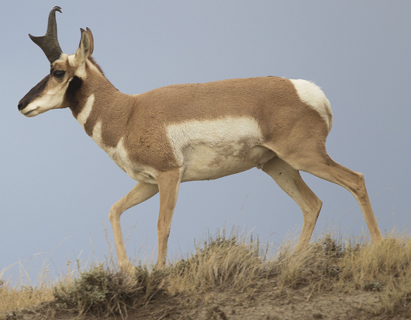
Motivation for Clustering
Clustering lets you reason about the world.
It allows you to generalize from incomplete information, to make predictions.
If you want to know a property of an object X. Place that object X into the cluster it belongs in, then use the most common property of that cluster to predict X’s property.
We probably do this, thousands of times per day (without realizing we are doing it).
For example, what does this animal eat? Fish, Carrion, Grass, Insects, Roots, Blood, Worms, Pollen, Wood, Fungus, Fruit, Tree Gum…..
Pronghorn

Slide 6
What is Clustering?
Also called unsupervised learning, sometimes called classification by statisticians and sorting by psychologists and segmentation by people in marketing
Organizing data into classes such that there is
  high intra-class similarity
  low inter-class similarity
Finding the class labels and the number of classes directly from the data (in contrast to classification).
More informally, finding natural groupings among objects.

Slide 7
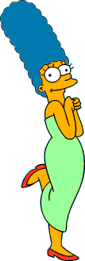

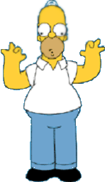

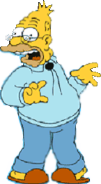
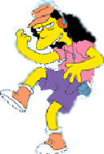
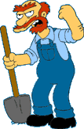

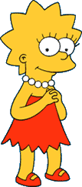
What is a natural grouping among these objects?

Slide 8


What is a natural grouping among these objects?
Clustering is subjective
Simpson's Family
School Employees
Females
Males

Slide 9
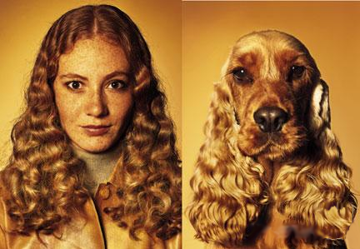
What is Similarity?
The quality or state of being similar; likeness; resemblance; as, a similarity of features.
Webster's Dictionary
Similarity is hard to define, but…
“We know it when we see it”
The real meaning of similarity is a philosophical question. We will take a more pragmatic approach.

Slide 10
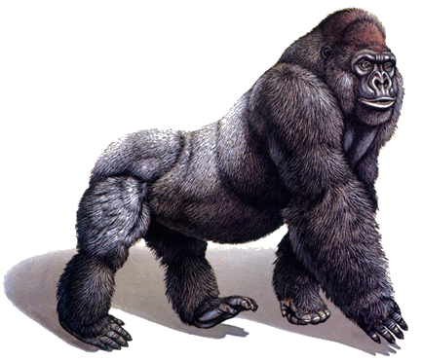
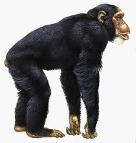
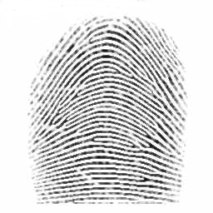
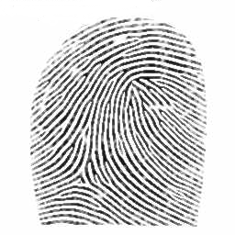
Defining Distance Measures
Definition: Let O₁ and O₂ be two objects from the universe of possible objects. The distance (dissimilarity) between O₁ and O₂ is a real number denoted by D(O₁,O₂)
Peter
Piotr
0.23
3
342.7

Slide 11
Peter
Piotr
When we peek inside one of these black boxes, we see some function on two variables. These functions might very simple or very complex.
In either case it is natural to ask, what properties should these functions have?
d('', '') = 0 d(s, '') = d('', s) = |s| -- i.e. length of s d(s1+ch1, s2+ch2) = min( d(s1, s2) + if ch1=ch2 then 0 else 1 fi, d(s1+ch1, s2) + 1, d(s1, s2+ch2) + 1 )
3
What properties should a distance measure have?
D(A,B) = D(B,A) Symmetry
D(A,A) = 0 Constancy of Self-Similarity
D(A,B) = 0 IIf A= B Positivity (Separation)
D(A,B) ≤ D(A,C) + D(B,C) Triangular Inequality

Slide 12
Intuitions behind desirable distance measure properties
D(A,B) = D(B,A) Symmetry
Otherwise you could claim “Alex looks like Bob, but Bob looks nothing like Alex.”
D(A,A) = 0 Constancy of Self-Similarity
Otherwise you could claim “Alex looks more like Bob, than Bob does.”
D(A,B) = 0 IIf A=B Positivity (Separation)
Otherwise there are objects in your world that are different, but you cannot tell apart.
D(A,B) ≤ D(A,C) + D(B,C) Triangular Inequality
Otherwise you could claim “Alex is very like Bob, and Alex is very like Carl, but Bob is very unlike Carl.”

Slide 13


Two Types of Clustering
Partitional algorithms: Construct various partitions and then evaluate them by some criterion (we will see an example called BIRCH)
Hierarchical algorithms: Create a hierarchical decomposition of the set of objects using some criterion
Hierarchical
Partitional

Slide 14
Two Types of Clustering
We can always convert a hierarchical clustering to a Partitional clustering of any size, by using a cut line.
Hierarchical
Partitional

Slide 15
A Useful Tool for Summarizing Similarity Measurements
In order to better appreciate and evaluate the examples given in the early part of this talk, we will now introduce the dendrogram.
The similarity between two objects in a dendrogram is represented as the height of the lowest internal node they share.

Slide 16
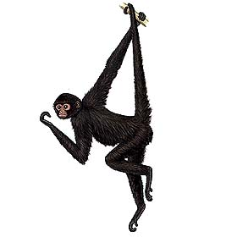
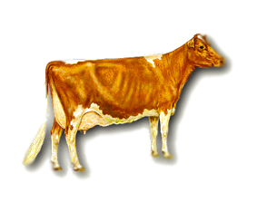
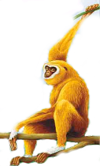
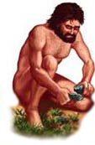
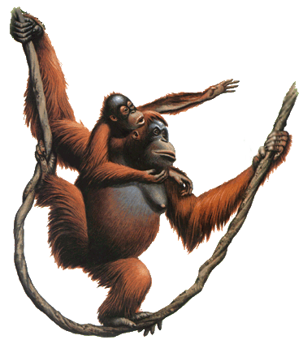
There is only one dataset that can be perfectly clustered using a hierarchy…
(Bovine:0.69395, (Spider Monkey 0.390, (Gibbon:0.36079,(Orang:0.33636,(Gorilla:0.17147,(Chimp:0.19268, Human:0.11927):0.08386):0.06124):0.15057):0.54939);

Slide 17
Do Trees Make Sense for non-Biological Objects?
Gibbon
Hellenic
Armenian
Persian
Sumatran Orangutan
Orangutan
Gorilla
Persian
Hellenic
Armenian
Human
Pygmy Chimp
Chimpanzee
The answer is “Yes”.
There are increasing theoretical and empirical results to suggest that phylogenetic methods work for cultural artifacts.
Does horizontal transmission invalidate cultural phylogenies? Greenhill, Currie & Gray.
Branching, blending, and the evolution of cultural similarities and differences among human populations. Collard, Shennan, & Tehrani.
“Armenian borrowed so many words from Iranian languages that it was at first considered a branch of the Indo-Iranian languages, and was not recognized as an independent branch of the Indo-European languages for many decades”
..results show that trees constructed with Bayesian phylogenetic methods are robust to realistic levels of borrowing

Slide 18

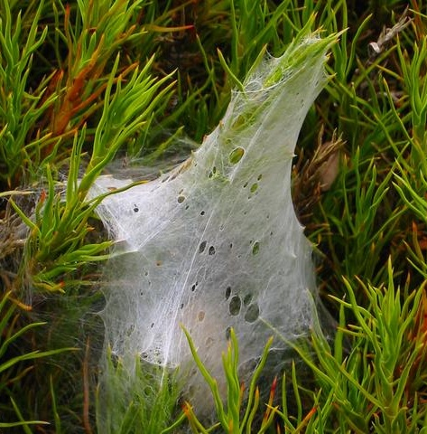
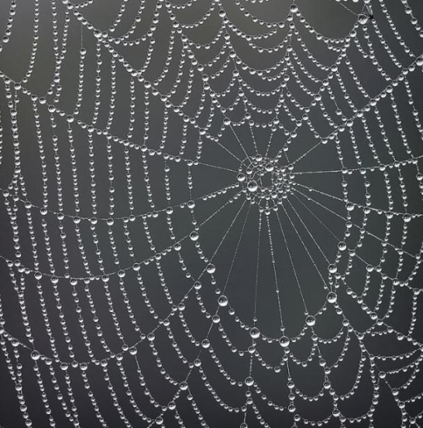
Why would we want to use trees for non biological things?
Because trees are powerful in biology
They make predictions
  Pacific Yew produces taxol which treats some cancers, but it is expensive. Its nearest relative, the European Yew was also found to produce taxol.
They tell us the order of events
  Which came first, classic geometric spider webs, or tangle cobwebs?
They tell us about..
  “Homelands”, where did it come from.
  “Dates” when did it happen.
  Rates of change
  Ancestral states
Spiral Orb Web
Tangle Webs
Notes:
Which came first, classic geometric spider webs, or messy cobwebs?
Surprisingly:
The classic geometric spider webs came first, then evolved into the messy cobwebs.
We know this because the “messy cobwebs” spiders are in a subtree embedded in a larger tree that consists mostly of “geometric web” spiders.

Slide 19
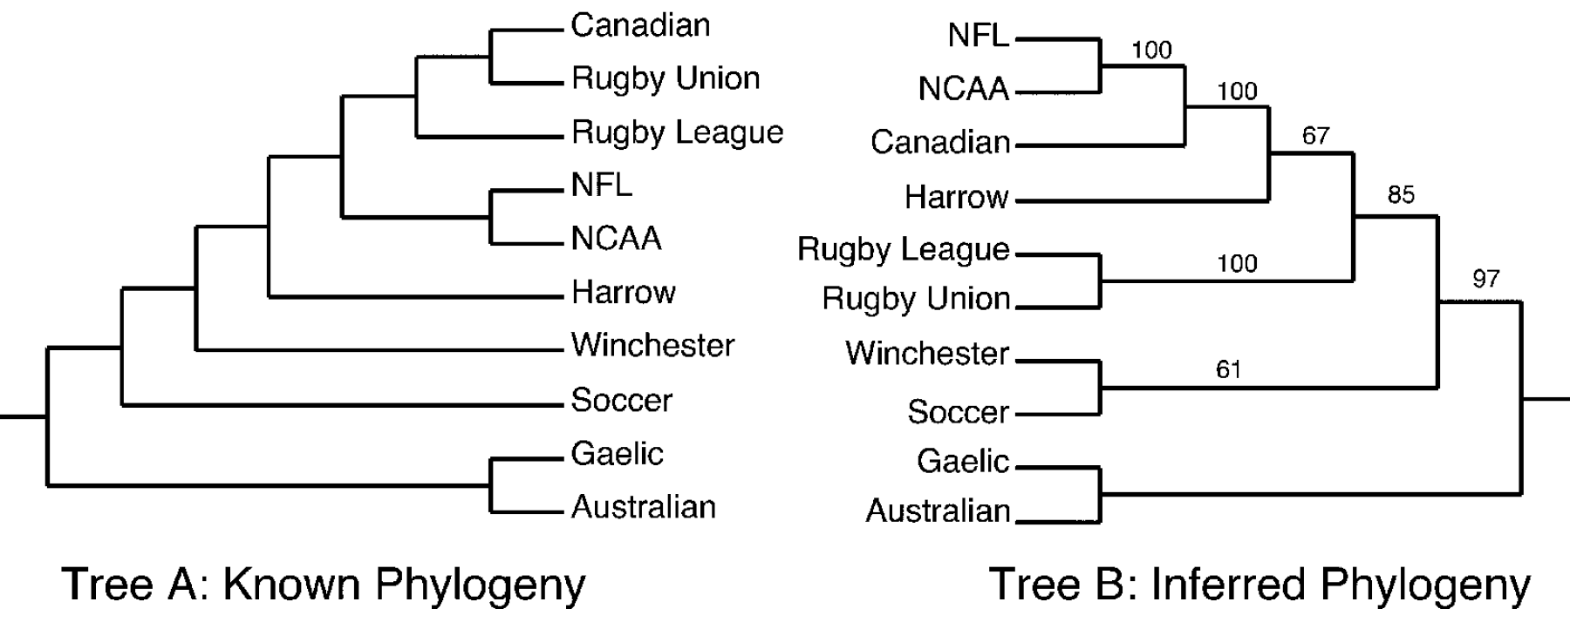
On trick to text the applicably of phylogenetic methods outside of biology is to test on datasets for which you know the right answer by other methods.
“Canadian Football is historically derived from the ancestor of rugby, but today closely resembles the American versions of the game. In this branch of the tree geography has trumped deeper phylogenetic history.”
Here the results are very good, but not perfect.
Gray, RD, Greenhill, SJ, & Ross, RM (2007). The Pleasures and Perils of Darwinizing Culture (with phylogenies). Biological Theory, 2(4)

Slide 20
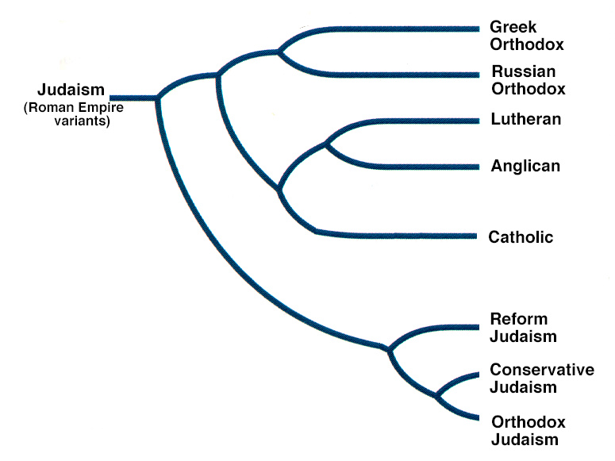

Slide 21
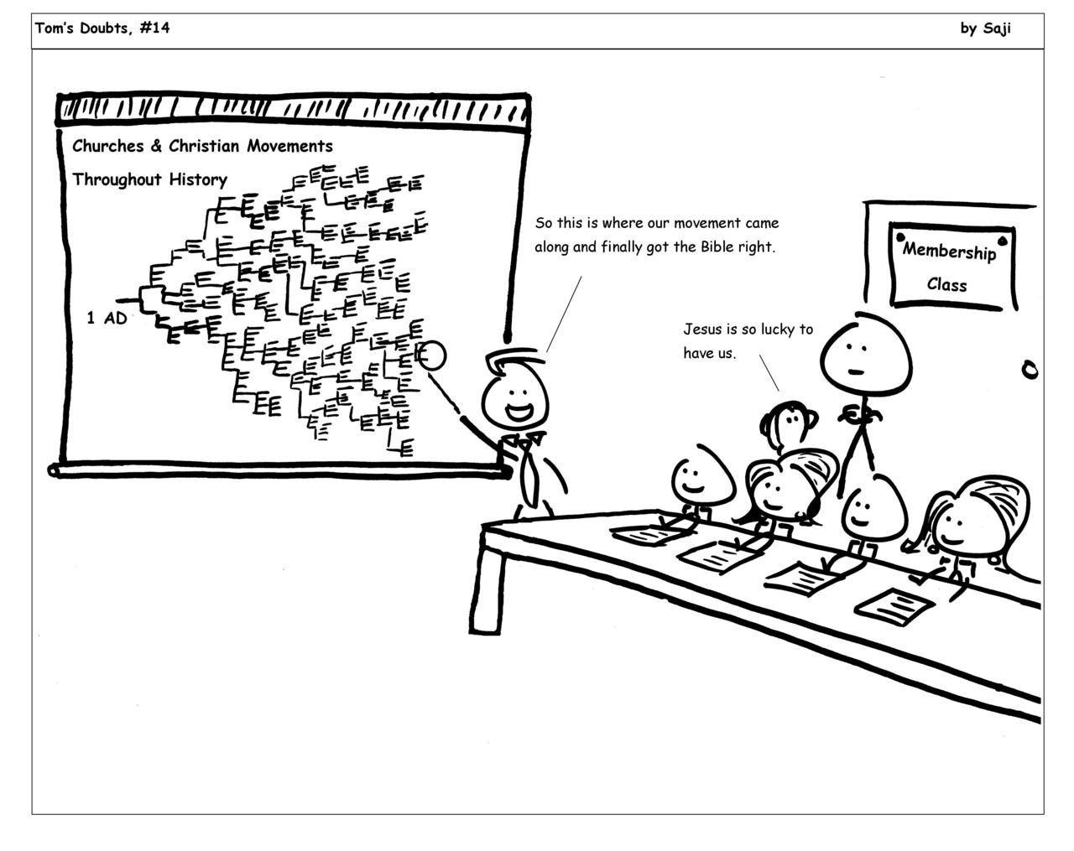

Slide 22
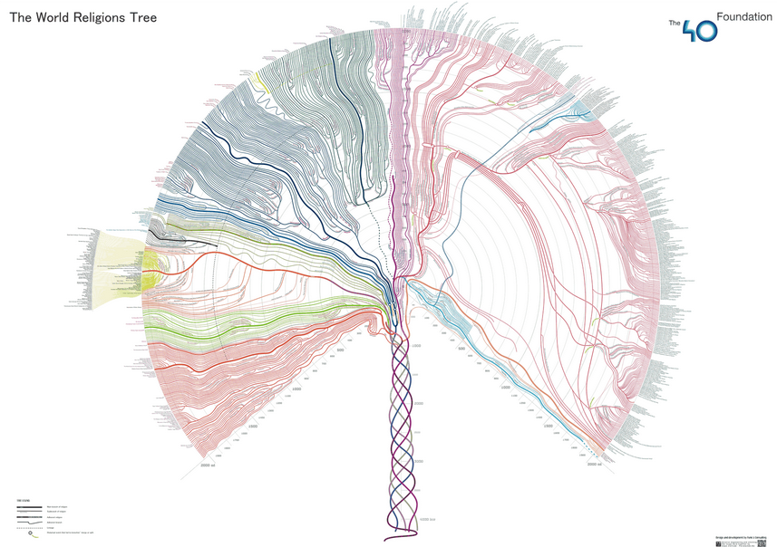
http://000024.org/religions_tree/

Slide 23

Note that hierarchies are commonly used to organize information, for example in a web portal.
Yahoo’s hierarchy is manually created, we will focus on automatic creation of hierarchies in data mining.
Business & Economy
B2B Finance Shopping Jobs
Aerospace Agriculture… Banking Bonds… Animals Apparel Career Workspace

Slide 24
A Demonstration of Hierarchical Clustering using String Edit Distance
Pedro (Portuguese)
Petros (Greek), Peter (English), Piotr (Polish), Peadar (Irish), Pierre (French), Peder (Danish), Peka (Hawaiian), Pietro (Italian), Piero (Italian Alternative), Petr (Czech), Pyotr (Russian)
Cristovao (Portuguese)
Christoph (German), Christophe (French), Cristobal (Spanish), Cristoforo (Italian), Kristoffer (Scandinavian), Krystof (Czech), Christopher (English)
Miguel (Portuguese)
Michalis (Greek), Michael (English), Mick (Irish!)
Piotr
Pedro
Piero
Peter
Peka
Mick
Pyotr
Pietro
Pierre
Peder
Petros
Peadar
Miguel
Krystof
Michael
Michalis
Crisdean
Cristovao
Christoph
Cristobal
Kristoffer
Christophe
Cristoforo
Christopher

Slide 25
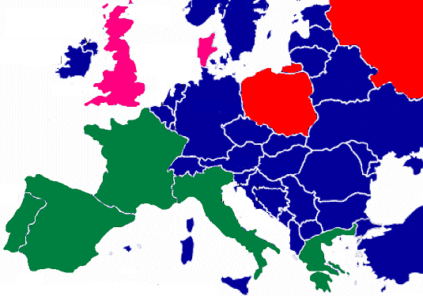
Pedro (Portuguese/Spanish)
Petros (Greek), Peter (English), Piotr (Polish), Peadar (Irish), Pierre (French), Peder (Danish), Peka (Hawaiian), Pietro (Italian), Piero (Italian Alternative), Petr (Czech), Pyotr (Russian)
Piotr
Pedro
Piero
Peter
Peka
Pyotr
Pietro
Pierre
Peder
Petros
Peadar

Slide 26





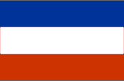


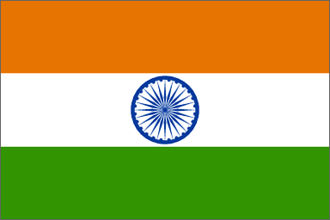


Hierarchal clustering can sometimes show patterns that are meaningless or spurious
For example, in this clustering, the tight grouping of Australia, Anguilla, St. Helena etc is meaningful, since all these countries are former UK colonies.
However the tight grouping of Niger and India is completely spurious, there is no connection between the two.
South Georgia &
South Sandwich
Islands
Serbia &
Montenegro
(Yugoslavia)
AUSTRALIA
St. Helena &
Dependencies
ANGUILLA
U.K.
FRANCE
NIGER
INDIA
IRELAND
BRAZIL

Slide 27
The flag of Niger is orange over white over green, with an orange disc on the central white stripe, symbolizing the sun. The orange stands the Sahara desert, which borders Niger to the north. Green stands for the grassy plains of the south and west and for the River Niger which sustains them. It also stands for fraternity and hope. White generally symbolizes purity and hope.
The Indian flag is a horizontal tricolor in equal proportion of deep saffron on the top, white in the middle and dark green at the bottom. In the center of the white band, there is a wheel in navy blue to indicate the Dharma Chakra, the wheel of law in the Sarnath Lion Capital. This center symbol or the 'CHAKRA' is a symbol dating back to 2nd century BC. The saffron stands for courage and sacrifice; the white, for purity and truth; the green for growth and auspiciousness.
South Georgia &
South Sandwich
Islands
Serbia &
Montenegro
(Yugoslavia)
AUSTRALIA
St. Helena &
Dependencies
ANGUILLA
U.K.
FRANCE
NIGER
INDIA
IRELAND
BRAZIL

Slide 28
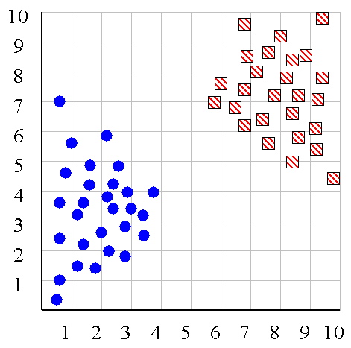
We can look at the dendrogram to determine the “correct” number of clusters. In this case, the two highly separated subtrees are highly suggestive of two clusters. (Things are rarely this clear cut, unfortunately)

Slide 29
One potential use of a dendrogram is to detect outliers
The single isolated branch is suggestive of a data point that is very different to all others
Outlier

Slide 30
(How-to) Hierarchical Clustering
The number of dendrograms with n leafs = (2n -3)!/[(2^{(n -2)}) (n -2)!]
Number Number of Possible
of Leafs Dendrograms
2 1
3 3
4 15
5 105
... …
34,459,425
Since we cannot test all possible trees we will have to heuristic search of all possible trees. We could do this..
Bottom-Up (agglomerative): Starting with each item in its own cluster, find the best pair to merge into a new cluster. Repeat until all clusters are fused together.
Top-Down (divisive): Starting with all the data in a single cluster, consider every possible way to divide the cluster into two. Choose the best division and recursively operate on both sides.

Slide 31


We begin with a distance matrix which contains the distances between every pair of objects in our database.
0
8
8
7
7
0
2
4
4
D( , ) = 8
D( , ) = 1
0
3
3
0
1
0

Slide 32
Bottom-Up (agglomerative): Starting with each item in its own cluster, find the best pair to merge into a new cluster. Repeat until all clusters are fused together.
Consider all possible merges…
Choose the best
…

Slide 33
Bottom-Up (agglomerative): Starting with each item in its own cluster, find the best pair to merge into a new cluster. Repeat until all clusters are fused together.
Consider all possible merges…
Choose the best
…
Consider all possible merges…
Choose the best
…

Slide 34
Bottom-Up (agglomerative): Starting with each item in its own cluster, find the best pair to merge into a new cluster. Repeat until all clusters are fused together.
Consider all possible merges…
Choose the best
…
Consider all possible merges…
Choose the best
…
Consider all possible merges…
Choose the best
…

Slide 35
Bottom-Up (agglomerative): Starting with each item in its own cluster, find the best pair to merge into a new cluster. Repeat until all clusters are fused together.
Consider all possible merges…
Choose the best
…
Consider all possible merges…
Choose the best
…
Consider all possible merges…
Choose the best
…

Slide 36
We know how to measure the distance between two objects, but defining the distance between an object and a cluster, or defining the distance between two clusters is non obvious.
Single linkage (nearest neighbor): In this method the distance between two clusters is determined by the distance of the two closest objects (nearest neighbors) in the different clusters.
Complete linkage (furthest neighbor): In this method, the distances between clusters are determined by the greatest distance between any two objects in the different clusters (i.e., by the "furthest neighbors").
Group average linkage: In this method, the distance between two clusters is calculated as the average distance between all pairs of objects in the two different clusters.
Wards Linkage: In this method, we try to minimize the variance of the merged clusters

Slide 37
Single linkage
Average linkage
Wards linkage

Slide 38
A
B
C
D
E
(Bovine:0.69395, (Spider Monkey 0.390, (Gibbon:0.36079,(Orang:0.33636,(Gorilla:0.17147,(Chimp:0.19268, Human:0.11927):0.08386):0.06124):0.15057):0.54939);
(A,((B,C),(D,E)))
A
B
C
D
E

Slide 39
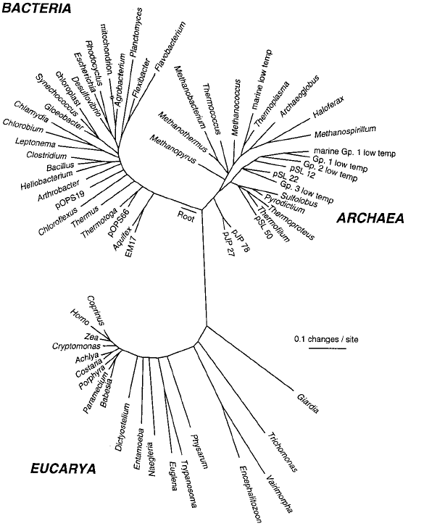
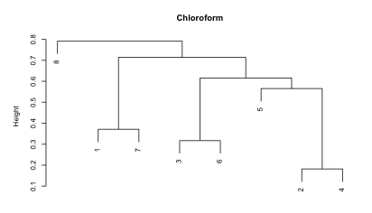
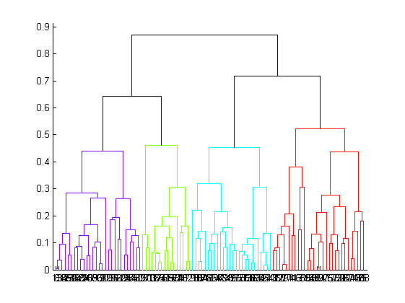
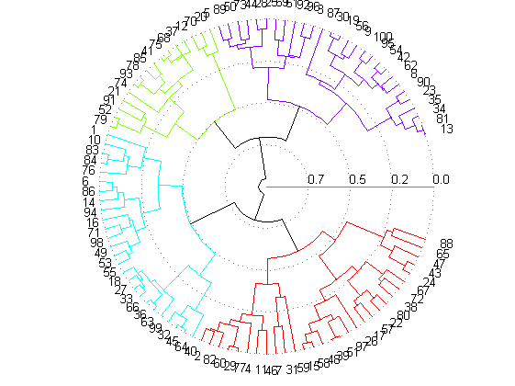

Slide 40
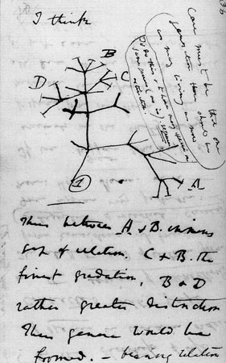

Slide 41
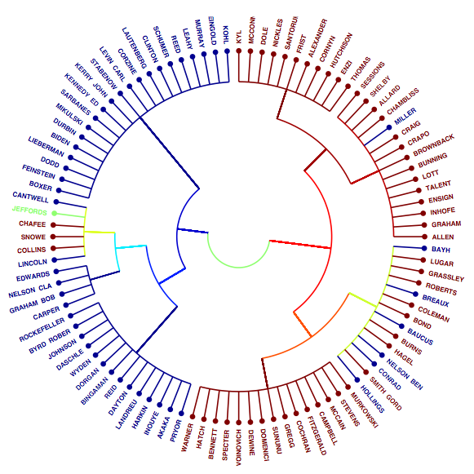
Co-Sponsorship Networks– Senators of the 108th Congress
Although a member of the Democratic Party, Miller backed Republican President George W. Bush over Democratic nominee John Kerry in the 2004 presidential election and since 2003 has frequently criticized the Democratic Party, and has publicly supported several Republican candidates.

Slide 42
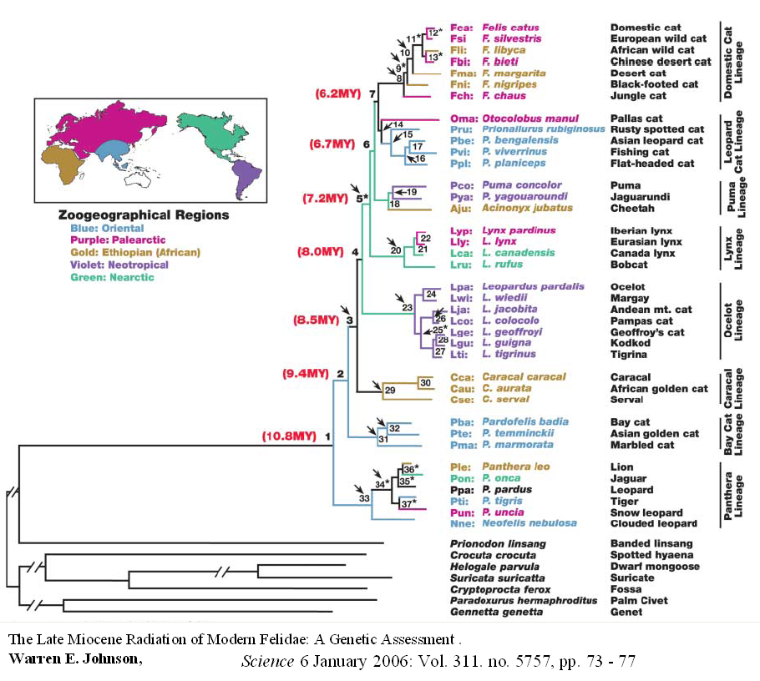

Slide 43






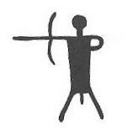

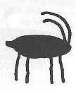
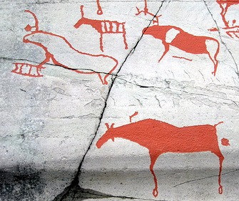
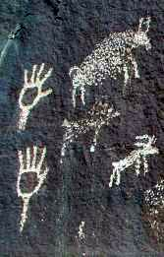
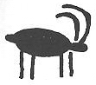
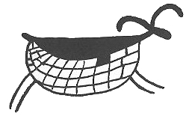
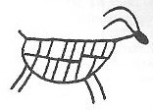
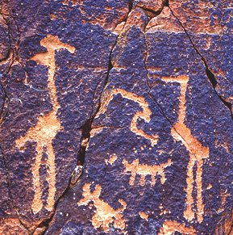
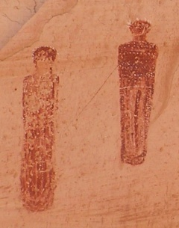
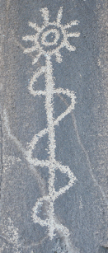
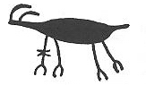
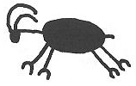
Atlatls
Anthropomorphs
Bighorn Sheep

Slide 44
Why Clustering?
Why is clustering part of AI?

Slide 45
I get a call from my boss, asking me to pick up a Cambodian professor from the airport.
Before I can get any more details, my phone dies.
I know almost nothing about Cambodia, I have never met (to my knowledge) a Cambodian.
In the baggage claim area, there are only three females, which one should I approach?

Slide 46
I know Cambodian is in the same subtree as Thailand
I know several Thai people
The lady in the middle looks like my Thai friends.

Slide 47
What religion is mostly likely for a person from Oman?
What religion is mostly likely for a person from Andorra?
Of course, hierarchical thinking can lead you astray..
What language do they speak in Paraguay?
I don’t know, but snice it is the South American
Subtree, and most of those counties speak Spanish
I will (correctly) guess Spanish.
What language do they speak in Guyana?
I don’t know, but snice it is the South American
Subtree, and most of those counties speak Spanish
I will guess Spanish. However, English is its official and most spoken language.

Slide 48
A hierarchical cluster can be seen as a way to generalize.
Suppose we need to predict the properties of an unknown object, but we can place it in an hierarchy. We can try to think of an object that we do know, and is clustered close to the unknown object…
Likewise, if we are just told the name of the subtree that an object is in, we can guess properties for it.
Can you tell me anything about a langur? No!
  If I tell you it is an animal: It probably has two eyes
  If I tell you it is a mammal: It probably has hair, is viviparous (live birth)
  If I tell you it is a primate: It probably lives in trees, eat fruit, has color vision, is social
  If I tell you it is a New World monkey: It probably has a prehensile tail, non-opposable thumb…
The smaller the subtree, the more properties we can predict.
animal
mammal
primate
NW monkey

Slide 49
Summary of Hierarchal Clustering Methods
No need to specify the number of clusters in advance.
Hierarchal nature maps nicely onto human intuition for some domains
They do not scale well: time complexity of at least O(n²), where n is the number of total objects.
Like any heuristic search algorithms, local optima are a problem.
Interpretation of results is (very) subjective.

