Slide 1
Optimizing Search
(Iterative Improvement Algorithms)
I.e Hill climbing, Simulated Annealing, Genetic Algorithms
Optimizing search is different to the path finding search we have studied in many ways.
  The problems are ones for which exhaustive and heuristic search are NP-hard.
  The path is not important (for that reason we typically don’t bother to keep a tree around) (thus we are CPU bound, not memory bound).
  Every state is a “solution”.
  The search space is can be continuous.
  Usually, we abandon hope of finding the best solution, and settle for a very good solution.
  The task is usually to find the minimum (or maximum) of a function.

Slide 2
Optimization for CNC Manufacturing
Please glance at this video, so you can understand what CNC milling is
https://www.youtube.com/watch?v=arb3iXfbpbI
There are two problems where AI search can help
Part Layout. How can you arrange the parts to reduce waste?
Tool Path Planning: How can you plan the tool movement to reduce wasted tool movement.

Slide 3
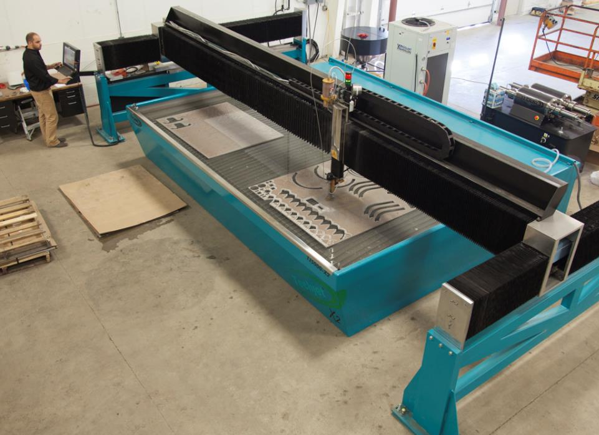
Sample Optimization Problem
Parts Layout for Waterjet cutting

Slide 4
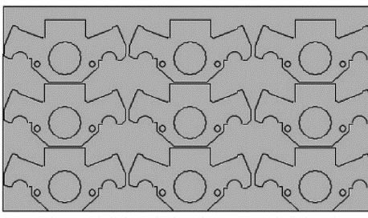
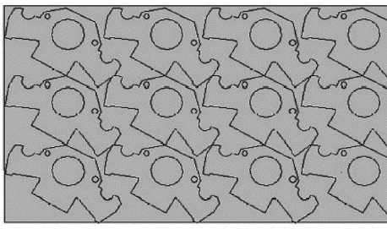
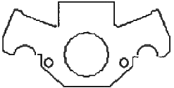
Part Layout
We need to make 50,000 of this part. How many blank sheets of metal do we need?
34% of the metal is wasted
19% of the metal is wasted
Xie et al. Nesting of two-dimensional irregular parts: an integrated approach. International Journal of Computer Integrated Manufacturing, Vol. 20, No. 8, December 2007, 741 – 756

Slide 5
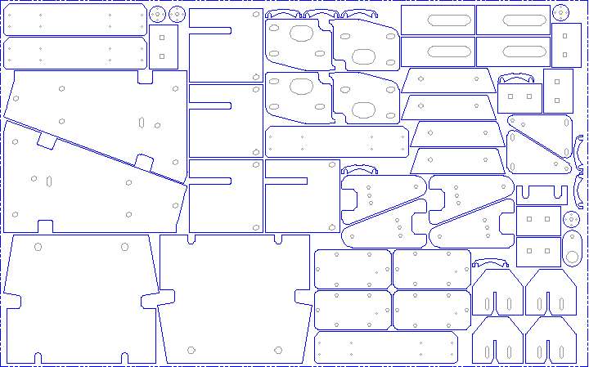
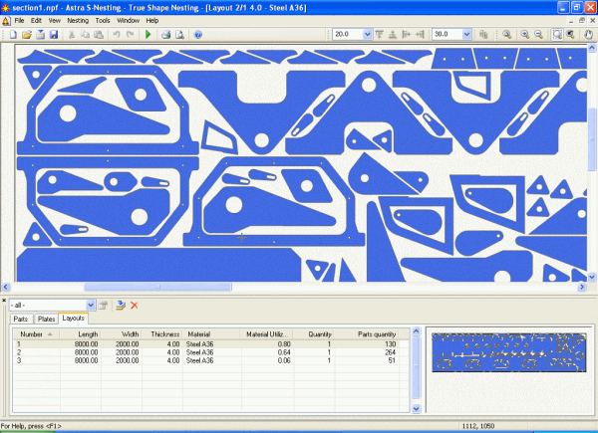
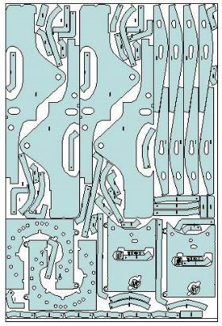
This is an example of super human AI. No human could do as well as an algorithm on a complex parts layout job.

Slide 6
Tool Path Planning
Key Point
When the tool is actually cutting the various shaped holes, it has to move at a certain speed, we cannot change that.
But when the tool is moving from hole to hole, that is “dead” time, we want to minimize that as much as possible.

Slide 7
Tool Path Planning
12
17
11
I want to cut out these shapes from a flat piece of stock.
Every movement between the parts, is wasted time. I need to minimize this wasted time.
Here I start with A, then jump to B, then jump to C etc.
I can surely to better!
Only a part of the solution is shown.
18
16
B
13
9
8
C
15
10
19
14
20
3
5
1
A
6
7
2
4

Slide 8
A Solution
12
17
11
18
16
2
4, 5
20, 19, 18, 17, 16, 15
13, 12, 11
9, 8
10,
6, 7
14
3, 1
13
9
8
15
10
19
14
20
3
5
1
6
7
2
4
Start

Slide 9
A Better Solution
12
17
11
18
16
2
4, 5
3
20, 15
14
6,7
8,9
10, 11, 12, 13
16, 17, 18, 19
1
13
9
8
10
19
15
14
20
3
5
1
6
7
2
4
Start
S. Umar Sherif. Sequential optimization approach for nesting and cutting sequence in laser cutting

Slide 11
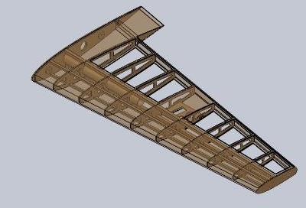
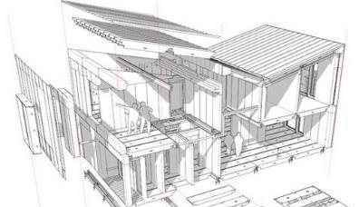
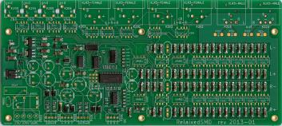
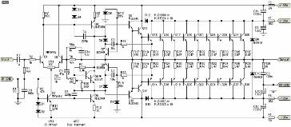
Background Info A
For many electrical, mechanical and physical systems we can model them essentially perfectly in a computer (a single model is a “state”)
This means we can ask questions such as:
For this wing design:
  What is its lift coefficient?
  What is its drag coefficient?
  How much would it cost make?
  What is its stall speed?

Slide 12
Background Info B
For these systems, we can do “what if” changes (changes are “operators”)
So we could make the wing 10% longer and then ask:
For this new wing design:
  What is its lift coefficient?
  What is its drag coefficient?
  How much would it cost to make?
  What is its stall speed?

Slide 13
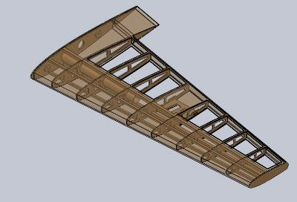
Background Info C
For these systems, we can come up with a single number that describes how good the solution is changes (this single number is a “fitness function”)
Creating this single number is often tricky, but not our job!
This single number is simply a weighted sum of the (suitably normalized) score on all the elements we care about:
  A = lift coefficient
  B = drag coefficient/10
  C = cost to make/ cost of 747 wing
  D = 100mph – stall speed
Quality Of Solution = A + 7B + 1/C + D²

Slide 14
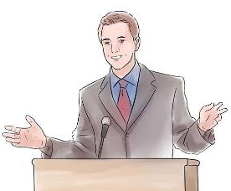
Background Info D
We can also model (but with more uncertainty) economic, business, social and political systems.
Here the state might be the politician’s positions.
  NRA ranking on guns
  Planned parenthood scorecard
  Tax Policy ranking
  Congressional Scorecard on LGBT rights
  Etc (these only includes things that can be changed)
Here the changes (operators) could include hardening stance on guns, or withdrawing objections to same-sex marriage etc
Here the quality of a solution (fitness) might be something like
Quality Of Solution = votesgained(CA) + votesgained(AR)
Note: votesgained(X) can be negative.

Slide 15
Imagine that I am in a good mood
Imagine that I am going to give you some money!
In particular I am going to give you z dollars, after you tell me the value of x and y
x and y in the range of 0 to 10

Slide 16
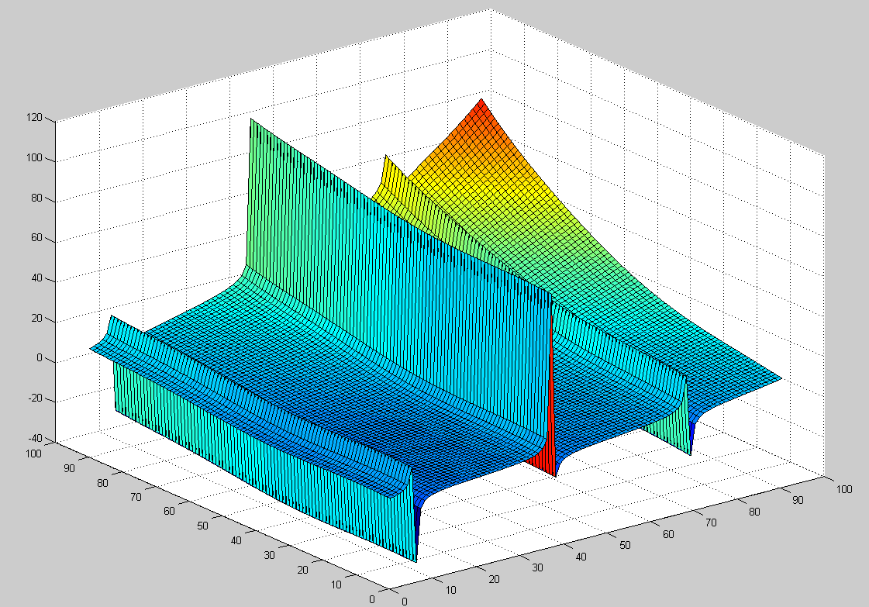
z
x
y

Slide 17
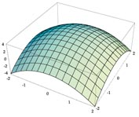
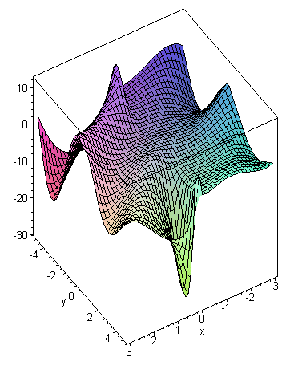
Example Problem I
(Continuous)
y = f(x)
Finding the maximum (minimum) of some function (within a defined range).

Slide 18
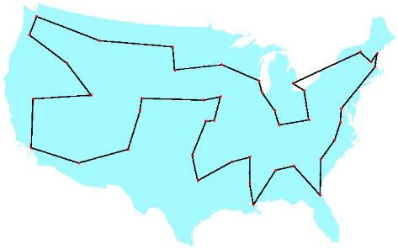
Example Problem II
(Discrete)
The Traveling Salesman Problem (TSP)
A salesman spends his time visiting n cities. In one tour he visits each city just once, and finishes up where he started. In what order should he visit them to minimize the distance traveled?
There are (n-1)!/2 possible tours.
B
A
C
Note that we don’t need the map to solve this, all we need is the distance matrix.

Slide 19
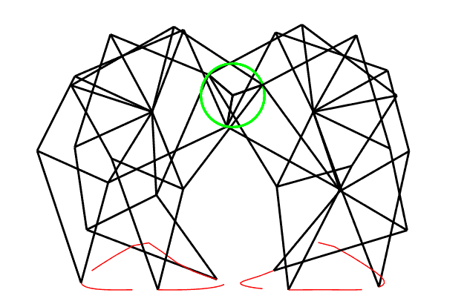

Slide 20
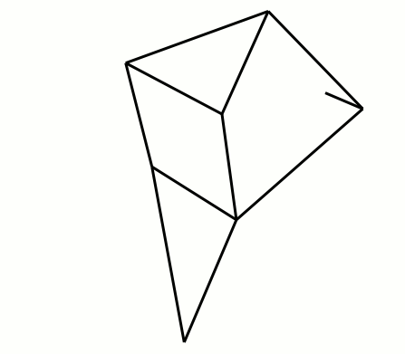
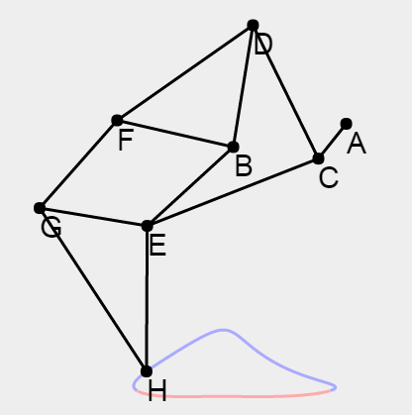
Example Problem III
(Continuous)
Bx=-38;
By=-7.8;
AC=15;
CD=50;
BD=41.5;
BE=39.3;
CE=61.9;
DF=55.8;
BF=40.1;
FG=39.4;
EG=36.7;
GH=65.7;
EH=49;
Find values of the following 13 parameters that make the device walk well.
Bx, By, AC, CD, BD, BE, CE, DF, BF, FG, EG, GH, EH
http://garethrees.org/2011/07/04/strandbeest/strandbeest.html

Slide 21
Assume that we can
  Represent a state (could be a list of numbers, an equation, a tree, a set, a linked list, a graph, a computer program…)
  Quickly evaluate the quality of a state.
  Define operators to change from one state to another.
Function Optimizing
Traveling Salesman
z = log(x) + sin(tan(y-x))
x = 2;
y = 7;
log(2) + sin(tan(7-2)) = 2.00305
x = add_10_percent(x)
y = subtract_10_percent(y)
….
A C F K W…..Q A
A to C = 34
C to F = 142
…
Total 10,231
A C F K W…..Q A
A C K F W…..Q A

Slide 22
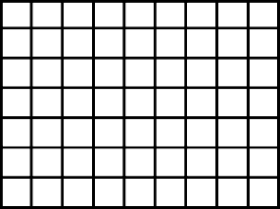
How expressive are our operators?
Will our operators allow us to reach any part of the search space?
10%
Function Optimizing
Traveling Salesman
x = add_10_percent(x)
y = subtract_10_percent(y)
….
A C F K W…..Q A
A C K F W…..Q A

Slide 23
Preview
We are going to see two simple algorithms
Hill-Climbing (greedy) Search Fast, but not optimal
Random Search Optimal, but unbelievably slow
Does this remind you of anything?
For path planning search, we combined a fast but not optimal algorithm (greedy search), with a slow but optimal algorithm (uniform cost search) to make A-Star, a fast and optimal algorithm.
We are later going to combine Hill-Climbing and Random Search into a single algorithm called Simulated Annealing, that is also “best of both worlds”

Slide 24

Hill-Climbing
i.e Greedy Search
function Hill-Climbing (problem) returns a solution state
inputs : problem // a problem.
local variables : current // a node.
next // a node.
current ← Make-Node ( Initial-State [ problem ]) // make random
loop do // initial state.
  next ← a highest-valued successor of current // try all operators
  if Value [next] < Value [current] then return current
  current ← next
end

Slide 25
Hill-Climbing
i.e Greedy Search
function Hill-Climbing (problem) returns a solution state
inputs : problem // a problem.
local variables : current // a node.
next // a node.
current ← Make-Node ( Initial-State [ problem ]) // make random
loop do // initial state.
  next ← a highest-valued successor of current
  if Value [next] < Value [current] then return current
  current ← next
end

Slide 26
Random Search
function Random Search (problem) returns a solution state
inputs : problem // a problem.
local variables : current // a node.
next // a node.
current ← Make-Node ( Initial-State [ problem ]) // make random
BSF ← - infinity // initial state.
loop do // runs forever!
  next ← any random successor of current
  if BSF < Value [next] then record (next’s state), update BSF.
  current ← next
end

Slide 27
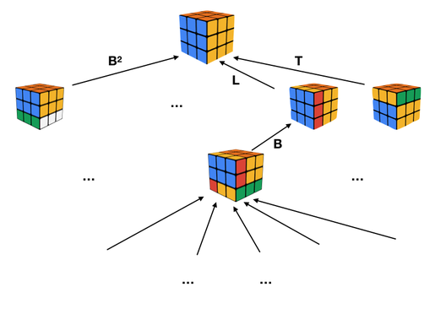
Just for fun: How would Hill-Climbing (greedy) Search and Random Search do on solving the Rubik Cube?
Hill-Climbing Search
Random Search
Under all known heuristics (objective functions), it would get stuck in local maxima. Recall the slides that showed the same thing for the 8-puzzle.
This would work. However, it is known [a] that expected number of turns is slightly more than
43,252,003,274,489,856,000
So, at one move per nanosecond, it would take 1,370 years.
This tree is upside down
[a] https://www.youtube.com/watch?v=vYEhCiP96Hg&ab_channel=Mathologer

Slide 28
Problem: We want to find the maximum value of sin(x^{0.3}) in the range 0 to 22.
Two notes:
  In 1D we can do this by ‘eyeball’, but this does not work for higher dimensions.
  In this case we could also do it with calculus, but that is not always possible.
0
22
sin(x^{0.3})

Slide 29
Pick random node:
We randomly picked “11”
Evaluate node: sin(11^{0.3}) = 0.885
11: value = 0.885
0
22
sin(x^{0.3})

Slide 30
Apply all legal operators
{go_left_1, go_right_1}
Evaluate them…
Make the winner the current node
11: value = 0.885
go_left_1
go_right_1
10: value = 0.911
12: value = 0.859
0
22
sin(x^{0.3})

Slide 31
Apply all legal operators
{go_left_1, go_right_1}
Evaluate them…
Make the winner the current node
10: value = 0.911
go_left_1
go_right_1
9: value = 0.935
11: value = 0.885
0
22
sin(x^{0.3})

Slide 32
After we reach 5, all operators give us worse results, so we terminate.
5: value = 0.999
go_left_1
go_right_1
4: value = 0.998
6: value = 0.990
0
22
sin(x^{0.3})

Slide 33
Problem with Greedy Search 1: Local Maxima
1.720
1.948
1.977
1.988
1.994
0
cos(x^{1.09}) + sin(x^{0.13})
22

Slide 34
Problem with Greedy Search 1: Local Maxima
We will only find the true maximum if we happen to randomly pick an initial node in the red region.
We can increase the probability of this happing by doing multiple random restarts, keeping the best value.
0
cos(x^{1.09}) + sin(x^{0.13})
22

Slide 35
Random Restarts
The length of the red region is about 4, the entire range is 22.
It is easier to think about the probability of failure. So, if we run greedy search once, the probability of failure is: One, subtract the fraction of the ‘good’ area raised to the power of number of restarts
1- (4/22)¹ = 0.81
Note that random restarts are easy to parallelize.
0
cos(x^{1.09}) + sin(x^{0.13})
22

Slide 36
Random Restarts
The length of the red region is about 4, the entire range is 22.
It is easier to think about the probability of failure. So, if we run greedy search once, the probability of failure is: One, subtract the fraction of the ‘good’ area raised to the power of number of restarts
1- (4/22)¹ = 0.81
If we run greedy search twice, the probability of failure is:
(1 –(4/22))² =0.66
Note that random restarts are easy to parallelize.
0
cos(x^{1.09}) + sin(x^{0.13})
22

Slide 37
Random Restarts
The length of the red region is about 4, the entire range is 22.
It is easier to think about the probability of failure. So, if we run greedy search once, the probability of failure is:
1- (4/22)¹ = 0.81
If we run greedy search twice, the probability of failure is:
(1 –(4/22))² =0.66
If we run greedy search three times, the probability of failure is:
(1 –(4/22))³ =0.54
If we run greedy search ten times, the probability of failure is:
(1 –(4/22))¹⁰ =0.13
If we run greedy search 100 times, the probability of failure is (1 –(4/22))¹⁰⁰ which is about one in a billion.
Note that random restarts are easy to parallelize.
0
cos(x^{1.09}) + sin(x^{0.13})
22

Slide 38
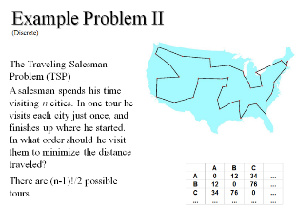
The Local Maxima problem is not just for continuous spaces, it also happens in discrete spaces.
For example, you can use greedy search for the TSP problem. The algorithm is sometimes called the nearest neighbor (NN) algorithm and makes the salesman choose the nearest unvisited city as his next move.
On average this gets you within 25% of the optimal solution.
However, we can make problems for which this greedy algorithm would give you the worst route!
(let us create such a route in class.)
*Johnson, D.S. and McGeoch, L.A.. "The traveling salesman problem: A case study in local optimization", Local search in combinatorial optimization, 1997, 215-310

Slide 39
We have to start and end at A. Let us do 6 cities, from A to F
Let us build a worse case (as an aside, building worse cases is always a good idea to understand algorithms)
A
B
1

Slide 40
We have to start and end at A. Let us do 6 cities, from A to F
Let us build a bad case (as an aside, building bad/worse cases is always a good idea, for all kinds of problems)
C
A
B
1
3

Slide 41
We have to start and end at A. Let us do 6 cities, from A to F
Let us build a worse case (as an aside, building worse cases is always a good idea)
C
A
B
D
1
3
7

Slide 42
We have to start and end at A. Let us do 6 cities, from A to F
Let us build a worse case (as an aside, building worse cases is always a good idea)
E
C
A
B
D
F
1
3
7
15
31

Slide 43
We have to start and end at A
The optimal thing to do here is to fly to one of the end cities (E or F), then fly in a straight line picking off the cities until we get to the end of the line, then fly back to A.
The greedy algorithm will fly from A to B to C to D to E to F to A
E
C
A
B
D
F
1
3
7
15
31

Slide 44
Problem with Greedy Search 2: Choice of Step Size
In this example, the true maximum is 3.989, but because we picked a random initial node of say 15, and our operators are {go_left_2, go_right_2} , we will never find the true maximum.
3.989
3.521
0
The standard normal distribution with µ to 10.5 and σ to 1.
22

Slide 45
Problem with Greedy Search 2: Choice of Step Size
Solution? Have a finer step size, such as{go_left_1/2, go_right_1/2}, however this will slow the search, by increasing the depth of the solution.
3.989
0
The standard normal distribution with µ to 10.5 and σ to 1.
22

Slide 46
Problem with Greedy Search 2: Choice of Step Size
Solution? Could we mix operators{go_left_1/2, go_right_1/2, go_left_1, go_right_1}
Not a bad idea, however this increases the branching factor.
3.989
0
The standard normal distribution with µ to 10.5 and σ to 1.
22

Slide 47
Dealing with Step Size Choice
There is a “trick” to deal with the problem of step size choice.
We can adaptively learn the step size choice.
We make the step proportional to the gradient of the function at the current point.
However, for non-differentiable functions, gradient methods are ill-defined.
3.521
0
The standard normal distribution with µ to 10.5 and σ to 1.
22

Slide 48
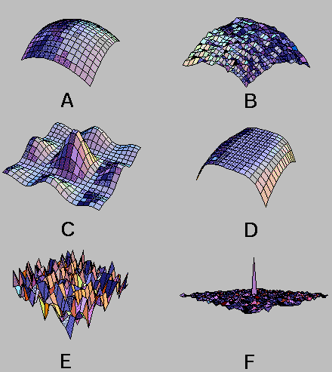
How would Hill-Climbing do on the following problems?
How can we improve Hill-Climbing?
Random restarts!
Intuition: call hill-climbing as many times as you can afford, choose the best answer.

Slide 49
By visual intuition.
What is the chance of finding the maximum with one random greedy search? With two random greedy searches…
If we run greedy search once, the probability of failure is:
1- (1/9)¹ = 0.88
If we run greedy search twice, the probability of failure is:
(1 –(1/9))² = 0.79
If we run greedy search one hundred times, the probability of failure is:
(1 –(1/9))¹⁰⁰ = 0.00000766
The probability of failure is: One, subtract the fraction of the ‘good’ area raised to the power of number of restarts

Slide 50
Simulated-Annealing
We have seen two optimizing search algorithms
  Greedy Search: Very fast, but suboptimal
  Random Search: Optimal, but very very very very very slow
We can try the classic CS idea of trying to combine them into a single algorithm that gets the best of both worlds.
First note that we can see both as being a special case of a probabilistic operator choice.
  x = randnumberbetween([0 1])
  if x > t, choose best operator, else choose random operator
If we set t to be 0, this is pure greedy search.
If we set t to be 1, it is pure random search.
If we set t to be in-between 0 and 1, it is partly random/partly greedy search. t stands for “temperature”

Slide 51
Simulated-Annealing Intuition
  x = randnumberbetween([0 1])
  if x > t, choose best operator, else choose random operator
If we set t to be 0, this is pure greedy search.
If we set t to be 1, it is pure random search.
If we set t to be in-between 0 and 1, it is partly random/partly greedy search. t stands for temperature
Here is the whole idea
Start the search with a high value of t, then slowly lower the temperature to zero.
In other words, start with pure random search, then slowly make it pure greedy search.
When the algorithm is “young” it explores wildly, as it gets “older”, it becomes more conservative, and more likely to move in the direction of improvement

Slide 52
function Simulated-Annealing ( problem, schedule ) returns a solution state
inputs : problem // a problem
schedule // a mapping from time to "temperature"
local variables : current // a node
next // a node
T // a "temperature" controlling the probability of downward steps
current ← Make-Node ( Initial-State [ problem ])
for t ← 1 to ∞ do
  T ← schedule [ t ]
  if T = 0 then return current
  next ← a randomly selected successor of current
  ΔE ← Value [ next ] - Value [ current ]
  if ΔE > 0 then current ← next
  else current ← next only with probability e^{ΔE/T}

Slide 53
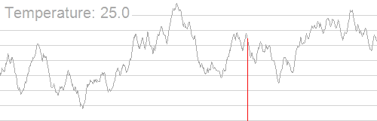
When the temperature is 25, we are doing pure random search
When the temperature is 12.5, we are doing a 50/50 mix random/greedy search
When the temperature is zero, we are doing pure greedy search
(most folks have the temp normalized between 1 and 0, this nice gif does not)
https://upload.wikimedia.org/wikipedia/commons/d/d5/Hill_Climbing_with_Simulated_Annealing.gif

Slide 54
Simulated-Annealing
It is possible to determine the rate at which t should go to zero, to have an optimal solution.
However, it is generally much too slow to use that rate.
So, in practice, you pick a time budget, say one hour
And you let the t go from 0 to 1 in one hour
This is not optimal, but tends to work very well in practice.

Slide 55

Genetic Algorithms I (R and N, pages 619-621)
Variation (members of the same species are differ in some ways).
Heritability (some of variability is inherited).
Finite resources (not every individual will live to reproductive age).
Given the above, the basic idea of natural selection is this.
Some of the characteristics that are variable will be advantageous to survival. Thus, the individuals with the desirable traits are more likely to reproduce and have offspring with similar traits ...
And therefore the species evolve over time…
Richard Dawkins

Slide 56

Chromatic Aberration

Slide 57
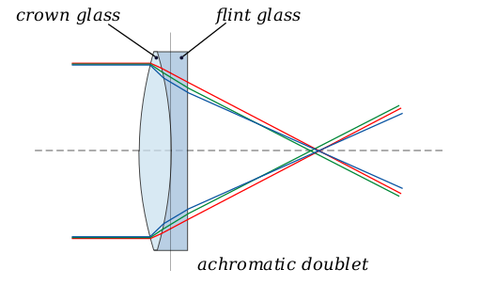
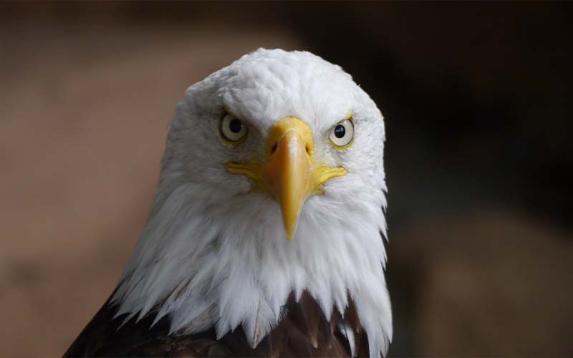
Chromatic Aberration
Solution 1: Change the lens shape.
Solution 2: Change lens glass, to have a different reflective index, as you get closer to the center.
Since natural selection is known to have solved many important optimizations problems it is natural to ask can we exploit the power of natural selection?

Slide 58
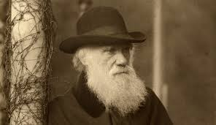
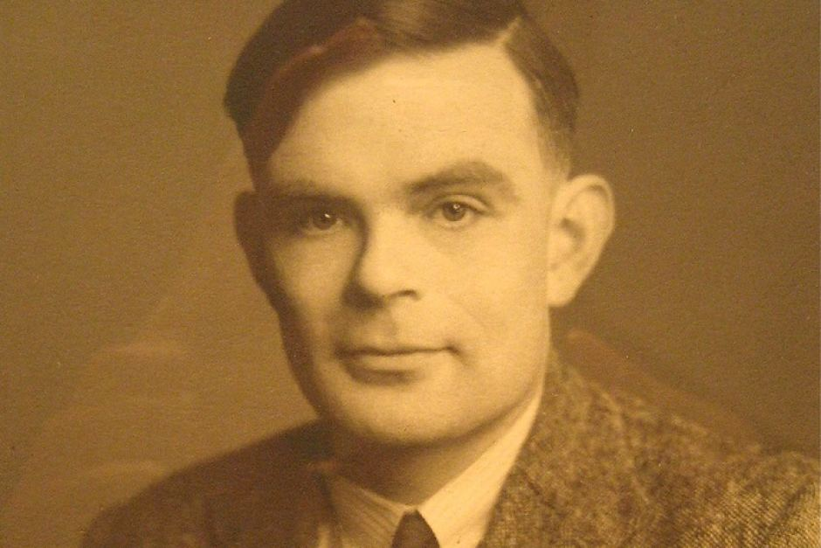
Origins
Charles Darwin 1809 –1882
Alan Turing 1912 – 1954
Turing, Alan M. (October 1950). "Computing machinery and intelligence". Mind. LIX (238): 433–460.

Slide 59
Genetic Algorithms II
The basic idea of genetic algorithms (evolutionary programming).
  Initialize a population of n states (randomly)
While time allows
  Measure the quality of the states using some fitness function.
  “kill off” some of the states.
  Allow the surviving states to reproduce (sexually or asexually or..)
end
  Report best state as answer.
All we need do is ...(A) Figure out how to represent the states. (B) Figure out a fitness function. (C) Figure out how to allow our states to reproduce (operators).

Slide 60
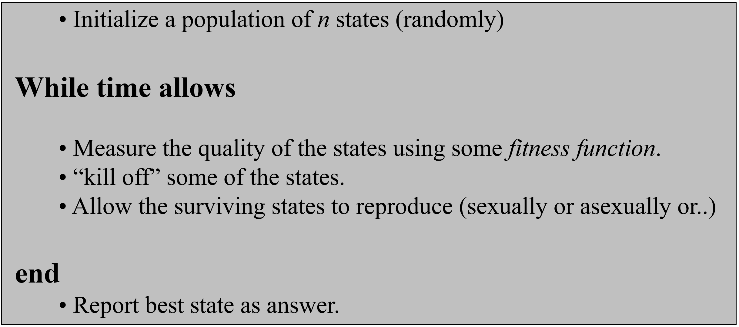
Visualization of Genetic Algorithms I
10
0
0
22

Slide 61
Visualization of Genetic Algorithms II
10
8.9
7.4
7.0
6.3
3.1
1.4
0
0
22

Slide 62
Visualization of Genetic Algorithms III
10
8.9
7.4
7.0
6.3
3.1
1.4
0
0
22

Slide 63
Visualization of Genetic Algorithms V
10
0
0
22

Slide 64
Genetic Algorithms III
One possible representation of the states is a tree structure…
(in GA, states are often called genomes)
log(x^{y}) + sin(tan(y-x))
+
Another is a bitstring…
log
sin
100111010101001
pow
tan
x
y
-
For problems where we are trying to find the best order to do some thing (TSP), a linked list might work...
y
x
A
C
E
F
D
B
A

Slide 65
Genetic Algorithms IIII
Usually the fitness function is fairly trivial.
For the function maximizing problem we can evaluate the given function with the state (the values for x, y, z... etc)
For the function finding problem we can evaluate the function and see how close it matches the data.
+
log
sin
pow
tan
x
y
-
y
x
For TSP the fitness function is just the length of the tour represented by the linked list
A
C
E
F
D
B
A
23
12
56
77
36
83

Slide 66
Genetic Algorithms V
Operators 1
Parent state A
Child of A
+
+
Mutation
cos
5
tan
5
Asexual Reproduction
(Mutation)
/
/
x
y
x
y
Parent state A
Parent state A
10011101
10011111
Child of A
Mutation
Child of A

Slide 67
Think of Asexual Reproduction (Mutation) as producing a child state close to its (single) parent
10
0
0
22

Slide 68
Genetic Algorithms VI
Operators 2
Parent state A
Parent state B
+
+
log
sin
cos
5
Sexual Reproduction
(crossover)
pow
tan
/
x
y
-
x
y
y
x
Child of A and B
+
Parent state A
cos
sin
10011101
/
tan
10011000
11101000
x
y
-
Child of A and B
Parent state B
y
x

Slide 69
Think of Sexual Reproduction (Crossover) as producing a child state that combines parts of its parents.
In 1D, this is simply the average of the partners, but in higher D, this is much more complex.
10
0
0
22

Slide 70
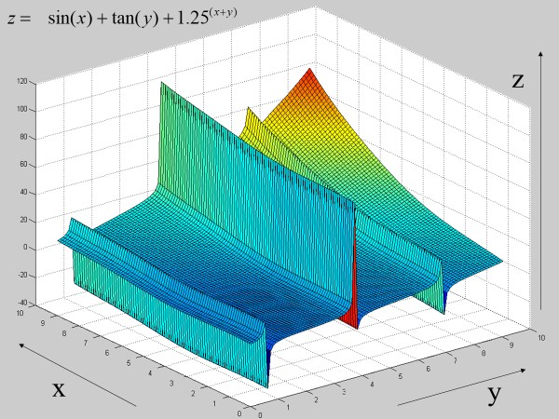
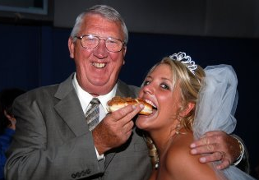
Suppose you had states A and B…
A child that had A’s Y value and B’s X value would be awful.
A child that had A’s X value and B’s Y value would be great.
A
B
This happens in nature, consider…
A child that had his looks and her ability to earn money.
vs
A child that had his ability to earn money and her looks.

Slide 71
What is Sex Good for?
Parent state A
Child of A and B
Parent state B
+
+
+
log
sin
cos
sin
cos
5
pow
tan
/
tan
/
x
y
-
x
y
-
x
y
y
x
y
x
state: Child of A and B
state A
state B
0
22

Slide 72
Discussion of Genetic Algorithms
It turns out that the policy of “keep the best n individuals” is not the best idea. Suppose we always “kill off” the worst half of the states in the example below
0
22

Slide 73
Discussion of Genetic Algorithms
Genetic Algorithms require many parameters... (population size, fraction of the population generated by crossover; mutation rate, number of sexes... ) How do we set these?
Genetic Algorithms are really just a kind of hill-climbing search, with some randomness but seem to have less problems with local maximums…
Genetic Algorithms are very easy to parallelize...
Applications
Protein Folding, Circuit Design, Job-Shop Scheduling Problem, Timetabling, designing wings for aircraft….

Slide 74
Genetic Algorithm Success Story
For an antenna for a particular job, we can measure its fitness by…
A straight antenna gives some fitness, but bending it in different locations can give you different fitness.
We can define a state, (not shown, say a linked list of “bends”)
We can define operators
forward(length, radius) Add a wire with the given length and radius extending from the current location and then change the current state location to the end of the new wire.
rotate-x(angle) Change the orientation by rotating it by the specified amount (in radians) about the x axis.
rotate-y(angle) Change the orientation by rotating it by the specified amount (in radians) about the y axis.
rotate-z(angle) Change the orientation by rotating it by the specified amount (in radians) about the z axis.

Slide 75
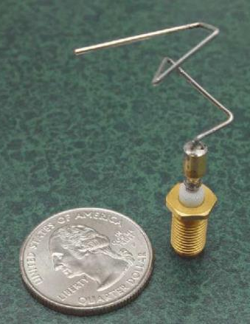
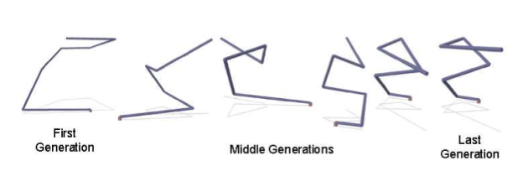
Genetic Algorithms
First Computer-Evolved Hardware in Space

Slide 76
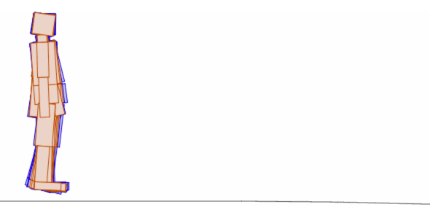
A great way to kill time
http://rednuht.org/genetic_walkers/

Slide 77
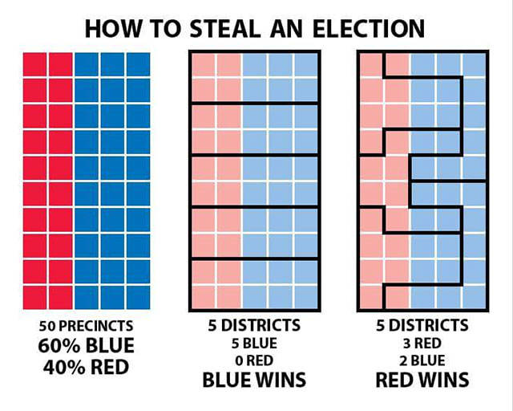
Sample Optimization Problem
Here we have a state which is divided into 50 precincts.
We have the task of assigning 5 districts of equal sizes.
The overall election is decided by who wins the most districts.
If, instead, the party that captured the most precincts won, this state would go to the blue party.
Popular vote

Slide 78
Sample Optimization Problem
All precincts in a districts must be connected.
For a sensible assignments of five districts, the blue party does win.

Slide 79
Sample Optimization Problem
However, we can search for assignments of the five districts, such that red wins!
This is called Gerrymandering
One basic idea of Gerrymandering, try to have just one or two districts that concentrate almost all of your rival.

Slide 80
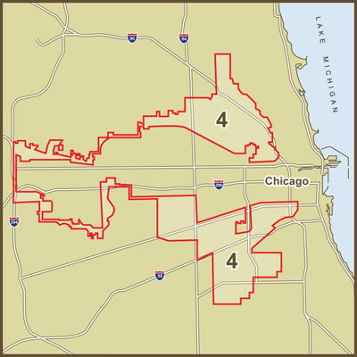
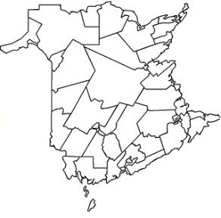
Sample Optimization Problem
Here is a real-world example.
We could frame Gerrymandering as an optimization problem.
What would be the initial state?
What are the operators?
What is the evaluation function?
Gerrymandered 4th Congressional District in Illinois

Slide 81
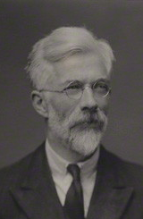
Why are Humans so Smart?
Basic idea of runaway evolution due to Ronald Fisher (whom we will meet as the inventor of the linear classifier)
Application to human intelligence mostly due to Geoffrey Miller
Geoffrey Miller The Mating Mind: How Sexual Choice Shaped Human Nature (2000)
This is a theory, but very plausible.
Ronald Fisher

Slide 82

1.5 inch tail
I like guys with a two inch tail..
2 inch tail
2.5 inch tail
Sexual selection is a big driver of evolution.
The tails of a bird are control by genes, but critically, so is their behavior.
Female choice is an example of a behavior. If a female that likes 2-inch tails has daughters, it is likely that the daughters will also like 2-inch tails.
Some female choice may be rational, they may choose for strong beaks, or for good nest making ability, or….
Some (perhaps most) female choices could be arbitrary.

Slide 83
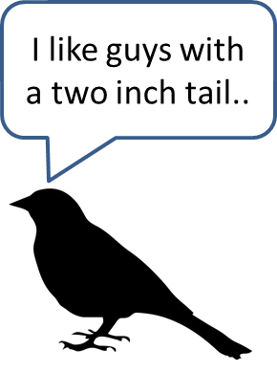
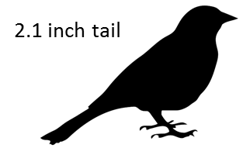
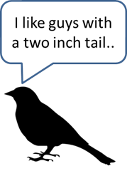
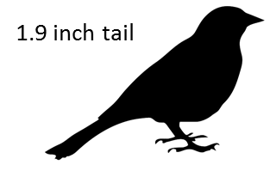
1.5 inch tail
I like guys with a two inch tail..
2 inch tail
2.5 inch tail
Under certain conditions, the genes for having a trait, and the genes for choosing the same trait, can “take hold” in a population.
If that happens, it is unlikely to ever break out of the cycle. A male that has a longer or shorter tail simply will not be able find a mate.

Slide 84
1.5 inch tail
I like guys whose tail is longer than average….
2 inch tail
2.5 inch tail
Suppose the female choice is not for a certain length tail, but for a tail that is longer than average….

Slide 85
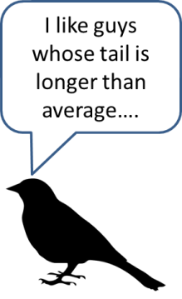
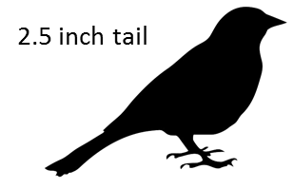


1.5 inch tail
I like guys whose tail is longer than average….
2 inch tail
2.5 inch tail
Now every generation has longer and longer tails….

Slide 86
2.9 inch tail
I like guys whose tail is longer than average….
2.8 inch tail
2.6 inch tail
Once the genes for liking longer-than-average-tails reach a critical mass, we have a positive feedback cycle….

Slide 87
5.1 inch tail
I like guys whose tail is longer than average….
6.2 inch tail
5.9 inch tail
…and the tails get longer and longer
Note that the male would be much better of without the long tail. It costs energy to grow it, it makes it very hard to fly, it makes it hard to avoid detection by predators, and hard to evade them… But any male without a long tale will not find a mate. This seems like a theoretical model, but….

Slide 88
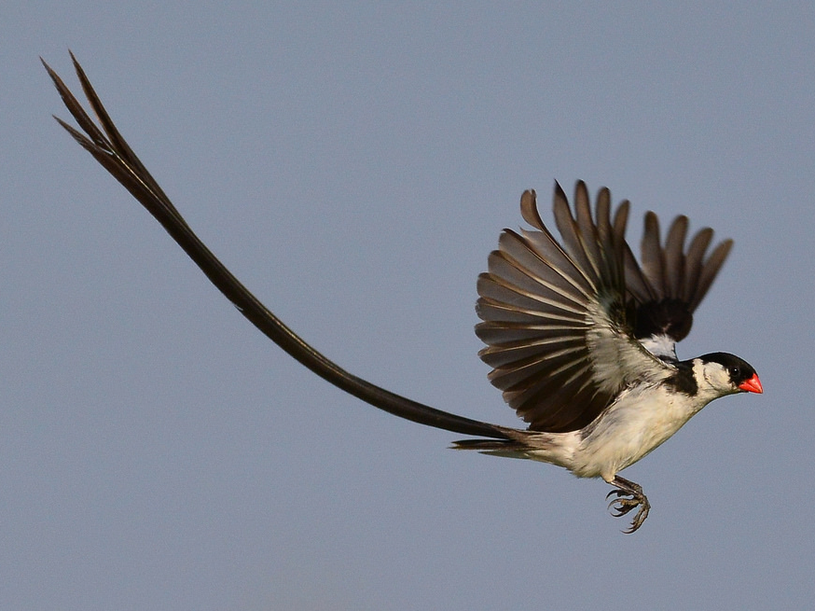
The pin-tailed whydah (Vidua macroura)

Slide 89


IQ = 90
I like guys whose are smarter than average….
IQ = 96
IQ = 50
Sometime in the last few hundred thousand years, human female choice started to select for guys that where smarter than average (how did the females know who was smart?)
So, Human intelligent is just a by-product of this arbitrary accident.

Slide 90

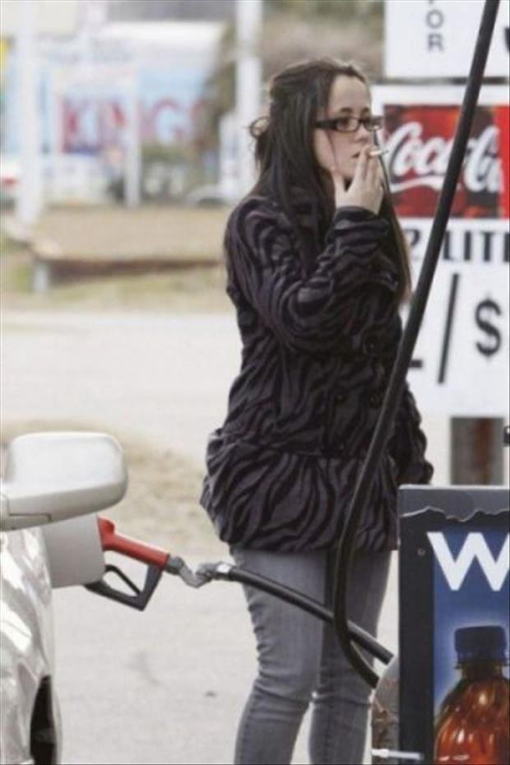


Before we get carried away, humans are not that smart

Slide 91
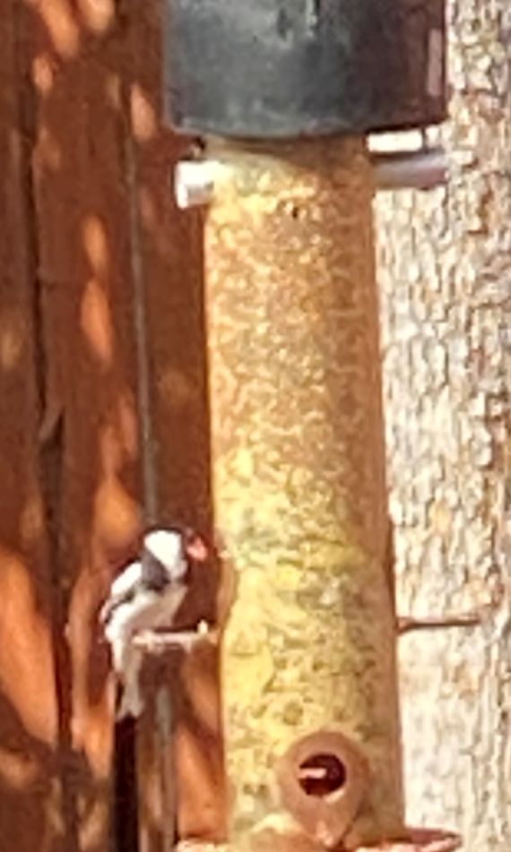
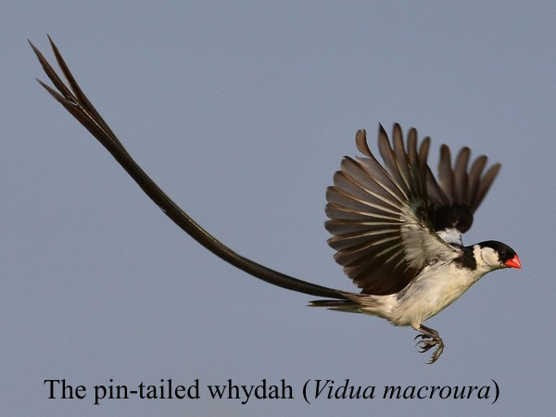
Two unbelievable coincidences: One
I have shown this slide for about 5 years. During COVID last year, I started to put out bird feeders….

Slide 92
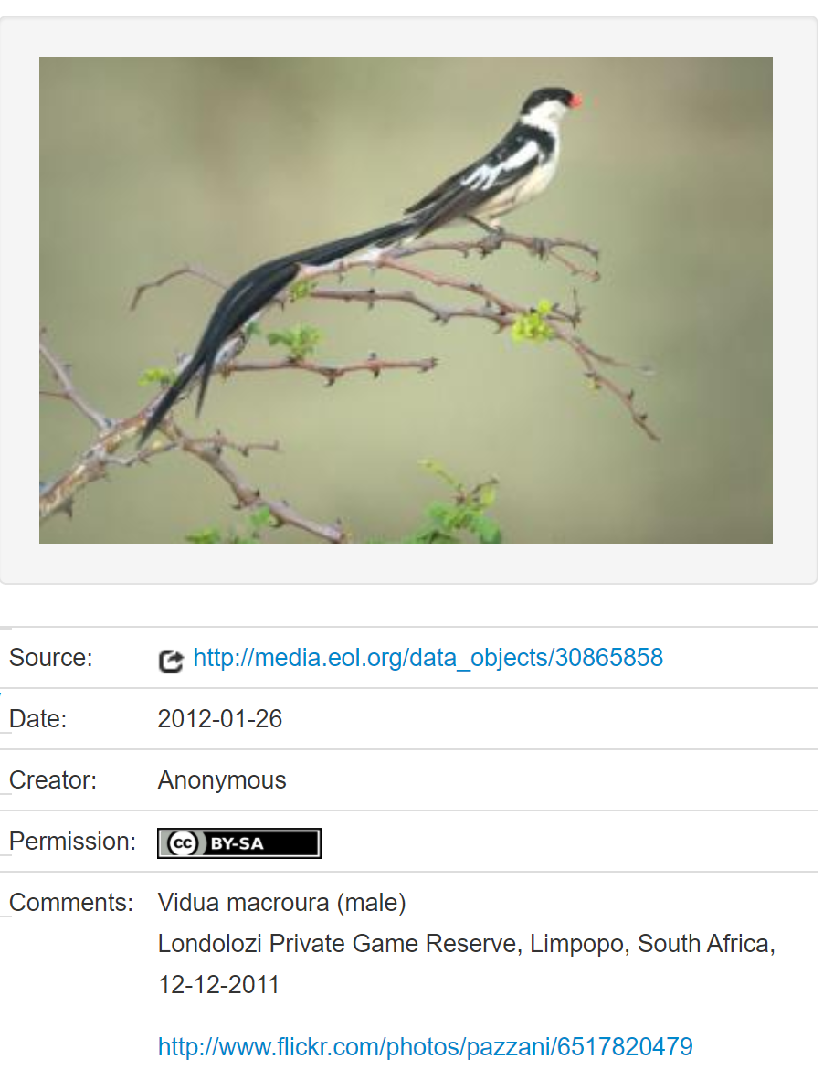
Two unbelievable coincidences: Two
When I spotted the pin-tailed whydah in my garden, I googled it to see if it really was a pin-tailed whydah. The first photo I found, confirm it. Then I notice who took this photo in Africa, it was my PhD advisor from 20 years ago.

Slide 93
Random Search Revisited
Random search can solve the Rubik Cube!
If I take a scrambled cube, and randomly rotate a side, eventually I will solve it.
How many moves will it take on average?

Slide 94

Random Search Revisited
Random search can solve the Rubik Cube!
If I take a scrambled cube, and randomly rotate a side, eventually I will solve it.
How many moves will it take on average?
Slightly more than
  43,252,003,274,489,856,000
https://www.youtube.com/watch?v=vYEhCiP96Hg&ab_channel=Mathologer

