Slide 1
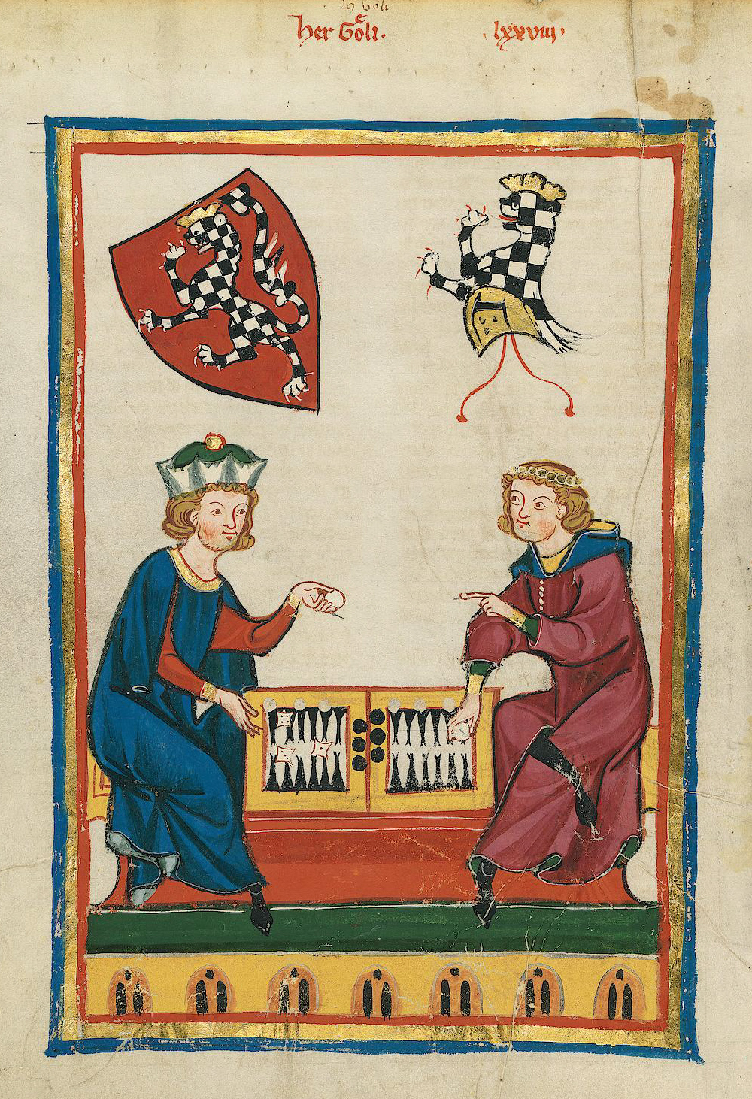
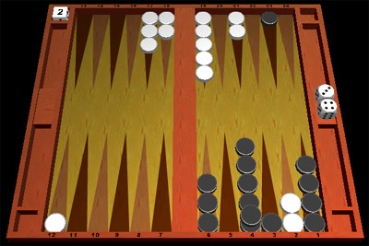
Games With Chance
Consider backgammon
  A die roll determines the moves a player can make
  Alternates moves and die rolls
Representation
  Add chance nodes to the game tree

Slide 2

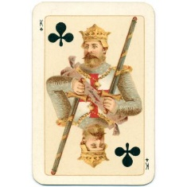
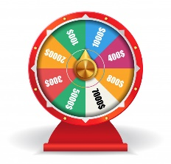
Chance Nodes
Note that different games can be:
Chance, Max, Min, Chance, Max, Min,..
Max, Chance, Min, Chance, Max, Chance, Min,..
Max, Min, Chance, Max, Min, Chance,..

Slide 3


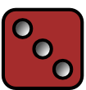
Chance Nodes
Note that different games can be:
Chance, Max, Min, Chance, Max, Min,..
Max, Chance, Min, Chance, Max, Chance, Min,..
Max, Min, Chance, Max, Min, Chance,..
Max
Chance
1/6
1
1/6
2
1/6
3
…
…
P(s) = Probability of roll
Value of roll

Slide 4



Chance Nodes
Note that different games can be:
Chance, Max, Min, Chance, Max, Min,..
Max, Chance, Min, Chance, Max, Chance, Min,..
Max, Min, Chance, Max, Min, Chance,..
Max
Chance
1/6
1
1/6
2
1/6
3
…
…
P(s) = Probability of roll
Min
Value of roll
…
…
Chance
…
…
…
…
…
…
Max
(The interleaving depends on the game)

Slide 5
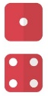
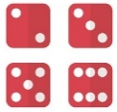
Expectminimax Value
Extend minimax (and α-β) idea to chance nodes
  Expectiminimax value
  P(s) is the probability of a random event (e.g., die roll) occurring
Time complexity
  O(b^{m}n^{m}), where n is the number of distinct events
  α-β pruning can be extended, but still enormous time complexity
((2/6) * 7 ) + ((4/6) * -1) = $1.66
Example: Imagine that one outcome of a game leads to this situation. A dice is tossed. If it is a 1 or a 4, Max wins $7. If it is any other number, Max “wins” -1$.
The expected value of that move for Max is $1.66
…
$7
$-1

Slide 6
Review
We have seen this slide before
For Adverserial Search
Minimax is the optimal algorithm
We can almost never use Minimax, because of its time complexity.
We can use depth-limited Minimax, to go as deep as possible in the time allowed
A clever pruning trick alpha-beta search, lets us go about twice as deep (in the best case).
Since that is all there is for search (but see later), all the research is spent on better evaluation functions

Slide 7
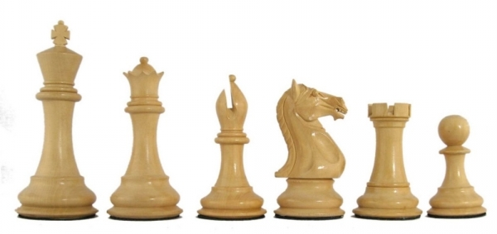
Example Utility Functions II
Chess I
Assume Max is “White”
Assume each piece has the following values
  pawn = 1;
  knight = 3;
  bishop = 3;
  rook = 5;
  queen = 9;
let w = sum of the value of white pieces
let b = sum of the value of black pieces
e(n) =
w - b
w + b
Note that this value ranges between 1 and -1

Slide 8
Depth limited Minimax search.
  Search the game tree as deep as you can in the given time.
  Evaluate the fringe nodes with the utility function.
  Back up the values to the root.
  Choose best move, repeat.
After reply, search to cutoff, make best move, wait for reply…
Search to cutoff, make best move, wait for reply…
After reply, search to cutoff, make best move, wait for reply…

Slide 9
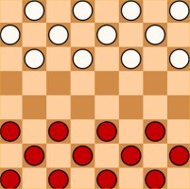
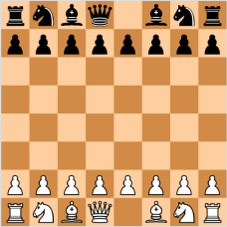
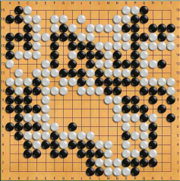
Branching Factor
Average game length
Game-tree complexity
The Game-tree complexity of Go is about 2⁷⁸⁷ times that of Chess. So even if Moore's law holds out forever, it would take about 700 years for Alpha-Beta to be competitive here.
Checkers
Chess
Go
8
35
250
70
123
150
10³¹
10¹²³
10³⁶⁰

Slide 10
Super Human Performance?
“Although progress has been steady, it will take many decades of research and development before world-championship– caliber go programs exist”. Jonathan Schaeffer, 2001
Checkers
Chess
Go
“It may be a hundred years before a computer beats humans at Go—maybe even longer.”
Dr. Piet Hut, 1997
1994
1997
?

Slide 11
Some Concrete Numbers
Exhaustively calculating the first eight moves would require computing 512 quintillion (5.12×10²⁰) possible combinations.
As of March 2014, the most powerful supercomputer in the world, NUDT's "Tianhe-2", can sustain 33 petaflops.
At that rate, even given an exceedingly low estimate of 10 operations required to assess the value of one play of a stone, Tianhe-2 would require 4 hours to assess all possible combinations of the next eight moves in order to make a single play.
Go
?
8

Slide 12
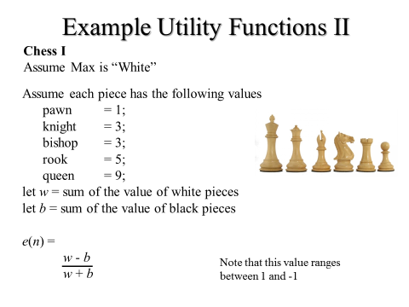
We have good utility functions for Checkers, Chess etc. What about Go?
All utility functions tend to work better, the deeper you are in the tree.
Even if we could get a supercomputer, and we could wait four hours, we would find that the utility function is basically the same for all nodes on the horizon! So we have no information to make an informed choice.
8

Slide 13
Monte Carlo Tree Search
Up to about ten years ago, Minimax or Alpha Beta was the last word in game playing.
However, a new idea, Monte Carlo Tree Search has now taken over,
Minimax/Alpha Beta are exact algorithms (at least exact as deep as their cutoff allows)
Monte Carlo Tree Search is a probabilistic algorithm, but it can search much larger trees.

Slide 14
Monte Carlo Tree Search Intuition
Imagine the following:
We are playing Go, and we need to choose between two moves, one is the move that is to the root of the red subtree, the other is the move that is to the root of the blue subtree.
The best evaluation function basically says “I have no idea which is better, maybe flip a coin?”
It happens to be true (but we have no way to know this) that:
  90% of the terminal nodes in Red are wins for white (Max)
  50% of the terminal nodes in Blue are wins for white (Max)
So, all things being equal, Red is a much better choice.
Red
Blue

Slide 15
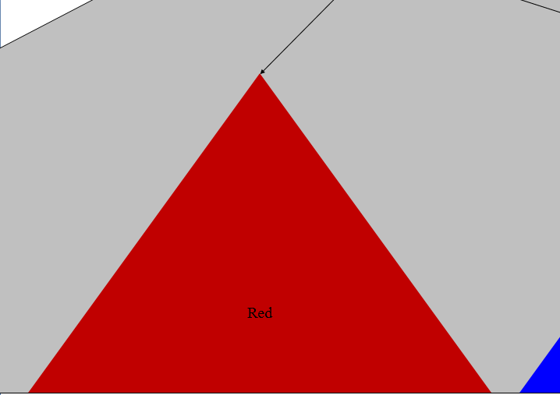
Suppose we started at the root of Red, and randomly traversed down the tree to a terminal node. What is the probability that this terminal node is a win for white (Max)?
It is 0.9
If I did the same for the Blue subtree, what is the probability that this terminal node is a win for white (Max)?
It is 0.5

Slide 16
Suppose I do this multiple times, lets say ten times, what is the expected number of wins for White (Max)?

Slide 18
Think of as: 9/10 = 90%
So 90% of the games that pass through this node are wins for Max
Likewise 6/10 = 60%
So 60% of the games that pass through this node are wins for Max
9/10
6/10
Red
Blue
Note that the correct value is 50%, but our estimate of 60% is pretty close

Slide 19
Monte-Carlo tree search (MCTS)
Until we run out of time (lets say one minute) MCTS repeats four phases:
descent, roll-out, update, and growth.
  descent phase: expand current node
  roll-out phase: play n random games from each leaf node (in my example, n = 3)
  update phase: the statistics (number of wins) are passed up the tree.
  growth phase: expand the most promising node.

Slide 20
descent phase

Slide 21
roll-out phase
Random Game 1: Win for white

Slide 22
roll-out phase
Random Game 2: Win for black
Random Game 1: Win for white

Slide 23
roll-out phase
Think of as: 2/3 =66.6%
So 66.6% of the games that pass through this node are wins for Max
2/3
Random Game 2: Win for black
Random Game 1: Win for white
Random Game 3: Win for white

Slide 24
roll-out phase
2/3
3/3
Random Game 3: Win for white
Random Game 1: Win for white
Random Game 2: Win for white

Slide 25
update phase
We can update the ancestor node(s)
So 7/12 of the games that pass through the root are wins for Max
7/12
2/3
3/3
1/3
1/3

Slide 26
growth phase
7/12
2/3
3/3
1/3
1/3

Slide 27
roll-out phase
7/12
2/3
3/3
1/3
1/3
1/3

Slide 28
update phase
8/15
2/3
4/6
1/3
1/3
1/3

Slide 29
growth phase
8/15
2/3
4/6
1/3
1/3
1/3

Slide 30
roll-out phase
8/15
2/3
4/6
1/3
1/3
3/3
1/3

Slide 31
update phase
11/18
5/6
4/6
1/3
1/3
3/3
1/3

Slide 32
11/18
5/6
4/6
1/3
1/3
3/3
1/3
Stop! We ran out of time, our one minute is up. Of our four options, one has the highest estimated probability of a win (5/6), so that is our move.

Slide 33
11/18
5/6
4/6
1/3
1/3
1/3
We wait a minute for Min to make his move. He choses the bold circle.
This now becomes the root of our new search tree, and we begin our one minute of MCTS again….

Slide 34
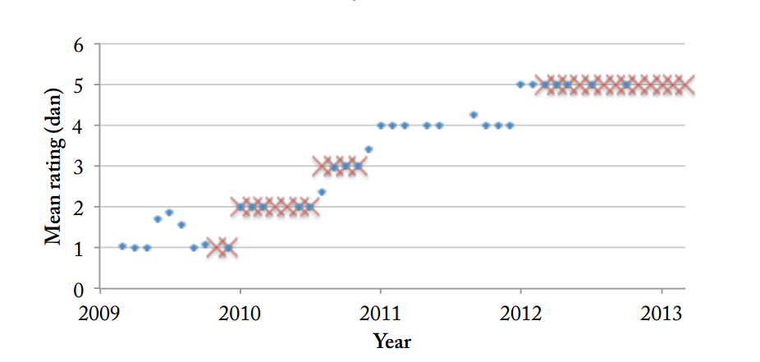
When will AI Go be superhuman?
I found this chart of progress in 2013, so I extrapolated it (next slide)….
9
Best Humans
8
7
Zen19 ratings over time on KGS Go servers. Data from KGS (2010, 2013a).
Adapted from: Algorithmic Progress in Six Domains. Katja Grace
There are about 100 USA players at 5 dan or above

Slide 35
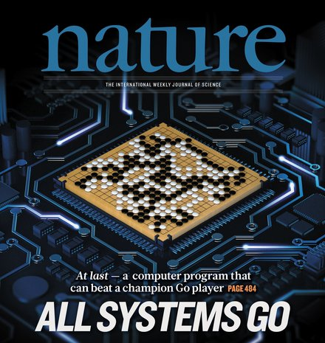

When will AI Go be superhuman?
It predicted human equivalence around 2017
9
Best Humans
8
7
2014
2015
2016
2017
In the 2017 Future of Go Summit, AlphaGo beat Ke Jie, the world No.1 ranked player at the time, in a three-game match.

Slide 36
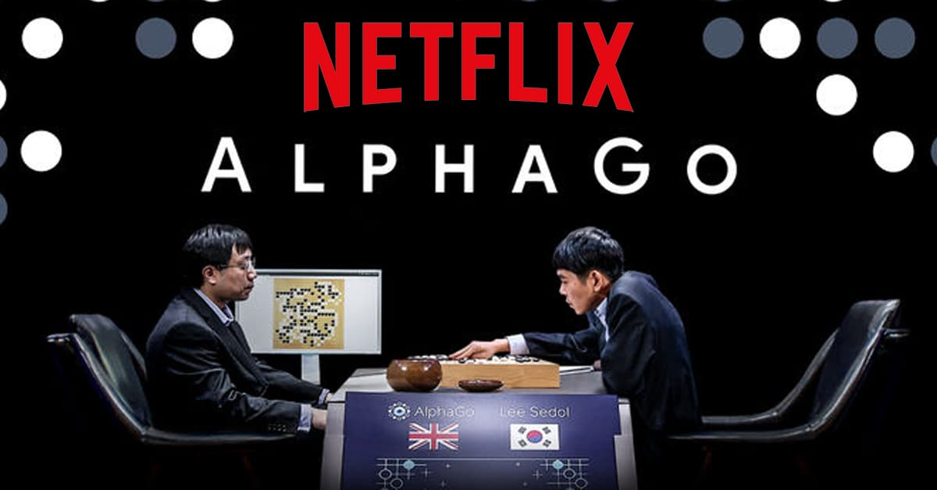
https://www.youtube.com/watch?v=WXuK6gekU1Y&

Slide 37
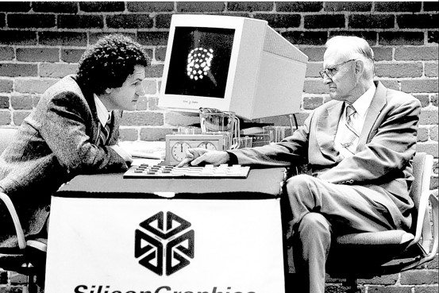
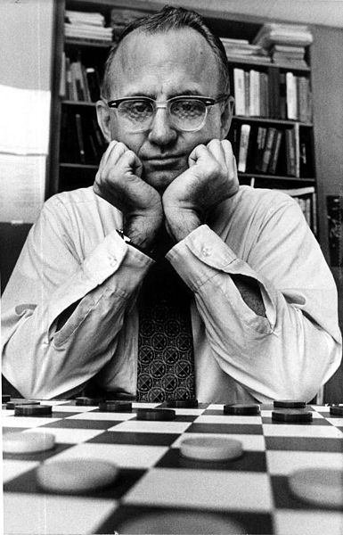
Checkers: Tinsley vs. Chinook
The average branching factor for checkers is about 10. The effective tree depth is about 40
Chinook is the first computer program to win the world champion title in a competition against humans. Chinook was declared the Man-Machine World Champion in checkers in 1994
Tinsley suffered loss to Chinook
Marion Tinsley (1927 – 1995) is considered the greatest checkers player who ever lived. He was world champion from 1955–1958 and 1975–1991. Tinsley never lost a World Championship match, and lost only five games (to humans) in his entire 45 year career.

Slide 38
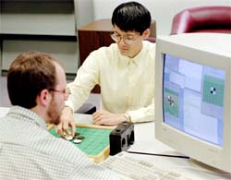
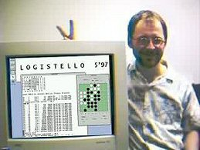
Othello: Murakami vs. Logistello
1997: The Logistello software crushed Murakami by 6 games to 0
The average branching factor for Othello is about 7. The effective tree depth is 60, assuming that the majority of games end when the board is full.
Logistello software written by Michael Buro
Takeshi Murakami: World (Human) Othello Champion

Slide 39
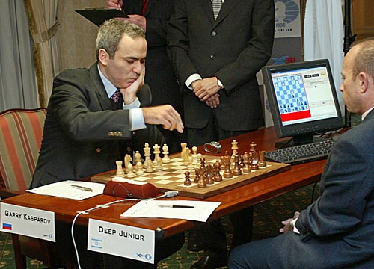
Chess: Kasparov vs. Deep Blue
1997: IBM Deep Blue wins by 3 wins, 1 loss, and 2 draws
The average branching factor for chess is about 36. The effective tree depth is about 40

Slide 40
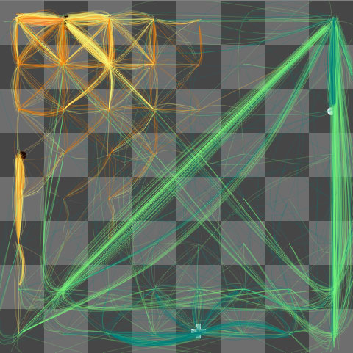
Very nice visualization of Chess Search
The machine's thoughts, endgame
The machine foresees that white's pawn will become a queen, and dominate the board as the black king flees.
www.turbulence.org/spotlight/thinking/chess.html

