Slide 1
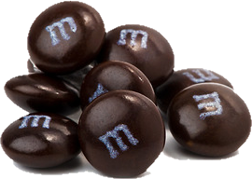
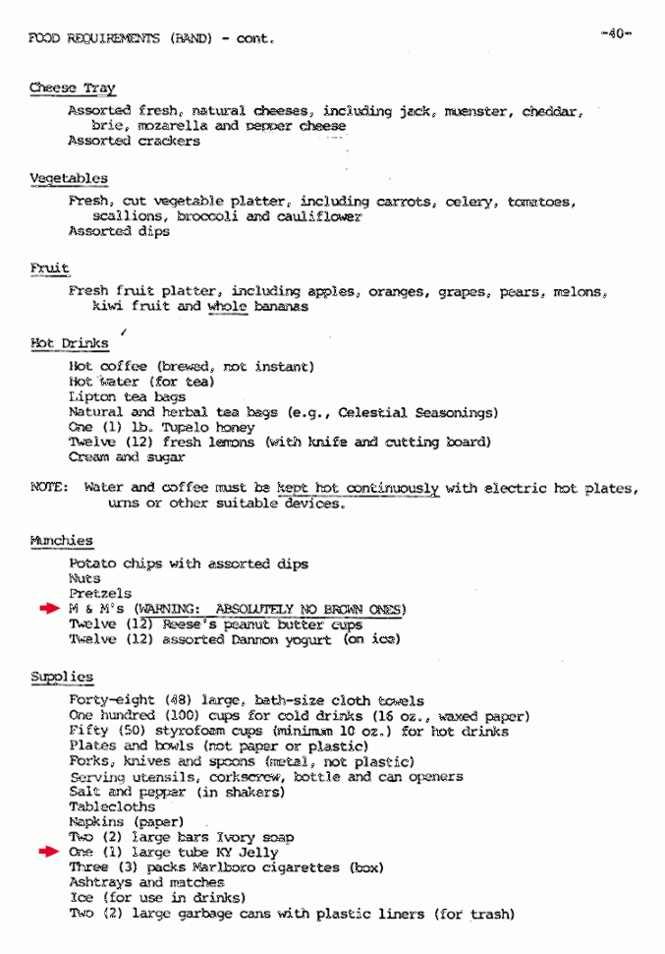
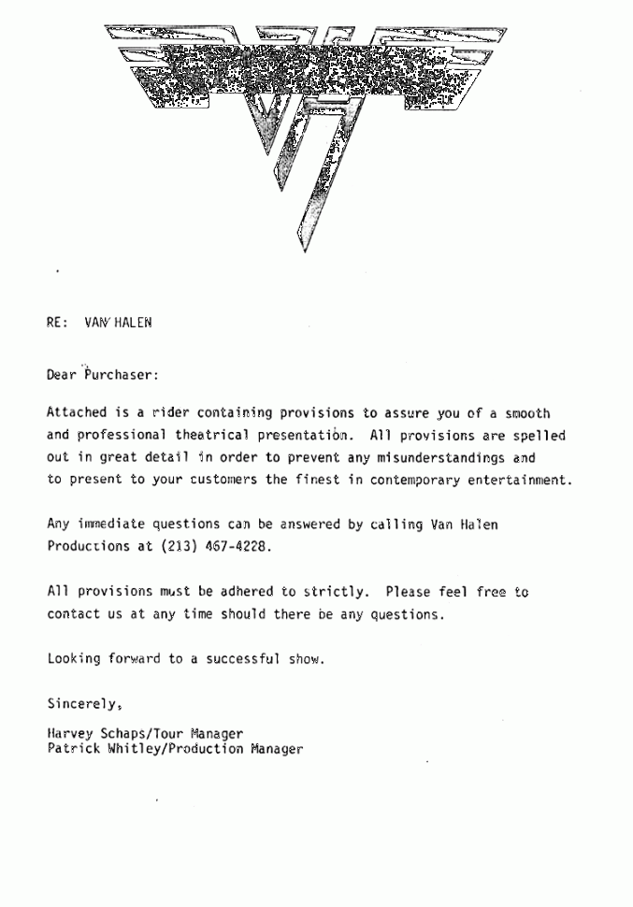

Slide 2
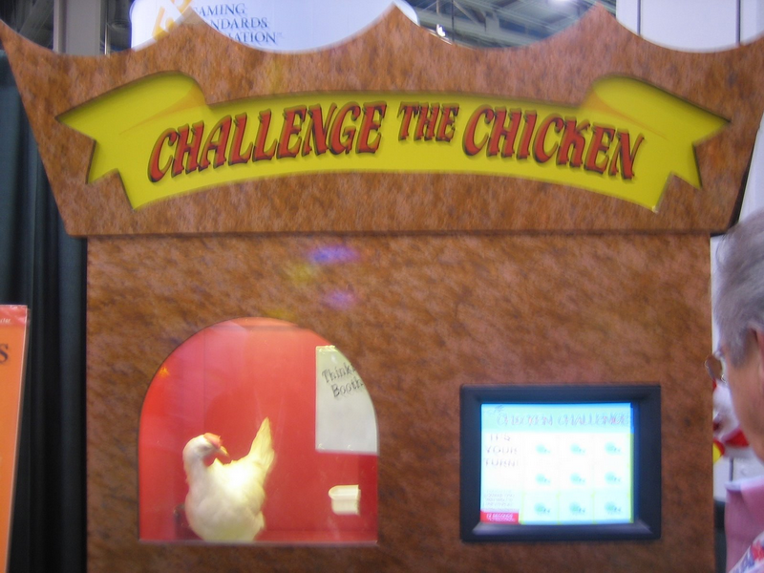

Slide 3
Adversarial Search
(game playing search)
We have experience in search where we assume that we are the only intelligent entity and we have explicit control over the “world”.
Let us consider what happens when we relax those assumptions. We have an enemy…

Slide 4
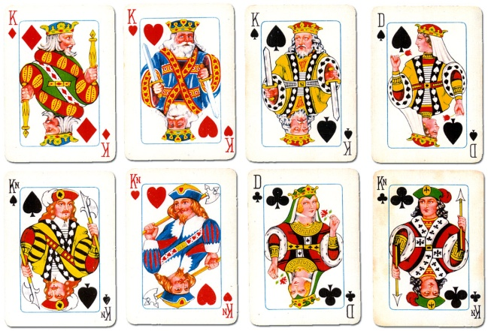
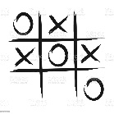
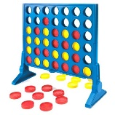
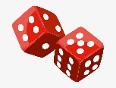
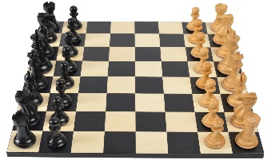
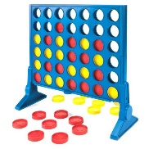
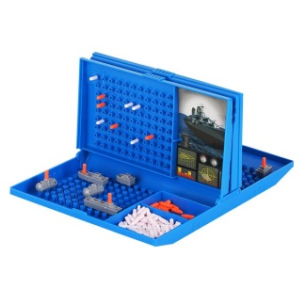
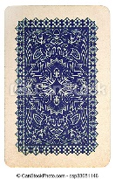
Types of Games
 | Deterministic | Stochastic
Perfect information (fully observable) | Chess, checkers, Go, Tic-Tac-Toe, Connect-Four, Hex | Backgammon
Imperfect information (partially observable) | Battleships | Scrabble, poker, bridge, Monopoly
Games can also be one, two or multi-player (we focus on two player)
Games can be cooperative or competitive (we focus on competitive, or zero-sum, games)

Slide 5
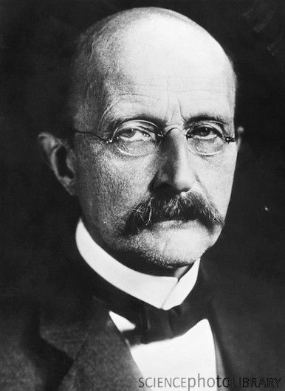
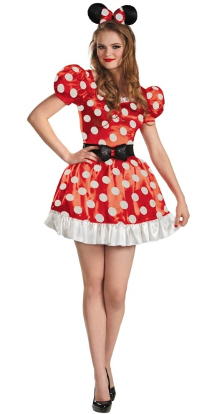
Two Player Games (Deterministic , fully observable)
Max always moves first.
Min is the opponent.
We have
  An initial state.
  A set of operators.
  A terminal test (which tells us when the game is over).
  A utility function (evaluation function).
The utility function is like the heuristic function we have seen in the past, except it evaluates a node in terms of how good it is for each player. Positive values indicate states advantageous for Max, negative values indicate states advantageous for Min.
Normally the closer to 1, the better things look for Max, the closer to -1, the better things look for Min.
Max Vs. Min

Slide 6
Two Player Games (Deterministic , fully observable)
Max always moves first.
Min is the opponent.
We have
  An initial state.
  A set of operators.
  A terminal test (which tells us when the game is over).
  A utility function (evaluation function).
  Sometimes the utility function can double as the terminal test. For example, if it returns exactly plus or minus 1.

Slide 7
Two Player Games (Deterministic , fully observable)
Assumption
We are assuming that both players are rational, and always make the optimal decision, with whatever information they have.

Slide 8
Adversarial Search Beyond Games
Adversarial search can be applied to economics, business, politics and war!
We will gloss over such considerations here

Slide 9
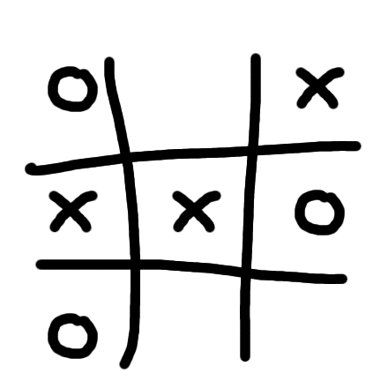
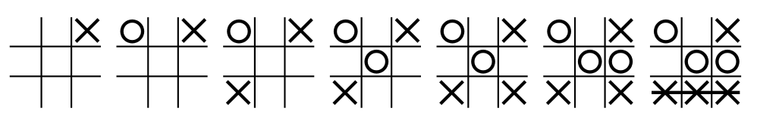
Tic-tac-toe
(noughts and crosses)

Slide 10
Max

Slide 11
Max
Min
...
...
...
...
...
...
...
...
...
Terminal States
Utility
-1
O
1

Slide 12
Max
Min
Max
...
...
...
...
...
...
...
...
...
Terminal States
Utility
-1
O
1

Slide 13
Max
Min
Max
...
...
...
...
...
...
...
...
...
Terminal States
Utility
-1
O
1

Slide 14
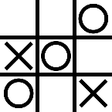
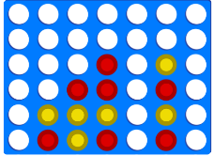
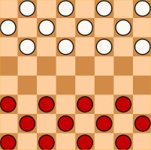
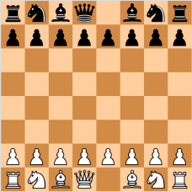
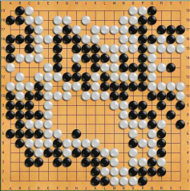
We can think about games mostly in terms of Game-Tree complexity
Branching Factor
Average game length
Game-tree complexity
Tic-Tac-Toe
Connect 4
Checkers
Chess
Go
9
9
7
255,168
42
8
35
250
4,531,985,219,092
70
40
150
10³¹
10¹²³
10³⁶⁰

Slide 15
A simple abstract game.
Max makes a move, then Min replies.
A1
A2
A3
A11
A12
A13
A21
A22
A23
A31
A32
A33
3
12
8
2
4
6
14
5
2
An action by one player is called a ply, two ply (a action and a counter action) is called a move.

Slide 16
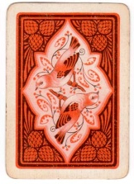
(To help make abstract games more concrete) Imagine a game: Max has 3 Kings,♦,♥,♠, he places one on the table.
Min has the Queen of ♣, he either places it on the table face up, face down, or says “no card!”.
Game over! We look up the payoffs in a table.
Payoff Table
K♦, Q ♣ $3
K♦, Face down $12
K♦, No Card! $8
etc
etc
etc
A1
A2
A3
A11
A12
A13
A21
A22
A23
A31
A32
A33
3
12
8
2
4
6
14
5
2
No Card
No Card
No Card

Slide 17
A simple abstract game.
Max makes a move, then Min replies.
A1
A2
A3
A11
A12
A13
A21
A22
A23
A31
A32
A33
3
12
8
2
4
6
14
5
2
An action by one player is called a ply, two ply (a action and a counter action) is called a move.

Slide 18
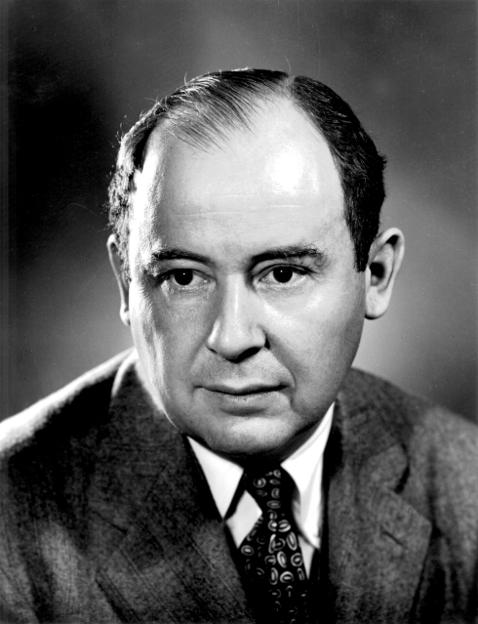
The Minimax Algorithm
Generate the game tree down to the terminal nodes.
Apply the utility function to the terminal nodes.
For a S set of sibling nodes, pass up to the parent…
  the lowest value in S if the siblings are
  the largest value in S if the siblings are
Recursively do the above, until the backed-up values reach the initial state.
The value of the initial state is the minimum score for Max.
Invention credited to von Neumann, but re-discovered by Turing, Shannon and others.
John von Neumann

Slide 19
A1
A2
A3
A11
A12
A13
A21
A22
A23
A31
A32
A33
Let's construct the full game tree.
We can do this with depth-first search, so memory is not an issue.

Slide 20
A1
A2
A3
A11
A12
A13
A21
A22
A23
A31
A32
A33
3
12
8
2
4
6
14
5
2
We run our evaluation function on all the terminal nodes.
In this case they are all at the same level, that need not be true in general.

Slide 21
A1
A2
A3
3
2
2
A11
A12
A13
A21
A22
A23
A31
A32
A33
3
12
8
2
4
6
14
5
2
We pass up the Minimum values one level….

Slide 22
3
A1
A2
A3
3
2
2
A11
A12
A13
A21
A22
A23
A31
A32
A33
3
12
8
2
4
6
14
5
2
…Then we pass up the Maximum values to the next level

Slide 23
3
A1
A2
A3
3
2
2
A11
A12
A13
A21
A22
A23
A31
A32
A33
3
12
8
2
4
6
14
5
2
We now know two things:
The expected payoff for Max (could be negative, could be binary)
The optimal strategy for Max and Min.

Slide 24
Although the Minimax algorithm is optimal, there is a problem…
The time complexity is O(b^{m}) where b is the effective branching factor and m is the depth of the terminal states.
(Note space complexity is only linear in b and m, because we can do depth-first search).
One possible solution is to do depth-limited Minimax search.
  Search the game tree as deep as you can in the given time.
  Evaluate the fringe nodes with the utility function.
  Back up the values to the root.
  Choose best move, repeat.
We would like to do Minimax on this full game tree...
… but we don’t have time, so we will explore it to some manageable depth.
cutoff

Slide 25
Depth Limited Minimax Search
  Search the game tree as deep as you can in the given time.
  Evaluate the fringe nodes with the utility function.
  Back up the values to the root.
  Choose best move, repeat.
After reply, search to cutoff, make best move, wait for reply…
Search to cutoff, make best move, wait for reply…
After reply, search to cutoff, make best move, wait for reply…

Slide 26
Example Utility Functions I
Tic Tac Toe
Assume Max is using “X”
e(n) =
  if n is win for Max, + ∞
  if n is win for Min, - ∞
else
  (number of rows, columns and diagonals available to Max) - (number of rows, columns and diagonals available to Min)
X
O
e(n) = 6 - 4 = 2
O
X
X
O
e(n) = 4 - 3 = 1

Slide 27
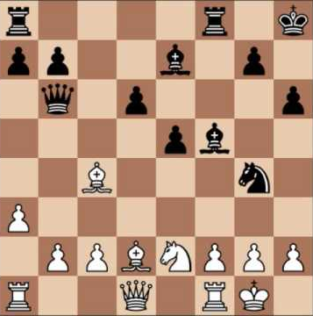
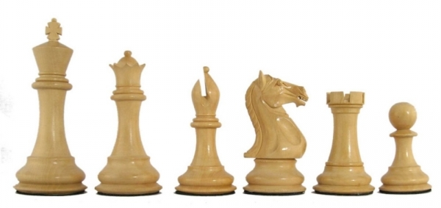
Example Utility Functions II
Chess I
Assume Max is “White”
Assume each piece has the following values
  pawn = 1;
  knight = 3;
  bishop = 3;
  rook = 5;
  queen = 9;
let w = sum of the value of white pieces
let b = sum of the value of black pieces
e(n) = w - b
w + b
Note that this value ranges between 1 and -1

Slide 28
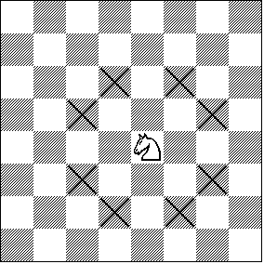
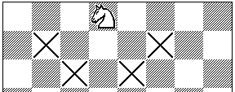
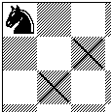
Example Utility Functions III
Chess II
The previous evaluation function naively gave the same weight to a piece regardless of its position on the board...
Let X_{i} be the number of squares the i^{th} piece attacks
e(n) =
piece₁value * X₁ + piece₂value * X₂ + ...
I have not finished the equation. The important thing to realize is that the evaluation function can be a weighted linear function of the pieces value, and its position

Slide 29
Utility Functions
We have seen that the ability to play a good game is highly dependant on the evaluation functions.
How do we come up with good evaluation functions?
Interview an expert.
Machine Learning.

Slide 30
Take Home Message
We cannot beat Minimax (but see Alpha-Beta below) for exact game playing.
All our time should be spent on better utility functions
Just like
We cannot beat A*, all our time should be spent on better heuristic functions

Slide 31
Alpha-Beta Pruning I
We have seen how to use Minimax search to play an optional game.
We have seen that because of time limitations we may have to use a cutoff depth to make the search tractable. Using a cutoff causes problems because of the “horizon” effect.
Is there some way we can search deeper in the same amount of time?
Yes! Use Alpha-Beta Pruning...
Game winning move.
Best move before cutoff...
… but all its children are losing moves

Slide 32
Alpha-Beta Pruning II
If you have an idea that is surely bad, don't take the time to see how truly awful it is.
Pat Winston
BestSoFar = -inf
A1
A2
A3
A11
A12
A13
A21
A22
A23
A31
A32
A33

Slide 33
Alpha-Beta Pruning II
If you have an idea that is surely bad, don't take the time to see how truly awful it is.
Pat Winston
BestSoFar = -inf
A1
A2
A3
A11
A12
A13
A21
A22
A23
A31
A32
A33
3
12
8

Slide 34
Alpha-Beta Pruning II
If you have an idea that is surely bad, don't take the time to see how truly awful it is.
Pat Winston
BestSoFar = 3
A1
A2
A3
3
A11
A12
A13
A21
A22
A23
A31
A32
A33
3
12
8

Slide 35
Alpha-Beta Pruning II
If you have an idea that is surely bad, don't take the time to see how truly awful it is.
Pat Winston
BestSoFar = 3
A1
A2
A3
3
≤ 2
A11
A12
A13
A21
A22
A23
A31
A32
A33
3
12
8
2
Stops completely evaluating a move when at least one possibility has been found that proves the move to be worse than a previously examined move.

Slide 36
Alpha-Beta Pruning II
If you have an idea that is surely bad, don't take the time to see how truly awful it is.
Pat Winston
3
BestSoFar = 3
A1
A2
A3
3
≤ 2
2
A11
A12
A13
A21
A22
A23
A31
A32
A33
3
12
8
2
14
5
2
Stops completely evaluating a move when at least one possibility has been found that proves the move to be worse than a previously examined move.

Slide 37
Alpha-Beta Pruning III
      Effectiveness of Alpha-Beta
Alpha-Beta is guaranteed to compute the same Minimax value for the root node as computed by Minimax
In the worst case Alpha-Beta does NO pruning, examining b^{d} leaf nodes, where each node has b children and a d-ply search is performed
In the best case, Alpha-Beta will examine only 2b^{d/2} leaf nodes. Hence if you hold fixed the number of leaf nodes then you can search twice as deep as Minimax!
The best case occurs when each player's best move is the leftmost alternative (i.e., the first child generated). So, at MAX nodes the child with the largest value is generated first, and at MIN nodes the child with the smallest value is generated first. This suggest that we should order the operators carefully...
In the chess program Deep Blue, they found empirically that Alpha-Beta pruning meant that the average branching factor at each node was about 6 instead of about 35-40

Slide 38
Here is a trivial, but legal example.
Max makes a move, and the game is immediately over!
What should Max do?
A
B (5)
C (100)
D (-7)

Slide 39
Max should move to C, and win 100 dollars
A
100
B (5)
C (100)
D (-7)

Slide 40
A more interesting game
Max has three choices, and depending on what he does, Min has 2 or 3 choices of a reply
What should Max do?
A
B
C
D
E (4)
F (5)
G(6)
H (2)
J (45)
K (3)
L (8)
Let us use Alpha-Beta pruning to find out.

Slide 41
First we explore the subtree under B
If we moved there, Min could give us 4 dollars, or 5 dollars
If we assume that Min in rational, the expected payoff is 4 dollars
A
4
B
C
D
E (4)
F (5)
G(6)
H (2)
J (45)
K (3)
L (8)
Note that some people would write here <=4 dollars.
That is to say, they would label subtree B as four dollars or greater
If Max is rational, that is unnecessary

Slide 42
Now we begin to explore the subtree under C, beginning with G
If we moved to C, and Min moved us to G, we would get 6 dollars, which is better than 4
This looks promising, so we keep exploring, visiting H
If we moved to C, and Min moved us to H, we would get 2 dollars, which is worse than 4
A
4
<=2
B
C
D
E (4)
F (5)
G(6)
H (2)
J (45)
K (3)
L (8)
Given this, we don’t care what is in J, we can prune it
We push less than or equal to 2 up the subtree to label node C

Slide 43
Finally we begin to explore the subtree under D, beginning with K
If we moved to D, and Min moved us to K, we would get 3 dollars, which is worst than 4
Given that, we don’t care what is in L, we can prune it.
A
4
<=2
<=3
B
C
D
E (4)
F (5)
G(6)
H (2)
J (45)
K (3)
L (8)
Given this, we don’t care what is in J, we can prune it
We push less than or equal to 3 up the subtree to label node D

Slide 44
So Max’s best move is to B, and he expects to win 4 dollars
A
4
4
<=2
<=3
B
C
D
E (4)
F (5)
G(6)
H (2)
J (45)
K (3)
L (8)

Slide 45
Here is more complex game tree, the depth and branching factors depend on how we play
As before, we will start exploring subtree B..
A
B
C
D
H
J
E (4)
F (99)
G(6)
K (3)
L (8)
M (3)
N (4)
O (7)
P (9)

Slide 46
Playing B guarantees me 4 dollars
If Max pays C and Min tried G, that would be a 6 dollar payoff, better than 4, so we must keep exploring the C subtree…
A
4
B
C
D
H
J
E (4)
F (99)
G(6)
K (3)
L (8)
M (3)
N (4)
O (7)
P (9)

Slide 47
If Max pays C and Min tried H, then there are two choices for Max
The first is M, it only pays 3 dollars
But suppose that N paid 10000 dollars! (actually, anything better than 4 would do)
We need to find out, so we go to N, and find 4
A
4
B
C
D
H
J
4
E (4)
F (99)
G(6)
K (3)
L (8)
M (3)
N (4)
O (7)
P (9)

Slide 48
…we need to find out, so we go to N, and find 4
At this, I can prune the J subtree. It does not help me to know what the values there are
A
4
B
<=4
C
D
H
J
4
E (4)
F (99)
G(6)
K (3)
L (8)
M (3)
N (4)
O (7)
P (9)

Slide 49
Finally , we need to visit the D subtree
As soon as we explore K and find its value is 3 we can prune the rest of the subtree
A
4
B
<=4
<=3
C
D
H
J
4
E (4)
F (99)
G(6)
K (3)
L (8)
M (3)
N (4)
O (7)
P (9)

Slide 50
Thus Max’s best move is to pay B, and he expects to win 4 dollars
A
4
4
B
<=4
<=3
C
D
H
J
4
E (4)
F (99)
G(6)
K (3)
L (8)
M (3)
N (4)
O (7)
P (9)

Slide 51
Use Minimax or Alpha-Beta, but don’t search so deep…
4-ply ≈ human novice
8-ply ≈ typical PC, human master/grandmaster
12-ply ≈ Deep Blue, Kasparov
Grandmaster
Master
Beginner

Slide 52
Solved Games
A solved game is a game whose outcome (win, lose, draw, infinite) can be correctly predicted from any position, given that both players play perfectly. Games which have not been solved are said to be "unsolved".
The most obvious way to solve a game, is to run the Minimax Algorithm all the way to the leaf nodes, and back up the scores to the root node. At that point, there are only four options:
    It is a win for first player.
    It is a win for second player.
    It is a draw.
    The game can be played forever, with no winner.
It is rare we can actually do this full search to the leaf nodes.

Slide 53
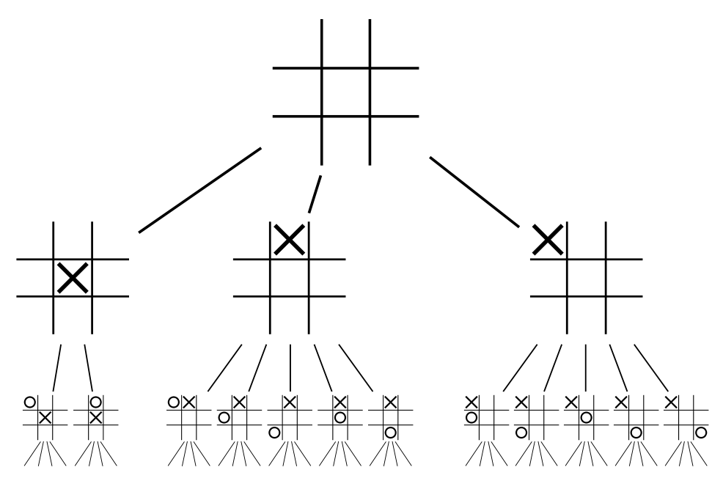
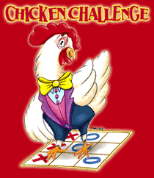
The backed-up utility function (evaluation function) for Tic-tac-toe is zero. In other words, it is a solved game, and a draw.
To put it another way, if god A played this game with god B a trillion times, the outcome would always be a draw.
0
Thus we say, Tic-tac-toe is solved
A solved game is a game whose outcome (win, lose, or draw) can be correctly predicted from any position, given that both players play perfectly.

Slide 54
Remember our toy example?
It is solved. It is a win for Max (a win of 3)
3
A1
A2
A3
3
2
2
A11
A12
A13
A21
A22
A23
A31
A32
A33
3
12
8
2
4
6
14
5
2

Slide 55
Here is a different toy example
It is solved. It is a loss for Max (a loss of 1 for Max, or a win for Min of 1)
-1
A1
A2
A3
-1
-44
-9
A11
A12
A13
A21
A22
A23
A31
A32
A33
-1
12
8
2
-44
6
0
-9
10,000

Slide 56
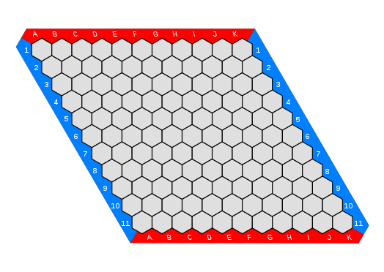
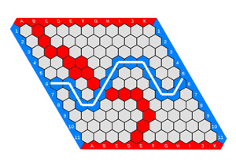
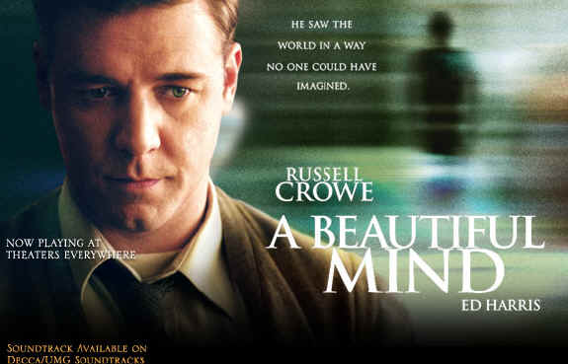
Hex is solved
Hex is a win (for Max)
One way to solve a game is to build the entire search tree and run Minimax on it.
However sometimes that is not necessary…

Slide 57
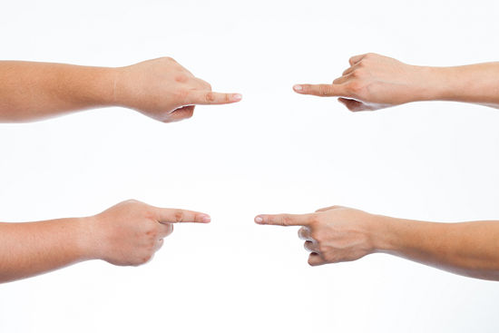
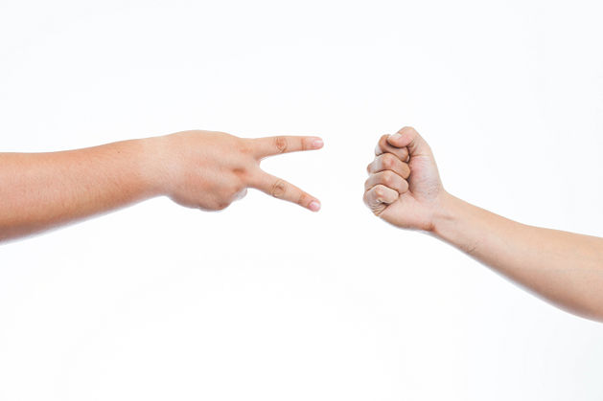
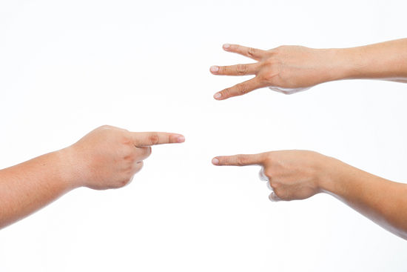
Chopsticks is Solved
(Swords, Sticks, Split, Cherries and Bananas)
Chopsticks is a loss (for Max)
Players extend a number of fingers from each hand and transfer those scores by taking turns to tap one hand against another.

Slide 58
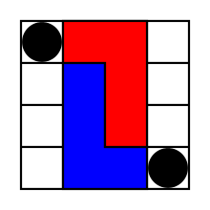
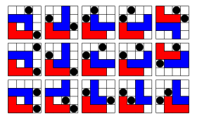
L game is Solved!
The L game is infinite
On each turn, a player must first move their L piece, and then may optionally move either one of the neutral pieces. The game is won by leaving the opponent unable to move their L piece to a new position.
Pieces may not overlap or cover other pieces. On moving the L piece, it is picked up and then placed in empty squares anywhere on the board. It may be rotated or even flipped over in doing so; the only rule is that it must end in a different position from the position it started—thus covering at least one square it did not previously cover.
To move a neutral piece, a player simply picks it up then places it in an empty square anywhere on the board.
There are only 2296 possible arrangements. Only 30 of them are winning positions (15 for each color).
However, both perfect players can avoid being forced into a losing position.
Of course, this does not mean that if two humans play that there will be no winner/loser.
Play online: https://hwwmath.looiwenli.com/l-game
Blue has won, red has no move

Slide 59
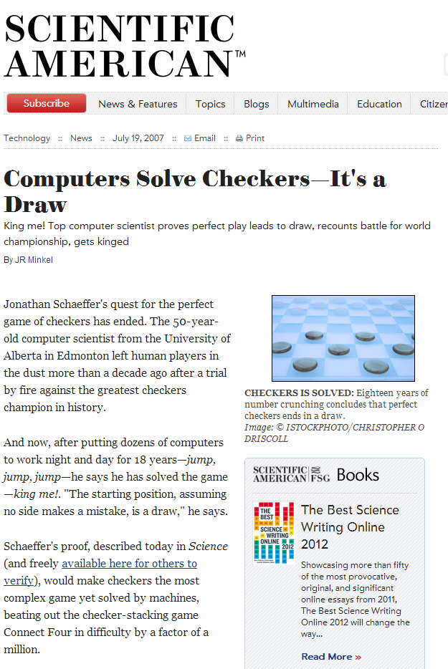
Checkers is Solved!
Checkers is a draw
The game of checkers has roughly 500 billion billion possible positions (5 × 10²⁰). The task of solving the game, determining the final result in a game with no mistakes made by either player, is daunting. From 1989 to 2007, almost continuously, dozens of computers have been working on solving checkers, applying state-of-the-art artificial intelligence techniques to the proving process.

Slide 60
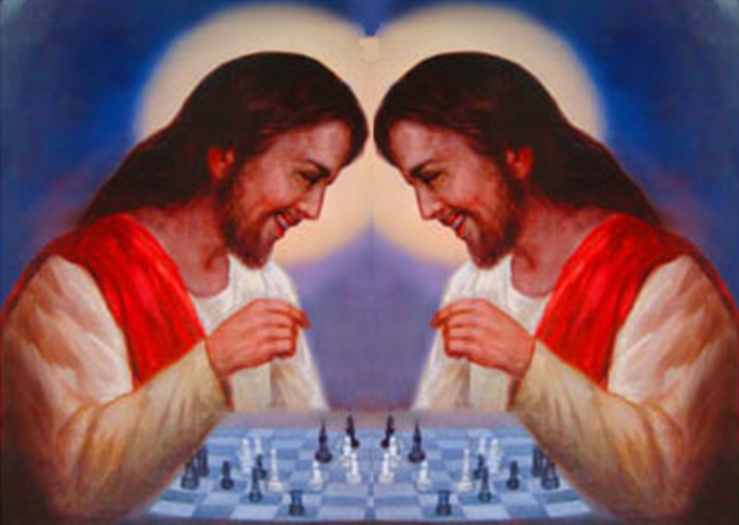
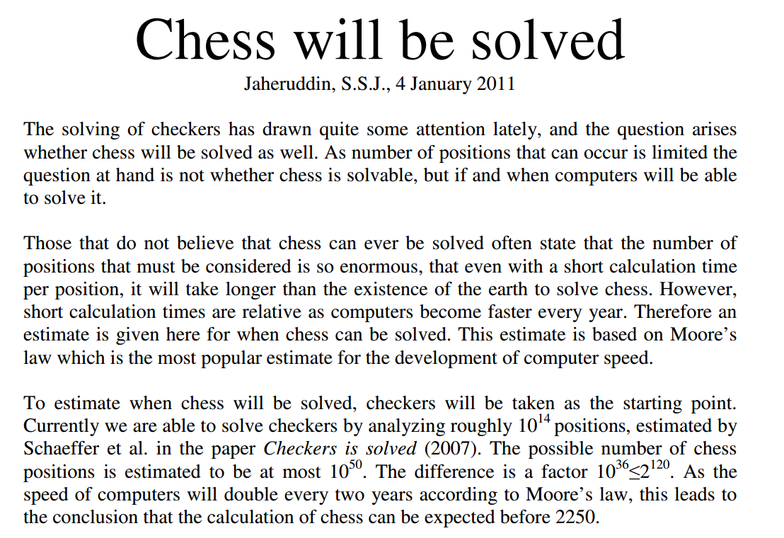
Chess is not Solved I
Will chess ever be solved?
One estimate is that it will be solved in 2250 (about 200 years) assuming Moore’s law holds all that time!!

Slide 61
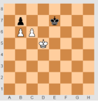
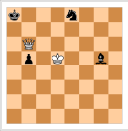
Chess is not Solved II
However, every endgame, with 7 pieces or fewer has been solved!
This does not help that much, since most games are over long before we get down to 7 pieces.
All 4-piece endgames were solved in the late 80s
In the early 90s, all 5-piece endgames were solved
In 2005, all 6-piece endings were solved.
In 2012, all 7-piece endings were solved.
The computer memory required for all 7-piece endings is 140 terabytes.

Slide 62
Review
For Adverserial Search
Minimax is the optimal algorithm
We can almost never use Minimax, because of its time complexity.
We can use depth-limited Minimax, to go as deep as possible in the time allowed
A clever pruning trick alpha-beta search, lets us go about twice as deep (in the best case).
Since that is all there is for search (but see later), all the research is spent on better evaluation functions

