Slide 1
4 | 1 | 2
5 | 3
7 | 8 | 6
Let’s us use this puzzle to compare the algorithms we have learned about…
  Breadth first search (Uniform cost search, each move costs one unit)
  Depth first search
  Depth limited search
  Iterative Deepening
1 | 2 | 3
4 | 5 | 6
7 | 8
This is our goal state

Slide 2
4 | 1 | 2
5 | 3
7 | 8 | 6
Let’s us use this puzzle to compare the algorithms we have learned about.
4 | 1 | 2
5 |  | 3
7 | 8 | 6
4 | 1 | 2
 | 5 | 3
7 | 8 | 6
 | 1 | 2
4 | 5 | 3
7 | 8 | 6
1 |  | 2
4 | 5 | 3
7 | 8 | 6
1 | 2
4 | 5 | 3
7 | 8 | 6
1 | 2 | 3
4 | 5
7 | 8 | 6
  I happen to know that the optimal solution takes seven moves, like this.
1 | 2 | 3
4 | 5 | 6
7 | 8

Slide 3
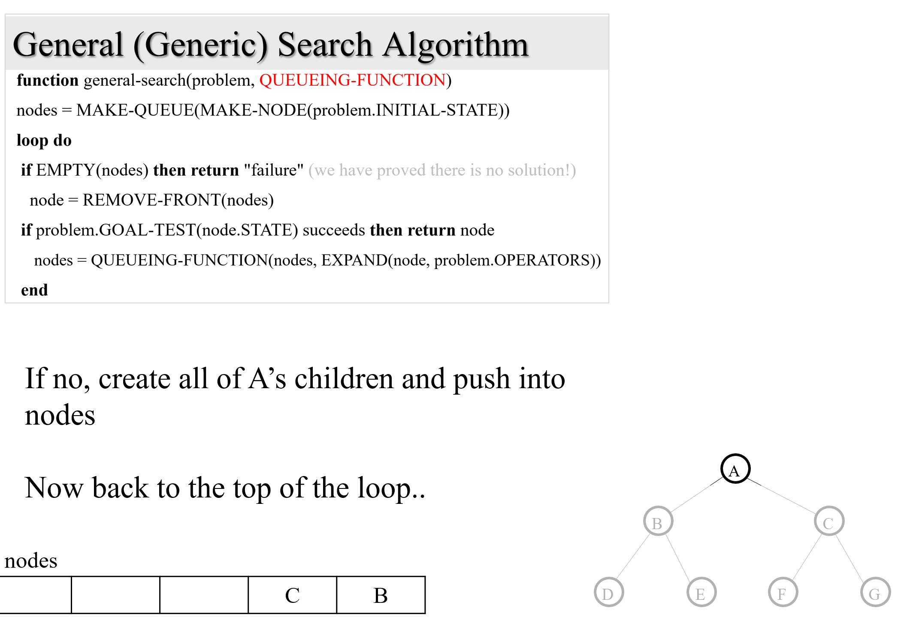
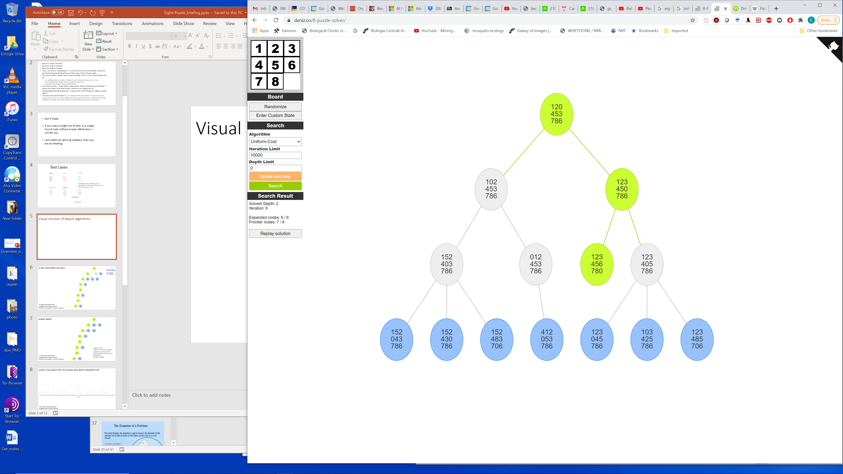
How to read my figures
Key
Green: Nodes on the solution path
Gray: Nodes that were tested to see if they were goal state
Blue: Nodes currently in the fronter (in nodes queue)
Solved! Depth: 2
Expanded nodes: 6
Frontier nodes: now 7, the maximum was 8
Initial state
Goal state
Recall that the number of “Expanded nodes” correlates with time spent, and “maximum Frontier node” correlates with memory needed.

Slide 4
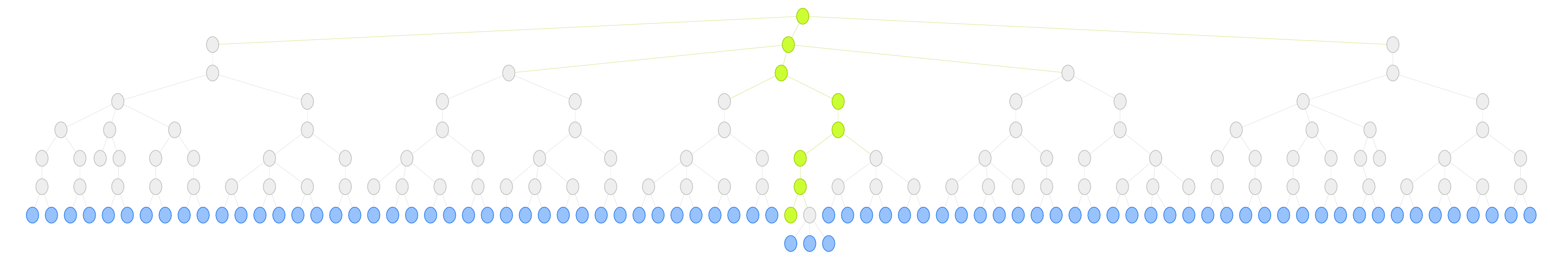
Uniform Cost Search (for this problem this is equivalent to Breadth-First)
104 nodes were expanded
Largest size of queue was 82
Solution is at depth 7, which is optimal

Slide 5
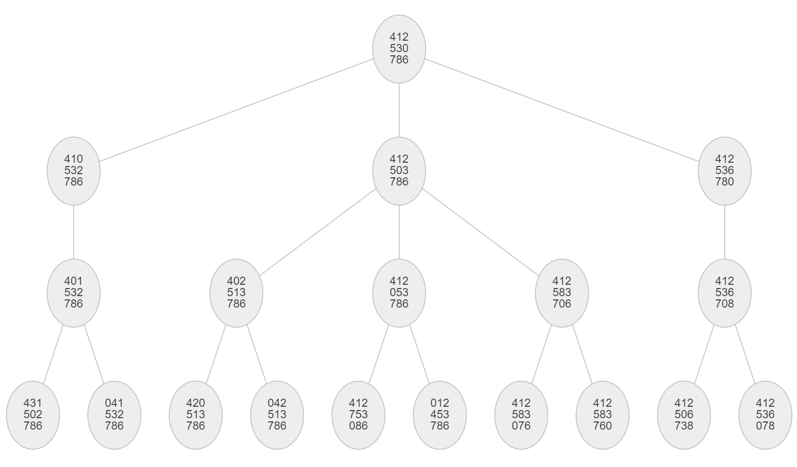
Depth-Limited Search with Limit = 3
Here I guessed a limit of 3. It turns out, that was a bad guess, not high enough.
However, this reveals a weakness of Depth-Limited Search, it is often hard to guess a limit
19 nodes were expanded
Largest size of queue was 3
Failed to find solution!

Slide 6
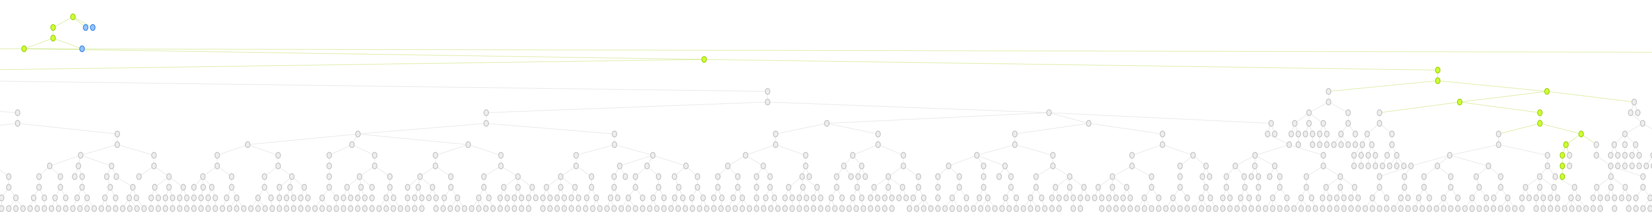
Depth-Limited Search with Limit = 18
Here I guessed a limit of 18. It turns out, that was a bad guess, much too high.
However, this reveals a weakness of Depth-Limited Search, it is often hard to guess a limit
Full Tree
Goal State
Zoom-in
6,550 nodes were expanded
Solution is at depth 15, recall optimal solution is at depth 7
Largest size of queue was 18

Slide 7
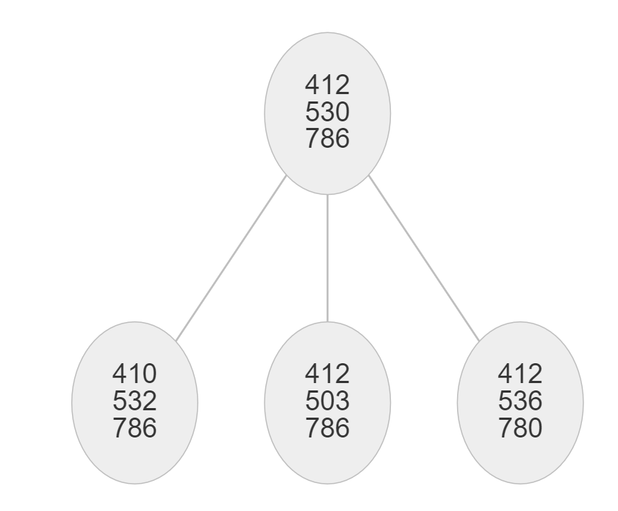
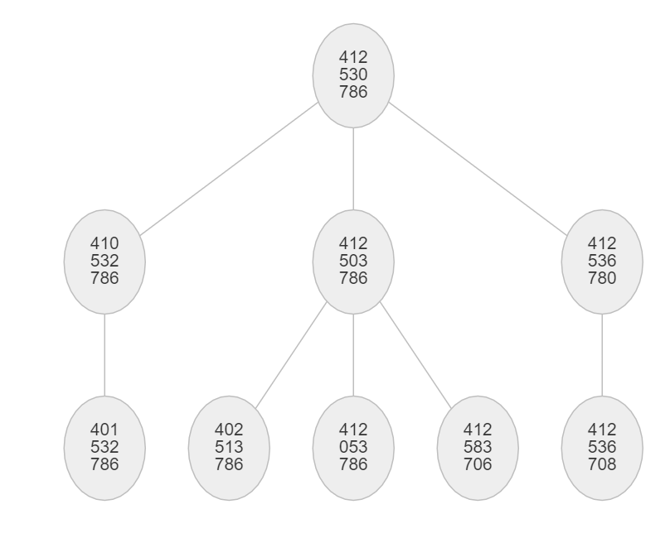
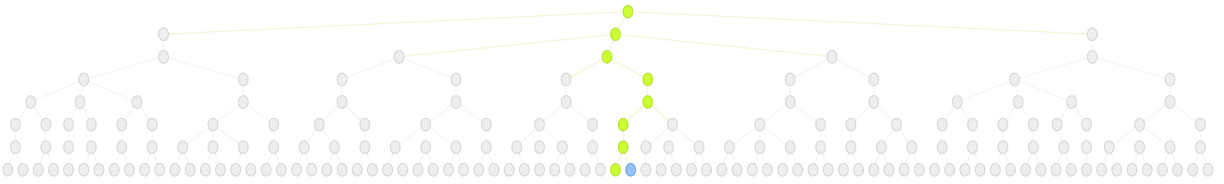
Iterative Deepening
depth 0
depth 1
depth 2
depth 3
depth 4, 5 and 6 omitted
depth 7
181 nodes were expanded. This includes the nodes that were expanded multiple times
Largest size of queue was 8
Solution is at depth 7, which is optimal

Slide 8
Depth-First
If we do this search without checking for repeated states, in general it will run forever.
If we check repeated states, then we may have to expand up to 181,440 nodes, the full size of the problem space.
Recall that even if we do check repeated states,
  We need memory of the order of 181,440 (to keep track of repeated states)
  We may not find the optimal solution
(assuming we track repeated states)
Up to 181,440 nodes may be expanded
Solution could be as deep as 31, recall optimal solution is at depth 7

Slide 9
An Apparent Digression

Slide 10

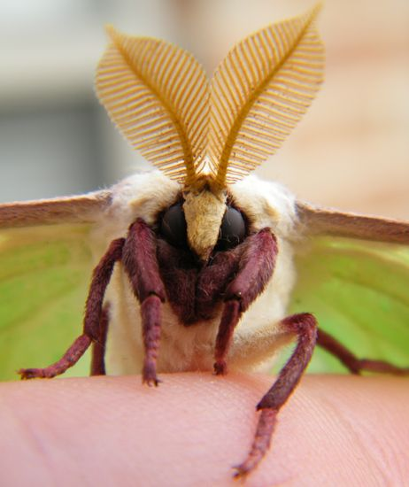
The male moth needs to find a female. The female may be up to five miles away!
Like all insects, moths have rather poor vision. In any case, most moths fly at night.
However, moths have an excellent sense of smell.
Smell, unlike sound or sight, is omnidirectional.
The female releases a pheromone, which spreads around her in a plume.
The plume spreads out in concentric circles, with a gradient reflecting the distance from the female.
If the female is moving or there is a wind, the circles become approximately elliptical.
Let us see how a male searches for a female. It may have implications for our use of search.

Slide 11
The moth has a vague idea of how far the female is from the strength of the smell.
Lets call this prediction DIST
Note that DIST is only distance, it has no directional information.
Ok, we are now ready to see the moth’s algorithm.
Begin Algorithm
He flies in a straight line, in a random direction (this is called casting).
He remember how strong the smell is along the straight path…

Slide 12
… he remembers two locations that have about equal strength (green) dots.
He creates a bisector line (fine dashed line) to a line connecting the two green dots.
This can be seen as a guess as to the direction of the female, she is close to the line somewhere.
Note that as I explained this, the female could be on either side of the line with green dots. In practice, the straight-line flight has a wobble that gives the side that is most likely to have the female.

Slide 13
… he remembers two locations that have about equal strength (green) dots.
He creates a bisector line (fine dashed line) to a line connecting the two green dots.
This can be seen as a guess as to the location of the female, she is close to the line somewhere.
The male already has an idea as to how far away she is, DIST.
So he flies to a point that is a little past DIST on his bisector, the pink dot. This is call surging.
DIST

Slide 14
On his way to the pink dot, he remembers the strength of the of the smell.
In particular, he remembers two new locations that have about equal strength of smell, two new green dots…
The moth can simply repeat the algorithm until he finds the female.

Slide 16
Success!

Slide 17
Blind (uniformed) search Heuristic (informed) search

Slide 18
Takeaway message
Blind (uniformed) search can be very very inefficient.
Heuristic (informed) search can be very efficient. This is true even if the information is very weak.
If we extend this analogy to AI search, it suggest that if we can just give the search algorithm some hints about how close it is to the goal, this might greatly improve search.

Slide 19
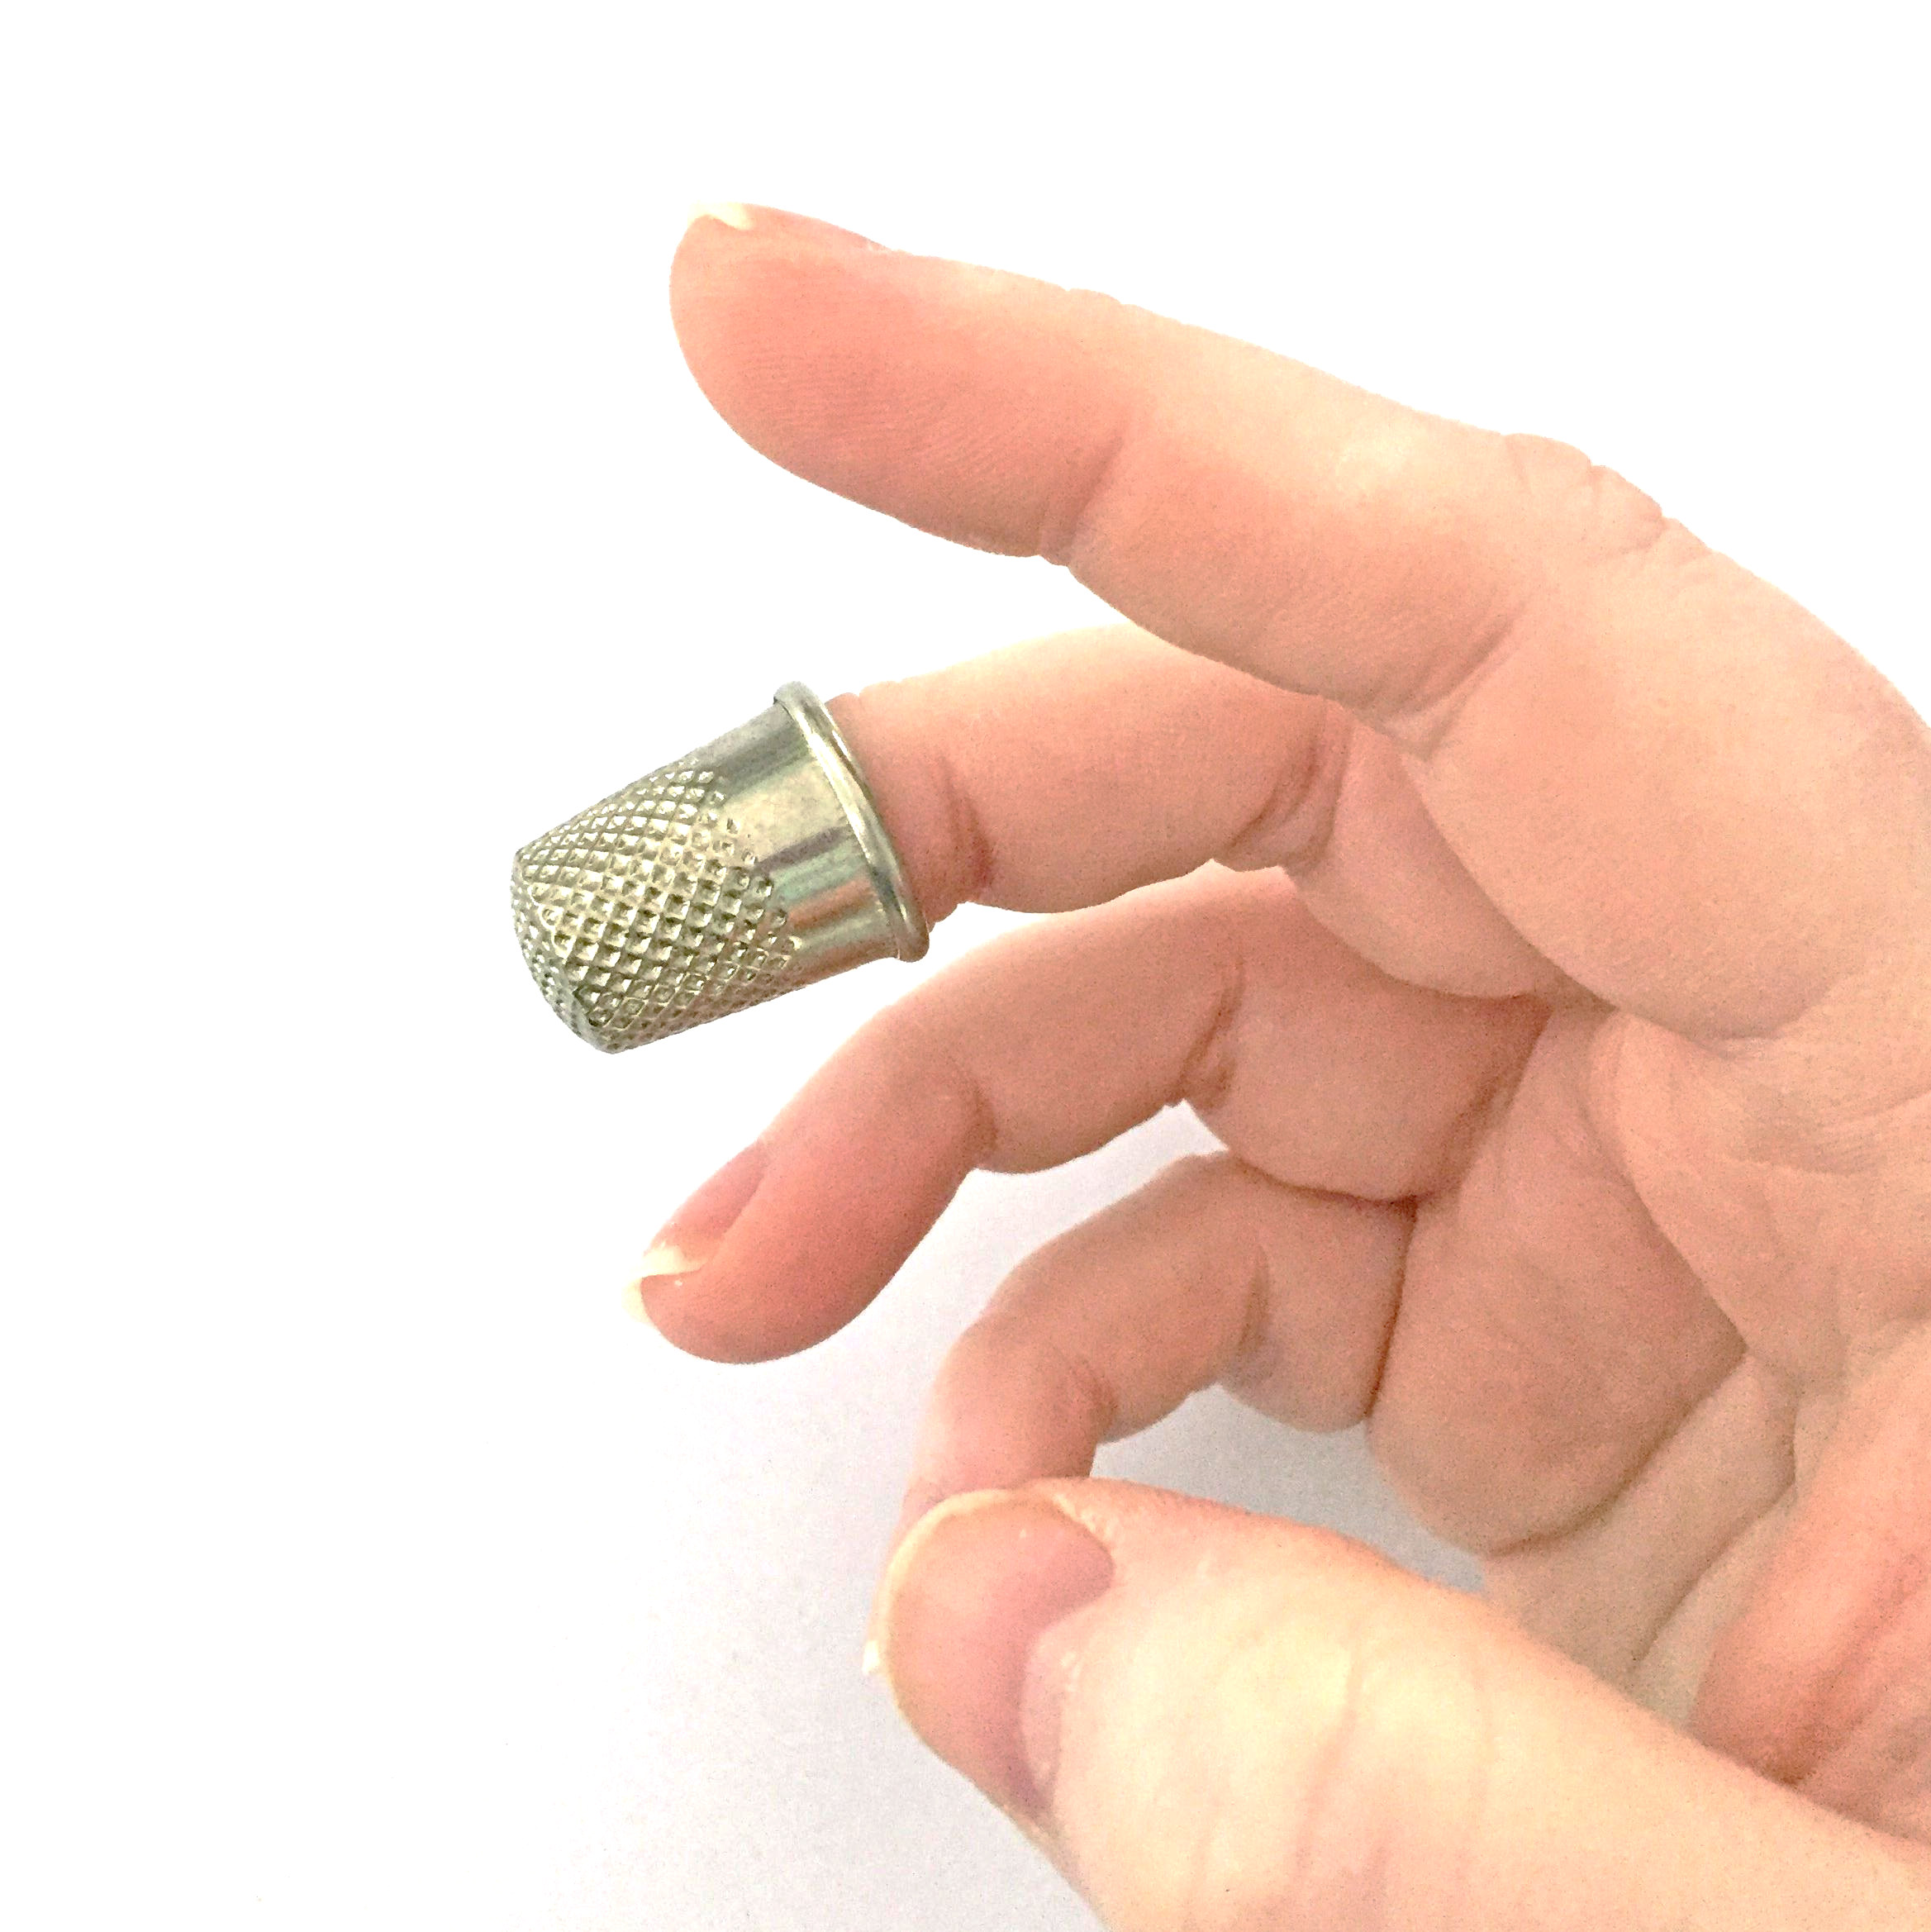
Hunt the Thimble (also known as Hide the Thimble) is a party game in which one person hides a thimble, or other small object, somewhere in the room, while all other players wait outside. (In some versions of the game, it must be hidden in plain sight.) When everyone comes back in, they race to locate the hidden object. The first to find it is the winner, and hides it for the next game.
In some versions of the game, the hider tells the searchers what "temperature" they are based on proximity to the hidden object—the closer they get, the hotter they are; thus, the farther they are from the object, the colder they are.
Similar games exist in Germany (Topfschlagen, in which a blindfolded player must find a pot guided by calls of hot or cold); in Poland (Ciepło-zimno) and in Russia (Kholodno-goryacho, both meaning Hot & Cold). In the Polish and Russian version, a player is guided to find a hidden object by calls of cold, colder, warm, hot, boiling; blindfold is not used. The game exists also in Spanish speaking countries.
Relevance to Search
So far, our search has been blind search or uniformed search. This is like the game above, but with no temperature clues.
Now we are going to see heuristic search or informed search. This is like the case where we have some clues about how close we are to the goal state. Even if these clues are weak, they can dramatically speed up search.

Slide 20
Heuristic Search
The search techniques we have seen so far...
  Breadth first search / Uniform cost search
  Depth first search
  Depth limited search
  Iterative Deepening
  Bi-directional Search
...are all too slow for most real-world problems
uninformed search
blind search

Slide 21
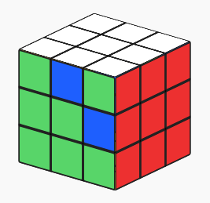
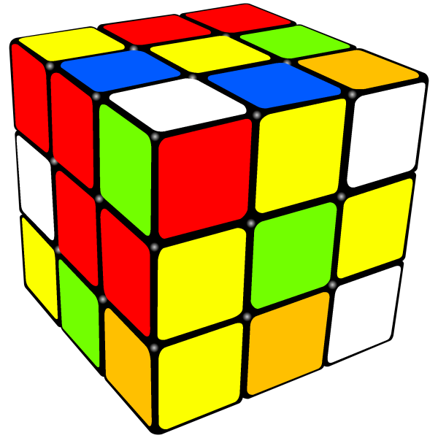
Sometimes we can tell that some states appear better that others...
7
8
4
1
2
3
3
5
1
4
5
6
6
2
7
8
FWD
D
C
FW C

Slide 22
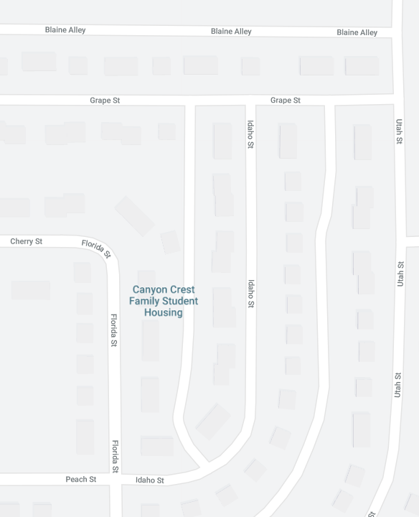
Sometimes we can tell that some states appear better that others...
Goal
Goal

Slide 23
...we can use this knowledge of the relative merit of states to guide search
Heuristic Search (informed search)
A Heuristic is a function that, when applied to a state, returns a number that is an estimate of the merit of the state, with respect to the goal. We write it as h(n)
In other words, the heuristic tells us approximately how far the state is from the goal state*.
Note we said “approximately”. Heuristics might underestimate or overestimate the merit of a state. But for reasons which we will see, heuristics that only underestimate are very desirable, and are called admissible.
*I.e Smaller numbers are better

Slide 24
Heuristics for 8-puzzle I
1
2
3
Current State
4
5
6
7
8
1
2
3
The number of misplaced tiles (not including the blank)
1
2
3
4
5
6
4
5
6
1
2
3
7
8
Goal State
7
8
4
5
6
7
8
N
N
N
In this case, only “8” is misplaced, so the heuristic function evaluates to 1.
In other words, the heuristic is telling us, that it thinks a solution might be available in just 1 more move.
N
N
N
N
Y
Notation: h(n) h(current state) = 1

Slide 25
Heuristics for 8-puzzle II
3
2
8
3
3
Current State
2 spaces
4
5
6
7
1
The Manhattan Distance (not including the blank)
8
1
2
3
Goal State
3 spaces
4
5
6
8
7
8
1
In this case, only the “3”, “8” and “1” tiles are misplaced, by 2, 3, and 3 squares respectively, so the heuristic function evaluates to 8.
In other words, the heuristic is telling us, that it thinks a solution is available in just 8 more moves.
3 spaces
1
Total 8
Notation: h(n) h(current state) = 8

Slide 26
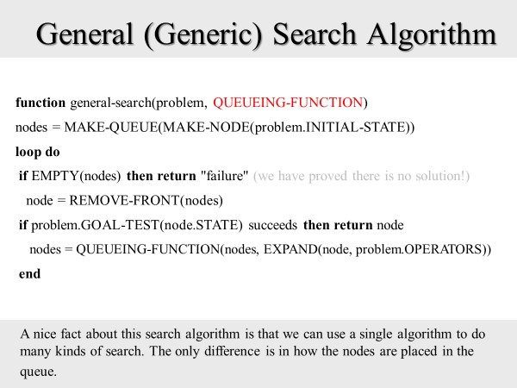
We can use a heuristic with our general search algorithm.
We simply use the queuing function, sort by cheapest h(n).
This algorithm is called greedy search or hill climbing search or best first search

Slide 27
h(n)
5
We can use heuristics to guide “hill climbing” search.
In this example, the Manhattan Distance heuristic helps us quickly find a solution to the 8-puzzle.
6
4
3
4
2
1
3
3
But “hill climbing has a problem...”
0
2

Slide 28
1
2
3
h(n)
In this example, hill climbing does not work!
All the nodes on the fringe are taking a step “backwards”
(local minima)
Note that this puzzle is solvable in just 12 more steps.
4
5
8
6
6
7
1
2
3
1
2
3
4
5
8
7
4
5
5
6
7
6
7
8
1
2
3
1
2
4
5
6
4
5
3
6
6
7
8
6
7
8

Slide 29

The physical analogy of Hill-Climbing I
Imagine two blind men trying to climb a mountain.
They repeatedly feel one step to the left, then one step to the right, and go in the direction that was highest…

Slide 30
The physical analogy of Hill-Climbing II
This sometimes gives the optimal solution.
But it can fail to give the optimal solution. And it can fail badly.

Slide 31
We have seen two interesting algorithms.
Uniform Cost
Measures the cost to each node from the initial state.
Is optimal and complete!
Can be very slow.
Hill Climbing (Best-First, Greedy)
Estimates how far away the goal is.
Is neither optimal nor complete.
Can be very fast.
Can we combine them to create an optimal and complete algorithm that is also very fast?

Slide 32
Uniform Cost Search
Enqueue nodes in order of cost
‘Looks backwards’
5
2
g(n)=
5
2
5
2
1
7
1
7
Intuition: Expand the cheapest node. Where the cost is the path cost g(n)
4
5
Hill Climbing Search
Enqueue nodes in order of estimated distance to goal
‘Looks forwards’
17
19
19
17
19
h(n)=
17
16
14
16
14
13
15
Intuition: Expand the node you think is nearest to goal. Where the estimate of distance to goal is h(n)

Slide 33
The A* Algorithm (“A-Star”)
Enqueue nodes in order of estimate cost to goal, f(n)
g(n) is the cost to get to a node.
h(n) is the estimated distance to the goal.
f(n) = g(n) + h(n)
We can think of f(n) as the estimated cost of the cheapest solution that goes through node n
Note that we can use the general search algorithm we used before. All that we have changed is the queuing strategy.
If the heuristic is admissible, that is to say, it never overestimates the distance to the goal, then…
A* is optimal and complete!

Slide 34
Discussion of Heuristics
The h(n) of the goal state must be zero.
However, if the h(n) is zero, it does not necessarily mean that we are at the goal state (it might for some heuristics, but it is not true in general).
If we hardcode a heuristic to always return zero, A* becomes uniform cost search
In general, we want a heuristic to be “tight”. That is to say, be as close to the true distance to the solution as possible (without going over).
Suppose we discover that for all n, h_{Misplacedtile}(n) ≤ h_{Manhattan}(n)
Then the Manhattan heuristic is said to dominate the misplaced tile heuristic, and we should only use the Manhattan heuristic.
However, it is possible that we can have two heuristics h₁(n) and h₂(n), neither of which dominates the other.
If that is the case, we can simply use both!
h₃(n) = max[ h₁(n), h₂(n)]

Slide 35
Informal proof outline of A* completeness
Assume that every operator has some minimum positive cost, epsilon.
Assume that a goal state exists, therefore some finite set of operators lead to it.
Expanding nodes produces paths whose actual costs increase by at least epsilon each time. Since the algorithm will not terminate until it finds a goal state, it must expand a goal state in finite time.
Informal proof outline of A* optimality
When A* terminates, it has found a goal state
All remaining nodes have an estimated cost to goal (f(n)) greater than or equal to that of goal we have found.
Since the heuristic function was optimistic, the actual cost to goal for these other paths can be no better than the cost of the one we have already found.

Slide 36
Nodes Data Structure
f(n) = g(n) + h(n)
 | 13 = 1 + 12 | 12 = 12 + 0 | 6 = 2 + 4
Time t-1
 | 13 = 12 + 1 | 13 = 1 + 12 | 12 = 12 + 0
Time t Goal!
14 = 7 + 7 | 13 = 12 + 1 | 13 = 1 + 12
At time t, we pop off the node corresponding to “12 = 12 + 0”, test to see if it is the goal state, and it is!
Could anything in the Node Data Structure have a cheaper cost? In other words, is our solution optimal?
The f(n) of all the items in the Node Data Structure can have essentially any combination of g(n) and h(n) that adds up to a value greater than 12 (if less than 12, they would have been dequeued first).
But whatever their value, any solution that passes through that node has to have a value greater than or equal to its current f(n) value, because the g(n) part will not change, and the h(n) part was a guess that was less than or equal to the true best path that passes through that node.
So “12 = 12 + 0”, was optimal.

Slide 37
How fast is A*?
A* is the fastest search algorithm. That is, for any given heuristic, no algorithm can expand fewer nodes than A*.
How fast is it? Depends on the quality of the heuristic.
If the heuristic is useless (ie h(n) is hardcoded to equal 0 ), the algorithm degenerates to uniform cost.
If the heuristic is perfect, there is no real search, we just march down the tree to the goal.
Generally, we are somewhere in between the two situations above. The time taken depends on the quality of the heuristic.

Slide 38
What is A*’s space complexity?
A* has worst case O(b^{d}) space complexity, but an iterative deepening version is possible, IDA*
IDA* has a space complexity of just O(bd)

Slide 39
A*’is the last word
There is no way to beat A*
So all research is on creating better heuristics

Slide 40
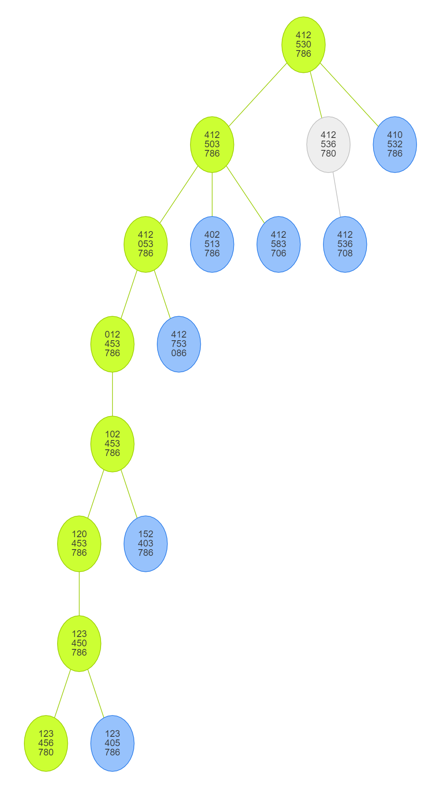
4 | 1 | 2
5 | 3
7 | 8 | 6
Let us revisit our benchmark problem
A-Star (Manhattan Heuristic)
8 nodes were expanded
Largest size of queue was 8
Solution is at depth 7, which is optimal
A-Star is amazing!!!

Slide 41
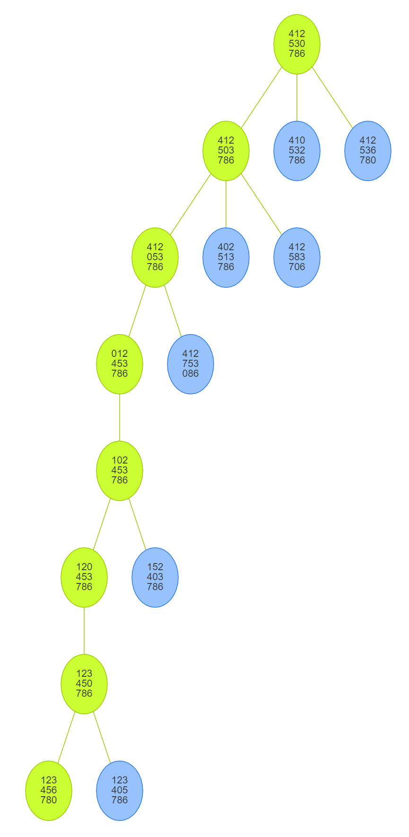
4 | 1 | 2
5 | 3
7 | 8 | 6
Greedy Search
Important note:
In this case it found the optimal solution, and it found it fast.
However, neither are true in the general case.
See later example
7 nodes were expanded
Largest size of queue was 8
Solution is at depth 7, which is optimal

Slide 42
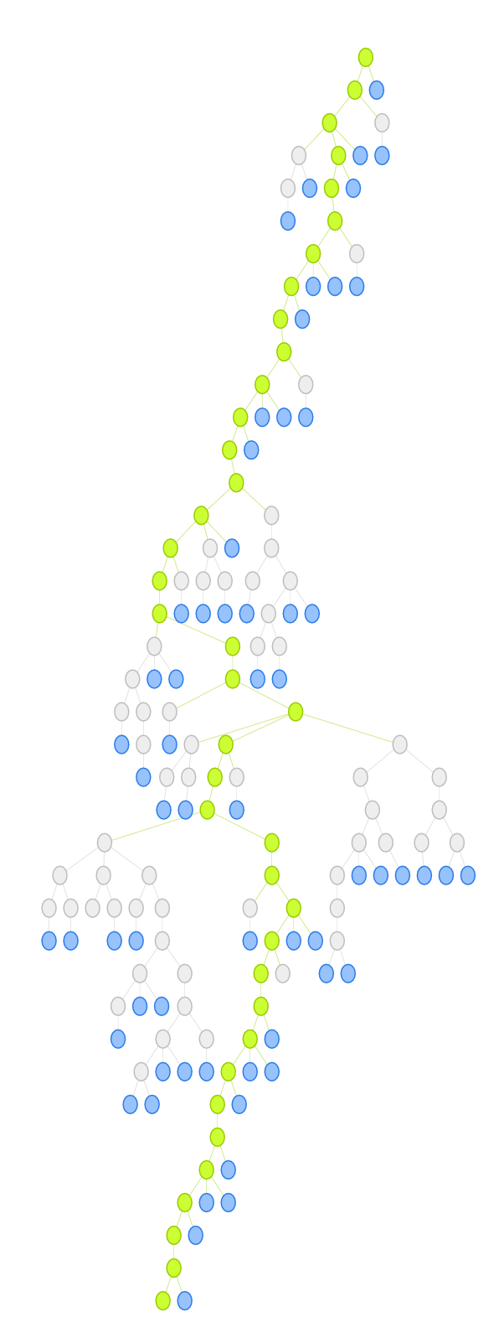
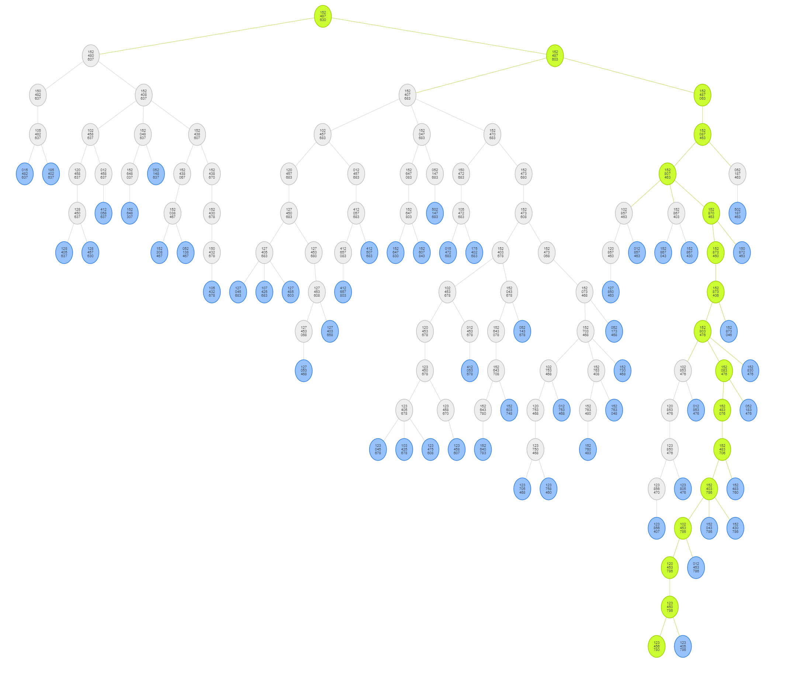
A-Star
Greedy Search
In the example above Greedy Search was as good as A-star.
However, it can be much worse.
Consider this example…
1 | 5 | 2
4 | 8 | 7
6 | 3 | 0
79 nodes were expanded
Largest size of queue was 55
Solution is at depth 16
Imagine someone give you driving directions that took 38 miles, when there was a 16-mile route!
96 nodes were expanded
Largest size of queue was 65
Solution is at depth 38

Slide 43
A Worked Example: Maze Traversal
Problem: To get from square A3 to square E2, one step at a time, avoiding obstacles (black squares).
Operators: (in order)
go_left(n)
go_down(n)
go_right(n)
each operator costs 1.
Heuristic: Manhattan distance
A
B
C
D
E
1
2
3
4
5

Slide 44
A3
A
A2
A4
g(A2) = 1
h(A2) = 4
g(B3) = 1
h(B3) = 4
g(A4) = 1
h(A4) = 6
B
B3
A2
B3
A4
C
D
E
1
2
3
4
5
Operators: (in order)
go_left(n)
go_down(n)
go_right(n)
each operator costs 1.

Slide 45
A3
A
A4
A1
A2
g(A2) = 1
h(A2) = 4
g(B3) = 1
h(B3) = 4
g(A4) = 1
h(A4) = 6
B
B3
A2
B3
A4
C
D
A1
g(A1) = 2
h(A1) = 5
E
1
2
3
4
5
Operators: (in order)
go_left(n)
go_down(n)
go_right(n)
each operator costs 1.

Slide 46
A3
A
A1
A2
A4
g(A2) = 1
h(A2) = 4
g(B3) = 1
h(B3) = 4
g(A4) = 1
h(A4) = 6
B
B3
B4
A2
B3
A4
C
C3
D
A1
g(A1) = 2
h(A1) = 5
E
C3
g(C3) = 2
h(C3) = 3
B4
g(B4) = 2
h(B4) = 5
1
2
3
4
5
Operators: (in order)
go_left(n)
go_down(n)
go_right(n)
each operator costs 1.

Slide 47
A3
A
A1
A2
A4
g(A2) = 1
h(A2) = 4
g(B3) = 1
h(B3) = 4
g(A4) = 1
h(A4) = 6
B
B1
B3
B4
A2
B3
A4
C
C3
D
A1
g(A1) = 2
h(A1) = 5
E
C3
g(C3) = 2
h(C3) = 3
B4
g(B4) = 2
h(B4) = 5
1
2
3
4
5
B1
g(B1) = 3
h(B1) = 4
Operators: (in order)
go_left(n)
go_down(n)
go_right(n)
each operator costs 1.

Slide 48
A3
A
A1
A2
A4
g(A2) = 1
h(A2) = 4
g(B3) = 1
h(B3) = 4
g(A4) = 1
h(A4) = 6
B
B1
B3
B4
B5
A2
B3
A4
C
C3
D
A1
g(A1) = 2
h(A1) = 5
E
C3
g(C3) = 2
h(C3) = 3
B4
g(B4) = 2
h(B4) = 5
1
2
3
4
5
B1
g(B1) = 3
h(B1) = 4
Operators: (in order)
go_left(n)
go_down(n)
go_right(n)
each operator costs 1.
B5
g(B5) = 3
h(B5) = 6

Slide 49
There is a very nice tool for “playing” with search on a grid
https://qiao.github.io/PathFinding.js/visual/
Note that what this tool calls best-first-search we have been calling hill-climbing search.

Slide 50
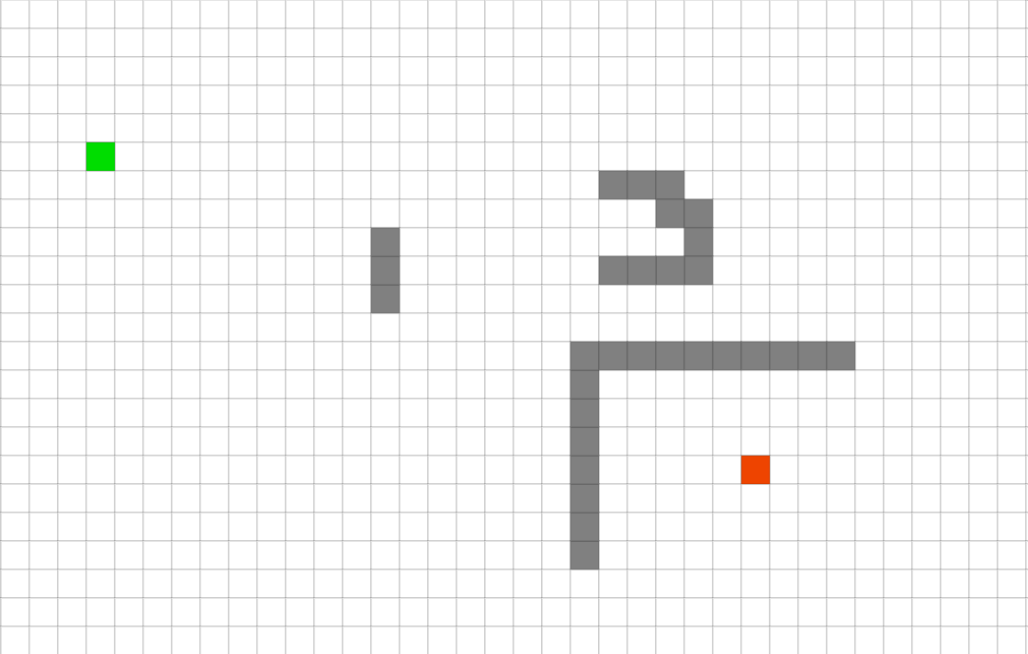
Let us create a problem. The green cell is the initial state, the red cell is the goal state, and the gray cells are walls.

Slide 51
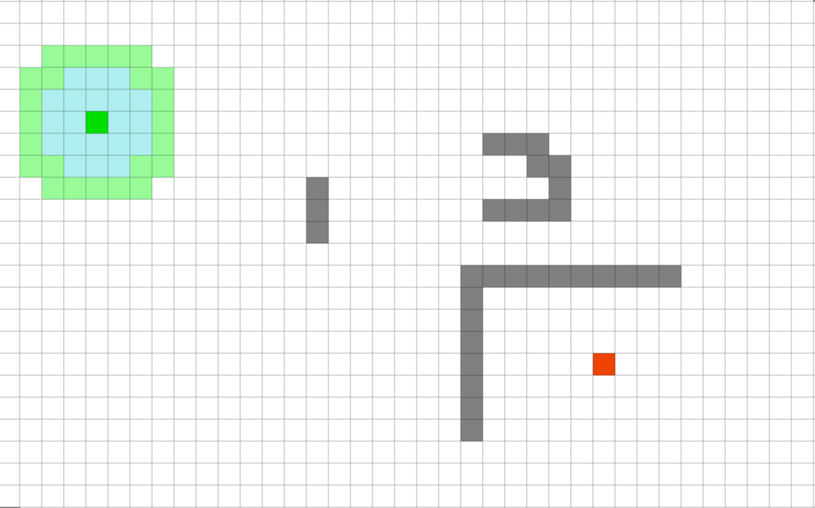
This is a snapshot of running breath-first-search. The cyan nodes have all been tested, the green nodes are on the frontier (they are in the nodes data structure).

Slide 52
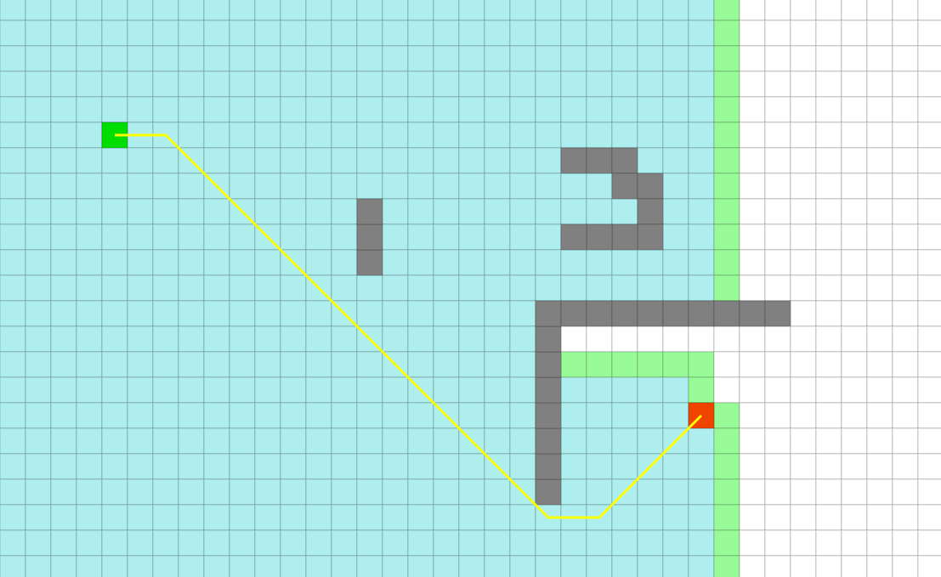
Breath-first-search finds the optimal answer, but in doing so expanded 2,026 nodes

Slide 53
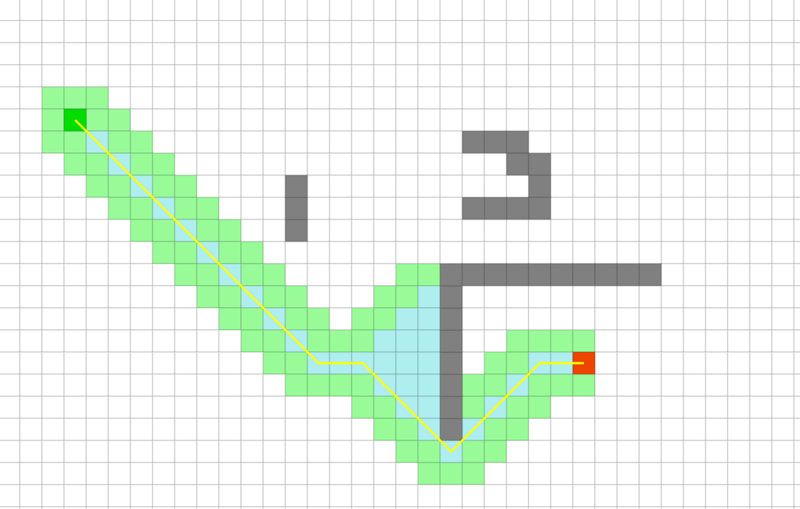
Hill-climbing search finds the optimal answer (in this case), expanding 158 nodes.

Slide 54
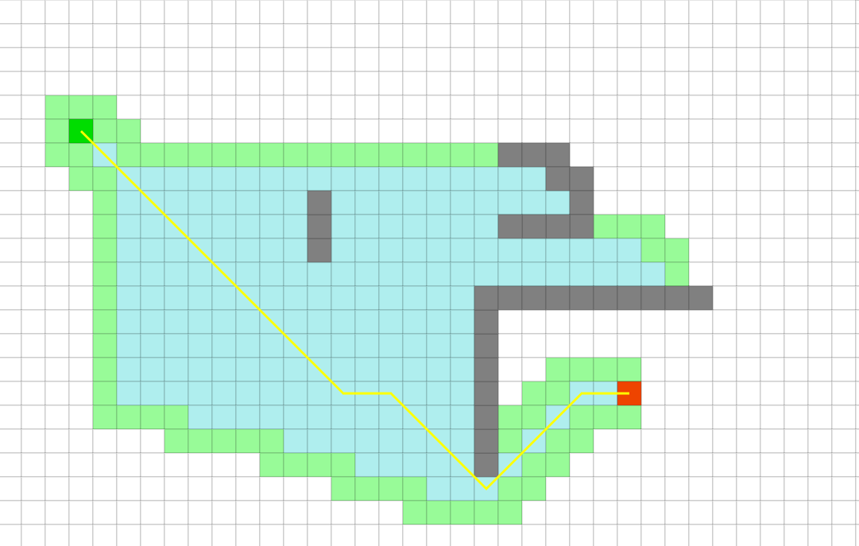
A-star search finds the optimal answer, expanding 493 nodes.

Slide 55
From the previous example, it seems that greedy search is a good algorithm. It gave the optimal answer here, and expanded fewer nodes.
However, it is possible to have a simple problem were greedy search gives a very very poor answer, and/or expands more nodes.
Let us see an example.

Slide 56
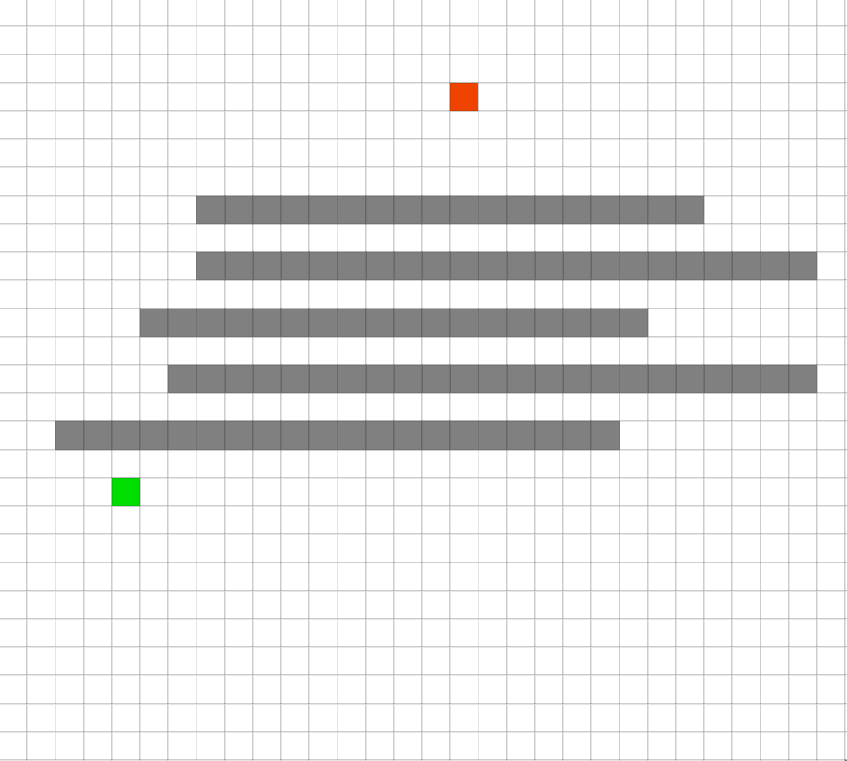
Let us compare hill-climbing and A-Star on this simple problem

Slide 57
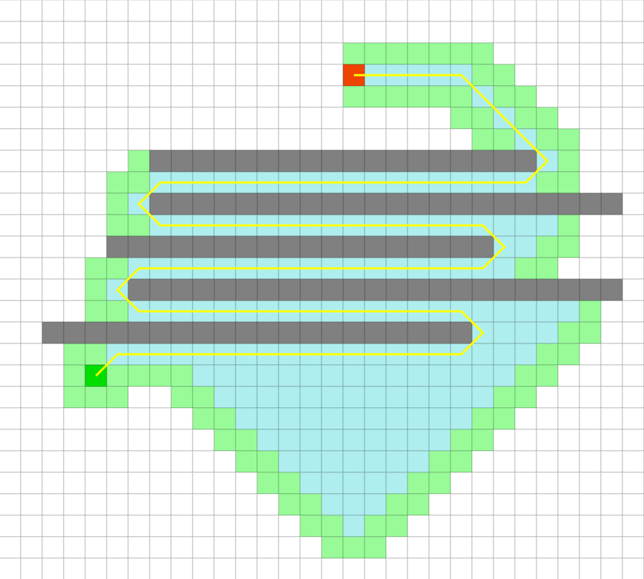
hill-climbing solution is 108.3 inches, expanding 450 nodes

Slide 58
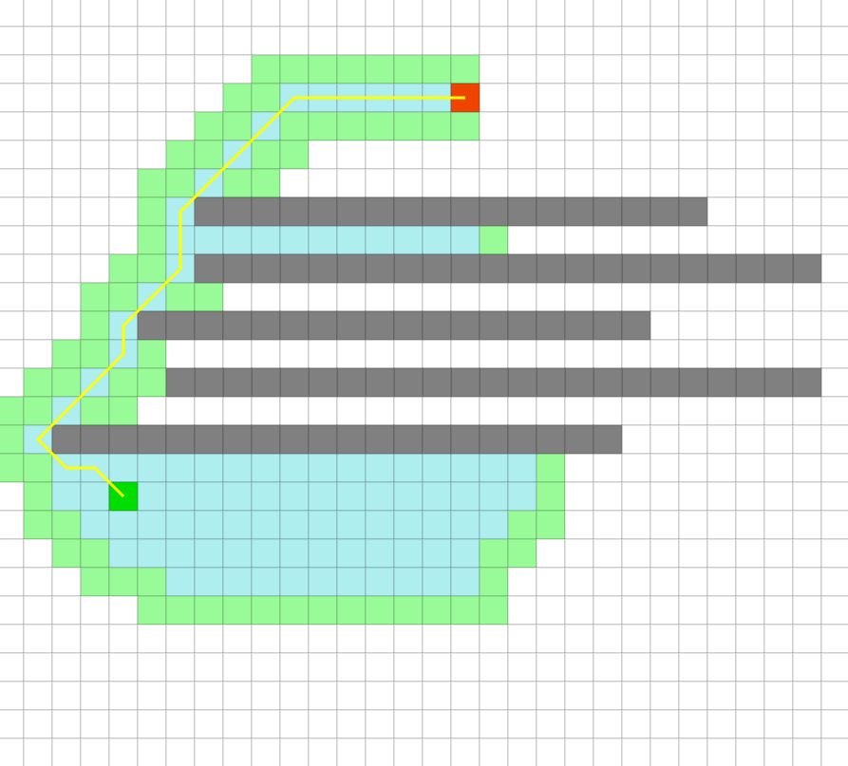
A-star’s solution is 25.6 inches, expanding 283 nodes

Slide 59
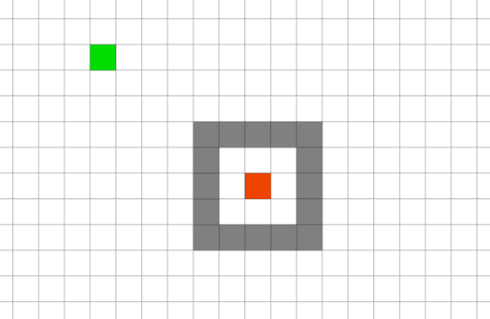
What will happen here?

Slide 60
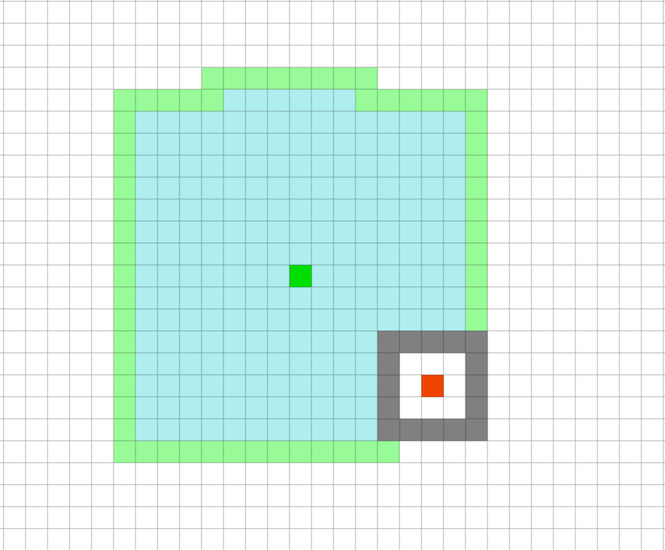
If the implementation considers the grid as bounded, then the green cells will flood to the edges. Then, one by one they get changed to cyan (they get popped off the nodes queue). When the queue is empty, and the search algorithm tries to access it, the algorithm will report “failure”.
This shows breath first search about half way thru its search

Slide 61
If the implementation considers the grid as unbounded, then we will keep searching forever.
In practice, at some point, we just run out of memory or time.
This shows breath first search during its search.

Slide 62
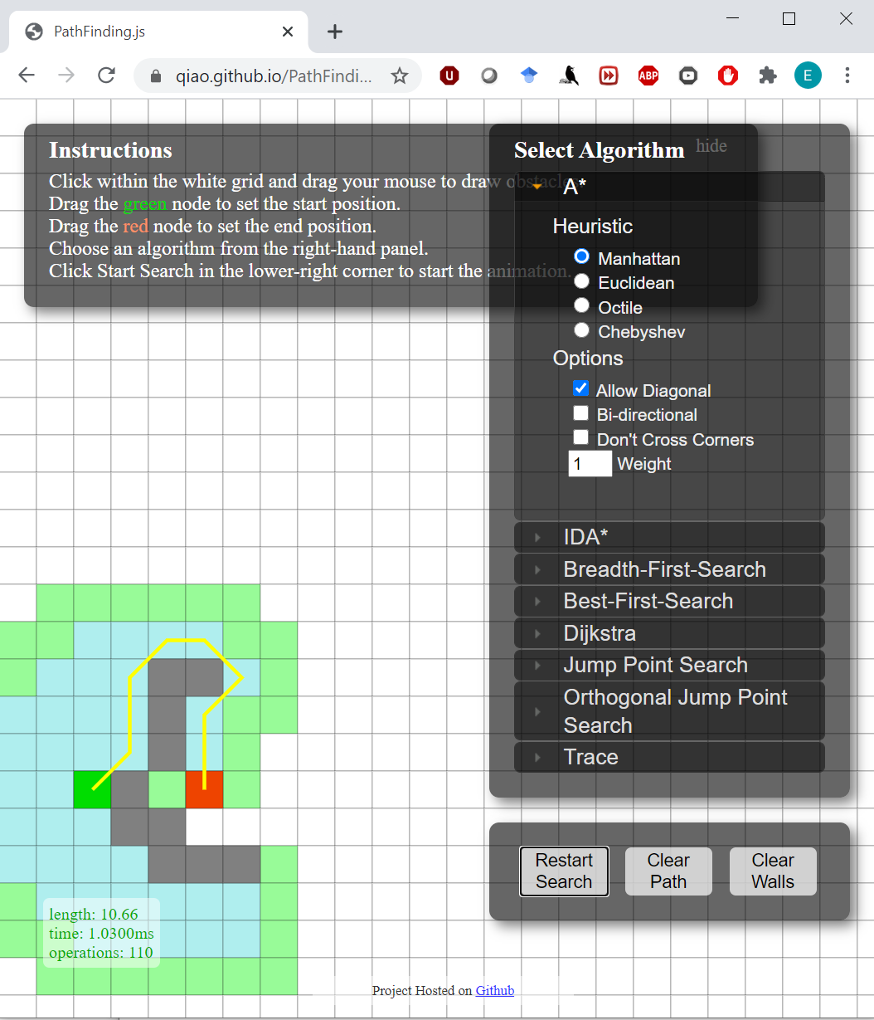
Assignment
Nothing to hand in, but please make a screendump of your solution, and be able to show it if I ask for it
Go to https://qiao.github.io/PathFinding.js/visual/
Create a single maze problem were
The optimal solution is about 20. Show it is optimal, by having A-star find it.
The solution found by hill-climbing search has a cost of at least 100.
cost
Note that what this tool calls best-first-search we have been calling hill-climbing search.

