Slide 1
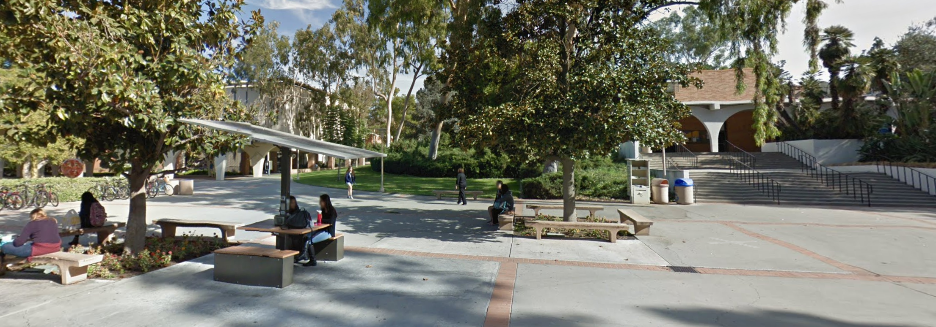
Office Hours
I am willing to do ad-hoc zoom office hours.
Send me an email requesting a meeting, giving me three options in the next 24 hours, like this:
  Dear Prof, can we meet to discuss decision trees, either now, or tonight at 5pm or tomorrow anytime before noon.
I will respond with a zoom link.
Before and after class meetings are good times for me for in-person office hours. We can meet at the table/benches between this classroom and University Theater.
If you want to have office hours before or after a class meeting, send me an email
  Dear Prof, can we meet tomorrow 15 minutes before class?
I will send you an email confirming (unless that day I have some other obligation)
<- The Hub
This classroom
Meet here

Slide 2
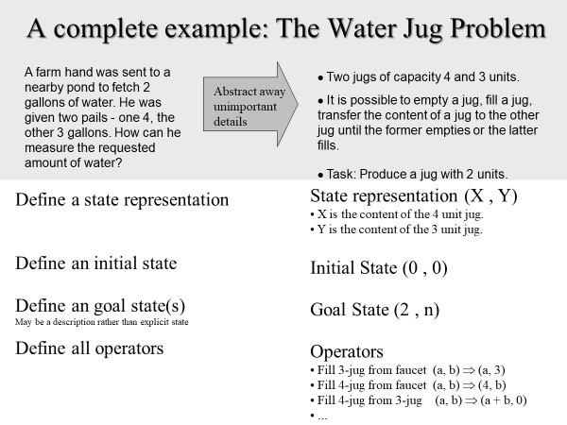
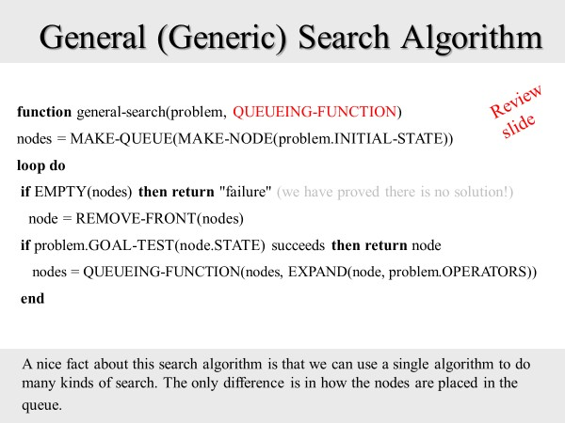
Let's begin with some review
We have seen that to solve a problem using search, we need to do two things
1) Define the problem space, what is…
  The initial state
  The goal state
  The state representation
  The operators
2) Pick a search algorithm
We have learned (but not yet fully explored) that there is a generic search algorithm, that can become any possible algorithm, simply by changing the queuing function.

Slide 3
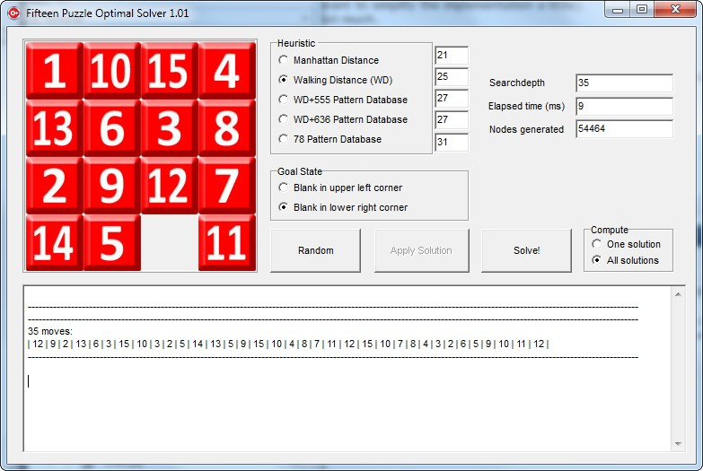
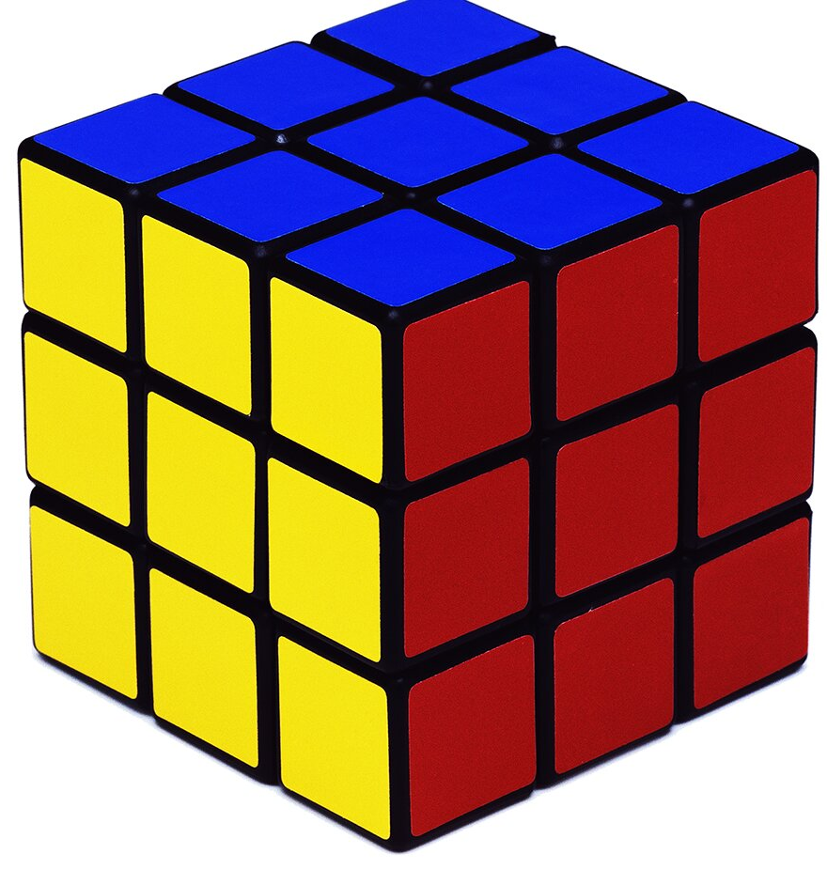
We often assume that each operator has the same cost.
This makes sense, in many problems, all the operators do have the same cost.
For example, it costs the same to move a tile up or down or left or right in a 15-puzzle
The cost to get to a state n, from the initial state is called the G(n). It is the sum of all the costs from n to the initial state.
  The G(E) is 2
  The G(K) is 3
  The G(A) is 0
When all the operators have the same cost, then any level of the tree will have nodes with the same G(n) cost. So all the nodes in the green highlighted region have the same cost.
1
1
1
1
1
1
1
1
1
1
1
1
1
1

Slide 4
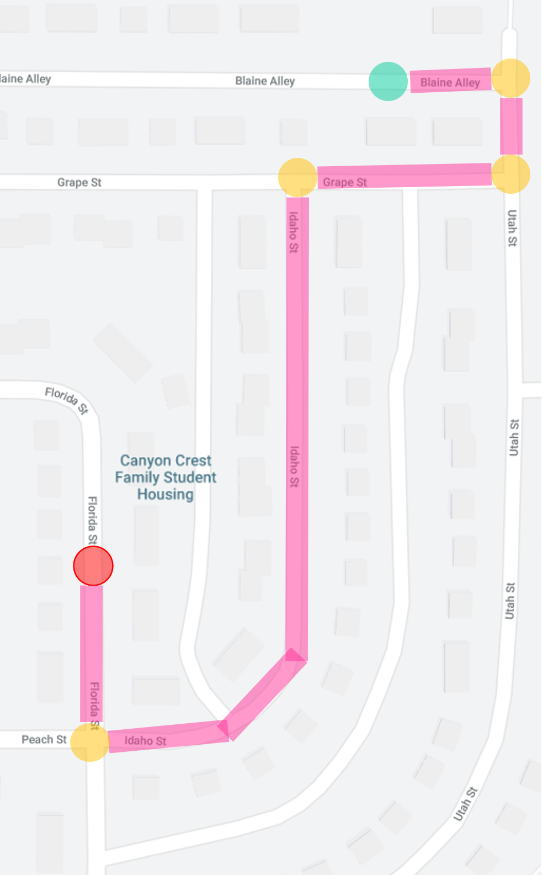
It is possible that each operator has different costs (but always positive numbers)
  The G(C) is 3
  The G(E) is 3
  The G(H) is 3
  The G(I) is 3
For example, when finding the shortest route, some roads are longer than others.
  Grape St is only 200ft
  Utah St is 1,000ft
Can you think of other problems that have different costs?
Maybe for FWDC we should have a higher cost for rowing with a big heavy wolf than for rowing with a tiny duck.
Maybe for the container ship problem, the cost to move a refrigerated container be more than the cost to move a non-refrigerated container.
1
3
1
2
7
1
1
1
1
4
8
1
3
12

Slide 5
When we say we want to find the optimal solution, what we mean is the solution with the smallest G(n) cost.
Suppose the red boxes indicate goal states.
For the example on the left, with all the operators having the same costs, the optimal solution is always the shallowest one.
For the example on the right, with operators having different costs, the optimal solution is not always the shallowest one. In this case the G(K) is just 4, but the G(C) is 7.
1
1
1
7
1
1
1
1
1
2
7
1
1
1
1
1
1
1
1
1
3
1
1
1
8
1
3
12

Slide 6
We are going to consider different techniques to search the problem space, we need to consider what criteria we will use to compare them.
Review
slide
Completeness: Is the technique guaranteed to find an answer (if there is one).
Optimality: Is the technique guaranteed to find the best answer, the one with the lowest G(n) (if there is more than one solution).
Time Complexity: How long does it take to find a solution.
Space Complexity: How much memory does it take to find a solution.

Slide 7
General (Generic) Search Algorithm
Review
slide
function general-search(problem, QUEUEING-FUNCTION)
nodes = MAKE-QUEUE(MAKE-NODE(problem.INITIAL-STATE))
loop do
if EMPTY(nodes) then return "failure" (we have proved there is no solution!)
node = REMOVE-FRONT(nodes)
if problem.GOAL-TEST(node.STATE) succeeds then return node
nodes = QUEUEING-FUNCTION(nodes, EXPAND(node, problem.OPERATORS))
end
A nice fact about this search algorithm is that we can use a single algorithm to do many kinds of search. The only difference is in how the nodes are placed in the queue.

Slide 8
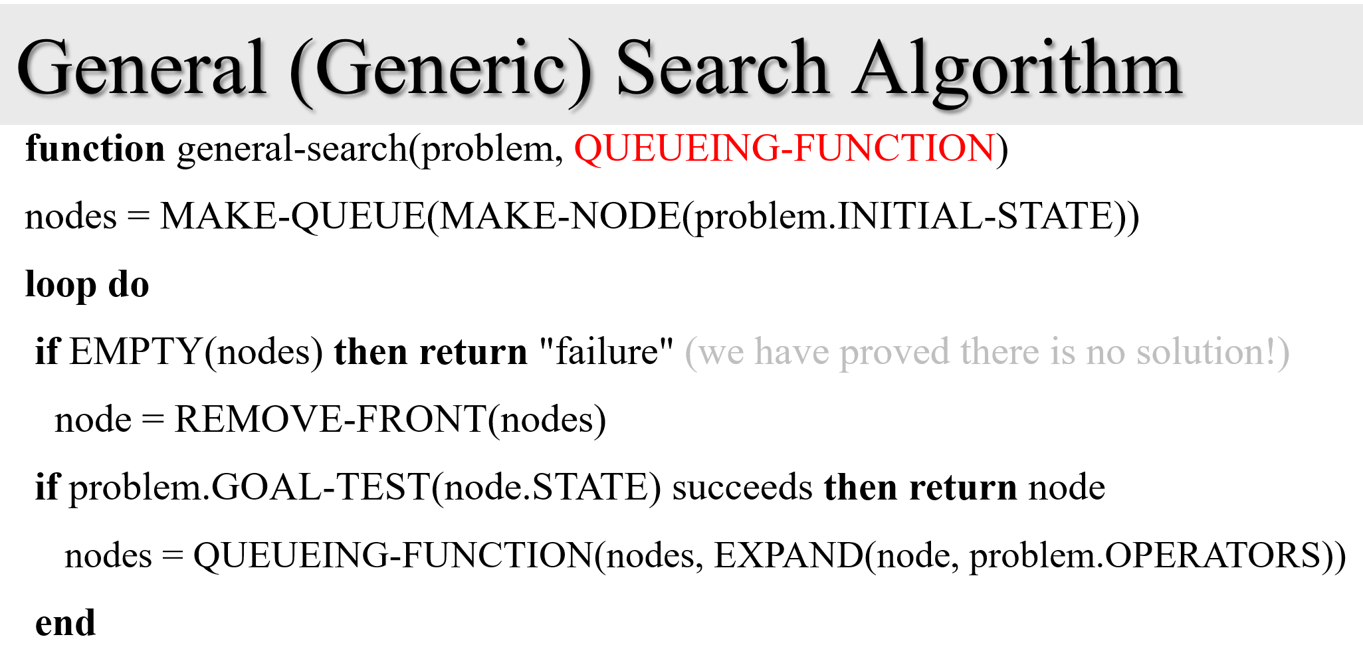
We have created our problem
We have decided on FIFO
Let go to the first line of code…
A
B
C
D
E
F
G

Slide 9
We create a data structure nodes
And we push into it, the initial state
A
B
C
nodes
 |  |  |  | A
D
E
F
G

Slide 10
We enter the loop.
First thing we do is ask if nodes is empty
(as it happens, the first time thru the loop is the only time this cannot be true)
As it was not true, we go to the next line..
A
B
C
nodes
 |  |  |  | A
D
E
F
G

Slide 11
We pop off the head off nodes
We ask “are you the goal state?”
If yes, we are done
If no, create all of A’s children and….
A
B
C
nodes
D
E
F
G

Slide 12
If no, create all of A’s children and push into nodes
Now back to the top of the loop..
A
B
C
nodes
 |  |  | C | B
D
E
F
G

Slide 13
Now back to the top of the loop.
Ask if nodes is empty
If not, remove the head of nodes
A
B
C
nodes
 |  |  |  | C
D
E
F
G

Slide 14
Now back to the top of the loop.
Ask if nodes is empty
If not, remove the head of nodes
We ask “are you the goal state?”
A
(lets stop here)
B
C
nodes
 |  |  |  | C
D
E
F
G

Slide 15
Observations
How can the algorithm terminate?
We find a solution!
We go to pull the head of nodes, but it is empty.
Unofficial: We let it run for a week, then we pulled the plug.
Unofficial: We get an out-of-memory error.
nodes
 | D | E | F | G

Slide 16
Breadth First Search
Enqueue nodes in FIFO (first-in, first-out) order.
Intuition: Expand all nodes at depth i before expanding nodes at depth i + 1
Complete? Yes.
Optimal? Yes.
Time Complexity: O(b^{d})
Space Complexity: O(b^{d}), note that every node in the fringe is kept in the queue.

Slide 17
Uniform Cost Search
Enqueue nodes in order of (cumulative) cost, the G(n)
5
2
5
2
5
2
1
7
1
7
4
5
Intuition: Expand the cheapest node. Where the cost is the path cost G(n)
Complete? Yes.
Optimal? Yes, if path cost is nondecreasing function of depth
Time Complexity: O(b^{d})
Space Complexity: O(b^{d}), note that every node in the fringe keep in the queue.
Note that Breadth First search can be seen as a special case of Uniform Cost Search, where the path cost is just the depth.

Slide 18
Depth First Search
Enqueue nodes in LIFO (last-in, first-out) order.
Intuition: Expand node at the deepest level (breaking ties left to right)
Complete? No (Yes on finite trees, with no loops).
Optimal? No
Time Complexity: O(b^{m}), where m is the maximum depth.
Space Complexity: O(bm), where m is the maximum depth.

Slide 19
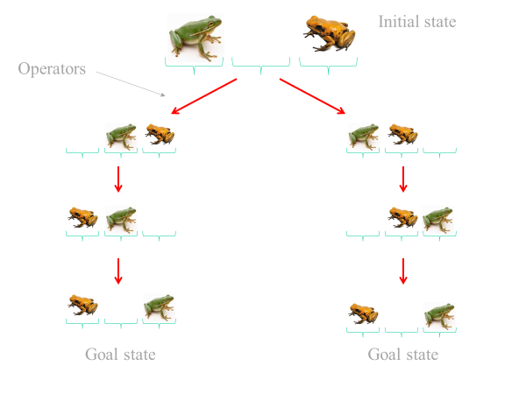
Sometimes we know the solution depth
While it is rare, sometimes we know the solution depth before we start.
Or, sometimes we know the maximum possible depth, and we know that it is a reasonably tight bound.
If we have M frogs and N toads, then the solution depth is MN + M + N.
We can exploit this information for depth-limited search (next slide)

Slide 20
Depth-Limited Search
Enqueue nodes in LIFO (last-in, first-out) order. But limit depth to L
L is 2 in this example
Intuition: Expand node at the deepest level, but limit depth to L
Complete? Yes if there is a goal state at a depth less than L
Optimal? No
Time Complexity: O(b^{L}), where L is the cutoff.
Space Complexity: O(bL), where L is the cutoff.
Picking the right value for L is a difficult, Suppose we chose 7 for FWDC, we will fail to find a solution...

Slide 21
The first clever idea
We like depth-limited search, because of its low space complexity.
But it is not optimal ;-(
Here is a clever idea. Let's put depth-limited search inside a loop, that loops over ever-increasing depths:
  Every iteration except the last one will end in failure.
  The last iteration will end is success, and it will be optimal!
This idea is called Iterative Deepening Search
Richard Korf UCLA 1985

Slide 22
Iterative Deepening Search I
Do depth limited search starting a L = 0, keep incrementing L by 1.
Intuition: Combine the Optimality and completeness of Breadth first search, with the low space complexity of Depth first search
Complete? Yes
Optimal? Yes
Time Complexity: O(b^{d}), where d is the depth of the solution.
Space Complexity: O(bd), where d is the depth of the solution.

Slide 23
Iterative Deepening Search II
Iterative deepening looks wasteful because we reexplore parts of the search space many times...
Consider a problem with a branching factor of 10 and a solution at depth 5...
If we knew the solution was a depth 5…
1+10+100+1000+10,000+100,000 = 111,111
1
1+10
1+10+100
1+10+100+1000
1+10+100+1000+10,000
1+10+100+1000+10,000+100,000
= 123,456

Slide 24
Bi-directional Search
Intuition: Start searching from both the initial state and the goal state, meet in the middle.
Notes
Not always possible to search backwards
How do we know when the trees meet?
At least one search tree must be retained in memory.
Complete? Yes
Optimal? Yes (if both algorithms are optimal)
Time Complexity: O(b^{d/2}), where d is the depth of the solution.
Space Complexity: O(b^{d/2}), where d is the depth of the solution.

Slide 25
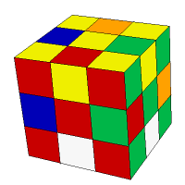
Characterizing the hardness of your search
Suppose you need to solve a problem using search, how bad can it be?
As we have seen, the time and space complexity depend on both the branching factor b, and the depth d [a]. So if you understand these, you have a good idea.
It is normally easy to get the average or worst-case branching factor. For example, for the sliding tile puzzle, the worst-case branching factor is clearly four.
For route-finding, while there are a tiny number of five-way intersections, in general four is the maximum branching we see (includes U-turn).
However, it can be tricker to know the depth.
Usually, we are interested in the worse-case depth, which is called the diameter.
For example, this Rubik Cube can be solved in zero moves, or depth zero.
We what to know is what is the diameter, what is the hardest cube to solve.
As it happens, it is this one, and it takes 20 moves to solve (it is called the superflip)
Sometimes, the best we can do is a guess, or upper and lower bounds, lets see this…
[a] We will see later it also depends on the quality of your heuristic

Slide 26
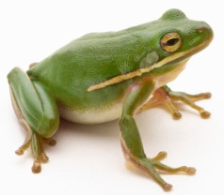
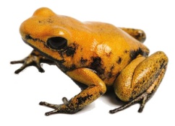
What is the diameter of this problem?
Since (unlike Rubik's Cube or 8-puzzle) the starting state is always the same, the diameter is the solution depth.

Slide 27
Upper and Lower Bounds
We can compute an upper bound and a lower bound.
There are two type of operators, slides and jumps
Slides move the frog/toads only one step. So let us imagine a solution that consisted only of slides…
Slide 4 places
Slide 4 places
Slide 4 places
Slide 4 places
Slide 4 places
Slide 4 places
Six times four is 24. Therefore 24 is an upper bound to the diameter of the 3-3 Frog-Toad puzzle.

Slide 28
Upper and Lower Bounds
What about jumps?
Jumps move the frog/toads two steps. So let us imagine a solution that consisted only of jumps…
Jump 2 places
Jump 2 places
Jump 2 places
Jump 2 places
Jump 2 places
Jump 2 places
Six times two is 12. Therefore 12 is a lower bound to the diameter of the 3-3 Frog-Toad puzzle.

Slide 29




Visualizing the Upper and Lower Bounds
0
12
Solution must be in this region somewhere
24

Slide 30



In fact, the solution depth is 15
0
For the N-N Frog-Toad problem, the solution depth is at (N+1)² -1
Solution N-N Frog-Toad problem, is always a palindrome
(1, 1)– SJS
(2, 2)– SJSJJSJS
(3, 3)– SJSJJSJJJSJJSJS
12
15
24

Slide 31








There are two solutions at depth 15
One from the move frog first path
One from the move toad first path
15

Slide 32
More generally, for arbitrary problems
The number of solutions can be from zero to infinity
If there are multiple solutions, they may be at different depths.
If so, we prefer the cheapest one (the shallowest one, if all operators have the same cost)
The smallest G(n)

Slide 33
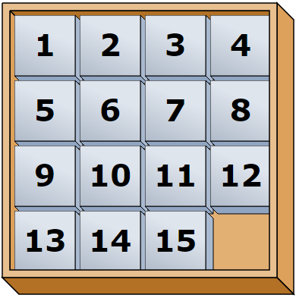
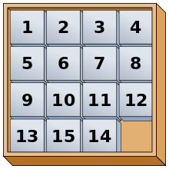
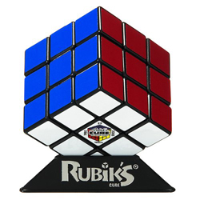
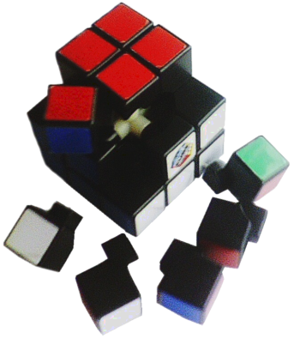
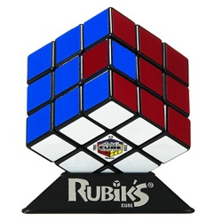

The number of solutions can be from zero to infinity
How can we have zero solutions?
solvable
Not solvable
Solvable
Not solvable
Sometimes there are simple ways to detect that a problem has zero solutions (true for 15 puzzle and Rubik’s cube), but there may not be a way (or at least, not an obvious way)
Siri: Give me driving directions from UCR to Honolulu Hawaii

Slide 34
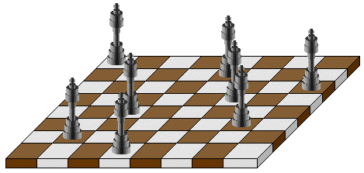
Your problem space formulation can affect both b and d, you can make good or bad decisions.
1
Can you place 8 queens on a chessboard such that no piece is attacking another?
8
2
We could try to solve this at least two ways
Start with an empty board, the operators are to add a queen.
Start with a full board, that is, 64 queens on the board. The operators are to remove a queen.
Which would be better?
56

Slide 35
Converting a continuous problem to a discrete problem
The problems we considered thus far are intrinsically discrete.
What happens if our problem space is continuous?

Slide 36
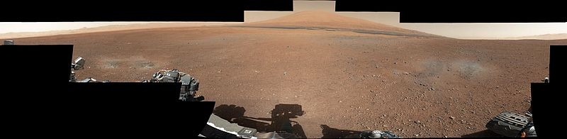
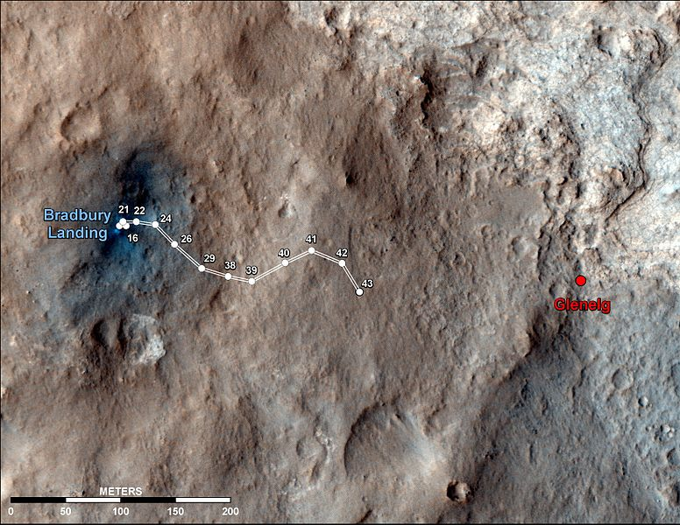
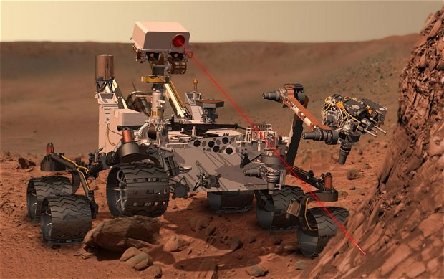
Curiosity was launched from Cape Canaveral on November 26, 2011, and successfully landed on Aeolis Palus in Gale Crater on Mars on August 6, 2012. The Bradbury Landing site[6] was less than 2.4 km (1.5 mi) from the center of the rover's touchdown target after a 563,000,000 km.

Slide 37
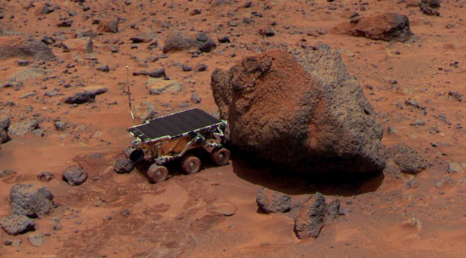
When Mars is closest to the Earth, it takes light three minutes to travel between the two planets.
Mars is usually a lot farther away than that. At its greatest distance it is 42 light minutes away

Slide 38

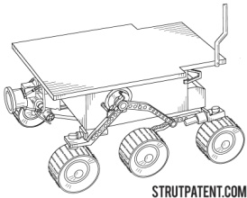
Path Planning Search
target
I will show you three possible solutions (there are others), just to give you examples of the issues involved.

Slide 39
Path Planning
What is the state space?
This example is by Jean-Claude Latombe

Slide 40
Formulation #1
Cost of one horizontal/vertical step = 1
Cost of one diagonal step = √2

Slide 41
Optimal Solution?
This path is the shortest in the discretized state
space, but not in the original continuous space
(Trade-off: The smaller the grid…The larger the grid..)

Slide 42
Formulation #2
sweep-line

Slide 43
Formulation #2

Slide 44
States

Slide 45
Operator: Visit center of adjacent region

Slide 46
Solution Path
A path-smoothing post-processing step is
usually needed to shorten the path further

Slide 47
Formulation #3
Cost of one step: length of segment

Slide 48
Formulation #3
Visibility graph
Cost of one step: length of segment

Slide 49
Solution Path
The shortest path in this state space is also the
shortest in the original continuous space

Slide 50
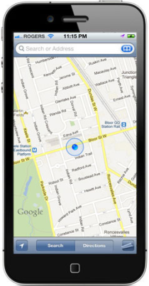
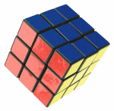
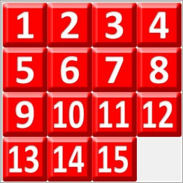


A description of the desired state of the world (goal state), this could be implicit or explicit.
explicit
FWDC
implicit
X= X
or
1=1
or
2=2

