Slide 1
Blind Search (Uniformed Search)
(to be later contrasted with Heuristic Search, or Informed Search)

Slide 2
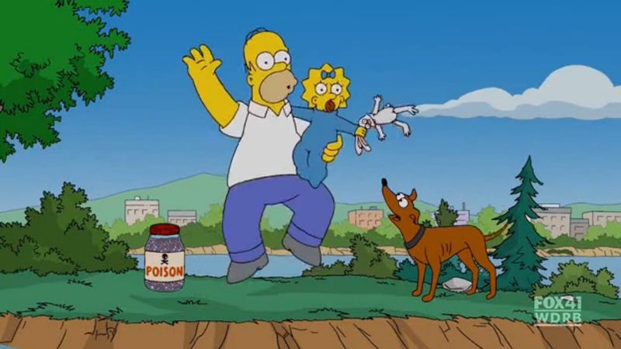
Review Slide
The Farmer, Wolf, Duck, Corn Problem
Farmer, Wolf, Goat, Cabbage
Farmer, Fox, Chicken, Corn
Farmer Dog, Rabbit, Lettuce
Homer, Maggie, poison, Santa’s Little Helper
A farmer with his wolf, duck and bag of corn come to the east side of a river they wish to cross. There is a boat at the rivers edge, but of course only the farmer can row. The boat can only hold two things (including the rower) at any one time. If the wolf is ever left alone with the duck, the wolf will eat it. Similarly if the duck is ever left alone with the corn, the duck will eat it. How can the farmer get across the river so that all four arrive safely on the other side?
The Farmer, Wolf, Duck, Corm problem dates back to the eighth century and the writings of Alcuin.

Slide 3
Review Slide
F
W
D
C
W
D
C
D
C
W
C
W
D
F
F
W
F
D
F
C
F
W
C
F
W
D
C
D
W
C
C
W
F
D
F
W
D
F
D
C
F
C
F
W
C
F
D
C
F
W
F
W
D
F
W
C
W
D
D
W
D
C
C
D
D
C
C
D
W
D
D
W
F
W
F
W
D
F
W
C
F
C
F
W
C
F
D
C
F
D
F
W
D
F
D
C
W
C
C
W
D
F
W
C
F
W
D
C
Search Tree for “Farmer, Wolf, Duck, Corn”
Illegal State
Repeated State
Goal State

Slide 4
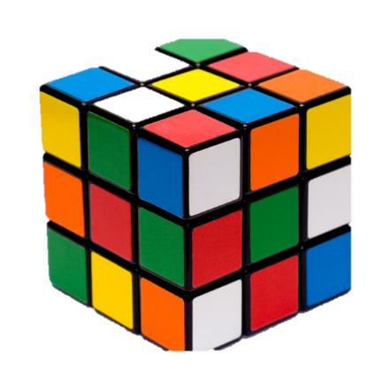
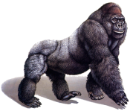
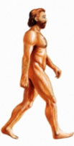
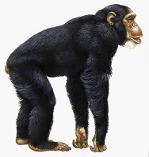

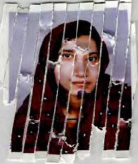



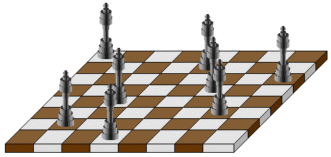
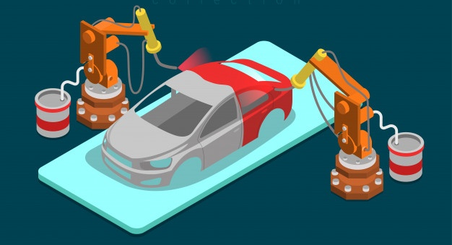
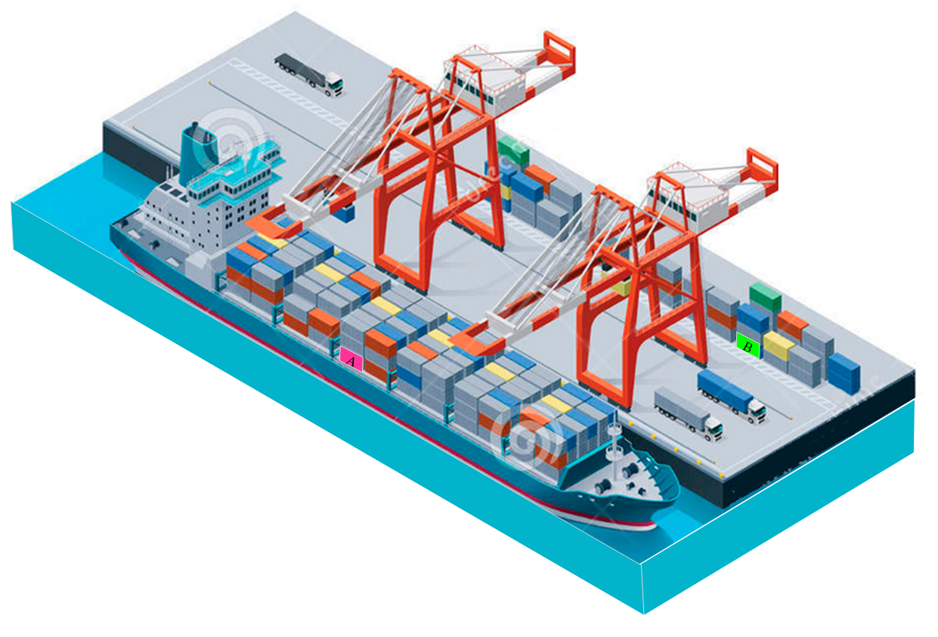
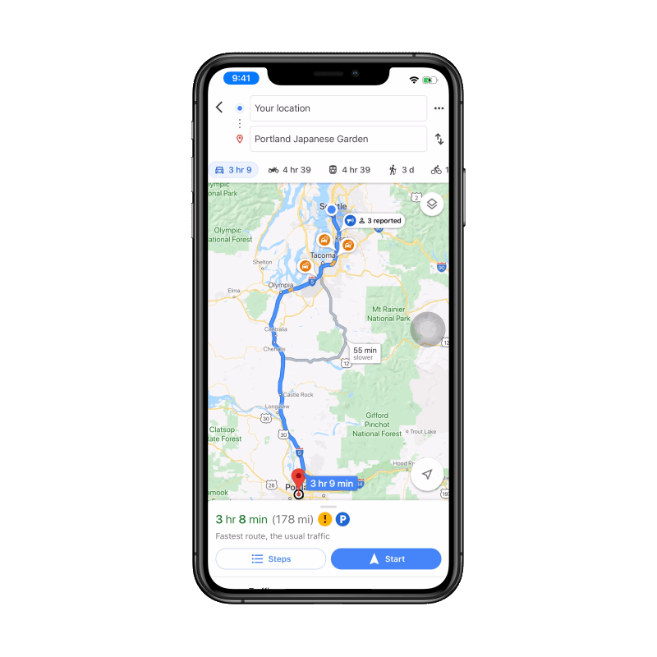
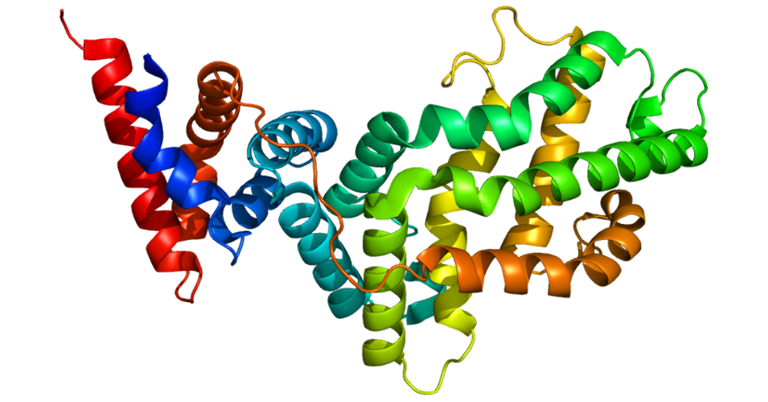
Review Slide
Reassemble these torn fragments into the original image
Which tree shows the correct relationship between gorilla, chimp and man?
When you have just 3 animals, there are only three possible trees, but with ten species there are 34,459,425 possible trees
Rubiks Cube
Can you place 8 queens on a chessboard such that no piece is attacking another?
What is the fastest way to paint this car?
How would this protein string.. HETATRQTETRQKIKFPCIMMWFGDCYEDY
..fold in 3D?
Find a route from my home to the airport that minimizes the mileage
What is the fastest way to unload this container ship of all red containers?

Slide 5
Search as a lens to view the world
Once you understand search, you begin to see it everywhere…
You see it as a tool to explain things, like evolution, economics etc.
You see it as a tool to solve problems.

Slide 6
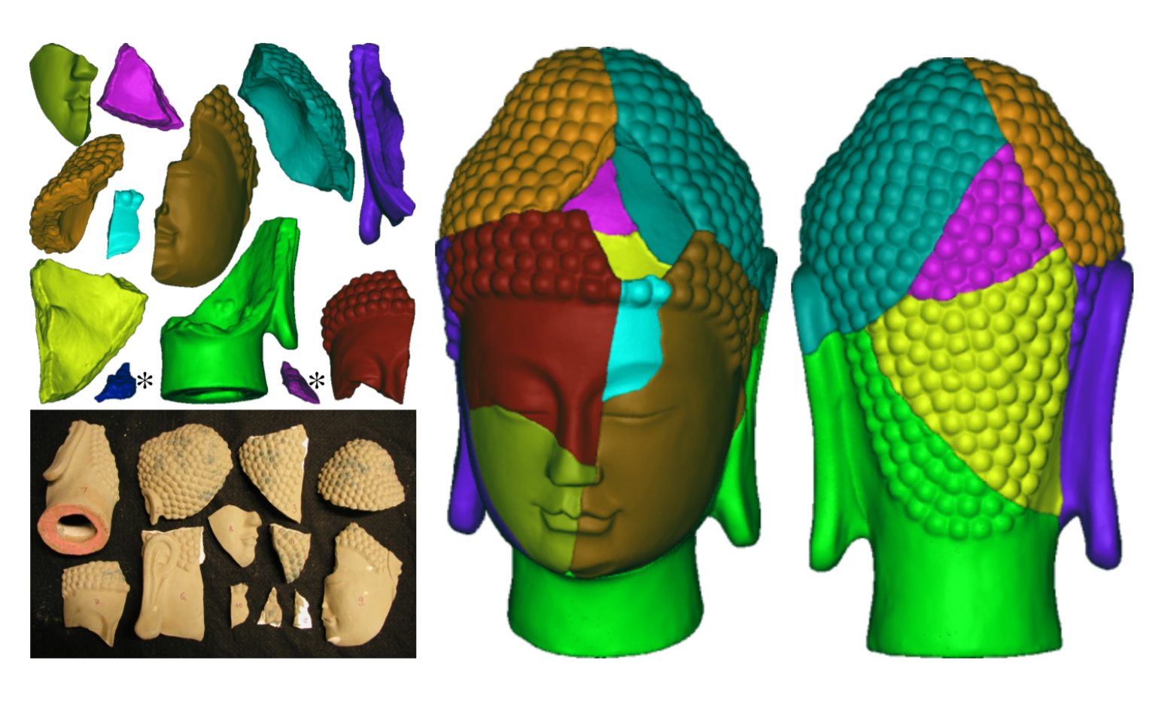
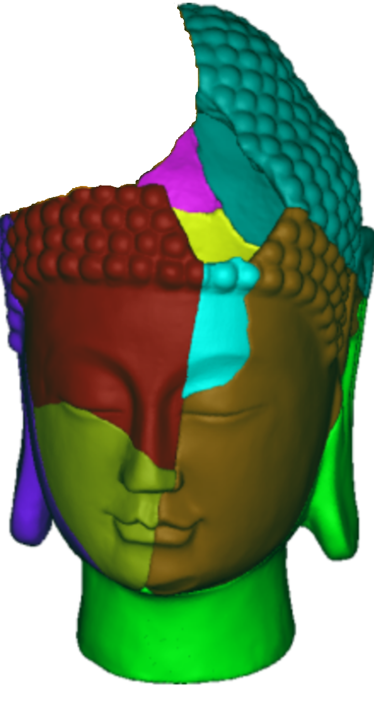
Search for Archaeology Problems
Qi-Xing Huang et al (2006) Reassembling Fractured Objects by Geometric Matching

Slide 7
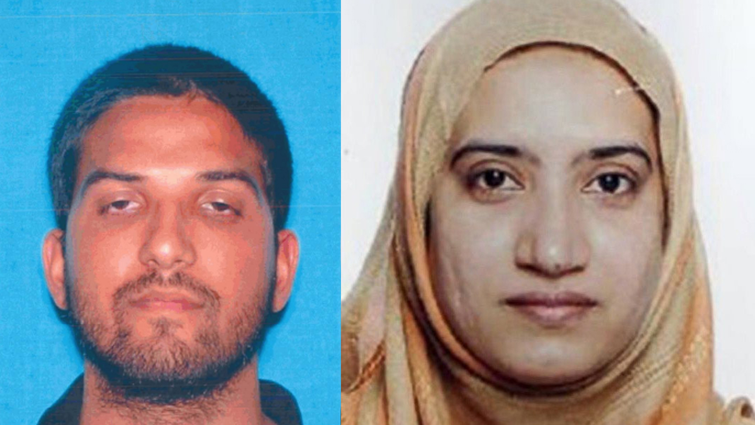
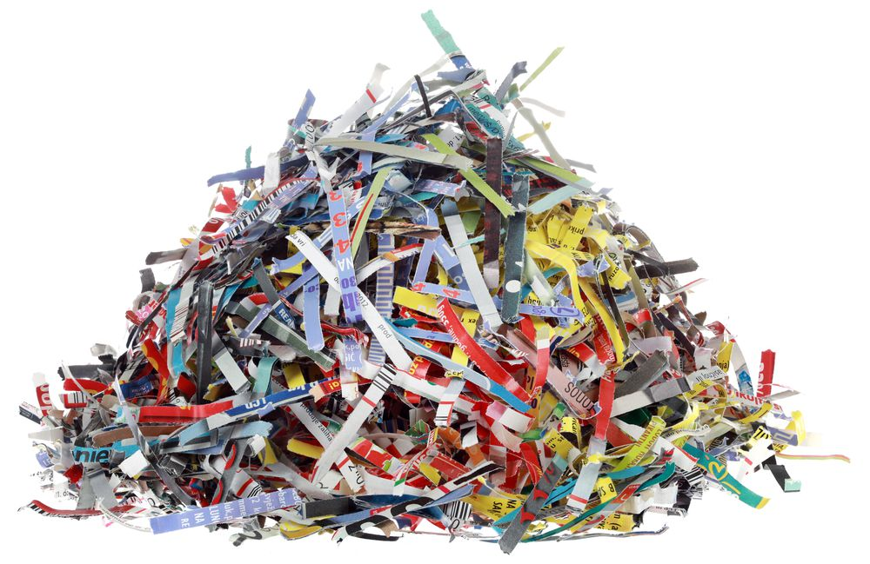
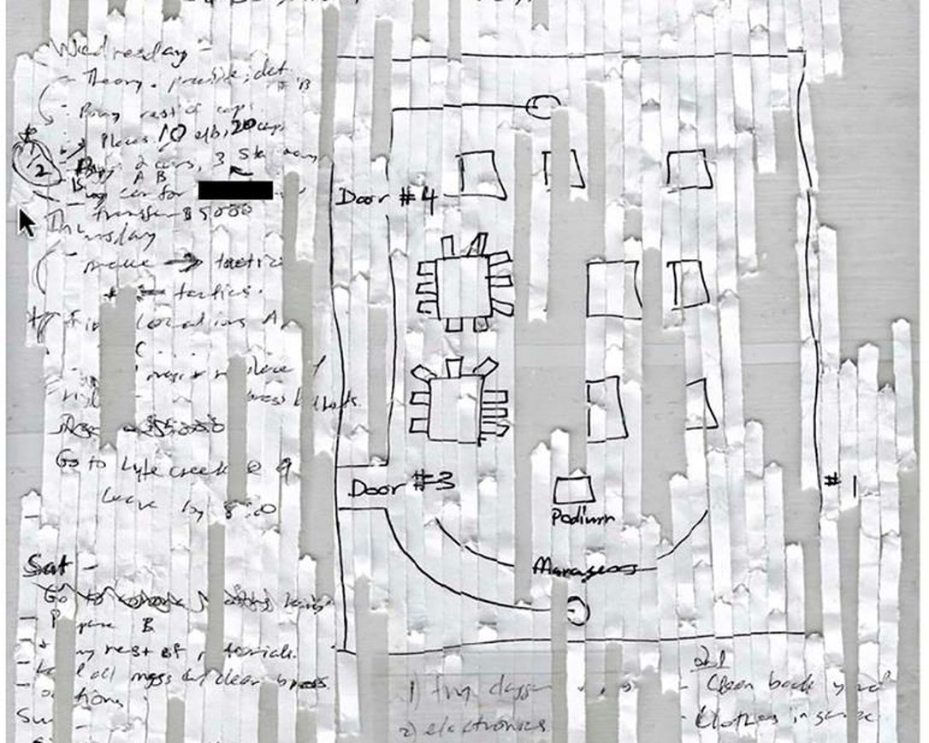
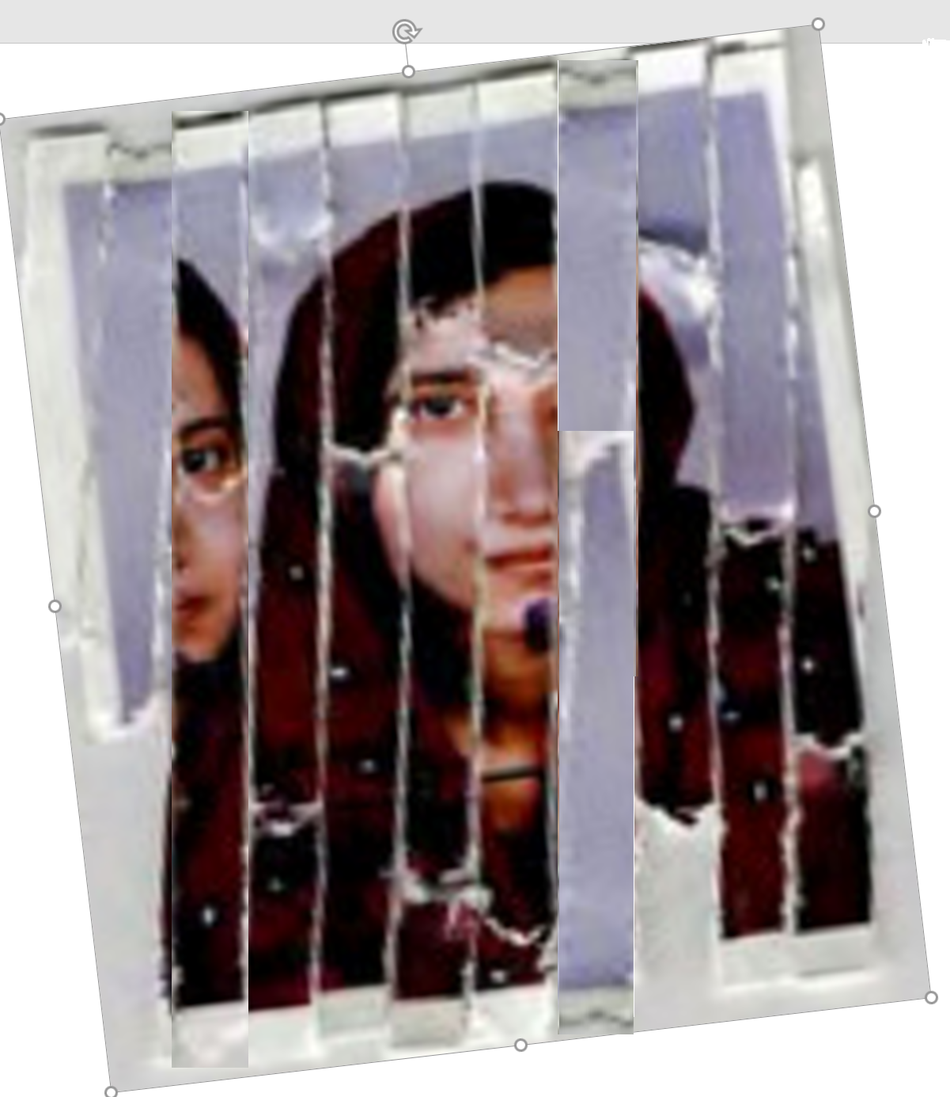
Search for Defense/Law Enforcement Problems
https://en.wikipedia.org/wiki/2015_San_Bernardino_attack
Syed Farook and Tashfeen Malik

Slide 8
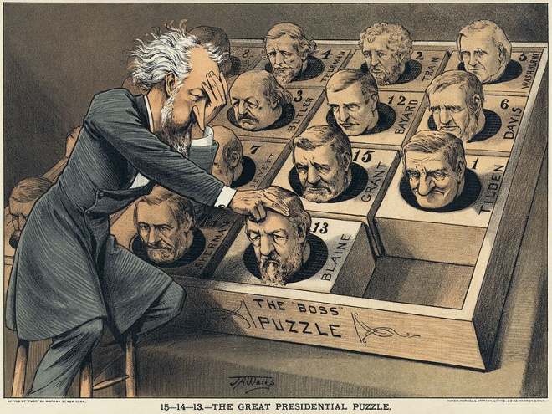
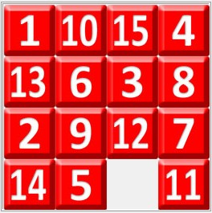
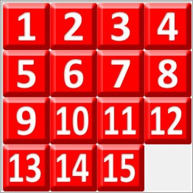
Initial state
Goal state
15-Puzzle
U.S. Political cartoon about finding a Republican presidential candidate in 1880
The puzzle can be shuffled into 10,461,394,944,000 different solvable positions (about 10.5 trillion)
In the worst case, it can take 80 moves to solve a puzzle (the diameter is 80).
The problem of finding an optimal solution is known to be NP-hard, for the general case of sliding tile puzzles.

Slide 9
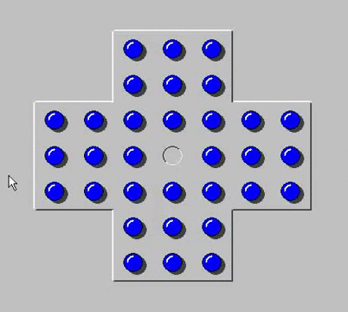
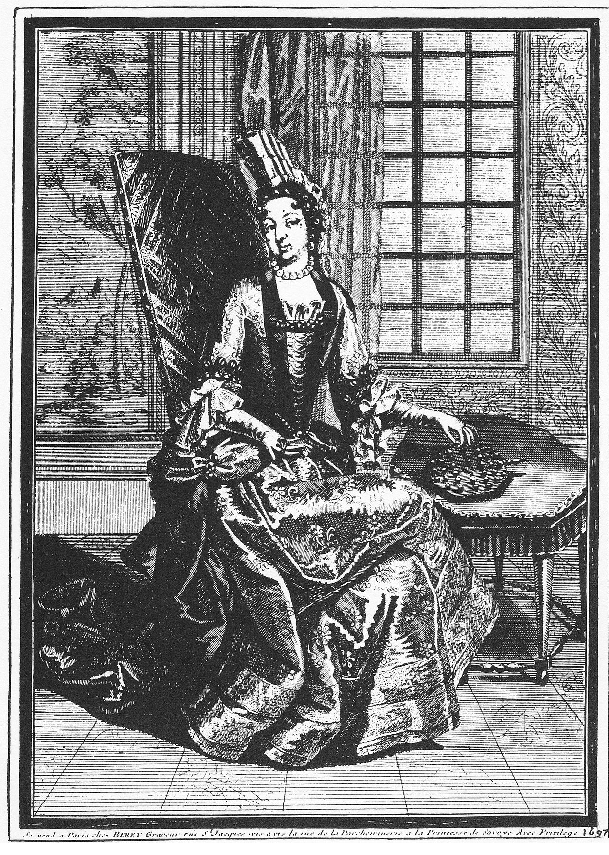
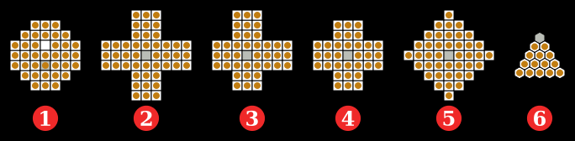
Peg solitaire (or Solo Noble) is a board game for one player involving movement of pegs on a board with holes.
The standard game fills the entire board with pegs except for the central hole. The objective is, making valid moves, to empty the entire board except for a solitary peg in the central hole.
.
The Princess of Soubise playing solitaire, 1687
(1) French (European) style, 37 holes, 17th century; (2) J. C. Wiegleb, 1779, Germany, 45 holes; (3) Asymmetrical 3-3-2-2 as described by George Bell, 20th century; (4) English style (standard), 33 holes; (5) Diamond, 41 holes; (6) Triangular, 15 holes

Slide 10
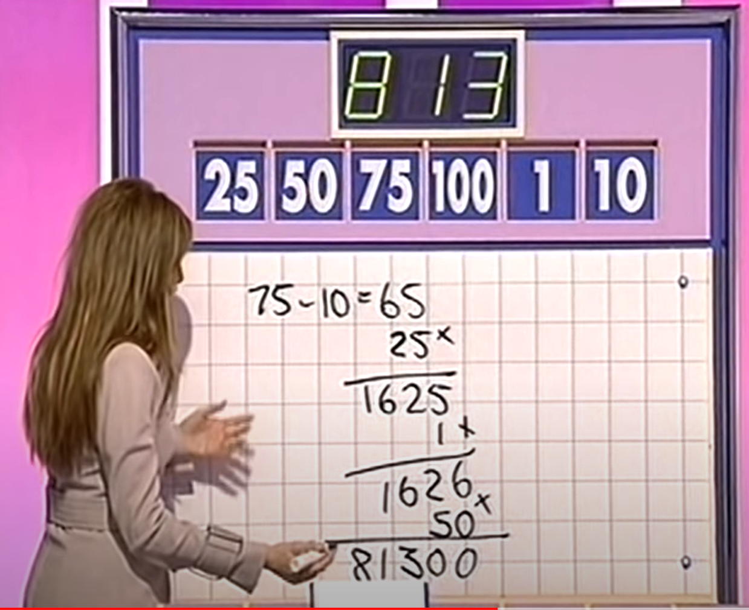

www.youtube.com/watch?v=_JQYYz92-Uk
Target is 812
2
2
2
8
8
8
(8) = 8
100
Using the given numbers, find a calculation that is as close to the target number as possible.
Use only the four basic operations of +,-, × and /.
You do not have to use all six numbers. A number may not be used more than once.
Division can only be performed if the result has no remainder.
Only positive integers may be obtained as a result at any stage of the calculation
+
/
+
/
50
((8) + 50) = 58
2
50
×
2
(((8) + 50) × 2) = 116
×
7
((((8) + 50) × 2) × 7) = 812

Slide 11
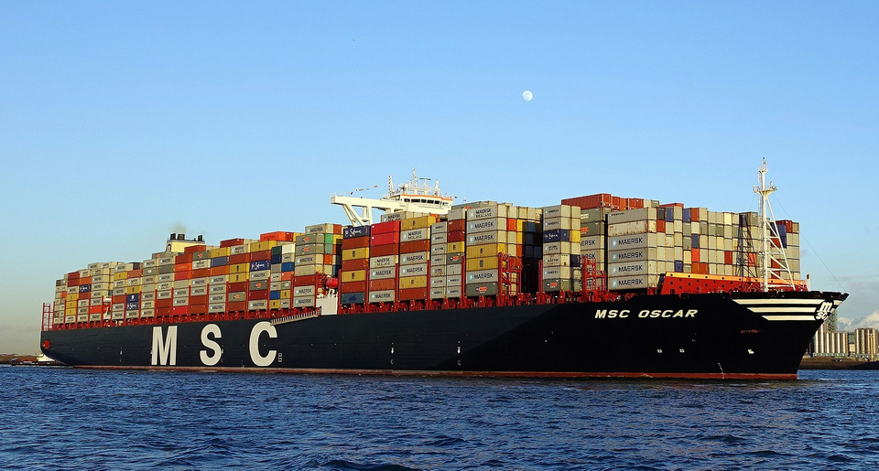
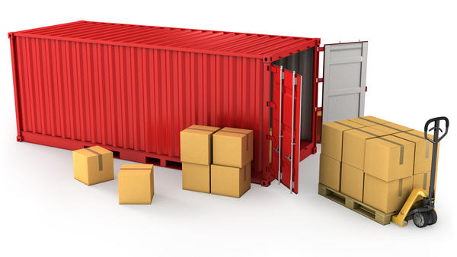
Thus far, we have seen mostly puzzles/games, but there are real, commercially important problems in this space
MSC Oscar is the largest container ship in the world (as of August 2015). It can carry 19,224 containers

Slide 12
Swap the containers marked A and B in as few moves as possible
A
B

Slide 13
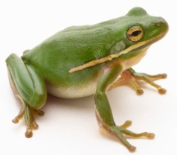
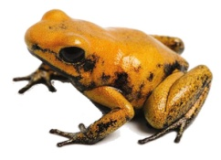
Toads And Frogs Puzzle
The Toads And Frogs Puzzle is also known under the names of Hares and Tortoise and Sheep and Goats.
N frogs are placed on N successive positions on the left of a string of squares; M toads occupy M rightmost squares.
On the whole, there are M + N + 1 squares, so that just one square remains unoccupied.
Frogs only move rightward; toads move leftward.
Every move is either a Slide to the nearby square or a Jump over one position, which is allowed only if the latter is occupied by a fellow of a different kind.
In any case, no two animals are allowed in the same square.
The goal is to move toads into M leftmost positions and the frogs into N rightmost positions.
Play online: https://nrich.maths.org/content/00/12/game1/frogs/index.html#/student/2/2

Slide 14
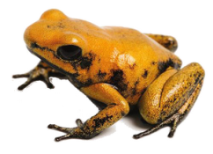
Move 1
Move 2
:::

Slide 15



Initial state
Operators
Goal state
Goal state

Slide 16








Slide 17
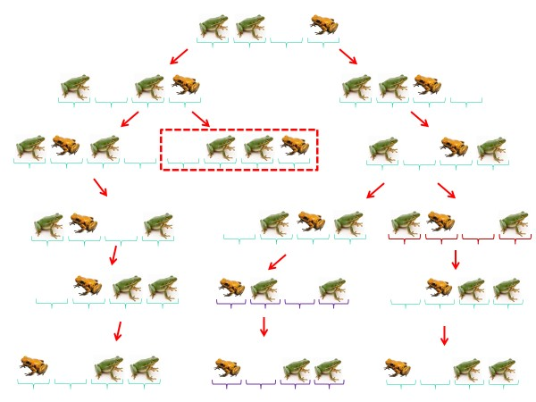
For this example, there are three possible solutions, and only one way to fail.
But as we add more frogs and toads, the number of ways to fail grows exponentially, but the number of solutions does not, so the problem become much harder

Slide 18
Problem Solving using Search
To solve problems with search, we need two things
  The Problem Space Your chance to be creative
  The Search Algorithm Your job is just to pick the right algorithm
As we will see today, these two things are totally independent of each other.
Let's look are problem space first.

Slide 19
Problem Solving using Search
A Problem Space consists of
The current state of the world (initial state)
A description of the actions we can take to transform one state of the world into another (operators).
A description of the desired state of the world (goal state), this could be implicit or explicit.
A solution consists of the goal state*, or a path to the goal state.
* Problems where the path does not matter are known as “constraint satisfaction” problems.

Slide 20
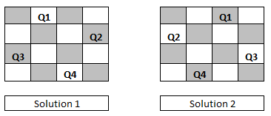
Initial State
Operators
Goal State
2
1
3
1
2
3
4
7
6
Slide blank square left.
Slide blank square right.
….
4
5
6
5
8
7
8
FWDC
Move F
Move F with W
….
FWDC
Is it true?
Distributive property
Associative property
Add constant to both side
etc.
4 Queens
A 4 by 4 chessboard with 4 queens placed on it such that none are attacking each other
Add a queen to the board.

Slide 21
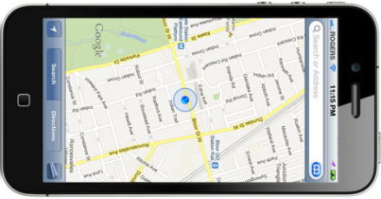
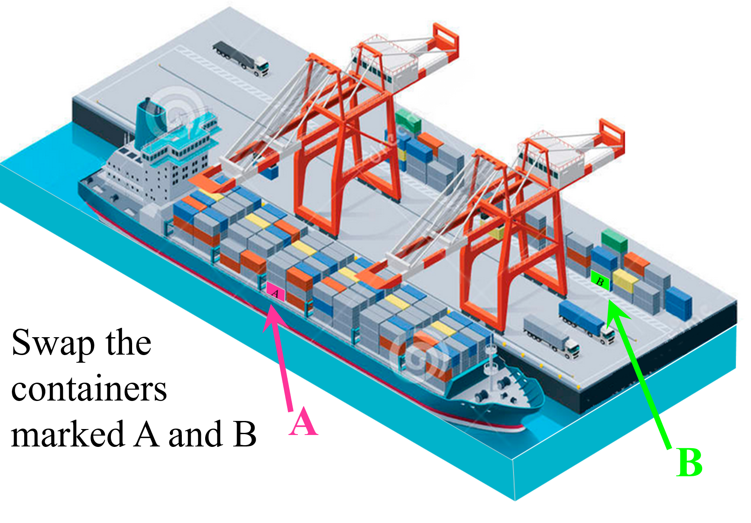
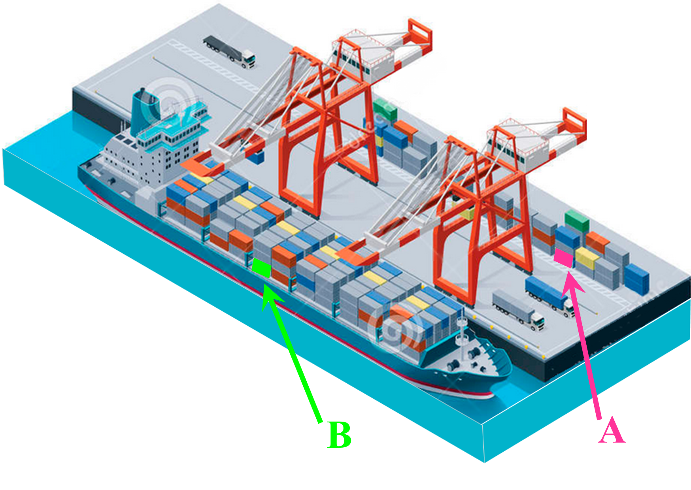
Initial State
Operators
Goal State
Drive north to next intersection
Drive south to next intersection
Make a U-turn
….
Your home address
LAX, Terminal 1
route finding
Move container A1 to holding area
Move container A2 to holding area
…
Move container in holding area to A1
…
Move container in holding area to F10
Slide Frog
Jump Frog
Slide Toad
Jump Toad

Slide 22
Representing the States
2
1
3
4
7
6
A state space should describe
Everything that is needed to solve the problem.
Nothing that is not needed to solve the problem.
5
8
For the 8-puzzle
3 by 3 array
  5, 6, 7
  8, 4, BLANK
  3, 1, 2
A vector of length nine
  5,6,7,8,4, BLANK,3,1,2
A list of facts
  Upper_left = 5
  Upper_middle = 6
  Upper_right = 7
  Middle_left = 8
  ….
In general, many possible representations are possible, choosing a good representation will make solving the problem much easier.
Choose the representation that make the operators easiest to implement, and if possible, has the lowest branching factor

Slide 23
Operators I
Single atomic actions that can transform one state into another.
You must specify an exhaustive list of operators, otherwise the problem may be unsolvable. Example U-turn
Operators consist of
  Precondition: Description of any conditions that must be true before using the operator.
  Instruction on how the operator changes the state.
In general, for any given state, not all operators are possible.
Examples:
In FWDC, the operator Move_Farmer_Left is not possible if the farmer is already on the left bank.
In this 8-puzzle,
The operator Move_6_down is possible
But the operator Move_7_down is not
2
1
3
4
7
6
5
8

Slide 24
Operators II
There are often many ways to specify the operators, some will be much easier to implement...
Example: For the eight puzzle we could have...
Move 1 left
Move 1 right
Move 1 up
Move 1 down
Move 2 left
Move 2 right
Move 2 up
Move 2 down
Move 3 left
Move 3 right
Move 3 up
Move 3 down
Move 4 left
…
Move Blank left
Move Blank right
Move Blank up
Move Blank down
2
1
3
Or
4
7
6
5
8

Slide 25
A complete example: The Water Jug Problem
A farm hand was sent to a nearby pond to fetch 2 gallons of water. He was given two pails - one 4, the other 3 gallons. How can he measure the requested amount of water?
Two jugs of capacity 4 and 3 units.
It is possible to empty a jug, fill a jug, transfer the content of a jug to the other jug until the former empties or the latter fills.
Task: Produce a jug with 2 units.
Abstract away unimportant details
Define a state representation
State representation (X , Y)
X is the content of the 4 unit jug.
Y is the content of the 3 unit jug.
Define an initial state
Initial State (0 , 0)
Define an goal state(s)
May be a description rather than explicit state
Goal State (2 , n)
Define all operators
Operators
Fill 3-jug from faucet (a, b) ⇒ (a, 3)
Fill 4-jug from faucet (a, b) ⇒ (4, b)
Fill 4-jug from 3-jug (a, b) ⇒ (a + b, 0)
...

Slide 26

Introduction to the next 7 slides
For some problems, the cost of each operator is identical. For example, Rubik Cube, 8-puzzle, etc.
For those problems, the depth of the tree at which we find a solution, is the cost for that solution.
However, for some problems, the cost of the operators can be different. In these cases, the sum of these costs back up to the initial state is the cost for a solution. This has a name, the G(n) which we will discuss more formally later
Let us see a familiar example…
2
1
3
4
7
6
5
8

Slide 27
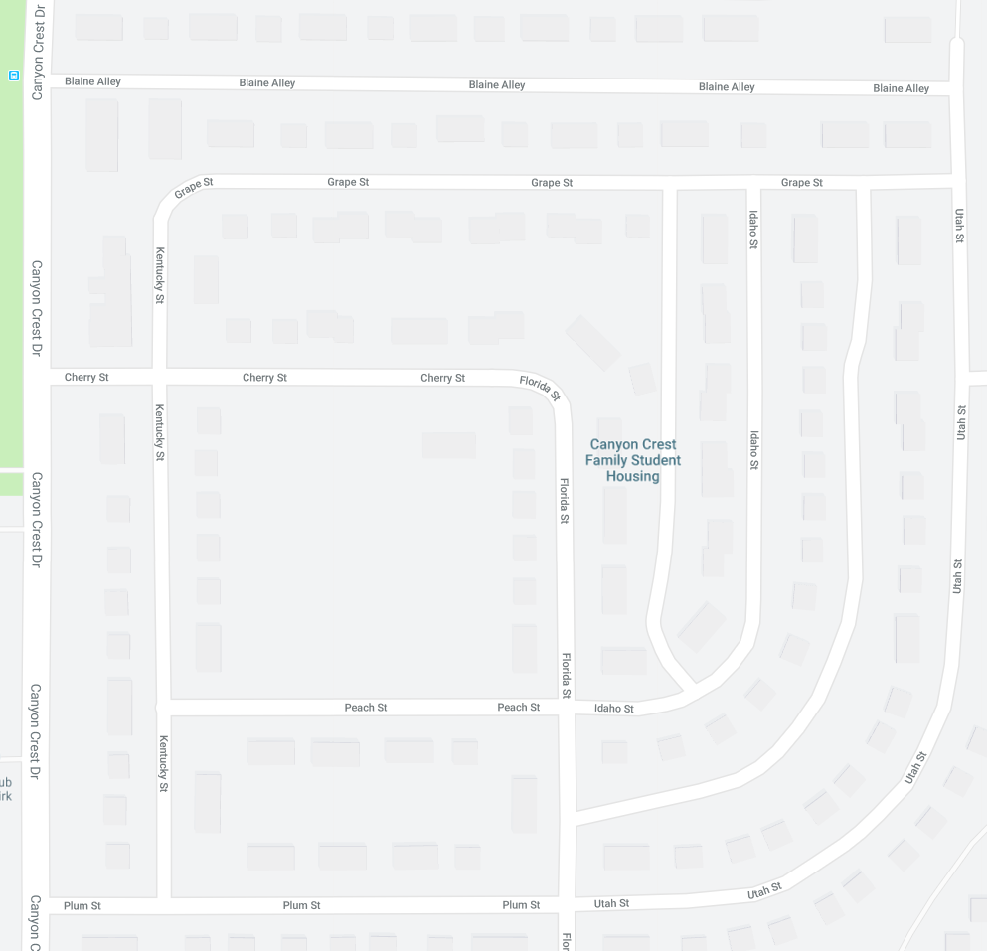
Suppose we are on Blaine Alley.
And we want to go this address on Florida St…

Slide 28
Suppose we are on Blaine Alley.
And we want to go this address on Florida…
Here is one solution…

Slide 29
Suppose we are on Blaine Alley.
And we want to go this address on Florida…
And here is another

Slide 30
Blaine Alley
Go Left (Utah)
Go Right (Utah)
Go Right (Grape)
Keep Straight (Utah)
Go Left (Idaho)
Go Right (Florida)
Go Right (Florida)
Arrive
4
Arrive
5
If we measured the cost in terms of number of moves (here number of intersections) then the green route is best.

Slide 31
Blaine Alley
100ft
100ft
Go Left (Utah)
Go Right (Utah)
100ft
100ft
Go Right (Grape)
Keep Straight (Utah)
200ft
1000ft
Go Left (Idaho)
Go Right (Florida)
600ft
400ft
Go Right (Florida)
Arrive
250ft
Arrive
If we measured the cost in terms of number of distance, then the pink route is much better
100 + 100 + 200 + 600 + 250 = 1250
100 + 100 + 1000 + 400 = 1600

Slide 32
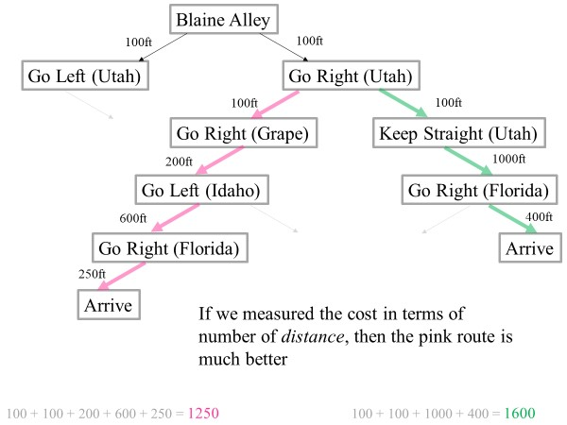
Which is correct?
Neither! This is a user choice.
For example, you might measure the cost in terms of:
1) Distance
2) Tolls you have to pay
3) Expected driving times (this is not the same as distance, when you have a mix of congested and empty roads)
4) Calories expended, if biking or walking (this is not the same as distance, when you have a mix of flat and hilly roads)
5) Beauty (you can score every road in terms of its scenic value)
6) etc.
The only constraint is that all costs must be non-zero, otherwise some of our algorithms will “blow up”.

Slide 33
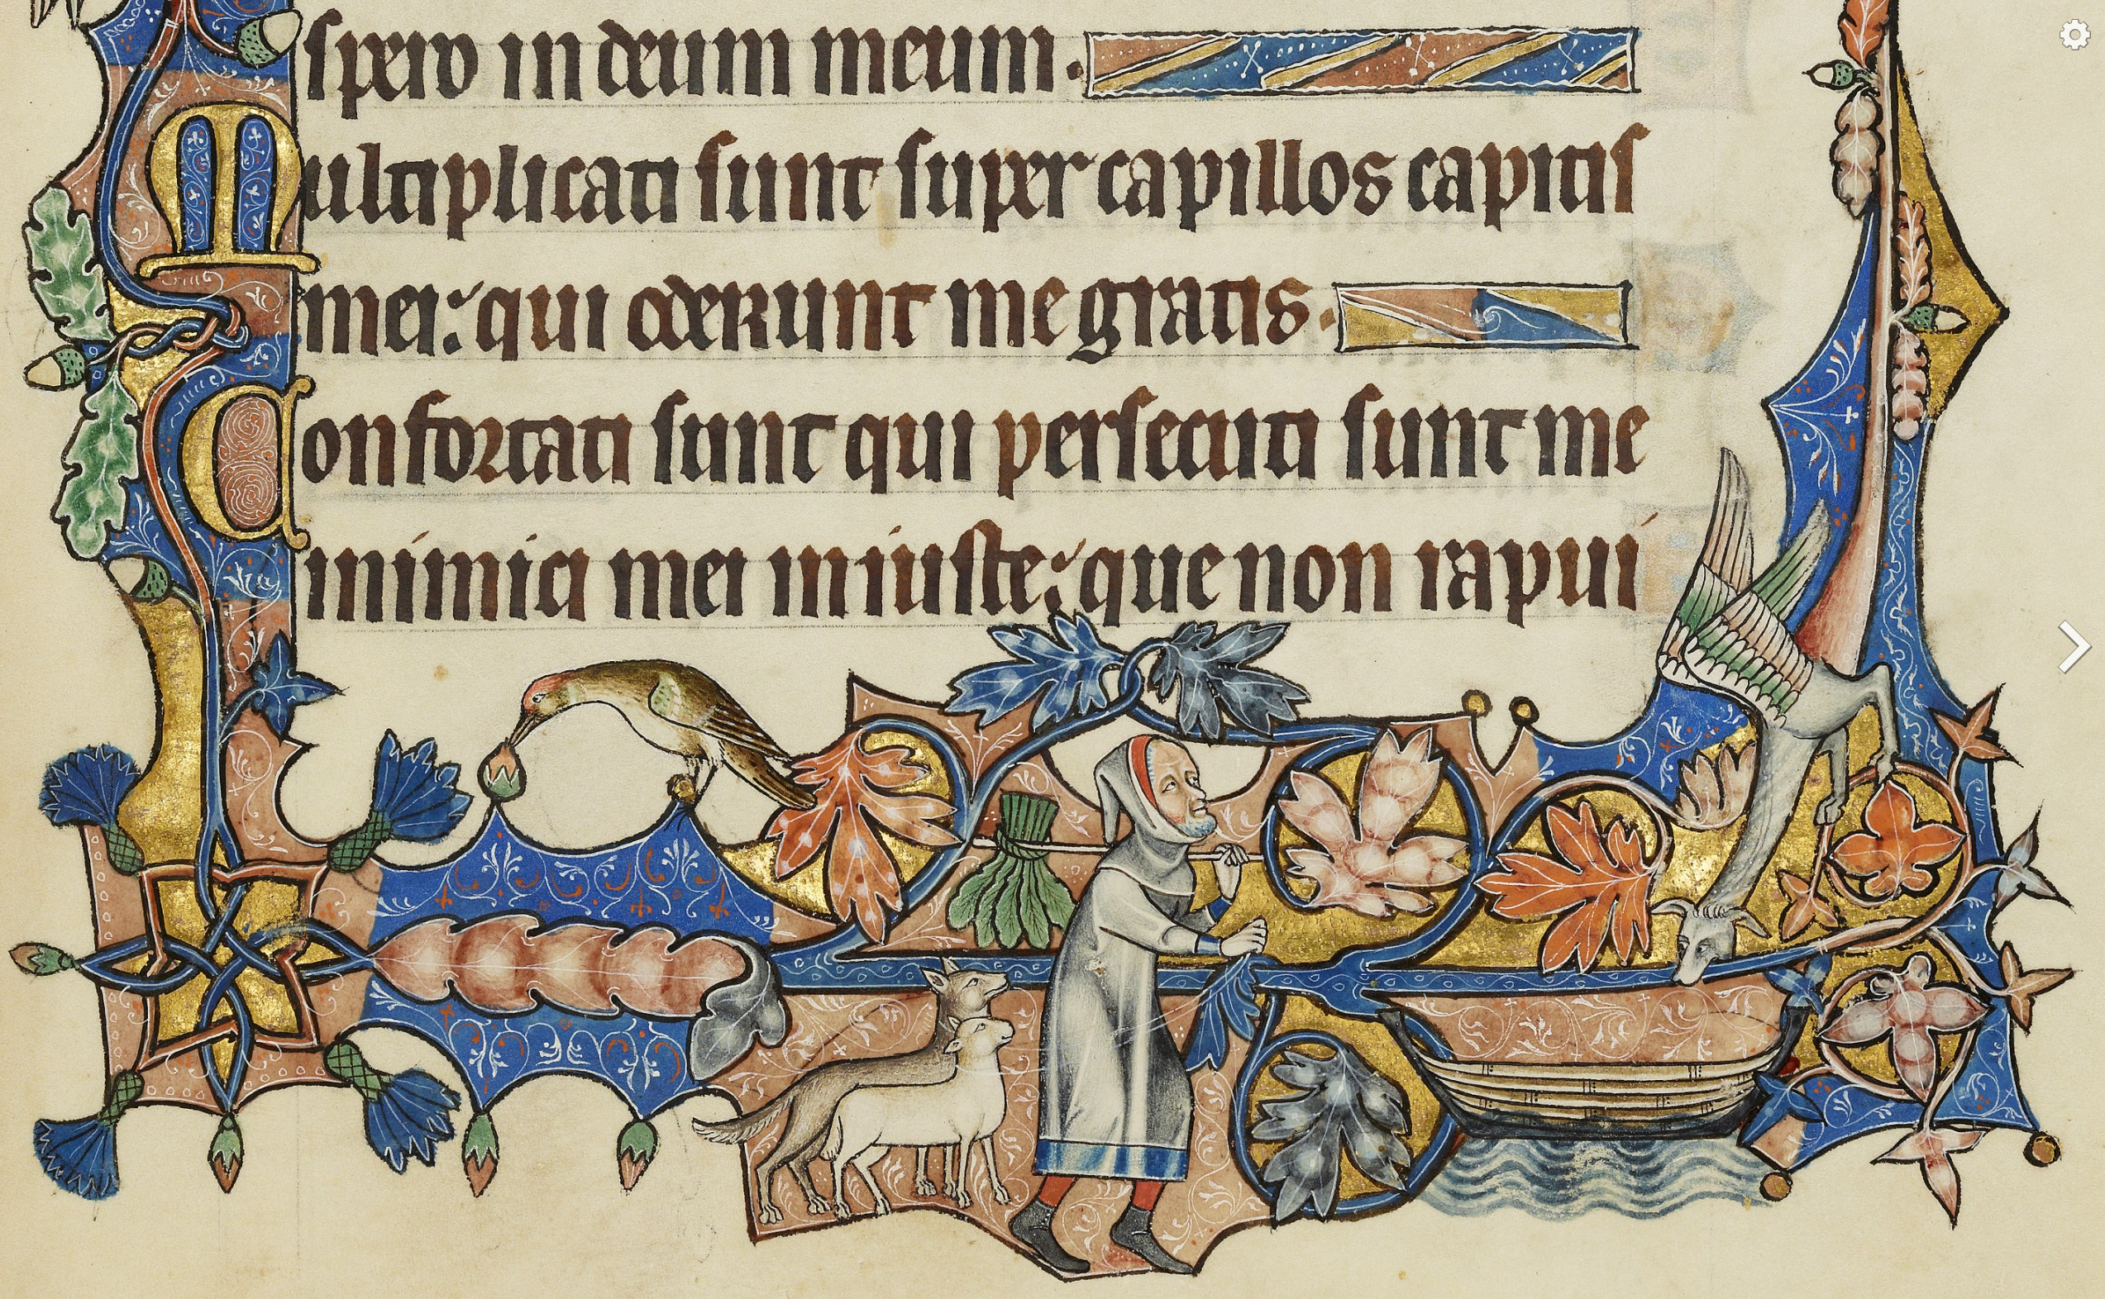
More Examples of
Non-Uniform Operator Costs
For FWDC, we normally think of the costs as be ‘1’ for each journey (and the cost was ‘7’)
However, we might decide that what we want to minimize is the effort required.
  Row, just farmer 200 calories
  Row, farmer and wolf 900 calories
  Row, farmer and duck 300 calories
  Row, farmer and corn 220 calories
The choice of the operator’s costs is our choice (or our customers choice).
Farmer, wolf, goat, cabbage
Ormesby Psalter 1250–1330

Slide 34
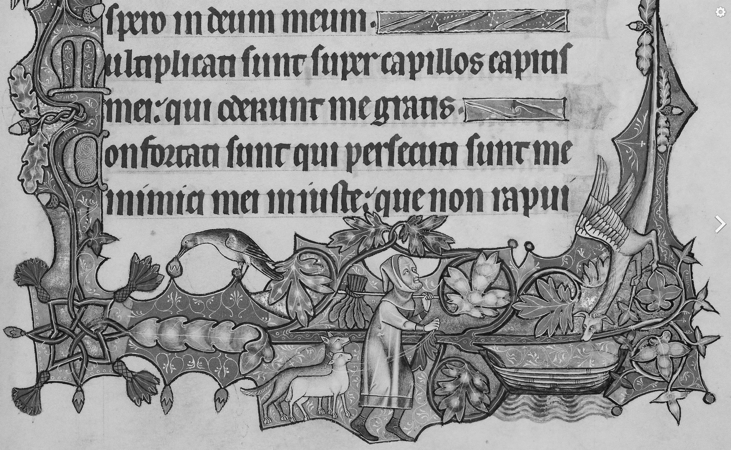
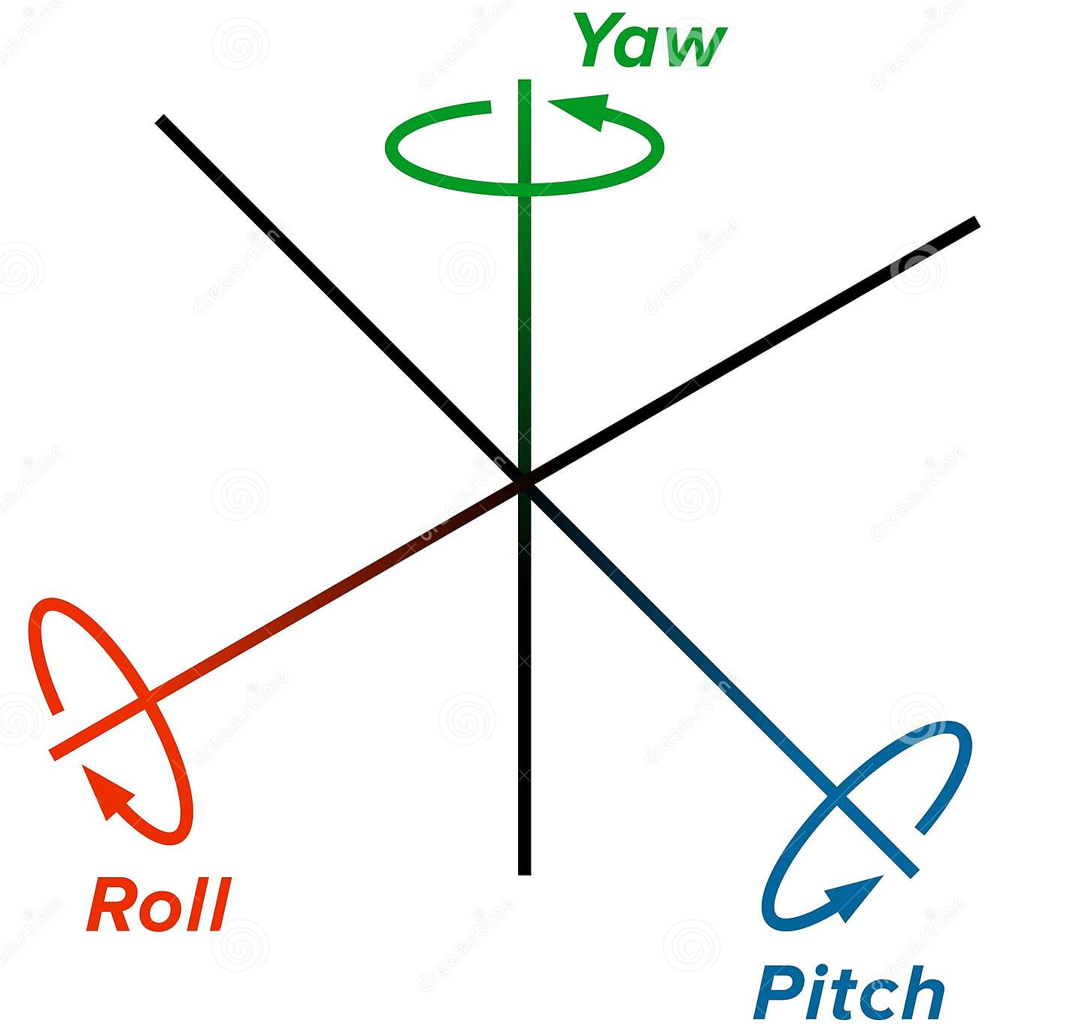
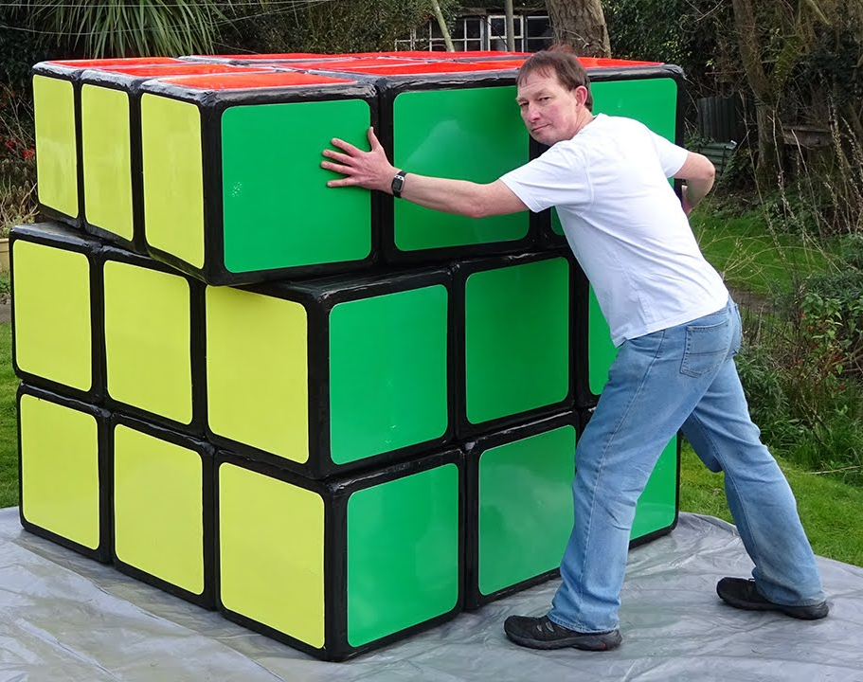
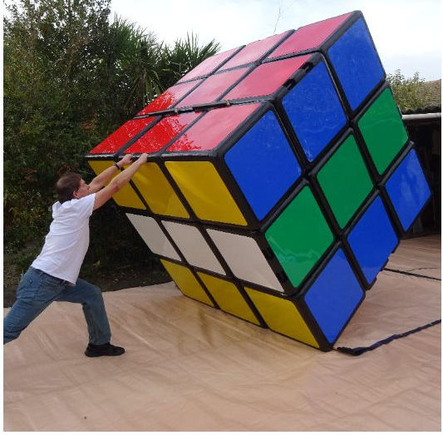
More Examples of
Non-Uniform Operator Costs
For FWDC, we normally think of the costs as be ‘1’ for each journey (and the cost was ‘7’)
However, we might decide that what we want to minimize is the effort required.
  Row, just farmer 200 calories
  Row, farmer and wolf 900 calories
  Row, farmer and duck 300 calories
  Row, farmer and corn 220 calories
The choice of the operator’s costs is our choice (or our customers choice).
For Rubik cubes, the cost of each operator is normally considered to be ‘1’.
However, for a 6-foot tall cube, movements in the yaw axis are easy, but movement in the roll or pitch axis are tricky. So, we could change the operator costs to minimize the harder moves.
Farmer, wolf, goat, cabbage
Ormesby Psalter 1250–1330

Slide 35
Once we have defined the problem space (state representation, the initial state, the goal state and operators) are we are done?
We start with the initial state and keep using the operators to expand the nodes till we find a goal state.
…but the search space might be large…
…really large…
So, we need some systematic way to search.

Slide 36
The average number of new nodes we create when expanding a new node is the (effective) branching factor b.
The length of a path to a goal is the depth d.
So visiting every node in the search tree to depth d will take O(b^{d}) time.
Not necessarily O(b^{d}) space.
This we call the size of the problem space.
A Generic Search Tree
b
b²
b^{d}
Fringe (Frontier)
Set of nonterminal nodes without children
I.e nodes waiting to be expanded.
Goal

Slide 37
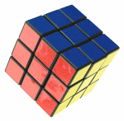
Branching factors for some problems: I
2
1
3
The eight puzzle has a branching factor of 2.13, so a search tree at depth 20 has about 3.7 million nodes. (note that there only 181,400 different states).
Rubik’s cube has a branching factor of 13.34. There are 43,252,003,274,489,856,000 different states. The average depth of a solution is about 18.
Frogs and Toads has a branching factor of about 2
4
7
6
5
8
forty three quintillion , two hundred fifty two quadrillion , three trillion ,two hundred seventy four billion ,four hundred eighty nine million , eight hundred fifty six thousand

Slide 38
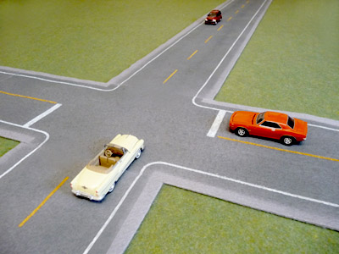

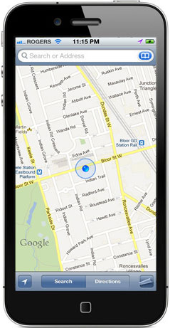
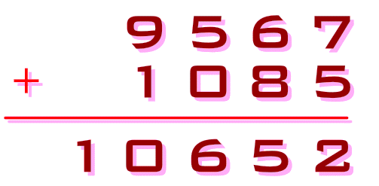
Branching factors for some problems: II
The branching factor for route finding is about 4. That is to say, most intersections are four way.
The branching factor for an alphametic (also known as cryptarithmetic, cryptarithm or word addition) is about ten.
Find a route from LAX to UCR that minimizes the mileage

Slide 39
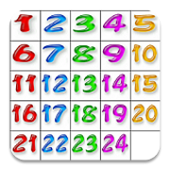
The Diameter of a Problem
The diameter of a problem is the depth of the longest solution, i.e. the worst case.
The diameter is sometimes called God’s Number
  For the 3-puzzle, the diameter is 6
  For the 8-puzzle the diameter is 31
  For the 15-puzzle the diameter is 80
  For the 24-puzzle the diameter is unknown. It is known to be at least 152 and at most 208.
2
1
3
1
2
4
7
6
3
5
8

Slide 40

The Diameter of a Problem
There exists at least one scrambled version of the 15-puzzle, that even god would need 80 moves to solve
The diameter of a problem is the depth of the longest solution, i.e. the worst case.
The diameter is sometimes called God’s Number
For the 3-puzzle, the diameter is 6
For the 8-puzzle the diameter is 31
For the 15-puzzle the diameter is 80
For the 24-puzzle the diameter is unknown. It is known to be at least 152 and at most 208.
There does not exist any scrambled version of the 15-puzzle, that god would need more than 80 moves to solve
This is one (of 17) puzzles that needs 80 moves to solve it.

Slide 41
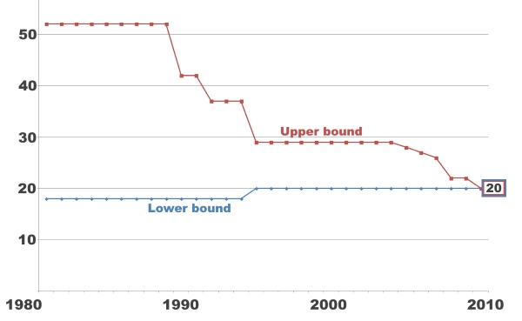
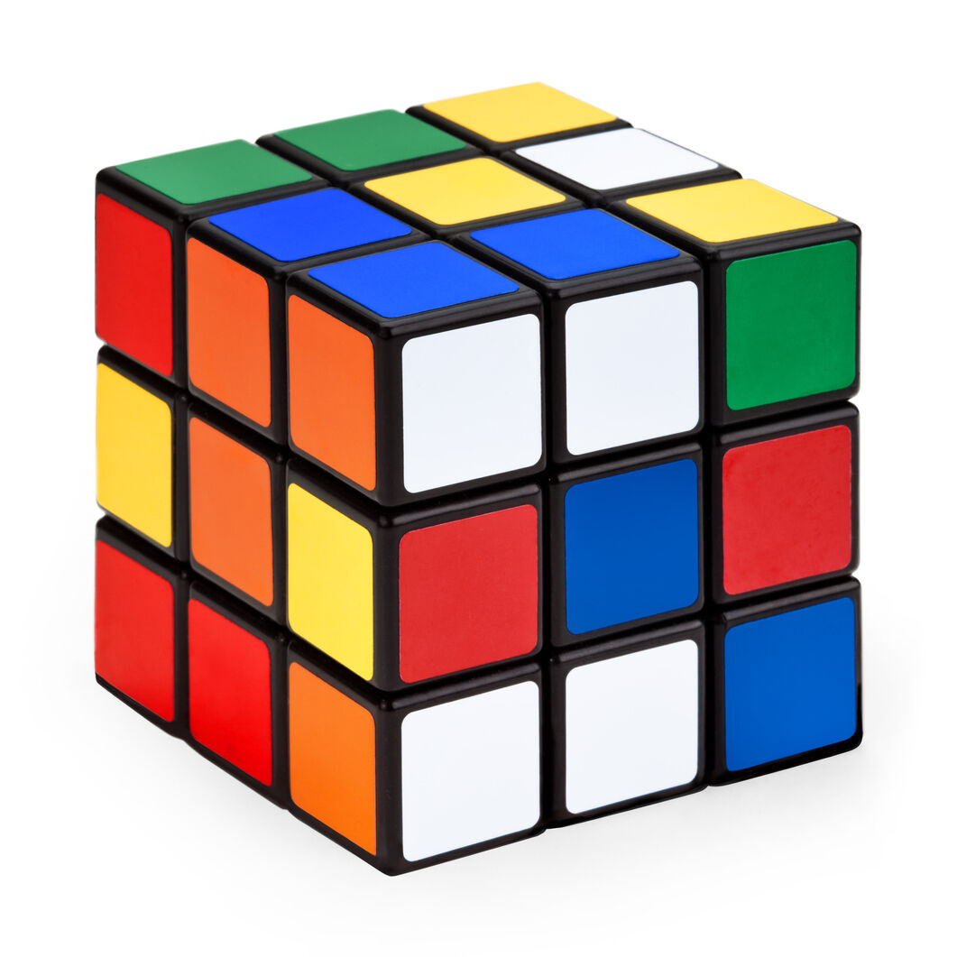
The Diameter of a Problem
What about the Rubik cube?
This took decades of effort to figure out, and the final push tool 35 years of CPU time (donated by Google).
For decades people had slowly proved
tighter and tiger lower bounds, at least 18, then 19...
tighter and tiger upper bounds, at most 52, then 42...
Finally, in 2010, these bounds both became 20
The Diameter of the Rubik Cube is 20
This assumes you count ¼ turns and ½ turns as a single move. If you only allow ¼ turns, the diameter is 26.

Slide 42
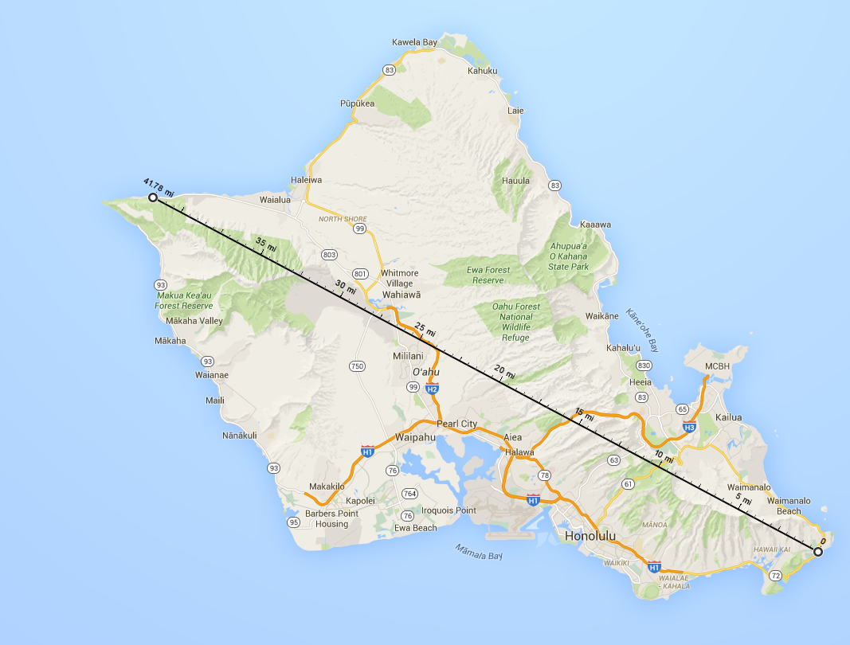
The Diameter of a Problem
For route finding, the diameter is approximately the diameter of the smallest circle that includes all the roads (in fact, this is a lower bound)
For Oahu, I estimated a diameter of 41.7 miles, but the shortest route I was able to find takes 49.7 miles

Slide 43
Detecting repeated states is hard….
If we don’t detect them, then we will expand them again, wasting time and space.
One way to detect them is to hash them. If we get a collision, we have been there before.
As we will later see, for an algorithm called A-star, it probably does not help to detect repeated states

Slide 44
We are going to consider different techniques to search the problem space, we need to consider what criteria we will use to compare them.
Completeness: Is the technique guaranteed to find an answer (if there is one).
Optimality: Is the technique guaranteed to find the best answer (if there is more than one). (remember that operators can have different costs)
Time Complexity: How long does it take to find a solution.
Space Complexity: How much memory does it take to find a solution.

Slide 45
General (Generic) Search Algorithm
function general-search(problem, QUEUEING-FUNCTION)
nodes = MAKE-QUEUE(MAKE-NODE(problem.INITIAL-STATE))
loop do
if EMPTY(nodes) then return "failure" (we have proved there is no solution!)
node = REMOVE-FRONT(nodes)
if problem.GOAL-TEST(node.STATE) succeeds then return node
nodes = QUEUEING-FUNCTION(nodes, EXPAND(node, problem.OPERATORS))
end
A nice fact about this search algorithm is that we can use a single algorithm to do many kinds of search. The only difference is in how the nodes are placed in the queue.

Slide 46
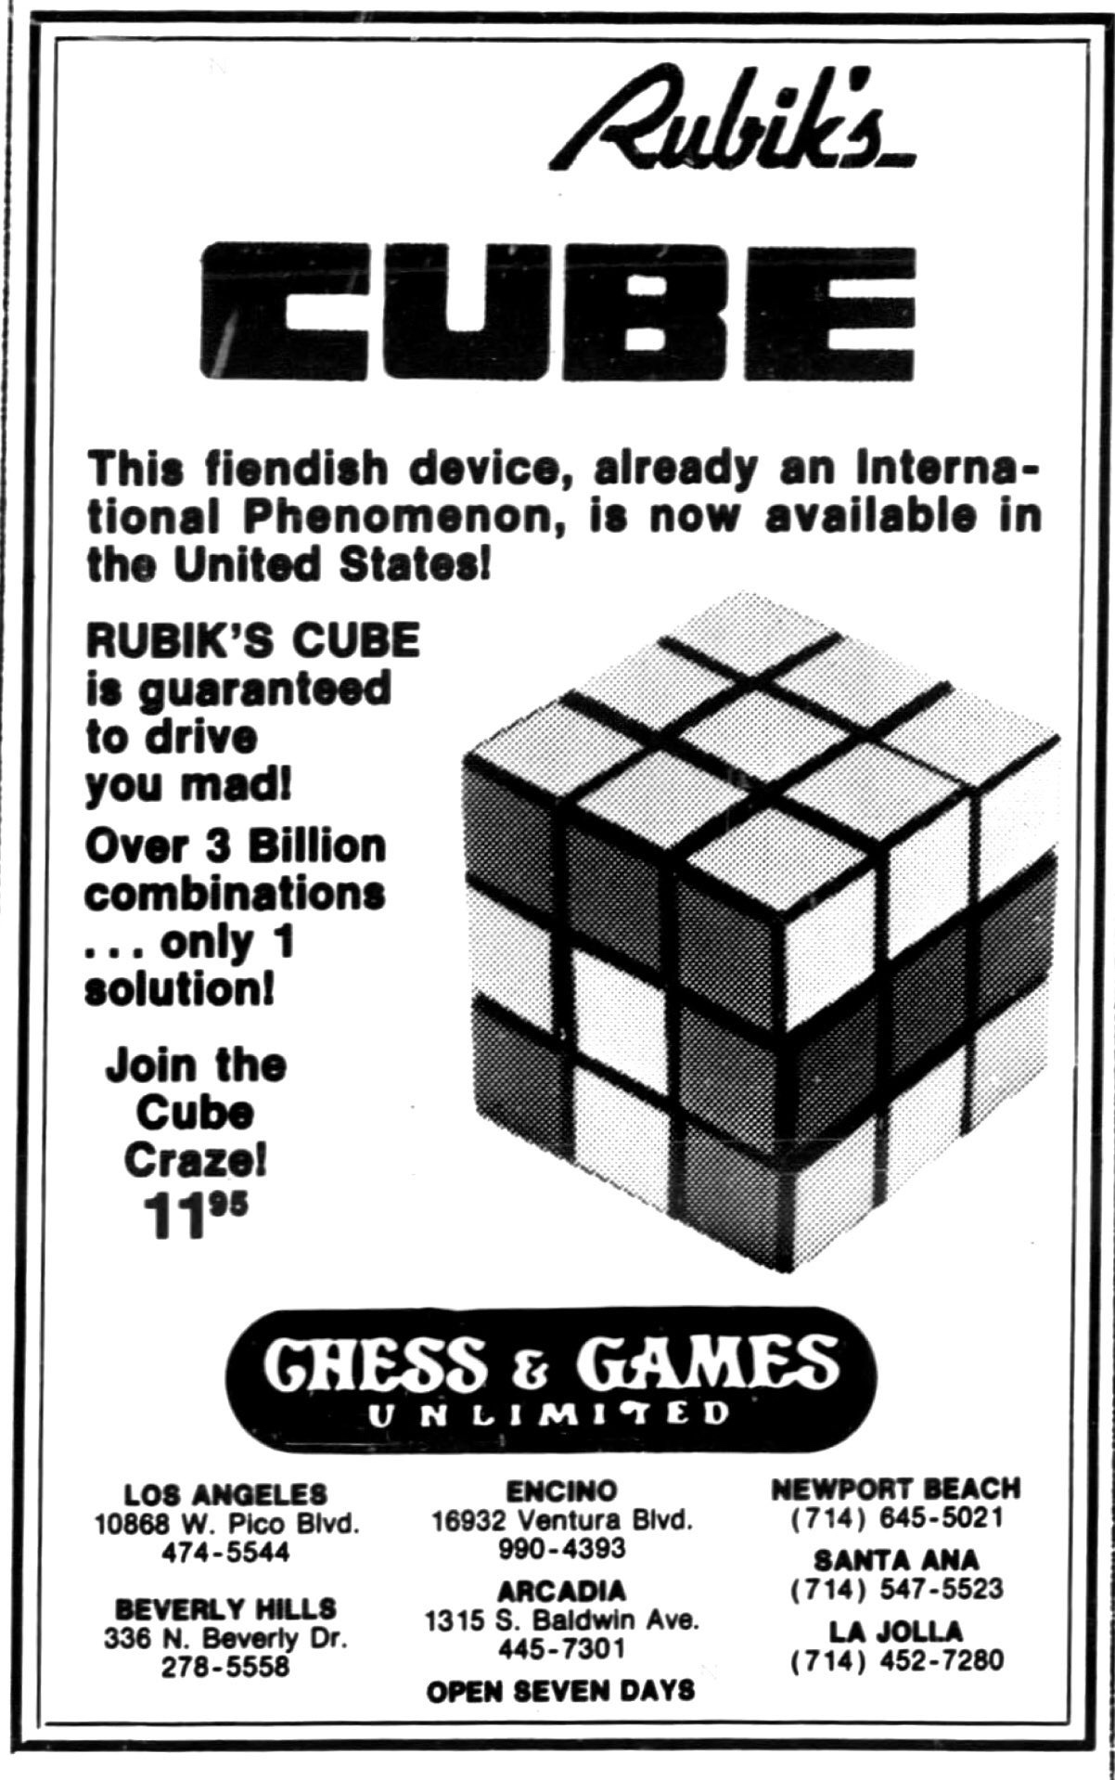

When the Rubik’s cube was first released, it was advertised as having “over three billon combinations”, a drastic undercount.

