Slide 1
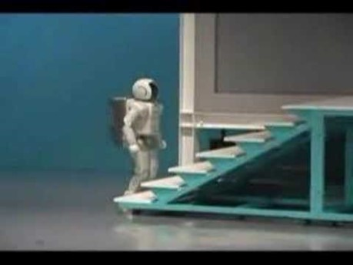

Slide 2
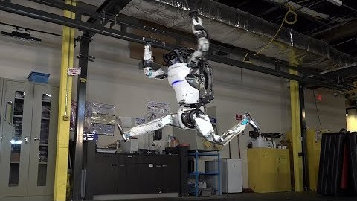

Slide 3
Anytime Algorithms for AI
Today we will learn about anytime algorithms.
Anytime algorithms are a general tool beyond A.I., but are especially critical for AI agents that operate in the real world (driverless cars, robots, web-bots etc)
Let's start with motivation…
https://www.youtube.com/watch?v=lgpZfSHaDAY

Slide 4
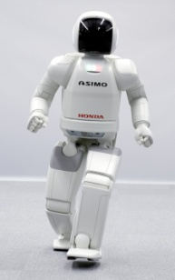
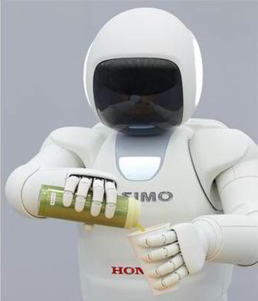
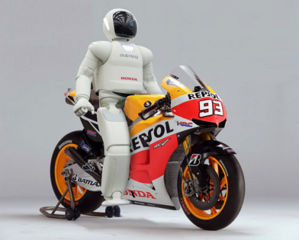
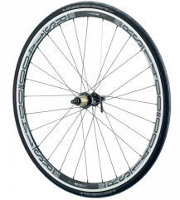
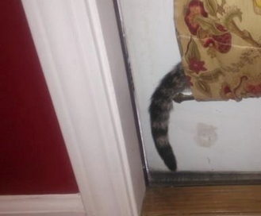
Motivation
We build a robot assistant
It uses ideas we learned this quarter…
“Asimo: go to Malcom Smiths and pick up my motorbike”. Uses A* to plan the route to and from the motorcycle repair shop.
“Asimo: find Mr. Mittens”. Uses machine learning to recognize cats in its video stream.
“Asimo: find Mr. Mittens”. Uses reasoning to understand that if you see a cat’s tail, you have found the cat.
This commonsense fact does need to be encoded (or learned). If you find a bike wheel, it does NOT mean you found the bike…
∀x,y isCatTail(x) ⇒ isAttachedTo(x,y) ∧ isCat(y)

Slide 5
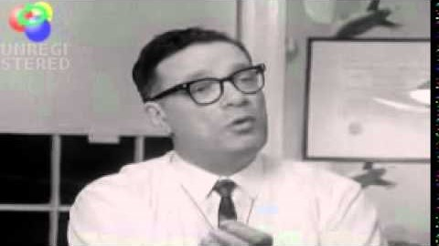

Slide 6
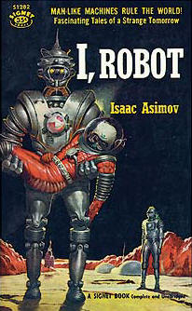
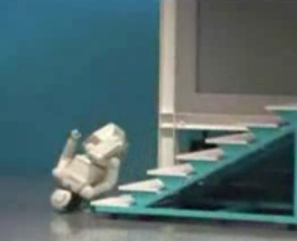
We need to tell the robot to protect itself
Isaac Asimov’s three laws of robotics
  A robot may not injure a human being or, through inaction, allow a human being to come to harm.
  A robot must obey the orders given it by human beings except where such orders would conflict with the First Law.
  A robot must protect its own existence as long as such protection does not conflict with the First or Second Laws
In order to protect himself, the robot must compute the expect cost of damage/wear, for various actions.
Example: We ask the robot to fetch milk from the shop. It could travel 3 different routes..
The cost is just the probably of getting damaged times the cost of the damage
So, the robot can compute the optimal action to protect itself, but it takes a few seconds…..
$1
$2
$9
Long walk, wear on battery and bearings
Walk through puddle, water damage
Walk up steps, risk of falling

Slide 7
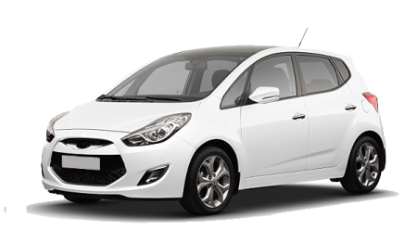
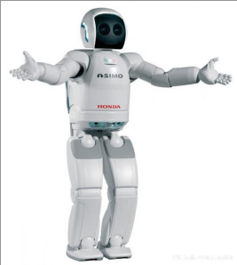
The robot is fetching my bagel one day, and he sees a car racing towards him.
There are two ways to avoid being hit, jump left or jump right
  Jump right means probably landing in a puddle in soft mud, maybe cause electrical shorts…
  Jump left means landing on hard concrete, maybe crack a robotic finger or two
What should the robot do? He begins to compute the optimal action..
$?
$?
Land on hard concrete
Land in puddle

Slide 8
The robot is fetching my bagel one day, and he sees a car racing towards him.
There are two ways to avoid being hit, jump left or jump right
  Jump right means probably landing in a puddle in soft mud
  Jump left means landing on hard concrete
What should the robot do? He begins to compute the optimal action..
$?
$?
.. and while the robot is still computing the optimal answer to the 20 decimal place, it gets smashed by the car.
Land on hard concrete
Land in puddle

Slide 9
Takeaway
There are problems for which we can compute a solution
But sometimes, while computing a solution, we are forced to make a choice NOW!
In such cases, we would be better off giving some answer, even if it is not optimal.
There is a framework to support this, anytime algorithms.

Slide 10
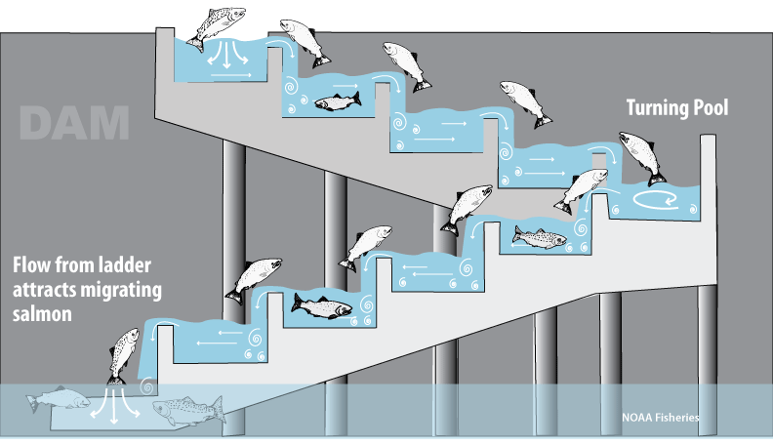
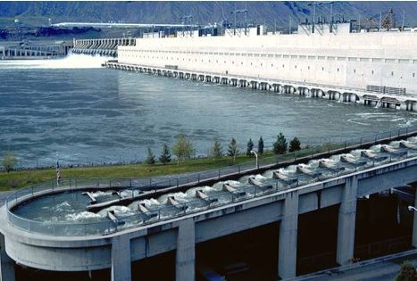
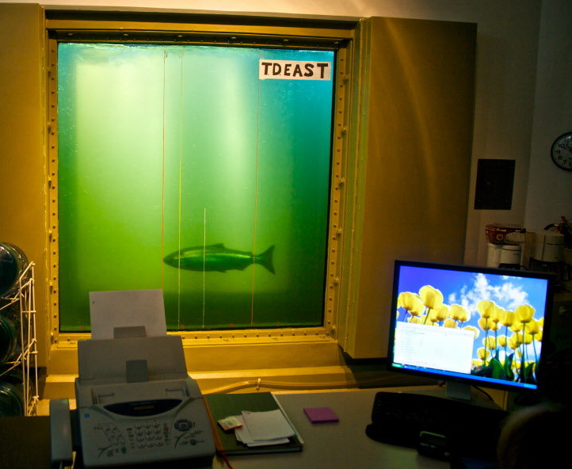
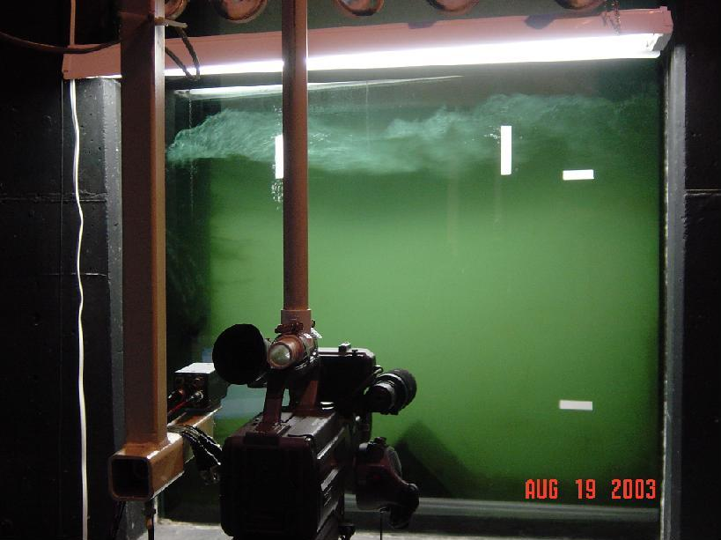
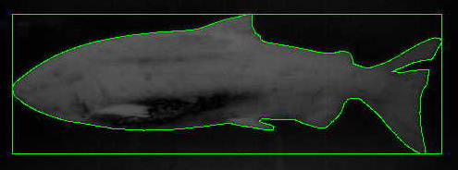

Slide 11
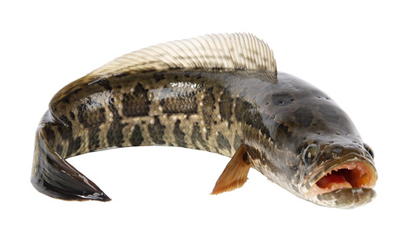
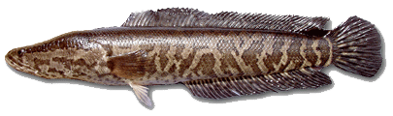
We want to recognize fish species.
If it is a snakehead, we want to turn on a large capacitor to electrically shock it and kill it.
We tested a bunch of algorithms. Nearest Neighbor Classification works best. It takes 4 seconds to classify each fish.
Some fish swim slowly passed the kill zone, and 4 seconds is enough.
However, many fish swim so fast, that they are gone before we can realize that they are snakeheads!

Slide 12
Classic Algorithms
Run for a fixed amount of time
Do not have any answer until that time is up.
Quality of
Solution
Time
4 seconds

Slide 13
Anytime Algorithms
Trading execution time for quality of results.
Always has a best-so-far answer available.
Quality of the answer improves with execution time.
Allowing users to suspend the process during execution, and keep going if needed.
Continue
If you want
Peek the results
Setup
Setup
Time
Time
Current Solution
Quality of
Current Solution
Quality of
Solution
Solution
Setup Time:
We may have to do a little overhead at the beginning, during which we cannot be interrupted
S
S
Time
Suspend
Time

Slide 14
Anytime Algorithms
So, we can run our fish classification algorithm.
If the fish swims slowly, we use all four seconds.
But if the fish swims fast, and is just about to leave the killing zone, we interrupt the algorithm, and ask it for its best current guess as to the class label.
3. Continue
If you want
2. Peek the results
Setup
Setup
Time
Time
Current Solution
Quality of
Current Solution
Quality of
Solution
Solution
S
S
Time
1. Suspend
Time

Slide 15
Anytime Algorithm Characteristics
Interruptability
After some small amount of setup time, the algorithm can be stopped at anytime
and provide an answer
Monotonicity
The quality of the result is a non-decreasing function of computation time
Diminishing returns
The improvement in solution quality is largest at the early stages of computation,
and diminishes over time
Measurable Quality
The quality of an approximate result can be determined
Preemptability
The algorithm can be suspended
and resumed with minimal overhead
[Zilberstein and Russell 95]

Slide 16
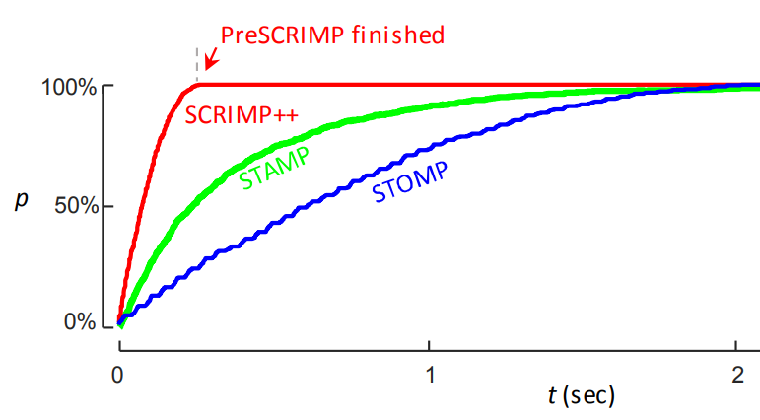
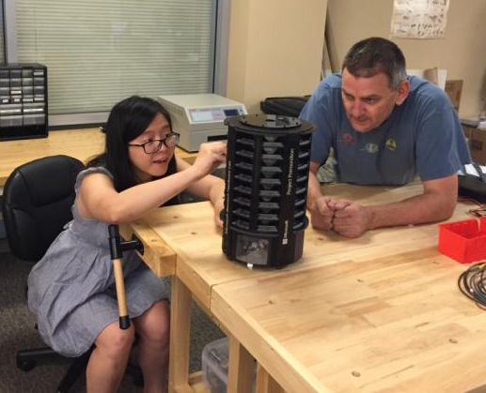
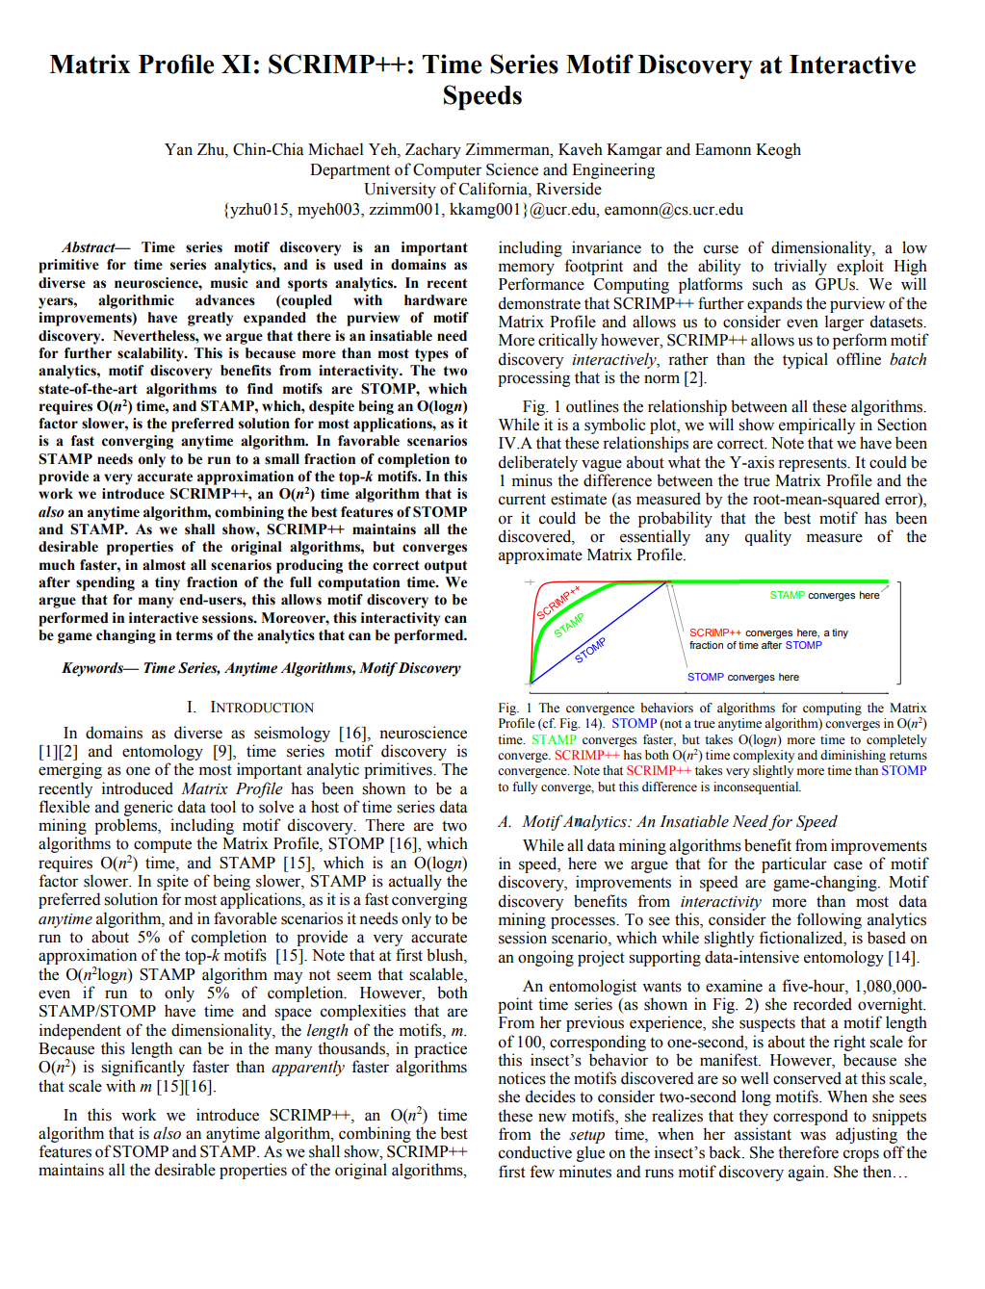
Yan Zhu
Matrix profile XI: SCRIMP++: time series motif discovery at interactive speeds. Y Zhu, CCM Yeh, Z Zimmerman, K Kamgar, E Keogh
2018 IEEE International Conference on Data Mining (ICDM), 837-846

Slide 17
This is possible, and undesirable.

Slide 18
We humans use anytime algorithms all the time
For example.
In a new busy restaurant it might take you ten minutes to really study the menu and choose the optimal dinner. But after 2 minutes the waiter suddenly shows up and demands your order.
In soccer, the ball is passed to you. You could try a long shot, or you could try to dribble past the defender. It would take you 5 seconds to compute the optimal strategy, but from the corner of your eye you see a defender running towards you, he will intercept you in 2 seconds…
Setup
Setup
Time
Time
Current Solution
Quality of
Current Solution
Quality of
Solution
Solution
S
Time
S
Time

Slide 19
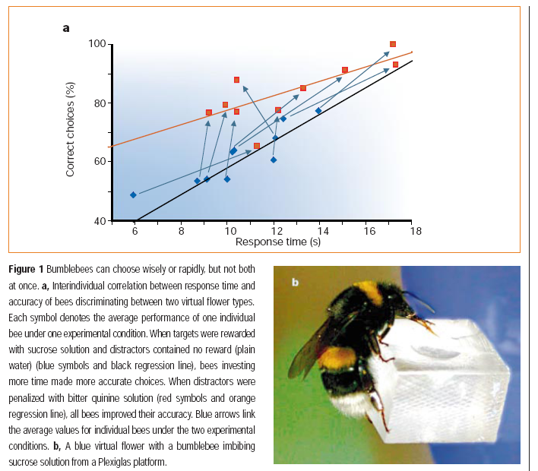
Bumble Bee’s Anytime Strategy
“Bumblebees can choose wisely or rapidly, but not both at once.”
Lars Chittka, Adrian G. Dyer, Fiola Bock, Anna Dornhaus, Nature Vol.424, 24 Jul 2003, p.388
To survive
I can perform the best judgment
for finding real nectars
like “anytime learning” !
Big Question:
How can we make classifiers
wiser / more rapid
like bees?

Slide 20
Some algorithms that we know about are already anytime algorithms
Some algorithms can be converted into anytime algorithms with a little work
Some algorithms are just very hard to convert into an anytime framework.
Already anytime algorithms
  Greedy search, random search, Simulated-Annealing, Genetic Algorithms, k-means clustering, decision tree construction, Monte Carlo game tree search…
Can be converted to anytime algorithm
  A-star. Suppose we do the following, we first run just greedy search, and record the answer we get (which will almost certainly be suboptimal), we then start classic A-star…
  Minimax. If we do these it in iterative deepening fashion, it becomes an anytime algorithms (see next slide)
Hard/impossible to convert to anytime algorithm (I think)
  Theorem proving. For resolution refutation, until the algorithm stops, it is impossible to know if it is leaning towards TRUE or not. It is an all-or-nothing algorithm.
  Dendrogram construction.
Quality of Solution

Slide 21
Although the Minimax algorithm is optimal, there is a problem…
The time complexity is O(b^{m}) where b is the effective branching factor and m is the depth of the terminal states.
(Note space complexity is only linear in b and m, because we can do depth first search).
One possible solution is to do depth limited Minimax search.
  Search the game tree as deep as you can in the given time.
  Evaluate the fringe nodes with the utility function.
  Back up the values to the root.
  Choose best move, repeat.
Minimax is not an anytime algorithms. It assumes it has a fixed time, and goes as deep as it can (to the cutoff) in that time
We would like to do Minimax on this full game tree...
… but we don’t have time, so we will explore it to some manageable depth.
cutoff

Slide 22
If I take force it to stop, say after only giving it half the time
Had I known I had half the time, I would have done this…
If I take the full time allowed
cutoff
cutoff
cutoff

Slide 23
Making Minimax an anytime algorithms is easy.
Just do iterative deepening!
Idea: Search to level 1, if you have not been interrupted, each to level 2, if you have not been interrupted, each to level 3, …………..
Setup
Setup
Time
Current Solution
Current Solution
S
Time
S
Time
cutoff
cutoff
cutoff

Slide 24
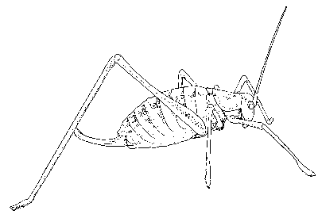

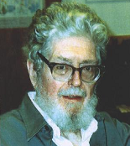
Nearest Neighbor Classifier
10
9
8
7
Evelyn Fix
1904-1965
Joe Hodges
1922-2000
6
Antenna Length
5
If the nearest instance to the previously unseen instance is a Katydid
class is Katydid
else
class is Grasshopper
4
3
2
1
Katydids
Grasshoppers
1
2
3
4
5
6
7
8
9
10
Abdomen Length

Slide 25
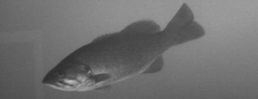
Case Study: Fish Recognition
In this dataset we have 3,000 instances.
The distance measure is not the superfast O(n) Euclidean distance we are use to.
We need to use an O(n³) distance measure. So it takes 4 seconds to compare the query to all 3,000 fish, and find the nearest neighbor.
We can get 99.9% accuracy.
100
100
99.5
99.5
accuracy(%)
accuracy(%)
99
99
98.5
98.5
98
98
0
0
500
500
1000
1000
1500
1500
2000
2000
2500
2500
3000
3000
Number of instances seen before interruption, S
Number of instances seen before interruption, S
4.0 sec
-
-
2
2
-
-
1.5
1.5
-
-
1
1
-
-
0.5
0.5
0
0
0.5
0.5
1
1
1.5
1.5
2
2
Rotation-Robust DTW [Keogh 05]

Slide 26
Case Study: Fish Recognition
In this dataset we have 3,000 instances.
The distance measure is not the superfast O(n) Euclidean distance we are use to.
We need to use a O(n³) distance measure. So it takes 4 seconds to compare the query to all 3,000 fish, and find the nearest neighbor.
We can get 99.9% accuracy.
But if we are interrupt the algorithm early, we can just report the class of the current best-so-far nearest neighbor as the answer.
So we have an anytime algorithm!
100
100
99.5
99.5
accuracy(%)
accuracy(%)
99
99
98.5
98.5
98
98
0
0
500
500
1000
1000
1500
1500
2000
2000
2500
2500
3000
3000
Number of instances seen before interruption, S
Number of instances seen before interruption, S
0.3 sec
4.0 sec
-
-
2
2
-
-
1.5
1.5
-
-
1
1
-
-
0.5
0.5
0
0
0.5
0.5
1
1
1.5
1.5
2
2
Rotation-Robust DTW [Keogh 05]

Slide 27
Case Study: Fish Recognition
Can we do better?
That is to say, can we converge even faster, like my fake hypothetical example.
100
100
99.5
99.5
accuracy(%)
accuracy(%)
99
99
98.5
98.5
98
98
0
0
500
500
1000
1000
1500
1500
2000
2000
2500
2500
3000
3000
Number of instances seen before interruption, S
Number of instances seen before interruption, S
0.3 sec
4.0 sec

Slide 28
Nearest Neighbor Classifier
Key insight into making nearest neighbor a better anytime algorithm
The order in which we visit the instances really matters
For example, suppose we visited all the red points first, and we are interrupted at the ½ way point…
10
9
8
7
Evelyn Fix
1904-1965
Joe Hodges
1922-2000
6
Antenna Length
5
If the nearest instance to the previously unseen instance is a Katydid
class is Katydid
else
class is Grasshopper
4
3
2
1
Katydids
Grasshoppers
1
2
3
4
5
6
7
8
9
10
Abdomen Length

Slide 29
Normally we do a nearest neighbor search in order, top to bottom
However, consider the first and third instances, they are highly redundant.
Any item that is correctly classified by instance 1, would surely be correctly classified by instance 3. So we should…
10
Insect ID | Abdomen Length | Antennae Length | Insect Class
1 | 2.7 | 5.5 | Grasshopper
2 | 8.0 | 9.1 | Katydid
3 | 2.6 | 5.5 | Grasshopper
4 | 1.1 | 3.1 | Grasshopper
5 | 5.4 | 8.5 | Katydid
6 | 2.9 | 1.9 | Grasshopper
7 | 6.1 | 6.6 | Katydid
8 | 0.5 | 1.0 | Grasshopper
9 | 8.3 | 6.6 | Katydid
10 | 8.1 | 4.7 | Katydids
9
8
7
6
5
4
3
2
1
1
2
3
4
5
6
7
8
9
10

Slide 30
Consider this dataset
How should we order the points?
10
9
Insect ID | Abdomen Length | Antennae Length | Insect Class
1
2
3
4
5
6
7
8
9
10
8
7
6
5
4
3
2
1
1
2
3
4
5
6
7
8
9
10

Slide 31
Consider this dataset
How should we order the points?
Which of the red points should we visit first?
10
9
Insect ID | Abdomen Length | Antennae Length | Insect Class
1
2
3
4
5
6
7
8
9
10
8
7
6
5
4
3
2
1
1
2
3
4
5
6
7
8
9
10

Slide 32
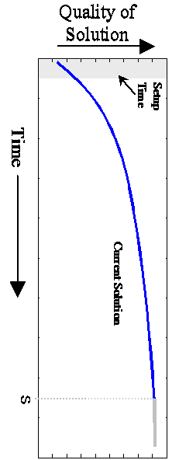
Designing the anytime Nearest Neighbor
How can we make
good Index for
training data?
Note that the number of possible orderings is n!
1 2 3 4 5 6 7 8 9 10 11 12 13 14 15 16 17 18 19 20 21 22 | Function [best_match_class]= Anytime_Classifier (Database, Index, O) best_match_val = inf; best_match_class = undefined; For p = 1 to number_of_classes(Database) D = distance(Database.object(Index_{p}) , O); If D < best_match_val best_match_val = D; best_match_class = Database.class_label(Index_{p}); End End Disp(‘The algorithm can now be interrupted’); p = number_of_classes(Database) + 1; While (user_has_not_interrupted AND p < max(index) ) D = distance(Database.object(Index_{p}) , O); If D < best_match_val best_match_val = D; best_match_class = Database.class_label(Index_{p}); End p = p +1; user_has_not_interrupted = test_for_user_interrupt; End
Initial
Step
(Constant Time)
Interruptible
step
Plug-in design for any ordering method

Slide 33
SimpleRank Ordering
Glossing over the details
We can invent a scoring function that combines the intuitions of the last few slides.
SimpleRank is one such function
We can then score all instances by this function, sort them by that score, and visit them in that order.
  based on NaïveRank Algorithm [Xi and Keogh 06]
  Sorting by leave-one-out with 1-Nearest Neighbor
NaiveRank Anytime Framework + SimpleRank
1. order training instances by the unimportance measure
2. sort it in reverse order.

Slide 34
JF:two-class classification problem
2-D Gaussian ball
Hard to classify correctly
because of the round shape.
Class A
Class B

Slide 35
How SimpleRank works.
SimpleRank Random Rank
T=10

Slide 36
Case Study: Fish Recognition
Using this reordering technique, we can dramatically improve the anytime classification of fish, especially in the very early stages.
100
100
99.5
99.5
accuracy(%)
accuracy(%)
99
99
Random Test
Random Test
SimpleRank Test
SimpleRank Test
98.5
98.5
98
98
0
0
500
500
1000
1000
1500
1500
2000
2000
2500
2500
3000
3000
Number of instances seen before interruption, S
Number of instances seen before interruption, S
0.3 sec
4.0 sec
-
-
2
2
-
-
1.5
1.5
-
-
1
1
-
-
0.5
0.5
0
0
0.5
0.5
1
1
1.5
1.5
2
2
Rotation-Robust DTW [Keogh 05]

Slide 37
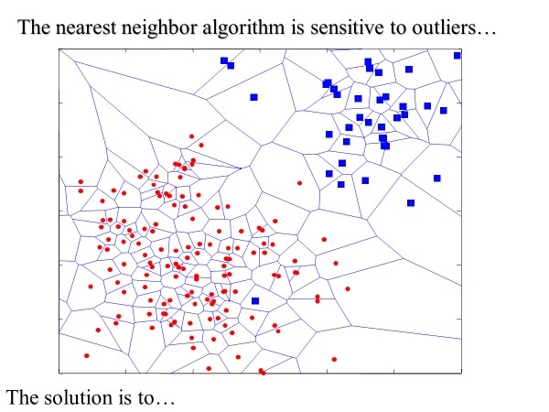
K=1: Voting Records
100
SimpleRank
accuracy(%)
90
Random Test
SimpleRank Test
RandomRank
0
50
100
150
200
250
300
350
Number of instances seen before interruption, S

Slide 38
K=1: Forest Cover Type
Accuracy (%)
# of instances seen before interruption

Slide 39
K=1,3,5 Australian Credit
10-CV, Euclidean
Accuracy (%)
Australian Credit dataset
# of instances seen before interruption

Slide 40
Conclusion
Normal batch algorithms are often too brittle to be deploy for real-world applications
Where possible, we should try to use anytime algorithms.
(as an aside, converting a batch algorithm, to an anytime algorithm can be a nice research project)

