Slide 1
Matlab Diary
Matlab allows you to keep a log or diary of your work.
This is useful because:
You can log all the new skills you practice, then take home the log file to study.
Some of you early homeworks will require you to print this log, and hand it in.

Slide 2
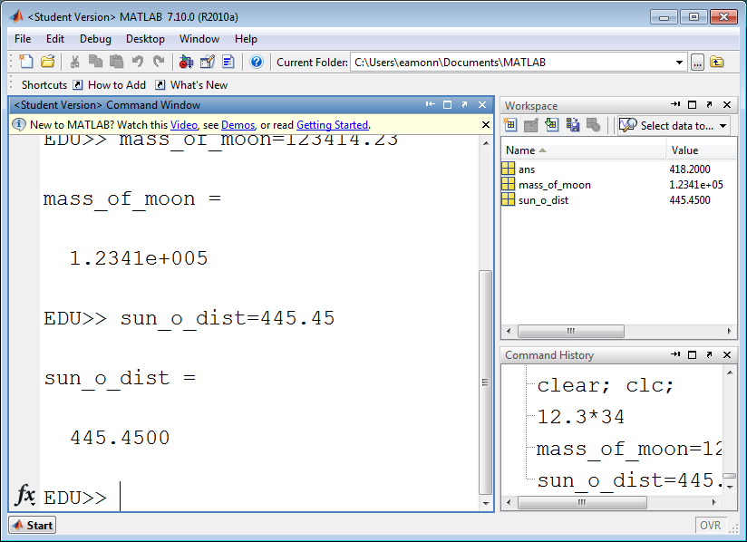
The first things we need to do are:
Clear all the variables currently in memory (ans, mass_of_moon, sun_o_dist )
Clear away all the old text in the command window

Slide 3
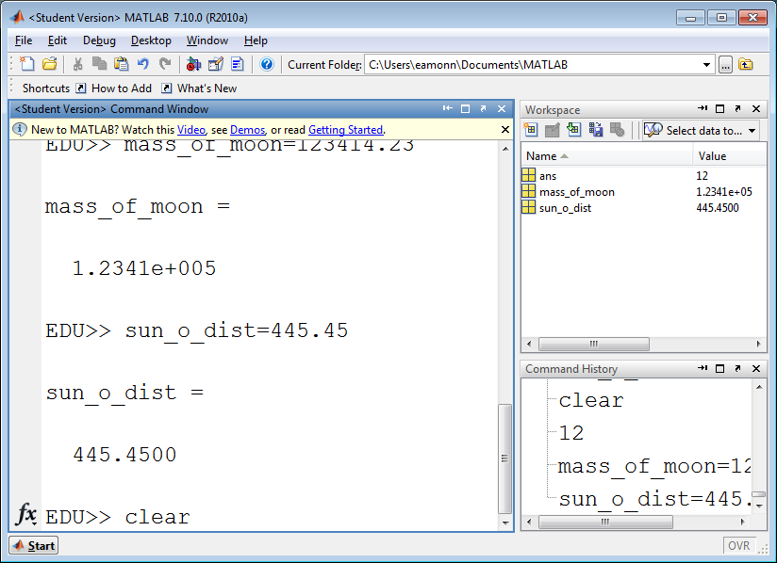
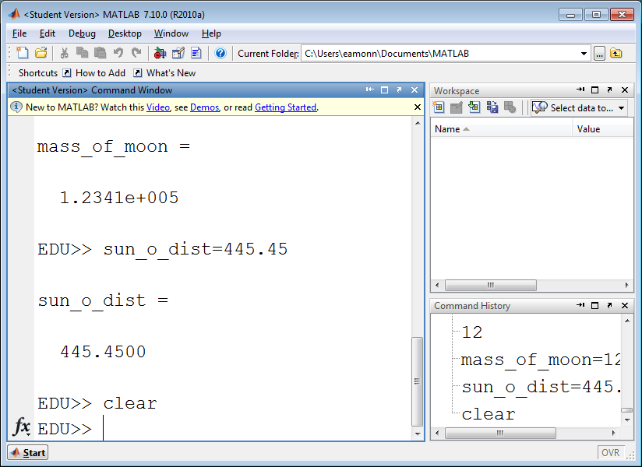
The first things we need to do are:
Clear all the variables currently in memory. The common clear will do this
Type clear then hit <enter>
Note that all the variables in memory are gone forever!

Slide 4
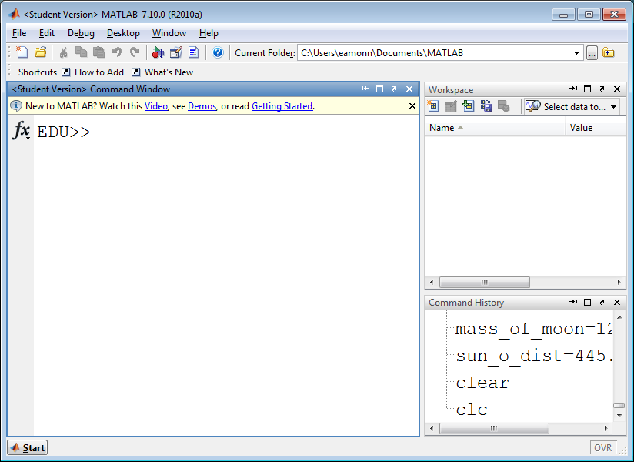
The first things we need to do are:
Clear all the variables currently in memory
Clear away all the old text in the command window. The command clc does this
Type clc then hit <enter>
All this text has been cleaned up.

Slide 5
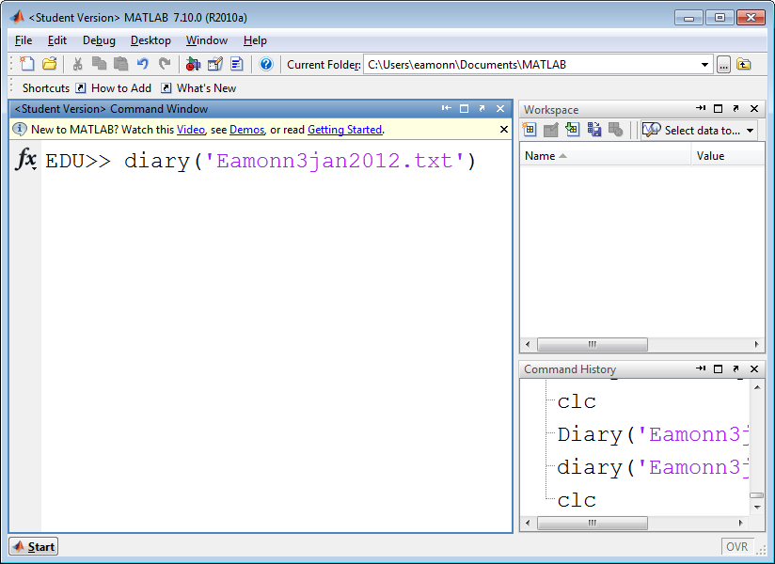
Now we have a brand new session we can record
We need to tell matlab to start recording the session, and the name of the file to save this session to. Suppose I want to save the session into a file with my name and data, Eamonn3jan2012, I will type
diary('Eamonn3jan2012.txt')
And hit <enter>
Note that I added .txt
To my file name. That tells matlab to make a text file

Slide 6
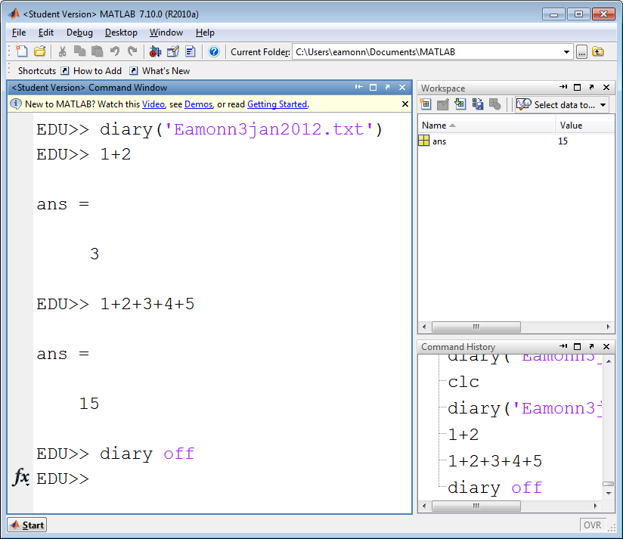
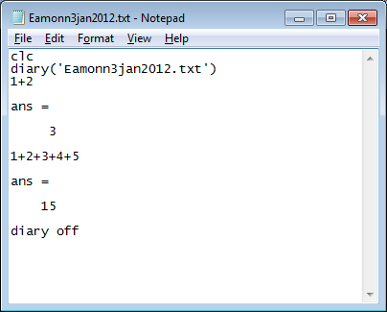
Now I do some work, adding 1 and 2, and then adding the first 5 integers.
When I am done, I type
diary off
And hit <enter>
Now if I go to the folder
C:\Users\eamonn\Documents\MATLAB
(your folder location will be a little different)
I can find the file
And open it with notepad

Slide 7
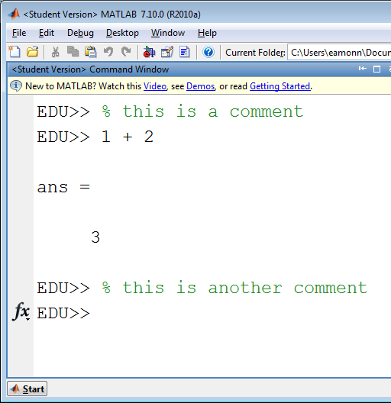
Matlab lets you write text in the command window that will be ignored.
Such text are called comments
As we will see, comments are very useful.
To write a comment, just make sure that the first character is the percent sign %
Matlab will let you know that it thinks this is a comment, by making the entire line green in color.
Commented text does nothing, but it can be useful to make notes to yourself or someone else…

