Slide 1
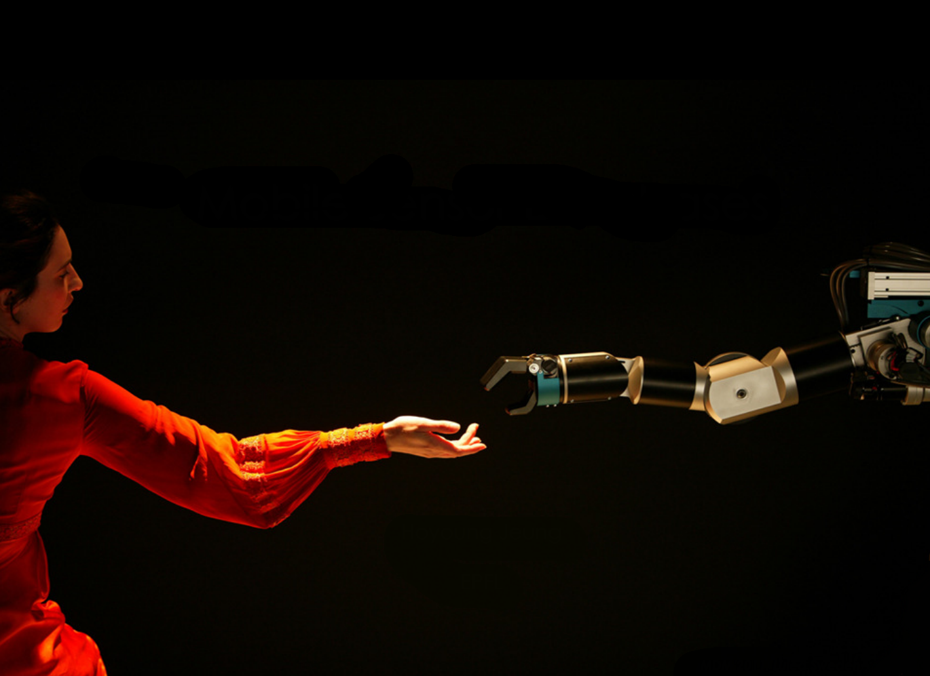
CS005 Introduction to Programming
Matlab
Eamonn Keogh
eamonn@cs.ucr.edu
Today we will start 10 min late, to wait for the stragglers…

Slide 2
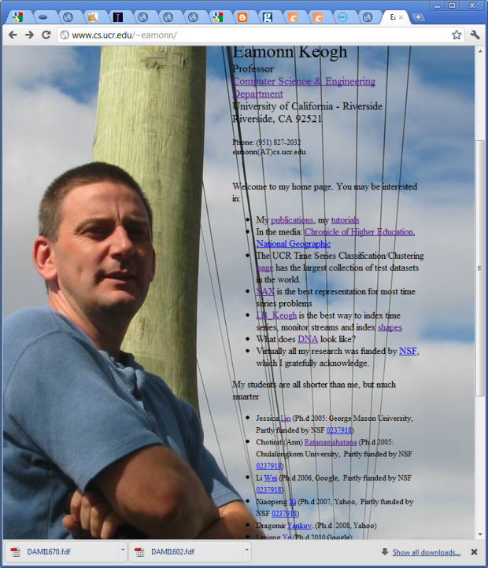
Professor: Eamonn Keogh
Office Hours: Stop by room Winston Chung (EB II 318) whenever
Email: eamonn@cs.ucr.edu
Website: www.cs.ucr.edu/~eamonn/cs005/
Find my webpage, and add
cs005 to the URL

Slide 3
Plan for today
We will talk about the administrative trivia.
We will all go home early.
(This is because somewhere between 5 and 20% of the class is not here now)

Slide 4
Questions I
Hands up if this describes you…
I think this class will be…
Pretty easy, and probably interesting
Very hard, but probably interesting
Pretty easy, but very boring
Very hard, very boring, I don’t want to be here!

Slide 5
Questions II
Hands up if this describes you…
I have done some programming in high school
I have more than 5 hours experience in MS Excel
I already know how to program quite well
I don’t know how to program, but I have lots of experience in Photoshop/MS word/powerpoint and those types of things

Slide 6
What this class is about
The class is not about Matlab per se
We what to learn is the basics how to program, and we have to use some language (which is Matlab)
We are not going to become expert programmers, but we will gain an appreciation of the beauty and power of programming.
We will also learn enough to write simple useful programs that we can use in linguistics, medicine, psychology, history etc..

Slide 7
Course Structure
We meet for lecture three times a week.
You have one lab a week.
It is highly recommend that you get some additional lab hours each week.
(we have open lab hours, and the libraries have Matlab)

Slide 8
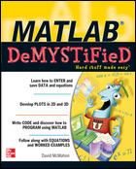
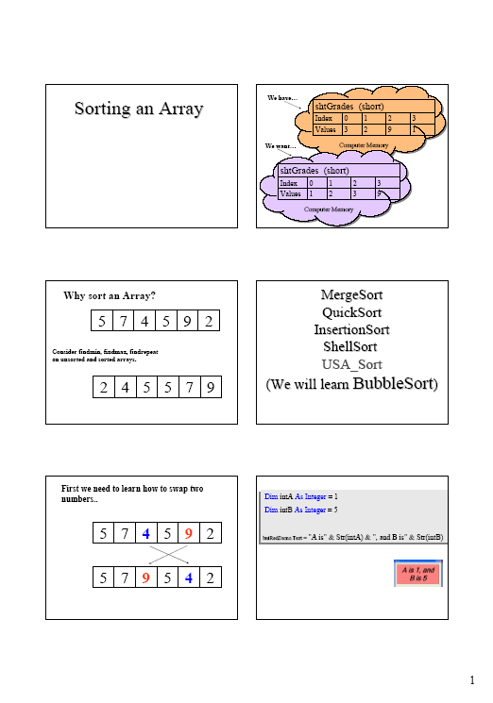
Course Materials
There is an official text
However, I make very nice slides, and I teach from them.
You should print the slides 6 per page, before the class!!!
The slides are only 90% complete. The idea is that in lecture, I will give you the missing 10%, which you will pencil in.

Slide 9
Course Materials
Not all slides are online now.
I am making this course up as we go!
I am doing this to be responsive to your needs/interests/skills etc.

Slide 10
Course Materials
There are lots of free materials online, some are very good
However, many are written for engineers or computer scientists, and may scare you off!
I recommend
www.mccormick.northwestern.edu/docs/efirst/matlab.pdf
www.contracosta.edu/legacycontent/math/Lmatlab.htm
www.math.umn.edu/~lerman/math5467/matlab_adv.pdf

Slide 11
Grading
Midterm Exam: ~ 25%
Final Exam: ~ 25%
Homework Assignments: ~ 10%
Programming Assignments (lab): ~ 30%
Participation / pop quizzes: ~ 10%
Homework assignments are a small part of your grade, but I reuse homeworks for the midterm and final.

Slide 12
Grading
Participation / pop quizzes: ~ 10%
I may give pop quizzes at the beginning of class. If you are more than one second late, you will not be allowed to take the quiz. You cannot “make up” missed quizzes.
If you are not sure if you are more than one second late, assume you are.
To get participation credit you can… ask meaningful questions in class, point out errors in my slides and handouts, email me with pointers to interesting websites (that refer to topics discussed in class)…

Slide 13
Academic Honesty
Anyone caught cheating will given a final grade of F and will have a letter placed in his or her permanent record.
Students are expected to take care that others cannot “cheat off them”. For example, if leave your homework on a shared hard drive or an abandoned USB stick and someone else hands it in, you are liable and will have your grade adjusted downward.
www.cs.ucr.edu/cs14/cs14_04spr/handouts/ucr_aca_dis_policy.html

Slide 14
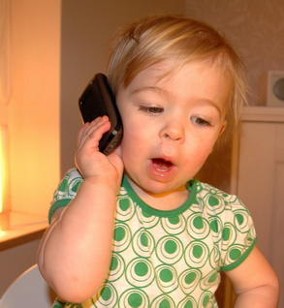
Classroom Behavior
I do not want to hear your cell phone during class. First offence will result in the lowering of your final grade by one letter. Second offence will result in a failing grade and removal from class.
(If you must have instant access to your phone because of some important reason, let me know in advance and I will make an exception).
You may not use your phone/tablet/laptop to send or receive messages during this class. Penalty, as above…
If you use your device to take notes, it must be in airplane mode

Slide 15
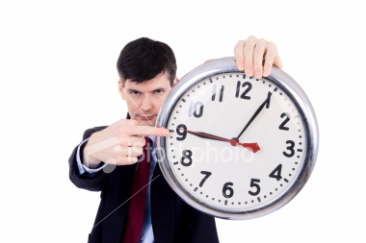
Classroom Behavior
Chronic lateness (or leaving class early) is unacceptable (it is disrespectful and disruptive to the instructor and other students).
If you are late once, forget about it. The second time you are late you should approach me after class to explain why (failing to do so will result in a 1-percentage point reduction in your grade).

Slide 16
Classroom Behavior
Attendance is optional, you will not be penalized for not showing up for class.
However, it is very hard for me to imagine someone doing well in this class without regular attendance (see next slide).
In addition, if you are regularly absent you should expect the lowest priority for office hours/ TA help and email replies.
Finally, I may make announcements and or changes in class, you are responsible for knowing what you missed.

Slide 17
Classroom Behavior
Attendance is highly correlated with grade

Slide 18
Lab Behavior
Behave in lab!
Be consider of others…
  Don’t look at objectionable websites, don’t play computer games.
  Keep the volume down.
  Don’t litter.
  Do not use printers for anything except this class.

Slide 19
Questions?

Slide 20
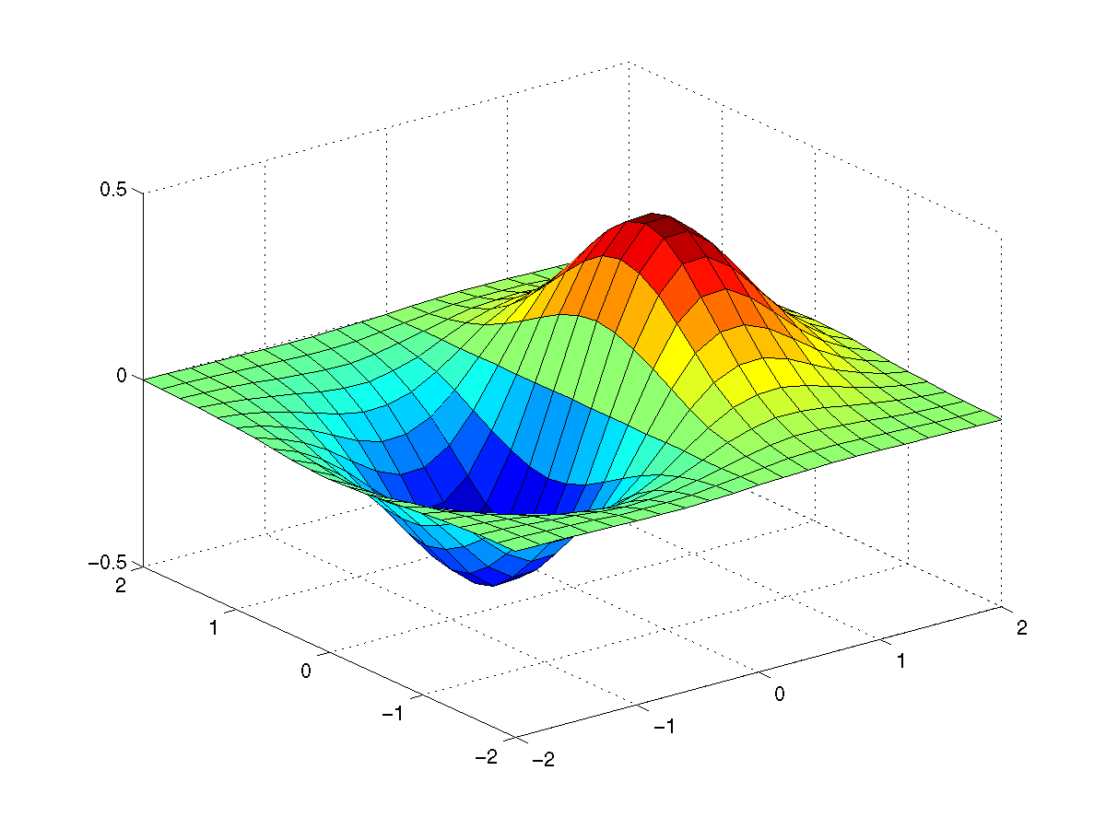
Matlab is fun and useful

Slide 21
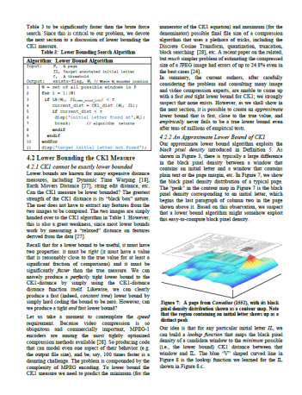
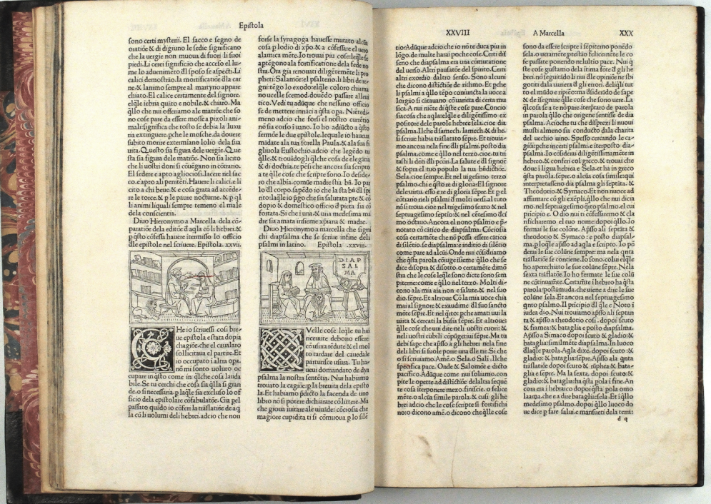

Slide 22
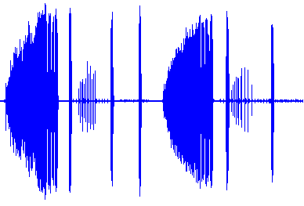
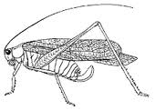

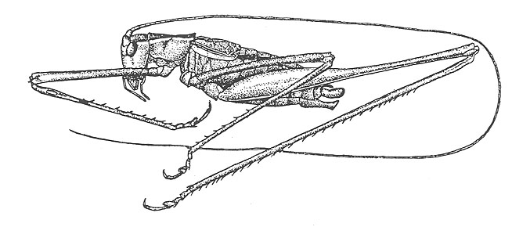













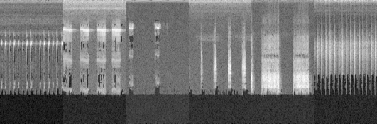
0
Frequency (kHz)
3
Common Virtuoso Katydid
(Amblycorypha longinicta)
Forty seconds
Tettigonioidea
Grylloidea
11
12
7
8
9
10
1
2
3
4
5
6
One Second
Conocephalus nemoralis
Aglaothorax ovata
Amblycorypha huasteca
Hispanogryllus nesion
Cyrtoxipha columbiana
Neocurtilla hexadactyla
Distance value
G. veletis
0.6
Recognition Threshold
0.4
A. monticola
0.2
0
A. allardi
Allonemobius tinnulus
Anaxipha litarena
Gryllus veletis
Atlanticus gibbosus
Atlanticus monticola
Allonemobius allardi

Slide 23
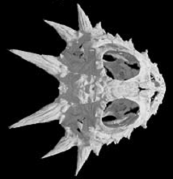
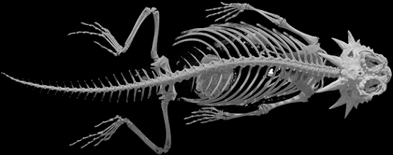
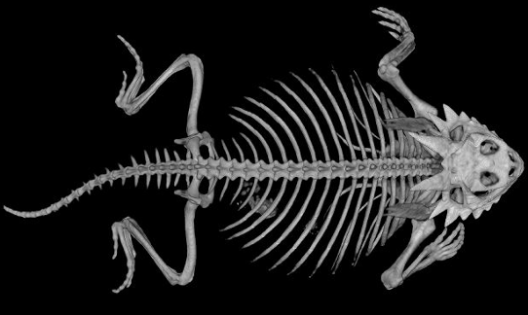
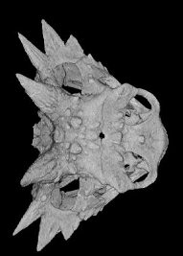
Flat-tailed Horned Lizard
Phrynosoma mcallii
Dynamic Time Warping
Texas Horned Lizard
Phrynosoma cornutum

