Slide 1
CS 150
The Theory of Automata and Formal Languages
Discussion 9
TA: Hao Chen (hchen069@ucr.edu)

Slide 2
Convert unambiguous CFG to ambiguous CFG
S → AB
A → Aa | a
B → b

Slide 3
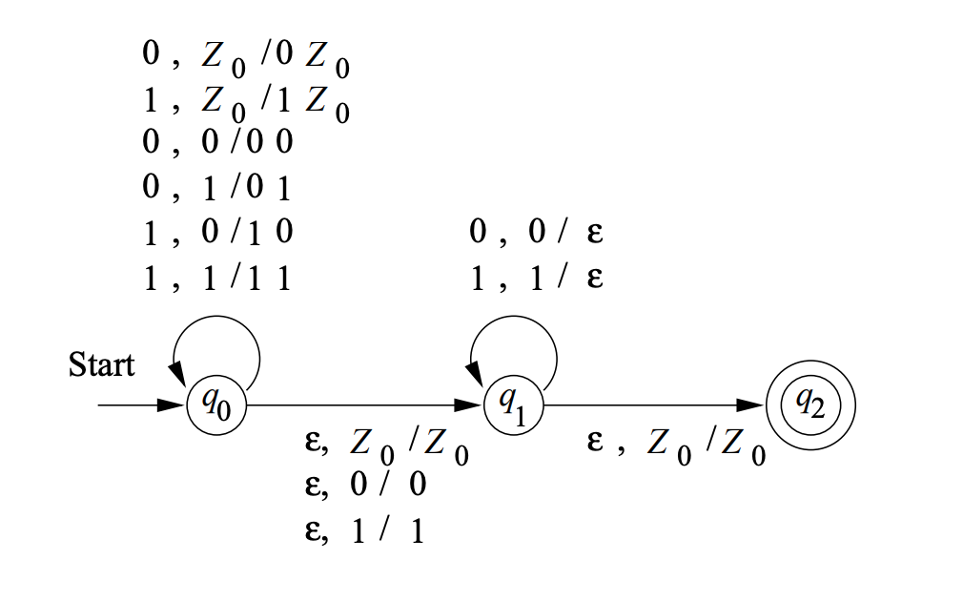
Computation Sequences of PDA

