Slide 1
CS 150
The Theory of Automata and Formal Languages
Discussion 8
TA: Hao Chen (hchen069@ucr.edu)

Slide 2
Design CFG

Slide 3
Derivation and Parse Tree

Slide 4
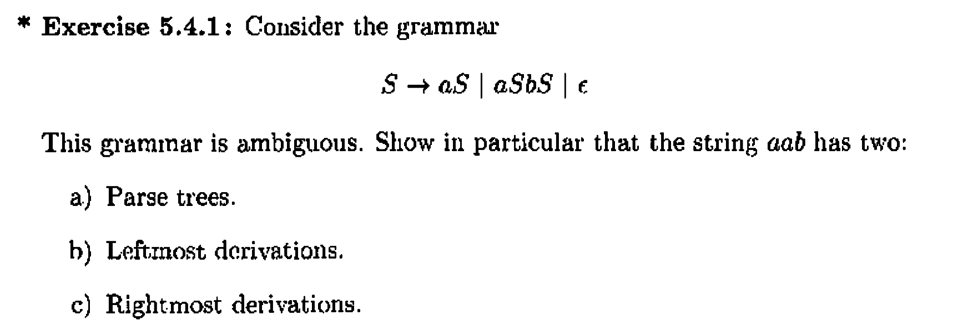
Ambiguity of CFG

Slide 5
Design PDA
Design a PDA to the following language:

