Slide 1
CS 150
The Theory of Automata and Formal Languages
Discussion 7
TA: Hao Chen (hchen069@ucr.edu)

Slide 2
Design DFA

Slide 3
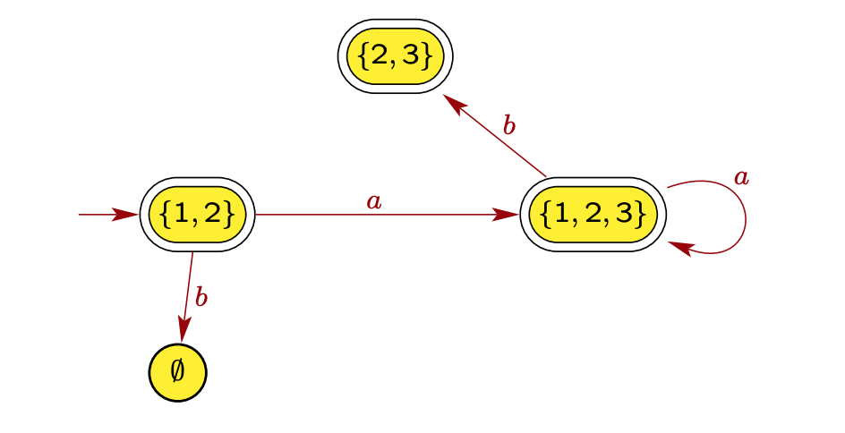
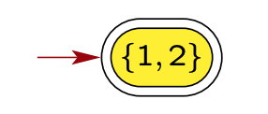
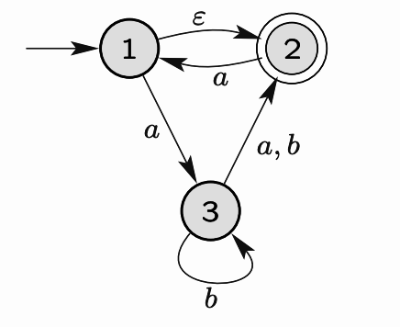
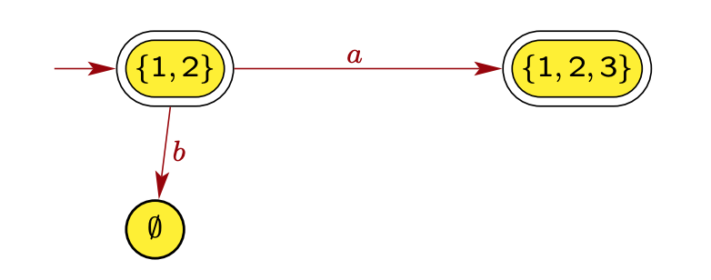
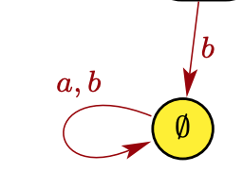
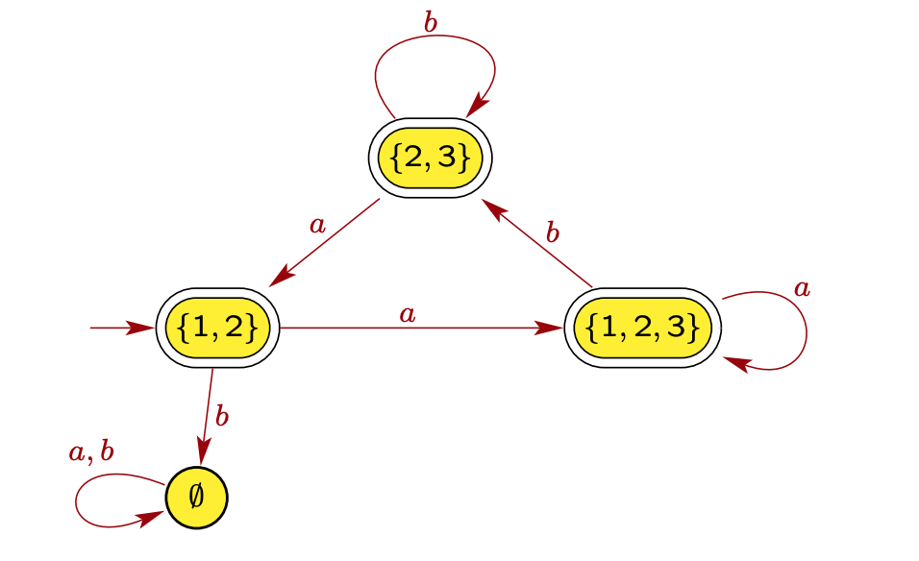
NFA -> DFA
(4)
(1)
(2)
(3)
(5)
Images from https://web.njit.edu/~marvin/cs341/hw/hwsoln03.pdf

Slide 4
Design Regex
0(0 + 1)*0 + 1(0 + 1)*1 + 0 + 1
a*b*
(aa)*(bb)* + a(aa)*b(bb)*

Slide 5
DFA -> Regex

