Slide 1
CS 150
The Theory of Automata and Formal Languages
Discussion 6
TA: Hao Chen (hchen069@ucr.edu)
2020/11/06

Slide 2
Pumping Lemma
Prove that is not regular.

Slide 3
Pumping Lemma
Prove that is not regular.

Slide 5
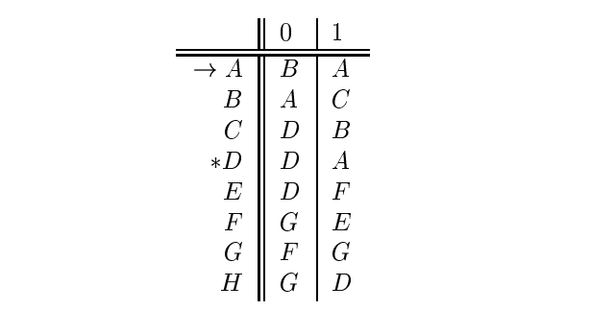
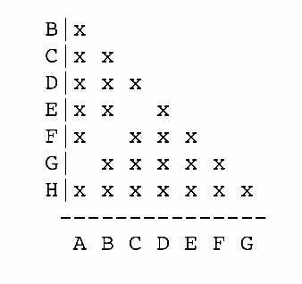
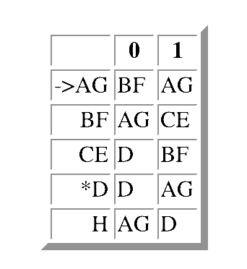
Answer:
Images from http://infolab.stanford.edu/~ullman/ialcsols/sol4.html#sol44

