Slide 1
CS 150
The Theory of Automata and Formal Languages
Discussion 5
TA: Hao Chen (hchen069@ucr.edu)
2020/10/30

Slide 2
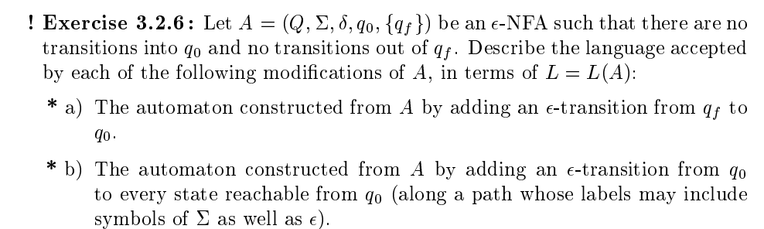
Describe the language

Slide 3
Test technique

