Slide 1
CS 150
The Theory of Automata and Formal Languages
Discussion 4
TA: Hao Chen (hchen069@ucr.edu)
2020/10/23

Slide 2
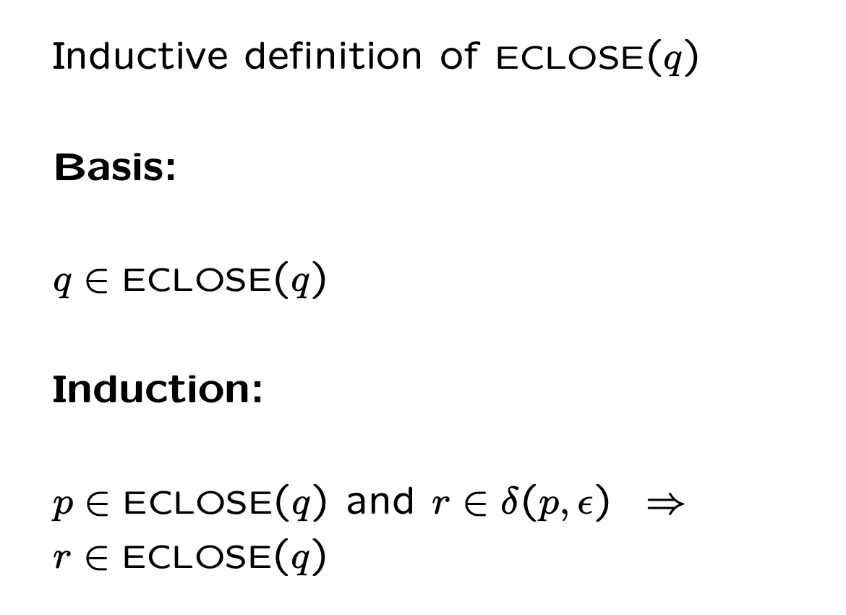
Epsilon closure
 | 𝝐 | a | b | c
→ p | ∅ | {p} | {q} | {r}
q | {p} | {q} | {r} | ∅
*r | {q} | {r} | ∅ | {p}

Slide 3
Give regular expressions for given languages

Slide 4
Convert DFA to Regex - state elimination
Convert the following DFA to a regular expression, using the state-elimination technique.
|| 0 | 1
--------------------
->*a || b | c
b || b | c
*c || b | a

