Slide 1
CS 150
The Theory of Automata and Formal Languages
Discussion 2
TA: Hao Chen (hchen069@ucr.edu)
2020/10/09

Slide 2
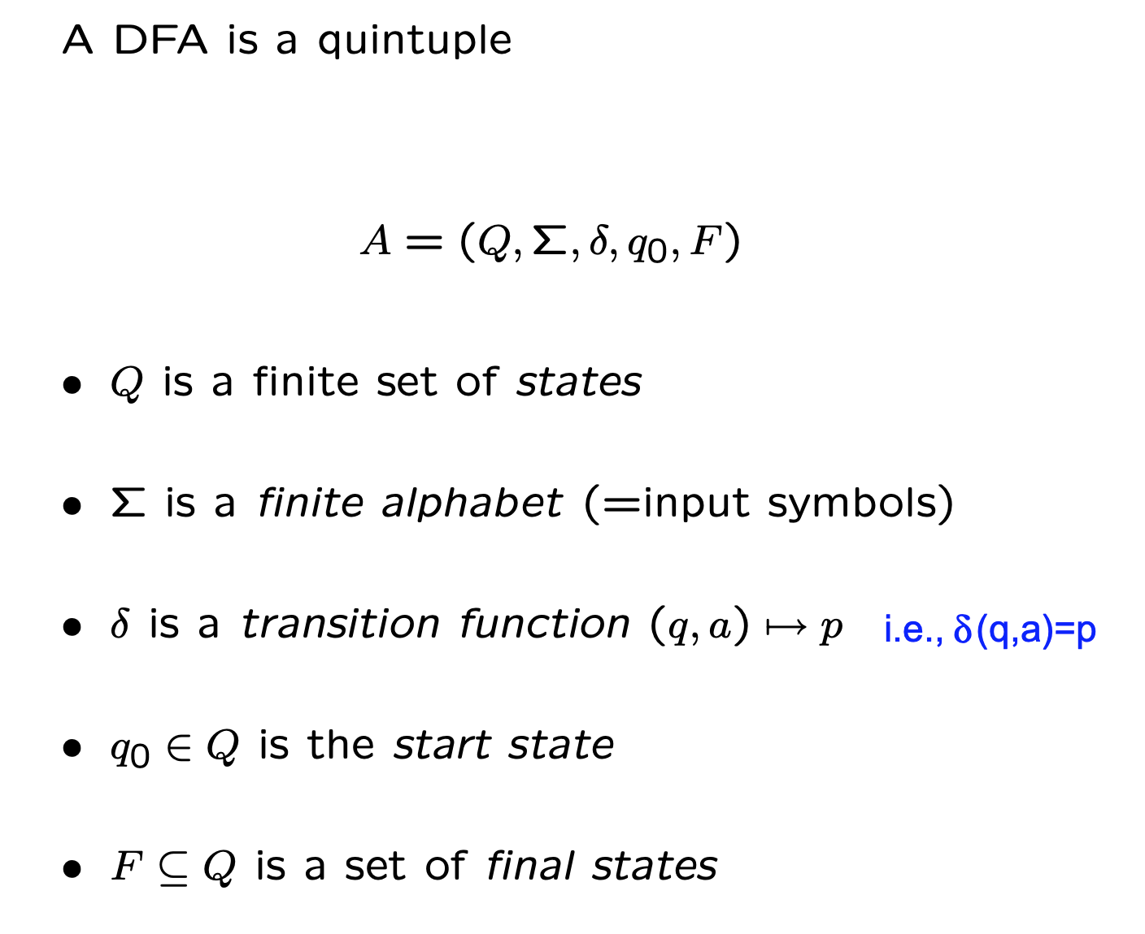
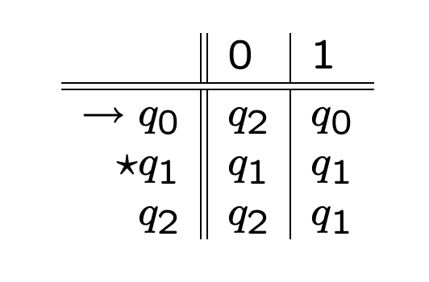
Definition of DFA
A DFA represented as a transition diagram
The same DFA represented as a transition table

Slide 3
DFA for a given language
Give DFA's accepting the following languages over the alphabet {a,b}:
The set of all strings that contain exactly two a’s and at least one b’s

Slide 4
DFA for a given language

Slide 5
Design DFA

Slide 6
Design DFA

Slide 7
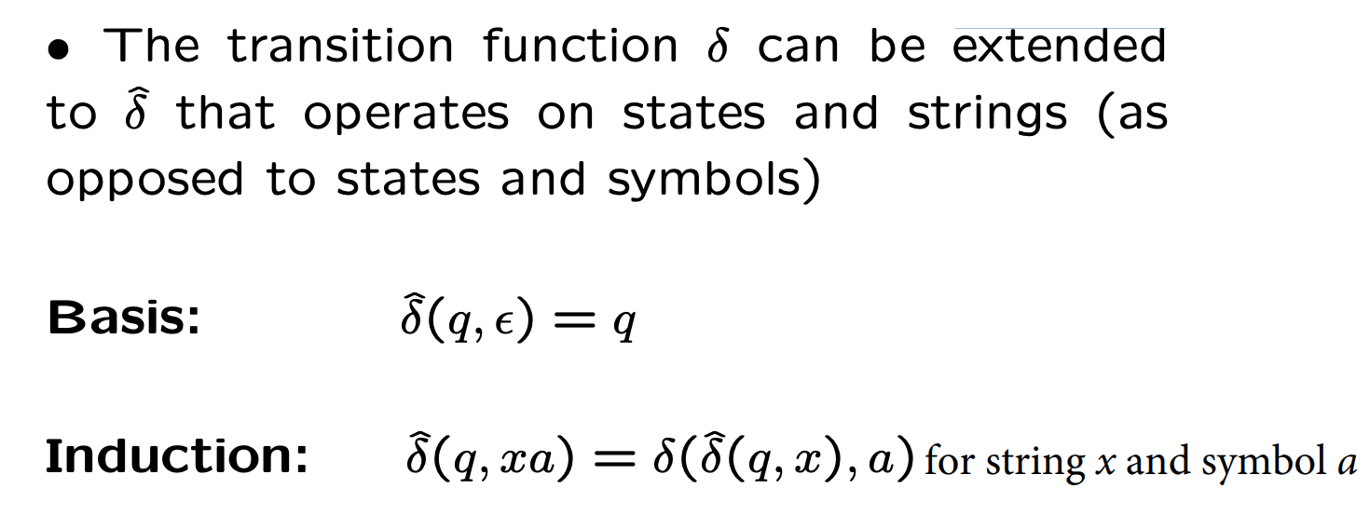
Extended transition function

Slide 8
Extended transition function
Given a DFA M, with transition function , prove by induction on |y| that (q, xy) = ( (q,x),y) for all states q and all strings x, y.

Slide 9
Extended transition function

