Slide 1
CS 150
The Theory of Automata and Formal Languages
Discussion 1
TA: Hao Chen (hchen069@ucr.edu)
2020/10/02

Slide 2
Discussion basics
Coordinates:
Discussions:
Dis 023 Mon 9:00 - 9:50am via Zoom 944 4387 6103 (pwd 150023)
Dis 021 Mon 12:00 - 12:50pm via Zoom 973 3169 7990 (pwd 150021)
Dis 022 Fri 4:00 - 4:50pm via Zoom 981 1619 7173 (pwd 150022)
Office hour:
Tue 2:00 PM - 3:00 PM, via Zoom 631 317 1896
Th 2:00 PM - 3:00 PM, via Zoom 631 317 1896
Discussion purpose:
Help you with your homework.
Review for midterms and the final exam.

Slide 3
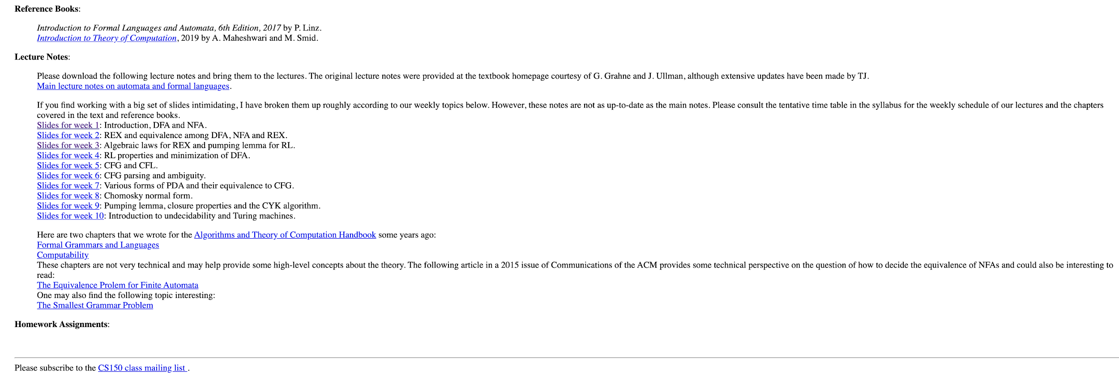
CS150 mailing list
CS150 Homepage - http://www.cs.ucr.edu/~jiang/150-homepage.html

Slide 4
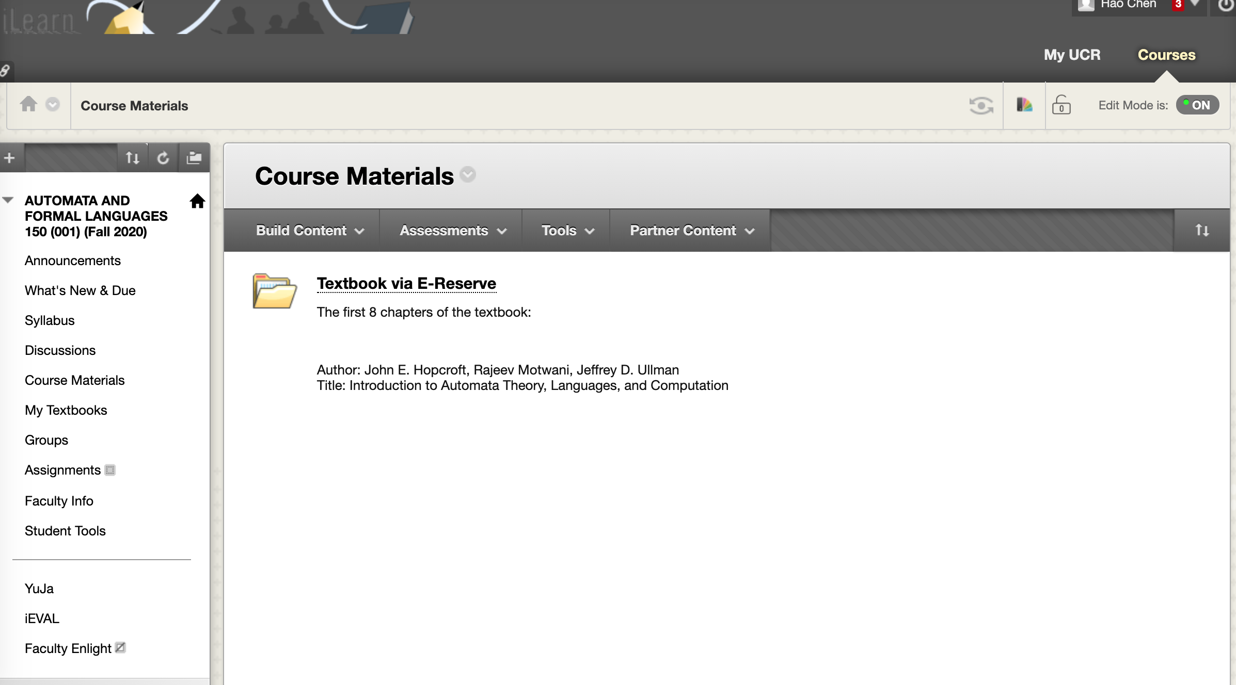
Online resources
Textbook

Slide 5
Online resources
Discussion Forum

Slide 6
Online resources
Lecture recording
Discussion recording
CS150 Homepage - http://www.cs.ucr.edu/~jiang/150-homepage.html

Slide 7
Recursive (inductive) definitions
Example 1.
Example 2.
Set S of integers is recursively defined as:

Slide 8
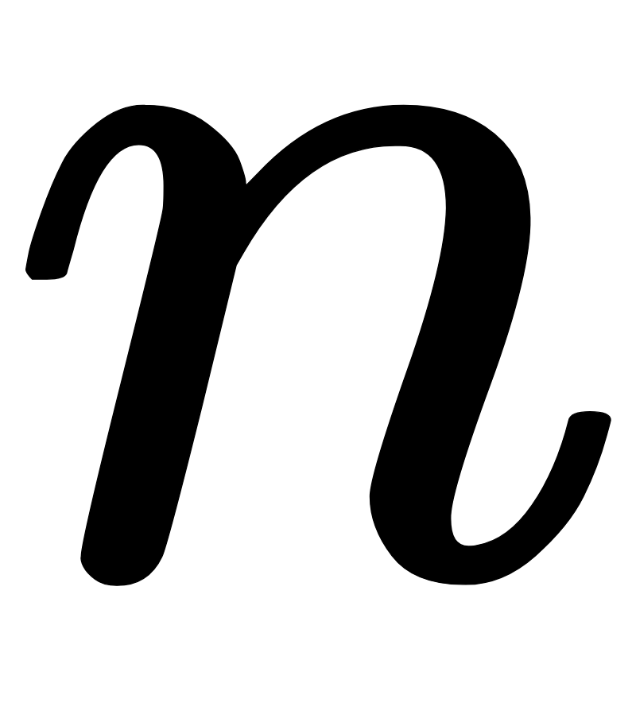
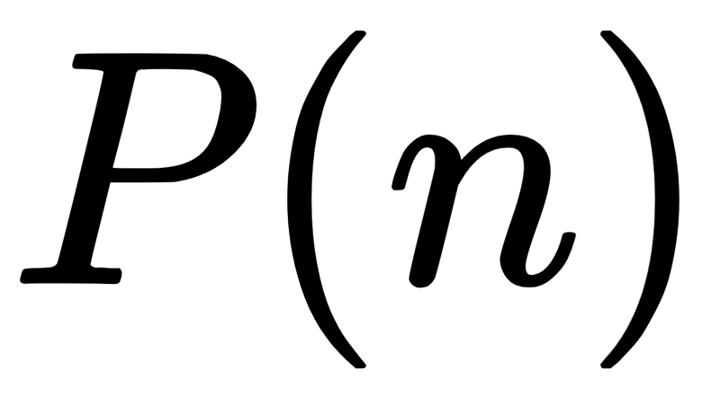
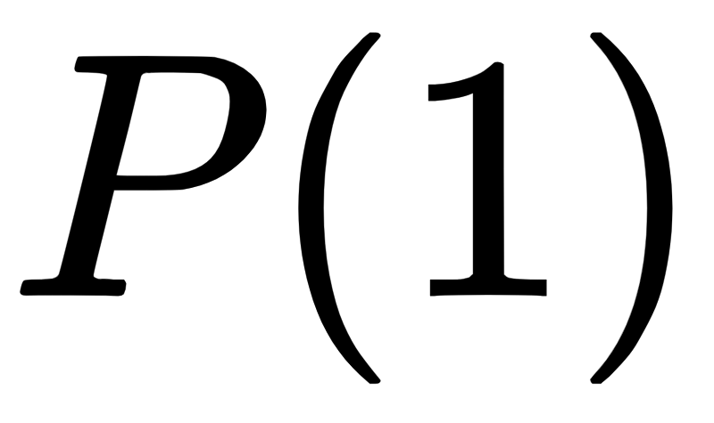
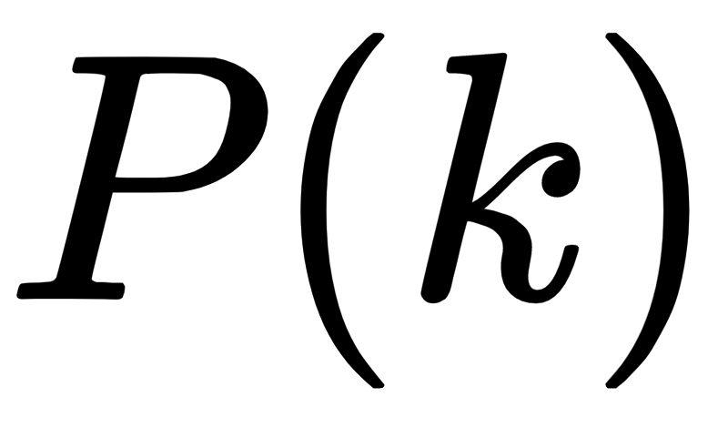
Proofs by induction
For each positive integer , let be a mathematical statement that depends on . Assume we wish to prove that is true for all positive integers . A proof by induction of such a statement is carried out as follows:
Three steps:
Base case: Prove that is true.
Induction hypothesis: Assume that the statement holds for .
Inductive Step: Prove that the statement holds for using the assumption above.
Notes:
Inductive proofs: effective way to deal with recursively defined objects. Many of the most familiar inductive proofs deal with integers, but in automata theory, we also need inductive proofs about other recursively defined concepts like trees.
Proofs by mathematical induction.
The way we are going to prove it is, first, we prove the base case. P(1) that is going to be our base case.
Then we are going to do the induction step.
Which is essentially saying, if we assume it works for some positive integer n, then we can prove it’s going to work for the next integer, for example k + 1.

Slide 9
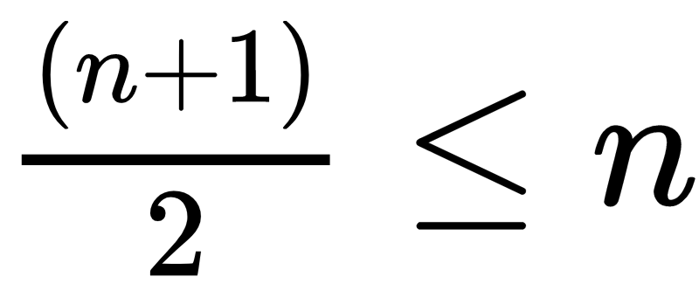
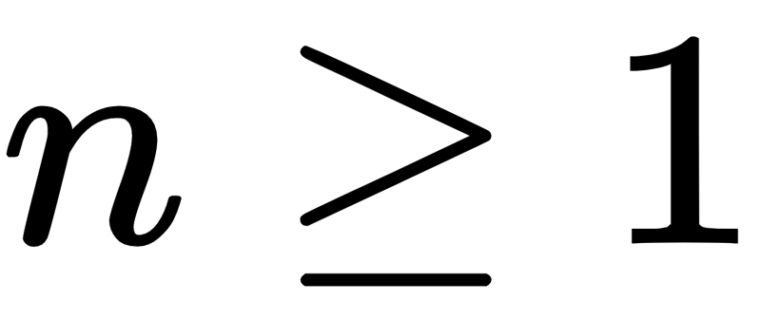
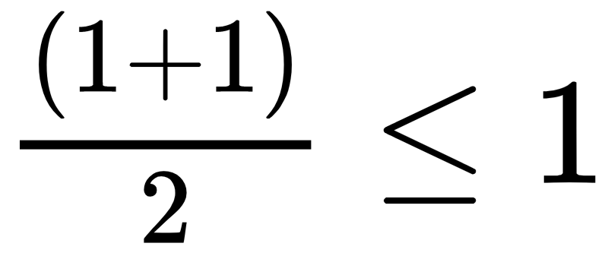
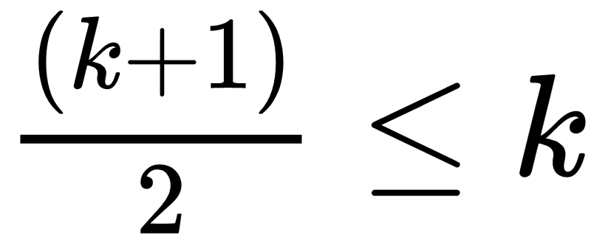
Proofs by induction
Prove that for all .
Base case: Prove for 1: .
Induction hypothesis: Assume that the statement holds for n = k, .
Inductive Step: ⇒

Slide 10
Problem 1:
Prove using mathematical induction that for all ,

Slide 11
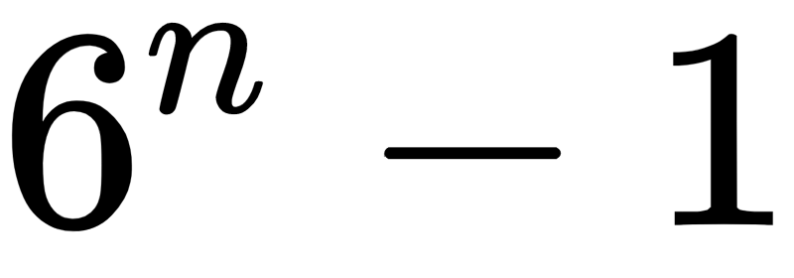
Problem 2:
Prove using mathematical induction that is divisible by 5, for all .
Base case: $6^{0}−1=1−1=0=5×k $
Induction hypothesis: $6^{n}−1=5×k$
Inductive step: $6^{n+1}−1=5×m ?$
$$6^{n+1}−1=6×6^{n}−1=6×\left(6^{n}−1\right)−1=6×5×k−6−1=30k−5=5\left(6k−1\right)=5×m $$

