Slide 1
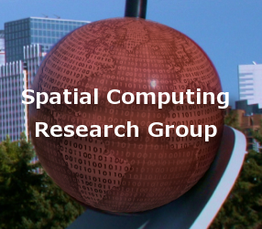
Spatial Networks

Slide 2
Outline
Motivation, and use cases
Example spatial networks
Conceptual model
Need for SQL extensions
CONNECT statement
RECURSIVE statement
Storage and data structures
Algorithms for connectivity query
Algorithms for shortest path

Slide 3
Network
An interconnected or interrelated chain, group, or system
  E.g., a network of hotels
  (Merriam-Webster)

Slide 4
Network
An interconnected or interrelated chain, group, or system
  E.g., a network of hotels
  (Merriam-Webster)
Used in computer science to model non-linear data
  E.g., tree or graph data structures

Slide 5
Spatial Network
An interconnected or interrelated set of spatial objects
  E.g., road network, river network, or transportation network

Slide 6
Spatial Network
An interconnected or interrelated set of spatial objects
  E.g., road network, river network, or transportation network
Components of a spatial network:
  Spatial objects that are connected
  Spatial relationships among the objects

Slide 7
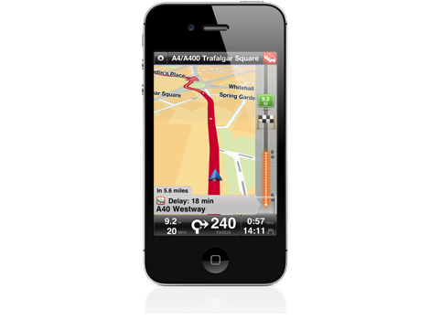
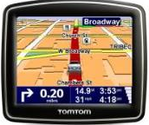

Navigation Systems
  Historical
    Navigation is a core human activity for ages!
    Trade-routes, Routes for Armed-Forces
  Recent Consumer Platforms
    Devices: Phone Apps, In-vehicle, “GPS”, …
    WWW: Google Maps, MapQuest, …
  Services
    Display map around current location
    Compute the shortest route to a destination
    Help drivers follow selected route

Slide 8
Location Based Services
Location: Where am I ?
  Geo-code: Place Name (or Street Address) → <latitude, longitude>
  Reverse Geo-code: <latitude, longitude> → Place Name
Directory: What is around me?
  Where is the nearest Clinic? Restaurant? Taxi?
  List all Banks within 1 mile.
Routes: How do I get there?
  What is the shortest path to get there?
  …

Slide 9

Spatial Networks & Modern Society
  Transportation, Energy, Water, Communications, …

Slide 10
Limitations of Spatial Querying
  OGIS Simple Feature Types
    Supports Geometry (e.g., Points, LineStrings, Polygons, …)
    However, lack Graphs data type, shortest_path operator
  Traditional SQL
    Supports select, project, join, statistics
    Lacked transitive closure, e.g., network analysis (next slide)
    SQL3 added recursion & transitive closure

Slide 11
Spatial Network Analysis
Route ( A start-point, Destination(s) )
  What is the shortest path to get there?
  What is the shortest path to cover a set of destinations?
Allocation ( A set of service centers, A set of customers)
  Assign customers to nearest service centers
  Map service area for each service center
Site Selection ( A set of customers, Number of new service centers)
  What are best locations for new service centers ?

Slide 12
Outline
Motivation, and use cases
Example spatial networks
Conceptual model
Need for SQL extensions
CONNECT statement
RECURSIVE statement
Storage and data structures
Algorithms for connectivity query
Algorithms for shortest path

Slide 13
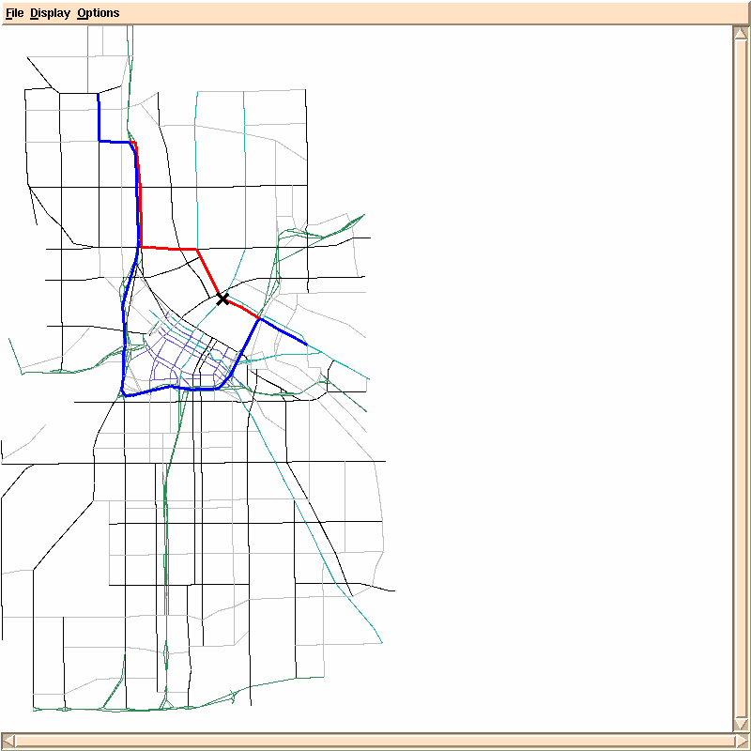
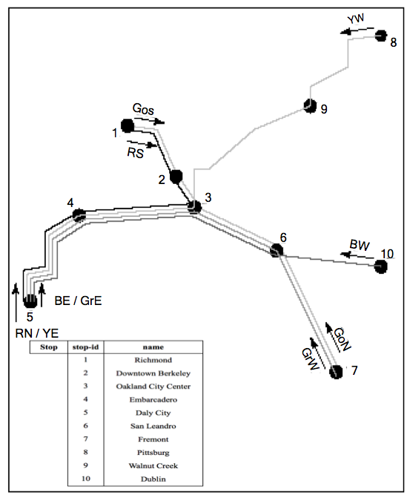
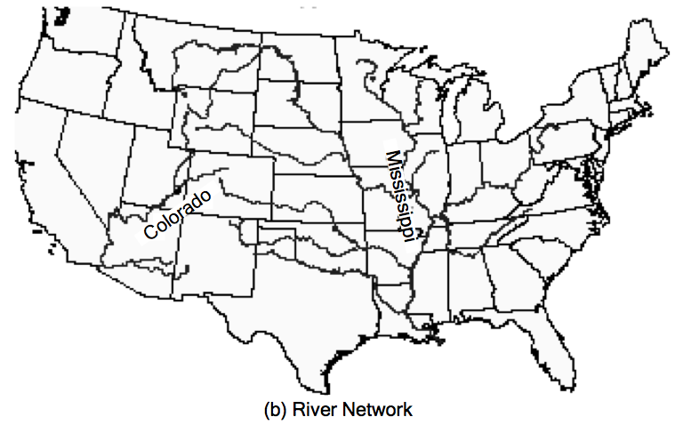
Spatial Networks: Three Examples
  A Road
  Network
  A Railway
  Network
  A River
  Network

Slide 14
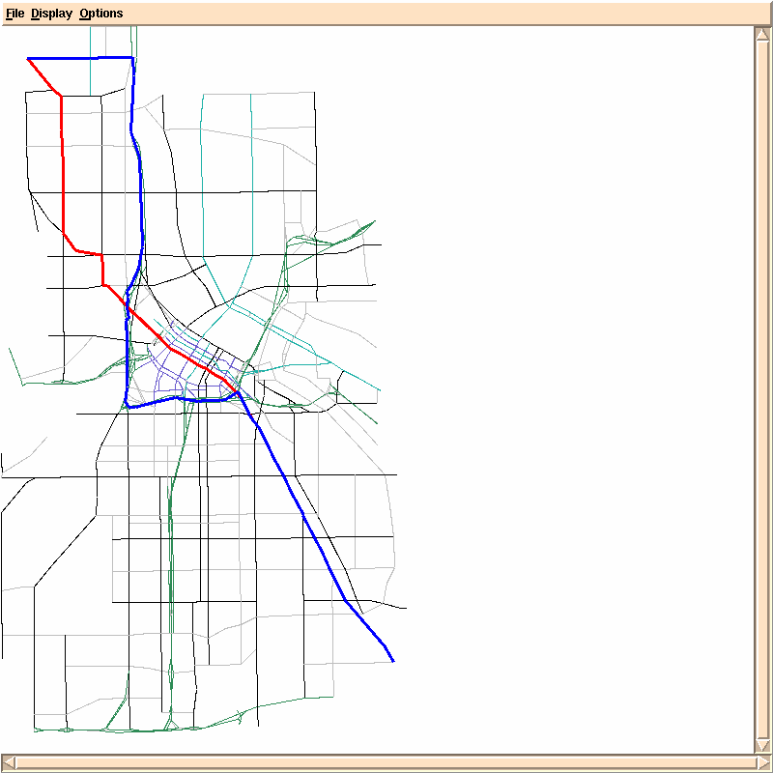
Spatial Network Query Example
  Find shortest path from a start-point to a destination
  Find nearest hospital by driving distance
  Find shortest route to deliver packages to a set of homes
  Allocate customers to nearest service center

Slide 15
Railway Network & Queries
  Find the number of stops on the Yellow West (YW) route.
  List all stops which can be reached from Downtown Berkeley (2)
  List the routes numbers that connect Downtown Berkeley (2) & Daly City (5)
  Find the last stop on the Blue West (BW) route

Slide 16
River Network & Queries
  List the names of all direct and indirect tributaries of Mississippi river
  List the direct tributaries of Colorado
  Which rivers could be affected if there is a spill in North Platte river

Slide 17
Spatial Networks: Three Examples
  A Road
  Network
  A Railway
  Network
  A River
  Network

Slide 18
Outline
Motivation, and use cases
Example spatial networks
Conceptual model
Need for SQL extensions
CONNECT statement
RECURSIVE statement
Storage and data structures
Algorithms for connectivity query
Algorithms for shortest path

Slide 19
Data Models of Spatial Networks
  Conceptual Model
    Information Model: Entity Relationship Diagrams
    Mathematical Model: Graphs
  Logical Data Model
    Abstract Data types
    Custom Statements in SQL
  Physical Data Model
    Storage-Structures
    Algorithms for common operations

Slide 20



Modeling Roadmaps
Many Concepts, e.g.
Roads (or streets, avenues)
Road-Intersections
Road-Segments
Turns
…

Slide 21
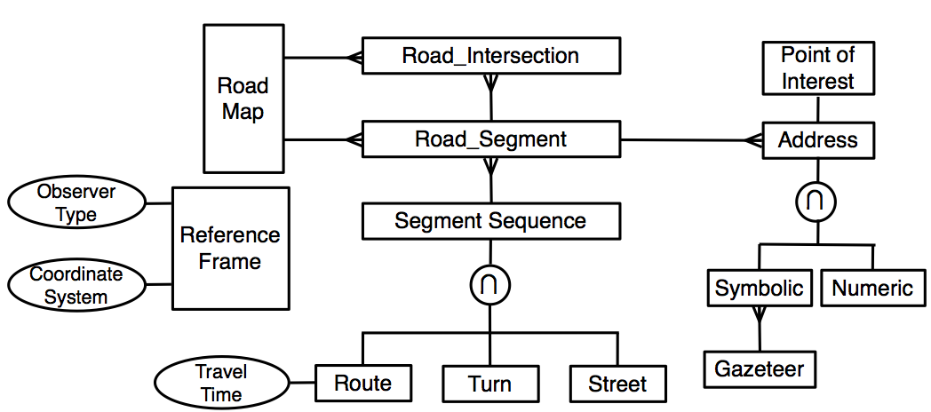
An Entity Relationship Diagram

Slide 22
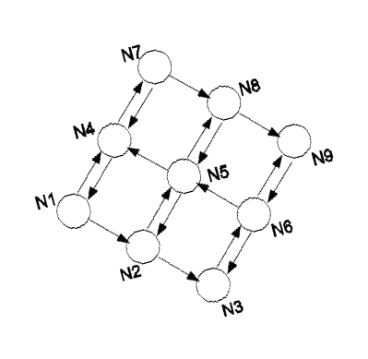
Graph Models
  A Simple Mathematical Model
    A graph G = (V,E)
    V = a finite set of vertices
    E = a set of edges model a binary relationship between vertices
  Example

Slide 23
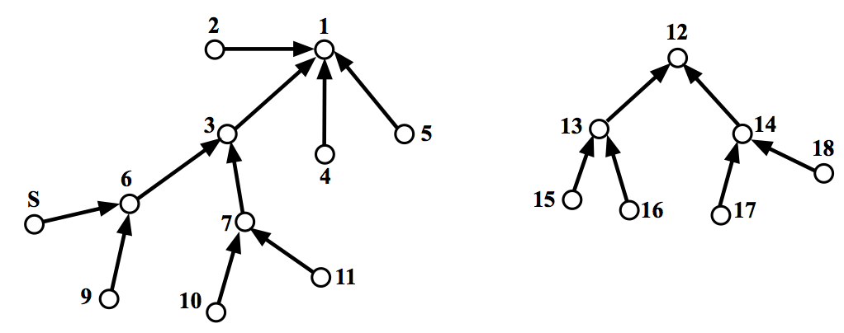
A Graph Model of River Network
  Nodes = rivers
  Edges = A river falls into another river

Slide 24
Alternative Graph Models for Roadmaps
  Choice 1 (most popular):
    Nodes = road-intersections
    Edge (A, B) = road-segment connects adjacent road-intersections A, B
  Choice 2:
    Nodes = (directed) road-segments
    Edge (A,B) = turn from road-segment A to road-segment B
  Choice 3:
    Nodes = roads
    Edge(A,B) = road A intersects_with road B

Slide 25
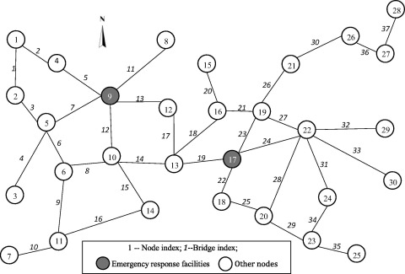
Spatial Network vs Traditional Graphs
Nodes and edges have spatial features
Spatial indexes are
used in a lot of
applications
  Moving objects apps
  Emergency response
  …etc

Slide 26
Data Models of Spatial Networks
  Conceptual Model : Entity Relationship Diagrams, Graphs
  Logical Data Model : Abstract Data types , Custom Statements in SQL
  Physical Data Model
    Storage: Data-Structures, File-Structures
    Algorithms for common operations

Slide 27
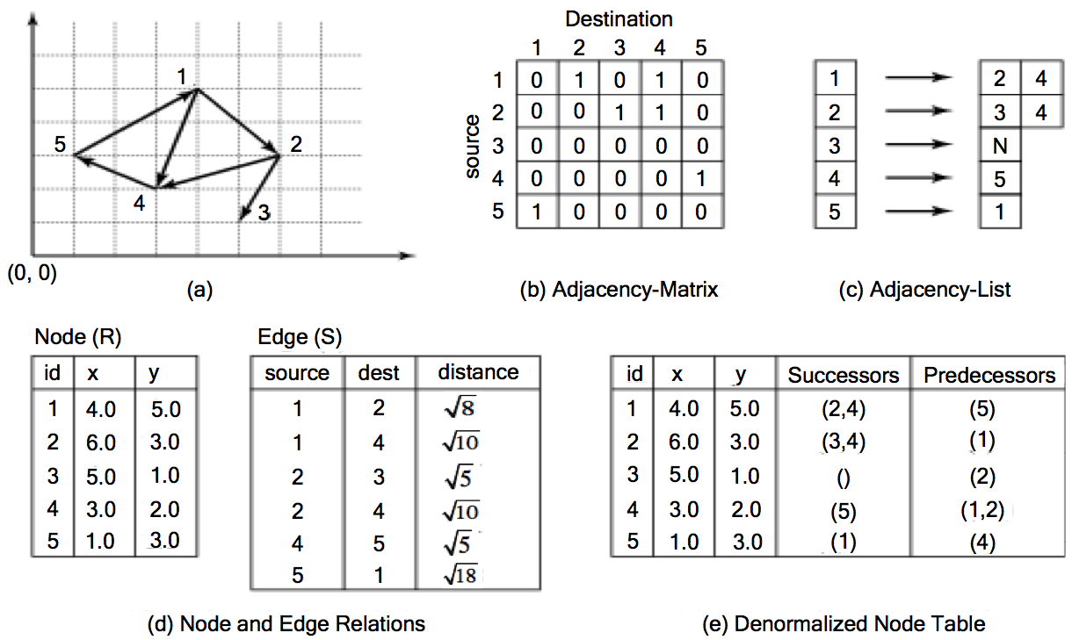
Main Memory Data-Structures
Adjacency matrix
    M[A, B] = 1 if and only if edge(vertex A, vertex B) exists
Adjacency list :
    maps a vertex to a list of its successors

Slide 28
Disk-based Tables
Normalized tables
    one for vertices, other for edges
Denormalized
    one table for nodes with adjacency lists

Slide 29
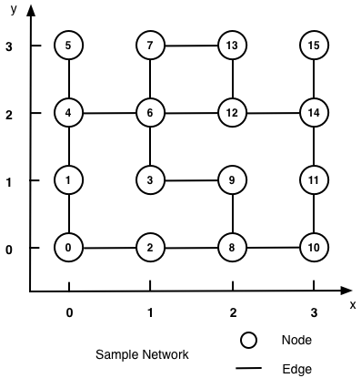
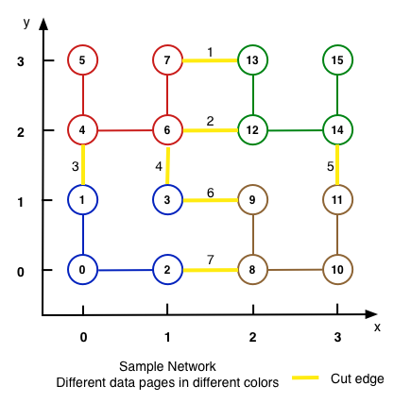
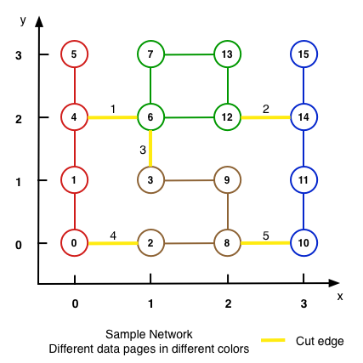
File-Structures:
Partition Graph into Disk Blocks
  Which partitioning reduces disk I/O for graph operations?
    Choice 1: Geometric partition
    Choice 2: min-cut Graph Partition
    Choice 2 cuts fewer edges and is preferred
    Assuming uniform querying popularity across edges

Slide 30
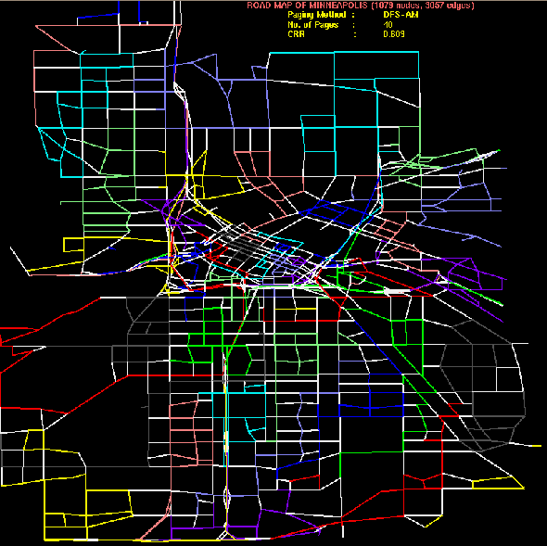
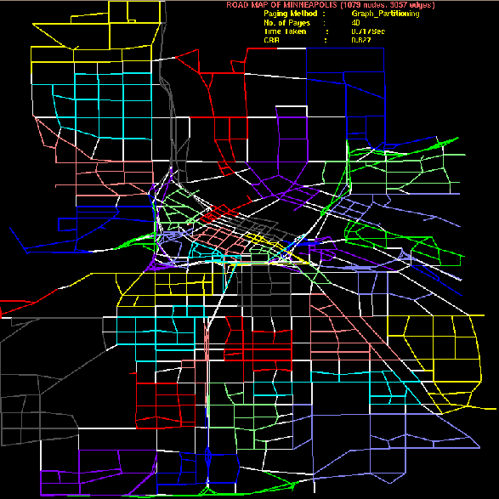
Graph Based Storage Methods
  Consider two disk-paging of Minneapolis major roads
    Non-white edges => node pair in same page
    White edge are cut-edges
    Node partitions on right has fewer cut-edges and is preferred

Slide 31
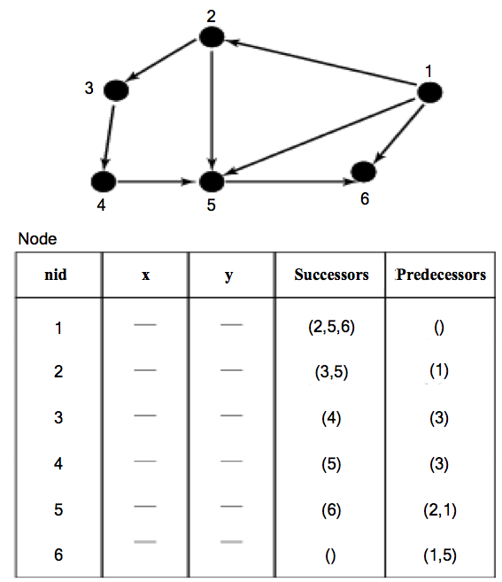
Exercise: Graph Based Storage Methods
  Consider spatial network on right
  If a disk page holds 3 records, which partitioning will have fewest cut-edges?
    (1, 2, 3), (4,5,6)
    (2, 3, 4), (1, 5, 6)
    (1, 2, 6), (3, 4, 5)

Slide 32
Outline
Motivation, and use cases
Example spatial networks
Conceptual model
Need for SQL extensions
CONNECT statement
RECURSIVE statement
Storage and data structures
Algorithms for connectivity query
Algorithms for shortest path

Slide 33
Data Models of Spatial Networks
  Conceptual Model : Entity Relationship Diagrams, Graphs
  Logical Data Model : Abstract Data types , Custom Statements in SQL
  Physical Data Model
    Storage-Structures
    Algorithms for common operations

Slide 34
Query Processing for Spatial Networks
  Query Processing
    DBMS decomposes a query into building blocks
    Keeps a couple of strategy for each building block
    Selects most suitable one for a given situation
  Building blocks
    Connectivity(A, B): Is node B reachable from node A?
    Shortest path(A, B): Identify least cost path from node A to node B

Slide 35
Algorithms
  Main memory
    Connectivity: Breadth first search, depth first search
    Shortest path: Dijkstra’s algorithm, A*
Disk-based
    Shortest path - Hierarchical routing algorithm
    Connectivity strategies are in SQL3

Slide 36
Algorithms for Connectivity Query
  Breadth first search
    Visit descendent by generation
    Children before grandchildren
    Example: 1 - (2,4) - (3, 5)
  Depth first search
    Try a path till dead-end
    Backtrack to try different paths
    Like a maze game
    Example: 1-2-3-2-4-5
    Note backtrack from 3 to 2
5
3

Slide 37
Outline
Motivation, and use cases
Example spatial networks
Conceptual model
Need for SQL extensions
CONNECT statement
RECURSIVE statement
Storage and data structures
Algorithms for connectivity query
Algorithms for shortest path

Slide 38
Shortest Path Algorithms
  Iterate
    Expand most promising descent node
      Dijkstra’s: try closest descendant to self
      A* : try closest descendent to both destination and self
    Update current best path to each node, if a better path is found
  Till destination node is expanded

Slide 39
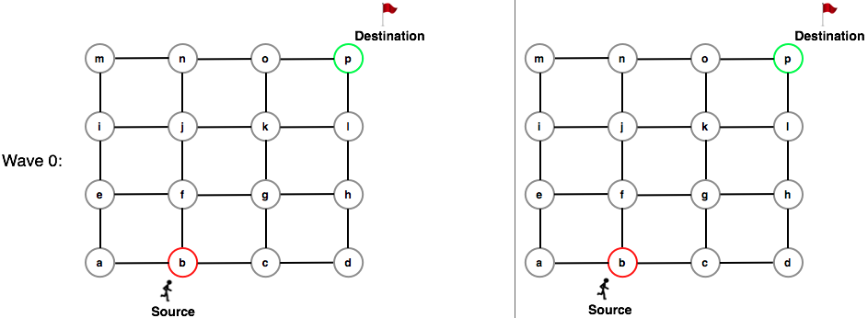
Dijkstra’s vs. A*
Dijkstra’s Algorithm
A* Algorithm

Slide 40
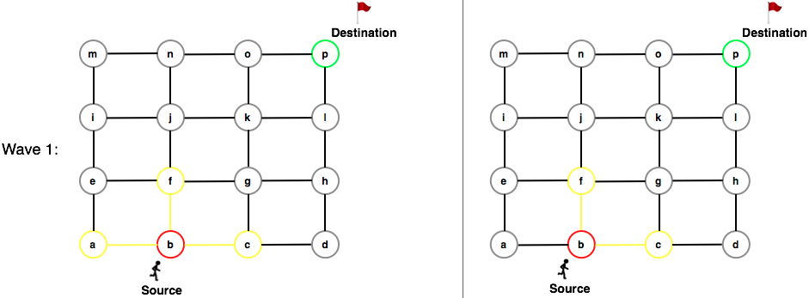
Dijkstra’s vs. A*
Dijkstra’s Algorithm
A* Algorithm

Slide 41
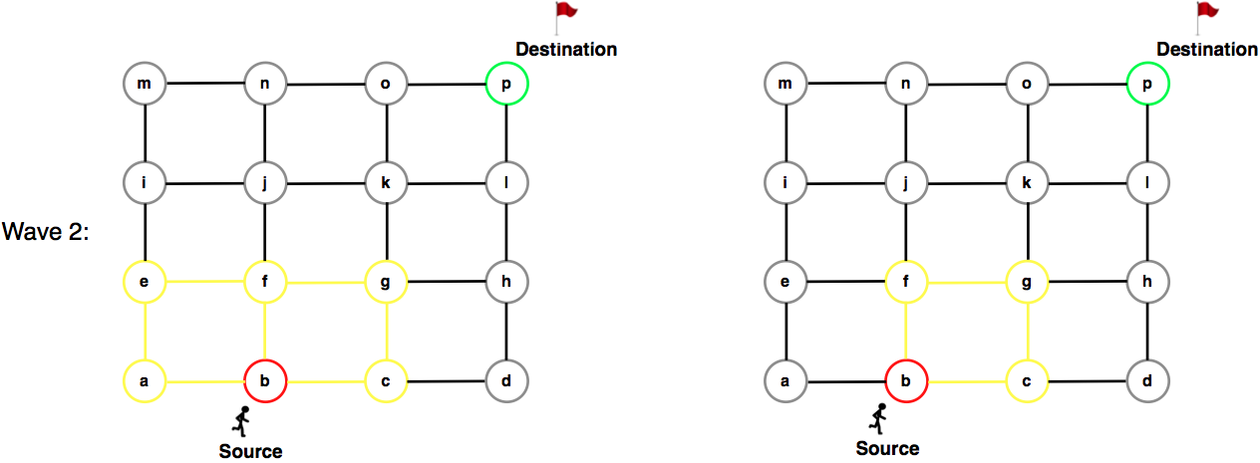
Dijkstra’s vs. A*
Dijkstra’s Algorithm
A* Algorithm

Slide 42
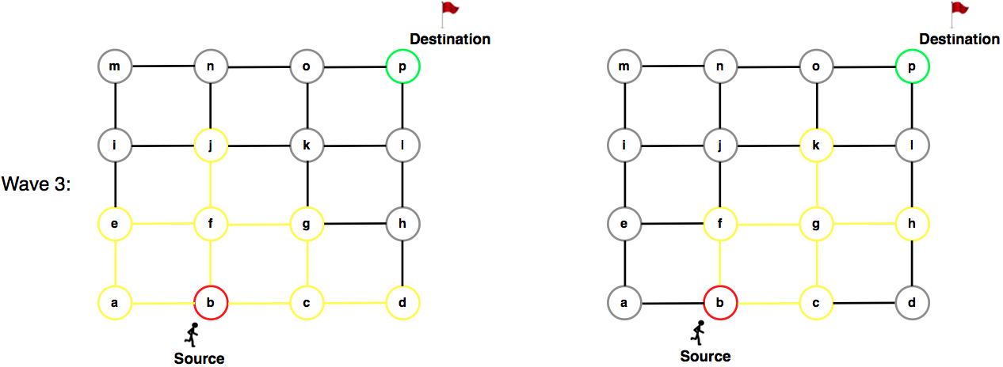
Dijkstra’s vs. A*
Dijkstra’s Algorithm
A* Algorithm

Slide 43
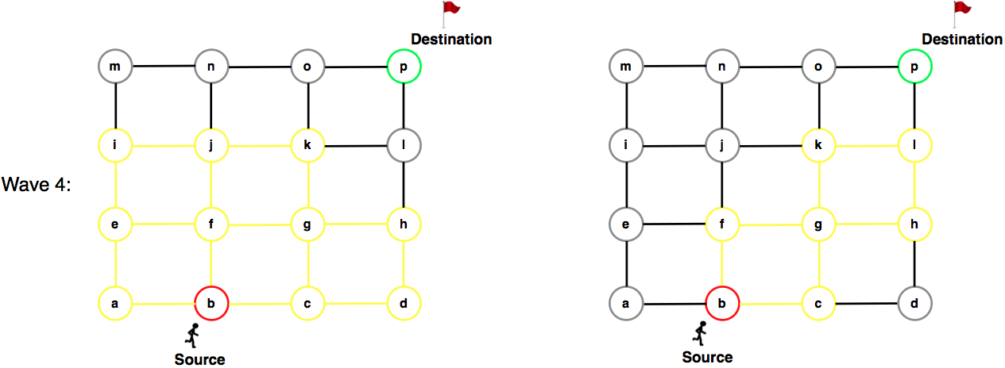
Dijkstra’s vs. A*
Dijkstra’s Algorithm
A* Algorithm

Slide 44
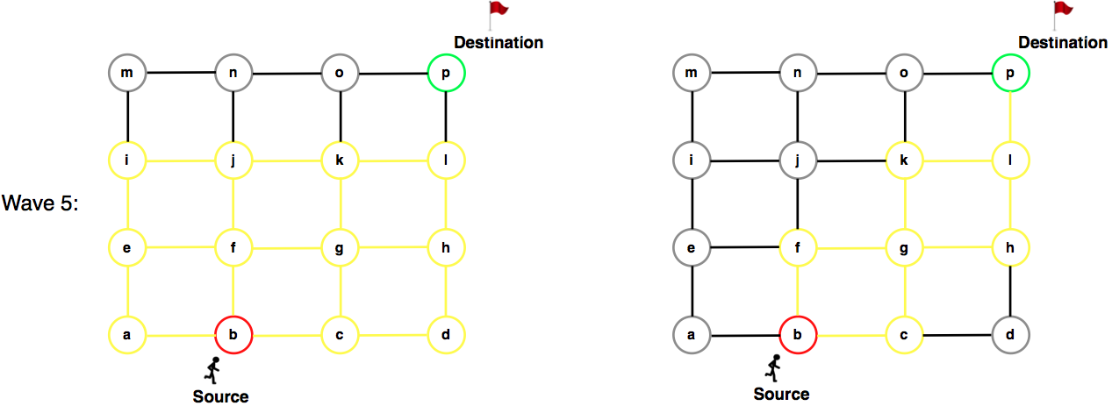
Dijkstra’s vs. A*
Arrived!
Dijkstra’s Algorithm
A* Algorithm

Slide 45
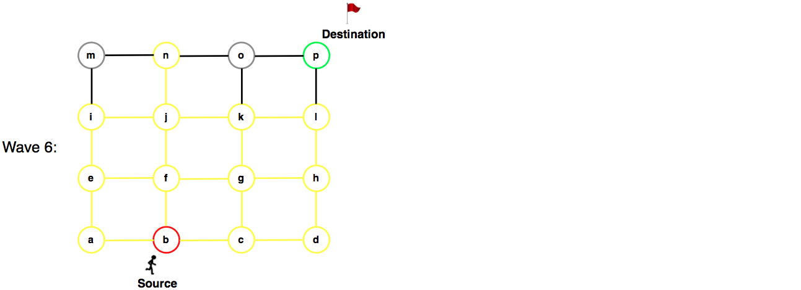
Dijkstra’s vs. A*
Dijkstra’s Algorithm

Slide 46
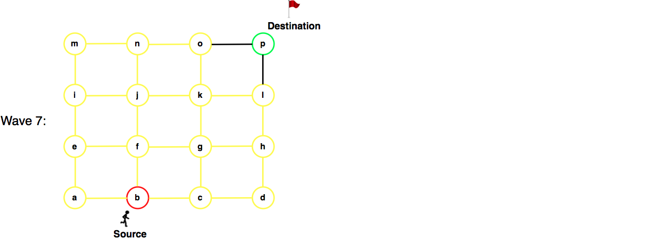
Dijkstra’s vs. A*
Dijkstra’s Algorithm

Slide 47
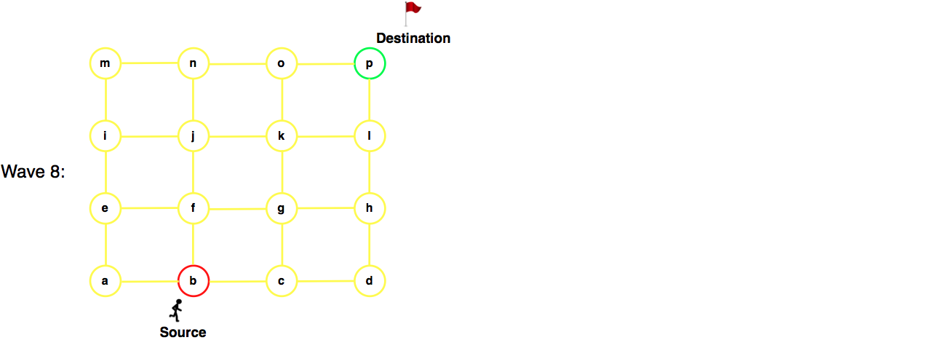
Dijkstra’s vs. A*
Arrived!
Dijkstra’s Algorithm

Slide 48
Shortest Path Algorithms
  Iterate
    Expand most promising node
      Dijkstra’s: try closest descendent to self
      A* : try closest descendent to both destination and self
    Update current best path to each node, if a better path is found
  Till destination node is expanded
  Correct assuming
    Sub-path optimality
    Fixed, positive and additive edge costs
    A* : underestimate function (i.e. admissible)

Slide 49
Shortest Path Strategies - 3
  Dijkstra’s and Best first algorithms
    Work well when entire graph is loaded in main memory
    Otherwise their performance degrades substantially
  Hierarchical Routing Algorithms
    Works with graphs on secondary storage
    Loads small pieces of the graph in main memories
    Can compute least cost routes

Slide 50
Shortest Path Strategies - 3 (Key Ideas)
  Key ideas behind Hierarchical Routing Algorithm
    Fragment graphs - pieces of original graph obtained via node partitioning
    Boundary nodes - nodes of with edges to two fragments
    Boundary graph - a summary of original graph
      Contains Boundary nodes
      Boundary edges: edges across fragments or paths within a fragment

Slide 51
Shortest Path Strategies – 3 (Insight)
  A Summary of Optimal path in original graph can be computed
    Using Boundary graph and 2 fragments
  The summary can be expanded into optimal path in original graph
    Examining fragments overlapping with the path
    Loading one fragment in memory at a time

Slide 52
End of required content.

Slide 53
Outline
Motivation, and use cases
Example spatial networks
Conceptual model
Need for SQL extensions
CONNECT statement
RECURSIVE statement
Storage and data structures
Algorithms for connectivity query
Algorithms for shortest path

Slide 54
Data Models of Spatial Networks
  Conceptual Model: Entity Relationship Diagrams, Graphs
  Logical Data Model & Query Languages
    Abstract Data types
    Custom Statements in SQL
  Physical Data Model: Storage-Structures, Algorithms

Slide 55
Transitive Closure
  Consider a graph G = (V, E)
  Transitive closure (G) is: G* = (V*, E*), where
    V* = V
    (A, B) in E* if and only if there is a path from A to B in G.

Slide 56
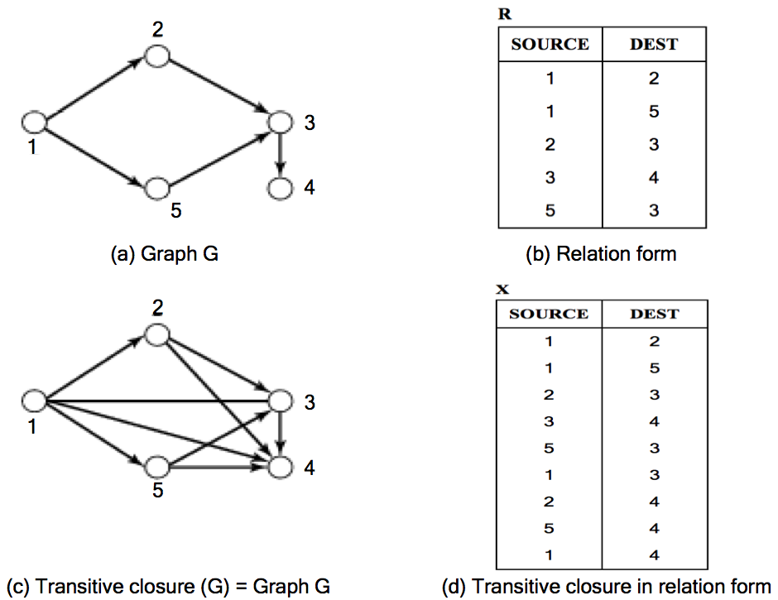
Transitive Closure - Example
  Example
    G has 5 nodes and 5 edges
    G* has 5 nodes and 9 edges
    Note edge (1,4) in G* for
      path (1, 2, 3, 4) in G.

Slide 57
Limitations of Original SQL
  Recall Relation algebra based languages
    Ex. Original SQL
    Can not compute transitive closure, e.g., shortest path

Slide 58
Supporting Graphs in SQL
  Abstract Data Type (user defined)
    SQL3
    May include shortest path operation!
  Custom Statements
    SQL2 - CONNECT clause in SELECT statement
      For directed acyclic graphs, e.g. hierarchies
    SQL3 - WITH RECURSIVE statement
      Transitive closure on general graphs

Slide 59
Outline
Motivation, and use cases
Example spatial networks
Conceptual model
Need for SQL extensions
CONNECT statement
RECURSIVE statement
Storage and data structures
Algorithms for connectivity query
Algorithms for shortest path

Slide 60
Querying Graphs: Overview
  Relational Algebra
    Can not express transitive closure queries
  Two ways to extend SQL to support graphs
    Abstract Data Types
    Custom Statements
      SQL2 - CONNECT BY clause(s) in SELECT statement
      SQL3 - WITH RECURSIVE statement

Slide 61
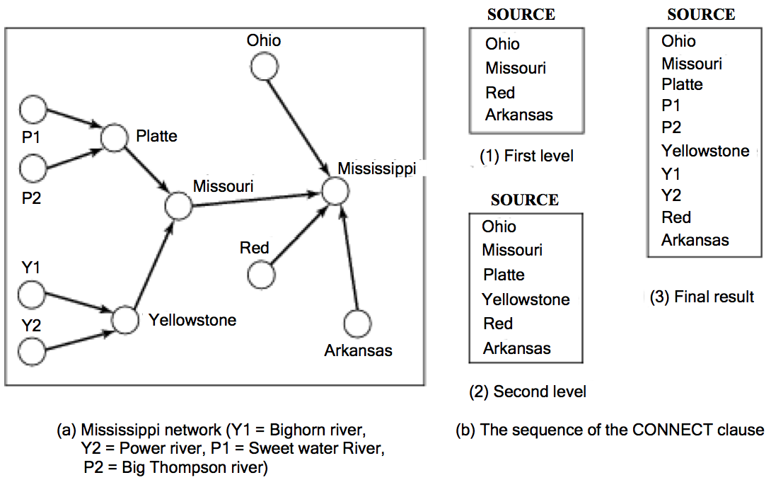
CONNECT BY : Input, Output
  Input: (a) Edges of a directed acyclic graph G
    (b) Start Node S, e.g., Missouri
    (c) Travel Direction
  Output: Part of transitive closure of G
    Ex. Predecessors of “S = Missouri”
    Ex. Successors of “S = Missouri”

Slide 62
Directed Edges: Tabular Representation
Table: Falls_Into
Source | Dest
P1 | Platte
P2 | Platte
Y1 | Yellowstone
Y2 | Yellowstone
Platte | Missouri
Yellowstone | Missouri
Missouri | Mississippi
Ohio | Mississippi
Red | Mississippi
Arkansas | Mississippi

Slide 63
CONNECT BY– PRIOR - START WITH
    SELECT source
    FROM Falls_Into
    CONNECT BY PRIOR source = dest
    START WITH dest =“Missouri”
Table: Falls_Into
Source | Dest
P1 | Platte
P2 | Platte
Y1 | Yellowstone
Y2 | Yellowstone
Platte | Missouri
Yellowstone | Missouri
Missouri | Mississippi
Ohio | Mississippi
Red | Mississippi
Arkansas | Mississippi
  Q? What does CONNECT BY … PRIOR specify?
  Direction of travel
  Example: From Dest to Source
  Alternative: From Source to Dest

Slide 64
CONNECT BY– PRIOR - START WITH
  Choice 1: Travel from Dest to Source
  Ex. List direct & indirect tributaries of Missouri.
  Choice 2: Travel from Source to Dest
  Ex. Which rivers are affected by spill in Missouri?
Table: Falls_Into
Source | Dest
P1 | Platte
P2 | Platte
Y1 | Yellowstone
Y2 | Yellowstone
Platte | Missouri
Yellowstone | Missouri
Missouri | Mississippi
Ohio | Mississippi
Red | Mississippi
Arkansas | Mississippi
    SELECT source
    FROM Falls_Into
    CONNECT BY PRIOR source = dest
    START WITH dest =“Missouri”
    SELECT dest
    FROM Falls_Into
    CONNECT BY source = PRIOR dest
    START WITH source =“Missouri”

Slide 65
Execution Trace – Step 1
    SELECT source
    FROM Falls_Into
    CONNECT BY PRIOR source = dest
    START WITH “dest = Missouri”
    Prior Result = SELECT * FROM Falls_Into
      WHERE dest = “Missouri”
Table: Falls_Into
Source | Dest
P1 | Platte
P2 | Platte
Y1 | Yellowstone
Y2 | Yellowstone
Platte | Missouri
Yellowstone | Missouri
Missouri | Mississippi
Ohio | Mississippi
Red | Mississippi
Arkansas | Mississippi
Table: “Prior ”
Source | Dest
Platte | Missouri
Yellowstone | Missouri

Slide 66
Execution Trace – Step 2.
    SELECT source
    FROM Falls_Into
    CONNECT BY PRIOR source = dest
    START WITH dest = Missouri
    2. Iteratively add Records(Prior_Result.source = Falls_Into.dest)
Table: Falls_Into
Source | Dest
P1 | Platte
P2 | Platte
Y1 | Yellowstone
Y2 | Yellowstone
Platte | Missouri
Yellowstone | Missouri
Missouri | Mississippi
Ohio | Mississippi
Red | Mississippi
Arkansas | Mississippi
Prior Result
Source | Dest
P1 | Platte
P2 | Platte
Y1 | Yellowstone
Y2 | Yellowstone
Platte | Missouri
Yellowstone | Missouri
Prior Result
Source | Dest
Platte | Missouri
Yellowstone | Missouri

Slide 67
Outline
Motivation, and use cases
Example spatial networks
Conceptual model
Need for SQL extensions
CONNECT statement
RECURSIVE statement
Storage and data structures
Algorithms for connectivity query
Algorithms for shortest path

Slide 68
Learning Objectives
After this segment, students will be able to
  Describe RECURSIVE statement in SQL3
  Use it to query Graphs

Slide 69
Querying Graphs: Overview
  Relational Algebra
    Can not express transitive closure queries
  Two ways to extend SQL to support graphs
    Abstract Data Types
    Custom Statements
      SQL2 - CONNECT clause(s) in SELECT statement
      SQL3 - WITH RECURSIVE statement

Slide 70
WITH RECURSIVE: Input, Output
  Input:
    (a) Edges of a directed graph G
    (b) Sub-queries to
      Initialize results
      Recursively grow results
      Additional constraints
  Output: Transitive closure of G
    Ex. Predecessors of a node
    Ex. Successors of a node

Slide 71
Syntax of WITH RECURSIVE Statement
  WITH RECURSIVE X(source,dest)
  AS (SELECT source,dest FROM R )
    UNION
    (SELECT R.source, X.dest
    FROM R, X
    WHERE R.dest=X.source )
    Description of Result Table
    Initialization Query
    Recursive Query to grow result

Slide 72
Example Input and Output
  WITH RECURSIVE X(source,dest)
  AS (SELECT source,dest FROM R )
    UNION
    (SELECT R.source, X.dest
    FROM R, X
    WHERE R.dest=X.source )

Slide 73
SQL3 Recursion Example - Meaning
  Initialize X by
    (SELECT source,dest FROM R )
  Recursively grow X by
    (SELECT R.source, X.dest
    FROM R, X
    WHERE R.dest=X.source )
Infer X(a,c) from R(a,b),X(b,c)
Infer X(1,3) from R(1,2),X(2,3)
Infer X(2,4) from R(2,3),X(3,4)
Infer X(5,4) from R(5,3),X(3,4)
Infer X(1,4) from R(1,5),X(5,4)

Slide 74
Quiz
Which of the following are true about WITH RECURSIVE clause?
a) It is able to output transitive closure of a directed graph
b) It usually works with an edge table
c) It includes two SELECT statements
d) All of the above

Slide 75
Outline
Where do we use spatial networks?
Example spatial networks
Conceptual model of spatial networks
Why do we need SQL extensions
CONNECT clause
RECURSIVE statement
Data structures
Algorithms for connectivity query
Algorithms for shortest path

Slide 76
Shortest Path Strategies – 3 (Illustration of the Algorithm)
  Figure 6.7(a) - fragments of source and destination nodes
  Figure 6.7(b) - computing summary of optimal path using
    Boundary graph and 2 fragments
    Note use of boundary edges only in the path computation
  Figure 6.8(a) - The summary of optimal path using boundary edges
  Figure 6.8(b) Expansion back to optimal path in original graph

Slide 77
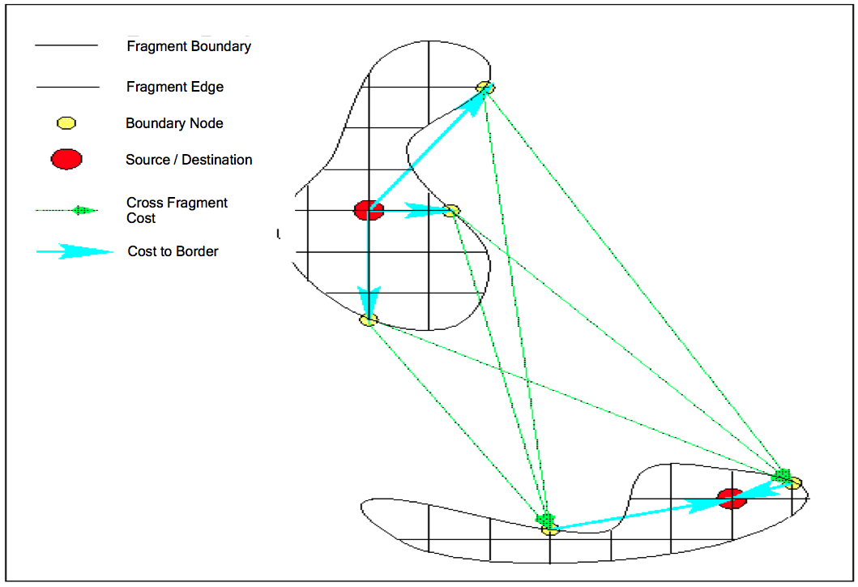
Hierarchical Routing Algorithm-Step 1
  Step 1: Choose Boundary Node Pair
    Minimize COST(S,Ba)+COST(Ba,Bd)+COST(Bd,D)
    Determining Cost May Be Non-Trivial
Fig 6.7(a)

Slide 78
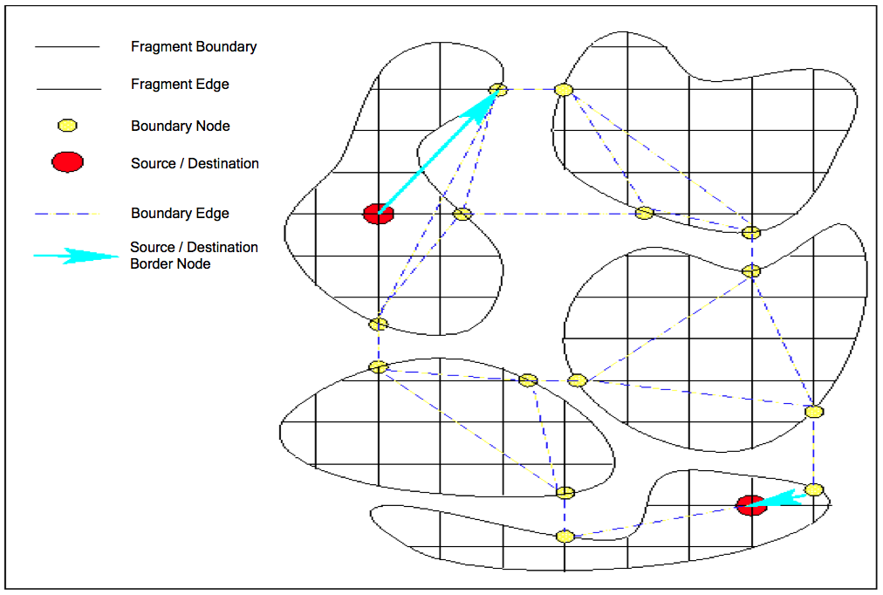
Hierarchical Routing- Step 2
  Step 2: Examine Alternative Boundary Paths
    Between Chosen Pair (Ba,Bd) of boundary nodes
Fig 6.7(b)

Slide 79
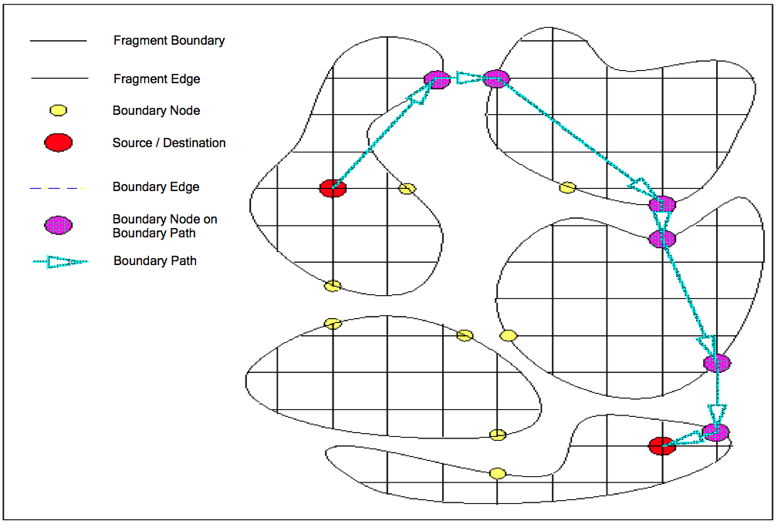
Hierarchical Routing- Step 2 Result
  Step 2 Result: Shortest Boundary Path
Fig 6.8(a)

Slide 80
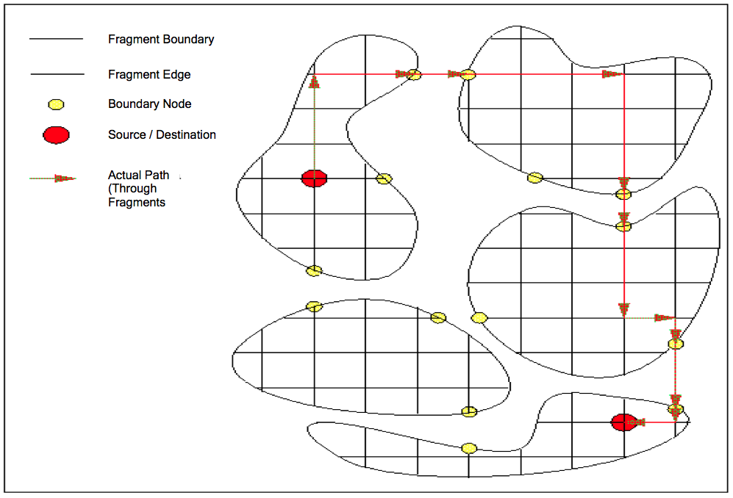
Hierarchical Routing- Step 3
  Step 3: Expand Boundary Path: (B_{a1},B_{d}) -> B_{a1} Bd_{a2} B_{a3} B_{da4}…B_{d}
    Boundary Edge (B_{ij},B_{j}) ->fragment path (B_{i1},N₁N₂N₃…….N_{k},B_{j})
Fig 6.8(a)

Slide 81
Quiz
Which of the following is false?
a) Hierarchical routing algorithms are Disk-based shortest
path algorithms
b) Breadth first search and depth first search are both
connectivity query algorithms
c) Best first algorithm is always faster than Dijkstra’s
algorithm
d) None of the above

Slide 82
Summary
  Spatial Networks are a fast growing applications of SDBs
  Spatial Networks are modeled as graphs
  Graph queries, like shortest path, are transitive closure
    not supported in relational algebra
    SQL features for transitive closure: CONNECT BY, WITH RECURSIVE
  Graph Query Processing
    Building blocks - connectivity, shortest paths
    Strategies - Best first, Dijkstra’s and Hierarchical routing
  Storage and access methods
    Minimize CRR

