Slide 1

Spatial Storage and Indexing

Slide 2
Outline
Physical data model
Physical data organization (file structures)
Space filling curves, e.g., Z-curve and Hilbert curve
Spatial index structures, e.g., grid, R-tree, and quad-tree

Slide 3
Physical Model – Analogy with Vehicles
  Logical models:
  Car: accelerator pedal, steering wheel, brake pedal, …
  Bicycle: pedal forward to move, turn handle, pull brakes on handle
  Physical models :
  Car: engine, transmission, master cylinder, break lines, brake pads, …
  Bicycle: chain from pedal to wheels, gears, wire from handle to brake pads
  We now go, so to speak, “under the hood”
3

Slide 4
Physical Model – Motivational Query
  Input
    Given: (1) my location L,
    (2) 100 millions spatial facilities (restaurants, schools, hotels, etc)
    Output
    Find the nearest 3 facilities to my location L
3

Slide 5
Physical Model – Motivational Query
  Input
    Given: (1) my location L,
    (2) 100 millions spatial facilities (restaurants, schools, hotels, etc)
    Output
    Find the nearest 3 facilities to my location L
  Logical models:
  Express query in a high-level language, what are the operators?
  Ex.: SELECT * FROM Facilities F WHERE Nearest( 3, F.Loc, L)
3

Slide 6
Physical Model – Motivational Query
  Input
    Given: (1) my location L,
    (2) 100 millions spatial facilities (restaurants, schools, hotels, etc)
    Output
    Find the nearest 3 facilities to my location L
  Logical models:
  Express query in a high-level language, what are the operators?
  Ex.: SELECT * FROM Facilities F WHERE Nearest( 3, F.Loc, L)
  Physical models:
  How spatial objects are physically stored and organized in files?
  How spatial objects are retrieved from files?
3

Slide 7
Physical Model – Motivational Query
  Input: Given my location L, and 100 millions spatial facilities
  Output: Find the nearest 3 facilities to my location L
  Physical models examples:
  One way:
  store all objects in one file in random order, then scan all objects to get the nearest 3 objects to L
3

Slide 8
Physical Model – Motivational Query
  Input: Given my location L, and 100 millions spatial facilities
  Output: Find the nearest 3 facilities to my location L
  Physical models examples:
  One way:
  store all objects in one file in random order, then scan all objects to get the nearest 3 objects to L
  Another way:
  store multiple files, each file contains portion of data, then locate files relevant to L to retrieve objects
3

Slide 9
What is a Physical Data Model of a Database?
  Concepts to implement logical data model
  Using current components, e.g. computer hardware, operating systems
  In an efficient and fault-tolerant manner
4

Slide 10
Why Learn Physical Data Model Concepts?
  To be able to choose between DBMS brand names
  Some brand names do not have spatial indices!
  To be able to use DBMS facilities for performance tuning
  For example, If a query is running slow,
  One may create an index to speed it up
  For example, if loading of a large number of tuples takes for ever
  One may drop indices on the table before the inserts
  And recreate index after inserts are done!
5

Slide 11
Concepts in a Physical Data Model
  Database concepts
  Conceptual data model - entity, (multi-valued) attributes, relationship, …
  Logical model - relations, atomic attributes, primary and foreign keys
  Physical model - secondary storage hardware, file structures, indices, …
6

Slide 12
Concepts in a Physical Data Model –
Examples from Relational DBMS
  Secondary storage hardware: Disk drives
  File structures - sorted
  Auxiliary search structure -
  Search trees (hierarchical collections of one-dimensional ranges)
8

Slide 13
An Interesting Fact about Physical Data Model
  Physical data model design is a trade-off between
  Efficiently support a small set of basic operations of a few data types
  Simplicity of overall system
  Each DBMS physical model
  Choose a few physical DM techniques
  Choice depends chosen sets of operations and data types
9

Slide 14
An Interesting Fact about Relational DBMS Physical Model
  Data types: numbers, strings, date, currency
  One-dimensional, totally ordered
  Operations:
  Search on one-dimensional totally order data types
  Insert, delete, ...
10

Slide 15
Physical Data Model for SDBMS
  Is relational DBMS physical data model suitable for spatial data?
  Relational DBMS has simple values like numbers
  Sorting, search trees are efficient for numbers
  These concepts are not natural for Spatial data (e.g. points in a plane)
  Reusing relational physical data model concepts
  Space filling curves define a total order for points
  This total order helps in using ordered files, search trees
  But may lead to computational inefficiency!
11

Slide 16
Physical Data Model for SDBMS –
New Spatial Techniques
  Spatial indices, e.g. grids, hierarchical collection of rectangles
  Provide better computational performance
12

Slide 17
Common assumptions for SDBMS physical model – Spatial Data
  Dimensionality of space is low, e.g. 2 or 3
  Data types: OGIS data types
  Approximations for extended objects (e.g. linestrings, polygons)
  Minimum Orthogonal Bounding Rectangle (MOBR or MBR)
  MBR(O) is the smallest axis-parallel rectangle enclosing an object O
  Supports filter and refine processing of queries
13

Slide 18
Common Spatial Queries
  Physical model provides simpler operations needed by spatial queries!
  Common Queries
  Range query: Find all objects within a query rectangle.
  k-nearest neighbor: Find k points closest to a query point.
  Join query: Find all intersecting objects from two spatial datasets.
15

Slide 19
Common Spatial Operations
  Common operations across spatial queries
  Find : retrieve records satisfying a condition on attribute(s)
  Findnext : retrieve next record in a dataset with total order
    After the last one retrieved via previous find or findnext
  Nearest neighbor of a given object in a spatial dataset
16

Slide 20
Storage Hierarchy in Computers –
Types of Storage Devices
  Main memories - fast but content is lost when power is off
  Secondary storage - slower, retains content without power
  Tertiary storage - very slow, retains content, very large capacity
20

Slide 21
Storage Hierarchy in Computers –
DBMS Usually Manage Data
  On secondary storage, e.g. disks
  Use main memory to improve performance
  User tertiary storage (e.g. tapes) for backup, archival etc.
21

Slide 22
Software View of Disks: Fields, Records and File
  Views of secondary storage (e.g. disks)
  Data on disks is organized into fields, records, files
28

Slide 23
Software View of Disks: Fields, Records and File – Concepts
  Field presents a property or attribute of a relation or an entity
  Records represent a row in a relational table
  Collection of fields for attributes in relational schema of the table
  Files are collections of records
  Homogeneous collection of records may represent a relation
  Heterogeneous collections may be a union of related relations
29

Slide 24
Mapping Records and Files to Disk
Records
  Often smaller than a sector
  Many records in a sector
Files with many records
  Many sectors per file
File system
  Collection of files
  Organized into directories
Mapping tables to disk
  Figure 4.1
  City table takes 2 sectors
  Others take 1 sector each
Figure 4.1
30

Slide 25
File Structures
What is a file structure?
  A method of organizing records in a file
  For efficient implementation of common file operations on disks
  Example: ordered files
Measure of efficiency
  I/O cost: Number of disk sectors retrieved from secondary storage
  CPU cost: Number of CPU instruction used
  See Table 4.1 for relative importance of cost components
  Total cost = sum of I/O cost and CPU cost
34

Slide 26
Common File Structures
Heap or unordered or unstructured
  Ordered
  Hashed
37

Slide 27
File Structures – Common File Operations
  Find: key value --> record matching key values
  Findnext --> Return next record after find if records were sorted
  Insert --> Add a new record to file without changing file-structure
  Nearest neighbor of a object in a spatial dataset
35

Slide 28
File Structures – Examples Using Figure 4.1
  Find(Name = Canada) on Country table returns record about Canada
  Findnext() on Country table returns record about Cuba
  Since Cuba is next value after Canada in sorted order of Name
  Insert(record about Panama) into Country table
  Adds a new record
  Location of record in Country file depends on file-structure
  Nearest neighbor Argentina in country table is Brazil
Figure 4.1
36

Slide 29
Common File Structures
Heap or unordered or unstructured
  Ordered
  Hashed
37

Slide 30
Basic Comparison of Common File Structures
  Heap file is efficient for inserts and used for log files
  But find, findnext, etc. are very slow
  Hashed files are efficient for find, insert, delete etc.
  But findext is very slow
  Ordered file organization are very fast for findnext
  And pretty competent for find, insert, etc.
38

Slide 31
File Structures: Heap
Figure 4.1
  Records are in no particular order (Example: Figure 4.1)
  Insert can simple add record to the last sector
  Find, findnext, nearest neighbor scan the entire files
39

Slide 32
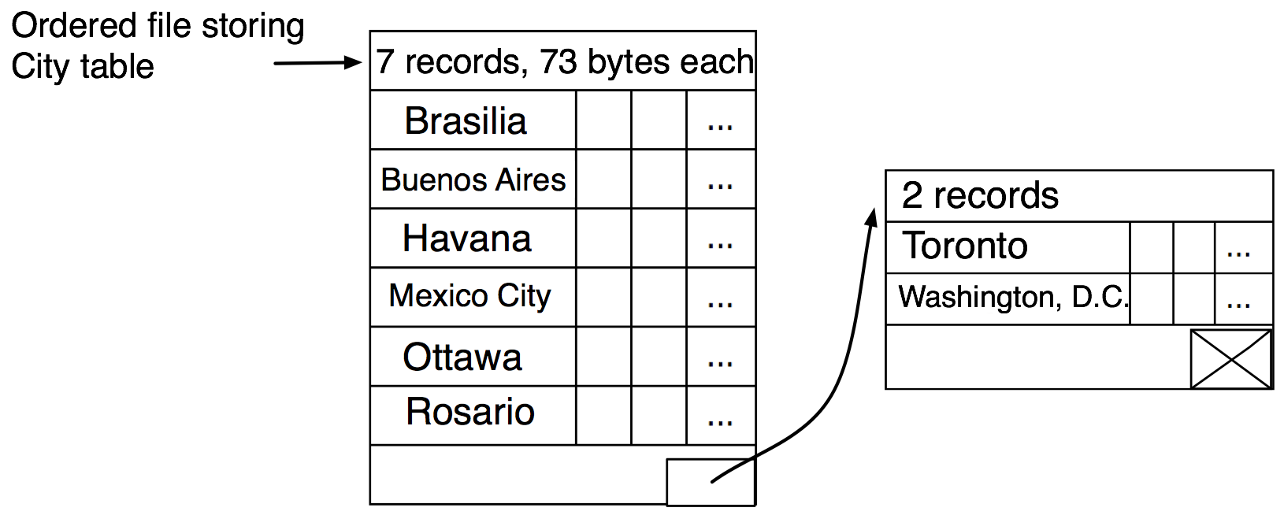
File Structures: Ordered
  Records are sorted by a selected field (Example Fig. 4.3 below)
  Findnext can simply pick up physically next record
  Find, insert, delete may use binary search, is very efficient
  Nearest neighbor processed as a range query
Figure 4.3
40

Slide 33
File Structures: Hash - Components
  A set of buckets (sectors)
  Hash function : key value --> bucket
  Hash directory: bucket --> sector
Figure 4.2
41

Slide 34
File Structures: Hash - Operations
  Find, insert, delete are fast
  Compute hash function
  Lookup directory
  Fetch relevant sector
  Findnext, nearest neighbor are slow
  No order among records
Figure 4.2
42

Slide 35
Space Filling Curves
  How to order country names?
45

Slide 36
Space Filling Curves
  How to order country names?
    Alphabetical order (total order, linear order)
45

Slide 37
Space Filling Curves
  How to order country names?
    Alphabetical order (total order, linear order)
  How to order country spatial locations?
45

Slide 38
Space Filling Curves
  How to order country names?
    Alphabetical order (total order, linear order)
  How to order country spatial locations?
    There is no linear order
    There is no total order
45

Slide 39
Space Filling Curves
  How to order country names?
    Alphabetical order (total order, linear order)
  How to order country spatial locations?
    There is no linear order
    There is no total order
  Why do we need to order?
45

Slide 40
Space Filling Curves
  How to order country names?
    Alphabetical order (total order, linear order)
  How to order country spatial locations?
    There is no linear order
    There is no total order
  Why do we need to order?
    Speed-up searching
    Use binary search, which is faster than linear search
45

Slide 41
Space Filling Curves
  Space Filling Curves (Geo-hashing)
    Discretized two-dimensional space
    Suggest a sorting order on points
      Ex.: row-major, column-major, Z-curve, Hilbert-curve, …
45

Slide 42
Space Filling Curves
  Naïve:
0 1 2 3
0
1
2
3
0 | 1 | 2 | 3
7 | 6 | 5 | 4
8 | 9 | 10 | 11
15 | 14 | 13 | 12
45

Slide 43
Space Filling Curves
  Naïve:
0 1 2 3
0
1
2
3
0 | 1 | 2 | 3
7 | 6 | 5 | 4
8 | 9 | 10 | 11
15 | 14 | 13 | 12
45

Slide 44
Space Filling Curves
  Naïve:
0 1 2 3
0
1
2
3
45

Slide 45
Space Filling Curves
  A better order:
0 1 2 3
0
1
2
3
0 | 1 | 4 | 5
2 | 3 | 6 | 7
8 | 9 | 12 | 13
10 | 11 | 14 | 15
45

Slide 46
Space Filling Curves
  A better order:
0 1 2 3
0
1
2
3
0 | 1 | 4 | 5
2 | 3 | 6 | 7
8 | 9 | 12 | 13
10 | 11 | 14 | 15
45

Slide 47
Space Filling Curves
  A better order:
0 1 2 3
0
1
2
3
45

Slide 48
Space Filling Curves
  A better order: Z-curve
0 1 2 3
0
1
2
3
45

Slide 49
Z – Curve
Figure 4.6
  Computing Z-value of a point
  Generated from interleaving bits
    x, y coordinate (see Fig. 4.6)
  Connecting points by z-order
    Looks like Ns or Zs
  Searching for a point P
    Assume pointed sorted by Z-order
    Compute Z-order for P
    Binary search
Figure 4.4
Figure 4.4
46

Slide 50
Space Filling Curves
  An alternative order: Hilbert curve
0 1 2 3
0
1
2
3
0 | 1 | 14 | 15
3 | 2 | 13 | 12
4 | 7 | 8 | 11
5 | 6 | 9 | 10
45

Slide 51
Hilbert Curve
  More complex to generate
  Due to rotations
  Searching for a point P
    Assume ordered pointed
    Compute Hilbert-order for P
    Binary search
Figure 4.5
48

Slide 52
Calculating Hilbert Values (Optional Topic)
Figure 4.8
49

Slide 53
Handling Regions
Challenge: non-unique values!
Figure 4.9
50

Slide 54
Z-order and Extended Objects
  Figure 4.7
  Left part shows a map with spatial object A, B, C
  Right part and Left bottom part Z-values within A, B and C
  Note C gets z-values of 2 and 8, which are not close
Figure 4.7
47

Slide 55
Common assumptions for SDBMS physical model – Spatial Data
  Dimensionality of space is low, e.g. 2 or 3
  Data types: OGIS data types
  Approximations for extended objects (e.g. linestrings, polygons)
  Minimum Orthogonal Bounding Rectangle (MOBR or MBR)
  MBR(O) is the smallest axis-parallel rectangle enclosing an object O
  Supports filter and refine processing of queries
13

Slide 56
Common Spatial Queries
  Physical model provides simpler operations needed by spatial queries!
  Common Queries
  Range query: Find all objects within a query rectangle.
  k-nearest neighbor: Find k points closest to a query point.
  Join query: Find all intersecting objects from two spatial datasets.
15

Slide 57
What is an index?
Figure 4.10
  Concept of an index
    Auxiliary file to search a data file
    Example: Fig. 4.10
  Index records have
    Key value
    Address of relevant data sector
    (see arrows in Fig. 4.10)
  Index records are ordered
    Find, findnext, insert are fast
  Note assumption of total order
    On values of indexed attributes
52

Slide 58
Classifying indexes
  Classification criteria
    Data-file-structure
    Key data type
    Others
  Secondary index
    Heap data file
    1 index record per data record
    Example: Fig. 4.10
  Primary index
    Data file ordered by indexed attribute
    1 index record per data sector
    Example: Fig. 4.11
Figure 4.11
53

Slide 59
Question
Why is a file/table can have at most one primary index?
54

Slide 60
Question
Why is a file/table can have at most one primary index?
(a) Reduce the ambiguity for users
(b) Data file is physically ordered by the primary index
(c) Save the storage space
(d) Make query faster
54

Slide 61
Attribute Data Types and Indexes
  Index file structure depends on data type of indexed attribute
  Attributes with total order
    Example, numbers, points ordered by space filling curves
    B-tree is a popular index organization
  Spatial objects (e.g. polygons)
    Spatial organization are more efficient
    Hundreds of organizations are proposed in literature
    Two main families are Grid Files and R-trees
55

Slide 62
Spatial Grids
  Basic Idea: Divide geographic space
    Example: latitude-longitude, ESRI Arc/SDE
    Store data in each cell in distinct disk sector(s)
  Efficient for
    uniformly distributed data
    Operations: find, insert, nearest neighbor
  But may waste disk sectors
    Empty cells
    Non-uniform data distribution
Figure 4.12
57

Slide 63
From Grids to Grid Files
  1. Use non-uniform grids (Fig. 4.14)
    Linear scale store row and column boundaries
1
2
3
4
Figure 4.14
58

Slide 64
Grid Files – Search Operation
  Steps
    Search linear scales
    Identify selected grid directory cells
    Retrieve selected disk sectors
  Optimization
    Scales & grid directory in main memory
    Efficient in terms of I/O costs
    Needs large main memory for grid directory
Figure 4.13
60

Slide 65
R–Tree Family – Basic Idea
  Hierarchical collection of rectangles organize spatial data
  Generalizes B-tree to spatial data sets
62

Slide 66
Example: R-tree
D
R2
D1
D
R1
R3
D1
D2
D3
D2
R4
D3
R1, R2, R3
R4, R5
R6, R7
R7
R5
R6
3

Slide 67
Example: R+ tree
D
R2
D1
D
R1
R3
D1
D2
D3
D2
R4
D3
R5
R1, R2, R3
R4, R5
R5, R6, R7
R7
R6
3

Slide 68
R–Tree Family – Basic Idea
  Hierarchical collection of rectangles organize spatial data
  Generalizes B-tree to spatial data sets
  Properties of R-trees
    Balanced
    Nodes are rectangle
      Child’s rectangle within parent’s
      Possible overlap among rectangle!
    Other properties in the section of R-tree family
62

Slide 69
Find Operation with R-tree
  Search root to identify relevant children
  Search selected children recursively
  Ex. Find record for rectangle 5
    Root search identifies child x
    Search of x identifies children b and c
    Search of b does not find object 5
    Search of c find object 5
Fig 4.15
Fig 4.16
65

Slide 70
R–Tree Family – Classifying Members
  Handling of large spatial objects
    Allow interior node rectangles to overlap - R-tree, R*-Tree
    Duplicate objects but keep interior node rectangles disjoint - R+tree
  Selection of rectangles for interior nodes
    Greedy procedures - R-tree, R+tree
    Procedure to minimize coverage, overlap – R* tree
  Other criteria exist
63

Slide 71
R+tree
  Properties of R+trees
    Balanced
    Interior nodes are rectangle
      Child’s rectangle within parent’s
      Disjoint rectangles
    Leaf nodes – MOBR of polygons or lines
      Leaf’s rectangle overlaps with parent’s
    Data objects may be duplicated across leafs
    Other properties in the section of R-tree family
  Find operation – same as R-tree
    But only one child is followed down in point queries
66

Slide 72
Comparison of Family of R trees
Property | R Tree | R + Tree | R * Tree
Overlap | Considerable | Allowed at leaf level | Minimum
Duplication | No | May be | No
Area | Minimizes | Does not consider | Minimizes
Margin | Not Applicable | Not Applicable | Minimizes
Reinsertion | No | No | Yes
Construction cost | Less | Somewhat More | Maximum
2

Slide 73
Dynamic Comparison (Insert)
Legend
a
b
2
e
h
3
i
Initial data:
{a,b,…,h,i}
1st level index
1
leafs
c
d
f
g
new data
x
new data: x
1
2
3
Initial R-tree
a
b
c
d
e
f
g
h
i
3

Slide 74
Insert in R-Tree
Legend
a
b
2
e
h
3
i
Initial data:
{a,b,…,h,i}
1st level index
1
leafs
c
d
f
g
new data
x
new data: x
3

Slide 75
Insert in R+ Tree
Legend
a
b
2
e
h
3
i
Initial data:
{a,b,…,h,i}
1st level index
1
leafs
c
d
f
g
new data
x
new data: x
3

Slide 76
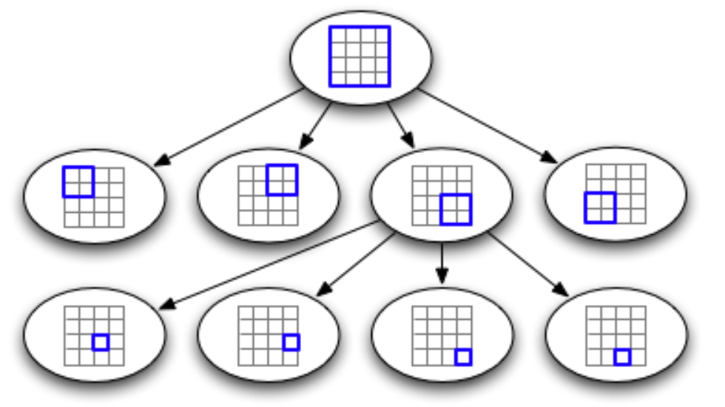
Quadtree
Hierarchical index
Partition boundaries depend only on parent’s boundaries and not data
  space-partitioning index
  vs. data-partitioning index
More efficient in dynamic insertions
Memory-friendly

Slide 77
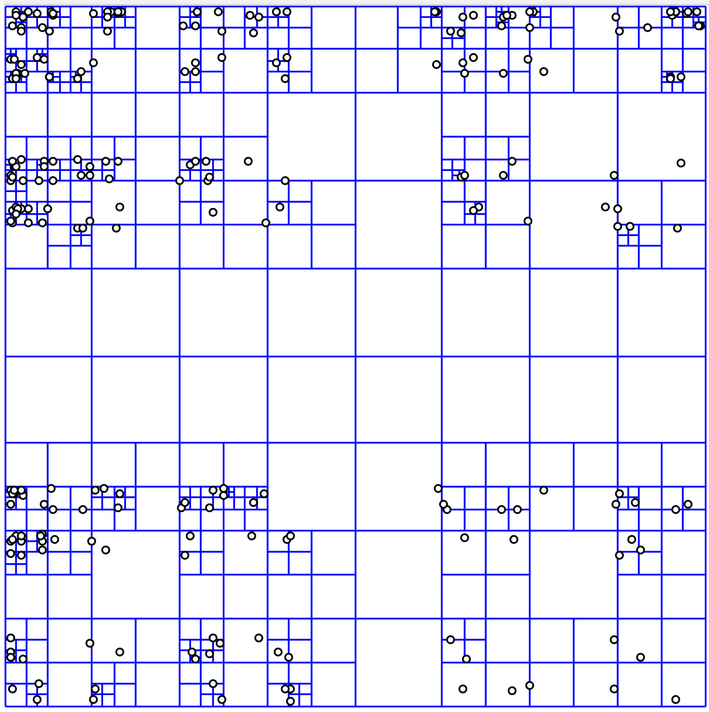
Quadtree
Can be seen as a multi-level
grid structure
Different types:
  Complete quadtree vs.
  partial quadtree
  Region, point, point-region, edge,
  and polygon quad tree.
Used in raster and vector data

Slide 78
Quadtree: Example
y
78
x

Slide 79
Quadtree: Example
y
79
x

Slide 80
Quadtree: Example
y
80
x

Slide 81
Quadtree: Example
y
81
x

Slide 82
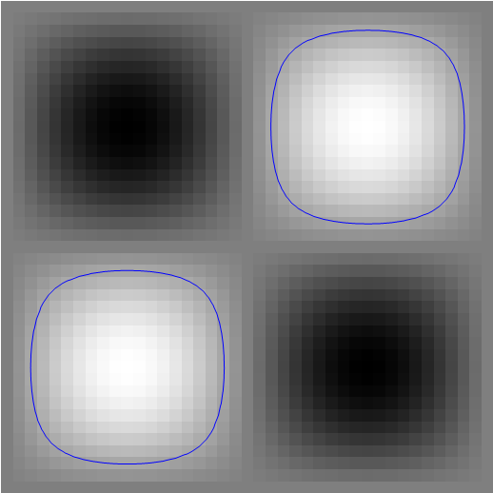
Quadtree: Example
Iso-value not in {min,max}
Iso-value in {min,max}

Slide 83
Quadtree: Example
Iso-value not in {min,max}
Iso-value in {min,max}

Slide 84
Quadtree: Example
Iso-value not in {min,max}
Iso-value in {min,max}

Slide 85
Quadtree: Example
Iso-value not in {min,max}
Iso-value in {min,max}

Slide 86
Credits
Prof. Tao Ju slides
  http://www.cse.wustl.edu/~taoju/cse554/lectures/lect05_Contouring_II.ppt

