Slide 1
Spatial data mining and geographic knowledge discovery
An Introduction

Slide 2
What is Spatial Data Mining?
Metaphors
  Mining nuggets of information embedded in large databases
  nuggets = interesting, useful, unexpected spatial patterns
  mining = looking for nuggets
  Needle in a haystack
Defining Spatial Data Mining
  Search for spatial patterns
  Non-trivial search - as “automated” as possible—reduce human effort
  Interesting, useful and unexpected spatial pattern

Slide 3
What is Spatial Data Mining?
Non-trivial search for interesting and unexpected spatial pattern
Non-trivial Search
  Large (e.g. exponential) search space of plausible hypothesis
  Ex. Asiatic cholera : causes: water, food, air, insects, …; water delivery mechanisms - numerous pumps, rivers, ponds, wells, pipes, ...
Interesting
  Useful in certain application domain
  Ex. Shutting off identified Water pump => saved human life
Unexpected
  Pattern is not common knowledge
  May provide a new understanding of world
Ex. Water pump - Cholera connection lead to the “germ” theory

Slide 4
What is not Spatial Data Mining?
Simple Querying of Spatial Data
  Find neighbors of Canada given names and boundaries of all countries
  Find shortest path from Boston to Houston in a freeway map
Search space is not large (not exponential)
Testing a hypothesis via a primary data analysis
  Ex. Female chimpanzee territories are smaller than male territories
Uninteresting or obvious patterns in spatial data
  Heavy rainfall in Minneapolis is correlated with heavy rainfall in St. Paul, Given that the two cities are 10 miles apart.
  Common knowledge: Nearby places have similar rainfall

Slide 5
Why Learn about Spatial Data Mining?
Two basic reasons
  Consideration of use in certain application domains
  Provide fundamental new understanding
Application domains
  describe/explain locations of human settlements in last 5000 years
  find cancer clusters to locate hazardous environments
  prepare land-use maps from satellite imagery
  predict habitat suitable for endangered species
Find new spatial patterns
  find groups of co-located geographic features

Slide 6
Why Learn about Spatial Data Mining?
New understanding of geographic processes for Critical questions
  Ex. How is the health of planet Earth?
  Ex. Characterize effects of human activity on environment and ecology
  Ex. Predict effect of El Nino on weather, and economy
Traditional approach: manually generate and test hypothesis
  But, spatial data is growing too fast to analyze manually satellite imagery, GPS tracks, sensors on highways, …
  Number of possible geographic hypothesis too large to explore manually
    large number of geographic features and locations
    number of interacting subsets of features grow exponentially
    ex. find tele-connections between weather events across ocean and land areas

Slide 7
Spatial classification and prediction
Classification is about grouping data items into classes (categories) according to their properties (attribute values).
Classification is also called supervised classification, as opposed to the unsupervised classification (clustering).
Supervised” classification needs a training dataset to train (or configure) the classification model, a validation dataset to validate (or optimize) the configuration, and a test dataset to evaluate the performance of the trained model.

Slide 8
Spatial classification and prediction
Classification methods include, for example, decision trees, artificial neural networks (ANN)
Spatial classification methods extend the general-purpose classification methods to consider not only attributes of the object to be classified but also the attributes of neighboring objects and their spatial relations
Spatial regression or prediction models form a special group of regression analysis that considers the independent and/or dependent variable of nearby neighbors in predicting the dependent variable at a specific location,

Slide 9
Spatial Association Rule Mining
Association rule mining was developed to discover regularities between items in large transaction databases
In other words it means used for finding a set of products that are frequently bought together.
Let U be a set of items and let X, Y ⊆ U, with X ∩ Y = ∅
An association rule is an expression of the form X ⇒ Y, whose meaning is: If the elements of X occur in some context, then so do the elements of Y
Example for this is if a customer buys bread and wine, then he/she will probably also buy cheese.
Application of this would include improving arrangement of items in shelves and Fraud detection

Slide 10
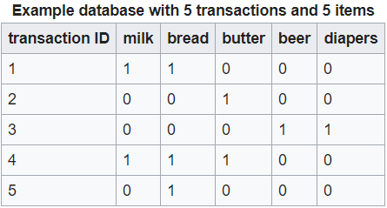
Spatial Association Rule Mining
Spatial Association rule mining is an extension to associate rule mining by taking into consideration the spatial properties. Spatial property is any property which relating to or occupying space.
A spatial association rule is expressed in the form A ⇒ B [s%, c%] where A and B are sets of spatial or non-spatial predicates, s% is the support of the rule and c% is the confidence of the rule.
Example:

Slide 11
Spatial Association Rule Mining
Support is an indication of how frequently the itemset appears in the dataset. In the example dataset, the itemset X={beer,diapers} has a support of 1/5=0.2 since it occurs in 20% of all transactions (1 out of 5 transactions).
Confidence is an indication of how often the rule has been found to be true. For example, the rule {butter,bread} ⇒ {milk} has a confidence of 0.2/0.2=1.0 in the database, which means that for 100% of the transactions containing butter and bread.
Some examples for spatial predicates are close_to, far_away, intersect, overlap, etc. which can be used in spatial association rules.

Slide 12
Spatial Association Rule Mining
It is computationally expensive to consider various spatial predicates in deriving association rules from a large spatial datasets.
Another potential problem with spatial association rule mining is that a large number of rules may be generated and many of them are obvious or common knowledge.
Domain knowledge is needed to filter out trivial rules and focus only on new and interesting findings.
Example would be deserts and cactus(Trivial) and Desert and Oases(Non trivial)

Slide 13
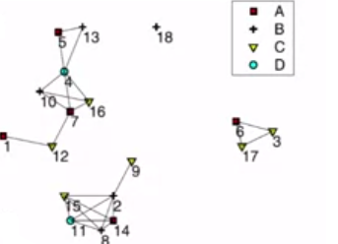
Spatial co-location pattern mining
Spatial co-location pattern mining is given a dataset of spatial features and their locations, a co-location pattern represents subsets of features frequently located together.
For example, human cases of West Nile Virus often occur in regions with poor mosquito control and the presence of birds.

Slide 14
Spatial clustering, regionalization and point pattern analysis
Cluster analysis is widely used for data analysis, which organizes a set of data items into groups (or clusters) so that items in the same group are similar to each other and different from those in other groups.
Clustering methods can be broadly classified into two groups: partitioning clustering and hierarchical clustering

Slide 15
Spatial clustering, regionalization and point pattern analysis
Three types of clustering analysis have been studied with respect to spatial information spatial clustering, regionalization and point pattern analysis
Spatial clustering is the process of grouping a set of objects into classes or clusters so that the objects within the same cluster have high similarity.
As a tool it can be used as a stand alone tool to gain insight into distribution of data and learn characteristics of each cluster.
It can be used in the identification of areas of similar land usage or merging reasons with similar weather patterns.
Some examples for spatial clustering partitioning or hierarchical, density-based, or grid-based.

Slide 16
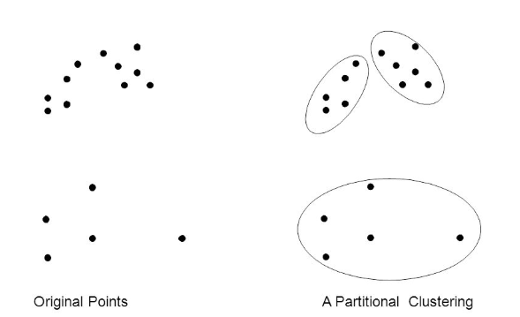
Spatial clustering, regionalization and point pattern analysis
A partitional clustering a simply a division of the set of data objects into non-overlapping subsets (clusters) such that each data object is in exactly one subset.

Slide 17
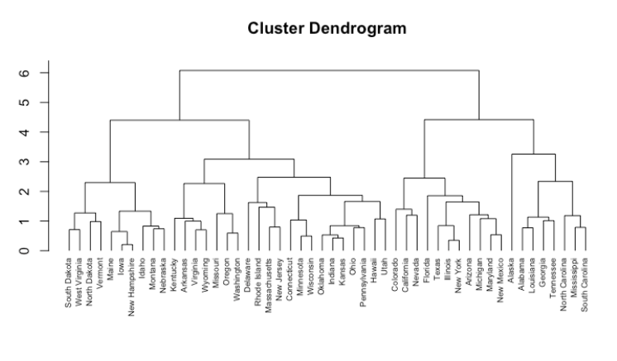
Spatial clustering, regionalization and point pattern analysis
Hierarchical – Splitting or merging; divisive or agglomerative – Tree of clusters, dendrogram

Slide 18
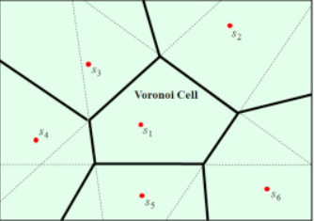
Spatial clustering, regionalization and point pattern analysis
Density based – Clusters are dense regions of objects in the data space – Multidimensional Voronoi -clustering

Slide 19
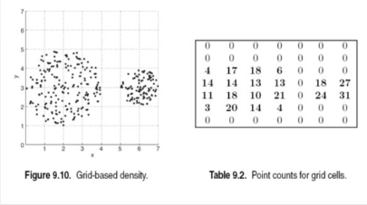
Spatial clustering, regionalization and point pattern analysis
Grid-based – Clustering space is organized into grid cells – Cells that contain more than certain number are treated as dense

Slide 20
Spatial clustering, regionalization and point pattern analysis
Regionalization is a term used for a special form of clustering that seeks to group objects into spatially contiguous clusters while optimizing the objective function (looking for similar clusters)
Existing regionalization methods that are based on a clustering concept can be classified into three groups: multivariate (non-spatial) clustering followed by spatial processing to rearrange clusters into regions, clustering with a spatially weighted dissimilarity measure and contiguity constrained clustering that enforces spatial contiguity during the clustering process
Many geographic applications, such as climate zoning, landscape analysis, often require that clusters are geographically contiguous.

Slide 21
Spatial clustering, regionalization and point pattern analysis
Point pattern analysis, which is also known as ‘‘hot spot” analysis focuses on the detection of unusual concentrations of events in space, such as geographic clusters of disease, crime, or traffic accidents.
Hotspot Analysis uses vectors to identify locations of statistically significant hot spots and cold spots in your data by aggregating points of occurrence into polygons or converging points that are in proximity to one another based on a calculated distance.
The analysis groups features when similar high (hot) or low (cold) values are found in a cluster. The polygons usually represent administration boundaries or a custom grid structure

Slide 22
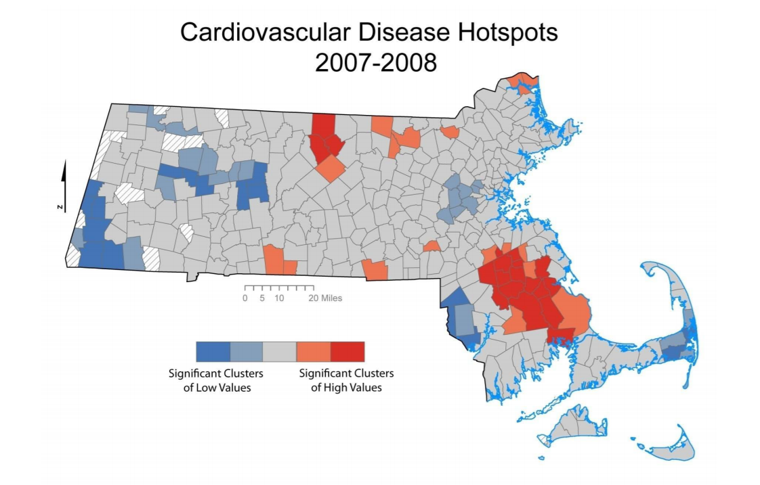
Spatial clustering, regionalization and point pattern analysis

Slide 23
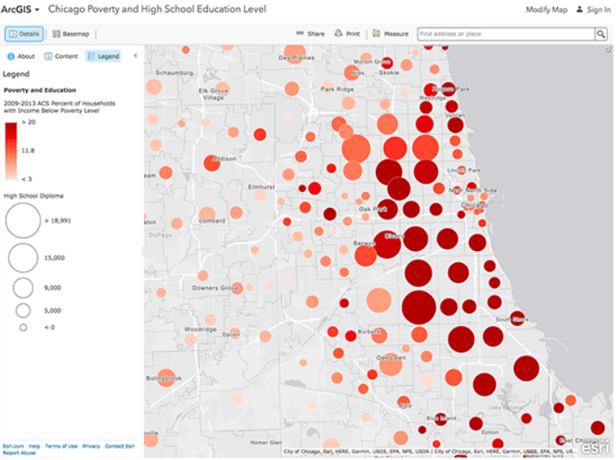
Spatial clustering, regionalization and point pattern analysis

Slide 24
Spatial clustering, regionalization and point pattern analysis
Geovisualization is short for geographic visualization. It is a branch or discipline within visualization that deals solely with displaying information that has a geospatial component to it. A geospatial component is geographic or positioning information. For example, consider the weather report on the evening news. You typically have precipitation information of some sort (fog, rain, or snow) displayed over a map of the local area as a background. The visual gives you a detailed look at how much precipitation you will get, where in the local area it will appear, and at what time of day. This is Geovisualization hard at work converting raw weather and positioning information into a graphic form that we can understand in a matter of seconds.

Slide 25
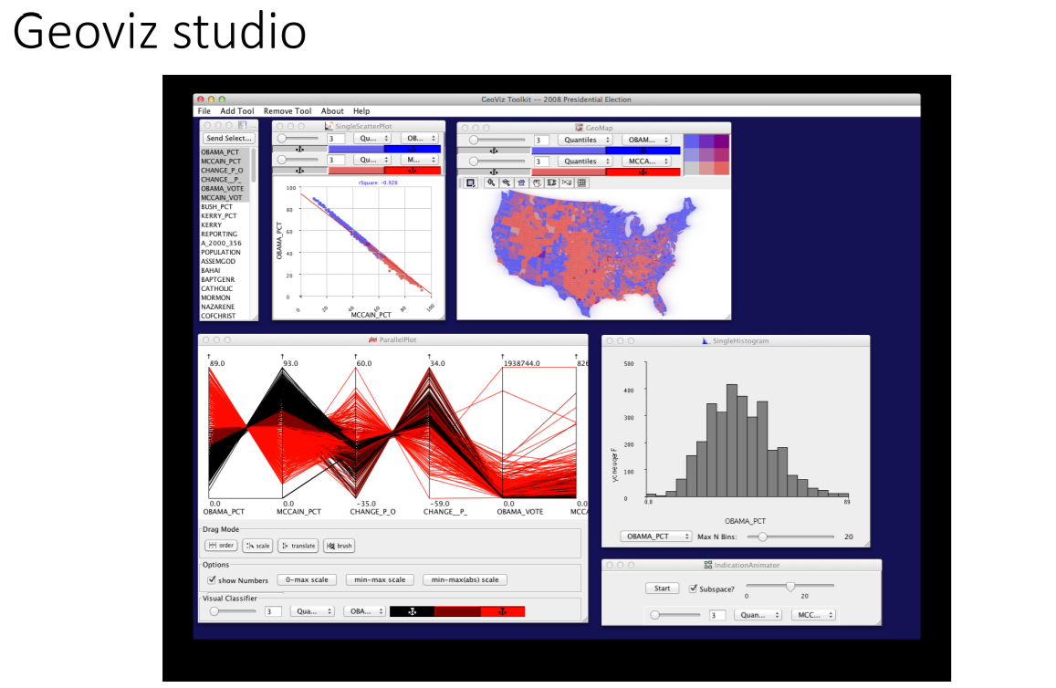
Geovisualization
The main difference between traditional cartography and geovisualization is that, the former focuses on the design and use of maps for information communication and public consumption while the latter emphasizes the
development of highly interactive maps and associated tools for data exploration, hypothesis generation and knowledge construction

Slide 26
Geovisualization
Geovisualization needs to address several major challenges, including
processing very large datasets efficiently and effectively
handling multiple perspectives and many variables simultaneously to discover complex patterns
the design of effective user interface and interactive strategy to facilitate the discovery process

Slide 27
Interesting work
Provide an overview of the articles make contributions to the spatial data mining literature in a variety of ways
Some of the articles extend established techniques, such as artificial neural networks (ANN) and spatial clustering, to account for issues of spatial dependency and spatial scale
Others develop new techniques for types of spatial data that are only recently becoming widely available, such as path and trajectory data describing moving objects.

Slide 28
Accommodating spatial associations in DRNN for space–time analysis.
Classification and prediction is a fundamental data-mining task and ANNs are among the commonly used classification methods.
Conventional ANN does not consider the spatial dependence and associations between neighboring objects.
Authors address this issue by accommodating spatial associations in DRNN for space–time analysis.
Approach incorporates spatial associations among observations into dynamic recursive neural networks.
DRNN is nothing but ANN incorporates feedback from previous iterations of the model inputs and outputs.

Slide 29
Accommodating spatial associations in DRNN for space–time analysis.
Hence it makes a good candidate for modeling time series data and the authors propose target prediction can be improved by not only incorporating the value of the target at the previous time interval but the values of nearby observations
This model was later tested on varying spatial and temporal records – the prediction of forest fires, economic gross domestic product, and temperature.
Results indicate that including spatial association information can improve the computational performance and accuracy of DRNN for space–time prediction.

Slide 30
Revealing the physics of movement: Comparing the similarity of movement characteristics of different types of moving objects
Major challenge to spatial data mining arises from handling new kinds of data.
Recent advances in embedding GPS to create location-aware devices have generated a massive volume of data about moving objects.
Detecting patterns in these data are challenging due to both the massive volume and temporal nature of the data.
Authors of this paper try to address this challenge by releasing a paper which focuses on the classification of moving trajectories.

Slide 31
Revealing the physics of movement: Comparing the similarity of movement characteristics of different types of moving objects
The authors present a way to characterize moving object trajectories from both a global perspective, i.e. those properties that characterize the entire trajectory of the object and a local perspective, i.e. those properties that characterize portions of the object’s trajectory.
Some common properties are path length and straightness as well as velocity and acceleration.
With these extracted characteristics, a SVM is applied to classify trajectories into categories.
we show how the method can be employed in classifying trajectory data generated by unknown moving objects and assigning them to known types of moving objects, whose movement characteristics have been previously learned.

Slide 32
On path anomaly detection in a large transportation network
Focuses on data mining of moving object data but they are interested in path anomaly detection, i.e., the identification of outliers in a set of moving object paths.
Authors propose several new metrics that may be used to identify the degree of similarity among paths, including metrics that capture the global character of a path, such as the perimeter of the region that the path occupies
Other metrics characterize smaller sections of a path, which may be segmented based on the edges shared with another path.

Slide 33
On path anomaly detection in a large transportation network
The path anomaly detection approach was tested on a set of synthetic paths mapped onto the street network of Oldenburg, Germany.
One of the was scenario, a set of shortest paths between randomly defined beginning and ending nodes in the city were generated, as well as a smaller set of paths that were forced to visit a vertex not on the shortest path.
The algorithm aimed to distinguish those paths that were not shortest-paths from the larger set.

Slide 34
Predicting air pollution using fuzzy genetic linear membership kriging in GIS.
Employ genetic algorithms as an approach to optimization
Genetic algorithm is an approach inspired by biological systems to identify optimal, or near-optimal, solutions to optimization problems
In this case the objective is the interpolation of air pollution data, using the fuzzy membership indicator Kriging method.
Fuzzy logic is used to model uncertainty in the prediction process, where degree of predicted membership can be represented using fuzzy logic.
The optimization challenge lies in defining optimal parameterization of the fuzzy logic function

Slide 35
Predicting air pollution using fuzzy genetic linear membership kriging in GIS.
the authors use genetic algorithms, where various fuzzy membership functions are allowed to compete to maximize the accuracy of pollution estimation.
Data set of air particulate concentrations gathered from air pollution monitoring stations in Tehran, Iran.

Slide 36
Conclusion
The abundance of spatial data provides exciting opportunities for new research directions but also demands caution in using these data
Careful selection, preprocessing, and transformation of the data are needed to ensure meaningful analysis and results.
New types of data and new application areas have significantly expanded the frontier of spatial data mining research.
Handling the very large volume and understanding complexstructure in spatial data are another two major challenges for spatial data mining, which demand both efficient computational algorithms to process large data sets and effective visualization approaches to present and explore complex patterns.

Slide 37


