Slide 1
HadoopViz: A MapReduce Framework for Extensible Visualization of Big Spatial Data
Author: Ahmed Eldawy, Mohamed F. Mokbel, Christopher Jonathan
Presented by Yuanlai Liu

Slide 2
Outline
Introduction
Related Work
Single-Level Visualization
Multilevel Visualization
Visualization Abstraction
Case Study
Experiments

Slide 3
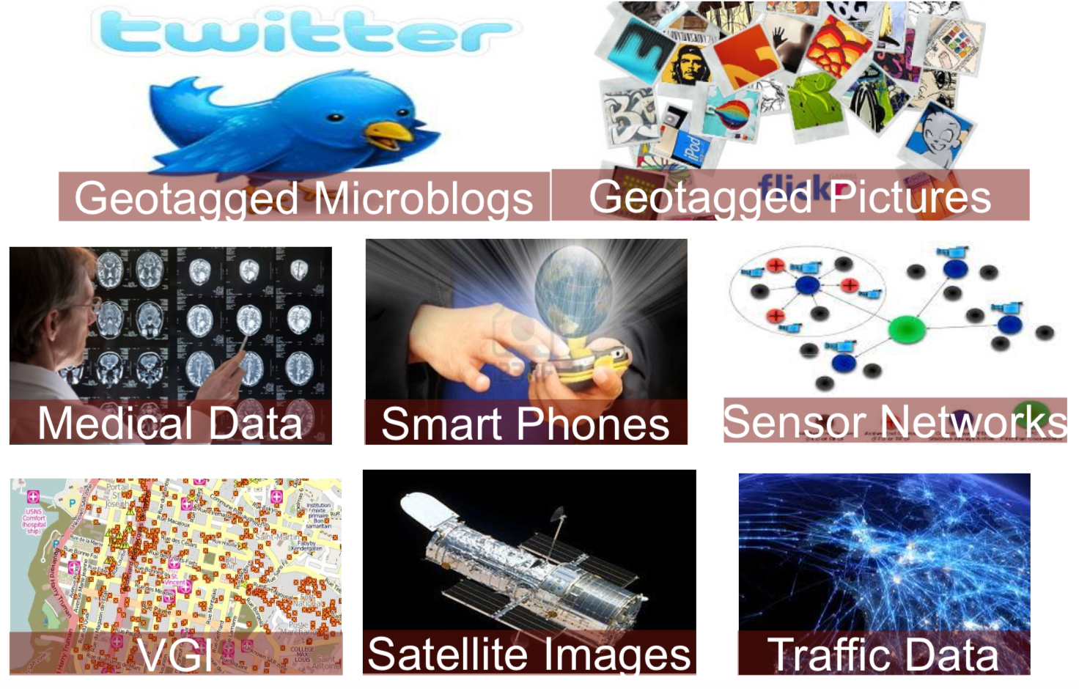
Introduction
An explosion in the amounts of spatial data
Space telescopes: 150GB weekly
Medical devices: 50 PB yearly
NASA satellite images: 25GB daily
Geotagged tweets: 10 Million daily

Slide 4
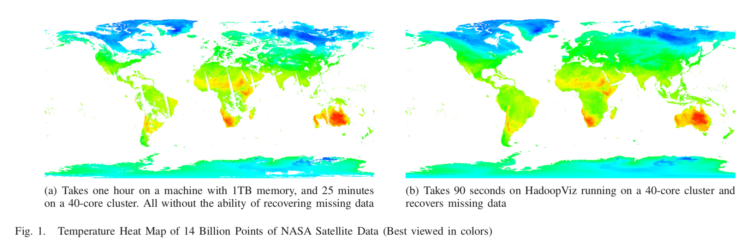
Introduction
The need to visualize big spatial data
  Provides a bird’s-eye data view
  Allows users to quickly spot interesting patterns

Slide 5
Introduction
HadoopViz
  It applies a smoothing technique that can fuse nearby records together.
  e.g. figure 1(b) where missing values are smoothed out.
  It employs partition-plot-merge approach to scale up to giga-pixel images.
  e.g. it takes only 90 seconds to visualize the image in Figure 1(b)
  It proposes a novel visualization abstraction to support dozens of
  image types
  e.g. scatter plot, road networks, or brain neurons

Slide 6
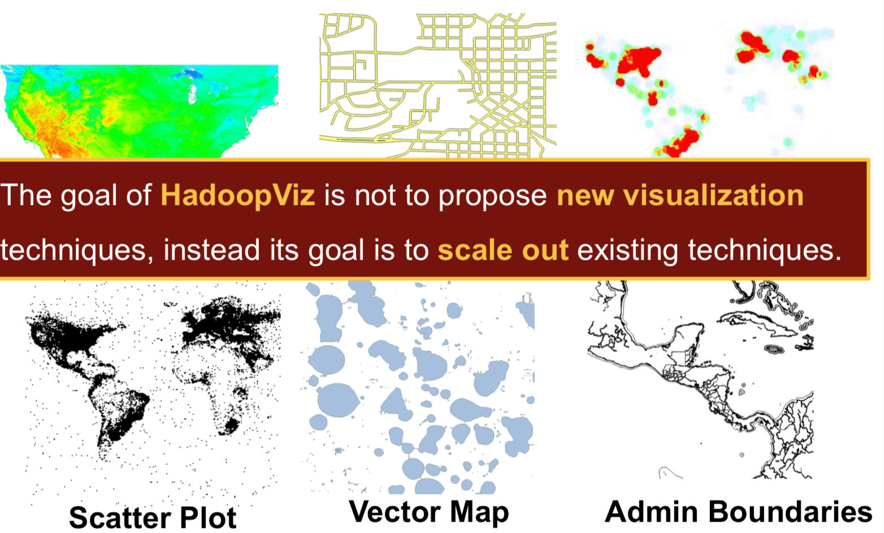
Introduction
HadoopViz

Slide 7
Related Work
Big Data Visualization
  Ermac, M4, Bin-summarise-smooth
  None of these techniques apply for spatial data visualization
Big Spatial Data
  Specific problems (range query, spatial join, kNN join)
  Building systems(Hadoop-GIS, SciDB, SpatialHadoop)
  none of these systems provide efficient visualization techniques for big spatial data

Slide 8
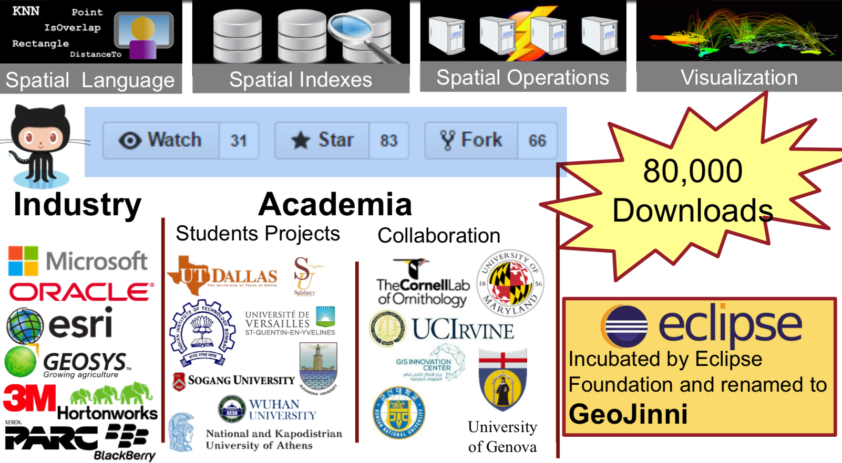
Related Work
SpatialHadoop

Slide 9
Related Work
Spatial Data Visualization
  Single machine solutions
    focus on how the generated image should look like
    Not scalable to big data
  Distributed solutions
    EarthDB and 3D visualization
    SHAHED relies on a heavy preprocessing phase
    No giga-pixel images, No extensibility

Slide 10
Related Work
Big Spatial Data Visualization
  HadoopViz
    Generates giga-pixel images
    Extensible to new visualization types
    Support Single-level and Multilevel Visualization

Slide 11
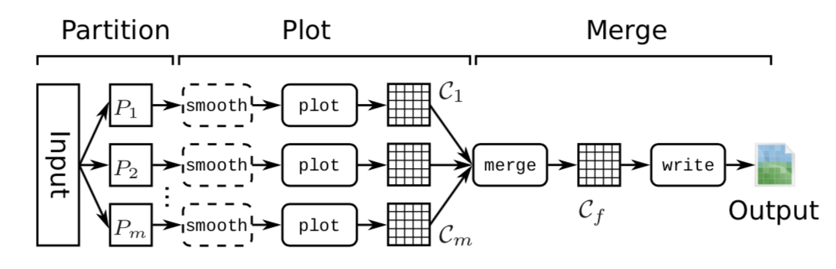
Single-Level Visualization
Three phase approach: partition-plot-merge
  the partitioning phase splits the input into m partitions
  the plotting phase plots a partial image for each partition
  the merging phase combines the partial images into one final image

Slide 12
Single-Level Visualization
Two algorithms that use this three phase approach
  Default-Hadoop Partitioning
  Spatial Partitioning

Slide 13
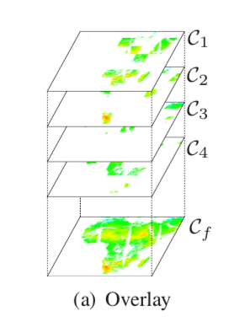
Single-Level Visualization
Default-Hadoop partitioning
  partitioning: default HDFS 128MB
  plotting: each mapper generates a partial image Ci for each partition Pi
  merging: merge all intermediate matrices Ci, in parallel, into one final matrix Cf and writes it as an output image

Slide 14
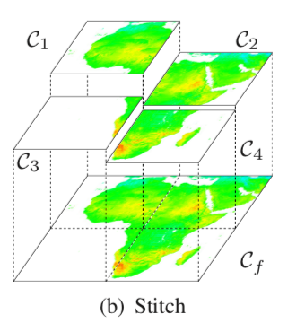
Single-Level Visualization
Spatial Partitioning
  partitioning: spatial partitioning
  plotting: each reducer generate one partial image Ci
  merging: merges the intermediate matrices Ci into one big matrix by stitching them together

Slide 15
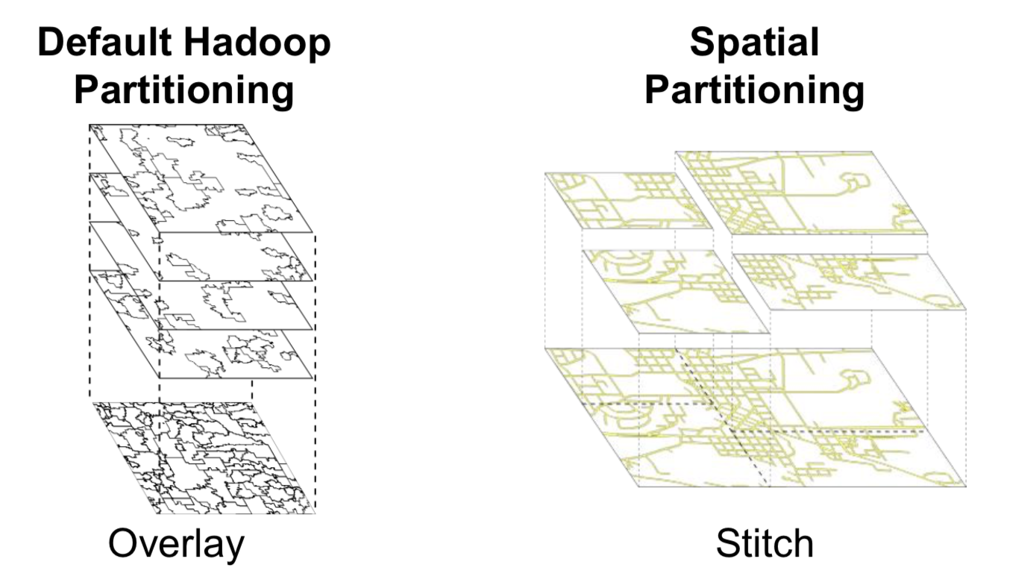
Single-Level Visualization
Default-Hadoop Partitioning VS Spatial Partitioning

Slide 16
Single-Level Visualization
Default-Hadoop Partitioning VS Spatial Partitioning
  need smooth image -> Spatial Partitioning
  tradeoff between the partitioning and merging phases
  Default-Hadoop Partitioning
    zero-overhead partitioning phase
    expensive overlay merging phase
  Spatial Partitioning
    pays an overhead in spatial partitioning
    more efficient stitching technique in merging phase

Slide 17
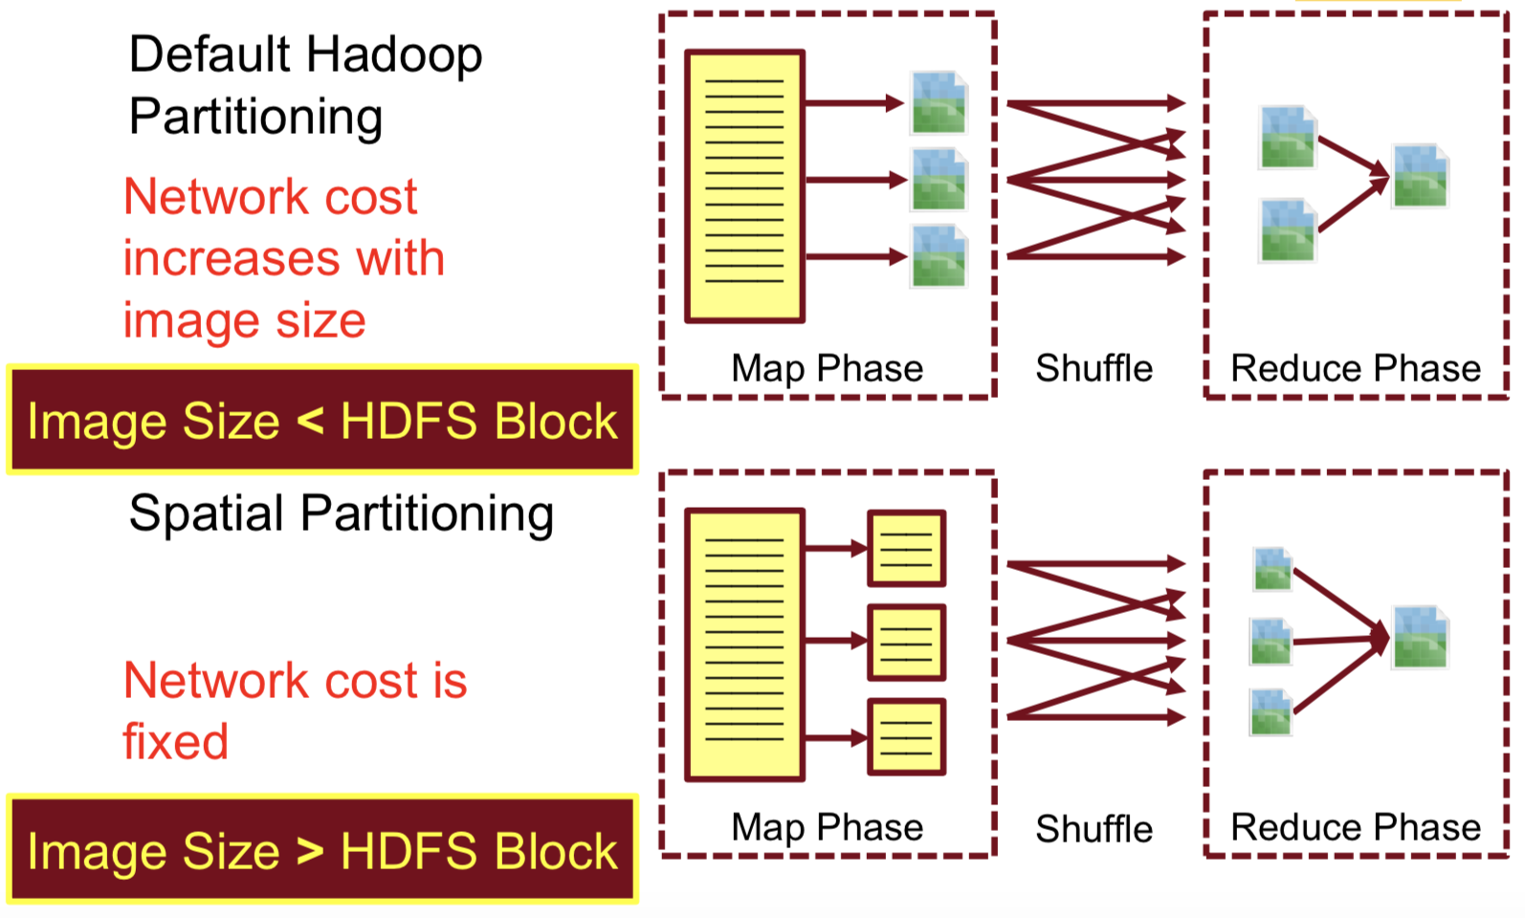
Single-Level Visualization
Default-Hadoop Partitioning VS Spatial Partitioning

Slide 18
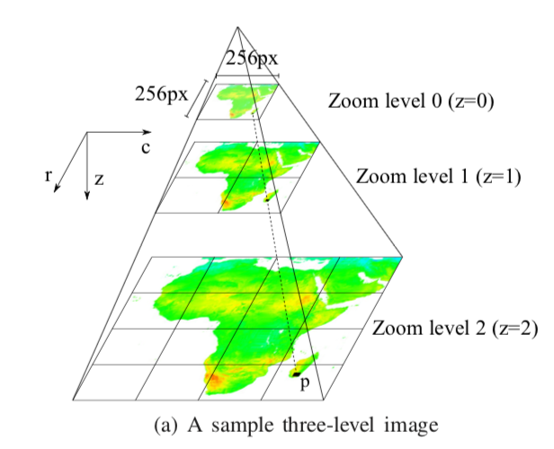
Multilevel Visualization
partition-plot-merge
Goal: Generate gigapixel multilevel images where users can zoom in/out to see more/less details in the generated image.
e.g. If z=10:
pixels at level 10 = 4¹⁰*(256*256)/2³⁰=64GB

Slide 19
Multilevel Visualization
Two algorithms that use this three phase approach
  Default-Hadoop Partitioning
  Coarse-grained Pyramid Partitioning

Slide 20
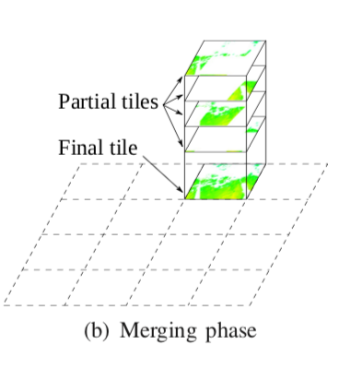
Multilevel Visualization
Default-Hadoop Partitioning
  partitioning: default HDFS 128MB
  plotting: Mapper plots each record in the assigned partition Pi to all overlapping tiles in the pyramid
  merging: Reducer merge partial pyramids into a final pyramid

Slide 21
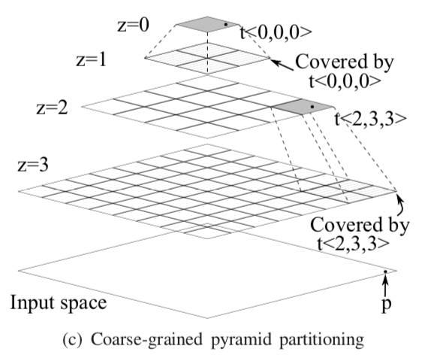
Multilevel Visualization
Coarse-grained Pyramid Partitioning
  partitioning: Mapper assigns
  each record p to select tiles, reduces overhead using k
  (create partitions for tiles only in levels that are multiples of k)
  plotting: Plot an image for each tile
  merging: Do nothing

Slide 22
Multilevel Visualization
Default-Hadoop Partitioning VS Coarse-grained Pyramid Partitioning
  Default-Hadoop Partitioning
    avoids the overhead of partitioning
    small pyramid size -> minimal plot & merge overhead
    generate the top levels
  Coarse-grained Pyramid Partitioning
    lowever plot and no merge overhead
    generate the remaining deeper levels

Slide 23
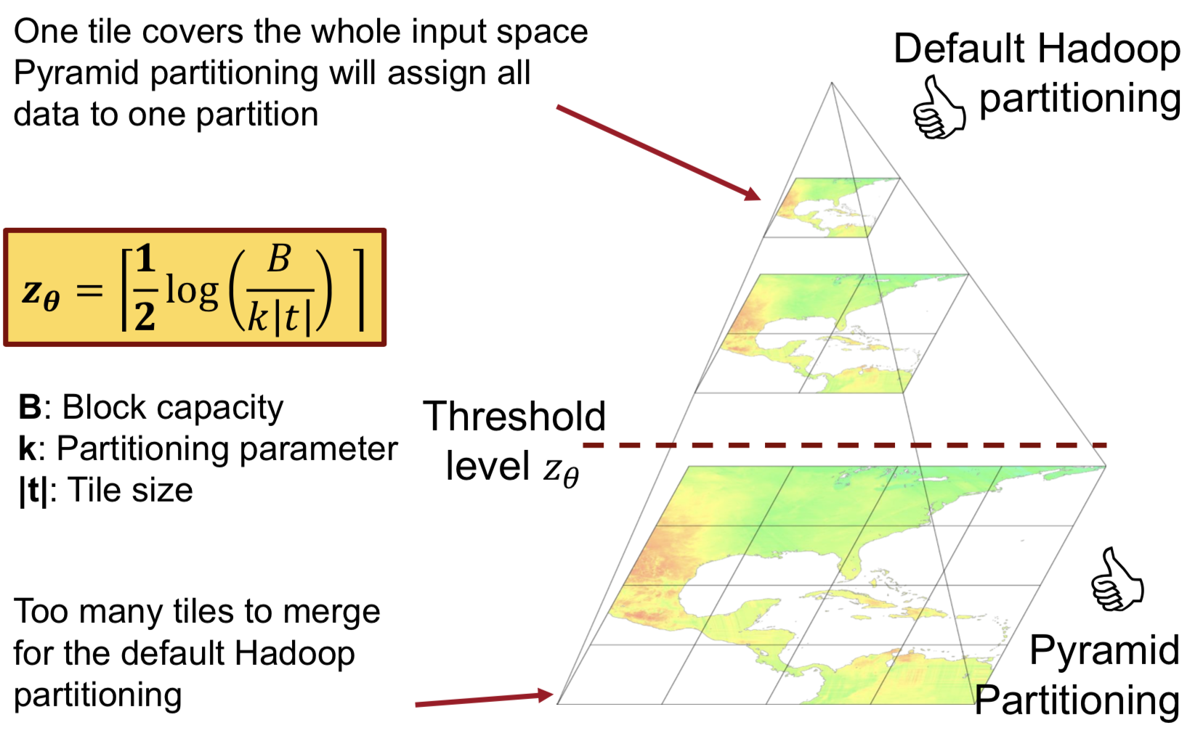
Multilevel Visualization
Default-Hadoop Partitioning VS Coarse-grained Pyramid Partitioning

Slide 24
Visualization Abstraction
HadoopViz is an extensible framework that supports a wide range of visualization for various image types.
User needs to define five abstract functions
  smooth
  create-canvas
  plot
  merge
  write

Slide 25
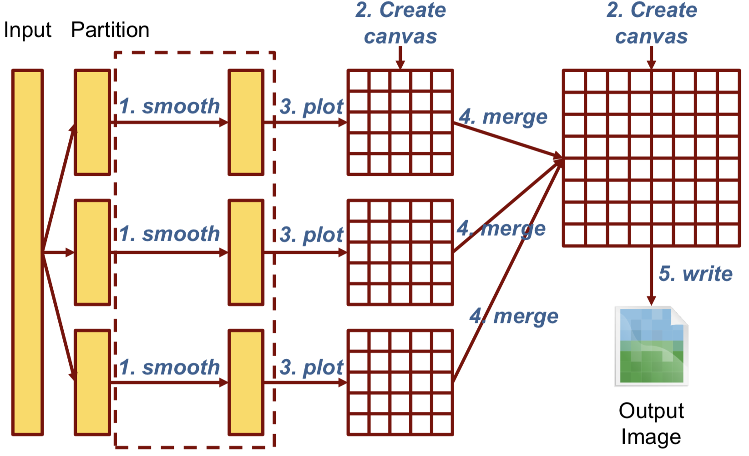
Visualization Abstraction
Overview

Slide 26
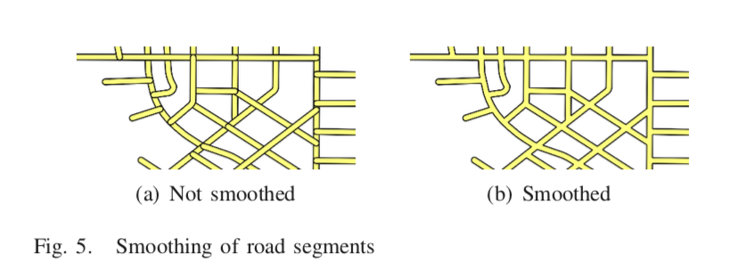
Visualization Abstraction
The Smooth abstract function
  optional
  HadoopViz tests for the existence of this function to decide whether to go for spatial or default partitioning
  e.g.

Slide 27
Visualization Abstraction
The Create-Canvas abstract function
  creates and initializes an in-memory data structure
  will be used to create the requested image
  is used in both the plotting and merging phases
The Plot abstract function
  the plotting phase calls this function for each record in the partition to draw the partial images
  can call any third party visualization package, e.g. VisIt and ImageMagick

Slide 28
Visualization Abstraction
The Merge abstract function
  The merging phase calls this function successively on a set of layers to merge them into one
The Write abstract function
  writes the final canvas to the output in a standard image format (e.g., PNG or SVG)

Slide 29
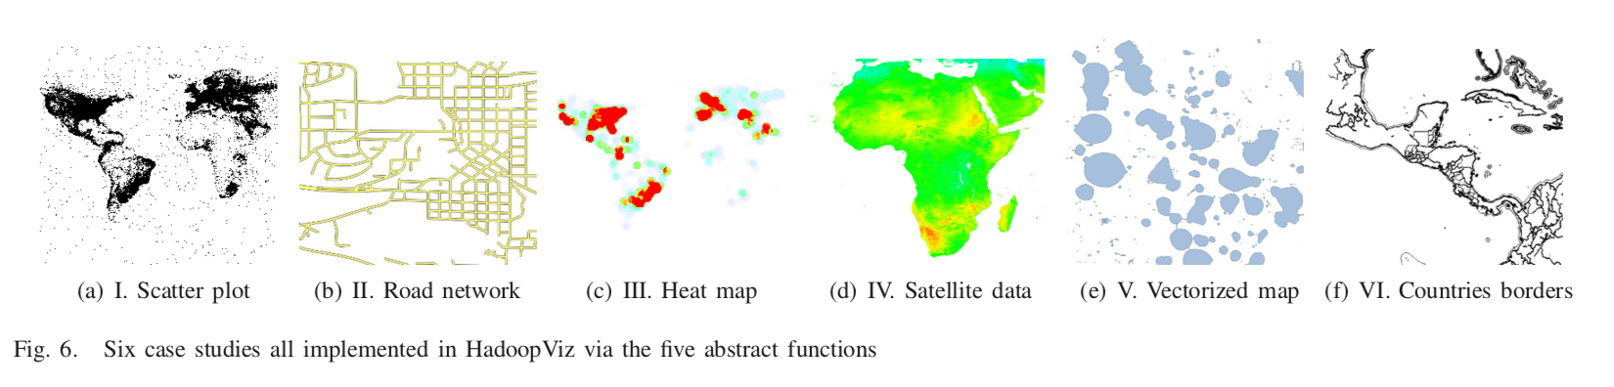
Case Studies
Six case studies
  case studies I and II: non-aggregate visualization, w/ & w/o smoothing
  case studies III and IV: aggregate-based visualization
  case study V: generating a vector image with a smoothing function
  case study VI: reuse and scale out an existing package(ImageMagick)

Slide 30
Experiements
Deployed on an Amazon EC2 cluster of 20 nodes
  Intel(R) Xeon E5472 processor with 4 cores @3 GHz
  8GB of memory
  250GB hard disk
Baseline is a single machine with 1TB RAM
Real datasets:
  OpenStreetMap(OSM): Up-to 1.7 billion points
  NASA: 14 billion points
Measure the end-to-end time for generating the image

Slide 31
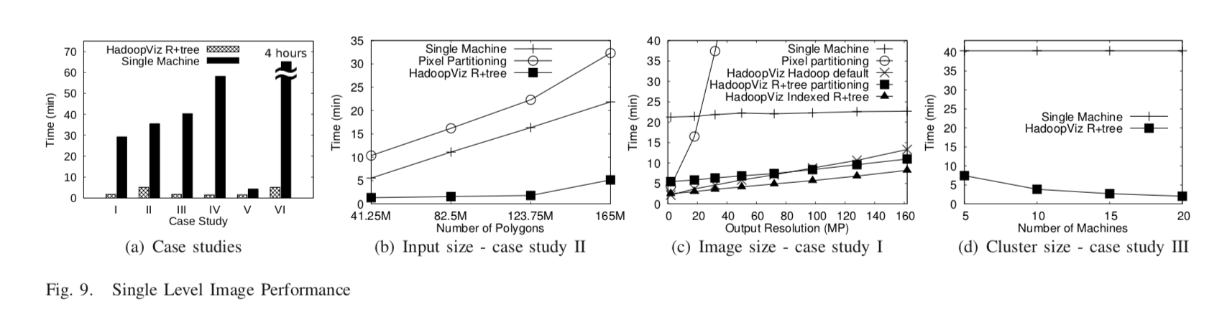
Experiements
Single-Level Visualization

Slide 32
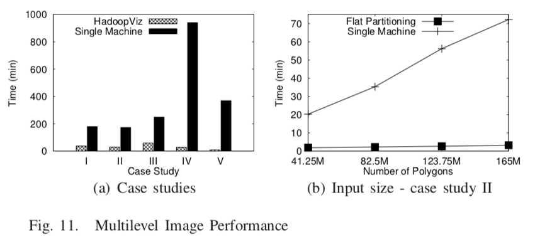
Experiements
Multilevel Visualization

Slide 33
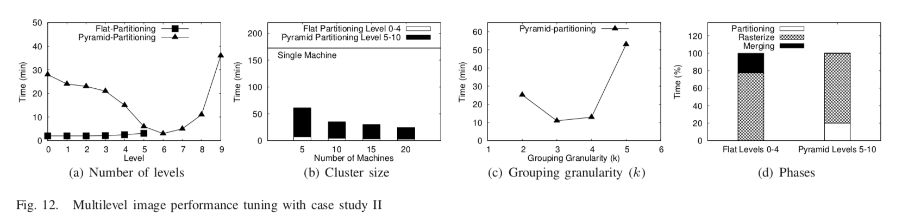
Experiements
Multilevel Visualization

Slide 34
Thanks & Question

Slide 35
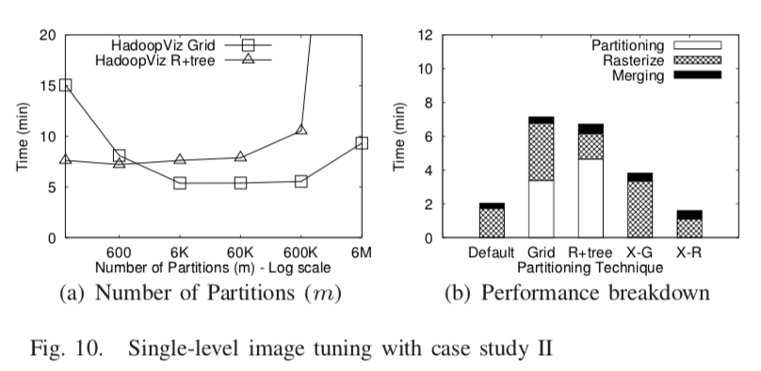
Experiements
Single-Level Visualization

Slide 36
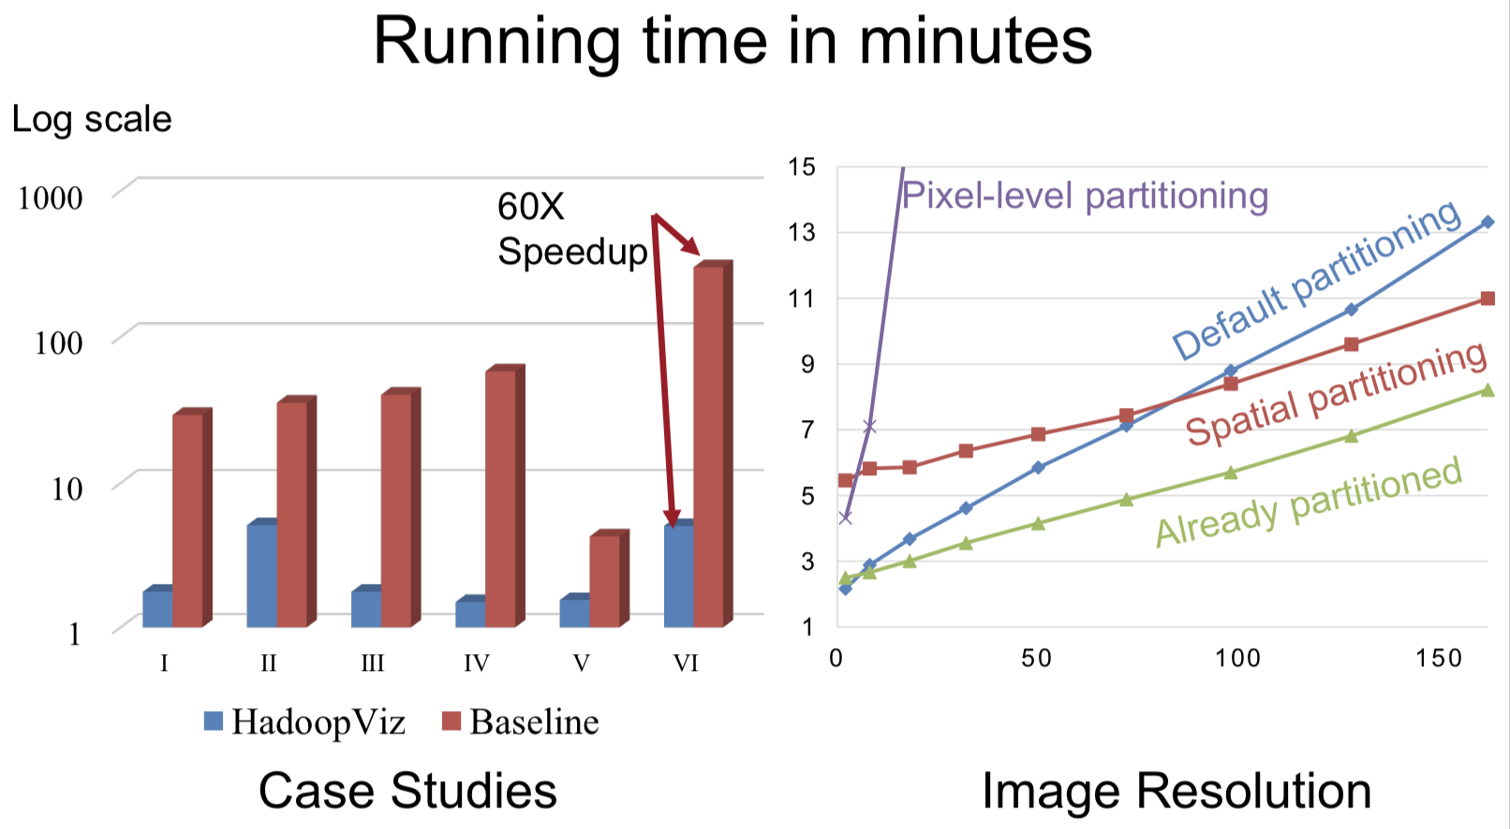
Experiements
Single-Level Visualization

Slide 37
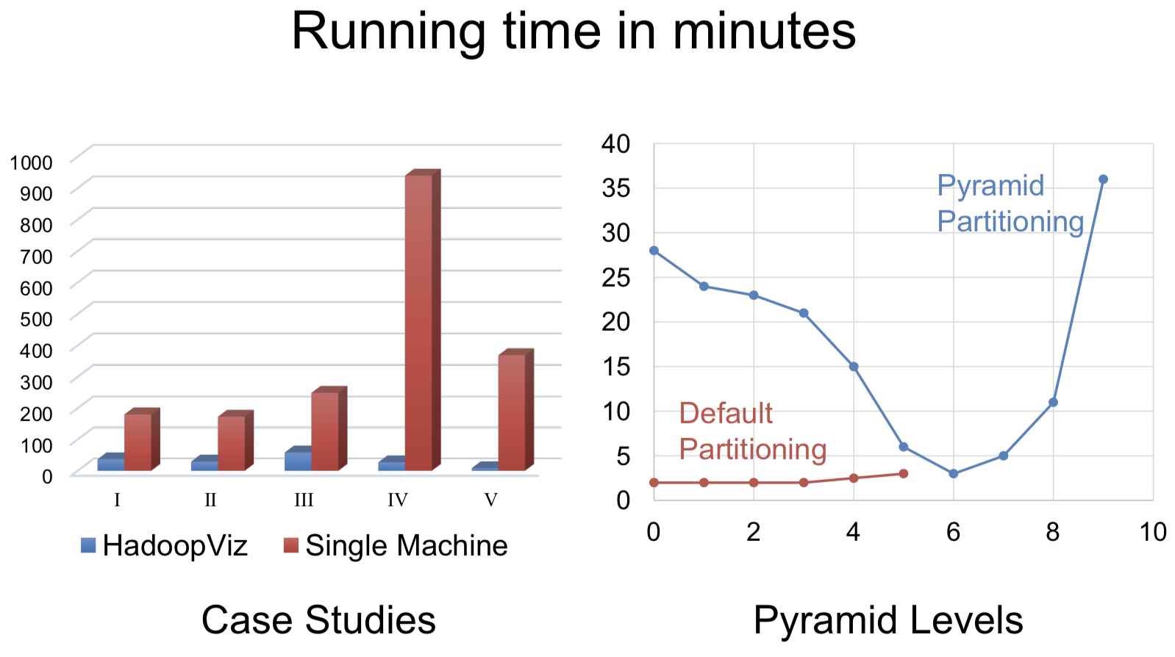
Experiements
Multilevel Visualization

Slide 38
Thanks & Question

