Slide 1

Spatial Data Mining

Slide 2
Outline
Motivation, Spatial Pattern Families
Spatial data types and relationships
Limitations of Traditional Statistics
Location Prediction model
Hotspots
Spatial outliers
Colocations and Co-occurrences
Summary: What is special about mining spatial data?

Slide 3
Why Data Mining?
Holy Grail - Informed Decision Making
Sensors & Databases increased rate of Data Collection
  Transactions, Web logs, GPS-track, Remote sensing, …
Challenges:
  Volume (data) >> number of human analysts
  Some automation needed
Approaches
  Database Querying, e.g., SQL3/OGIS
  Data Mining for Patterns
  …

Slide 4
Data Mining vs. Database Querying
Recall Database Querying (e.g., SQL3/OGIS)
  Can not answer questions about items not in the database!
    Ex. Predict tomorrow’s weather or credit-worthiness of a new customer
  Can not efficiently answer complex questions beyond joins
    Ex. What are natural groups of customers?
    Ex. Which subsets of items are bought together?
Data Mining may help with above questions!
  Prediction Models
  Clustering, Associations, …

Slide 5
Spatial Data Mining (SDM)
The process of discovering
  interesting, useful, non-trivial patterns
  from large spatial datasets
Spatial pattern families
  Hotspots, Spatial clusters
  Spatial outlier, discontinuities
  Co-locations, co-occurrences
  Location prediction models
  …

Slide 6
Application Domains
Spatial data mining is used in
  NASA Earth Observing System (EOS): Earth science data
  National Inst. of Justice: crime mapping
  Census Bureau, Dept. of Commerce: census data
  Dept. of Transportation (DOT): traffic data
  National Inst. of Health (NIH): cancer clusters
  Commerce, e.g. Retail Analysis

Slide 7
Application Domains
Sample Global Questions from Earth Science
  How is the global Earth system changing
  What are the primary forcing of the Earth system
  How does the Earth system respond to natural and human included changes
  What are the consequences of changes in the Earth system for human civilization
  How well can we predict future changes in the Earth system

Slide 8
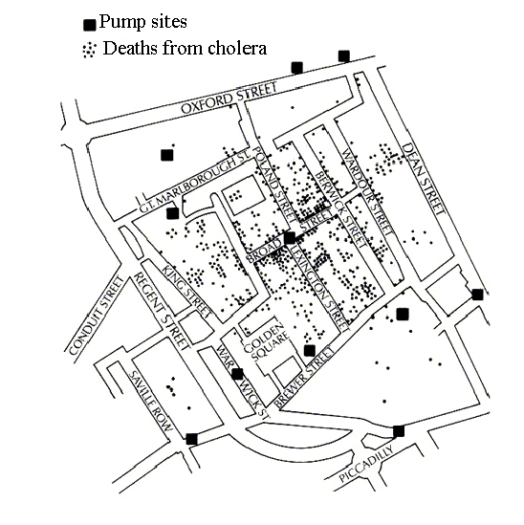

Pattern Family 1: Hotspots, Spatial Cluster
The 1854 Asiatic Cholera in London
  Near Broad St. water pump except a brewery

Slide 9
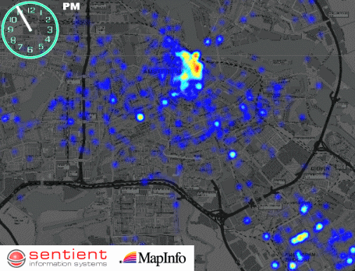
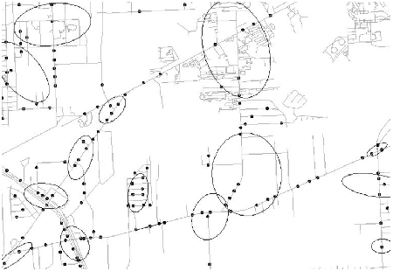
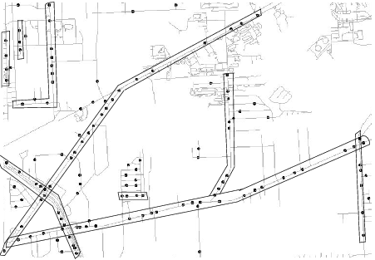
Complicated Hotspots
Complication Dimensions
  Time
  Spatial Networks
Challenges: Trade-off b/w
  Semantic richness and
  Scalable algorithms

Slide 10
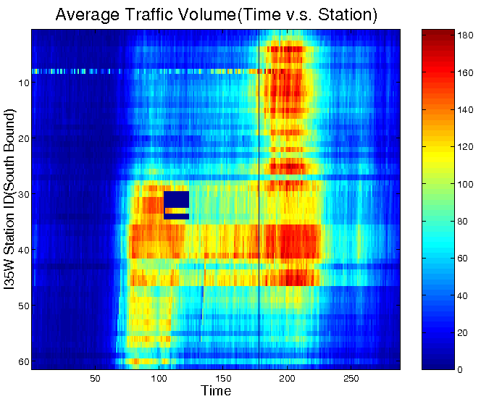
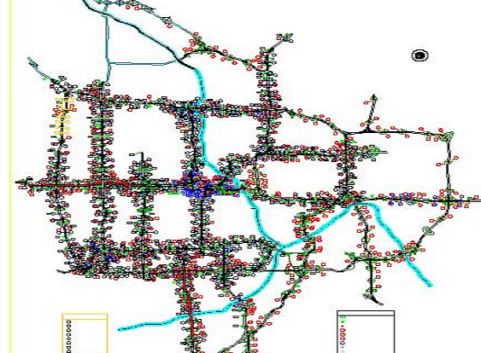
Pattern Family 2: Spatial Outliers
Spatial Outliers, Anomalies, Discontinuities
  Traffic Data in Twin Cities
  Abnormal Sensor Detections
  Spatial and Temporal Outliers
Source: A Unified Approach to Detecting Spatial Outliers, GeoInformatica, 7(2), Springer, June 2003.
(A Summary in Proc. ACM SIGKDD 2001) with C.-T. Lu, P. Zhang.

Slide 11
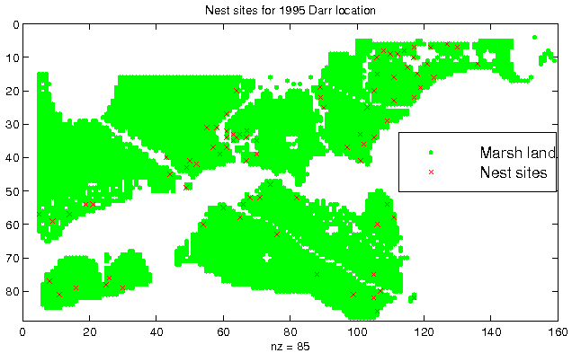
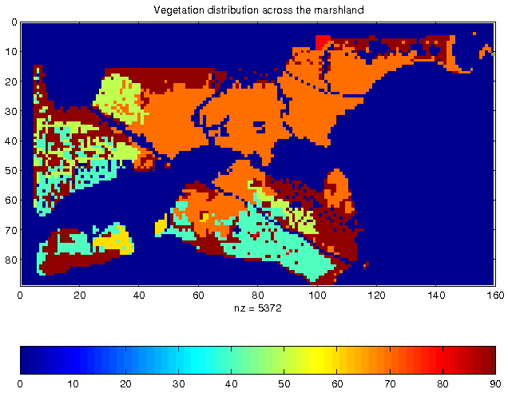
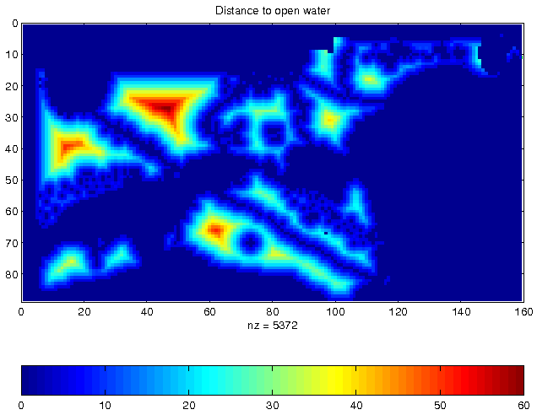
Pattern Family 3: Predictive Models
Location Prediction:
  Predict Bird Habitat Prediction
  Using environmental variables

Slide 12
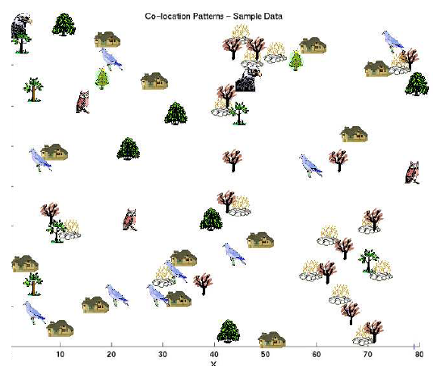

Family 4: Co-locations/Co-occurrence
Given: A collection of different types of spatial events
Find: Co-located subsets of event types
Source: Discovering Spatial Co-location Patterns: A General Approach, IEEE Transactions
on Knowledge and Data Eng., 16(12), December 2004 (w/ H.Yan, H.Xiong).

Slide 13
What’s NOT Spatial Data Mining (SDM)
Simple Querying of Spatial Data
  Find neighbors of Canada, or shortest path from Boston to Houston
Testing a hypothesis via a primary data analysis
  Ex. Is cancer rate inside Hinkley, CA higher than outside ?
  SDM: Which places have significantly higher cancer rates?
Uninteresting, obvious or well-known patterns
  Ex. (Warmer winter in St. Paul, MN) => (warmer winter in Minneapolis, MN)
  SDM: (Pacific warming, e.g. El Nino) => (warmer winter in Minneapolis, MN)
Non-spatial data or pattern
  Ex. Diaper and beer sales are correlated
  SDM: Diaper and beer sales are correlated in blue-collar areas (weekday evening)

Slide 14
Outline
Motivation, Spatial Pattern Families
Spatial data types and relationships
Limitations of Traditional Statistics
Location Prediction model
Hotspots
Spatial outliers
Colocations and Co-occurrences
Summary: What is special about mining spatial data?

Slide 15
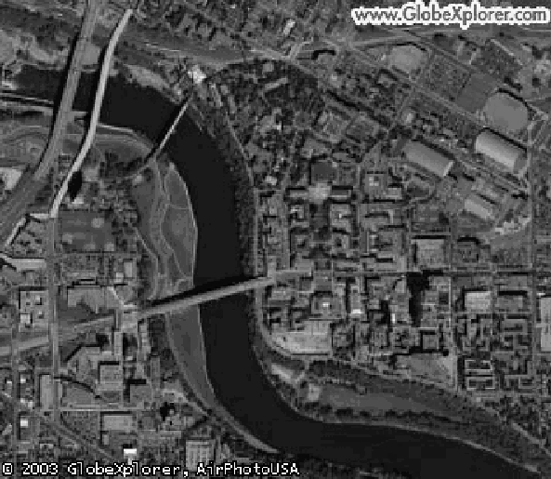
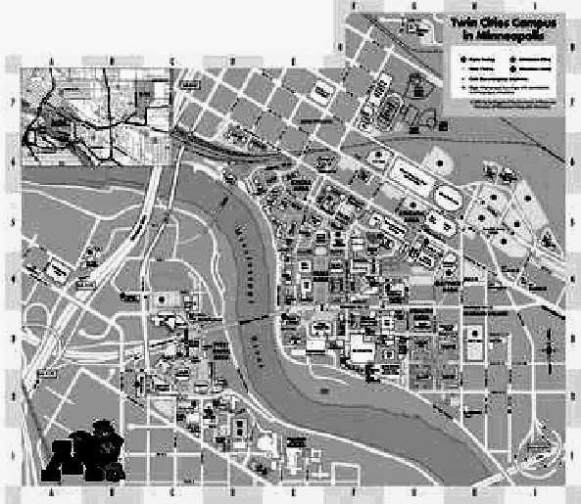
Data-Types: Non-Spatial vs. Spatial
Non-spatial
  Numbers, text-string, …
  e.g., city name, population
Spatial (Geographically referenced)
  Location, e.g., longitude, latitude, elevation
  Neighborhood and extent
Spatial Data-types
  Raster: gridded space
  Vector: point, line, polygon, …
  Graph: node, edge, path
Raster (Courtesy: UMN)
Vector (Courtesy: MapQuest)

Slide 16
Relationships: Non-spatial vs. Spatial
Non-spatial Relationships
  Explicitly stored in a database
  Ex. New Delhi is the capital of India
Spatial Relationships
  Implicit, computed on demand
  Topological: meet, within, overlap, …
  Directional: North, NE, left, above, behind, …
  Metric: distance, area, perimeter
  Focal: slope
  Zonal: highest point in a country
  …

Slide 17
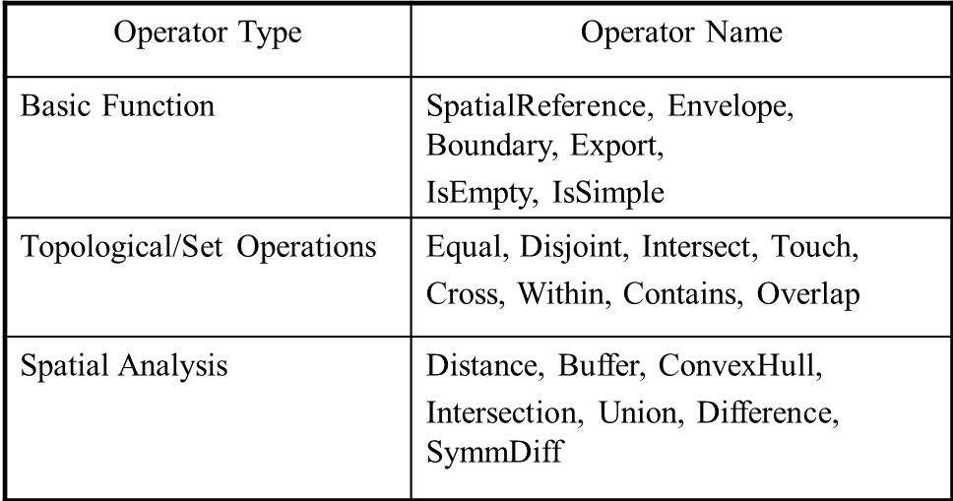
OGC Simple Features
Open GIS Consortium: Simple Feature Types
  Vector data types: e.g. point, line, polygons
  Spatial operations :
Examples of Operations in OGC Model

Slide 18
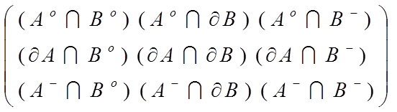
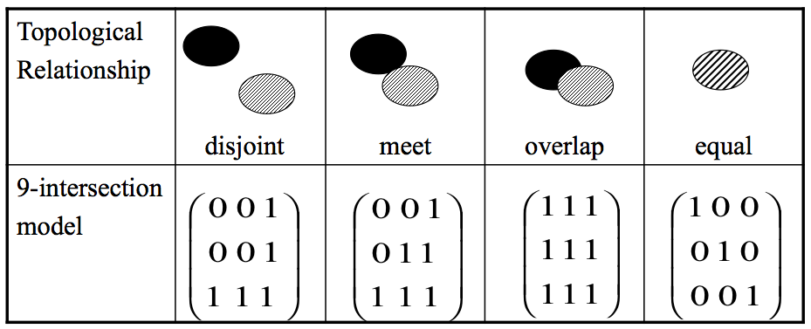
OGIS – Topological Operations
Interior(B)
Boundary(B)
Exterior(B)
Topology: 9-intersections
  interior
  boundary
  exterior
Interior(A)
Boundary(A)
Exterior(A)

Slide 19
Research Needs for Data
Limitations of OGC Model
  Direction predicates - e.g. absolute, ego-centric
  3D and visibility, Network analysis, Raster operations
  Spatio-temporal
Needs for New Standards & Research
  Modeling richer spatial properties listed above
  Spatio-temporal data, e.g., moving objects

Slide 20
Outline
Motivation, Spatial Pattern Families
Spatial data types and relationships
Limitations of Traditional Statistics
Location Prediction model
Hotspots
Spatial outliers
Colocations and Co-occurrences
Summary: What is special about mining spatial data?

Slide 21
Limitations of Traditional Statistics
Classical Statistics
  Data samples: independent and identically distributed (i.i.d)
  Simplifies mathematics underlying statistical methods, e.g., Linear Regression
Spatial data samples are not independent
  Spatial Autocorrelation metrics
    distance-based (e.g., K-function), neighbor-based (e.g., Moran’s I)
  Spatial Cross-Correlation metrics
Spatial Heterogeneity
  Spatial data samples may not be identically distributed!
  No two places on Earth are exactly alike!
…

Slide 22
Spatial Statistics: An Overview
  Point process
  Discrete points, e.g., locations of trees, accidents, crimes, …
  Complete spatial randomness (CSR): Poisson process in space
  K-function: test of CSR
Geostatistics
  Continuous phenomena, e.g., rainfall, snow depth, …
  Methods: Variogram measure how similarity decreases with distance
  Spatial interpolation, e.g., Kriging
Lattice-based statistics
  Polygonal aggregate data, e.g., census, disease rates, pixels in a raster
  Spatial Gaussian models, Markov Random Fields, Spatial Autoregressive Model

Slide 23
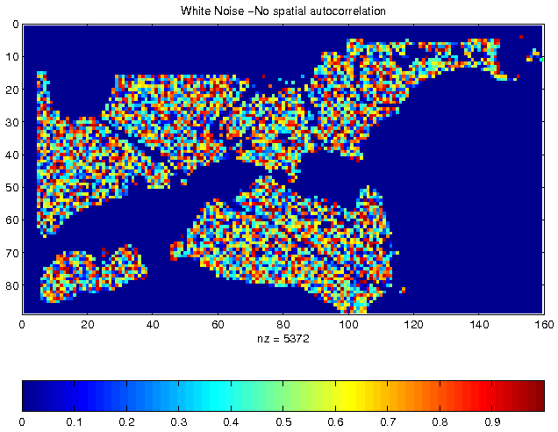
Spatial Autocorrelation (SA)
  First Law of Geography
  All things are related, but nearby things are more related than distant things. [Tobler70]
  Spatial autocorrelation
  Traditional i.i.d. assumption is not valid
  Measures: K-function, Moran’s I, Variogram, …
Independent, Identically Distributed pixel property
Vegetation Durability with SA

Slide 24
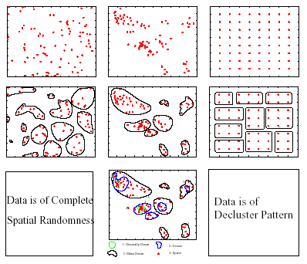
Spatial Autocorrelation: K-Function
CSR
Clustered
De-clustered

Slide 25
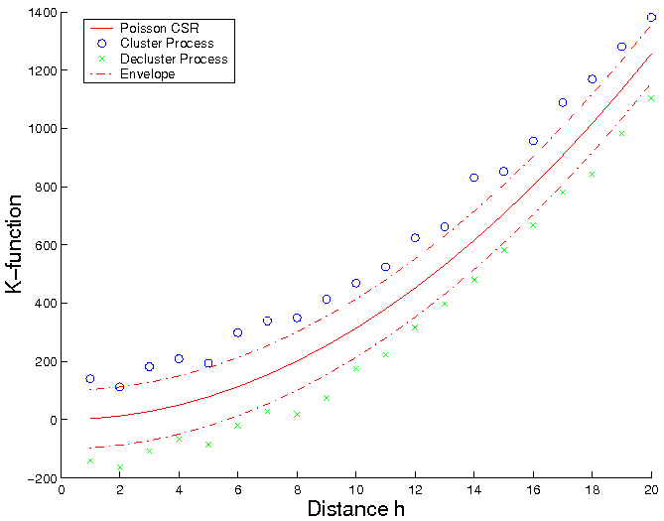
Spatial Autocorrelation: K-Function
  Purpose: Compare a point dataset with a complete spatial random (CSR) data
  Input: A set of points
  where λ is intensity of event
Interpretation: Compare k(h, data) with K(h, CSR)
  K(h, data) = k(h, CSR): Points are CSR
      > means Points are clustered
      < means Points are de-clustered
[number of events within distance h of an arbitrary event]
CSR
Clustered
De-clustered

Slide 26
Cross-Correlation
  Cross K-Function Definition
  Cross K-function of some pair of spatial feature types
  Example
    Which pairs are frequently co-located
    Statistical significance
[number of type j event within distance h
of a randomly chosen type i event]

Slide 27
Recall Pattern Family 4: Co-locations
Given: A collection of different types of spatial events
Find: Co-located subsets of event types
Source: Discovering Spatial Co-location Patterns: A General Approach, IEEE Transactions
on Knowledge and Data Eng., 16(12), December 2004 (w/ H.Yan, H.Xiong).

Slide 28
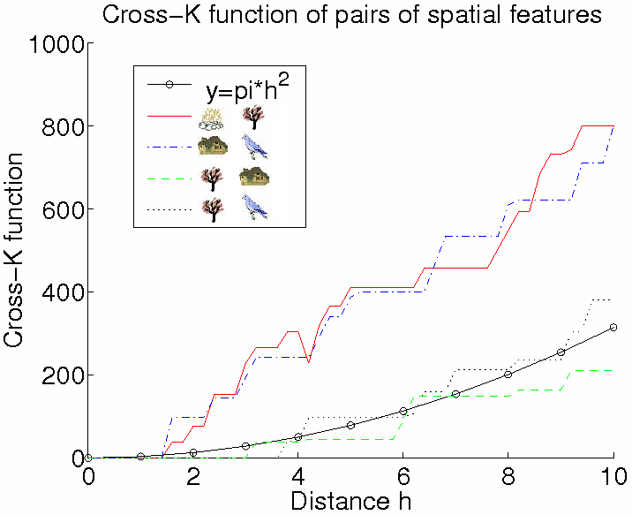
Illustration of Cross-Correlation
  Illustration of Cross K-function for Example Data
Cross-K Function for Example Data

Slide 30
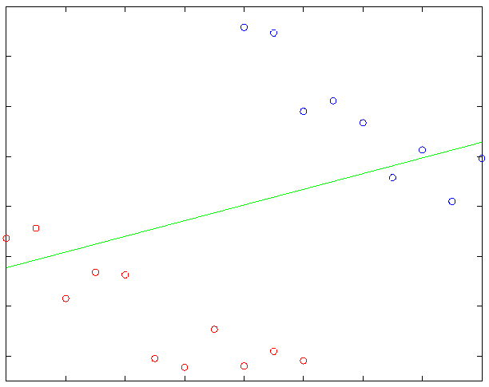
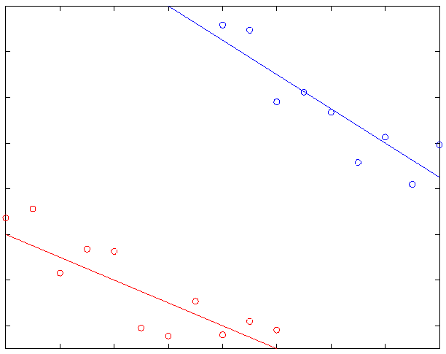
Spatial Heterogeneity
  “Second law of geography” [M. Goodchild, UCGIS 2003]
  Global model might be inconsistent with regional models
  Spatial Simpson’s Paradox
  May improve the effectiveness of SDM, show support regions of a pattern

Slide 31
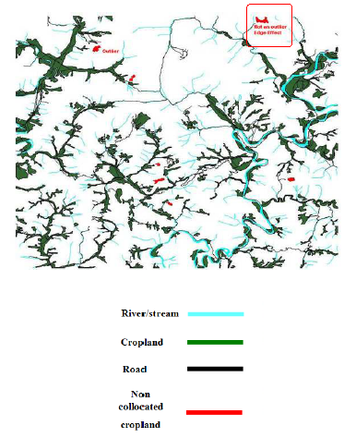
Edge Effect
  Cropland on edges may not be classified as outliers
  No concept of spatial edges in classical data mining
Korea Dataset, Courtesy: Architecture Technology Corporation

Slide 32
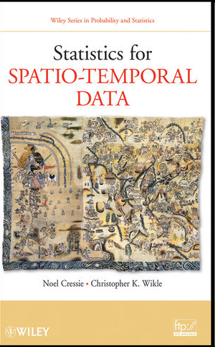
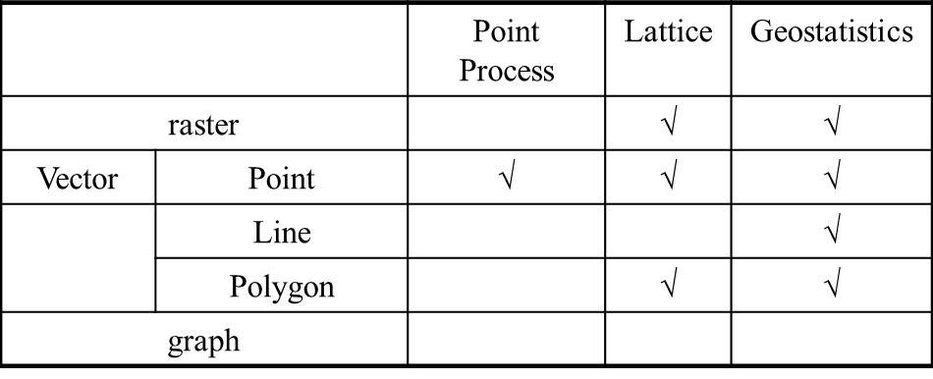

Research Challenges of Spatial Statistics
  State-of-the-art of Spatial Statistics
Data Types and Statistical Models
  Research Needs
  Correlating extended features, road, rivers, cropland
  Spatio-temporal statistics
  Spatial graphs, e.g., reports with street address

Slide 33
Outline
Motivation, Spatial Pattern Families
Spatial data types and relationships
Limitations of Traditional Statistics
Location Prediction model
Hotspots
Spatial outliers
Colocations and Co-occurrences
Summary: What is special about mining spatial data?

Slide 34
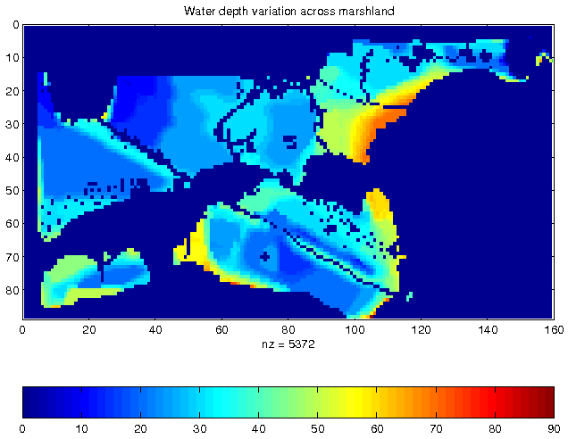
Illustration of Location Prediction Problem
Nest Locations
Vegetation Index
Water Depth
Distance to Open Water

Slide 35
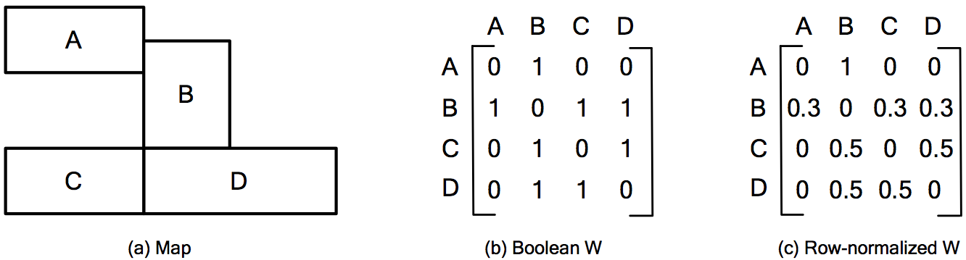
Neighbor Relationship: W Matrix

Slide 36
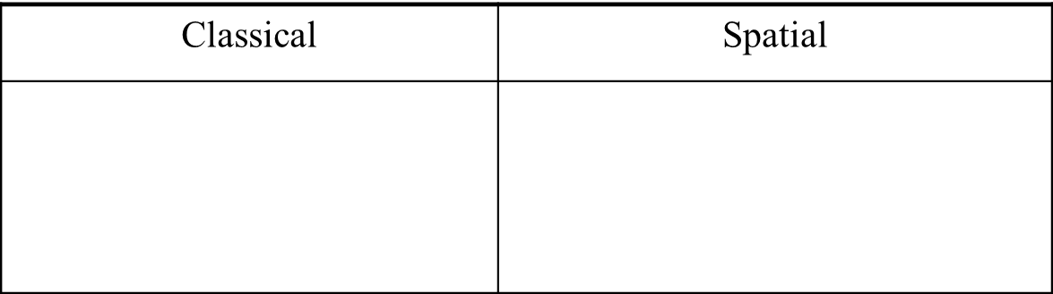
Location Prediction Models
  Traditional Models, e.g., Regression (with Logit or Probit),
    Bayes Classifier, …
Spatial Models
  Spatial autoregressive model (SAR)
  Markov random field (MRF) based Bayesian Classifier

Slide 37
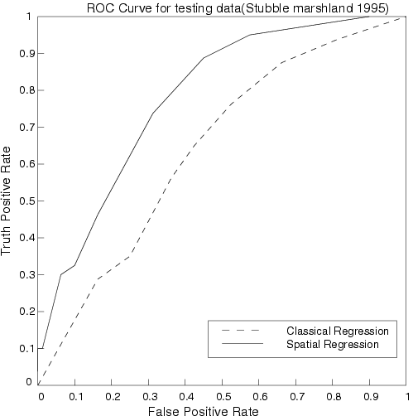
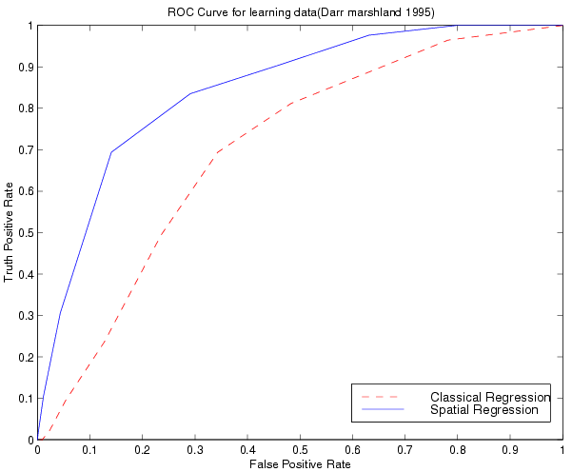
Comparing Traditional and Spatial Models
  Dataset: Bird Nest prediction
  Linear Regression
    Lower prediction accuracy, coefficient of determination,
    Residual error with spatial auto-correlation
  Spatial Auto-regression outperformed linear regression
ROC Curve
for learning
ROC Curve
for testing

Slide 38
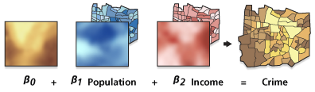
Modeling Spatial Heterogeneity: GWR
  Geographically Weighted Regression (GWR)
  Goal: Model spatially varying relationships
  Example:
  Where are location dependent
Source: resources.arcgis.com

Slide 39
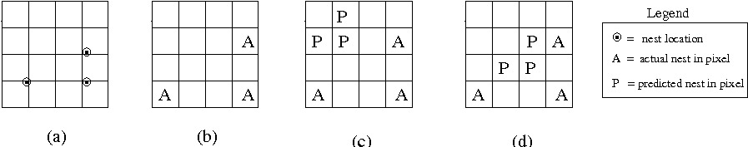
Research Needs for Location Prediction
Spatial Auto-Regression
  Estimate W
  Scaling issue
Spatial interest measure
  e.g., distance(actual, predicted)
Actual Sites
Pixels with
actual sites
Prediction 1
Prediction 2.
Spatially more interesting
than Prediction 1

Slide 40
Outline
Motivation, Spatial Pattern Families
Spatial data types and relationships
Limitations of Traditional Statistics
Location Prediction model
Hotspots
Spatial outliers
Colocations and Co-occurrences
Summary: What is special about mining spatial data?

Slide 41
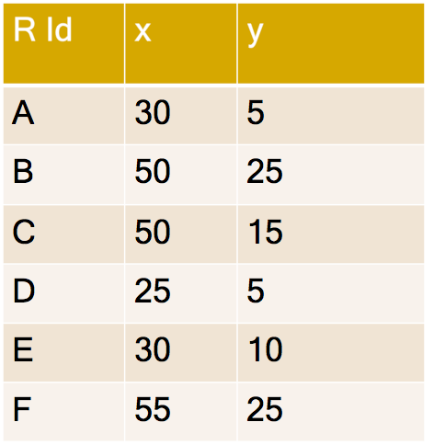
Clustering Question
  Question: What are natural groups of points?

Slide 42
Maps Reveal Spatial Groups
  Map shows 2 spatial groups!
B
F
20
C
y
10
E
D
A
30
40
50
x

Slide 43
K-Means Algorithm
  1. Start with random seeds
K = 2
B
F
20
Seed
C
Seed
y
10
E
D
A
30
40
50
x

Slide 44
K-Means Algorithm
B
F
  2. Assign points to closest seed
20
K = 2
Seed
C
y
10
E
Seed
D
A
30
40
50
x
B
F
20
C
y
10
E
D
A
30
40
50
x

Slide 45
K-Means Algorithm
  3. Revise seeds to group centers
K = 2
Revised seeds
B
F
20
C
y
10
E
D
A
30
40
50
x

Slide 46
K-Means Algorithm
B
F
  2. Assign points to closest seed
20
K = 2
C
Colors show
closest Seed
y
10
E
D
A
30
40
50
x
Revised seeds
B
F
20
C
y
10
E
D
A
30
40
50
x

Slide 47
K-Means Algorithm
B
  3. Revise seeds to group centers
F
20
K = 2
C
y
10
E
Colors show
closest Seed
D
A
30
40
50
x
B
F
20
Revised seeds
C
y
10
E
D
A
30
40
50
x

Slide 48
K-Means Algorithm
  If seeds changed then loop back to
  Step 2. Assign points to closest seed
K = 2
B
F
20
Colors show
closest Seed
C
y
10
E
D
A
30
40
50
x

Slide 49
K-Means Algorithm
B
F
  3. Revise seeds to group centers
20
K = 2
C
Termination
y
10
E
D
A
30
40
50
x
B
F
20
Colors show
closest Seed
C
y
10
E
D
A
30
40
50
x

Slide 50
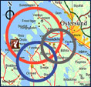
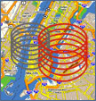

Limitations of K-Means
  K-Means does not test Statistical Significance
    Finds chance clusters in complete spatial randomness (CSR)
Classical
Clustering
Spatial
Clustering

Slide 51
Spatial Scan Statistics (SatScan)
  Goal: Omit chance clusters
  Ideas: Likelihood Ratio, Statistical Significance
  Steps
    Enumerate candidate zones & choose zone X with highest likelihood ratio (LR)
      LR(X) = p(H1|data) / p(H0|data)
      H0: points in zone X show complete spatial randomness (CSR)
      H1: points in zone X are clustered
    If LR(Z) >> 1 then test statistical significance
      Check how often is LR( CSR ) > LR(Z)
        using 1000 Monte Carlo simulations

Slide 52
SatScan Examples
Test 1: Complete Spatial Randomness
SatScan Output: No hotspots !
Highest LR circle is a chance cluster!
p-value = 0.128
Test 2: Data with a hotspot
SatScan Output: One significant hotspot!
p-value = 0.001

Slide 53
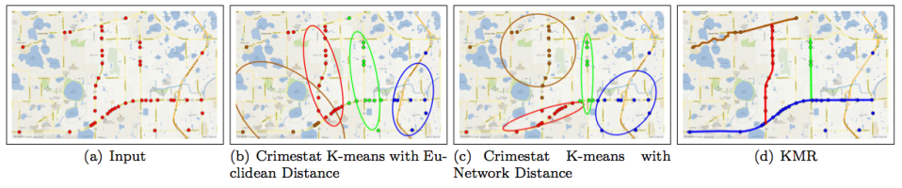
Spatial-Concept/Theory-Aware Clusters
  Spatial Theories, e.g,, environmental criminology
    Circles ➔ Doughnut holes
  Geographic features, e.g., rivers, streams, roads, …
    Hot-spots => Hot Geographic-features
Source: A K-Main Routes Approach to Spatial Network Activity Summarization, to appear in IEEE
Transactions on Knowledge and Data Eng. (www.computer.org/csdl/trans/tk/preprint/06574853-abs.html)

Slide 54
Quiz
Which of the following is false?
a) SatScan computes likelihood ratio and tests statistical
significance to eliminate many chance clusters
b) Monte Carlo simulation may help estimate statistical
significance
c) K-means is able to omit chance clusters
d) K-means finds clusters even in data representing complete
spatial randomness

Slide 55
Outline
Motivation, Spatial Pattern Families
Spatial data types and relationships
Limitations of Traditional Statistics
Location Prediction model
Hotspots
Spatial outliers
Colocations and Co-occurrences
Summary: What is special about mining spatial data?

Slide 56
Learning Objectives
After this segment, students will be able to
  Contrast global & spatial outliers
  List spatial outlier detection tests

Slide 57
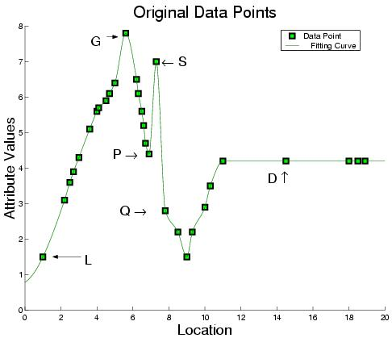
Outliers: Global (G) vs. Spatial (S)

Slide 58
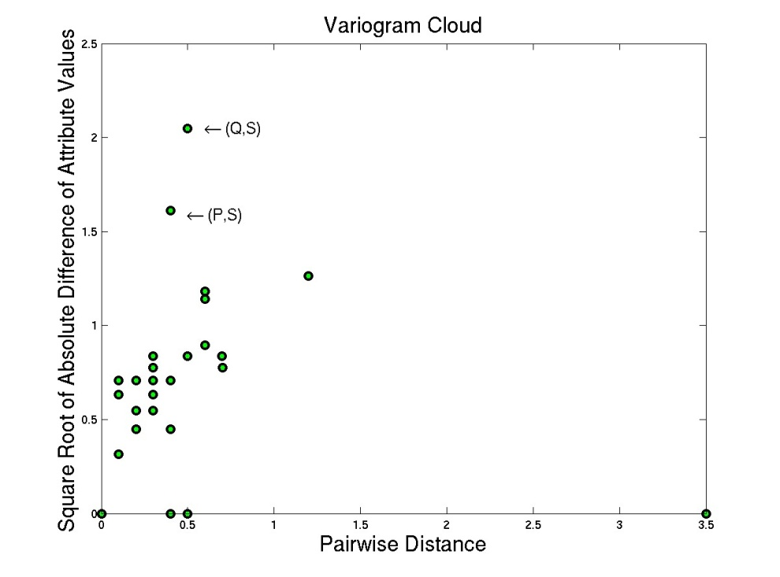
Outlier Detection Tests: Variogram Cloud
  Graphical Test: Variogram Cloud

Slide 59
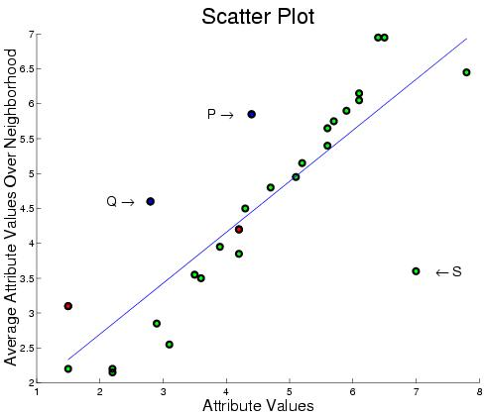
Outlier Detection – Scatterplot
  Quantitative Tests: Scatter Plot

Slide 60
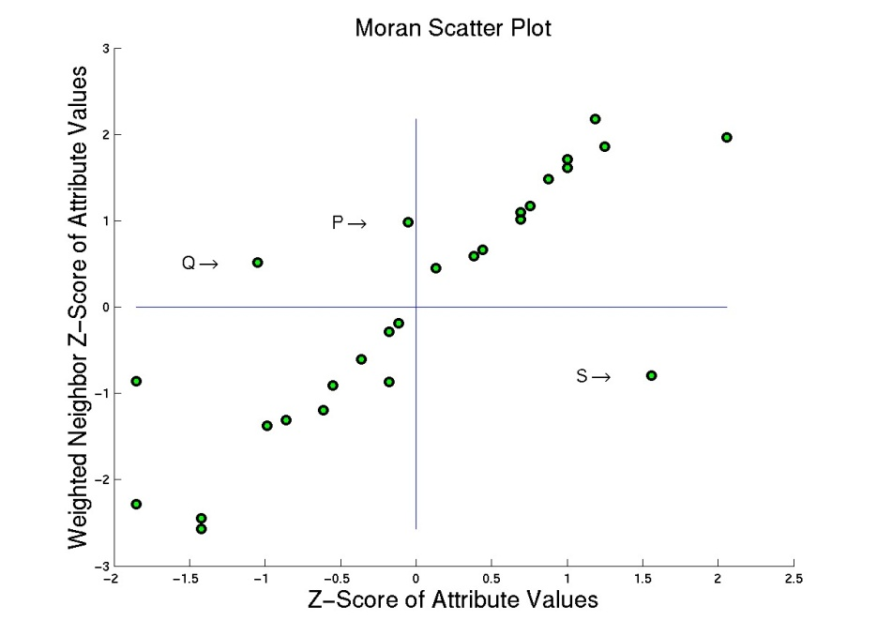
Outlier Detection Test: Moran Scatterplot
  Graphical Test: Moran Scatter Plot

Slide 61
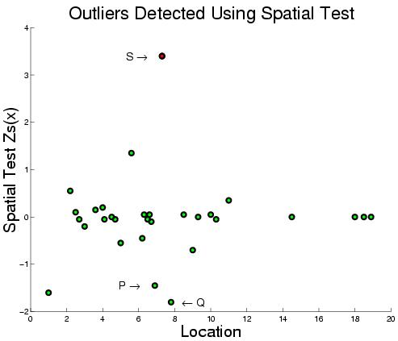
Outlier Detection Tests: Spatial Z-test
  Quantitative Tests: Spatial Z-test
    Algorithmic Structure: Spatial Join on neighbor relation

Slide 62
Spatial Outlier Detection: Computation
  Separate two phases
    Model Building
    Testing: test a node (or a set of nodes)
  Computation Structure of Model Building
    Key insights:
      Spatial self join using N(x) relationship
      Algebraic aggregate function computed in one scan of spatial join

Slide 63
Trends in Spatial Outlier Detection
  Multiple spatial outlier detection
    Eliminating the influence of neighboring outliers
  Multi-attribute spatial outlier detection
    Use multiple attributes as features
  Scale up for large data

Slide 64
Quiz
Which of the following is false about spatial outliers?
a) Oasis (isolated area of vegetation) is a spatial outlier area in a desert
b) They may detect discontinuities and abrupt changes
c) They are significantly different from their spatial neighbors
d) They are significantly different from entire population

Slide 65
Outline
Motivation, Spatial Pattern Families
Spatial data types and relationships
Limitations of Traditional Statistics
Location Prediction model
Hotspots
Spatial outliers
Colocations and Co-occurrences
Summary: What is special about mining spatial data?

Slide 66
Learning Objectives
After this segment, students will be able to
  Contrast colocations and associations
  Describe colocation interest measures

Slide 67
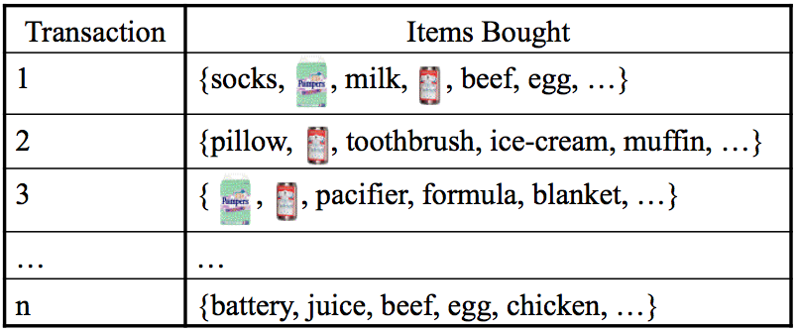
Background: Association Rules
  Association rule e.g. (Diaper in T => Beer in T)
    Support: probability (Diaper and Beer in T) = 2/5
    Confidence: probability (Beer in T | Diaper in T) = 2/2
  Apriori Algorithm
    Support based pruning using monotonicity

Slide 68
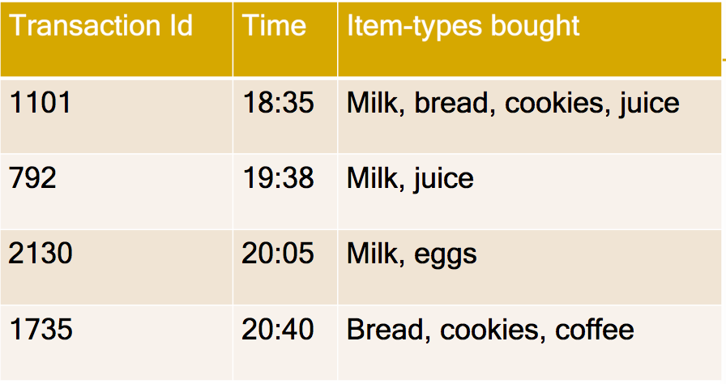
Apriori Algorithm
How to eliminate infrequent item-sets as soon as possible?
Support threshold >= 0.5

Slide 69
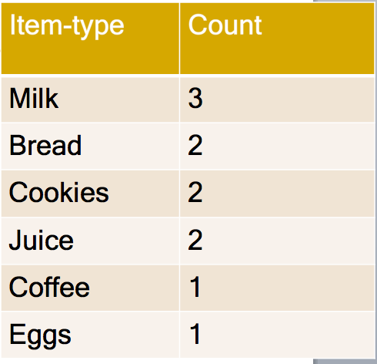
Apriori Algorithm
Eliminate infrequent singleton sets
Support threshold >= 0.5
Milk
Bread
Cookies
Juice
Coffee
Eggs

Slide 70
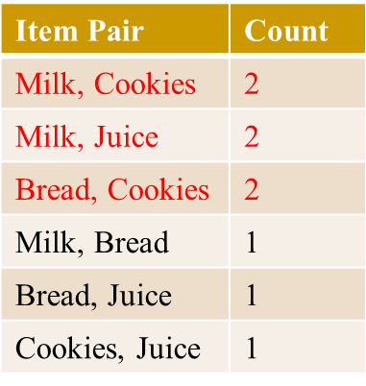
Apriori Algorithm
Make pairs from frequent items & prune infrequent pairs!
Support threshold >= 0.5
MB
MC
MJ
BC
BJ
CJ
Milk
Bread
Cookies
Juice
Coffee
Eggs
81

Slide 71
Apriori Algorithm
Make triples from frequent pairs & Prune infrequent triples!
1
Support threshold >= 0.5
MBCJ
No triples generated
Due to Monotonicity!
Apriori algorithm
examined only
12 subsets
instead of 64!
MBC
MBJ
MCJ
BCJ
MB
MC
MJ
BC
BJ
CJ
Milk
Bread
Cookies
Juice
Coffee
Eggs

Slide 72
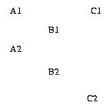
Association Rules Limitations
  Transaction is a core concept!
    Support is defined using transactions
    Apriori algorithm uses transaction based Support for pruning
  However, spatial data is embedded in continuous space
    Transactionizing continuous space is non-trivial !

Slide 73
Limitations of Traditional Statistics: An Example
R1
Y1
R1
Y1
Y1
R1
Type R
B1
B1
R2
B1
Type Y
B2
R2
Y2
R2
Y2
Type B
R3
B2
Y2
R3
B2
R3
(a) A map of 3 types
(b) Boundary fragmentation
(c) Neighbor graph
 | Pearson’s correlation coefficient | Support | Ripley’s cross-K | Participation Index
R - B | -0.90 | 0 | 0.33 | 0.5
Y - B | 1 | 0.5 | 0.5 | 1

Slide 74
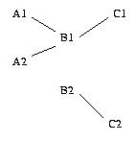
Spatial Association vs. Cross-K Function
  Spatial Association Rule (Han 95)
  Output = (B,C) with threshold 0.5
  Transactions by Reference feature, e.g. C
  Transactions: (C1, B1), (C2, B2)
  Support (A,B) = Ǿ
  Support(B,C)=2 / 2 = 1
  Cross-K Function
    Cross-K (A, B) = 2/4 = 0.5
    Cross-K(B, C) = 2/4 = 0.5
    Cross-K(A, C) = 0
Input = Feature A,B, and, C, & instances A1, A2, B1, B2, C1, C2
  Output = (A,B), (B, C) with threshold 0.5

Slide 75
Spatial Colocation
Features: A. B. C
Feature Instances: A1, A2, B1, B2, C1, C2
Feature Subsets: (A,B), (A,C), (B,C), (A,B,C)
Participation ratio (pr):
pr(A, (A,B)) = fraction of A instances neighboring feature {B} = 2/2 = 1
pr(B, (A,B)) = ½ = 0.5
Participation index (A,B) = pi(A,B) = min{ pr(A, (A,B)), pr(B, (A,B)) } = min (1, ½ ) = 0.5
pi(B, C) = min{ pr(B, (B,C)), pr(C, (B,C)) } = min (1,1) = 1
Participation Index Properties:
(1) Computational: Non-monotonically decreasing like support measure
(2) Statistical: Upper bound on Ripley’s Cross-K function

Slide 76
Participation Index >= Cross-K Function
B.1
A.1
B.1
A.1
B.1
A.1
A.3
A.3
A.3
B.2
A.2
B.2
A.2
B.2
A.2
Cross-K (A,B) | 2/6 = 0.33 | 3/6 = 0.5 | 6/6 = 1
PI (A,B) | 2/3 = 0.66 | 1 | 1

Slide 77
Association Vs. Colocation
 | Associations | Colocations
underlying space | Discrete market baskets | Continuous geography
event-types | item-types, e.g., Beer | Boolean spatial event-types
collections | Transaction (T) | Neighborhood N(L) of location L
prevalence measure | Support, e.g., Pr.[ Beer in T] | Participation index, a lower bound on Pr.[ A in N(L) | B at L ]
conditional probability measure | Pr.[ Beer in T | Diaper in T ] | Participation Ratio(A, (A,B)) = Pr.[ A in N(L) | B at L ]

Slide 78
Spatial Association Rule vs. Colocation
  Spatial Association Rule (Han 95)
  Output = (B,C)
  Transactions by Reference feature C
  Transactions: (C1, B1), (C2, B2)
  Support (A,B) = Ǿ, Support(B,C)=2 / 2 = 1
  Cross-K Function
    Cross-K (A, B) = 2/4 = 0.5
    Cross-K(B, C) = 2/4 = 0.5
Input = Spatial feature A,B, C, & their instances
  Output = (A,B), (B, C)
  Colocation - Neighborhood graph
  Output = (A,B), (B, C)
  PI(A,B) = min(2/2,1/2) = 0.5
  PI(B,C) = min(2/2,2/2) = 1

Slide 79
Spatial Colocation: Trends
  Algorithms
    Join-based algorithms
      One spatial join per candidate colocation
    Join-less algorithms
  Spatio-temporal
    Which events co-occur in space and time?
      (bar-closing, minor offenses, drunk-driving citations)
    Which types of objects move together?

Slide 80
Quiz
Which is false about concepts underlying association rules?
a) Apriori algorithm is used for pruning infrequent item-sets
b) Support(diaper, beer) cannot exceed support(diaper)
c) Transactions are not natural for spatial data due to continuity of
geographic space
d) Support(diaper) cannot exceed support(diaper, beer)

Slide 81
Outline
Motivation, Spatial Pattern Families
Spatial data types and relationships
Limitations of Traditional Statistics
Location Prediction model
Hotspots
Spatial outliers
Colocations and Co-occurrences
Summary: What is special about mining spatial data?

Slide 82
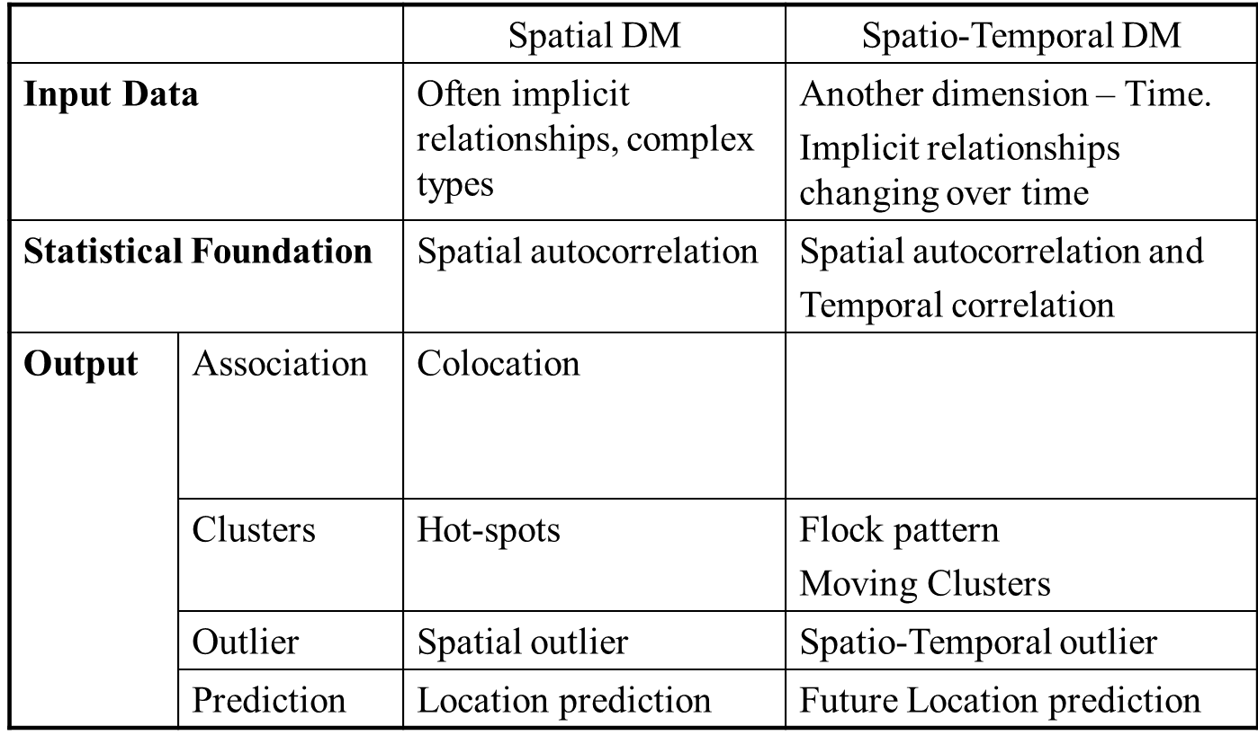
Summary
  What’s Special About Mining Spatial Data ?

Slide 83
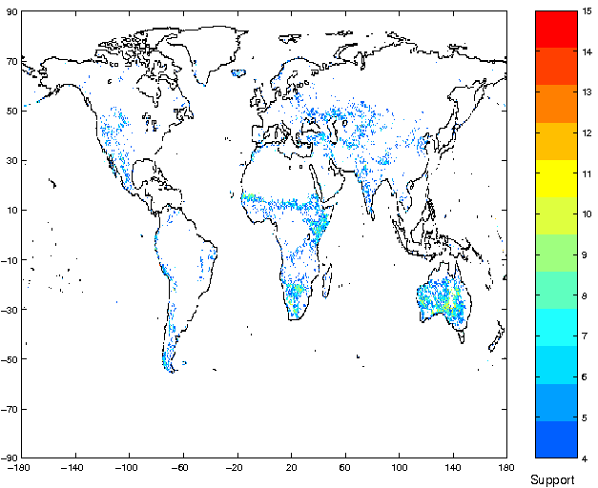
Three General Approaches in SDM
  A. Materializing spatial features, use classical DM
  Ex. Huff's model – distance (customer, store)
  Ex. spatial association rule mining [Koperski, Han, 1995]
  Ex: wavelet and Fourier transformations
  Commercial tools: e.g., SAS-ESRI bridge
  B. Spatial slicing, use classical DM
  Ex. Regional models
  Commercial tools: e.g., Matlab, SAS, R, Splus
Association rule with support map
(FPAR-high -> NPP-high)

Slide 84
Review Quiz
Consider an Washingtonian.com article about election micro-targeting using a database of 200+ Million records about individuals. The database is compiled from voter lists, memberships (e.g. advocacy group, frequent buyer cards, catalog/magazine subscription, ...) as well polls/surveys of effective messages and preferences. It is at www.washingtonian.com/articles/people/9627.html

Slide 85
Review Quiz – Question 1
  Q1. Match the following use-cases in the article to categories of traditional SQL2 query, association, clustering and classification:
    (i) How many single Asian men under 35 live in a given
    congressional district?
    (ii) How many college-educated women with children at home are in
    Canton, Ohio?
    (iii) Jaguar, Land Rover, and Porsche owners tend to be more
    Republican, while Subaru, Hyundai, and Volvo drivers lean
    Democratic.
    (iv) Some of the strongest predictors of political ideology are things
    like education, homeownership, income level, and household size.

Slide 86
Review Quiz – Question 1 (Continued)
  Q1. Match the following use-cases in the article to categories of traditional SQL2 query, association, clustering and classification:
    (v) Religion and gun ownership are the two most powerful predictors
    of partisan ID.
    (vi) ... it even studied the roads Republicans drove as they commuted
    to work, which allowed the party to put its billboards where they
    would do the most good.
    (vii) Catalyst and its competitors can build models to predict voter
    choices. ... Based on how alike they are, you can assign a
    probability to them. ... a likelihood of support on each person
    based on how many character traits a person shares with your
    known supporters..
    (viii) Will 51 percent of the voters buy what RNC candidate is offering?
    Or will DNC candidate seem like a better deal?

Slide 87
Review Quiz – Question 2
  Q2. Compare and contrast Data Mining with Relational Databases.

Slide 88
Review Quiz – Question 3
  Q3. Compare and contrast Data Mining with Traditional Statistics (or Machine Learning).

