Slide 1

Query Processing and Optimization

Slide 2

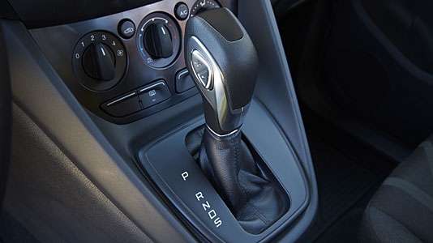
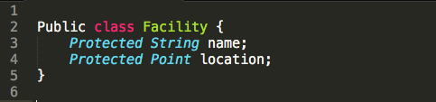
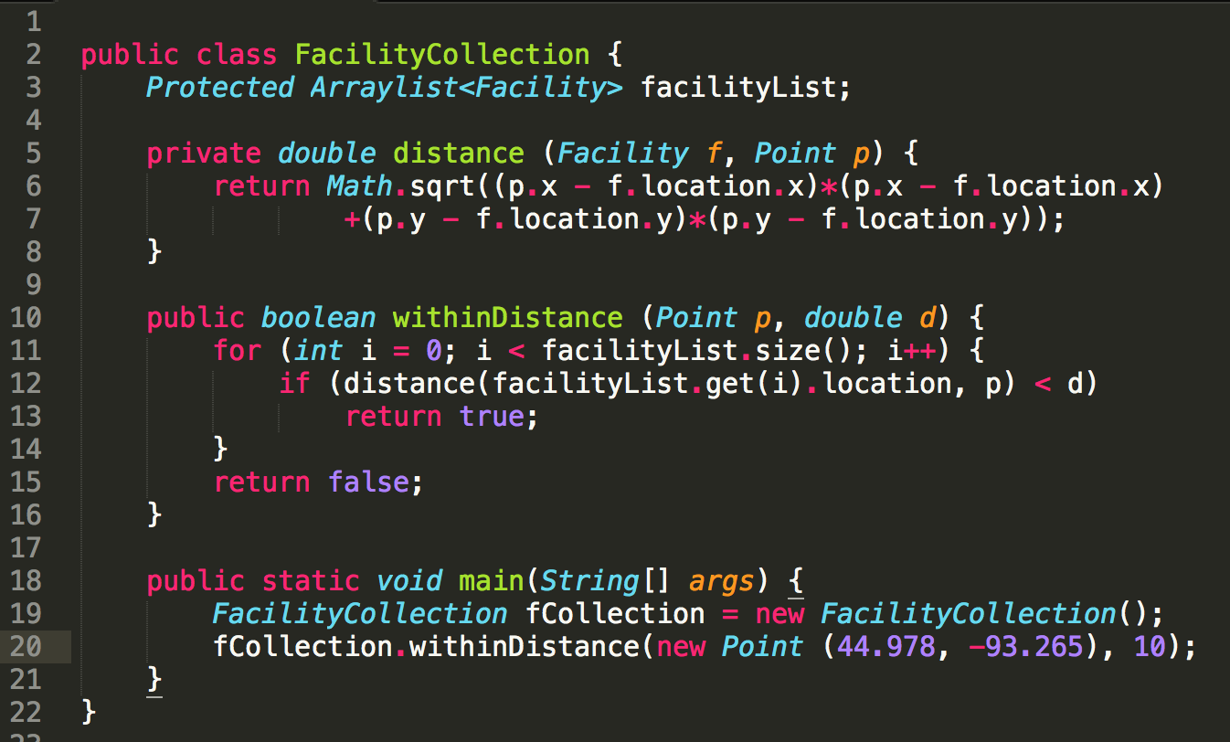
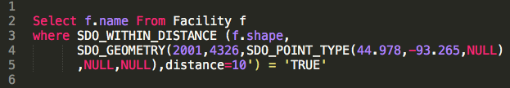
Analogy of Automatic Transmission in Cars -1
Manual transmission : automatic :: Java : SQL
Ex. List facilities within 10km of Minneapolis (44.978, -93.265)
Java JDK 1.8
Manual
Automatic
SQL (Oracle spatial)
2

Slide 3
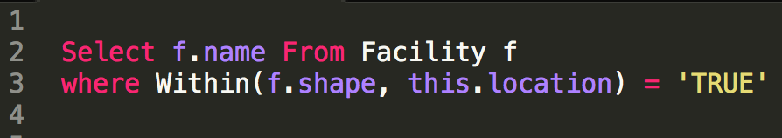
SQL : Java :: Automatic Transmission : Manual
SQL queries are declarative
  Users do not specify algorithms and data-structures
    Logical design and physical design are independent
    No re-write needed for different users and data
  DBMS needs to pick an algorithm to answer query
  Analogy: automatic transmission choosing gear (1, 2, 3, …)
SQL (Oracle Spatial)
3

Slide 4
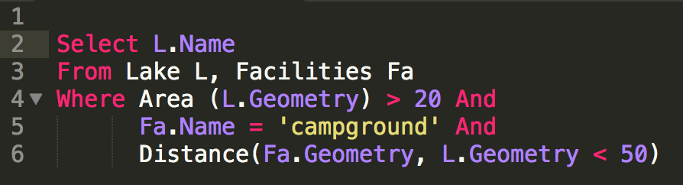
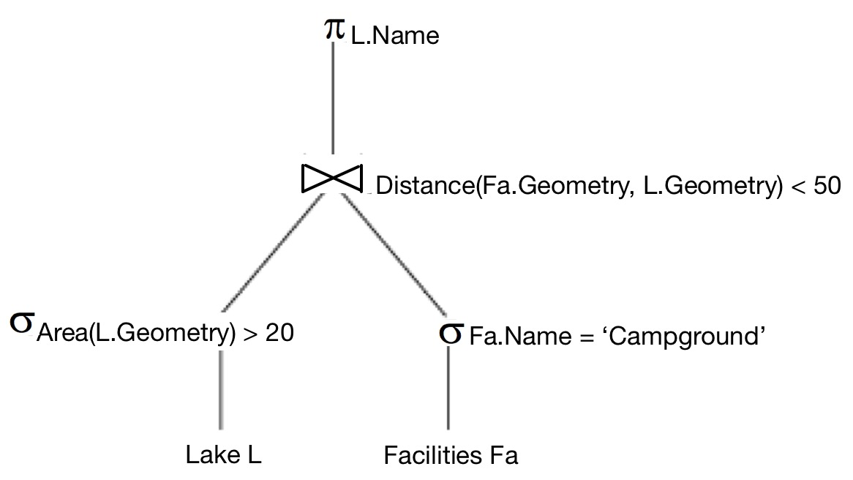
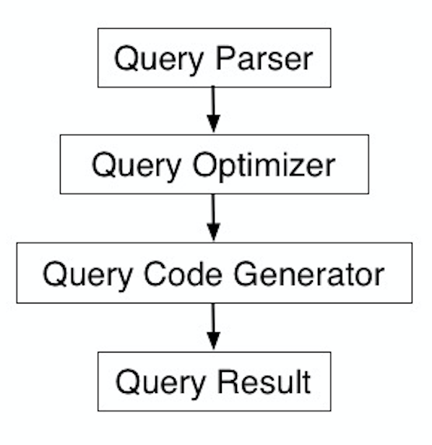
How does SQL choose algorithms & data-structures?
  Query processing and optimization (QPO)
    Picks algorithms to process a SQL query
  QPO : Physical data model :: automatic transmission ： engine
Query tree
Nested loop with index
Scan
Index
4

Slide 5
What is Query Processing and Optimization (QPO)?
Translate a SQL query to an execution plan
  using operations on file-structures, indices
Goal: reduce run-time of execution plan
  answers query in as little time as possible
Constraints: QPO overheads are small
  Optimization time << plan execution time
Query tree
Space-partitioning join
Scan
Index
5

Slide 6
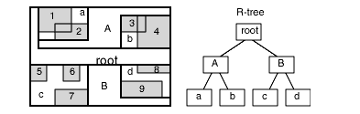
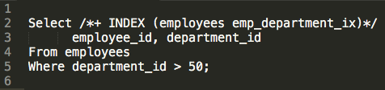
Why learn about QPO? - Continued
Why learn about QPO in a SDBMS?
  Identify performance bottleneck for a query
    Is it the physical data model or QPO ?
  How to help QPO speed up processing of a query ?
    Providing hints, rewriting query, etc.
  How to enhance physical data model to speed up queries?
    Add indices (e.g., R-tree), change file-structures (e.g., ordered files), …
Hints of using Index (Oracle)
R-tree
7

Slide 7
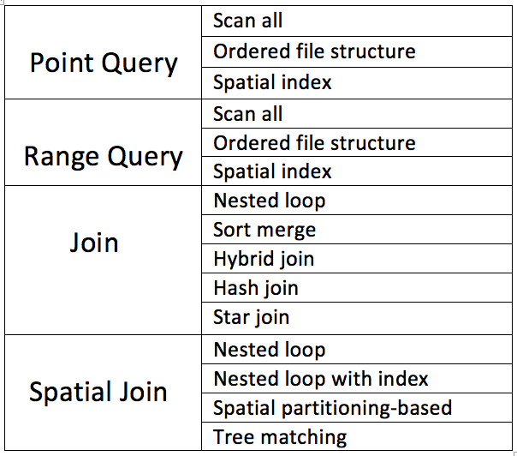
QPO Key Concepts:1. Building Blocks, 2. Strategies
1. Building blocks
  Most cars have few motions, e.g. forward, reverse
  Similar most DBMS have few building blocks:
    select (point query, range query), join, sorting, ...
  A SQL queries is decomposed in building blocks
2. Query processing strategies for building blocks
  Cars: few gears for forward motion: 1st, 2nd, 3rd, …
  DBMS: a few strategies for each building block
    e.g. a point query: an index, linear search
8

Slide 8
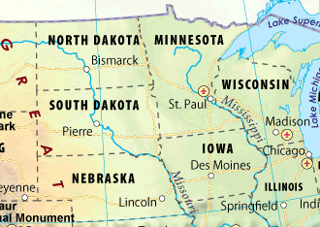
Strategies for Point Queries
Point Query
  Given a location
  Return a property (e.g., place name) of the location
List of strategies
  Linear Search
  Binary Search
    If records ordered by a space filling curve
  Index Search
    If a spatial index is available
24

Slide 9
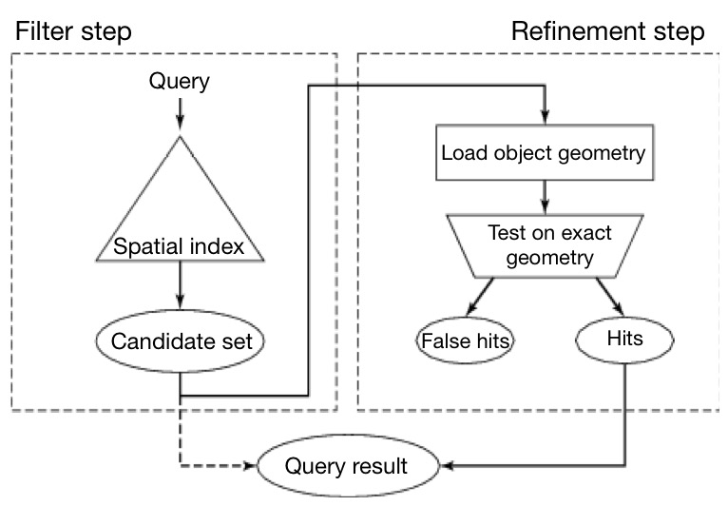
The Filter-Refine Paradigm
Processing a spatial query Q
  Filter step : find a superset S of object in answer to Q
    Using approximate of spatial data type and operator
  Refinement step : find exact answer to Q reusing a GIS to process S
    Using exact spatial data type and operation
18

Slide 10
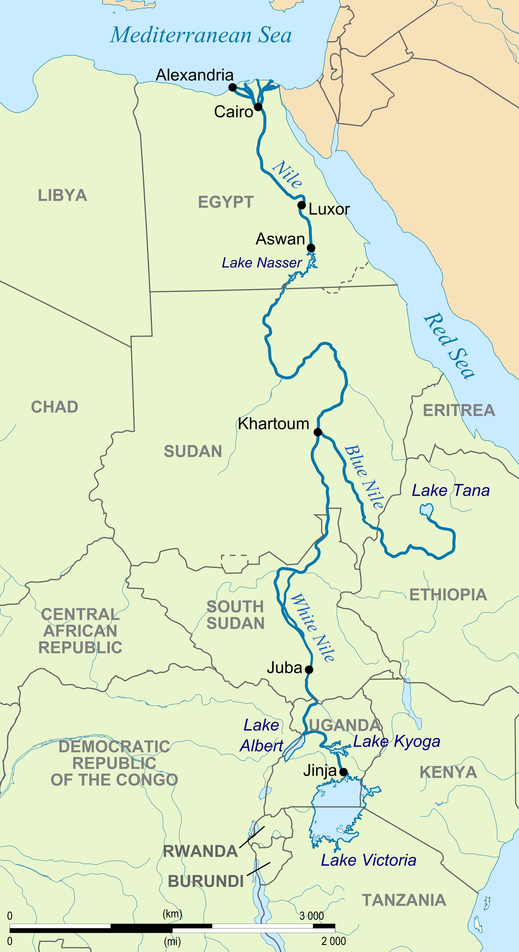
Simplifying Choices for Building
Reusing a Geographic Information System (GIS)
  GIS has rich spatial data types and operations
  However may have difficulties processing large data set on disk
SDBMS is used as a filter to reduces set of objects sent to a GIS
This is filter-and-refine approach
Which countries are crossed by Nile River?
Filter-and-refine approach
Brute-force approach:
Traverse all countries in the world and identify the crossed countries.
Filter:
Rule out all the countries outside Africa
Refine:
Traverse all countries in Africa and identify the crossed countries
17
http://desktop.arcgis.com/

Slide 11
Approximating Spatial Data Types
Minimum orthogonal bounding rectangle (MOBR or MBR)
  approximates line string, polygon, …
  See Examples below (red rectangle are MBRs for black objects)
MBRs are used by spatial indexes, e.g. R-tree
Algorithms for spatial operations MBRs are simple
y
y
x
x
MOBR of a line string
MOBR of a polygon
19

Slide 12
Approximating Spatial Operations
Approximating spatial operations
  SDBMS processes MBRs for refinement step
  Overlap predicate used to approximate topological operations
  Example: inside(A, B) replaced by
    overlap(MBR(A), MBR(B)) in filter step
    See picture below - Let A be outer polygon and B be the inner one
    inside(A, B) is true only if overlap(MBR(A), MBR(B))
    However overlap is only a filter for inside predicate needing refinement later
y
y
y
A
A
B
B
x
x
x
20

Slide 13
Strategies for Point Queries
Point Query
  Given a location
  Return a property (e.g., place name) of the location
List of strategies
  Linear Search
  Binary Search
    If records ordered by a space filling curve
  Index Search
    If a spatial index is available
24

Slide 14
An Example Dataset
Data: 14 points, each with a type triangle or star
Query: Return type at location (x, y) = (10, 11)
Candidate Storage Methods:
  7 data blocks, each with 2 points
Query point
25

Slide 15
Candidate Storage & Indexing Methods
C. R-tree (primary index)
root
a
b
A. Unordered
B. Z-order (Y-major)
c
d
e
f
g
h
i
Sorting number (Z-order index)
25

Slide 16
Linear Search for Point Queries
Data: 14 points stored in data blocks with 2 points in each block
(Marked) Query: Return the type of crime in the location (x, y) = (2, 3)
Storage Methods: Unordered
Cost for linear search on this dataset: 7
Linear Search on data blocks 0 .. 6
25

Slide 17
Binary Search for Point Queries
Data: 14 points stored in data blocks with 2 points in each block
(Marked) Query: Return the type of crime in the location (x, y) = (2, 3)
Storage Method: Z-order (Y-major)
  Cost for binary search on this dataset: 3
Y-major
Binary search on data blocks 0 .. 6
(0+6) / 2 = 3
3
Ceil((3+6) / 2) = 5
5
Ceil((5+6) / 2) = 6
6
3 blocks (i.e., green, cyan, yellow) accessed
25

Slide 18
Search for Point Queries Using R-Tree
Data: 14 data points stored in data blocks with 2 points in each block
(Marked) Query: Return the type of crime in the location (x, y) = (2, 3)
Storage Methods: R-tree (Primary Index), root cached in main memory
  I/O cost
In this example
Index block | 1
Data block | 1
Root
root
a
b
b
c
d
e
f
g
h
i
g
25

Slide 19
Comparing 3 Strategies for Point Queries
Data: 14 points stored in data blocks with 2 points in each block
(Marked) Query: Return the type of crime in the location (x, y) = (2, 3)
Storage Method | In this example
Linear Search | 7
Binary Search | 3
Index Search | Index blocks | 1
 | Data Blocks | 1
Query point
25

Slide 20
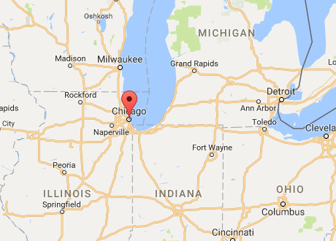
Nearest Neighbor Queries
Example
  Find the city closest to Chicago.
  Return one spatial object from city data file C
28

Slide 21
Nearest Neighbor – Running Examples
Each point represents location of a restaurant.
Query:
Given the location of a user p, find the nearest restaurant.
(If more than one nearest neighbors, return all results)
c
a
d
f
b
e
Result:
Nearest neighbor of p is j
h
i
k
j
l
g
Query point p
Restaurants
User
3

Slide 22
Strategies for Nearest Neighbor Queries
Two phase approach
  Fetch C’s disk sector(s) containing the query point
  M = minimum distance(query point, objects in fetched leaf)
  Test all cities within distance M of query point (Range Query)
Single phase approach
28

Slide 23
Two Phase Strategy (with a R-tree)
Find the index leaf containing the query point p: block red
In red leaf, Point g, h are the closest points to p, d_{B} = 2
Create a circle Circle_{p} whose center is p, and radius = d_{B}
Create the MOBR of Circle_{p} : M_{p}
X
c
Range query: M_{p}, and test all points in M_{p}
Root -> Y -> Block brown
a
d
f
b
e
Since dist(p, j) = 1.41 < D_{B}, point j is nearest neighbor of p
h
i
k
Y
j
l
Root
 | Index blocks | Data blocks
Phase 1 | 1 | 1
Phase 2 | 1 | 1
g
p
Cost:
3
X
Y
Restaurants
User

Slide 24
Strategies for Nearest Neighbor Queries
Two phase approach
Single phase approach
  Recursive algorithm for R-tree
  Eliminate children dominated by some other children
  Check the remaining data blocks for nearest neighbor
28

Slide 25
One Phase Strategy with a R-treee
Root
Finally, check blocks 0, 1, 3, 4 for nearest neighbors
X
Y
Index blocks | Data blocks
2 | 4
X
c
a
d
f
b
e
Node | MinDist | MaxDist
First
level:
X 3 7.47
h
i
k
Nothing eliminated
Y
Y 0 4.47
j
l
0 3.16 4.12
g
p
Second
level:
3
1 3.16 5.10
2 4.47
Node 2 eliminated
Data block 0
Data block 1
Data block 2
Data block 3
3 0 2.83
Data block 4
Data block 5
4 1.41 2.83
5 3.16
Node 5 eliminated

Slide 26
Comparing Algorithms for Nearest Neighbor Queries
Data:
Each point in this dataset represents the location of a restaurant.
Query:
Given the location of a user p, find the nearest restaurant.
(If more than one nearest neighbors, return all results)
c
a
d
f
b
e
h
i
k
Result:
Nearest neighbor of p is j
j
l
g
Storage Method | In this example
Two phase approach | Index blocks | 2
 | Data Blocks | 2
One phase approach | Index blocks | 2
 | Data Blocks | 4
Query point p
Restaurants
User
25

Slide 27
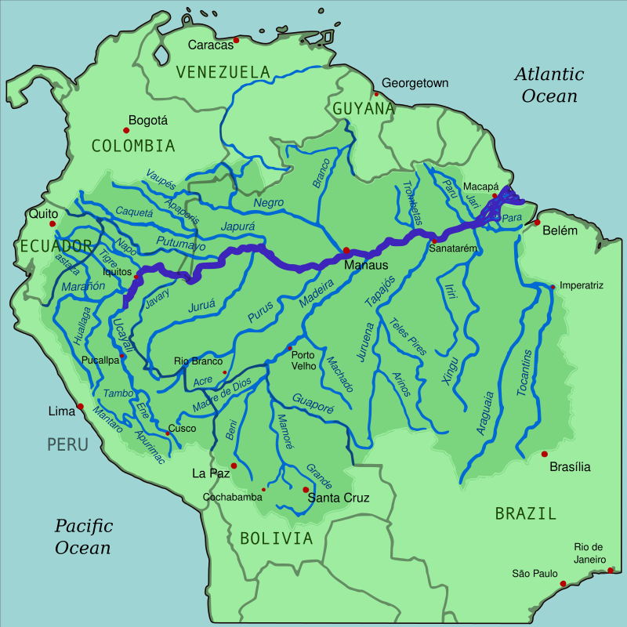
Range Queries
Range Query Example
  List all countries crossed by of the river Amazon.
  Returns several objects within a spatial region from a table
25

Slide 28
Strategies for Range Queries
Linear Search:
  Scan all disk blocks of the data file
Binary Search
  If records are ordered using space filling curve (say Z-order)
  Decompose into disjoint Z-order intervals
  For each Z-interval,
    a binary search to get lowest Z-order within the Z-interval
    then scan forward till end of the Z-interval
Index Search
  If an index is available on spatial location of data objects,
  then use range-query operation on the index
25

Slide 29
Range Query – Running Example
Data: 14 points stored in data blocks with 2 points each
(Brown Box) Query: ( 2 <= x <= 3 ) and ( 2 <= y <= 3 )
Storage Methods:
  7 data block with 2 points each
  Unordered, Z-ordered, R-tree
25

Slide 30
Range Query – Candidate Storage Methods
root
a
b
c
d
e
f
g
h
i
Z-order (Y-major)
Unordered
R-tree (primary index)
Sorting order (Z-order index)
25

Slide 31
Linear Search for Range Queries
Data: 14 points stored in data blocks with 2 points each
(Brown Box) Query: ( 2 <= x <= 3 ) and ( 2 <= y <= 3 )
Storage Method: Unordered
Cost for range query on unordered data: 7
Linear search on data blocks 0 ..6
25

Slide 32
Binary Search for Range Queries
Data: 14 points stored in data blocks with 2 points each
(Brown Box) Query: ( 2 <= x <= 3 ) and ( 2 <= y <= 3 )
Storage Method: Z-order
  One Z-interval 12 .. 15 => search for 12 then scan forward
3 blocks (i.e., green, cyan, yellow) accessed
Binary search
on data blocks 0..6
(0+6) / 2 = 3
3
ceil((3+6) / 2) = 5
5
Found Z = 12,
scan forward till Z=15
6
25

Slide 33
Range Query with Two Z-intervals
Data: 14 points stored in data blocks with 2 points each
(Brown Box) Query: ( 2 <= x <= 3 ) and ( 1 <= y <= 2)
  Two Z-intervals: [5 .. 6] and [12 .. 13]
  One binary search (followed by scan) for each Z-interval !
3 blocks
(i.e., green, purple, cyan)
accessed
Binary search to find [(12), (13)]
(0+6) / 2 = 3
Binary search to find [(6), (7)]
3
3
(0+6) / 2 = 3
ceil((3+6) / 2) = 5
5
Found Z=10
Scan till Z= 11
2
Found Z=5
Scan till Z= 6
25

Slide 34
Search for Range Queries Using R-tree Index
Data: 14 points stored in data blocks with 2 points each
(Brown Box) Query: ( 2 <= x <= 3 ) and ( 2 <= y <= 3 )
Candidate Storage Methods: R-tree (Primary Index)
Cost in this example
Index block | 1
Data block | 2
Root
root
a
b
b
c
d
e
f
g
h
i
g, i
25

Slide 35
Comparing Algorithms for Range Queries
Data: 14 points stored in 7 data blocks with 2 points each
(Brown Box) Query: ( 2 <= x <= 3 ) and ( 2 <= y <= 3 )
Storage Method | In this example
Linear Search | 7
Binary Searches | 3
Index Search | Index blocks | 1
 | Data Blocks | 2
25

Slide 36
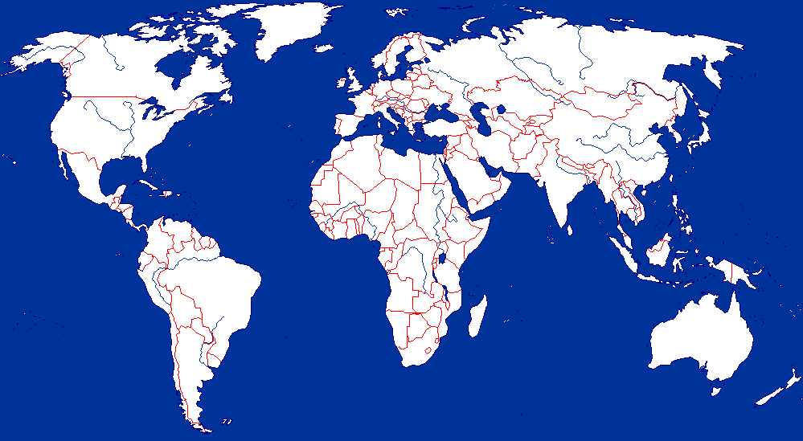
Spatial Join Example
  Pairs rivers with countries, they flow through.
  Return pairs across “Rivers” and “Countries” tables satisfying “overlap” predicate
26

Slide 37
Spatial Join – Example Data
Query: For each fire station, find all the houses within a distance <= 1
Fire-station | House
A | a
B | f
D | h
D | j
Fire station map
House map
Overlay
B
c
c
B
a
d
a
d
A
f
A
f
b
e
b
e
C
C
h
i
k
h
i
k
D
g
j
l
g
D
j
l
Fire-stations
Houses
3

Slide 38
Storage Structure
2 blocks for fire stations
6 blocks for houses
Data block 2
Data block 3
Data block 4
Data block 0
Data block 1
Data block 5
Data block 6
Data block 7
B
c
a
A
d
f
b
e
C
h
i
k
Fire stations
D
g
j
l
Houses

Slide 39
Strategy 1: Nested Loop
List of strategies
  Nested loop:
    Test all possible pairs for spatial predicate
    Outer loop: bring data blocks of first table in memory
    Inner loop: scan the second table
  Nested Loop with a spatial index
  Space Partitioning:
  Tree Matching
  Other, e.g. spatial-join-index based, external plane-sweep, …
27

Slide 40
Nested loop Example
Data block 0
Data block 1
Data block 2
Data block 3
Data block 4
Data block 5
Data block 6
Data block 7
Algorithm:
For each block B_{fs} of fire stations
For each block B_{h} of houses
Scan all pairs of fire stations in B_{fs} and houses in B_{h}
Fire stations
Houses
Cost:
For Blue block, inner loop fetches all 6 (circle) blocks
For Red block, inner loop fetches all 6 (circle) blocks
# blocks for fire stations * # blocks for houses = 2*6 = 12
Assume: 3 memory buffers
(i.e., 1 for fire-stations, 1 for houses, 1 for results)

Slide 41
Refining Nested Loop with a spatial index
Root_{h}
X
Y
B
c
A
a
d
f
b
e
C
h
i
k
D
g
j
l

Slide 42
Strategy 2. Nested loop with spatial index
Root_{h}
X
Y
Outer loop: For each data blocks D of first table
Inner loop: Range Query second table for overlapping block
  E.g., Houses within a distance <= 1
B
c
A
a
d
f
b
e
C
h
i
k
D
g
j
l

Slide 43
Ex.: Nested Loop with a spatial index
Root_{h}
X
Y
Outer loop: For each data blocks D of first table
Inner loop: Range Query second table for overlapping block
  E.g., Houses within a distance <= 1
Fire stations
Outer | Inner blocks
0 | 2, 3, 5, 6
1 | 4, 6, 7
c
Houses
a
d
f
b
e
h
i
k
Data block 0
Data block 1
g
j
l
Data block 2
Data block 3
Data block 4
Data block 5
Data block 6
Data block 7

Slide 44
Cost of Nested loop with Index
Root_{h}
X
Y
Fire stations
Block 0:
Root -> X -> 2, 3
-> Y -> 5, 6
Houses
Block 1:
Root -> X -> 4
-> Y -> 6, 7
Index blocks | Data blocks
2 + 2 = 4 | FS | 2
 | House | 4+3=7
 | Total | 9
Data block 0
Data block 1
Data block 2
Data block 3
Data block 4
Data block 5
Data block 6
Data block 7

Slide 45
Strategy 3. Space Partitioning Join
Example Query: Pair rivers with countries they pass through.
  Do we need to test Nile river with countries outside Africa?
Space Partitioning Idea
  Rivers in Africa are tested with countries in Africa only
  Test pairs of objects within common spatial regions
27

Slide 46
Common Space Partitioning
Query: For each fire station, find houses within distance <= 1
Four Partition: P₀, P₁, P₂, P₃
For each fire station, create MOBR with length of 1
Q? Why C in two partitions?
P₀ | A | a, b, c, e
P₁ | B, C | d, f
P₂ | D | g, h, j
P₃ | C | i, k, l
P₀
P₁
P₀
P₁
B
c
A
a
d
f
b
e
C
h
i
k
D
g
j
l
P₂
P₃
Data block 4
Data block 2
Data block 3
Data block 0
Data block 1
Data block 5
Data block 6
Data block 7

Slide 47
Space Partition Join Algorithm
Ex. For each fire station, find houses within distance <= 1
Filter: For each partition P_{i}
Bring Partition in main memory
Test all pairs of MOBR M_{fs} of fire-station in P_{i} and all houses in P_{i}
Refinement: Test remaining pair with exact geometry, e.g., distance <= 1
P₀
P₁
c
B
Result after Filter Phase
Partitions
a
A
d
P₀ | A | a, b, c, e
P₁ | B, C | d, f
P₂ | D | g, h, j
P₃ | C | i, k, l
Result | MOBR | House
e
f
b
C
P₀
A a, b, c, e
B f
C d, f
h
i
k
P₁
g
D
j
l
P₂
D h, j
P₂
P₃
P₃
C i, k

Slide 48
Cost of Space Partitioning Join
Total cost = 8+8+(3+2+3+3) = 27
Read all data blocks | Write partitioning back | Compute for each partition
8 | 8 | P₀ | 3
 |  | P₁ | 2
 |  | P₂ | 3
 |  | P₃ | 3
P₀
P₁
c
B
a
A
d
e
f
b
C
h
i
k
About 3 “scans” of each table
If replication of objects across partitions is rare.
g
D
j
l
Data block 2
Data block 3
Data block 4
3
P₂
P₃
Data block 5
Data block 6
Data block 7

Slide 49
Strategy 4 : Tree Matching – Basic Idea
Nested Loop with an Index
  Inner loop range queries
  Eliminated pairs of data-blocks if disjoint MOBRs
Space-partitioning join
  Eliminated partition-pairs (( P0, P1), …) since disjoint MOBRs
Tree Matching, if both tables are indexed:
  Eliminate pairs of index/data-blocks if disjoint MOBRs
  Start at Root level – Eliminate child-pair if irrelevant
  Recursion on remaining pairs
Fire stations
Houses
P₀ | A | a, b, c, e
P₁ | B, C | d, f
P₂ | D | g, h, j
P₃ | C | i, k, l
27

Slide 50
Inputs forTree Matching: Both table have spatial indexes
Root_{h}
Root_{fs}
X
Y
B
X
c
A
a
d
f
b
e
C
h
i
k
Y
D
g
j
l
Data block 0
Data block 1
Data block 2
Data block 3
Data block 4
3
Data block 5
Data block 6
Data block 7

Slide 51
Example Spatial Join Query
Query: For each fire station, find houses within distance <= 1
MOBR buffer of size 1 to mimic spatial join predicate, i.e. distance <= 1
Root level – no child-pair is eliminated
Recursion on remaining pairs, i.e., (X, 0), (Y, 0), (X, 1), (Y, 1)
Root_{fs}
B
X
c
a
d
f
A
Root_{h}
b
e
C
X
Y
h
i
k
Y
D
g
j
l
Data block 0
Data block 1
Data block 2
Data block 3
Data block 4
3
Data block 5
Data block 6
Data block 7

Slide 52
Tree Matching Algorithm –
Next Iteration
Data block 0
Data block 1
Data block 2
Data block 3
Data block 4
Data block 5
Data block 6
Data block 7
Recursion on (X, 0) => remaining pairs: (2, 0), (3, 0),
Recursion on (Y, 0) => remaining pairs: (5, 0), (6, 0)
Recursion on (X, 1) => remaining pairs: (4, 1),
Recursion on (Y, 1) => remaining pairs: (6, 1), (7, 1)
Root_{h}
MOBR of
X
Y
Root_{h}
X
c
MOBR of
a
X
Y
d
f
b
e
Index blocks | Data blocks
2 + 2 = 4 | FS | 2
 | House | 4+3=7
 | Total | 9
h
i
k
Fire stations
Y
g
j
l
Data block 2
Data block 3
Data block 4
3
Houses
Data block 5
Data block 6
Data block 7

Slide 53
Cost of Tree Matching Algorithm
Data block 0
Data block 1
Data block 2
Data block 3
Data block 4
Data block 5
Data block 6
Data block 7
Pairs examined:
  (X, 0), (Y, 0), (X, 1), (Y, 1)
  (2, 0), (3, 0), (5, 0), (6, 0), (4, 1), (6, 1), (7, 1)
Blocks accessed
  Index blocks besides roots: X, Y
  Data blocks: all with 6 accessed twice
Root_{h}
X
Y
Root_{fs}
Index blocks | Data blocks
2 + 2 = 4 | FS | 2
 | House | 4+3=7
 | Total | 9
Fire stations
Houses

Slide 54
Comparing Algorithms for Spatial Join
Default choice is Nested loop
Neither table has spatial index
  Space partitioning if spatial-join predicate is selective
One table has a spatial index
  nested loop with index
Both table have spatial tree indexes & selective spatial join predicate
  Tree matching

