Slide 1
Enabling Faster Convergence in
Distributed Irregular Graph Processing
Abbas Mazloumi and Rajiv Gupta
Department of Computer Science and Engineering
University of California, Riverside

Slide 2
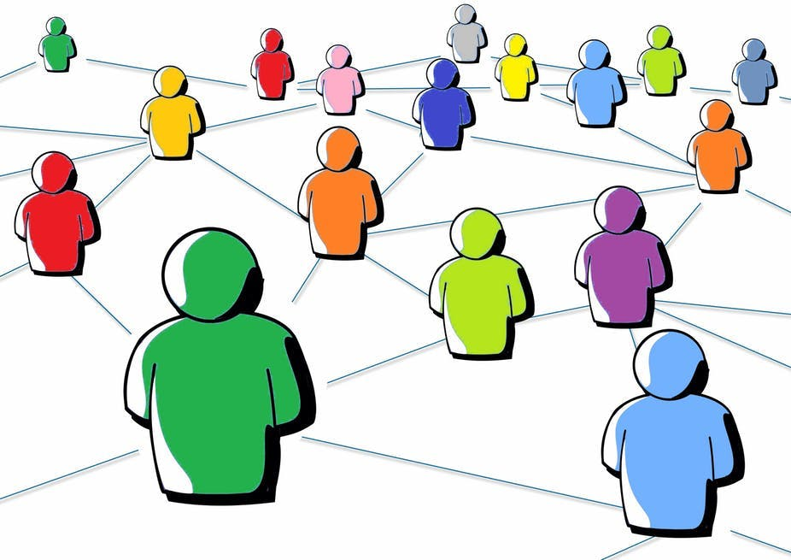
Graphs are Ubiquitous
Social Networks
Finding social behaviors like communities
Traffic Networks
Detecting malicious activities
Biology
Predicting diseases
Web Search
Page ranking
By Jamie posted in Blog Traffic
By Megan Deskin
http://10best4u.com/
https://theconversation.com/rethinking-ethics-in-social-network-research-88988
Enabling Faster Convergence in Distributed Irregular Graph Processing Presenter: Abbas Mazloumi
2 / 25

Slide 3
Graphs are Ubiquitous
Graphs encode relationships among
Users
Facts
Web pages
These Graphs are Huge
Billions of vertices and edges
Needs distributed systems
Load balancing Vs. locality
By Jamie posted in Blog Traffic
By Megan Deskin
http://10best4u.com/
https://theconversation.com/rethinking-ethics-in-social-network-research-88988
Enabling Faster Convergence in Distributed Irregular Graph Processing Presenter: Abbas Mazloumi
3 / 25

Slide 4
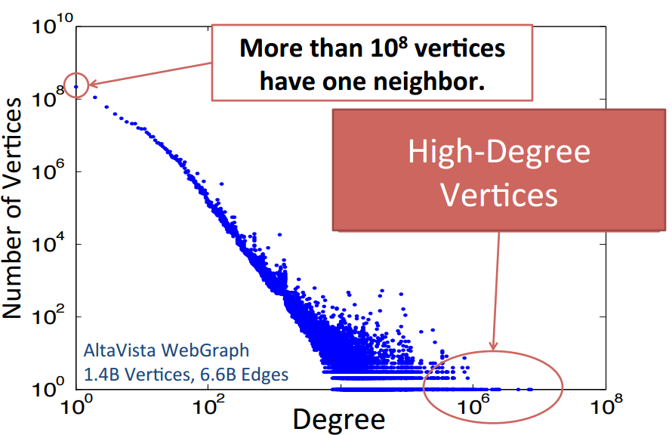
Real-World Graphs are Irregular
Irregular graphs
Degree distribution follows the power-law model
[2] PowerGraph
Enabling Faster Convergence in Distributed Irregular Graph Processing Presenter: Abbas Mazloumi
4 / 25

Slide 5
Graph Processing
Graph Algorithms are Iterative
Vertices are continuously processed until convergence
Highly Parallel
Vertex-centric approach which is follows “Think as a vertex” philosophy
Process vertices in parallel, and communicate along the edges
Distributed Processing
Graph partitioning techniques
Distributed computation – GAS model
Enabling Faster Convergence in Distributed Irregular Graph Processing Presenter: Abbas Mazloumi
5 / 25

Slide 6
Outline
Background on PowerLyra
Most recent graph processing distributed framework
Differential Processing of Low vs. High Degree Vertices
Process low degree vertices frequently to enable less frequent processing of high degree vertices
Propagating Deltas
Efficient local processing of low degree vertices
Conclusions
Enabling Faster Convergence in Distributed Irregular Graph Processing Presenter: Abbas Mazloumi
6 / 25

Slide 7
PowerLyra [EuroSys’15]
Distributed Vertex-centric Framework
Graph is Partitioned Across Machines
For remote adjacent vertices, replicas or mirrors are created
Using hybrid-cut partitioning
All Machines Process Local vertices in parallel, and communicate with other machines
Using GAS model
Enabling Faster Convergence in Distributed Irregular Graph Processing Presenter: Abbas Mazloumi
7 / 25

Slide 8
GAS Computation Model
Gather data from predecessors
Send the partial gather from mirrors to local
Apply/Update vertex with new data
Send the updated data to mirrors
Scatter data to successors
Send activation between machines
Mirror
Mirror
Mirror
Mirror
Local
Local
Local
Local
Machine 2
Machine 2
Machine 1
Machine 2
Machine 1
Machine 2
Machine 1
Machine 1
Enabling Faster Convergence in Distributed Irregular Graph Processing Presenter: Abbas Mazloumi
8 / 25

Slide 9
GAS Computation Model
1: gather_data←∅
2: for P ∈ Predecessors(V) do
3: gather_data←gather_data ∪ P.value
4: end for
1: while !global_avctive_list.empty() do
2: distribute_run(gather_phase)
3: distribute_run(apply_phase)
4: distribute_run(scatter_phase)
5: end while
1: V.value←f(gather_data)
1: if Changed(V) then
2: for S ∈ Successors(V) do
3: Activate(S)
4: end for
5: end if
Enabling Faster Convergence in Distributed Irregular Graph Processing Presenter: Abbas Mazloumi
9 / 25

Slide 10
Graph Partitioning
Hybrid-cut partitioning
Localizing Incoming edges for low-degree vertices, towards efficient processing
Distributed incoming edges for high-degree vertices, towards better load balancing
Low cost for low-degree computation
High cost for high-degree computation
Mirror
Local
Machine 1
Machine 2
L
L
Mirror
Local
Machine 1
Machine 2
H
H
Enabling Faster Convergence in Distributed Irregular Graph Processing Presenter: Abbas Mazloumi
10 / 25

Slide 11
Differential Processing
Low-degree vertex computation is cheap
Processing them more frequently, before the high-degree vertices
Our goal: maximizing the number of changes delivered to high-degree vertices before they are processed
High-degree vertex computation is expensive
Processing them less frequent
Enabling Faster Convergence in Distributed Irregular Graph Processing Presenter: Abbas Mazloumi
11 / 25

Slide 12
Drawback in PowerLyra
Changes may be delivered to a high-degree vertex one by one in consecutive iterations
The High-degree vertex will compute and scatter in each iteration
Expensive!!
Enabling Faster Convergence in Distributed Irregular Graph Processing Presenter: Abbas Mazloumi
12 / 25

Slide 13
Drawback in PowerLyra
Iteration i+1
Iteration i
Iteration i+2
Iteration i+2
Iteration i+1
Iteration i
L
L
L
L
L
L
L
L
L
L
L
L
L
L
L
L
L
L
L
L
L
H
H
H
H
H
H
H
# of H updates:
# of H updates:
# of H updates:
# of H updates:
# of H updates:
# of H updates:
1
0
2
2
1
0
Enabling Faster Convergence in Distributed Irregular Graph Processing Presenter: Abbas Mazloumi
13 / 25

Slide 14
Differential Processing
Iteration i+1
Reduced 1 iteration
Iteration i
Iteration i+1
Iteration i
Iteration i
Iteration i
L
L
L
L
L
L
L
L
L
L
L
L
L
L
L
L
L
L
L
L
L
H
H
H
H
H
H
# of H updates:
H
# of H updates:
# of H updates:
# of H updates:
# of H updates:
# of H updates:
1
0
1
0
0
0
Enabling Faster Convergence in Distributed Irregular Graph Processing Presenter: Abbas Mazloumi
14 / 25

Slide 15
Differential Processing
re-computing low-degree vertices
Re-computing across the machines to get most of the low-degree changes
1: while !global_avctive_list.empty() do
2: while !inner_loop_active_list.empty() do
3: locally_run(lowD_gather_phase)
4: locally_run(lowD_apply_phase)
5: locally_run(lowD_scatter_phase)
6: end while
7: distribute_run(lowD_update_mirror_phase)
8: distribute_run(lowD_scatter_to_highD_phase)
9: distribute_run(highD_gather_phase)
10: distribute_run(highD_gather_phase)
11: distribute_run(highD_gather_phase)
12: end while
updating the mirrors once and scatter to high-degree vertices
computing high-degree vertices
Enabling Faster Convergence in Distributed Irregular Graph Processing Presenter: Abbas Mazloumi
15 / 25

Slide 16
Experimental Setup for Evaluation
Input Graphs:
Friendster:
# Vertices: 65,608,366
# Edges : 1,806,067,135
Twitter (TF):
# Vertices: 52,579,678
# Edges : 1,963,263,508
Cluster:
UCR HPCC - AMD 64 cores with 128 GB memory
Using 4 machines
Implementing:
Using PowerLyra distributed framework
Enabling Faster Convergence in Distributed Irregular Graph Processing Presenter: Abbas Mazloumi
16 / 25

Slide 17
Differential Processing
Reducing the number of iteration by 48% and 24% in average for input graphs Friendster and twitter respectively
-48%
-24%
Enabling Faster Convergence in Distributed Irregular Graph Processing Presenter: Abbas Mazloumi
17 / 25

Slide 18
Efficient Processing of Low Degree Vertices
Optimize computation – Propagating Deltas
Perform extra processing of low degree vertices only when it is expected to benefit high degree vertices.
Enabling Faster Convergence in Distributed Irregular Graph Processing Presenter: Abbas Mazloumi
18 / 25

Slide 19
Propagating Deltas
When a vertex gets activated
It is activated by one or more incoming edges
It gathers the data from all its incoming edges no matter the edge has a updated data or not
Propagating Deltas
Cache the gather data from the first iteration
Send the data changes along with the activating message
Update the cached data
No need to get data from incoming edges in gather-phase
Enabling Faster Convergence in Distributed Irregular Graph Processing Presenter: Abbas Mazloumi
19 / 25

Slide 20
Drawback
Iteration i+1
Iteration i+2
Iteration i+2
Iteration i+1
Iteration i
Iteration i+2
2
2
2
2
2
2
1
2
1
1
1
1
1
2
1
2
2
2
2
2
2
2
2
2
2
2
2
Gathering data:
1
Gathering data:
Gathering data:
Gathering data:
Gathering data:
L1: 7
L1: 7
L1: 7
L1: 2+1+2+2
L1: 7
L1
L1
L1
L1
L1
L1
1
L1
1
1
1
1
1
1
2
2
2
2
2
2
2
L2:
L2: 13
L2: 3+1+2+7
L2:
L2: 13
3
3
3
3
3
3
3
L3:
L3:
L3:
L3:
L3: 2+1+2+13
L2
L2
L2
L2
L2
L2
L2
2
2
2
2
2
2
2
1
1
1
1
1
1
1
# data gathers:
# data gathers:
# data gathers:
# data gathers:
# data gathers:
2
2
2
2
2
2
L3
2
L3
L3
L3
L3
L3
L3
4
8
8
4
12
Enabling Faster Convergence in Distributed Irregular Graph Processing Presenter: Abbas Mazloumi
20 / 25

Slide 21
Propagating Delta
Iteration i+3
Iteration i+2
Iteration i+3
Iteration i
Iteration i+1
Iteration i+1
Iteration i+2
2
2
2
2
2
2
2
1
2
1
1
1
1
1
1
2
1
2
2
2
2
2
2
2
2
2
2
1
2
2
2
Gathering data:
2
Gathering data:
Gathering data:
Gathering data:
Gathering data:
Gathering data:
L1: 7
L1: 7
L1: 7
L1: 6+1
L1: 7
L1: 7
L1
1
L1
L1
L1
L1
L1
L1
1
L1
1
1
1
1
1
1
1
2
2
2
2
2
2
2
2
L2: 13
L2: 13
L2: 13
L2:
L2:
L2: 12+1
3
3
3
3
3
3
3
3
7
7
7
6
6
6
7
1
7
L3: 18
L3:
L3: 17+1
L3:
L3:
L3:
L2
L2
L2
L2
L2
L2
L2
L2
2
2
2
2
2
2
2
2
1
1
1
1
1
1
1
13
1
13
13
12
12
12
12
12
1
# data gathers:
# data gathers:
# data gathers:
# data gathers:
# data gathers:
# data gathers:
2
2
2
2
2
2
2
L3
2
L3
L3
L3
L3
L3
L3
L3
3
2
3
1
1
2
18
17
17
17
17
17
17
1
17
Enabling Faster Convergence in Distributed Irregular Graph Processing Presenter: Abbas Mazloumi
21 / 25

Slide 22
Do the Low-degree when benefits
Re-computing the low-degree vertices when there is enough work to do
Enabling Faster Convergence in Distributed Irregular Graph Processing Presenter: Abbas Mazloumi
22 / 25

Slide 23
Experimental Results
-6.5%
-16.5%
+27%
-28%
-15%
-11%
23 / 25

Slide 24
Conclusions
Differential Processing for Low Degree Vertices
Process low degree vertices frequently to enable faster convergence in high degree vertices
Propagating Deltas
Efficient local processing of low degree vertices
Do it only when high number of vertices are active
Enabling Faster Convergence in Distributed Irregular Graph Processing Presenter: Abbas Mazloumi
24 / 25

Slide 25
Thank you,
For your time and attendance.
Enabling Faster Convergence in Distributed Irregular Graph Processing Presenter: Abbas Mazloumi
25 / 25

