Slide 1
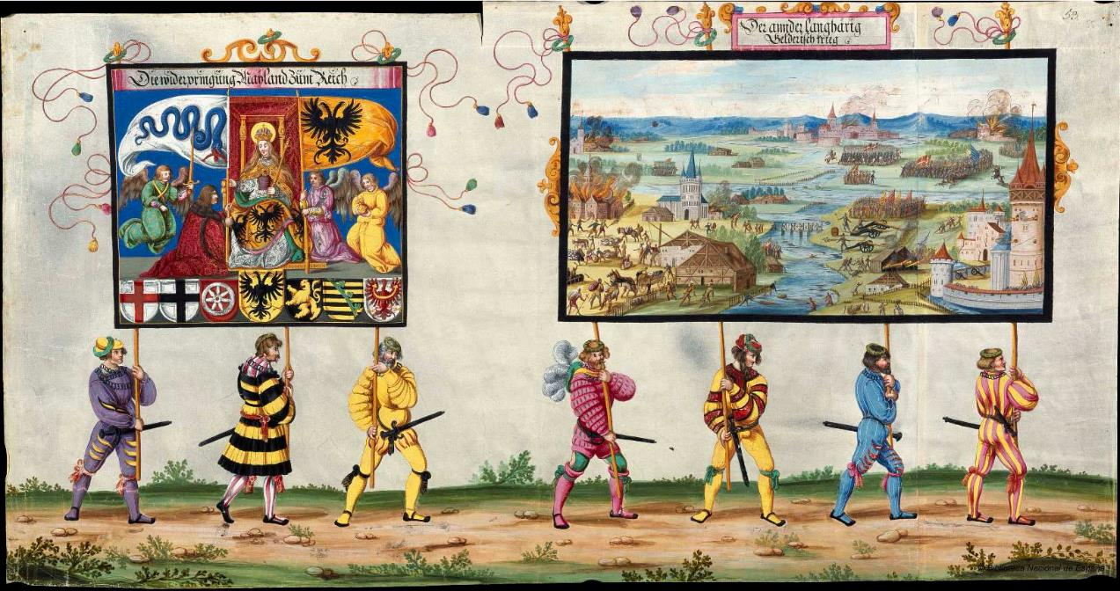



Matrix Profile VII
Time Series Chains: A New Primitive for Time Series Data Mining
Yan Zhu
Makoto Imamura
Daniel Nikovski
Eamonn Keogh
UC Riverside
Tokai University, Japan
MERL, USA

Slide 2




A Big Thanks to all our Collaborators…
Especially Chin-Chia Michael Yeh and Abdullah Mueen, who did much of the heavy lifting behind the original Matrix Profile.
And, in no particular order,
Nurjahan Begum, Yifei Ding, Hoang Anh Dau, Diego Silva, Liudmila Ulanova, Shaghayegh Gharghabi, Zachary Zimmerman, Nader S. Senobari, Gareth Funning, Philip Brisk, Kaveh Kamgar
..and others that have inspired us, forgive any omissions.

Slide 3
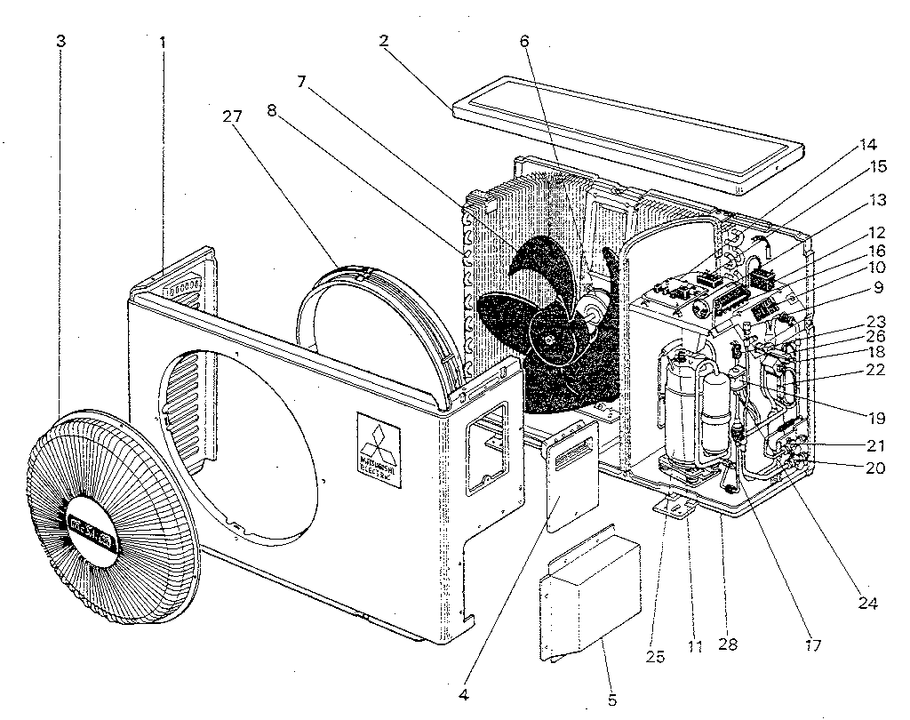
A Motivating Example
Something happened here
status bar
normal
Anomaly/Failure
sensor data
We would like to find a primitive from the raw data that indicates the evolving trend of the system, given:
Only one example time series
No knowledge of the system
No knowledge of when the system starts to evolve/drift

Slide 4
What is the Matrix Profile?
The Matrix Profile (MP) is a data structure that annotates a time series.
For example, here is a seismograph time series:
We can run a sliding window across the time series:
If the time series is of length n, and the window size is m,
then we can extract n-m+1 subsequences. We can calculate their pairwise distances.
Matrix Profile tells us the nearest neighbor information of every subsequence.

Slide 5
Matrix Profile and Matrix Profile Index
Matrix Profile shows the distance from each subsequence to its nearest neighbor.
Matrix Profile Index shows the location of the nearest neighbor of each subsequence.
matrix profile
0
50000
matrix profile index
(zoom in )
…
…
…
 | 20038 | 20039 | 20040 |  |  | 41304 | 41305 | 41306
The lowest valleys in the matrix profile are corresponding to time series motifs.

Slide 6
A Visual Mapping Trick
It is sometime useful to think of time series subsequences as points in m-dimensional space.
In this view, dense regions in the m-dimensional space correspond to regions of the time series that have a low corresponding MP
0
500
1000
1500

Slide 7
The Top 2 Motifs

Slide 8
From Motifs to Chains
Take a look at the blue ‘subsequences”
They would not from a single motif (but perhaps they could form a set of motifs).

Slide 9
From Motifs to Chains
10
However, if we label them by arrival time, you can see that they are drifting, or evolving in time.
This is actionable, for example, where will the 11th item land? Surely just Northeast of the 10th item
We call such pattern chains, with the first item as the anchor.
Do such patterns exist in the real world?
Can we find them?
9
8
6
7
5
4
3
2
1

Slide 10
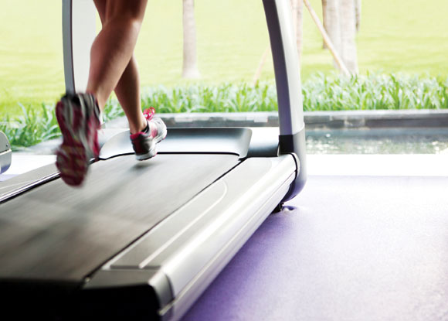
Do Time Series Chains Really Exist?
Yes, actually they are ubiquitous…
12:07
20 March 2014
13:04
13:33
14:04
0
1
Minutes
2
3
Power consumption of a freezer
700
740
970
1010
1130
1170
1670
1710
2200
2240
3110
3150
Sensor recording from the left calf of the an athlete when he started jogging on a threadmill
…and we will show more chains later.

Slide 11
How Do We Find Time Series Chains?
Let’s consider this time series:
47 32 1 22 2 58 3 36 4 -5 5 40
For simplicity, let us assume the subsequence length is 1, and the distance between every two subsequences is their absolute difference.
Do you see some potential chains here?
Notes:
Left - ahead of time
Right – later in time

Slide 12
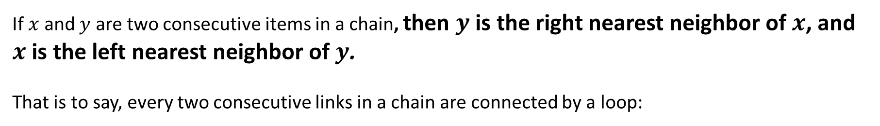


How Do We Find Time Series Chains?
First we need to define Time Series Chains.
Let’s consider this time series:
47 32 1 22 2 58 3 36 4 -5 5 40
Our chain definition is based on the left and right nearest neighbors of every subsequence.
Let’s use arrows to point every subsequence to its left/right nearest neighbors.
47 32 1 22 2 58 3 36 4 -5 5 40
Right Nearest Neighbor (RNN)
Left Nearest Neighbor (LNN)
If $x$ and $y$ are two consecutive items in a chain, then $y$ is the right nearest neighbor of $x$, and $x$ is the left nearest neighbor of $y$.
That is to say, every two consecutive links in a chain are connected by a loop:
$$x$$
$$y$$
Notes:
Left - ahead of time
Right – later in time

Slide 13


Defining Time Series Chains
Right Nearest Neighbor (RNN)
47 32 1 22 2 58 3 36 4 -5 5 40
Left Nearest Neighbor (LNN)
We require every two consecutive link in a chain to be connected by a loop:
Here are some example chains satisfying this definition:
$$y$$
$$x$$
47 32 1 22 2 58 3 36 4 -5 5 40
47 32 1 22 2 58 3 36 4 -5 5 40

Slide 14
Finding the Left/Right Nearest Neighbors of Every Subsequence
The matrix profile provides the general nearest neighbor information.
Instead of evaluating the matrix profile, here we evaluate two directional matrix profiles: Left and Right Matrix Profiles*.
The two directional matrix profiles (and indices) contain left/right nearest neighbor information for every subsequence in the time series.
time series
left matrix profile
right matrix profile
matrix profile
*We leverage the STOMP algorithm [ICDM’16, “Matrix Profile II”] to evaluate the left and Right Matrix Profiles. For details of how we adapted STOMP to evaluate Left/Right Matrix Profiles, see Section III of our paper.
Notes:
Appear before, appear after, we direct the interested audience to

Slide 15
Anchored Chain and Unanchored Chain
Right Nearest Neighbor (RNN)
47 32 1 22 2 58 3 36 4 -5 5 40
Left Nearest Neighbor (LNN)
We care about two types of chains: anchored chain and unahcnored chain.
47 32 1 22 2 58 3 36 4 -5 5 40
Anchored chain (ATSC) starting from 32
47 32 1 22 2 58 3 36 4 -5 5 40
Unanchored chain (UTSC): the longest chain in the data

Slide 16


The All-Chain Set
47 32 1 22 2 58 3 36 4 -5 5 40
Right Nearest Neighbor (RNN)
Left Nearest Neighbor (LNN)
The All-Chain Set is the set of all the anchored chains of the time series that are not subsumed by another chain.
47
32$⇌$36 $⇌$40
1$⇌$ 2 $⇌$3 $⇌$4 $⇌$5
22
58
-5
Properties of the all-chain set:
All the numbers are included.
Every number appears exactly once.
We can use an auxiliary array to mark whether a subsequence is visited.

Slide 17
Compute The All-Chain Set
47 32 1 22 2 58 3 36 4 -5 5 40
Right Nearest Neighbor (RNN)
Left Nearest Neighbor (LNN)
Number | 47 | 32 | 1 | 22 | 2 | 58 | 3 | 36 | 4 | -5 | 5 | 40
Visited? | 0 | 0 | 0 | 0 | 0 | 0 | 0 | 0 | 0 | 0 | 0 | 0

Slide 18
Compute The All-Chain Set
47 32 1 22 2 58 3 36 4 -5 5 40
Right Nearest Neighbor (RNN)
Left Nearest Neighbor (LNN)
Number | 47 | 32 | 1 | 22 | 2 | 58 | 3 | 36 | 4 | -5 | 5 | 40
Visited? | 1 | 0 | 0 | 0 | 0 | 0 | 0 | 0 | 0 | 0 | 0 | 0
47
47

Slide 19
Compute The All-Chain Set
47 32 1 22 2 58 3 36 4 -5 5 40
Right Nearest Neighbor (RNN)
Left Nearest Neighbor (LNN)
Number | 47 | 32 | 1 | 22 | 2 | 58 | 3 | 36 | 4 | -5 | 5 | 40
Visited? | 1 | 0 | 0 | 0 | 0 | 0 | 0 | 0 | 0 | 0 | 0 | 0
47
47

Slide 20


Compute The All-Chain Set
47 32 1 22 2 58 3 36 4 -5 5 40
Right Nearest Neighbor (RNN)
Left Nearest Neighbor (LNN)
Number | 47 | 32 | 1 | 22 | 2 | 58 | 3 | 36 | 4 | -5 | 5 | 40
Visited? | 1 | 1 | 0 | 0 | 0 | 0 | 0 | 1 | 0 | 0 | 0 | 1
32$⇌$36 $⇌$40
47
32$⇌$36 $⇌$40

Slide 21
Compute The All-Chain Set
47 32 1 22 2 58 3 36 4 -5 5 40
Right Nearest Neighbor (RNN)
Left Nearest Neighbor (LNN)
Number | 47 | 32 | 1 | 22 | 2 | 58 | 3 | 36 | 4 | -5 | 5 | 40
Visited? | 1 | 1 | 0 | 0 | 0 | 0 | 0 | 1 | 0 | 0 | 0 | 1
32$⇌$36 $⇌$40
47
32$⇌$36 $⇌$40

Slide 22


Compute The All-Chain Set
47 32 1 22 2 58 3 36 4 -5 5 40
Right Nearest Neighbor (RNN)
Left Nearest Neighbor (LNN)
Number | 47 | 32 | 1 | 22 | 2 | 58 | 3 | 36 | 4 | -5 | 5 | 40
Visited? | 1 | 1 | 1 | 0 | 1 | 0 | 1 | 1 | 1 | 0 | 1 | 1
1$⇌$ 2 $⇌$3 $⇌$4 $⇌$5
47
32$⇌$36 $⇌$40
1$⇌$ 2 $⇌$3 $⇌$4 $⇌$5

Slide 23
Compute The All-Chain Set
47 32 1 22 2 58 3 36 4 -5 5 40
Right Nearest Neighbor (RNN)
Left Nearest Neighbor (LNN)
Number | 47 | 32 | 1 | 22 | 2 | 58 | 3 | 36 | 4 | -5 | 5 | 40
Visited? | 1 | 1 | 1 | 0 | 1 | 0 | 1 | 1 | 1 | 0 | 1 | 1
1$⇌$ 2 $⇌$3 $⇌$4 $⇌$5
47
32$⇌$36 $⇌$40
1$⇌$ 2 $⇌$3 $⇌$4 $⇌$5

Slide 24
Compute The All-Chain Set
47 32 1 22 2 58 3 36 4 -5 5 40
Right Nearest Neighbor (RNN)
Left Nearest Neighbor (LNN)
Number | 47 | 32 | 1 | 22 | 2 | 58 | 3 | 36 | 4 | -5 | 5 | 40
Visited? | 1 | 1 | 1 | 1 | 1 | 0 | 1 | 1 | 1 | 0 | 1 | 1
22
47
32$⇌$36 $⇌$40
1$⇌$ 2 $⇌$3 $⇌$4 $⇌$5
22

Slide 25
Compute The All-Chain Set
47 32 1 22 2 58 3 36 4 -5 5 40
Right Nearest Neighbor (RNN)
Left Nearest Neighbor (LNN)
Visited!
Number | 47 | 32 | 1 | 22 | 2 | 58 | 3 | 36 | 4 | -5 | 5 | 40
Visited? | 1 | 1 | 1 | 1 | 1 | 0 | 1 | 1 | 1 | 0 | 1 | 1
22
47
32$⇌$36 $⇌$40
1$⇌$ 2 $⇌$3 $⇌$4 $⇌$5
22

Slide 26
Compute The All-Chain Set
47 32 1 22 2 58 3 36 4 -5 5 40
Right Nearest Neighbor (RNN)
Left Nearest Neighbor (LNN)
Number | 47 | 32 | 1 | 22 | 2 | 58 | 3 | 36 | 4 | -5 | 5 | 40
Visited? | 1 | 1 | 1 | 1 | 1 | 0 | 1 | 1 | 1 | 0 | 1 | 1
22
47
32$⇌$36 $⇌$40
1$⇌$ 2 $⇌$3 $⇌$4 $⇌$5
22

Slide 27
Compute The All-Chain Set
47 32 1 22 2 58 3 36 4 -5 5 40
Right Nearest Neighbor (RNN)
Left Nearest Neighbor (LNN)
Number | 47 | 32 | 1 | 22 | 2 | 58 | 3 | 36 | 4 | -5 | 5 | 40
Visited? | 1 | 1 | 1 | 1 | 1 | 1 | 1 | 1 | 1 | 0 | 1 | 1
58
47
32$⇌$36 $⇌$40
1$⇌$ 2 $⇌$3 $⇌$4 $⇌$5
22
58

Slide 28
Compute The All-Chain Set
47 32 1 22 2 58 3 36 4 -5 5 40
Right Nearest Neighbor (RNN)
Left Nearest Neighbor (LNN)
Number | 47 | 32 | 1 | 22 | 2 | 58 | 3 | 36 | 4 | -5 | 5 | 40
Visited? | 1 | 1 | 1 | 1 | 1 | 1 | 1 | 1 | 1 | 1 | 1 | 1
-5
47
32$⇌$36 $⇌$40
1$⇌$ 2 $⇌$3 $⇌$4 $⇌$5
22
58
-5
Once we have the left/right matrix profile indices, the all-chain set can be computed in O(n) time.

Slide 29


The Unanchored Chain
Once we have the all-chain set, we can simply find the unanchored chain as the longest chain in the set.
47
32$⇌$36 $⇌$40
1$⇌$ 2 $⇌$3 $⇌$4 $⇌$5
22
58
-5
In the following slides, we will show the applications of the unanchored chain on real-world datasets in various domain.

Slide 30
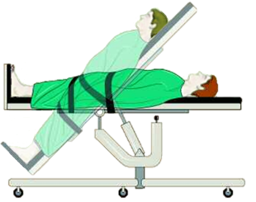
Case Study 1: The Tilt Table Experiment
Arterial Blood Pressure
0
0.5
1
1.5
2
2.5
3 mins
We will zoom-in to here in the next slide
We ran time series chain discovery on the dataset. The only thing we tell it is the length of the subsequence to use (about one heartbeat long).

Slide 31
Zoom In
60
mmHg
40
20
tilt begins
0
5000
As the chain progresses, the depth of the dicrotic notch decreases….
Peak systolic pressure
Systolic uptake
Dicrotic notch
Systolic decline
Dicrotic runoff
2040
2220
2440
2620
3040
3220

Slide 32
Case Study 2: Kohl’s Data
We looked at the google query volume for Kohl’s, an American retail chain.
2004
2014
0
250 weeks
500 weeks

Slide 33
Case Study 2: Kohl’s Data
We looked at the google query volume for Kohl’s, an American retail chain.
The discovered chain shows that over the decade, the bump transitions from a smooth bump covering most of the period between thanksgiving and Xmas, to a more sharply focus bump centered on thanksgiving. This seems to reflect the growing importance of Cyber Monday, a marketing term for the Monday after Thanksgiving. The phrase was created by marketing companies to persuade people to shop online. The term made its debut on November 28th, 2005 in a press release entitled “Cyber Monday Quickly Becoming One of the Biggest Online Shopping Days of the Year” . Note that this date coincides with the first glimpse of the sharping peak in our chain.
2004
2014
0
250 weeks
500 weeks
Thanksgiving
Xmas
45
55
95
105
150
165
305
315
410
420
460
475
Note that not all the “bumps” are included in the chain. There are some special years that do now follow this general trend.

Slide 34




Using Chains to Predict the Future
Given the first five links of the chain, can we predict the red shape well?
?
2004
2014
0
250 weeks
500 weeks
2.5
$L_{k}$-1
$$L_{k}$$
$L_{k+1, predicted}$= $L_{k}$+ $D$
2
1.5
1
$$D=L_{k}−L_{k−1}$$
0.5
0
-0.5
-1
1.525
1.53
1.535
1.54
10
4
1.585
1.59
1.595
1.6
10
4
1.645
1.65
1.655
1.66
10
4
Shape predicted by persistence prediction
Shape predicted with the discovered chain
We can use the difference between links to predict the future.
We can predict better with Time Series Chains.

Slide 35
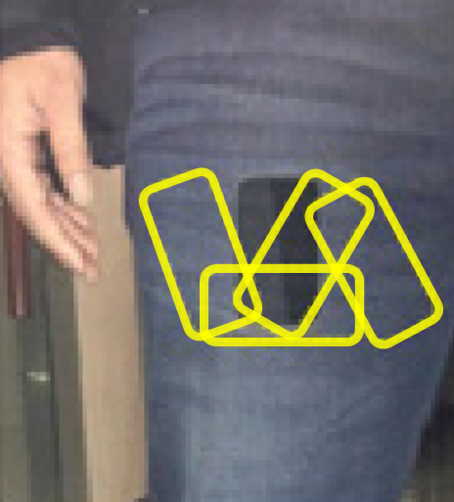
Case Study 3: Human Gait
Consider a snippet of a gait dataset recorded to test a hypothesis about biometric identification . As hinted at in the figure below (taken from the original paper), the authors of the study where interested in “the instability of the mobile in terms of its orientation and position when it is put freely in the pocket”
Given the experimental setup, we suspected that the gait pattern might start out as being unpredictable as the phone jostled about in the user’s pocket, eventually settling down as the phone settled into place.
0

Slide 36
Case Study 3: Human Gait
Consider a snippet of a gait dataset recorded to test a hypothesis about biometric identification . As hinted at in the figure below (taken from the original paper), the authors of the study where interested in “the instability of the mobile in terms of its orientation and position when it is put freely in the pocket”
Given the experimental setup, we suspected that the gait pattern might start out as being unpredictable as the phone jostled about in the user’s pocket, eventually settling down as the phone settled into place.
This is exactly what we see in the figure below.
0
200
400
600
800
160
180
380
420
620
660
760
780
780
820
820
860
Note that the first few links are far apart and asymmetrical, but the last few links are close together, and almost perfectly symmetric.

Slide 37
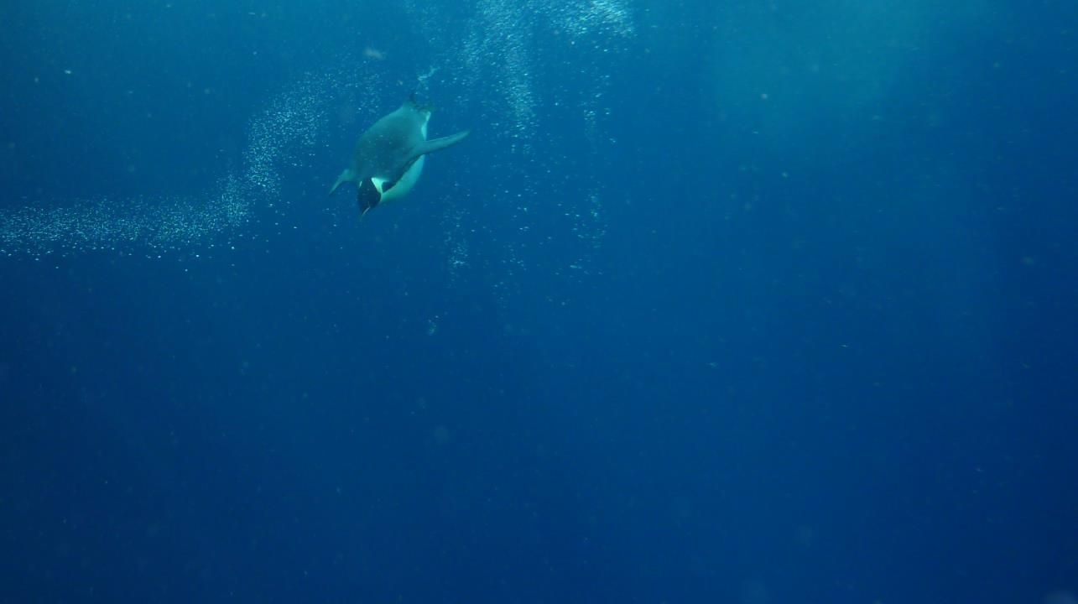
Case Study 4: A diving Penguin
Magellanic penguins regularly dive to depths of up to 50m to hunt prey. Penguins have typical body densities for a bird, but just before diving they take a very deep breath that makes them exceptionally buoyant. This positive buoyancy is difficult to overcome near the surface, but at depth, the compression of water pressure cancels it. In order to get to down to their hunting ground below sea level it is clear that “locomotory muscle workload, varies significantly at the beginning of dives”*.
The snippet of time series shown in does not suggest much of a change in stroke-rate, however penguins are able vary the thrust of their flapping by twisting their wings. The chains we discovered shows this dramatic and evolving sprint downwards leveling off to a comfortable cruise.
3-minute snippet of X-Axis Acceleration
pressure
Zoom-In
0
*Williams, C.L. et al. Muscle energy stores and stroke rates of emperor penguins: implications for muscle metabolism and dive performance. Physiological and Biochemical Zoology.85.2(2011):120-133
18 seconds
Photo by Paul J. Ponganis
Notes:
This chain does have a simple interpretation. Adult Magellanic penguins regularly dive to depths of up to 50m to hunt prey, and may spend as long as fifteen minutes under water. One of our sensors measures pressure, which we showed as a fine/red line. This shows that the chain begins just after the bird begins its dive, and ends as it reached its maximum depth of 6.1 meters. Magellanic penguins have typical body densities for a bird at sea-level, but just before diving they take a very deep breath that makes them exceptionally buoyant [16]. This positive buoyancy is difficult to overcome near the surface, but at depth, the compression of water pressure cancels it, giving them a comfortable neutral buoyancy.
In order to get to down to their hunting ground below sea level it is clear that “(for penguins) locomotory muscle workload, varies significantly at the beginning of dives” . The snippet of time series shown in does not suggest much of a change in stroke-rate, however penguins are able vary the thrust of their flapping by twisting their wings.
The chains we discovered shows this dramatic sprint downwards leveling off to a comfortable cruise. Fortunately, our data contains about a dozen major dives, allowing us to confirm our hypothesis about the meaning of this chain on more data.
Note that our chain does not include every stroke in the dive. Our data is undersampled (only 40Hz for a bird that can swim at 36kph) and this data is recorded in the wild, the bird may have changed directions to avoid flotsam or fellow penguins. However, this is a great strength of our algorithm, we do not need “perfect” data to find chains, we can find chains in real-world datasets.

Slide 38
How Robust are Chains in the Face of Noise?
We used a synthetic dataset with 20 embedded patterns, and tested how well our chain discovery algorithm can recover these embedded patterns.
random noise is added to distort the patterns
0
500

Slide 39
How Robust are Chains in the Face of Noise?
We used a synthetic dataset with 20 embedded patterns, and tested how well our chain discovery algorithm can recover these embedded patterns.
random noise is added to distort the patterns
0
500
100%
Precision
no noise
50%
Recall
20% noise
0%
0
20
40
60
80
100
noise amplitude / signal amplitude (%)

Slide 40

Summary
Code/Dataset:
We have introduced Time Series Chains, and developed a simple and robust definition for it.
Time Series Chain Discovery is independent of domain knowledge, and requires only one example time series.
We developed an ultra-fast tool to mine Time Series Chains, all you have to provide is the data, and a subsequence length.
Our algorithm leverages STOMP, the the state-of-the-art motif discovery algorithm. With the same amount of time that STOMP uses to evaluate motifs, our algorithm can compute all the chains in a time series.
Contact us:
yzhu015@ucr.edu
eamonn@cs.ucr.edu

Slide 41
Future Research Directions
Code/Dataset:
Time Series Chains have implications for prognostics, time series prediction, concept drift, causality analysis, etc.
We can expand time series chains to multidimensional chains, chains based on other distance measure, spatial chains, etc.
Note that the Chain definition is not restricted to time series subsequences.
Contact us:
yzhu015@ucr.edu
eamonn@cs.ucr.edu

Slide 42
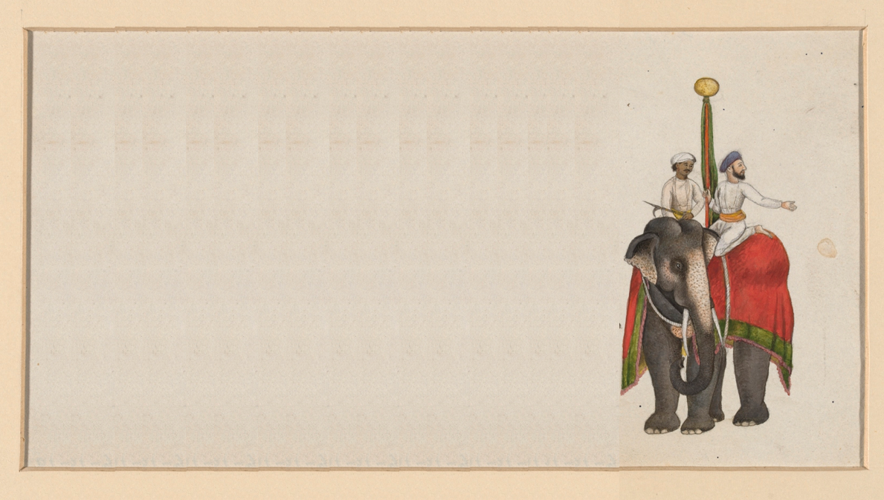
The Matrix Profile Series
This paper “Matrix Profile VII”, is the seventh in a series of papers that outline our vision for the Matrix Profile as the only tool you need for solving a large portion of time series data mining analytics.
The first nine papers are freely available at The UCR Matrix Profile Page, together with the code/data.
If you want to contribute suggestions, brainpower, computational resources, data, funding… Lets talk.
www.cs.ucr.edu/~eamonn/MatrixProfile.html

Slide 43


The Highly Desirable Properties of the Matrix Profile
Matrix Profile can be used to do:
Fast Motif Discovery
Anomaly Detection
Data Visualization
Guided Motif Search
Multivariate Time Series Mining
Semantic Segmentation
Fast Various-Length Motif Discovery
Chain Discovery
…and much more!
exact
deterministic computation time
simple
Parameter-free
can be evaluated online
intuitive
allows anytime algorithms
highly parallelizable
space efficient
Matrix Profile Project Webpage:
www.cs.ucr.edu/~eamonn/MatrixProfile.html

Slide 44
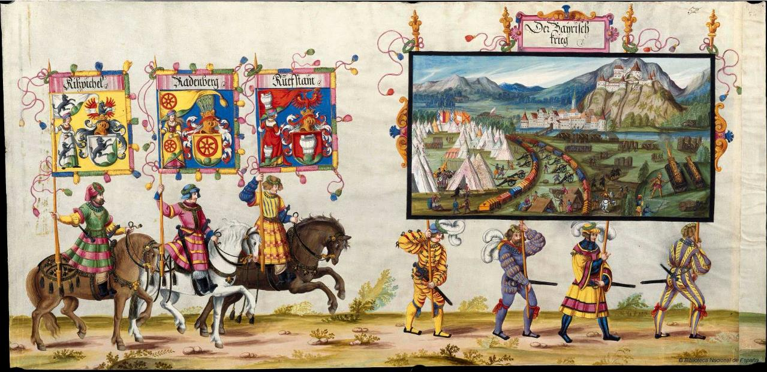


To get these slides, go to www.cs.ucr.edu/~eamonn/MatrixProfile.html
Thanks for Listening
Questions?

