Slide 1
Elix Path-selective taint analysis for extracting mobile app links
Yongjian Hu Two Sigma Investments
Oriana Riva Microsoft Research
Suman Nath Microsoft Research
Iulian Neamtiu New Jersey Institute of Technology

Slide 2
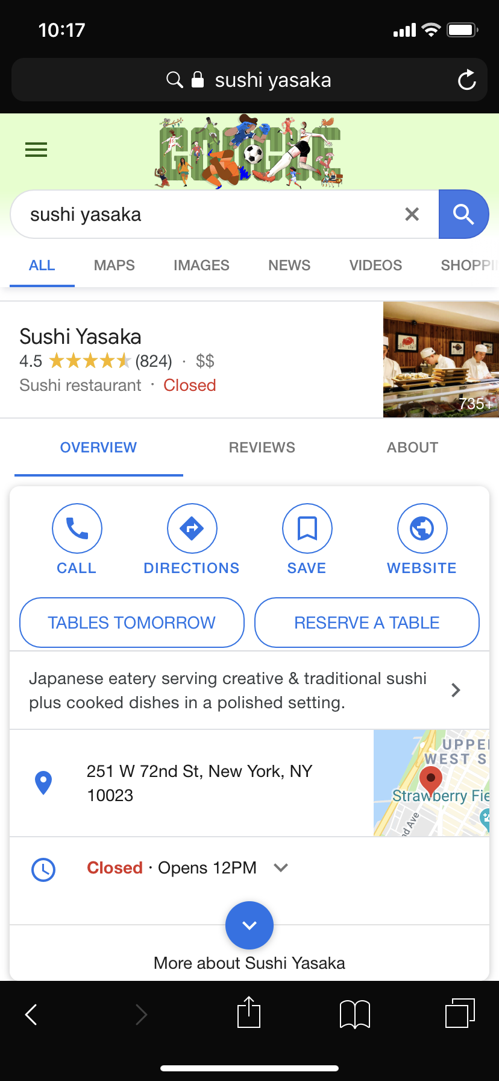
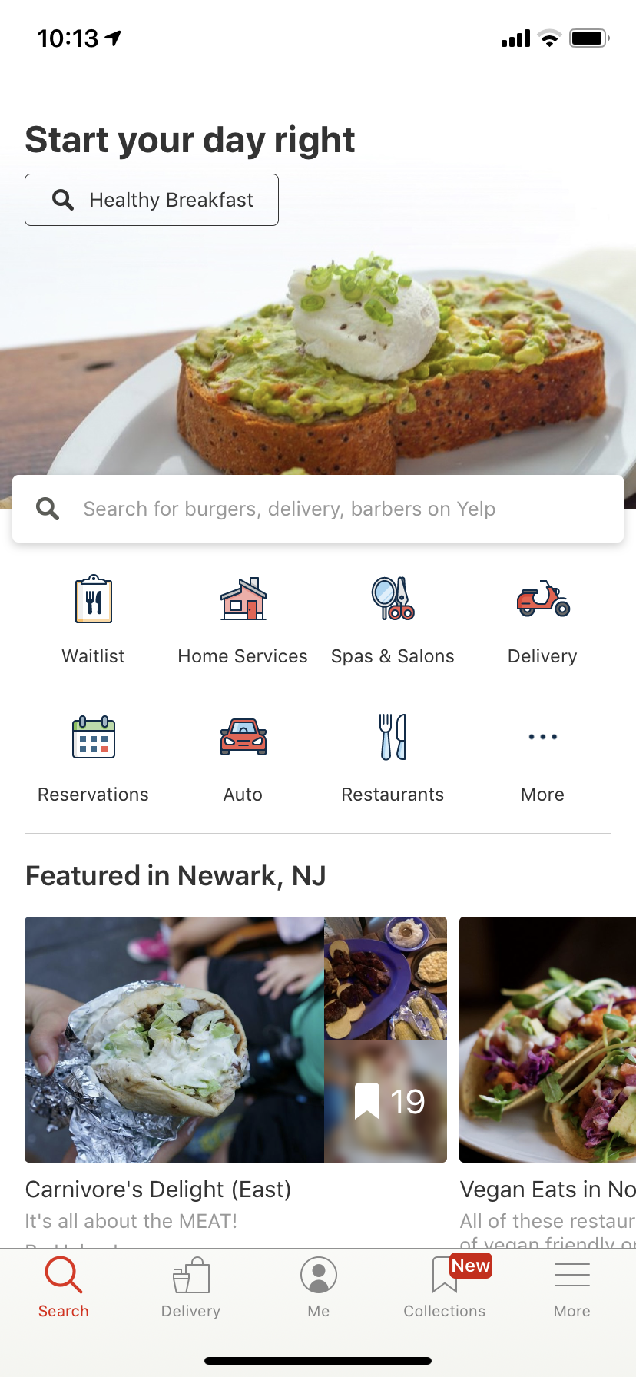
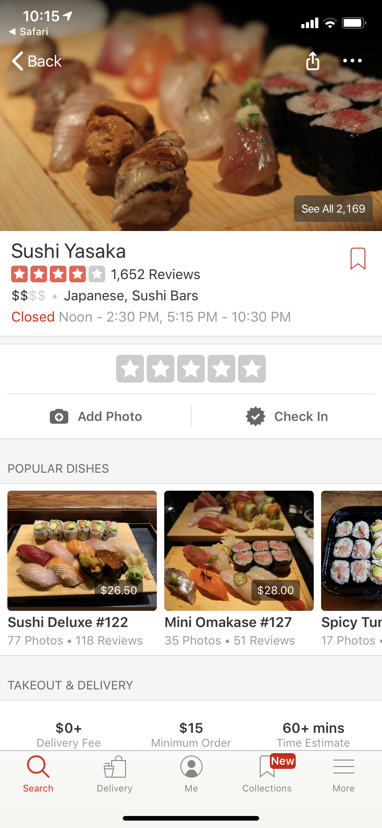
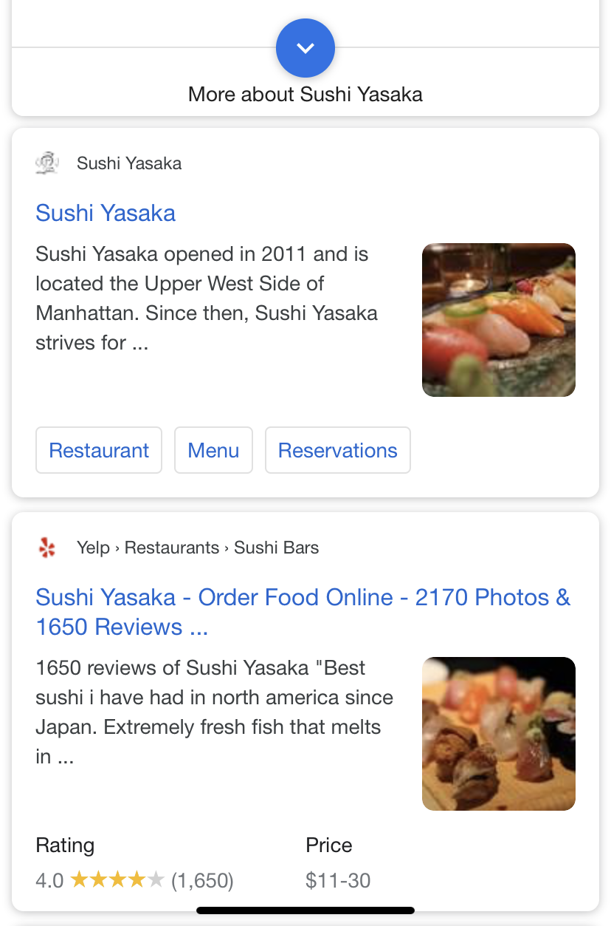
Browser app
m.yelp.com/biz/sushi-yasaka-new-york
Yelp app
App (“deep”) link

Slide 3
Mobile app links
URIs that point to specific pages in an app
m.yelp.com/biz/<restaurant-id>
spotify:track:<track-id>
imdb/title/<movie-id>
App
Home screen
App
Specific page
App link
Also used by intelligent assistants, e.g., “which movies are playing today?”
“call an Uber to this location”
Problems
Discovering app links (at scale) is hard
Coverage of app pages is low: few apps expose few links
Notes:
How can we enable the equivalent of web URLs in mobile apps?
We could leverage mobile deep links, uris… for instance, the foursquare app includes a deep link to uber.
However, deep links have limitations, and are not suitable to achieve our goal of apps with uris.
{ "name": "She's So Unusual", "type": "album", ... "uri": "spotify:album:0sNOF9WDwhWunNAHPD3Baj" }

Slide 4
Discovery of app links

Slide 5
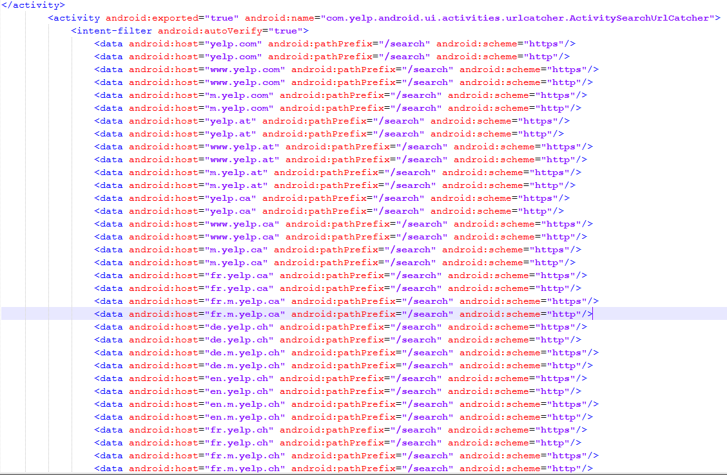
Option #1: Use app manifest file
https://www.yelp.com/search
Notes:
Repeating the link for each scheme and host

Slide 6
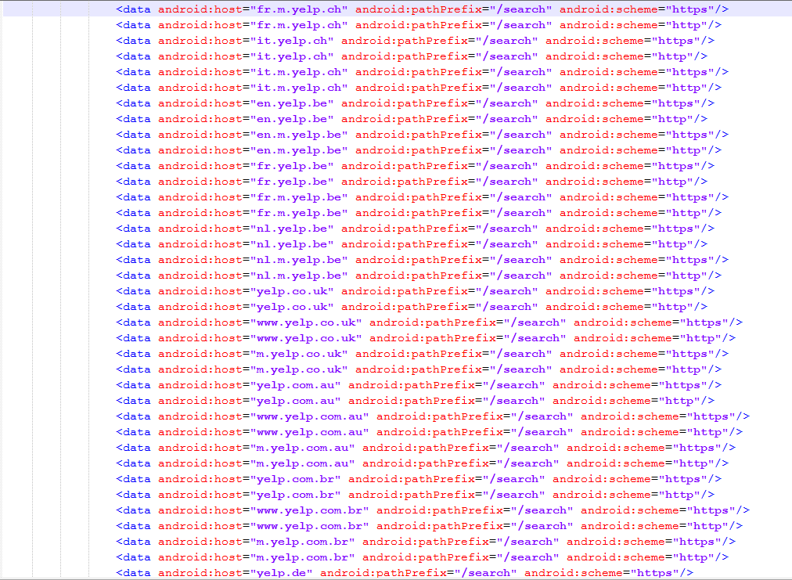
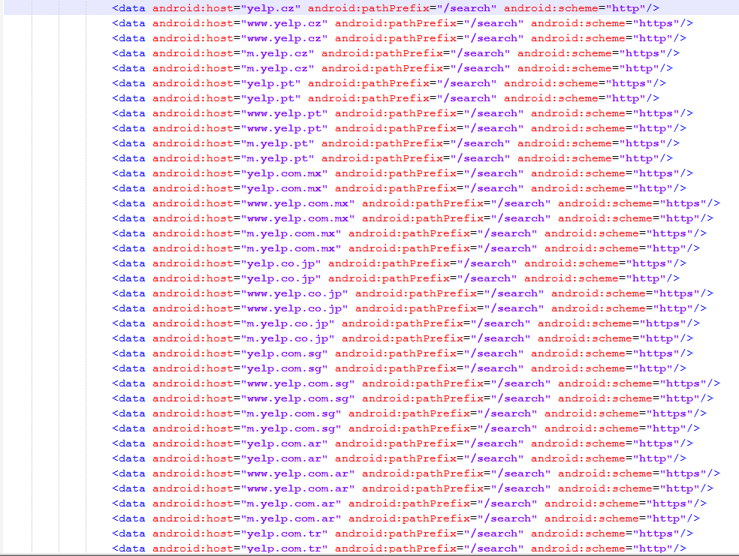
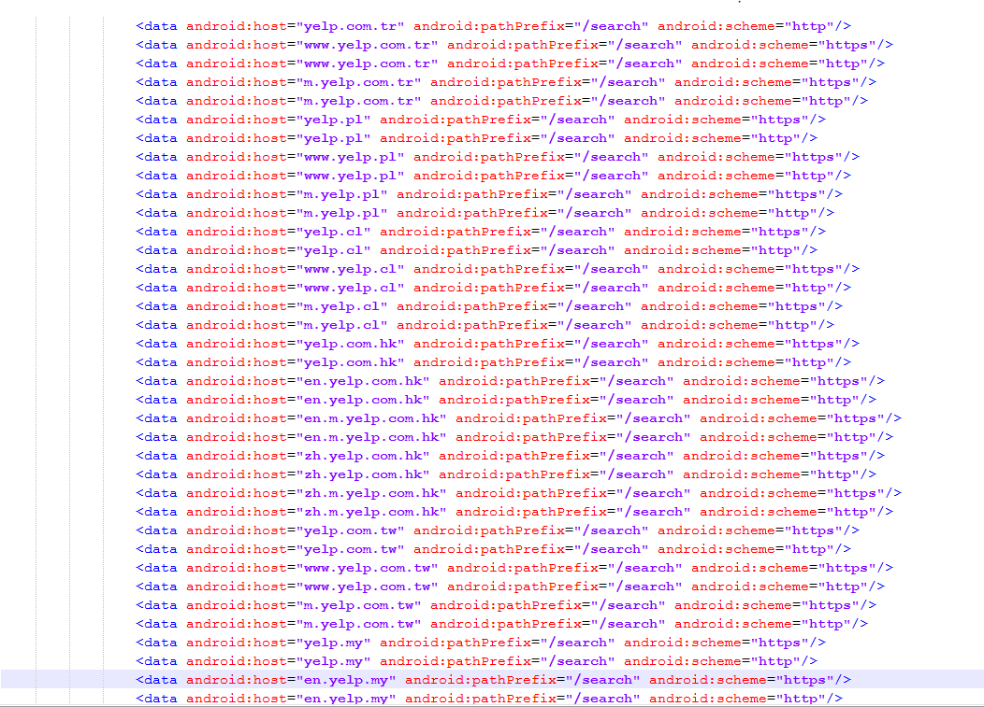
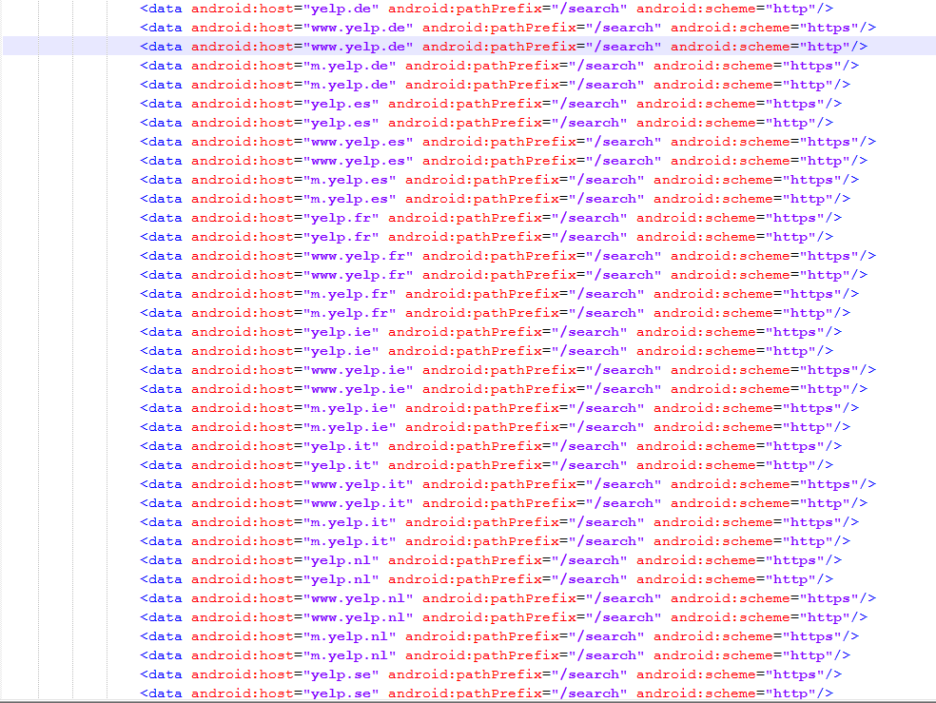
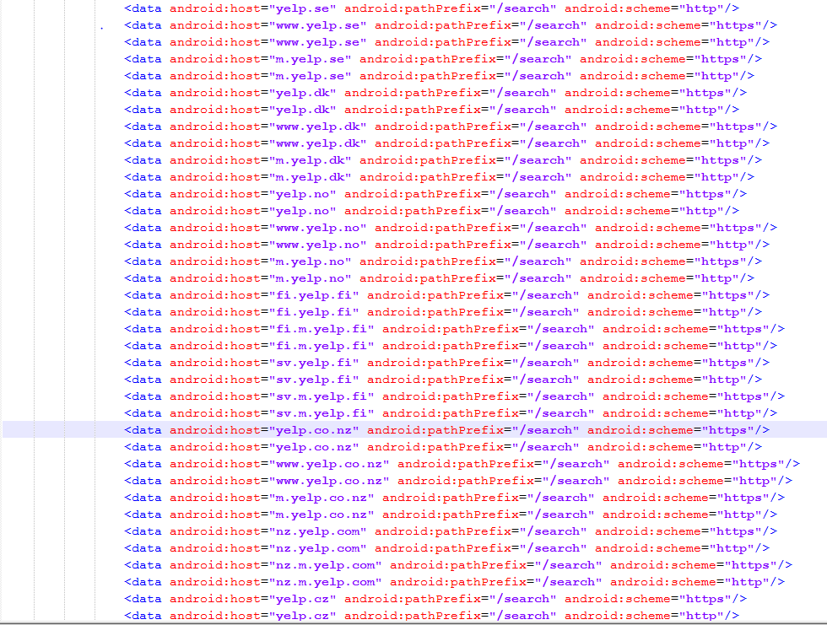

Slide 7
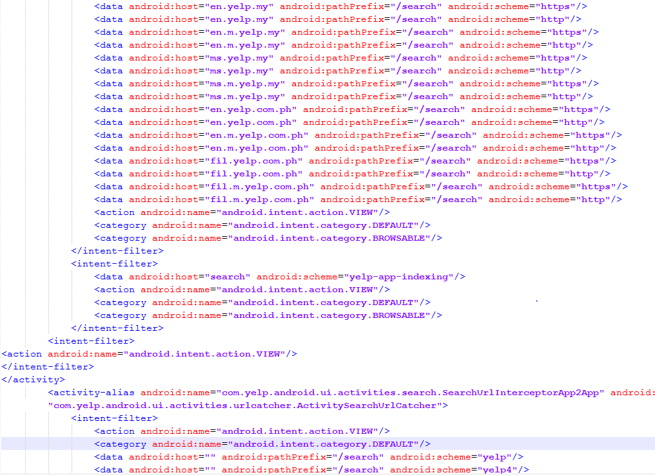
https://www.yelp.com/search
Problem: schemes declared in the manifest file are not useful
The actual app link is http://www.yelp.com/search?find_desc=<>&find_loc=<>
Notes:
At the end it doesn’t even tell me the full scheme

Slide 8
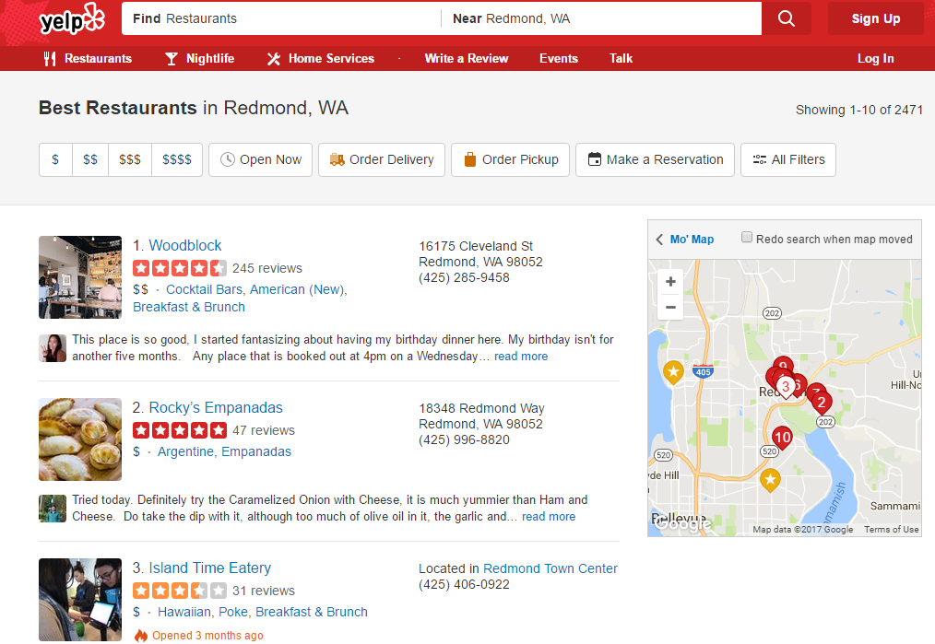
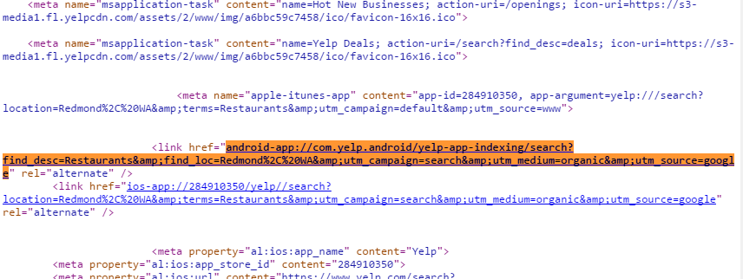
Option #2: Use app website (if it exists)
http://www.yelp.com/search?find_desc=<>Restaurants&find_loc=Redmond

Slide 9
App | Web-discoverable | Actual links
Open Table | 1 | 10
Kayak | 3 | 10
Fandango | 0 | 15
CNN | 2 | 6
Shazam | 3 | 15
Duolingo | 0 | 10
Airbnb | 8 | 19
Zomato | 1 | 10
Dictionary.com | 0 | 8
ABC news | 1 | 3
BBC news | 0 | 1
AirWatchESPN | 0 | 3
IMDB | 0 | 23
Eat24 | 2 | 2
Average | 1.5 | 9.6
Problem:
Web-based discovery provides low coverage of an app’s links
Coverage: 16%
Notes:
14 apps/websites
Elix: 99%

Slide 10
Elix approach

Slide 11
Elix addresses these problems via static analysis
Discovery of app links
→ Elix uses static analysis to discover more app links and at scale
Coverage of an app pages
→ Elix discovers both exposed and non-exposed app links, thus increasing coverage
Notes:
To address both problems – discovering existing app links and
the scarcity of available app links – we propose the Elix app link
extractor. For discovery, Elix statically analyzes an app binary to
automatically extractitsapp links,aprocessthatcanscale toalarge
number of apps, including apps without webpages or that do not
list app links on their webpages. To address the scarcity challenge,
in addition to the links exposed by the app developer, Elix provides
developers with an automated approach to build new links and
publish them, if the are willing to do so. Thus, Elix increases app
link coverage of both link-enabled apps (i.e., apps whose developers
have manually exposed some app links) and of link-enabled pages
inside each app (i.e., pages that the developer has not explicitly
exposed).

Slide 12
Key insight
A1
A2
A3
Unlike legacy programs, mobile apps are highly structured
In Android, Intent contains the parameters necessary to launch an app page
Idea: capture intents statically and observe how their parameters flow in the app
→ App link extraction as static taint analysis
startActivity(intent)
Android Framework
Notes:
The way mobile apps are built allows us to define the problem of link extraction as a taint tracking problem. At the high level, using taint propagation we observe how the parameters contained in the intent object describing the activity to launch flow in the activity code to create it. The parameters and their flow implicitly define the link to that activity.
Let’s make this more concrete with an example.

Slide 13
Modelling app link extraction as a static taint analysis problem
Look at how parameters propagate in the activity code. Their flow defines the link
void onCreate(Bundle savedInstanceState) {
Intent intent = getIntent();
Bundle bundle = intent.getBundle();
if (intent.getAction().equals("android.intent.action.VIEW")) {
Restaurant restaurant = (Restaurant) bundle.getSerializable("restaurant");
this.titleView.setText(this.restaurant.getName());
RestaurantLocation loc = (RestaurantLocation) bundle.getParcelable("location");
GoogleMapApi.setLocation(loc);
} else if (intent.getAction.equals("android.intent.action.SEARCH")){
String query = bundle.getString("query");
List<Restaurant> nearby = bundle.getParcelable("nearby_restaurants");
for (Restaurant r : nearby) {
... // process r
}
}
}
Receive request parameters in intent/bundle
ACTION = view
First app link
ACTION=search
Second app link
⊗
(path-insensitive) Static analysis would merge (conflate) these branches
Incorrect link: ACTION = view ∨ ACTION = search
Notes:
We start by looking at app link extraction. At a high level the idea is to look at how parameters propagate in the activity code. Their flow defines the link.
Each time an activity must be started an intent carrying the parameters necessary to its construction is passed to it.
The carried parameters and how they are used in the activity code implicitly define one or multiple “paths” to start that activity. We save paths in the format of app links.
Based on the code above, an app link extractor should: (i) Accurately extract separate app links fortheViewandSearchfunctionalities,and(ii)foreachlink,
simplify the inputs by reducing the number of object fields so the app link can be invoked easily.
The app fetches the restaurant complex object from the link parameters and displays the restaurant name (line 12), and then sets the Google Maps location to the restaurant’s location loc (line 15). Lines 17–22 handle the case of a request with action=SEARCH: a list of nearby restaurants is extracted from the bundle and iterated upon (the “for” loop on lines 20–22)

Slide 14
Idea: use symbolic execution to avoid conflation
Path condition
void onCreate(Bundle savedInstanceState) {
Intent intent = getIntent();
Bundle bundle = intent.getBundle();
if (intent.getAction().equals("android.intent.action.VIEW")) {
Restaurant restaurant = (Restaurant) bundle.getSerializable("restaurant");
this.titleView.setText(this.restaurant.getName());
RestaurantLocation loc = (RestaurantLocation) bundle.getParcelable("location");
GoogleMapApi.setLocation(loc);
} else if (intent.getAction.equals("android.intent.action.SEARCH")){
String query = bundle.getString("query");
List<Restaurant> nearby = bundle.getParcelable("nearby_restaurants");
for (Restaurant r : nearby) {
... // process r
}
}
}
𝜋
Precise but unscalable!
(“path explosion”)
𝜋 ∧ I=VIEW ∧ ⌐ I=SEARCH
First app link
𝜋 ∧ I=SEARCH ∧ ⌐ I=VIEW
Second app link
Fork into two different, mutually exclusive symbolic executions
𝜋 ∧ I=VIEW ∧ ⌐ I=SEARCH
𝜋 ∧ I=SEARCH ∧ ⌐ I=VIEW
Notes:
We start by looking at app link extraction. At a high level the idea is to look at how parameters propagate in the activity code. Their flow defines the link.
Each time an activity must be started an intent carrying the parameters necessary to its
construction is passed to it.
The carried parameters and how they are used in the activity code implicitly define one or multiple “paths” to start that activity. We save paths in the
format of app links.
Based on the code above, an app link
extractor should: (i) Accurately extract separate app links
fortheViewandSearchfunctionalities,and(ii)foreachlink,
simplify the inputs by reducing the number of object fields
so the app link can be invoked easily.

Slide 15
Taming path explosion: path-selective taint tracking
Path condition
void onCreate(Bundle savedInstanceState) {
Intent intent = getIntent();
Bundle bundle = intent.getBundle();
if (savedInstanceState != null) // branch not tainted, MERGE
bundle = si;
else
bundle = intent.getBundle();
if (intent.getAction().equals("android.intent.action.VIEW")) {// branch tainted, NO MERGE
Restaurant restaurant = (Restaurant) bundle.getSerializable("restaurant");
this.titleView.setText(this.restaurant.getName());
RestaurantLocation loc = (RestaurantLocation) bundle.getParcelable("location");
GoogleMapApi.setLocation(loc);
} else if (intent.getAction.equals("android.intent.action.SEARCH")){
String query = bundle.getString("query");
List<Restaurant> nearby = bundle.getParcelable("nearby_restaurants");
for (Restaurant r : nearby) {
... // process r
}
}
}
Static taint analysis tracks the propagation of information from a SOURCE to a SINK
𝜋
𝜋 ∧ savedInstanceState != null
⊗
𝜋 ∧ savedInstanceState = null
𝜋
𝜋 ∧ I=VIEW ∧ ⌐ I=SEARCH
𝜋 ∧ I=SEARCH ∧ ⌐ I=VIEW
Notes:
We start by looking at app link extraction. At a high level the idea is to look at how parameters propagate in the activity code. Their flow defines the link.
Each time an activity must be started an intent carrying the parameters necessary to its
construction is passed to it.
The carried parameters and how they are used in the activity code implicitly define one or multiple “paths” to start that activity. We save paths in the
format of app links.
Based on the code above, an app link
extractor should: (i) Accurately extract separate app links
fortheViewandSearchfunctionalities,and(ii)foreachlink,
simplify the inputs by reducing the number of object fields
so the app link can be invoked easily.

Slide 16
Result: extracted app links
void onCreate(Bundle savedInstanceState) {
Intent intent = getIntent();
Bundle bundle = null;
if (intent.getAction().equals("android.intent.action.VIEW")) {
Restaurant restaurant = (Restaurant) bundle.getSerializable("restaurant");
this.titleView.setText(this.restaurant.getName());
RestaurantLocation loc = (RestaurantLocation) bundle.getParcelable("location");
GoogleMapApi.setLocation(loc);
} else if (intent.getAction.equals("android.intent.action.SEARCH")){
String query = bundle.getString("query");
List<Restaurant> nearby = bundle.getParcelable("nearby_restaurants");
for (Restaurant r : nearby) {
... // process r
}
Link 1
Path constraint: android.intent.action == "VIEW"
p1: string:android.intent.action
p2: Serializable:restaurant // complex object reduction
p3: Parcelable: location
Link 2
Path constraint: android.intent.action == "SEARCH"
p1: string:android.intent.action
p2: string:query
p3: Parcelable: nearby_restaurants
Notes:
Activity: com.opentable.activities.rest.info.MapActivity
Activity: com.airbnb.activities.ManageListingActivity
Taint analysis is used to track the
propagation of information from a source to a sink

Slide 17
Examples of Elix-extracted app links
OpenTable - view restaurant information on a map Activity: com.opentable.activities.restaurant.info.MapActivity
p1: string:(com.opentable.models.Restaurant)_restaurant{restaurantName}
// complex object reduction: only expose used params, see paper
p2: bool:EXTRA_ENABLE_DINING_MODE_UI
p3: bool:streetViewExtra
Airbnb – search room listings Activity: com.airbnb.activities.ManageListingActivity
p1: string:android.intent.action
IMDB - view showtimes for a movie on a day
Activity: com.imdb.mobile.showtimes.ShowtimesActivity p1: string:com.imdb.mobile.tconst p2: string:com.imdb.mobile.date

Slide 18
Implementation & Evaluation

Slide 19
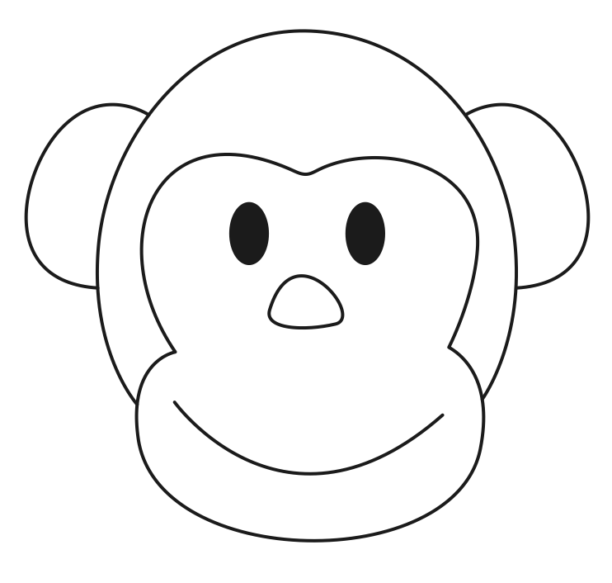
Testbed
Static app link extractor
Link executor installed on device
Testing infrastructure
Dynamic analysis for link parameterization
Phones + Azure VMs
Tested on top-1007 Google Play apps
app links
Link extraction
(Static analysis)
Validated
app links
apps
Testing infrastructure
...
Execution
Log analysis
+
x
+
x
Input collection
x
...
...
+
...
Monkey logs
Notes:
Apps are executed on physical phones (Nexus 5) and Virtual Machines (VMs). VMs are hosted in Azure Hyper-V and run Android X86
false negatives were rare. False positives occurred mainly when a link executed, but did not lead to the target page (e.g., a page with a popup error).

Slide 20
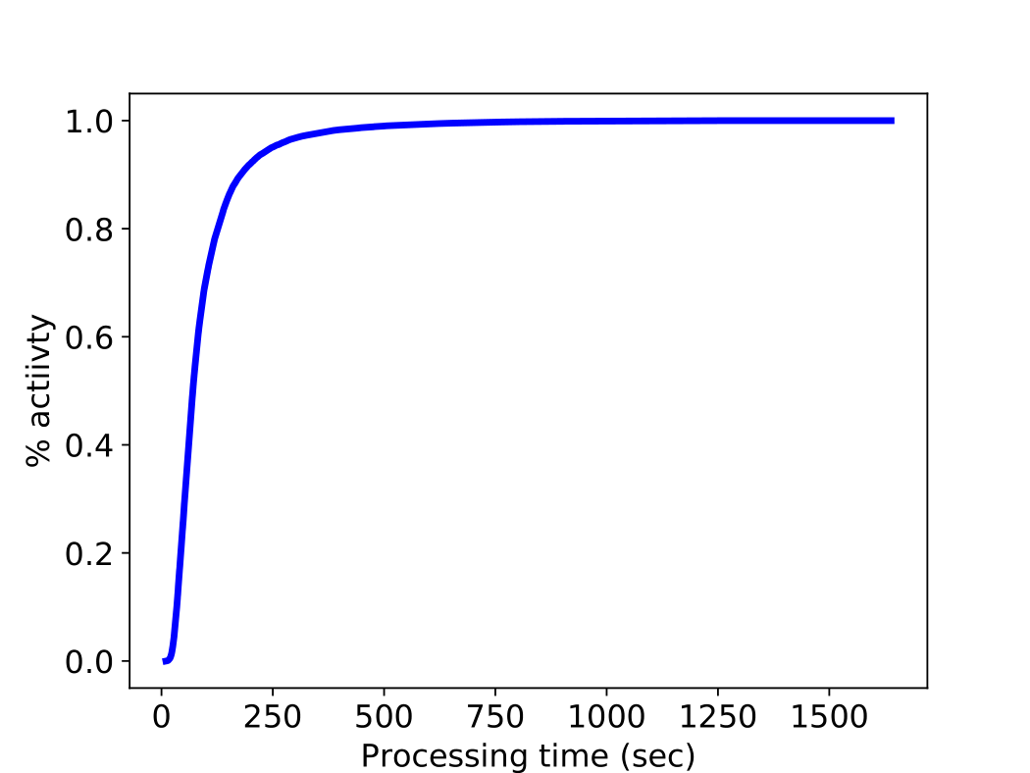
Static analysis performance
Total of 38,419 activities analyzed
89% succeeded
10% timed out; 1% failed
(FlowDroid, symbolic executor)
Avg proc time per activity = 104 sec
57,750 links extracted (1.7 per activity)
Notes:
for 80% of apps the analysis for a single activity was done within 2.1 minutes

Slide 21
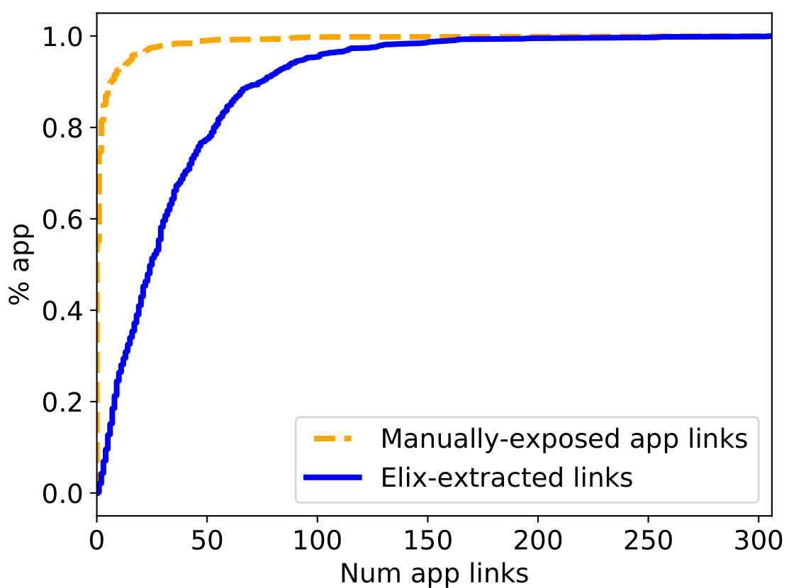
App coverage
Status quo, top-1007 Android apps
Only 45% apps the expose >1 link Only 25% apps expose >2 links
Elix extracts
>2 links for 98% of apps >25 links for 50% of apps
Elix increases coverage of link-enabled apps and link-enabled pages in an app

Slide 22
Execution success rate
Run app with Monkey, intercept intent params, link-execute w/those params
Executed 1,386 links in 100 apps; check logs & GUIs
For 80% apps, success rate=67%; for 50% apps, success rate=92%
(84% avg success rate per app)
App | Activities Total With Links |  | Tested links | Success | Fail
IMDB | 67 | 67 | 14 | 12 | 2
Netflix | 47 | 45 | 10 | 9 | 1
Spotify | 82 | 53 | 27 | 22 | 5
OpenTable | 54 | 52 | 13 | 12 | 1
CNN News | 31 | 28 | 10 | 9 | 1
Instagram | 24 | 22 | 13 | 8 | 5
Failure causes: missed param due to Dependency Injection, serialization, fragments
Notes:
false negatives were rare. False positives occurred mainly when a link executed, but did not lead to the target page (e.g., a page with a popup error).
We found three main causes of failure, listed in order of prevalence. 1) Dependency injection: the link was missing a required parameter due to dependency injection not yet supported by Elix (see §3.4). 2) Link Executor limitations: links failed when i) they required parameters of type Bundle, ParcelableArray or ParcelableArrayList whose seri- alization/deserialization is not yet supported by our Link Executor, and ii) their parameters included field types of a class declared as a Java Interface so our Link Executor was not able to load the appropriate constructor (the constructor name should be captured during static analysis). 3) False negatives due to Fragments (§3.4).

Slide 23
Conclusions
Automatically extracting app links is technically feasible
89% activities processed successfully
84% apps extracted & tested successfully
Many possible applications for Elix
Search engines
In-house app developers
App stores

Slide 24
Backup

Slide 25
sources sinks
activity_1
APKs
Harness generation
Taint
propagation
...
activity_n
...
Static symbolic execution
Taint summary
Tainted complex objects
Activity_1.link
Activity_2.link
Activity_n.link
...
Complex object reduction
2nd round taint propagation

Slide 26
app links
Automated testing infrastructure
Link extraction
(Static analysis)
Validated
app links
apps
Testing infrastructure
...
Execution
Log analysis
+
x
+
x
Input collection
...
x
...
+
...
monkey logs

Slide 27
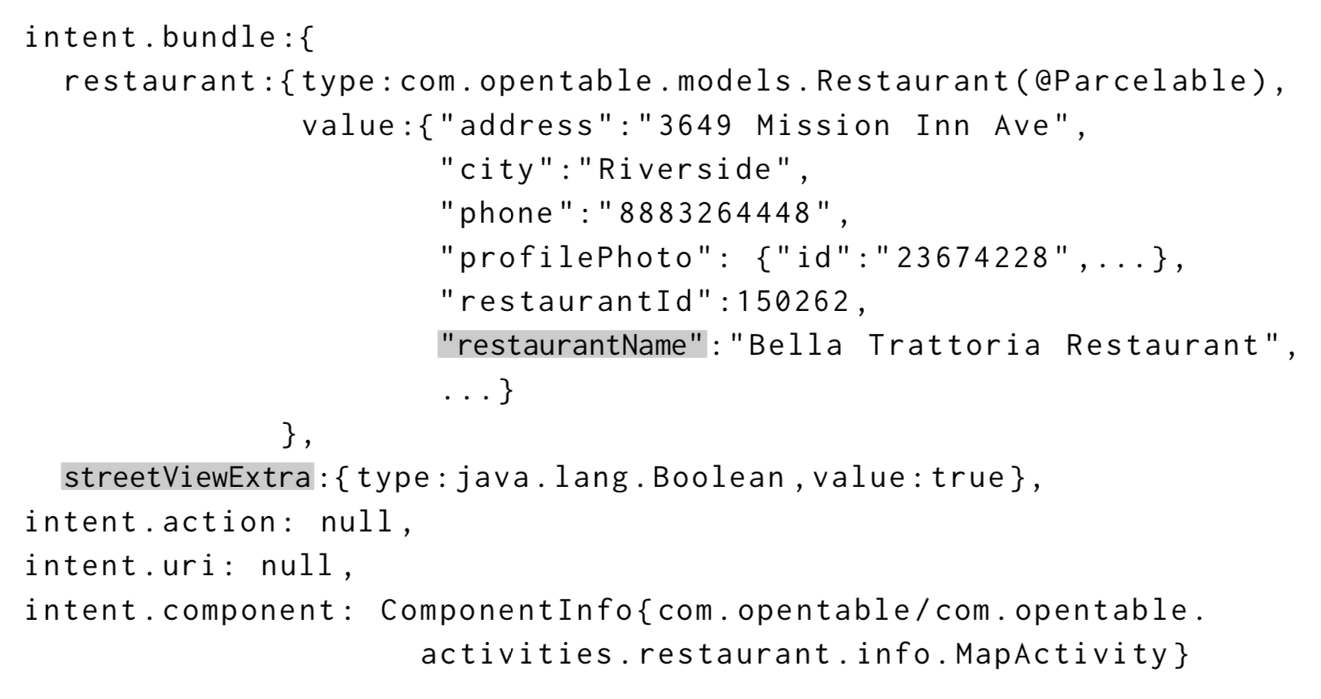
Complex object reduction
2nd round of taint propagation with getSerializableExtra(String key) and getParcelableExtra(String key) as sources
Keeps track of the object fields accessed
If it flows outside the analysis scope it assumes all fields are used

Slide 28
Mobile app links
URIs that point to specific pages in an app
m.yelp.com/biz/sushi-yasaka-new-york
spotify:track:<track-id>
imdb/title/<movie-id>
App
Home screen
App
Specific page
App link
Also used by intelligent assistants, e.g., “which movies are playing today”
“call an Uber to this location”
Problems: discovering links (at scale) is hard; exposing links is hard and error-prone
Notes:
How can we enable the equivalent of web URLs in mobile apps?
We could leverage mobile deep links, uris… for instance, the foursquare app includes a deep link to uber.
However, deep links have limitations, and are not suitable to achieve our goal of apps with uris.
{ "name": "She's So Unusual", "type": "album", ... "uri": "spotify:album:0sNOF9WDwhWunNAHPD3Baj" }

Slide 29
How to expose an app link in a mobile app (e.g., imdb/title/tt.* in the Android IMDB app)
1. Declare app links in the app manifest
2. Write handling code in the actual app
3. (Optional) Declare app links in the website counterpart
<activity android:name="com.imdb.mobile.intents.IntentsActivity">
<intent-filter>
<action android:name="android.intent.action.VIEW"/>
<category android:name="android.intent.category.DEFAULT"/>
<category android:name="android.intent.category.BROWSABLE"/>
<data android:host="" android:pathPattern="/title/tt.*" android:scheme="imdb"/>
</intent-filter>
</activity>
Notes:
e.g. imdb/title/tt3716530
Specify the ACTION_VIEW intent action so that the intent filter can be reached from Google Search.
Add one or more <data> tags, each of which represents a URI format that resolves to the activity. At minimum, the <data> tag must include the android:scheme attribute.
Include the BROWSABLE category. It is required in order for the intent filter to be accessible from a web browser. Without it, clicking a link in a browser cannot resolve to your app.Also include the DEFAULT category. This allows your app to respond to implicit intents. Without this, the activity can be started only if the intent specifies your app component name.

Slide 30
Problems with app links
Discovery of app links is hard
Hard to discover “usable” app links at scale
Coverage of app pages is low
Only a small fraction of apps expose app links
An app exposing links usually expose links for a small fraction of its pages
Among top-1,000 most popular Android apps, 55% expose no links, 20% expose 1 link, 25% expose 2 or more

Slide 31
Idea: use symbolic execution to avoid conflation
Path condition
void onCreate(Bundle savedInstanceState) {
Intent intent = getIntent();
Bundle bundle = intent.getBundle();
if (intent.getAction().equals("android.intent.action.VIEW")) {
Restaurant restaurant = (Restaurant) bundle.getSerializable("restaurant");
this.titleView.setText(this.restaurant.getName());
RestaurantLocation loc = (RestaurantLocation) bundle.getParcelable("location");
GoogleMapApi.setLocation(loc);
} else if (intent.getAction.equals("android.intent.action.SEARCH")){
String query = bundle.getString("query");
List<Restaurant> nearby = bundle.getParcelable("nearby_restaurants");
for (Restaurant r : nearby) {
... // process r
}
}
}
𝜋
𝜋 ∧ I=VIEW
First app link
𝜋 ∧ I=SEARCH
Second app link
Static analysis would merge (conflate) these branches, extracting incorrect link!!
Our solution: symbolic execution, which keeps separate paths (path conditions)
But problem: symbolic execution -> path explosion.
Solution: path-selective taint tracking
Notes:
We start by looking at app link extraction. At a high level the idea is to look at how parameters propagate in the activity code. Their flow defines the link.
Each time an activity must be started an intent carrying the parameters necessary to its
construction is passed to it.
The carried parameters and how they are used in the activity code implicitly define one or multiple “paths” to start that activity. We save paths in the
format of app links.
Based on the code above, an app link
extractor should: (i) Accurately extract separate app links
fortheViewandSearchfunctionalities,and(ii)foreachlink,
simplify the inputs by reducing the number of object fields
so the app link can be invoked easily.

Slide 32
Challenges in app link extraction
Static taint analysis tracks the propagation of information from a SOURCE to a SINK
void onCreate(Bundle savedInstanceState) {
Intent intent = getIntent();
Bundle bundle = null;
if (intent.getAction().equals("android.intent.action.VIEW")) {
Restaurant restaurant = (Restaurant) bundle.getSerializable("restaurant");
this.titleView.setText(this.restaurant.getName());
RestaurantLocation loc = (RestaurantLocation) bundle.getParcelable("location");
GoogleMapApi.setLocation(loc);
} else if (intent.getAction.equals("android.intent.action.SEARCH")){
String query = bundle.getString("query");
List<Restaurant> nearby = bundle.getParcelable("nearby_restaurants");
for (Restaurant r : nearby) {
... // process r
}
}
}
Problem 1: False positives due to merging branches
e.g., path = (action, restaurant, loc, query, nearby)
Problem 2: Complex objects
e.g., restaurant → restName
Notes:
Taint analysis is used to track the
propagation of information from a source to a sink

Slide 33
Elix’ approach
Problem 1: Selective path taint tracking with symbolic execution
Taint status and path condition are stored in a taint summary
Symbolic executor updates the symbolic state after each statement
To avoid path explosion, path merging and path killing
Problem 2: Complex object reduction
2nd round of taint propagation with getSerializableExtra(String key) and getParcelableExtra(String key) as sources
Keeps track of the object fields accessed
If it flows outside the analysis scope it assumes all fields are used
Notes:
Symbolic execution is a technique that allows symbolic reasoning about program state (symbolic state) and conditions to be met for executing a certain path (path constraints). Variables whose values are known are said to have concrete values; variables whose value is not known are handled symbolically. A symbolic executor “executes” the program in the symbolic domain.
Aquila keeps track of the program counter, current method and the call stack in the symbolic state.
3 For any statement b, its post-dominator pd is the first statement that will be executed on any path from b to program end.
we do not merge if either of the branch condition operand is tainted
path is killed at a statement (or branch condition) which invalidates the current path
symbolic execution can suffer
severely due to path explosion. Aquila avoids path explosion
through a novel path selectivity approach that uses path
merging and path killing.

Slide 34
Implementation details
Android 6.0
Based on FlowDroid
3 modules
App link extractor
Link executor to be installed on device
Testing infrastructure
Dynamic analysis for link parameterization
Phones + Azure VMs
Tested on top-1007 Android apps
app links
Link extraction
(Static analysis)
Validated
app links
apps
Testing infrastructure
...
Execution
Log analysis
+
x
+
x
Input collection
x
...
...
+
...
monkey logs

Slide 35
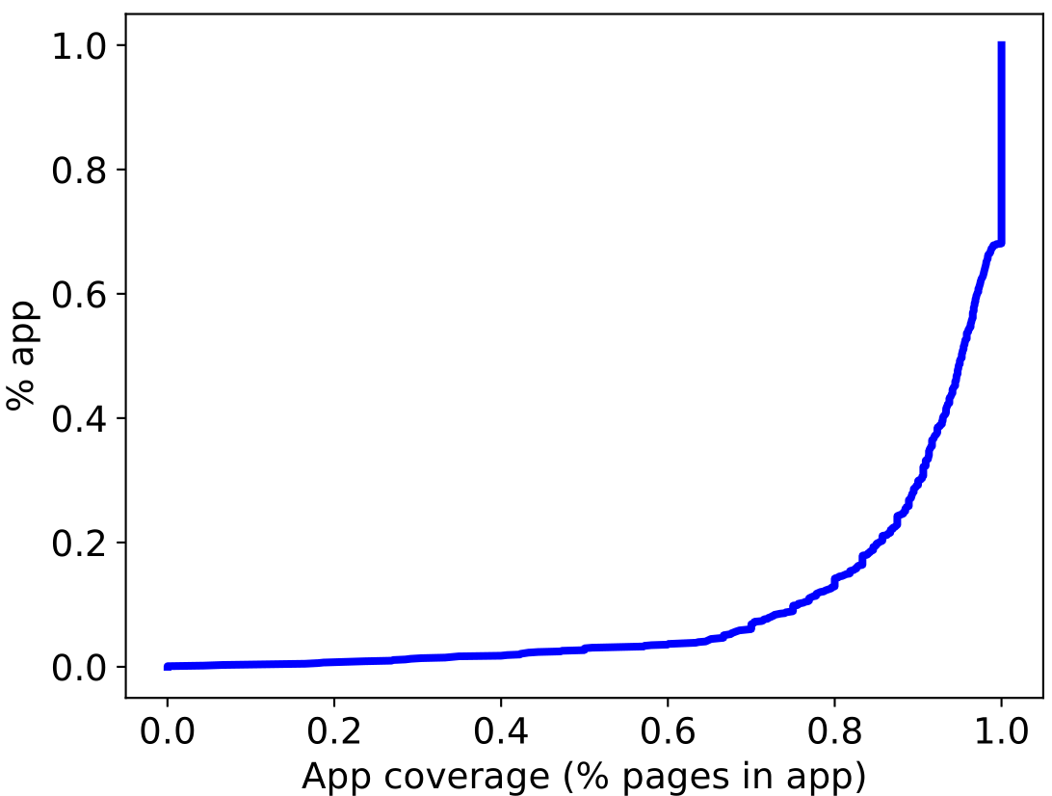
App coverage
Elix increases coverage of link-enabled apps and link-enabled pages in an app

Slide 36
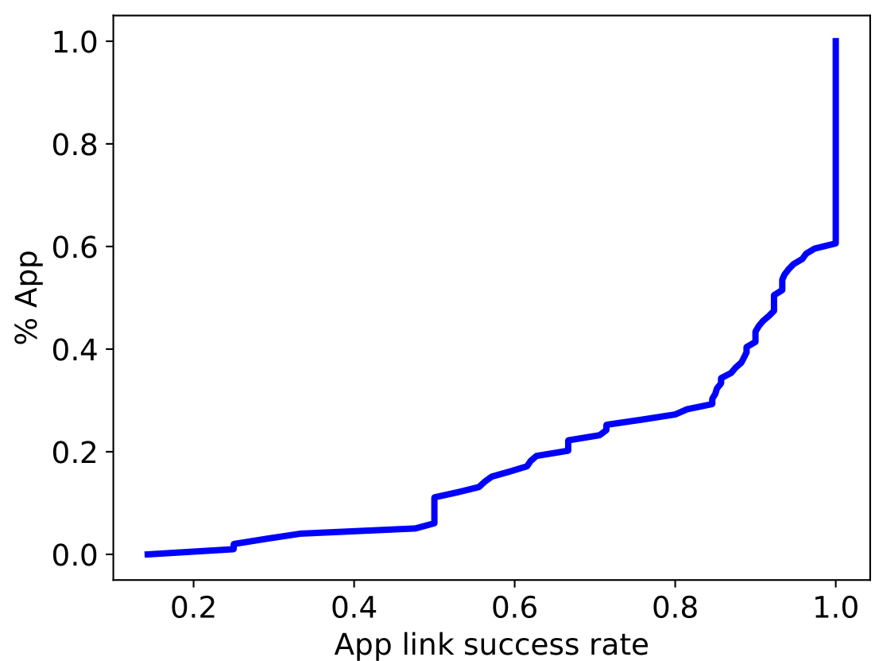
Execution success rate
Executed links for 100 apps
84% avg success rate per app
>67% for 80% of apps
>92% for 50% of apps

