Slide 1
COP5725 – Principles of Database Management Systems
Review
by Eduardo J Ruiz
(Adapted from Fernando Farfan Slides)

Slide 2
AGENDA
Ch1. Overview of DBMSs
Ch2. Database Design
Ch3. Relational Model
Ch4. Relational Algebra

Slide 3
AGENDA
Ch1. Overview of DBMSs
Ch2. Database Design
Ch3. Relational Model
Ch4. Relational Algebra

Slide 4
CH1 EXERCISES
1.4. Explain the difference between external, internal, and conceptual schemas.
  External schemas:
    Allow data access to be customized at the level of individual users or groups of users using different VIEWS of the same conceptual schema.
    Views are not stored in DBMS but they generated on-demand.
  Conceptual (logical) schemas:
    Describes all the data in terms of the data model. In a relational DBMS, it describes all relations stored.
    While there are several views for a given database, there is exactly one conceptual schema to all users.
  Internal (physical) schemas:
    Describes how the relations described in the conceptual schema are actually stored on disk (or other physical media).

Slide 5
CH1 EXERCISES
1.4. How are these different schema layers related to the concepts of logical and physical data independence?
Logical Data Independence
  Protection from changes in Logical Structure of Data (The Conceptual Schema)
  Provided by External Schema (Views).
  Views definitions are updated on changes. The external schema definition are maintained (and more important the programs running on this schemas)
Physical Data Independence
  Protection from changes in Physical Structure of Data
  A relation can be stored in different ways at the physical level .

Slide 6
CH1 EXERCISES
Logical Independence
Physical Independence
Providers
(name, phone, contact)
Providers
(name, phone, contact, zip, state)
Providers
(name, phone, contact)
National Providers
(name, phone, contact, zip, state, city)
International Providers
(name, phone code, phone, contact, country, city)
Provider
Heap
Clustered Index
Conceptual
Physical

Slide 7
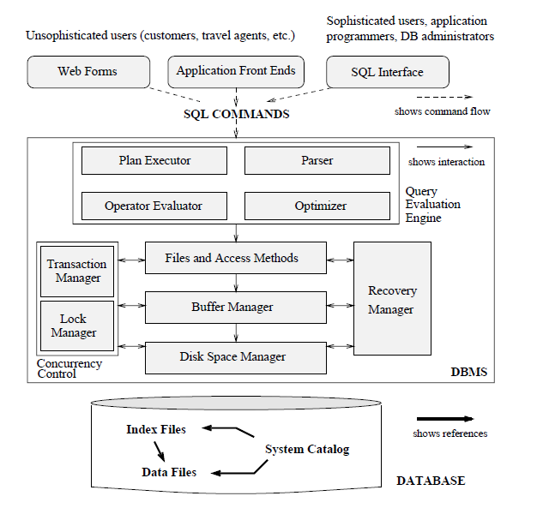
CH1 EXERCISES

Slide 8
CH2
Ch1. Overview of DBMSs
Ch2. Database Design
Ch3. Relational Model
Ch4. Relational Algebra

Slide 9
CH2 - Concepts
Domain
Attribute
Entity (Set)
Relationship (Set)
Key
Candidate
Primary Key
Participation Constraint
Key Constraint
Aggregation
Overlap Constraint
Descriptive Attributes
Roles
One-to-Many
Many-to-Many
Weak Entity Set
Identifying Owner/Relationship

Slide 10
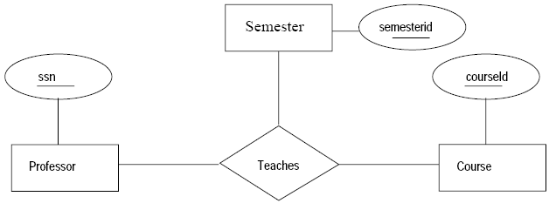
CH2 EXERCISES
2.2. A university database contains information about professors (id. by SSN) and courses (id. by courseid). Professors teach courses; each of the following situations concerns the Teaches relationship set. For each situation, draw an ER diagram that describes it (assuming no further constraints hold).
  Professors can teach the same course in several semesters, and each offering must be recorded.

Slide 11
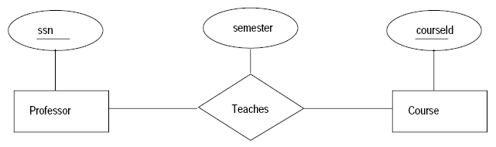
CH2 EXERCISES
2.2. CONT…
  Professors can teach the same course in several semesters, and only the most recent such offering needs to be recorded. (Assume this condition applies in all subsequent questions.)

Slide 12
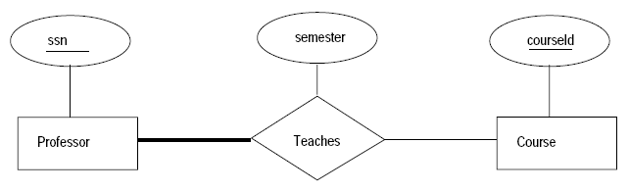
CH2 EXERCISES
2.2. CONT…
  Every professor must teach some course.

Slide 13
CH2 EXERCISES
2.2. CONT…
  Every professor teaches exactly one course (no more, no less).

Slide 14
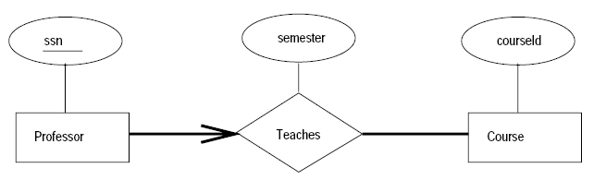
CH2 EXERCISES
2.2. CONT…
  Every professor teaches exactly one course (no more, no less), and every course must be taught by some professor.

Slide 15
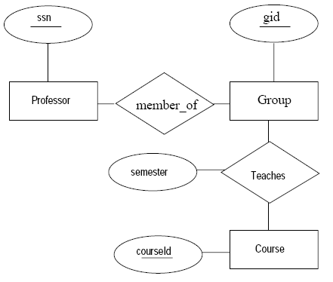
CH2 EXERCISES
2.2. CONT…
  Certain courses can be taught by a team of professors jointly, but it is possible that no one professor in a team can teach the course. Model this situation, introducing additional entity sets and relationship sets if necessary.

Slide 16
CH2 EXERCISES
2.4 A company database needs to store information about employees (identified by ssn, with salary and phone as attributes), departments (identified by dno, with dname and budget as attributes), and children of employees (with name and age as attributes).
Employees work in departments;
Each department is managed by an employee;
A child must be identified uniquely by name when the parent (who is an employee; assume that only one parent works for the company) is known.
We are not interested in information about a child once the parent leaves the company.

Slide 17
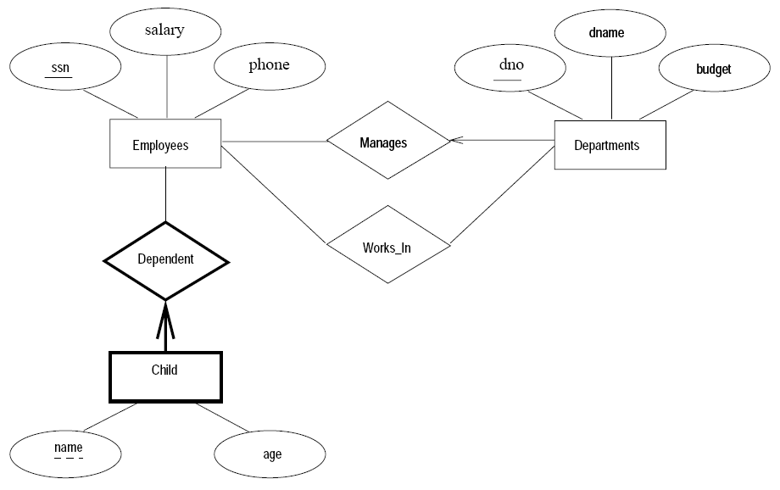
CH2 EXERCISES

Slide 18
CH2 EXERCISES
2.8 Galleries keep information about artists, their names (which are unique), birthplaces, age, and style of art. For each piece of artwork, the artist, the year it was made, its unique title, its type of art (e.g., painting, lithograph, sculpture, photograph), and its price must be stored. Pieces of artwork are also classified into groups of various kinds, for example, portraits, still lifes, works by Picasso, or works of the 19th century; a given piece may belong to more than one group. Each group is identified by a name (like those above) that describes the group. Finally, galleries keep information about customers. For each customer, galleries keep their unique name, address, total amount of dollars they have spent in the gallery (very important!), and the artists and groups of art that each customer tends to like.

Slide 19
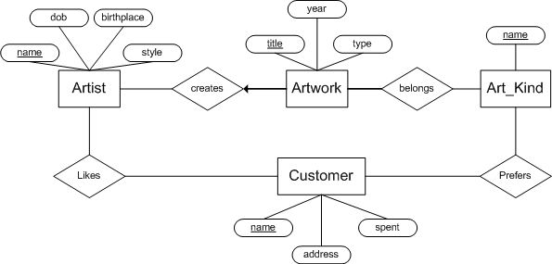
CH2 EXERCISES

Slide 20
AGENDA
Ch1. Overview of DBMSs
Ch2. Database Design
Ch3. Relational Model & SQL
Ch4. Relational Algebra

Slide 21
CH3 - Concepts
Table, Relation
Relation Schema
Attributes/Domain
Relation Instance
Tuple /Records
Degree/Arity
Cardinality
Relational Database
DDL
Primary Key
Superkey
Candidate Key
Foreign Key

Slide 22
CH3 EXERCISES
3.4. What is the difference between a candidate key and the primary key for a given relation? What is a superkey?
  The primary key is the key selected by the DBA from among the group of candidate keys, all of which uniquely identify a tuple. A superkey is a set of attributes that contains a key.

Slide 23
CH3 EXERCISES
3.8. Answer each of the following questions briefly. The questions are based on the following relational schema:
Emp(eid: integer, ename: string, age: integer, salary: real)
Works(eid: integer, did: integer, pcttime: integer)
Dept(did: integer, dname: string, budget: real, managerid: integer)
1. Give an example of a foreign key constraint that involves the Dept relation. What are the options for enforcing this constraint when a user attempts to delete a Dept tuple?
  CREATE TABLE Works (
  eid INTEGER NOT NULL ,
  did INTEGER NOT NULL ,
  pcttime INTEGER,
  PRIMARY KEY (eid, did),
  FOREIGN KEY (did) REFERENCES Dept ) (*)

Slide 24
CH3 EXERCISES
OPTIONS for maintaining referential integrity
  ON DELETE { CASCADE, SET DEFAULT, SET NULL, NO ACTION}
  ON UPDATE { CASCADE, SET DEFAULT, SET NULL, NO ACTION}

Slide 25
CH3 EXERCISES
3.8.
2. Write the SQL statements required to create the preceding relations, including appropriate versions of all primary and foreign key integrity constraints.
CREATE TABLE Emp ( eid INTEGER, ename CHAR(10), age INTEGER, salary REAL, PRIMARY KEY (eid) ) | CREATE TABLE Works ( eid INTEGER, did INTEGER, pcttime INTEGER, PRIMARY KEY (eid, did), FOREIGN KEY (did) REFERENCES Dept ON DELETE CASCADE, FOREIGN KEY (eid) REFERENCES Emp ON DELETE CASCADE ) | CREATE TABLE Dept ( did INTEGER, budget REAL, managerid INTEGER , PRIMARY KEY (did), FOREIGN KEY (managerid) REFERENCES Emp ON DELETE SET NULL )

Slide 26
CH3 EXERCISES
3.8.
3. Define the Dept relation in SQL so that every department is guaranteed to have a manager.
  CREATE TABLE Dept (
  did INTEGER,
  budget REAL,
  managerid INTEGER NOT NULL ,
  PRIMARY KEY (did),
  FOREIGN KEY (managerid) REFERENCES Emp
  )

Slide 27
CH3 EXERCISES
3.8.
4. Write an SQL statement to add John Doe as an employee with eid = 101,
age = 32 and salary = 15, 000.
  INSERT INTO emp VALUES (101, ’John Doe’, 32, 15000)
  INSERT INTO emp (eid, ename, age, salary)
  VALUES (101, ’John Doe’, 32, 15000)
  (Basic Insertions)

Slide 28
CH3 EXERCISES
3.8.
5. Write an SQL statement to give every employee a 10 percent raise.
  UPDATE Emp E SET E.salary = E.salary * 1.10
  UPDATE Emp E SET E.salary = E.salary * 1.10 WHERE E.ename= ’John Doe’,

Slide 29
CH3 EXERCISES
3.8.
6. Write an SQL statement to delete the Toy department. Given the referential integrity constraints you chose for this schema, explain what happens when this statement is executed.
  DELETE
  FROM Dept D
  WHERE D.dname = ’Toy’

Slide 30
AGENDA
Ch1. Overview of DBMSs
Ch2. Database Design
Ch3. Relational Model
Ch4. Relational Algebra

Slide 31
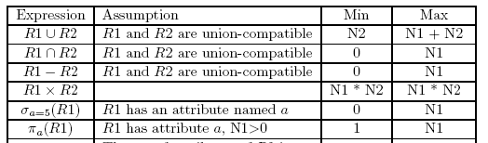
CH4 EXERCISES
4.2. Given two relations R1 and R2, where R1 contains N1 tuples, R2 contains N2 tuples, and N2 > N1 > 0, give the min and max possible sizes for the resulting relational algebra expressions:

Slide 32
CH4 EXERCISES
4.4. Consider the Supplier-Parts-Catalog schema. State what the following queries compute:
Find the Supplier names of the suppliers who supply a red part that costs less than 100 dollars.
This Relational Algebra statement does not return anything
Find the Supplier names of the suppliers who supply a red part that costs less than 100 dollars and a green part that costs less than 100 dollars.

Slide 33
CH4 EXERCISES
4.4. Cont:
Find the Supplier ids of the suppliers who supply a red part that costs less than 100 dollars and a green part that costs less than 100 dollars.
Find the Supplier names of the suppliers who supply a red part that costs less than 100 dollars and a green part that costs less than 100 dollars.

Slide 34
CH4 EXERCISES
4.6. What is relational completeness? If a query language is relationally complete, can you write any desired query in that language?
  Relational completeness means that a query language can express all the queries that can be expressed in relational algebra. It does not mean that the language can express any desired query.
  Relational Algebra can’t represent Recursion

Slide 35
CH4 EXERCISES
4.3. Consider the Supplier-Parts-Catalog schema. State what the following queries compute:
Write the following queries in relational algebra, tuple relational calculus, and domain relational calculus:

Slide 36
CH4 EXERCISES
Find the names of suppliers who supply some red part.
Find the sids of suppliers who supply some red part or are at 221 Packer Ave.
Find the sids of suppliers who supply every red part.
Find pairs of sids such that the supplier with the first sid charges more for some part than the supplier with the second sid.
Find the pids of the most expensive parts supplied by suppliers named Yosemite Sham.

Slide 37
Questions?
Eduardo Ruiz
  ECS-232 (> 1 pm )
  Subject: COP-5725 <YOUR NAME>

Slide 38
Project
Schema (18)
  Incomplete representation, wrong representation, Misapplied notation (-3)
  (-12) Schemas with diff notation that the one used in the book or handwritten diagrams (you will not graded until you present the digital format)
Relational Schema Definition (15)
  SQL errors, consistency with the ER, missing constraints, normal form problems (-3)
  (-10) if you don’t use the INNODB engine

Slide 39
Project
Data (5)
  Invalid Syntax (-2)
View Definitions (12)
  SQL errors, consistency with the definition (-2)
  You must define the semantic for your proposed views (-2)
  Select count(*) queries (-1)

Slide 40
Project
40% penalty for late submissions (2 days max)
Mail Title: COP5725 Project Submission -<Names>
Hard Copy (can be printed at both sides)

