Slide 1
Revisiting Aggregation Techniques for Big Data
Vassilis J. Tsotras
University of California, Riverside
tsotras@cs.ucr.edu
Joint work with Jian Wen (UCR), Michael Carey and Vinayak Borkar (UCI);
supported by NSF IIS grants: 1305253, 1305430, 0910859 and 0910989.

Slide 2
Roadmap
A brief introduction to ASTERIX project
  Background
  ASTERIX open software stack
  AsterixDB and Hyracks
Local group-by in AsterixDB
  Challenges from Big Data
  Algorithms and Observations
Q&A

Slide 3
Why ASTERIX: From History To The Next Generation
1970’s
1980’s
1990’s
2000’s
2010’s
Business data:
Relational DB
(w/SQL)
Distributed for
efficiency:
Parallel DB
Historical Data:
Data Warehouse
OLTP Data:
Fast Data
Traditional Enterprises
Google, Yahoo
huge web data:
MR (Hadoop)
ASTERIX
Project
Web Information Services
Twitter, Facebook
social data:
key-value (NoSQL)
Web 2.0:
Semi-structured data
Social Media
Big Data: Driven by unprecedented growth in data being generated and its potential uses and value
Notes:
Brief history for data processing
Begins from relational database, aimed at business data (small), with high-level declarative language (SQL)
Later: parallel database, for larger data size and faster processing speed
Now: big data, to query historical data and “seems-useless” data; fast data, to query over fast updating data
MR for analytical queries (update page rank based on web changes)
More data
Web information: links, html
Social media: social messages, graphs
Social data with tags, topics, text not easily added to a relational db

Slide 4
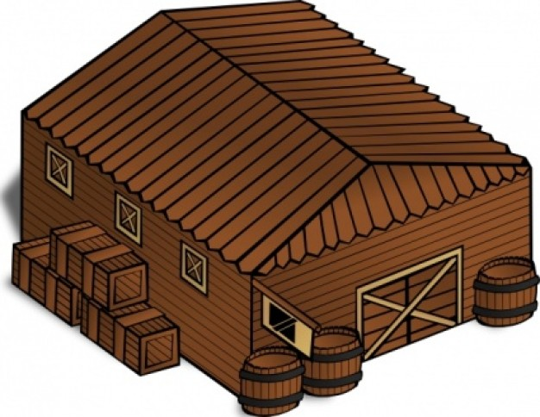

“Bigger” Data for Data Warehouse
Traditional Data Warehouse
  Data: recent history, and business-related data
  Hardware: few servers with powerful processor, huge memory, and reliable storage
  Interface: high-level query language
  Expensive???
Big Data Based Data Warehouse
  Data: very long history, and various data (maybe useful in the future)
  Hardware: lots of commodity servers, with low memory and unreliable storage
  Interface: programming interface, and few high-level query languages
  Cheap???
Notes:
Data warehouse, OLAP requires big data by natural
Data warehouse: historical data, integrated and merged data
OLAP: multi-dimensional data
New trend: much bigger than their initial definition
Data warehouse: longer history
OLAP: more dimensions, from both business itself and other social media.
Web warehouse

Slide 5
Tool Stack: Parallel Database
SQL
Advantages:
Powerful declarative language level;
Well-studied query optimization;
Index support in the storage level
Disadvantages:
No much flexibility for semi-structured and unstructured data;
Not easy for customization.
SQL Compiler
Relational Dataflow Layer
Row/Column Storage Manager
RDBMS
Notes:
Traditional parallel database: why it is not the perfect solution for big data?
Comes in one box, all ready not easy to change (Oracle, Teradata, IBM DB2)
Need to transform your data to relational
Cannot change optimization
May want to focus on the customization:
researchers may want a more open-source project to easy adding their work into the system
Researchers also want to utilize the existing state-of-art research in parts not directly related to their components, but could be an important feature. For example, cube operation in OLAP relies on the group-by algorithms from the database systems.

Slide 6







Tool Stack: Open Source Big Data Platforms
HiveQL
PigLatin
Jaql script
Advantages:
Massive unreliable storage;
Flexible programming framework;
Un/semi-structured data support.
Disadvantages:
Lack of user-friendly query language (although there are some…);
Hand-crafted query optimization;
No index support.
HiveQL/Pig/Jaql
(High-level Languages)
Hadoop M/R job
Hadoop MapReduce
Dataflow Layer
Get/Put ops.
HBase Key-Value Store
Hadoop Distributed File System
(Byte-oriented file abstraction)
Notes:
Why we need to start ASTERIX, instead of using the existing big data solution (Hadoop)?
Want to utilize the research from RDBMS on query optimization
Storage: index support
Powerful query language:
Support spatial and temporal features;
Utilize query optimizer.
To use the optimization you can either
Use the one coming with the language you use (but are quite limited in comparison with parallel dbs opt)
Write your own optimizer; difficult since you need to know MR well and it is hard.

Slide 7
Our Solution: The ASTERIX Software Stack
AsterixQL
HiveQL
Piglet
…
AsterixDB
Hivesterix
Other HHL Compilers
Hadoop
M/R Job
Pregel
Job
IMRU
Job
Algebricks
Algebra Layer
Hadoop M/R
Compatibility
Pregelix
IMRU
Hyracks
Job
Hyracks Data-parallel Platform
ASTERIX Software Stack:
User-friendly interfaces: AQL, and also other popular language support.
Extendible, reusable optimization layer: Algebricks.
Parallel processing and storage engine: Hyracks; also support index.
Notes:
Try to combine the best from both worlds
From traditional warehouse we want user-friendly language layer (AsterixQL –declarative language – btw SQL and XQuery) and optimization layer (Algebricks) from parallel db research as well as native index support (Hyracks + Algebricks)
From big-data world: flexibility of programming framework (Hadoop M/R) support for HiveQL and Piglet
Can also support graph based data structures and querying (Pregel) (not on top of Hadoop but on Hyracks so better performance)
Interactive Map Reduce Updates (for recursive map Reduce – for machine learning and DM) also not on top of Hadoop but on Hyracks.
Can even code directly on the Hyracks (Java library)

Slide 8

ASTERIX Project: The Big Picture
Build a new Big Data Management System (BDMS)
  Run on large commodity clusters
  Handle mass quantities of semistructured data
  Open layered, for selective reuse by others
  Open Source (beta release today)
Conduct scalable system research
  Large-scale processing and workload management
  Highly scalable storage and index
  Spatial and temporal data, fuzzy search
  Novel support for “fast data”
Semi-
structured
Data Management
Parallel
Database
Systems
Data-
Intensive
Computing

Slide 9

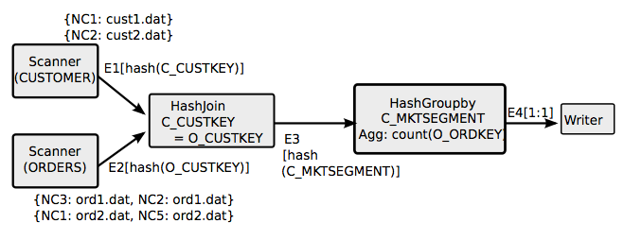
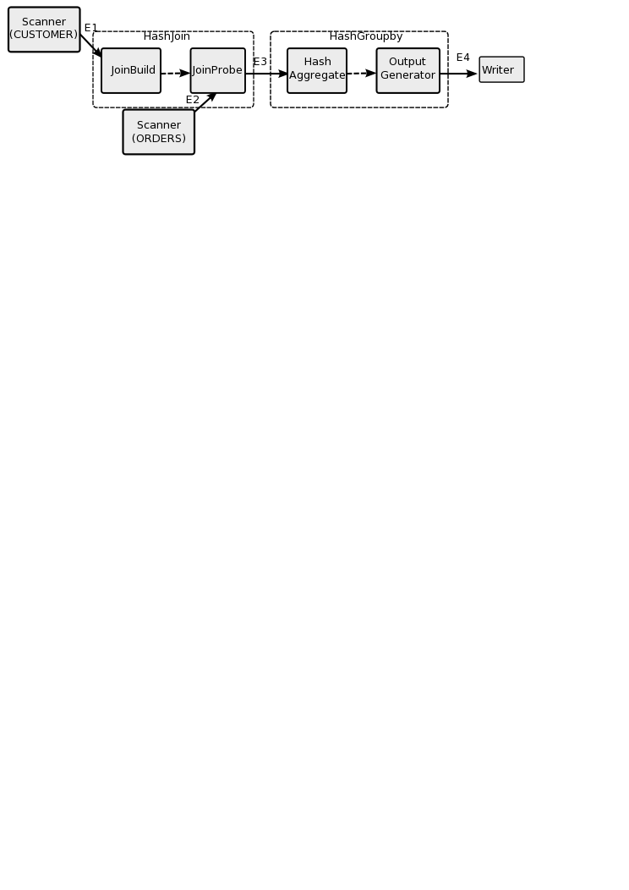
The Focus of This Talk: AsterixDB
for $c in dataset('Customer’)
for $o in dataset('Orders')
where $c.c_custkey = $o.o_custkey
group by $mktseg := $c.c_mktsegment with $o
let $ordcnt := count($o)
return {"MarketSegment": $mktseg, "OrderCount": $ordcnt}
AsterixQL
(AQL)
Compile
Algebricks
Algebra Layer
Optimize
Hyracks Data-parallel Platform
Notes:
Overall of AsterixDB:
User creates DDL (data models) and issue DML (query) using AQL;
AQL is compiled and optimized by Algebricks. Algebricks outputs the optimized physical plan;
The optimized physical plan is executed by Hyracks in parallel.
TPCH query
Customer (c_custkey, c_mktsegment, …) primary is custkey
Orders (o_ordkey, o_custkey, ….) primary is ordkey (a customer can make many orders)
NC: nodes that have the partitions. Orders is distributed in 2 partitions (ord1 and ord2 and also duplicated)
Algebrics knows where data is partitioned and gives Hyracks hints on how to parallelize the work.
Blocks are operators doing data processing while arrows represent transfer of data. (if we have multiple machines, data will be hash-partitioned by custkey)
The result of the hashjoin will be send to the groupby operator hash-partitioned by mktsegment
The final arrow is 1-1 ie each node will produce the result (no need to send to many nodes).
About optimization
Asterix will create the logical plan and then the optimized plan; the dotted arrow means you have to wait until all result is ready.
Traditional single-machine RDBMS optimization: projection push down, unused variable elimination, …
Parallel database optimization: create parallel physical data plan

Slide 10
AsterixDB Layers: AQL
AsterixQL
(AQL)
ASTERIX Data Model
  JSON++ based
  Rich type support (spatial, temporal, …)
  Support open types
  Support external data sets and data feeds
ASTERIX Query Language
  Native support for join, group-by;
  Support fuzzy matching;
  Utilize query optimization from Algebricks
create type TweetMessageType as open {
tweetid: string,
user: {
screen-name: string,
followers-count: int32
},
sender-location: point?,
send-time: datetime,
referred-topics: {{ string }},
message-text: string
}
create dataset TweetMessages(TweetMessageType) primary key tweetid;
DDL
for $tweet in dataset('TweetMessages')
group by $user := $tweet.user with $tweet
return {
"user": $user,
"count": count($tweet)
}
DML
Notes:
Key points:
Native support for spatial and temporal types and operations (so they are well optimized)
Open type: for semi-structured data
Nested structure: for semi-structured data
Open: have at least these attributes but also more
Can have missing attributes ( like the point ?)
Has records (like user), lists (use [] ) and bags (see {{}})
How many tweets we have per user

Slide 11
AsterixDB Layers: Algebricks
Algebricks
Algebra Layer
Algebricks
  Data model agnostic logical and physical operations
  Generally applicable rewrite rules
  Metadata provider API
  Mapping of logical plans to Hyracks operators
Logical Plan
… …
assign <- function:count([$$10])
group by ([$$3]) {
aggregate [$$10] <- function:listify([$$4])
}
… …
… …
assign <- $$11
group by ([$$3]) |PARTITIONED| {
aggregate [$$11] <- function:sum([$$10])
}
exchange_hash([$$3])
group by ([$$3]) |PARTITIONED| {
aggregate [$$10] <- function:count([$$4])
}
… …
Optimized Plan
* Simplified for demonstration; may be different from the actual plan.
Notes:
Optimization in the example:
Function being pushed into group-by
Parallel group-by
The data is streamed from the bottom and processed one by one to the top
Logic plan says:
$$4 is the input data
$$3 is the grouping key (user)
$$10 is the list created for each group
For each group (user) create a list of tweets (listify comes from AQL) to collect all the user’s tweets together; this is a form of aggregation
Then the count function is applied on the list ($$10)
Optimized Plan makes the local group_by plan global group_by (i.e. Takes advantage of partitions in many nodes)
Since data is distributed in many nodes, we can do the count in each node locally and then send the local counts to a global node (hashed) where the counts are summed up.
Also removes listify (because it is a count, so you do not want to first get all records, but as records come, count them)
Exchange hash sents the results based on grouping key. All counts from a user will go to the same machine.

Slide 12
AsterixDB Layers: Hyracks
Hyracks Data-parallel Platform
Hyracks
  Partitioned-parallel platform for data-intensive computing
  DAG dataflow of operators and connectors
  Supports optimistic pipelining
  Supports data as a first-class citizen
BTreeSearcher
(TweetMessages)
OneToOne
Conn
ExternalSort
($user)
GroupBy
(count by $user, LOCAL)
HashMerge
Conn
GroupBy
(sum by $user, GLOBAL)
ResultDistribute
Notes:
Hyracks briefs:
Hyracks has operators and connectors
Each operator has tight memory budget
About connector
OneToOne: local data transfer
HashMerge: hash partition, and guarantee the sorted order on the receiver side (require the data is sorted on the sender side)
Btree searcher: Asterix tells Hyracks to do an index search (since there is an index)

Slide 13
Specific Example: Group-by
Simple syntax: aggregation over groups
  Definition: grouping key, and aggregation function
Factors affecting the performance
  Memory: can the group-by be performed fully in-memory?
  CPU: comparisons needed to find group
  I/O: needed if group-by cannot be done in-memory
uid | tweetid | geotag | time | message | …
1 | 1 | … | … | … | …
1 | 2 | … | … | … | …
2 | 3 | … | … | … | …
SELECT uid, COUNT(*)
FROM TweetMessages
GROUP BY uid;
uid | count
1 | 2
2 | 1

Slide 14
Challenges From Big Data On Local Group-by
Classic approaches: sorting or hashing-and-partitioning on grouping key
  However, the implementation of the two approaches are not trivial for big data scenario.
Challenges:
  Input data is huge
    the final group-by results may not fit into memory
  Unknown input data
    there could be skew (affecting hash-based approaches)
  Limited memory
    whole system is shared by multiple users, and each user has a small part of the resource.

Slide 15
Group-By Algorithms For AsterixDB
We implemented popular algorithms and considered their big-data performance wrt: CPU, disk I/O.
We identified various places where previous algorithms would not scale and have thus provided two new approaches to solve these issues.
In particular we studied the following six algorithms, and finally picked three for AsterixDB (marked as red, and showed in following slides):
Algorithm | Reference | Using Sort? | Using Hash?
Sort-based | [Bitton83], [Epstein97] | Yes | No
Hash-Sort | New | Yes | Yes
Original Hybrid-Hash | [Shapiro86] | No | Yes
Shared Hashing | [Shatdal95] | No | Yes
Dynamic Destaging | [Graefe98] | No | Yes
Pre-Partitioning | New | No | Yes
Notes:
All algorithms are covered in the following slides

Slide 16
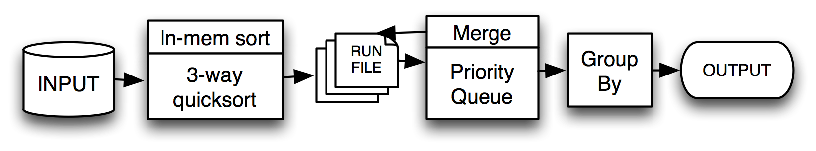
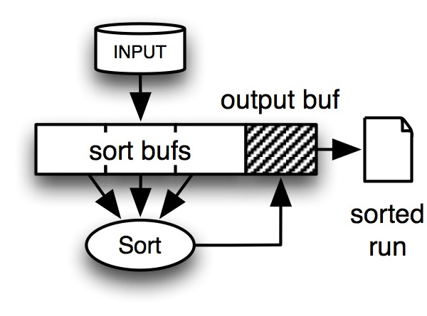
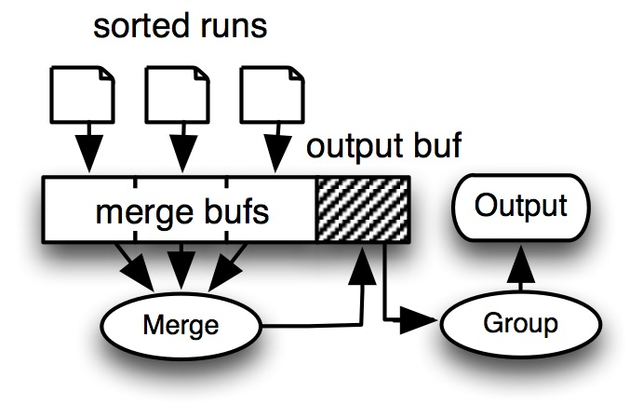
Sort-Based Algorithm
Straightforward approach: (i) sort all records by the grouping key, (ii) scan once for group-by.
  If not enough memory in (i), create sorted run files and merge.
Notes:
Fill up the memory; when full, sort it and write it in a sorted run.
Then we have a list of run files, do a merge with one buffer page per run file.
As you merge you aggregate and write output.
If we do not have enough buffers for all runs, then the merge result is written on a run and another round of merging.

Slide 17
Sort-Based Algorithm
Pros
  Stable performance for data skew.
  Output is in sorted order.
Cons
  Sorting is expensive on CPU cost.
  Large I/O cost
    no records can be aggregated until file fully sorted

Slide 18
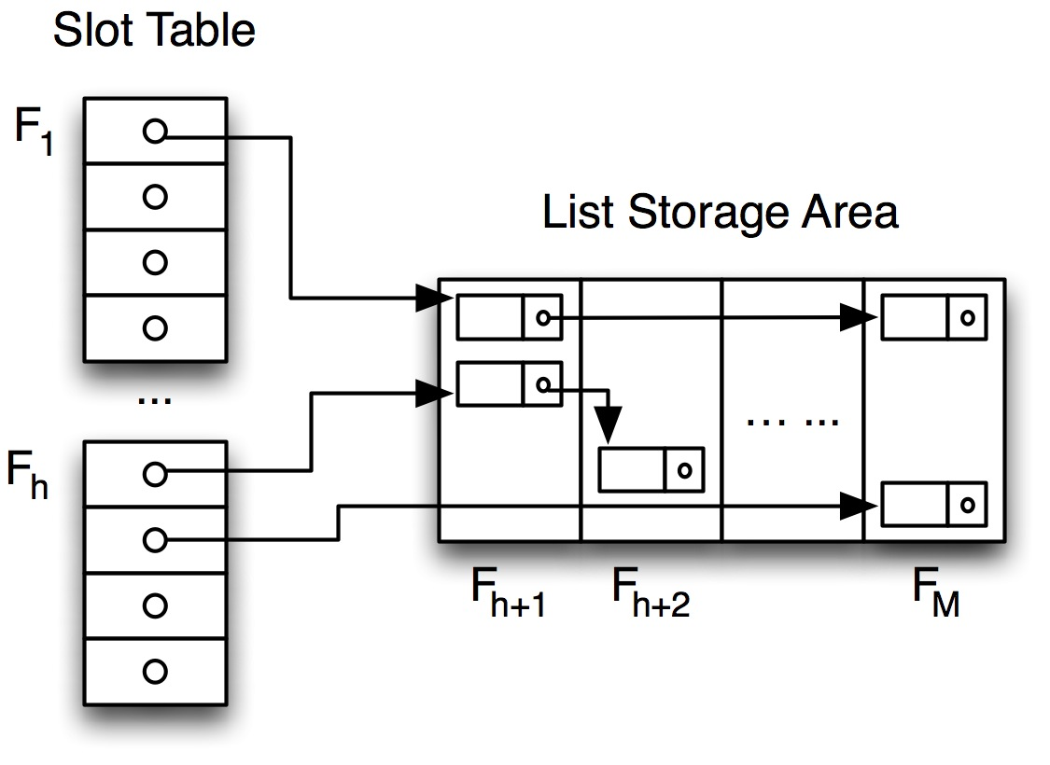
Hash-Sort Algorithm
Instead of first sorting the file, start by hash-and-group-by:
  Use an in-memory hash table for group-by aggregation
  When the hash table becomes full, sort groups within each slot-id, and create a run (sorted by slot-id, group-id)
  Merge runs as before
Main Memory (Frames from F₁ to F_{M})
In-memory hash table
  Good: Constant lookup cost.
  Bad: Hash table overhead.
Linked list based hash table
Notes:
New algorithm.
Start aggregation early.

Slide 19
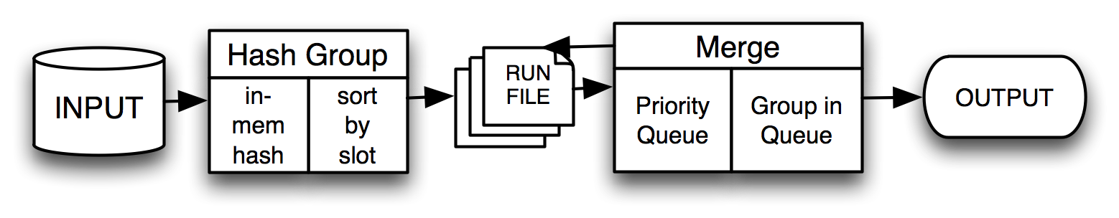
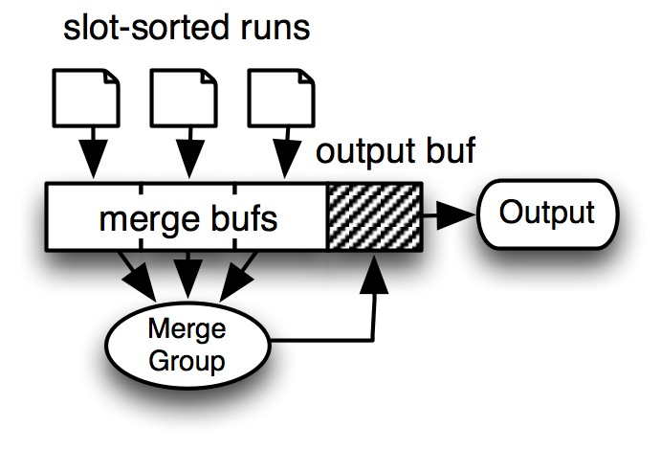
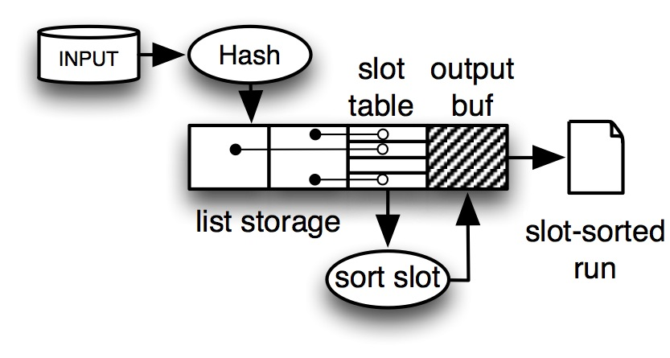
Hash-Sort Algorithm
The hash table allows for early aggregation
Sorting only the records in each slot is faster than full sorting.

Slide 20
Hash-Sort Algorithm
Pros
  Records are (partially) aggregated before sorting, which saves both CPU and disk I/O.
  If the aggregation result can fit into memory, this algorithm finishes without the need for merging.
Cons
  If the data set contains mainly unique groups, the algorithm behaves worse than Sort-Based (due to the hash table overhead)
  Sorting is still the most expensive cost.

Slide 21
Hash-Based Algorithms: Motivation
Two ways to use memory in hash-based group-by:
  Aggregation: build an in-memory hash table for group-by; this works if the grouping result can fit into memory.
  Partition: if the grouping result cannot fit into memory, input data can be partitioned by grouping key, so that each partition can be grouped in memory.
    Each partition needs one memory page as the output buffer.
key = 3, value = 0
P0
key = 1, value = 3
key = 1, value = 1
key
(mod 3)
key = 1, value = 3
P1
key = 2, value = 1
key = 1, value = 1
key = 3, value = 0
key = 2, value = 1
P2
Notes:
Partition: divide and conquer
(divide so that each partition can then be aggregated on its own in memory)

Slide 22
Hash-Based Algorithms: Motivation
To allocate memory between aggregation and partition:
  All for aggregation? Memory is not enough to fit everything;
  All for partition? The produced partition may be less than the memory size (so memory is under-utilized when processing the partitions).
Hybrid: use memory for both
  How much memory for partition: as far as the spilled partition can fit in memory when reloading;
  How much memory for aggregation: all the memory left!

Slide 23
Hash-Based Algorithms: Hybrid
Output
Buffer
1
Output
Buffer
2
Output
Buffer
3
Output
Buffer
4
In-Memory
Hash Table
Memory
Partition
Disk
Input Data
Spill File
1
Spill File
2
Spill File
3
Spill File
4

Slide 24
Hybrid-Hash Algorithms: Partitions
Assume P+1 partitions, where:
  one partition (P0, or resident partition) is fully aggregated in-memory
  the other P partitions are spilled, using one output frame each
  a spilling partition is loaded recursively and processed in-memory (i.e. ideally each spilling partition fits in memory).
  Fudge factor: used to adjust the hash table overhead
Size of Spilled Parts
Size of P0
Total Size
Notes:
G*F computes the total memory requirement if we want to fit all grouping keys in memory
(M-1)*P is the size of the spilled partitions (each will use M-1 pages when reloaded, since we need 1 page for output of the result)
Their difference is the size of the fully aggregated partition P0

Slide 25
Issues with Existing Hash-based Solutions
We implemented and tested:
  Original Hybrid-Hash [Shapiro86]
  Shared Hashing [Shatdal95]
  Dynamic Destaging [Graefe98]
However:
  We optimized the implementation to adapt the tight memory budget.
  The hybrid-hash property cannot be guaranteed: the resident partition could be spilled.
Notes:
Using this formula we implemented previous algorithms, but they cannot guarantee that the resident partition will be fully aggregated.
We do not know the group distribution so the hashing may not work well because of skew.

Slide 26
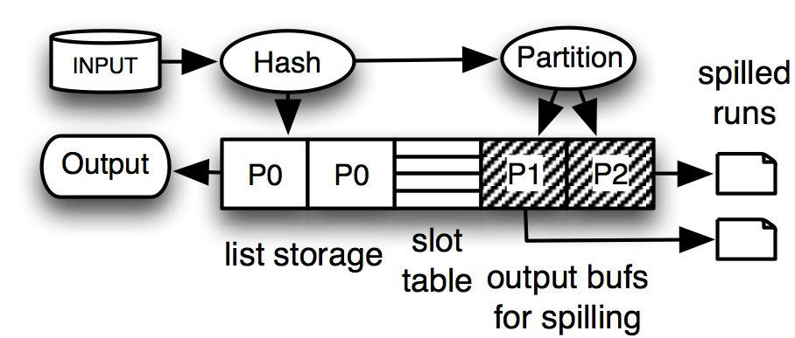
Original Hybrid-Hash [Shapiro86]
Partition layout is pre-defined according to the hybrid-hash formula.
Assume a uniform grouping key distribution over the key space:
  (M - P) / GF of the grouping keys will be partitioned into P0.
Issue: P0 will spill if the grouping keys are not uniformly distributed.
Notes:
Original hybrid hash partitions the input data just as the formula indicates.
All keys in the first (M - P)/GF part will be hashed and aggregated into the hash table.
Other keys are uniformly distributed into the P spilling buffers.

Slide 27
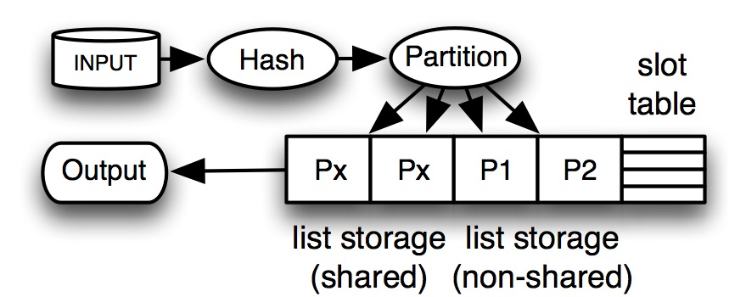
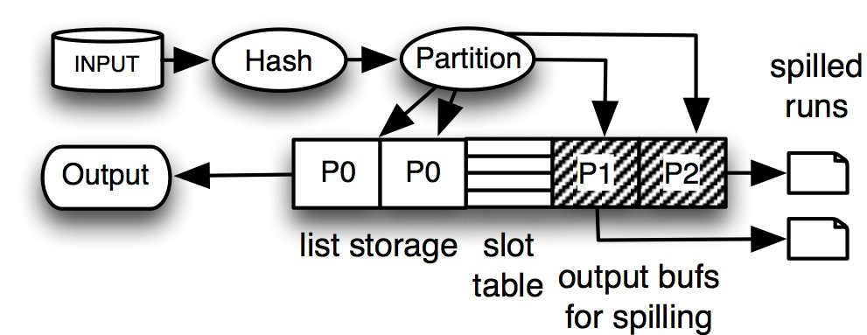
Shared Hash [Shatdal95]
Initially all memory is used for hash-aggregation
  A hash table is built using all pages.
When the memory is full, groups from the spilling partitions are spilled.
  Cost overhead to re-organize the memory.
Issue: the partition layout is still the same as the original hybrid-hash, so it is possible that P0 will be spilled.
Before Spilling: Px is for P0, and it will also be used by other partitions if the reserved memory for them are full.
After Spilling: the same as original hybrid-hash
Notes:
Like the Original Hybrid Hash, but we allow the partitions to aggregate (they can use their page but also share the space of P0, shown as Px in the figure)
When full, they are spilled (and take the records from Px)
At the beginning, the full memory is used for hash and aggregation.
- For each spilling partition, one page for each spilling partition. Records are hashed and aggregated into the spilling partition, as far as the assigned page is not full. If the page is full, new groups will be inserted into the P0 part
- (M - P) pages are assigned for P0. P0 will be used for records of P0, and also records from other spilling partitions if the [age reserved for the spilling partition is full.
When to spill: if a new group cannot be inserted into the memory. Two possible cases to trigger the spilling
- P0 is full
- A spilling partition is full, and P0 has no space either.
Spill will first remove all spilling partitions;
Since we only share the P0 space, the memory re-organization cost can be reduced.

Slide 28
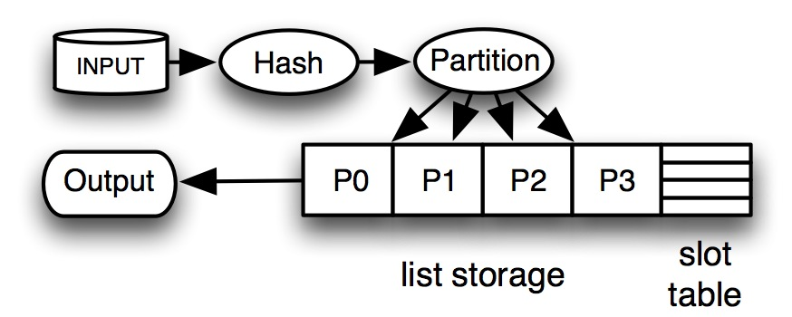
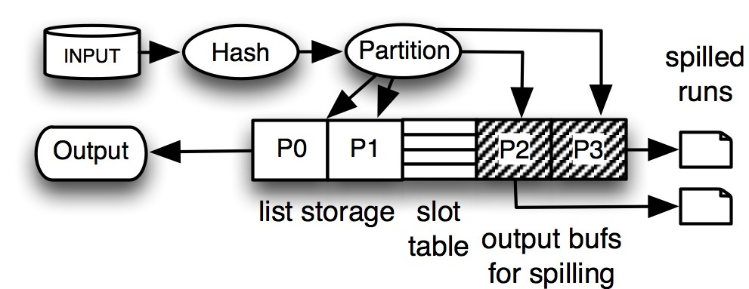
Dynamic Destaging [Graefe98]
Initialization:
  one page per partition
  other pages are maintained in a pool
When processing:
  If a partition is full, allocate one page from the pool.
Spilling: when the pool is empty
  Spill the largest partition to recycle their memory (can also spill the smallest, but need extra cost to guarantee to free enough space)
Issue: difficult to guarantee that the P0 will be maintained in memory (i.e., the last one to be spilled).
At the beginning: one page for each partition (the memory pool is omitted).
Spilling: when memory is full and the pool is empty, the largest partition will be spilled. Here P2 and P3 are spilled.
Notes:
Decide the number of partitions using the same formula, but allocate just one page to each partition (even P0). Start aggregation.
When more space is needed, I will give you more pages. When no more pages then we need to spill.
Decide to spill the largest partition (just keep one page for that and the rest goes back to the pool).
Continue until the pool becomes empty again (i.e., pick another partition to spill), etc. Until there is only one partition in memory (will be the final and
We hope it will be fully aggregated, but there is no guarantee).
At the beginning each partition is assigned one page, and all the other pages are maintained in a buffer pool.
When a new group is to be inserted but the reserved page is full, one new page from the pool is assigned to this partition.
When no page can be retrieved from the pool, the largest partition will be spilled, and the pages it occupied will be recycled into the pool.
Note that we can also spill the smallest partition, however to pick the largest one because it guarantees to make more space for the remaining frames, and no extra cost to check whether the smallest partition cannot provide enough memory to avoid continuous spilling.

Slide 29
Pre-Partitioning
Guarantee an in-memory partition.
  Memory is divided into two parts: an in-memory hash table, and P output buffers for spilling partitions.
  Before the in-memory hash table is full, all records are hashed and aggregated in the hash table.
    No spilling happens before the hash table is full; each spilling partition only reserves one output buffer page.
  After the in-memory hash table is full, partition 0 will not receive any new grouping keys
    Each input record is checked: if it belongs to the hash table, it is aggregated; otherwise, it is sent to the appropriate spilling partition.
Notes:
We use again the same formula for number of partitions but the difference is on how we do the partitioning.
Keep filling P0 with records (i.e. initially every record is sent to partition P0) and aggregate the records with a hashing function.
Do this until no more record can be aggregated (P0 is full). After that, all new records will first be checked if they have been seen before (in which case
they will be aggregated in partition P0. If not, they will be partitioned to the other partitions P1 – PN that
will be spilled.

Slide 30
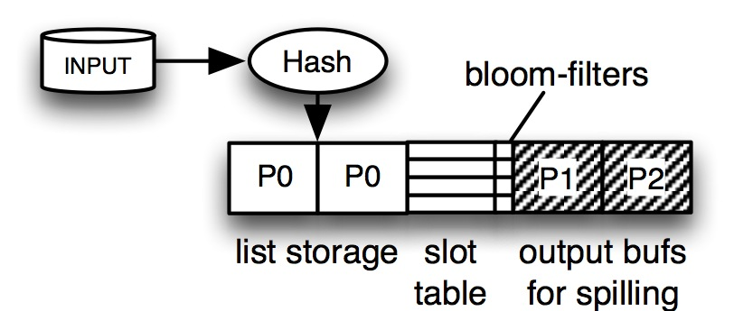
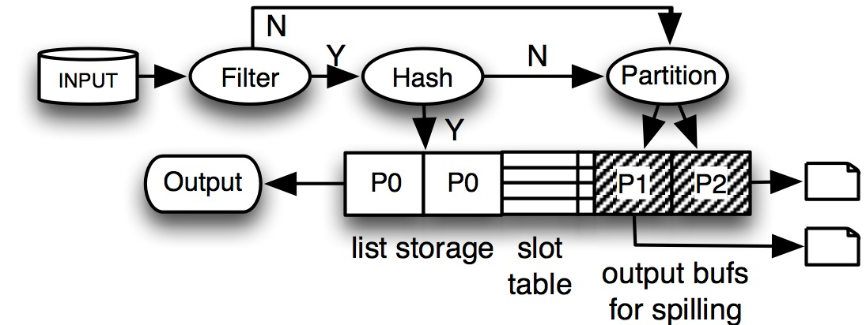
Pre-Partitioning (cont.)
Before the in-memory hash table is full:
  All records are hashed into the hash table.
After the in-memory hash table is full, each input record is first checked for aggregation in hash table.
  If it can be aggregated, then aggregate it in hash table.
  Otherwise, spill that record by partitioning it to some spilling partition.

Slide 31
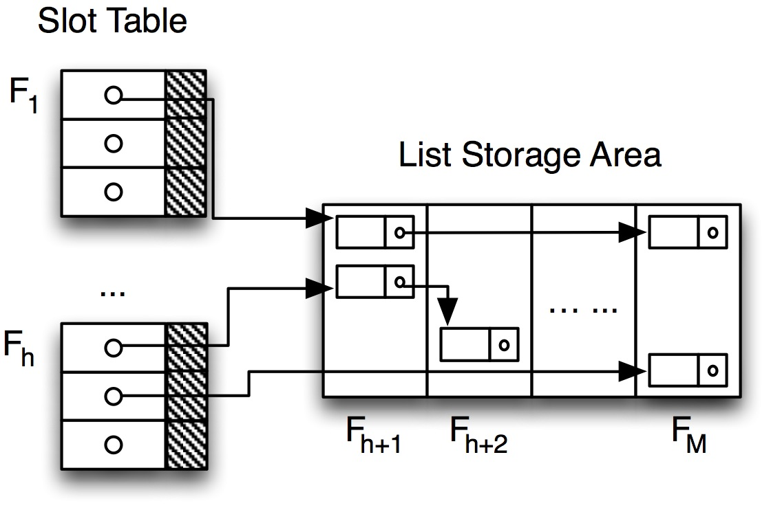
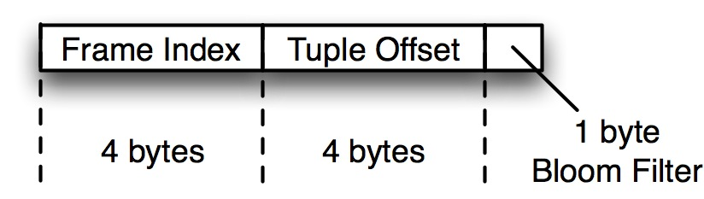
Pre-Partitioning: Use Mini Bloom Filters
After the in-memory hash table is full, each input record need to be hashed once.
  Potential high hash miss cost.
We add a mini bloom filter for each hash table slot
  1 byte bloom filter
  Before each hash table lookup, a bloom filter lookup is processed.
  A hash table lookup is necessary only when the bloom filter lookup returns true.
1 byte (8 bits) is enough, assuming that each slot has no more than 2 records.
Notes:
If the record does not match a record in the hash table (this means we need to search the whole list in that slot), we spent the time to check for it.
Can we do better?
Instead of searching the list, we create a bloom filter that tells us what records are in the list of a slot. If the bloom filter is true then probably
you have a match in the list, so go and check.
1 byte for Bloom filter is fine since on average we have about 2 records per list.

Slide 32
Pre-Partitioning
Pros
  Guarantee to fully aggregate partition 0 in-memory.
  Robust to data skew.
  Robust to incorrect estimation of the output size (used to compute the partition layout)
  Statistics (we also guarantee the size of the partition 0 that can be completely aggregated)
Cons
  I/O and CPU overhead on maintaining the mini bloom filters (however in most cases this is less than its benefit)
Notes:
Robust to data skew since even if there is skew, it does not change the size of partition P0.
Robust to G underestimation. (overestimation of G will create more spilling partitions, which will have smaller average size, thus they will be easily aggregated in memory in the next round).
Underestimation, means less spilling partitions, so larger, therefore they may need to be re-spilled.
It is robust since we can still guarantee that partition p0 will never be spilled.

Slide 33
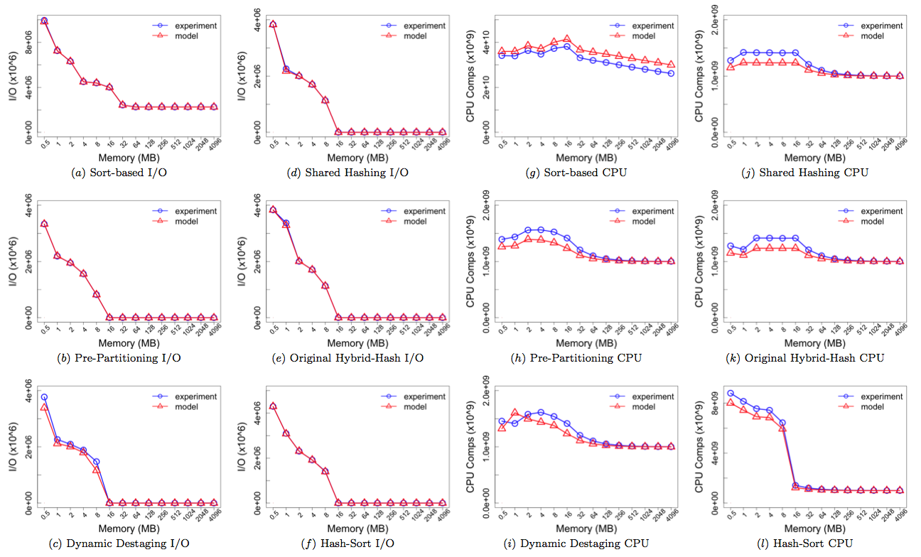
Cost Models
We devise precise theoretical CPU and I/O models for all six algorithms.
  Could be used for optimizer to evaluate the cost of different algorithms.

Slide 34
Group-by Performance Analysis
Parameters and values we have used in our experiments:
Notes:
HT slot factor: deals with hash skew. ratio of hash table slot size and hash table capacity (2 example: 1000 slots with universe of 500 unique keys)
Using HT=1 means that we will have a longer average list (since more collisions) But also fewer number of slots thus less space.
Cardinality: number of unique keys in 100 records. 100%: all unique. 6.25% means: around 6.25 unique keys in 100 records.
Fudge factor is used to count for various overheads (a page not fully utilized, etc.)
HH Error: Hybrid hash needs to estimate G (1 means we have correct knowledge; 4k means grand overestimation i.e., instead of G we think it is 4000G
1/4K is for underestimation.

Slide 35
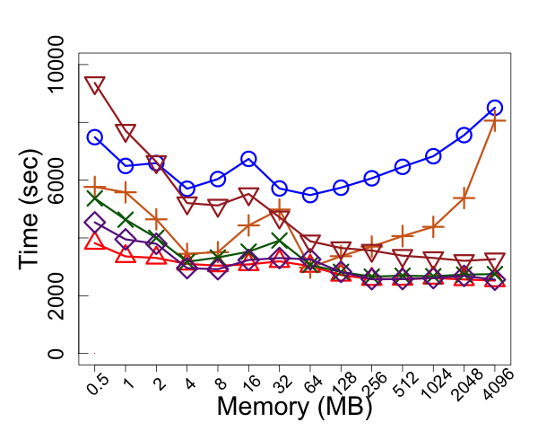
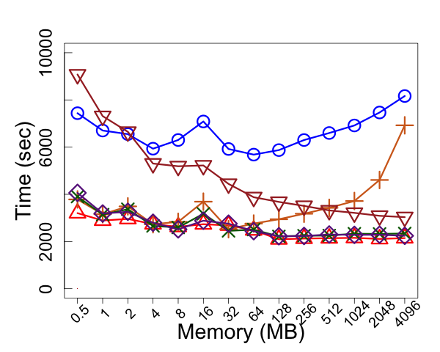
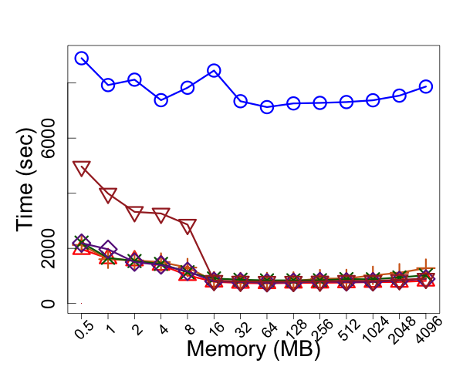
Cardinality and Memory
High Cardinality
Medium Cardinality
Low Cardinality
Observations:
Hash-based (Pre-Partitioning) always outperforms the Sort-based and the Hash-sort algorithms;
Sort-based is the worst for all cardinalities;
Hash-Sort is as good as Hash-based when data can be fit into memory.

Slide 36
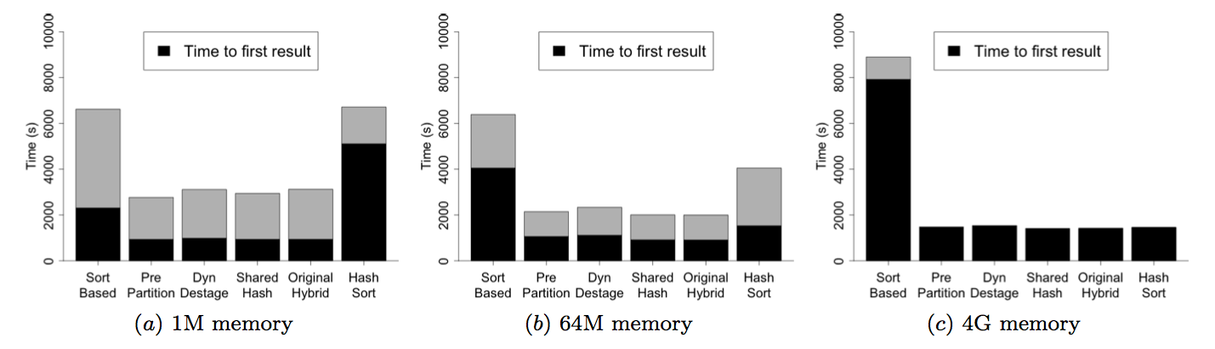
Pipeline
Observations:
In order to support better pipelining, final results should be produced as early as possible.
Hybrid-hash algorithms starts to produce the final results earlier than the sort-based and the hash-sort based algorithms
Notes:
The black part is the time from the beginning of the algorithm to the time when the first result is outputted.
For the large memory case, the black is the only time (for in-memory aggregation).

Slide 37
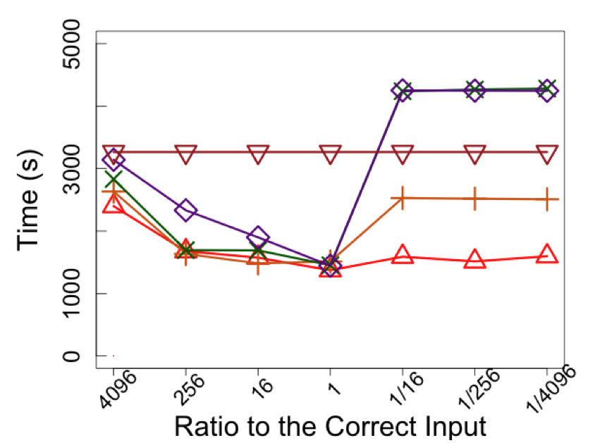
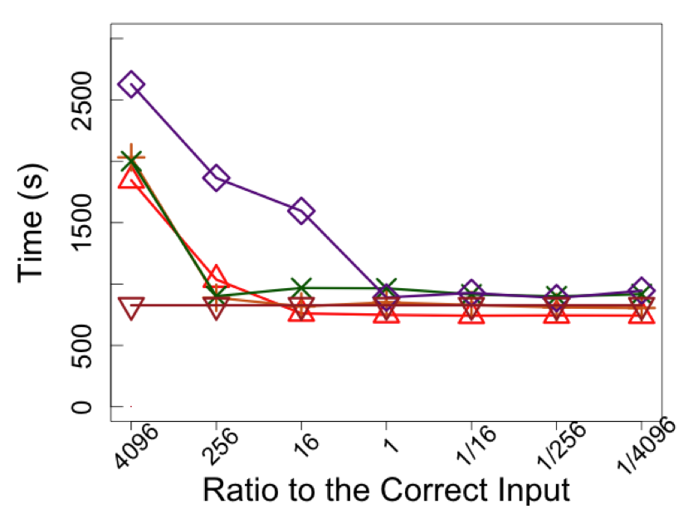
Hash-Based: Input Error
Small Memory
(aggregation needs spills)
Large Memory
(aggregation can be done in-memory )
Observations:
Input error has influence over the Hash-based algorithms through imprecise partitioning strategy (so it effects only when spilling is needed);
Pre-Partitioning is more tolerant to input error than the other two algorithms we have implemented.
Notes:
4096x is overestimation
For small memory, prepartition is the best and not affected by estimation.
For large memory, most of the calculations are done in memory, so the algorithms do not differ by much.

Slide 38
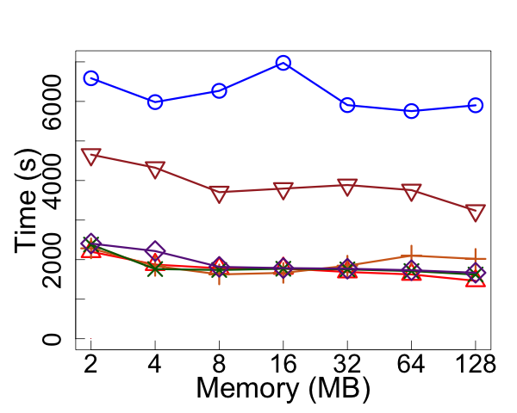
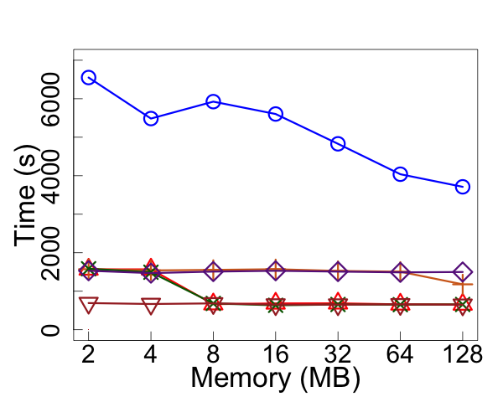
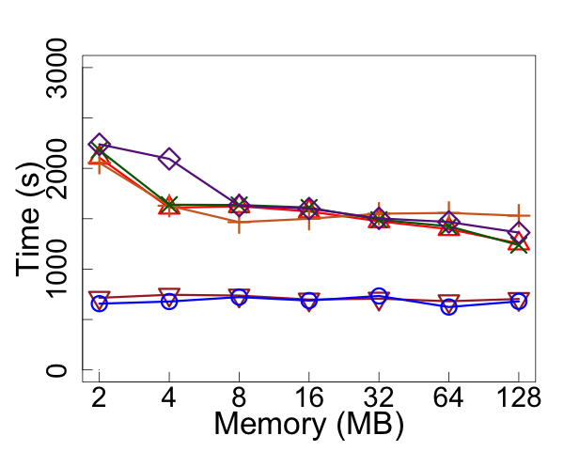
Skewed Datasets
Zipfian 0.5
Heavy-Hitter
Uniform and Sorted
Observations:
Hash-sort algorithm adapts well with highly skewed dataset (early in-memory aggregation to eliminate the duplicates);
Hash-based (Pre-Partitioning) has inferior performance compared with Hash-sort for highly skewed dataset, due to the imprecise partitioning.
When data is sorted: sort-based is the choice (hash-sort is also good, but may need spilling as it does not know the group in the hash table is completed).
Notes:
Heavy hitter: one key that has lots of duplicates. The rest of the keys uniformly distributed.
Hash sort is great then since the hash will aggregate the most of the file.
Since it needs only 1 page for output buffer, it has more space for hashing than the Prepartitioning.

Slide 39
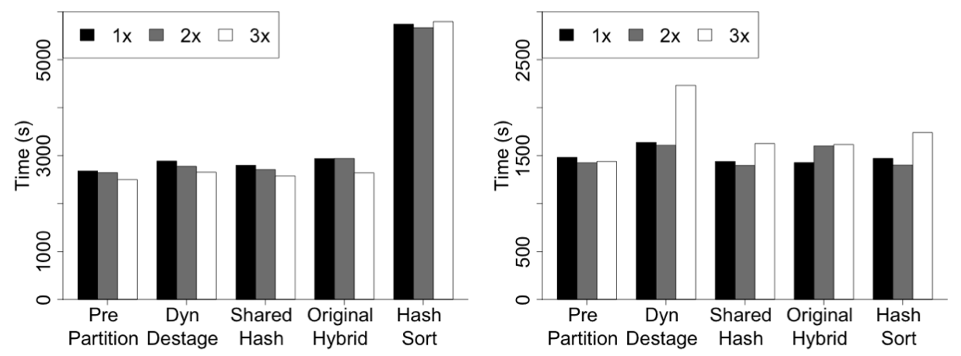
Hash Table: Number of Slots
Small Memory
Large Memory
Observations:
We try to vary the number of slots in the hash table to be 1x, 2x and 3x of the hash table capacity (i.e., the number of unique groups that can be maintained).
Although 2x is the rule-of-thumb from literature, we found that in our experiments 1x and 2x have the similar performance.
3x uses too much space for the hash table slots, so it will cause spill (Dynamic Destaging with large memory).
Notes:
1x means the number of slots of the hash table should be 1x of the total number of unique groups the hash table can maintain.
Larger ratio (2x, 3x) means more slots (so less hash collision) but less actual usable space.

Slide 40
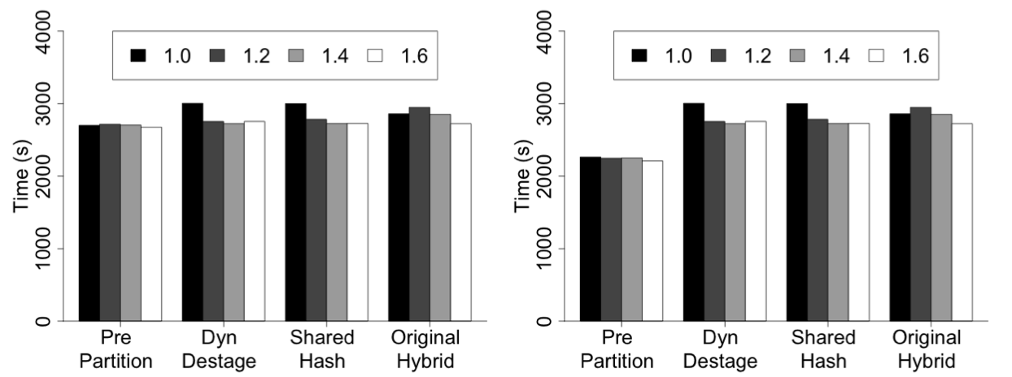
Hash Table: Fudge Factor
Small Memory
Large Memory
We tuned the fudge factor from 1.0 to 1.6.
  This is just the fuzziness without considering the hash table overhead. So 1.0 means we only consider the hash table overhead, but no other fuzziness like the page fragmentation.
Observation: clearly it is not enough to only consider the hash table overhead (case of 1.0), however different fudge factor does not influence the performance a lot.
Notes:
Fudge factor: we consider two part of the fuzziness:
The hash table overhead, which can be precisely computed if the hash table structure is known.
The other extra memory cost, like the memory to align the records, and the page fragmentation. This cannot be precisely decided.
The factors (1.0 ~ 1.6) here is about the extra memory cost (bullet 2)

Slide 41
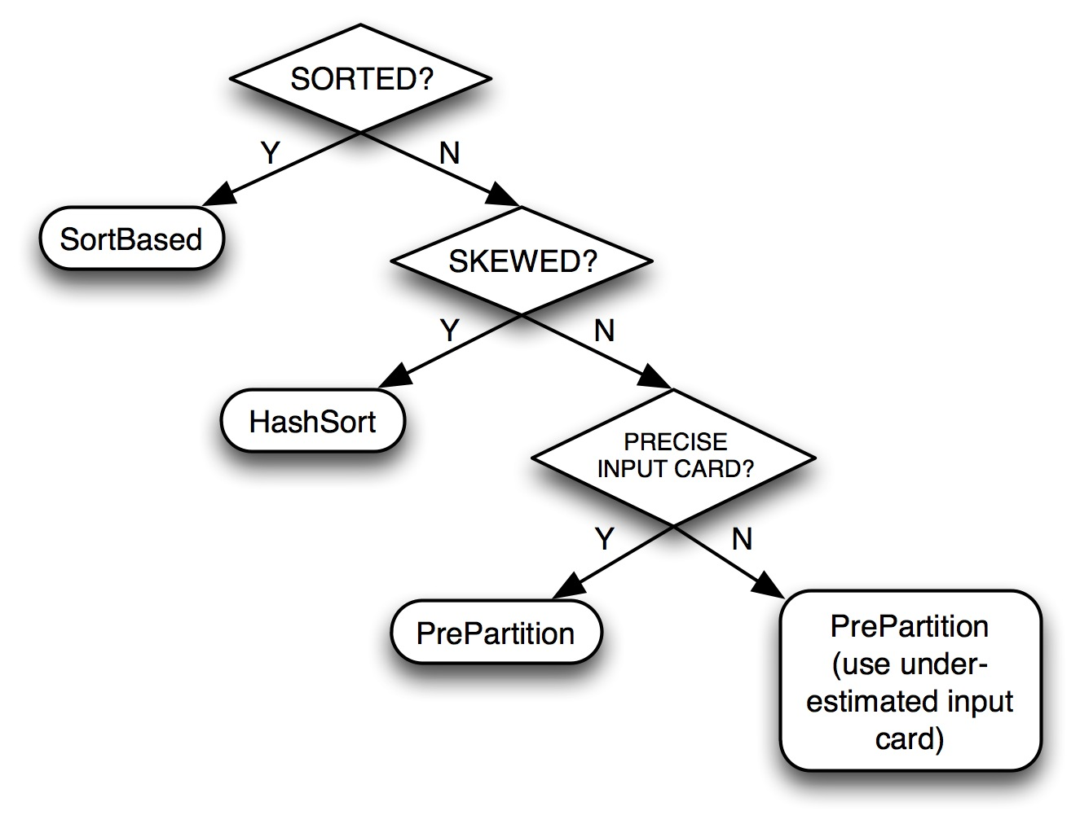
Optimizer Algorithm For Group-By
There is no one-fits-all solution for group-by.
Pick the right algorithm, given:
  Is the data sorted?
  Does the data has skew?
  Do we know any statistics about the data (and how precise our knowledge is)?
Notes:
Skew: distribution of UNIQUE keys
Cardinality: number of copies per unique key
If do not know the cardinality, just underestimate.

Slide 42
On-Going Work: Global Aggregation
Problem Setup:
  N nodes, and each node with M memory.
  Each node runs in single-thread (simplification).
  Input data are partitioned onto different nodes (may be residing in some of the N nodes).
Question: how to plan the aggregation, considering the following cost factors:
  CPU
  I/O
  Network

Slide 43
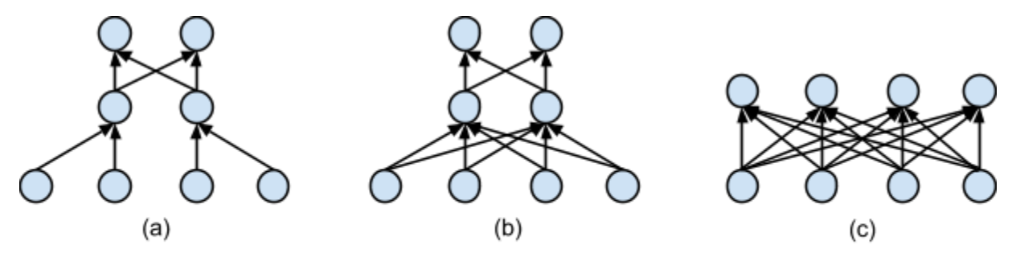
Challenges for Global Aggregation
Local algorithm: should we always pick the best one from the local-group-by study?
  Not always!
    it could be beneficial to send records for global aggregation without doing local aggregation, if most of the records are unique.
Topology of the aggregation tree: how to use nodes?
  Consider 8 nodes, and the input data is partitioned on 4 nodes.
    (a): less network connections; could be used to consider the rack-locality.
    (b): shorter aggregation pipeline
(a)
(b)

Slide 44














ASTERIX Project: Current Status
Approaching 4 years of initial NSF project (~250 KLOC)
AsterixDB, Hyracks, Pregelix are now public available (beta release, open-sourced).
Code scale-tested on a 6-rack Yahoo! Labs cluster with roughly 1400 cores and 700 disks.
World-spread collaborators from both academia and industry.

Slide 45
For More Info
NSF project page: http://asterix.ics.uci.edu
Open source code base:
ASTERIX: http://code.google.com/p/asterixdb/
Hyracks: http://code.google.com/p/hyracks
Pregelix: http://hyracks.org/projects/pregelix/

Slide 46
Questions?
more engine less trunk

