Slide 1
Fast Transportation Network Traversal with Hyperedges
Petko Bakalov, Erik Hoel, Wee-Liang Heng
Esri

Slide 2
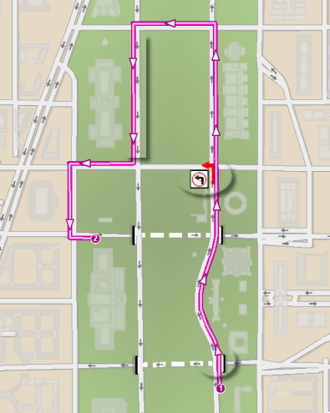
The problem
The goal: Improve the performance of the point to point hierarchical solve algorithms
The problem: the granularity of the high level edge elements – very high cardinalities
The requirement: Preserve the multi-user editing capability of the network data

Slide 3
Outline
Overview of the network model
Nature of commercial data
Hyperedges
Incorporating hyperedges into the network model
Internal representation
Build process
Experimental results

Slide 4
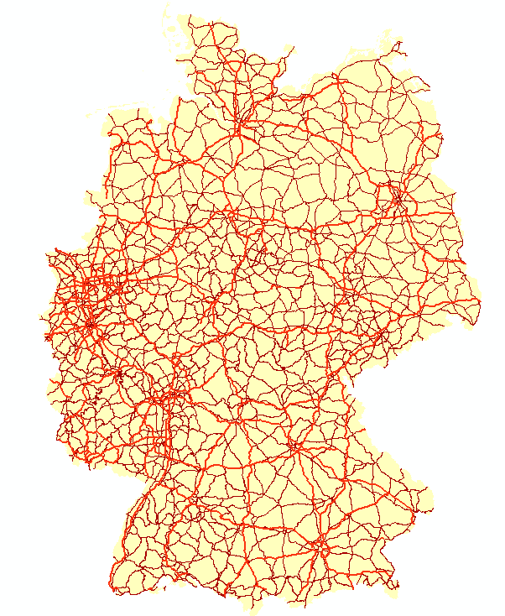
Network Model definition
A mechanism for defining and managing connectivity information between features in a geodatabase
A feature is graphic representation of a real-world object
Lines (e.g., streets, highways, subways, and railways)
Points (e.g., railway, bus, and subway stations)

Slide 5
Feature Sources
Network Index (Graph)
Point Features
Attributes
Line Features
Attributes
Table Sources
Turns
Metadata
Connectivity
Model
Attribute
Model
Historical
Traffic

Slide 6
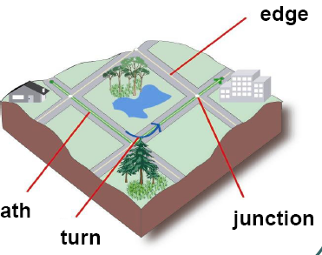
Network Index
The connectivity information is explicitly represented with network elements that are found in an associated network index (graph)
Three types of network elements in the network index:
Junctions
Edges
Turn restrictions and maneuveurs

Slide 7
Network Index
Feature space – stores features which have geometry
Network index – contains connectivity information about the features in the feature space as well as turn restrictions and maneuveurs
Line Feature
Point Feature
* FID
* FID
* Geometry
* Attributes
* Geometry * Attributes
1
1
Network Index
1 .. *
1 .. *
Edge
Junction
* NID
0..n
2
* NID
* Attributes
* Attributes
1..n
Turn
1..n
0 .. n
* NID
0 .. n
* Attributes

Slide 8
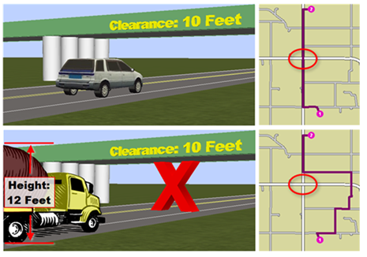
Network Model definition
Network attributes are properties of the network elements that control traversability
Cost. Certain attributes are used to measure and model impedances, such as travel time
Descriptors. Those are attributes that describe characteristics of the network or its elements.

Slide 9
Network Index Maintaining
Build – the process of discovering geographic coincidence between features that are persisted as junction and edges in the network index
As edits are made to the features, the network index becomes stale
We keep track of the modified features
Employ the dirty area concept (an envelope encompassing the edited feature)
When a feature is modified, a dirty area is created
The build process incrementally maintains the network index based upon the present dirty areas

Slide 10
Build Algorithm
Initial build of the network index
Simply a special case of a rebuild over a dirty region that encompasses the entire network
Network index is empty prior to the initial build
Incremental (re)builds
Rebuilt region corresponds to the dirty regions
When we rebuild the dirty regions, the resulting network index is completely correct

Slide 11
Build Algorithm Step 1: Connectivity Analysis
Extract the geometry of all features in the network model.
Sort the vertex information in the table by coordinate values so that the coincident vertexes are grouped together
Analyze each group of coincident vertexes according to the connectivity model

Slide 12
Build Algorithm
line endpoint
Connectivity Nodes
I3
mid-span vertex
(X,Y)
Point FCID, FID
Line FCIDs, FIDs, %'s along
P1
(-1,1)
I3/0%
I1
(0,0)
B1
I2
S4
(0,1)
S1/0%
(-1,0)
I1/0%; I3/100%
interstates
T1
interstate
Interstate group:
(0,0)
T1
I1/100%; I2/0%
connect
connects to
interstate
(0,0)
B1
S1/33%
S1
street
(indivisble)
(1,0)
P1
I2/100%; S4/0%
interstate tunnel
(2,0)
S4/100%
S2
(-1,-1)
S2/0%
streets
Street group:
(0,-1)
S2/50%; S1/67%
connect
street
(1,-1)
S2/100%
(divisible)
(-1,-2)
S3/0%
street bridge
(0,-2)
S3/50%; S1/100%
S3
Interstate--Street interconnect:
(1,-2)
S3/100%
streets
transition point
connect

Slide 13
Build Algorithm Step 2: Junction creation
Create junction elements and populate vertex information table from the extracted connectivity nodes
For each connectivity node
Create a logical junction element and set its x and y coordinate weight values
If there is a point feature participating in the connectivity node
Associate the junction element with the point feature
For each line vertex participating in the connectivity node
Add a record to the vertex information table, tagged with the junction element

Slide 14
Build Algorithm Example
j1
j2
j3
j4=T1
j6=P1
j7
Connectivity Nodes
j5=B1
(X,Y)
Point FCID, FID
Line FCIDs, FIDs, %'s along
(-1,1)
I3/0%
(0,1)
S1/0%
(-1,0)
I1/0%; I3/100%
j8
j9
j10
(0,0)
T1
I1/100%; I2/0%
(0,0)
B1
S1/33%
(1,0)
P1
I2/100%; S4/0%
(2,0)
S4/100%
(-1,-1)
S2/0%
j11
j12
j13
(0,-1)
S2/50%; S1/67%
(1,-1)
S2/100%
Vertex Information Table
(-1,-2)
S3/0%
Line FCID
Line FID
Relative Position
Junction EID
(0,-2)
S3/50%; S1/100%
Interstate
I3
0%
j1
(1,-2)
S3/100%
Streets
S1
0%
j2
Interstate
I1
0%
j3
Interstate
I3
100%
j3
Interstate
I1
100%
j4
Interstate
I2
0%
j4
Streets
S1
33%
j5
Interstate
I2
100%
j6
Streets
S4
0%
j6
Streets
S4
100%
j7
Streets
S2
0%
j8
Streets
S2
50%
j9
Streets
S1
67%
j9
Streets
S2
100%
j10
Streets
S3
0%
j11
Streets
S3
50%
j12
Streets
S1
100%
j12
Streets
S3
100%
j13

Slide 15
Build Algorithm Step 3: Edge creation
Create edge elements from vertex information table
Sort the vertex information table using the line FCID as primary key, line FID as secondary key, and relative position as tertiary key
For each adjacent pair of records in the sorted table
If the pair involves the same line feature
Create a logical edge element between the junction elements specified by the two records

Slide 16
Build Algorithm Example
j1
j2
Sorted Vertex Information Table
Line FCID
Line FID
Relative Position
Junction EID
e11
e1
Streets
S1
0%
j2
Streets
S1
33%
j5
Streets
S1
67%
j9
j3
e9
j4=T1
e10
j6=P1
j7
Streets
S1
100%
j12
e8
Streets
S2
0%
j8
j5=B1
Streets
S2
50%
j9
Streets
S2
100%
j10
Streets
S3
0%
j11
e2
Streets
S3
50%
j12
Streets
S3
100%
j13
Streets
S4
0%
j6
j8
j9
Streets
S4
100%
j7
e4
e5
j10
Interstate
I1
0%
j3
Interstate
I1
100%
j4
Interstate
I2
0%
j4
Interstate
I2
100%
j6
e3
Interstate
I3
0%
j1
Interstate
I3
100%
j3
j11
e6
j12
e7
j13

Slide 17
Outline
Overview of the network model
Nature of commercial data
Hyperedges
Incorporating hyperedges into the network model
Internal representation
Build process
Experimental results

Slide 18
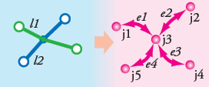
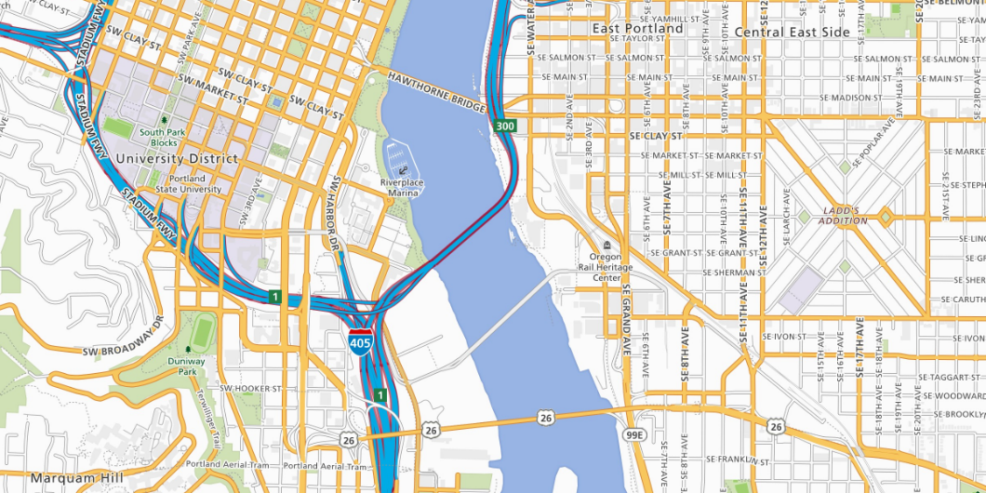
Commercial Data
Planar
Planar: Commercial street data is based on a planar model (originating from the TIGER model) where line geometries are split whenever they cross
Hierarchical: The number of hierarchical levels is a parameter of the model and can be adjusted accordingly
E.g., highway overpasses and underpasses
Non
Planar

Slide 19
Commercial Data

Slide 20
Outline
Overview of the network model
Nature of commercial data
Hyperedges
Incorporating hyperedges into the network model
Internal representation
Build process
Experimental results

Slide 21
Hyperedges
A hyperedge is an edge element that spans on top of regular edge elements and has hierarchical rank higher or equal to the hierarchical rank of the feature it models
Hyperedges have all the cost and restriction attributes of the network
Cost attributes will be summed
Restriction attributes will be copied

Slide 22
Hyperedges Example

Slide 23
Outline
Overview of the network model
Nature of commercial data
Hyperedges
Incorporating hyperedges into the network model
Internal representation
Build process
Experimental results

Slide 24
Hyperedge build
We augment the connectivity analysis (step 1) by assigning a hierarchy rank to the junctions
a junction is given rank r where r is the highest rank such that there is a point or line vertex with rank r
We then generate edge elements (step 3) connecting adjacent vertices of the line, and if necessary, hyperedge elements spanning those edges
This is accomplished by keeping a stack of related junction elements in rank order

Slide 25
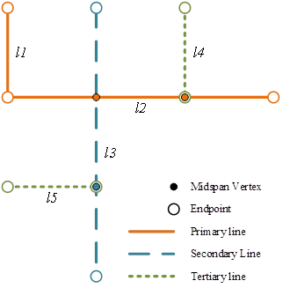
Hyperedge build
Rank 1
Rank 2
Rank 3
J1
J2
J3
J4

Slide 26
Hyperedge build
Rank 1
Rank 2
Rank 3
J1
J2
J3
J4
Stack
J1

Slide 27
Hyperedge build
Rank 1
Rank 2
Rank 3
J1
J2
J3
J4
Stack
J2
J1

Slide 28
Hyperedge build
Rank 1
Rank 2
Rank 3
J1
J2
J3
J4
Stack
J3
J2
J1

Slide 29
Hyperedge build
Rank 1
Rank 2
Rank 3
J1
J2
J3
J4
Stack
Stack
J3
J2
J1

Slide 30
Hyperedge build
Rank 1
Rank 2
Rank 3
J1
J2
J3
J4
Stack
J2
J1

Slide 31
Hyperedge build
Rank 1
Rank 2
Rank 3
J1
J2
J3
J4
Stack
J1

Slide 32
Outline
Overview of the network model
Nature of commercial data
Hyperedge extension
Incorporating hyperedges into the network model
Internal representation
Build process
Experimental results

Slide 33
Experimental Results test datasets
 | Edges | Junctions | Size
North America | 73.5 million | 27.2 million | 23.7 GB
Europe | 141.5 million | 55.5 million | 51.8 GB
Latin America | 25.1 million | 8.4 million | 6.9 GB

Slide 34
Experimental Results hyperedge percentages for the different datasets
 | Level 3 | Level 2 | Level 1
North America | 4.8% | 0.9% | 0.05%
Paris Metro | 2.9% | 0.7% | 0.03%
Online Data | 2.3% | 0.5% | >0.01%
 | Solve time (with hyperedges) | Solve time (without hyperedges)
ArcGIS Online Data | ≈ 0.05 sec | ≈ 0.07 sec
Paris Metro | ≈ 0.12 sec | ≈ 0.69 sec
United States | ≈ 1 sec | ≈ 5.3 sec

Slide 35
Experimental Results conclusion
Even though the number of hyper edges in the network model is relatively small (around 7% for our largest dataset) they have huge impact on the solve time.
Traversal operations on large operations are sometimes 5 times faster!!
The hyperedge are added as a standard element in our network model and are created for all hierarchical models from release 10.1 onwards

