Slide 1
A High-Resolution Side-Channel Attack on Last-Level Cache
Mehmet Kayaalp, IBM Research
Nael Abu-Ghazaleh, University of California Riverside
Dmitry Ponomarev, State University of New York at Binghamton
Aamer Jaleel, Nvidia Research
The 53rd Design Automation Conference (DAC), Austin, TX, June 8, 2016

Slide 2
Cache Side-Channel
28 1e 4c 24
09 bf 15 82
30 6f 53 d9
a4 49 2d 0e
f2 85 5c 06
6a 91 4e 0c
c4 fc da a8
d5 37 e9 9c
SubBytes
S-Box
Set-associative cache
sets
ways

Slide 3
Flush+Reload Attack
CPU1
CPU2
Victim
Attacker
1- Flush each line in the critical data
2- Victim accesses critical data
3- Reload critical data (measure time)
L1-I
L1-D
L1-I
L1-D
L2
L2
Shared L3
Cache
Evicted
Time
sets
ways

Slide 4
Prime+Probe: L1 Attack
2-way SMT core
1- Prime each cache set
2- Victim accesses critical data
Victim
Attacker
3- Probe each cache set (measure time)
L1-I
L1-D
L2
L1 Cache
Evicted
Time
sets
ways

Slide 5
Prime+Probe: LLC Attack
CPU1
CPU2
Victim
Attacker
1- Prime each cache set
2- Victim accesses critical data
3- Probe each cache set (measure time)
Back-invalidations
L1-I
L1-D
L1-I
L1-D
L2
L2
Evict critical data
Shared L3
Inclusive
Challenges:
Find collision groups for each cache set
Discover hardware details
Identify a minimal set of addresses per cache set
Find which are the critical cache sets
Find which cache sets incur the most slowdown for the victim
Among those, look for the expected access pattern

Slide 6
Discovering LLC Details
Intel Sandy Bridge die
4x Cores
4x 2MB
LLC Banks
63
12
0
Virtual Address
virtual page number
page offset
63
12
6
0
L1 Access
tag
set index
line offset
35
12
0
Physical Address
physical page number
page offset
35
17
6
0
LLC Access
tag
set index
line offset
Hash
bank select

Slide 7
Bank Selection and Cavity Sets
<H₀, H₁>:
<00>
<11>
<01>
<10>
Number of ways:
15
16
16
16
cavity
sets
35
17
6
0
tag
set index
line offset
●
●
●
●
●
●
●
●
●
●
●
●
●
●
●
●
●
H₀
●
●
●
●
●
●
●
●
●
●
●
●
●
●
●
●
●
●
●
●
H₁
XOR

Slide 8
Finding Collision Groups
Memory Page
same set index
same set index
x N = Cache Size
number of ways
…
N = (8 MB / 4 KB / 16)
= 128
ɸ = { }
Add page ρ to ɸ
Measure ∆t = t( ɸ ) - t( ɸ - ρ )
If ∆t is high
For each ρ_{i}∈ ɸ
Measure ∆t_{i} = t( ɸ ) - t( ɸ - ρ_{i} )
Add ρ_{i} to the new group if ∆t_{i} is high
Remove the group from ɸ
Repeat until N groups are found
N
ways

Slide 9
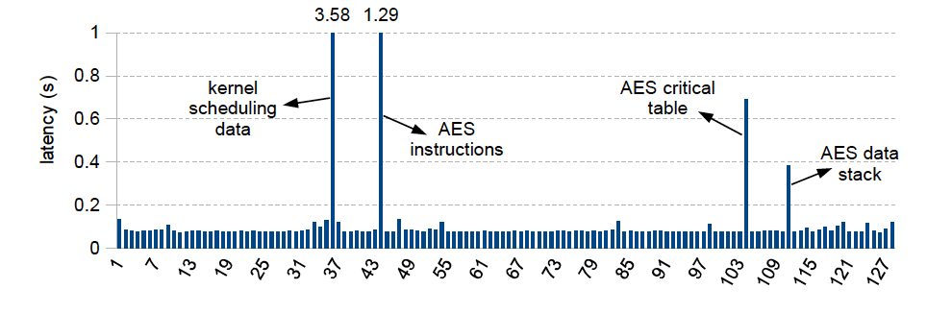
Finding Critical Sets

Slide 10
Attack on Instructions
for round = 1:9
if round is even
/* even rounds */
else
/* odd rounds */
/* last round */
sets
time

Slide 11
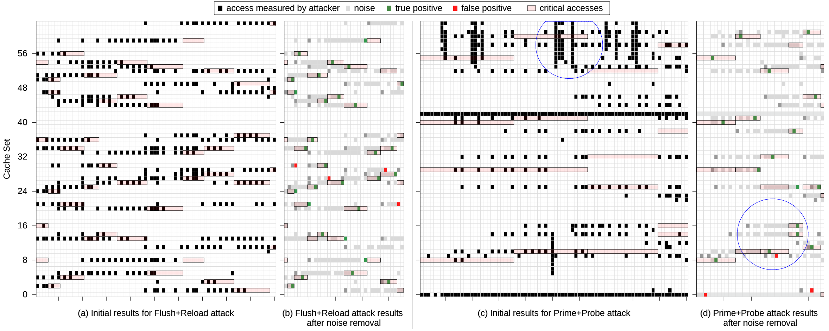
Attack on Critical Table

Slide 12
Attack Analysis
True Positive Rate
# true critical accesses observed
# all critical accesses of the victim
False Discovery Rate (FDR)
# false critical accesses observed
# all measurements of the attacker
Cache Side-Channel Vulnerability (CSV)
CSV = Pearson-correlation (Attacker trace, Victim trace)
TPR =
FDR =

Slide 13
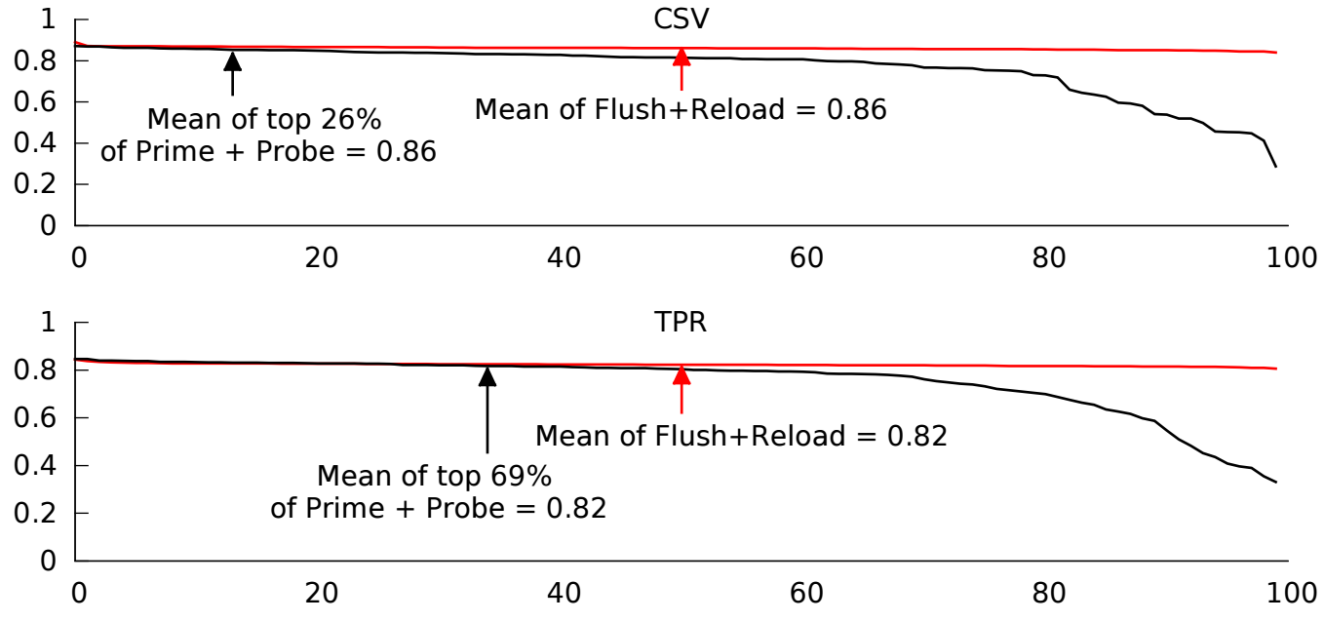
Comparison to Flush+Reload

Slide 14
Summary
A new high-resolution Prime+Probe LLC attack is proposed
It does not rely on large pages or the sharing of cryptographic data between the victim and the attacker
Mechanisms to discover precise groups of addresses that map into the same LLC set in the presence of:
Physical indexing
Index hashing
Varying cache associativity across the LLC sets
Concurrent attack on the instruction and data tp improve the signal and reduce the noise
Not limited to AES and can be applied to attacking any ciphers that rely on pre-computed cryptographic tables (e.g. Blowfish, Twofish)

