Slide 1
Adversarial Evasion-Resilient Hardware Malware Detectors
Nael Abu-Ghazaleh
Joint work with Khaled Khasawneh, Dmitry Ponomarev and Lei Yu

Slide 2
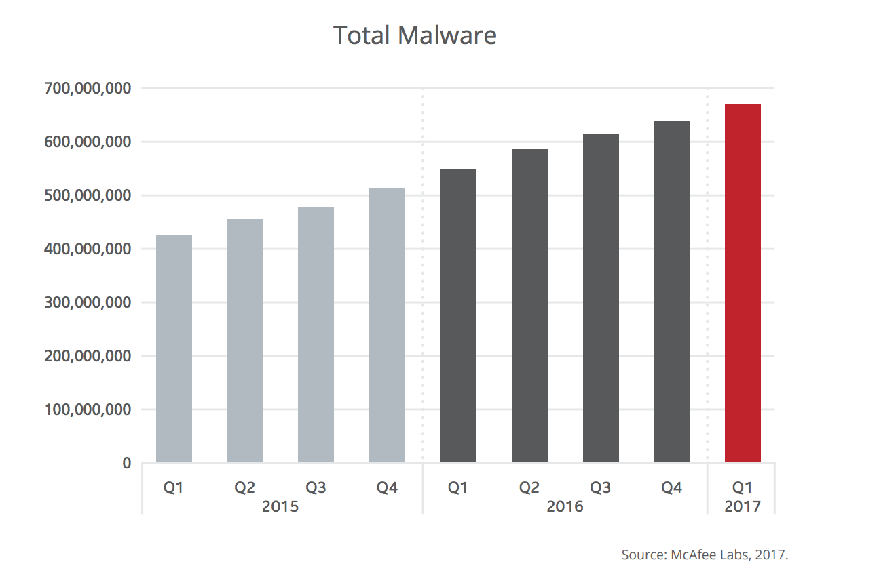
Malware is Everywhere!

Slide 3
Malware is Everywhere!
Over 250,000 malware registered every day!

Slide 4
Hardware Malware Detectors (HMDs)
Use Machine Learning: detect malware as computational anomaly
Use low-level features collected from the hardware
Can be always-on without adding performance overhead
Many research papers including ISCA’13, HPCA’15 and MICRO’16

Slide 5
Overview
Can malware evade detection?
Reverse-engineer HMDs
Develop evasive malware
Evade detection after re-training

Slide 6
Overview
Can malware evade detection?
If yes
Can we make HMDs robust to evasion?
Reverse-engineer HMDs
Develop evasive malware
Evade detection after re-training
Yes! using RHMD
1- Provably harder to reverse-engineer
2- Robust to evasion

Slide 7
Reverse Engineering

Slide 8
How to Reverse Engineer HMDs?
Challenges:
  We don’t know the detection period
  We don’t know the features used
  We don’t know the detection algorithm
Approach:
  Train different classifiers
  Derive specific parameters as an optimization problem

Slide 9
Reverse Engineering HMDs
Attacker Training Data
_________________________

Slide 10
Reverse Engineering HMDs
Victim HMD
Attacker Training Data
_________________________
10100
Black box
output

Slide 11

Reverse Engineering HMDs
Victim HMD
Attacker Training Data
_________________________
10100
Black box
output
Training model
Data
Labels

Slide 12
Reverse Engineering HMDs
Victim HMD
Attacker Training Data
_________________________
10100
Black box
output
Training model
Data
Labels
Reverse-engineered HMD

Slide 13
We Can Guess Detectors Parameters!
Victim HMD parameters:
  - 10K detection period - Instructions features vector

Slide 14
We Can Guess Detectors Parameters!
Victim HMD parameters:
  - 10K detection period - Instructions features vector
Guessing detection period:
LR: Logistic Regression
DT: Decision Tree
SVM: Support Vector Machines

Slide 15
We Can Guess Detectors Parameters!
Victim HMD parameters:
  - 10K detection period - Instructions features vector
Guessing feature vector:
LR: Logistic Regression
DT: Decision Tree
SVM: Support Vector Machines

Slide 16
Reverse Engineering Effectiveness
Logistic Regression
Victim HMD
Neural Networks

Slide 17
Reverse Engineering Effectiveness
Current generation of HMDs can be reverse engineered
Logistic Regression
Neural Networks

Slide 18
Evading HMDs

Slide 19
How to Create Evasive Malware?
Challenges:
  - We don’t have malware source code
  - We can’t decompile malware because its obfuscated
  Our approach:
PIN
Dynamic Control Flow Graph

Slide 20
What we Should Add to Evade?
Logistic Regression (LR)
  LR is defined by a weight vector θ
  Add instructions whose weights are negative

Slide 21
What we Should Add to Evade?
Neural Network (NN)
  Collapse the description of the NN into a single vector
  Add instructions whose weights are negative

Slide 22
What we Should Add to Evade?
Current generation of HMDs are vulnerable to evasion attacks!
Neural Network (NN)
  Collapse the description of the NN into a single vector
  Add instructions whose weights are negative

Slide 23
Does re-training Help?

Slide 24
Can we Retrain with Samples of Evasive Malware?
Linear Model (LR)

Slide 25
Can we Retrain with Samples of Evasive Malware?
Linear Model (LR)
  Non-Linear Model (NN)

Slide 26
Explaining Retraining Performance
Linear Model (LR)

Slide 27
Explaining Retraining Performance
Non-Linear Model (NN)

Slide 28
What if we Keep Retraining?

Slide 29
What if we Keep Retraining?

Slide 30
What if we Keep Retraining?

Slide 31
What if we Keep Retraining?

Slide 32
What if we Keep Retraining?
Re-training is not a general solution

Slide 33
Can we Build Detectors that Resist Evasion?

Slide 34
Overview of RHMDs
RHMD
HMD
1
HMD
2
Pool of diverse
HMDs
.
.
.
HMD
n

Slide 35
Overview of RHMDs
RHMD
HMD
1
HMD
2
Input
Output
.
.
.
HMD
n
Selector

Slide 36
Overview of RHMDs
Detection period
Number of committed instructions
0
Features vector
…
RHMD
HMD
1
HMD
2
Input
Output
.
.
.
HMD
n
Selector

Slide 37
Overview of RHMDs
Detection period
Number of committed instructions
0
Features vector
…
…
RHMD
HMD
1
HMD
2
Input
Output
.
.
.
HMD
n
Selector

Slide 38
Overview of RHMDs
Detection period
Number of committed instructions
0
Features vector
…
…
…
RHMD
HMD
1
HMD
2
Input
Output
.
.
.
HMD
n
Selector

Slide 39
Overview of RHMDs
Detection period
Number of committed instructions
0
Features vector
…
…
…
RHMD
Diversify by Different:
1- Features
2- Detection periods
HMD
1
HMD
2
.
.
.
HMD
n
Selector

Slide 40
Reverse Engineer RHMDs
Randomizing the features
2 feature vectors
3 feature vectors

Slide 41
Reverse Engineer RHMDs
Randomizing the features & detection period
2 feature vectors & 2 periods
3 feature vectors & 2 periods

Slide 42
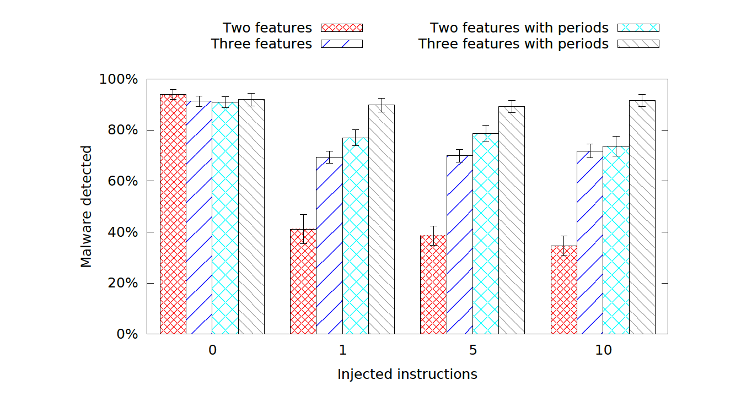
RHMD is Resilient to Evasion

Slide 43
Hardware Overhead
FPGA prototype on open core (AO486):
RHMD with three detectors:
  Area increase 1.72%
  Power increase 0.78%

Slide 44

Transferability
Given an evasive malware crafted to evade Detector A how likely would it evade Detector B
Target
Detector A
Craft evasive
malware
How likely it
will evade?
Detector B

Slide 45
Impact on RHMDs?
RHMD resilient to black-box attacks
  Making reverse engineering is not accurate
Transferability help understanding resilience to
  White-box attack: attacker knows some/all base detectors
  Gray-box attacks: attacker has access to training data

Slide 46
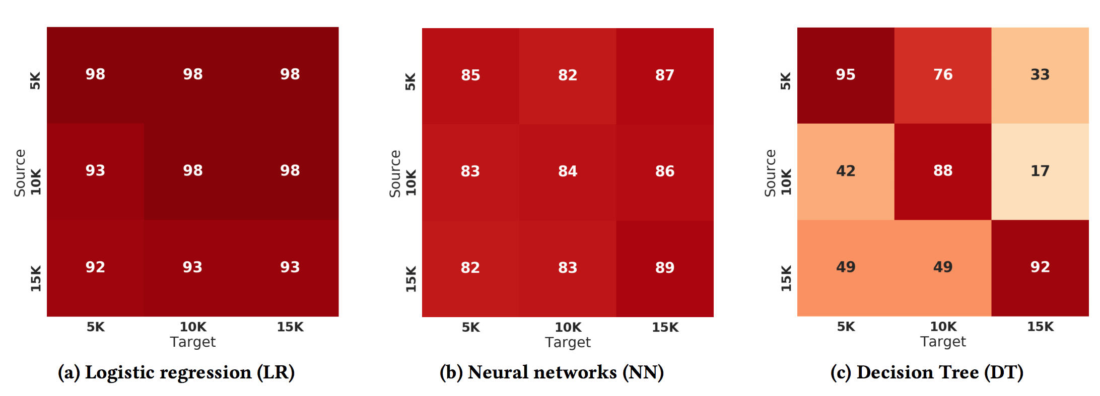
Intra-algorithm Transferability

Slide 47
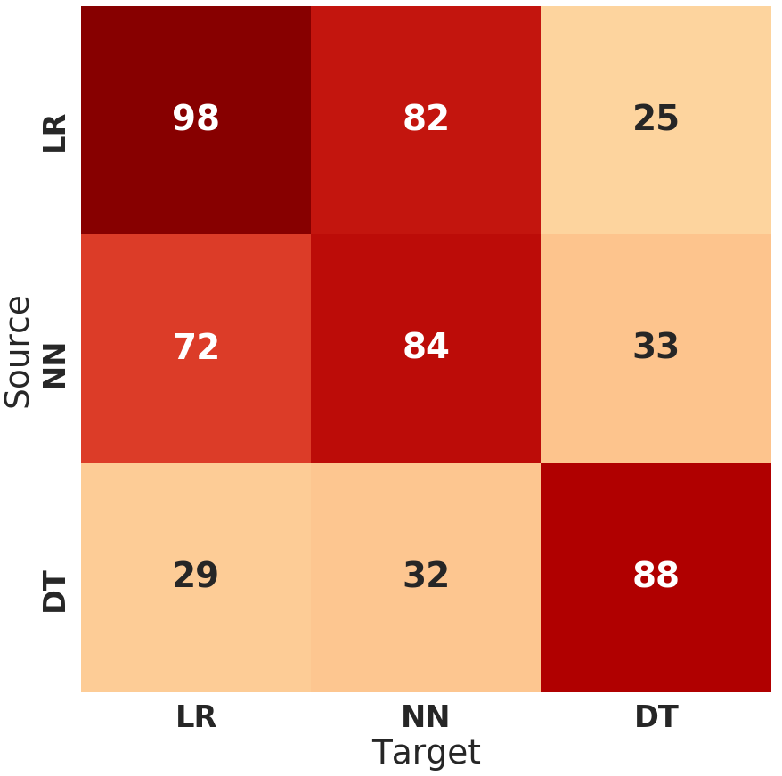
Cross-algorithm Transferability

Slide 48
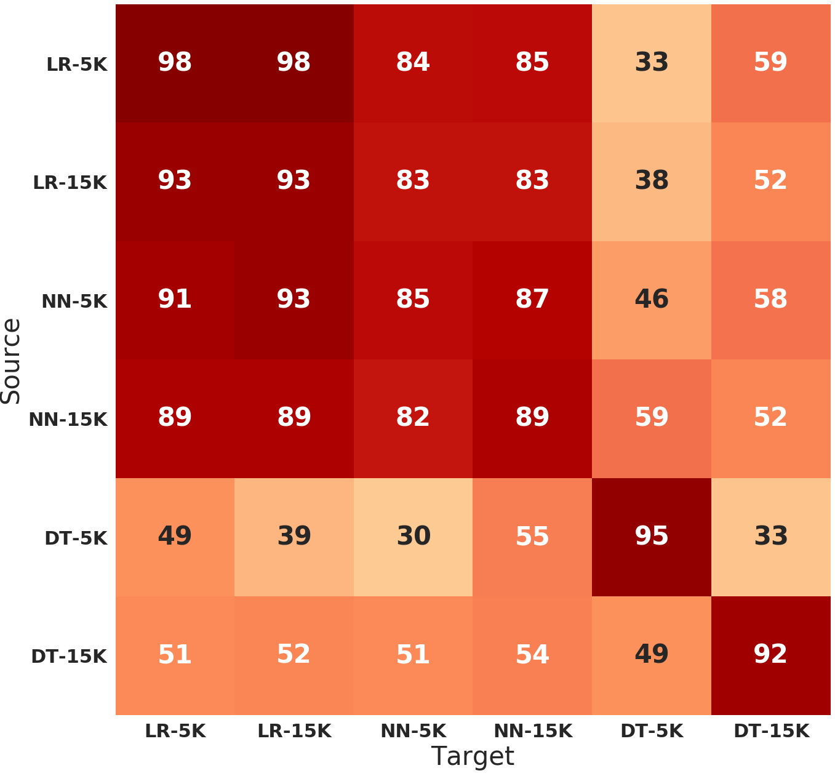
Combined Transferability

Slide 49
Final thoughts
Machine learning will be prevalent in systems
  Already used in a number of predictors
Especially true as systems and applications continue to evolve
Important to understand implications and design for resilience against adversarial attacks

Slide 50

Thank you!
Questions?

Slide 51
Can’t Just Randomly Add Instructions

Slide 52
Evasion Overhead

