Slide 1
Hardware Security Primitives with focus on PUFs
Slide credit: Srini Devedas and others

Slide 2
Hardware security primitives
Our next topic looks at hardware primitives that can assist with security
Examples
  True random number generators (Intel’s RdRand)
  AES/SHA instructions (hardware crypto support)
  PUFs (today)
  ORAM (today?)
  The wire-tap problem for generating keys
  Higher level mechanisms (starting next class)
What does hardware offer; lets consider some of the above.

Slide 3
PUF Introduction
Physical Unclonable Function (PUF)
Rely on process variations
Variation is inherent in fabrication process
  Unique for each physical instance—”hardware fingerprint”
  Cannot model, cannot clone (or can you?)
  Relative variation increases as the fab process advances--good
Non-silicon PUFs can help with tamper resistance

Slide 4
Definition
A Physical Random Function or Physical Unclonable Function (PUF) is a function that is:
  Based on a physical system
  Easy to evaluate (using the physical system)
  Its output looks like a random function
  Unpredictable even for an attacker with physical access
  Reliable: returns the same (or similar) value for the same input challenge

Slide 5
Advantages and Applications of PUFs
Advantages:
  No secure memory required
    Not vulnerable to physical attacks
    Can be very small – embedded devices
  Intrinsic defense against intrusive hardware
Some applications
  Device identification and authentication
  Secure key generation
  software licensing to a specific machine
  Building block for crypto algorithms (RNG, Key generation, …)

Slide 6
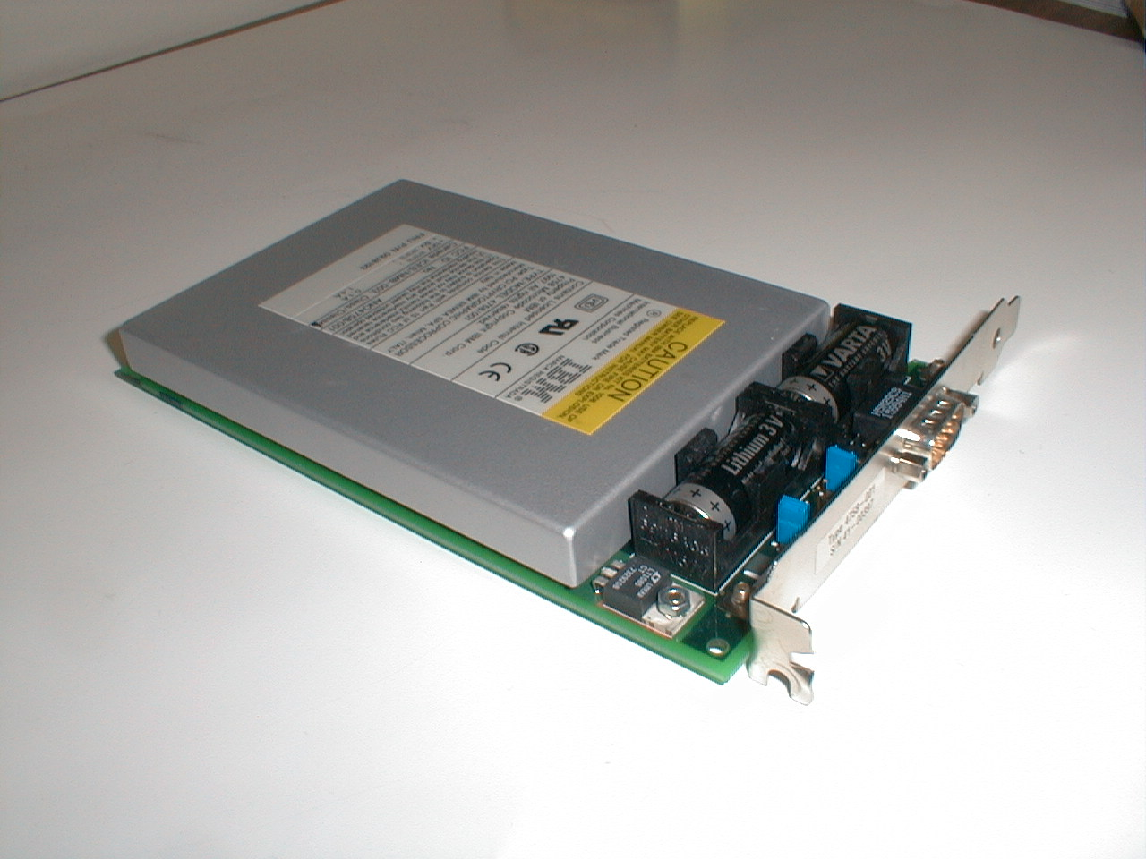
Scenario:
Storing digital information in a device in a way that is resistant to physical attack is difficult and expensive.
IBM 4758
Tamper-proof package
containing a secure processor
which has a secret key and
memory
  Tens of sensors, resistance,
  temperature, voltage, etc.
  Continually battery-powered
~ $3000 for a 99 MHz processor
and 128MB of memory

Slide 7
Silicon PUF – Proof of Concept
Because of process variations, no two Integrated Circuits are identical
Identical circuits with identical layouts on different FPGAs: path delays vary enough across ICs to use them for identification.
Challenge
Response
Combinatorial Circuit

Slide 8
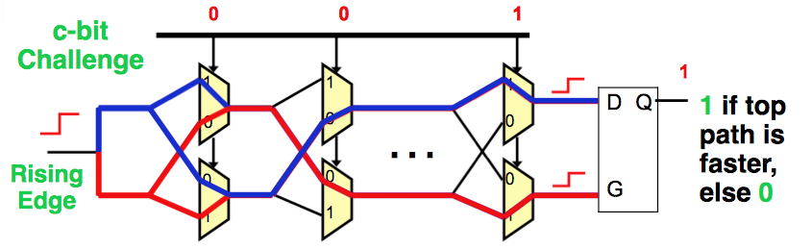
PUF Circuits
  Arbiter PUF

Slide 9
Experiments
Fabricated candidate PUF on multiple IC’s, 0.18μ TSMC
Apply 100 random challenges and observe response
100 bits of response
Distance between Chip X and Y
responses = 24 bits
At 70C measurement
noise for chip X = 2
Measurement noise for Chip X = 0.5
Can identify
individual ICs
Notes:
Summarize a year’s worth of work in one slide.

Slide 10
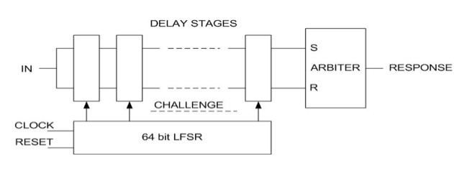
PUF Circuits
  construct a k-bit response
    one circuit can be used k times with different inputs
    duplicate the single-output PUF circuit

Slide 11
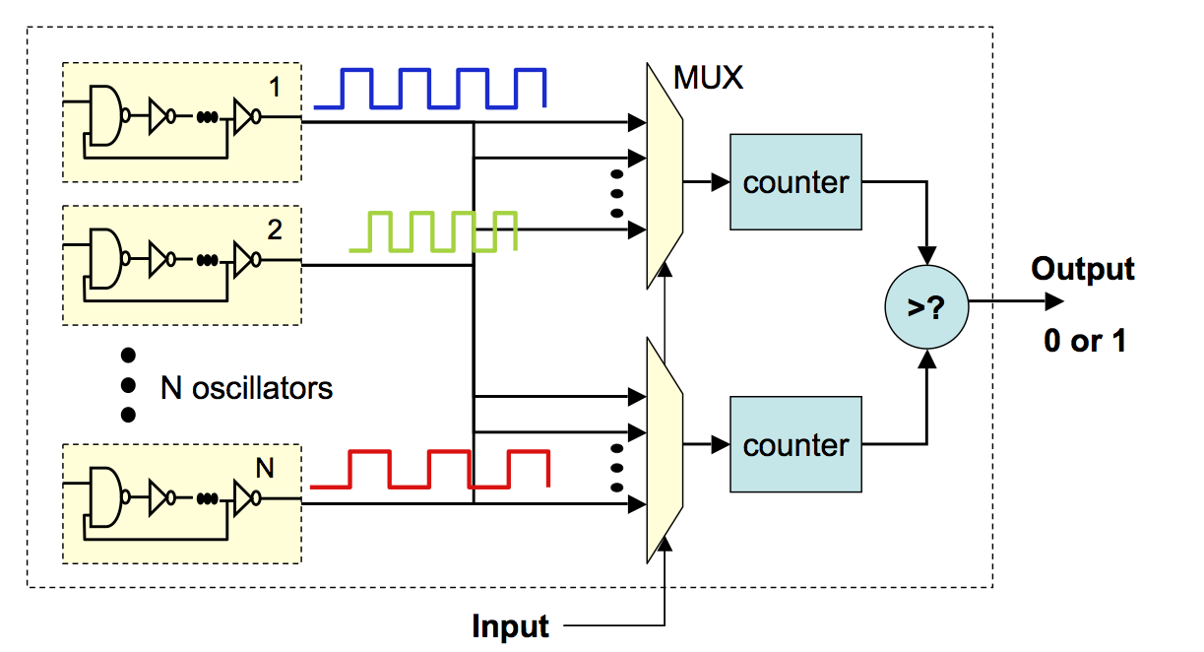
PUF Circuits
  Ring Oscillator PUF

Slide 12
Ring Oscillator Circuits
Easier Implementation
  No need for careful layout and routing
Slower, Larger, more power to generate bits
Better for FPGAs and secure processors
Hard to generate many challenge response pairs

Slide 13
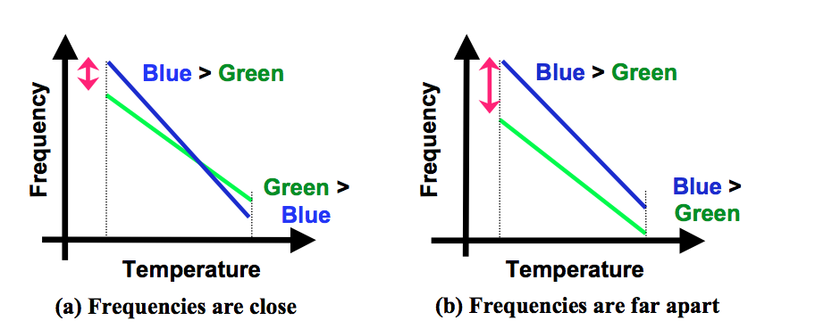
PUF Circuits
  Ring Oscillator PUF
    environmental conditions
    Choose ring oscillator pairs, whose frequencies are far apart=>remove key generation error

Slide 14
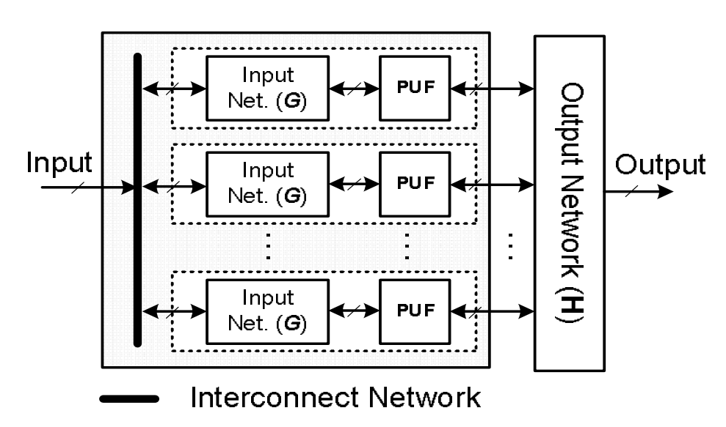
PUF Circuits
  Lightweight Secure PUF. Avalanche property

Slide 15
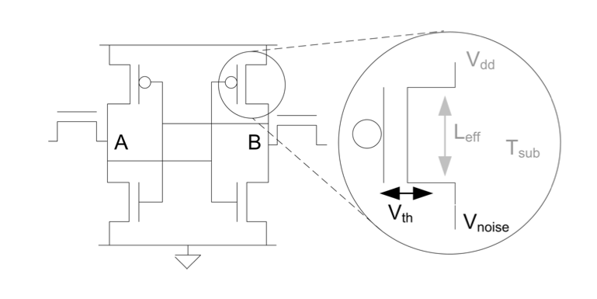
PUF Circuits SRAM
  SRAM PUF

Slide 16
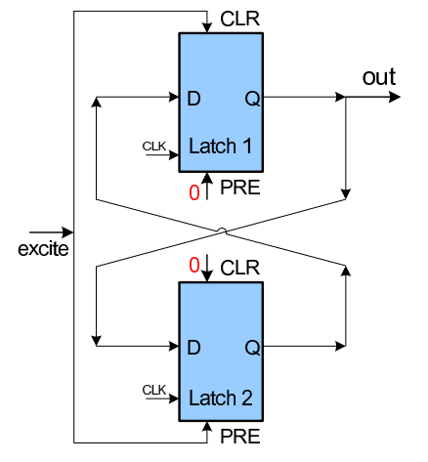
PUF Circuits
  Butterfly PUF

Slide 17
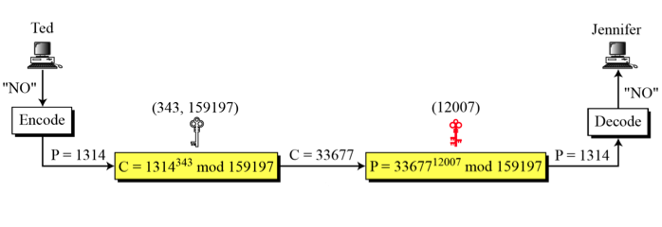
Challenges=>Conventional Authentication
Conventional Authentication Schemes
  Need to store keys
  Power and area consumption

Slide 18
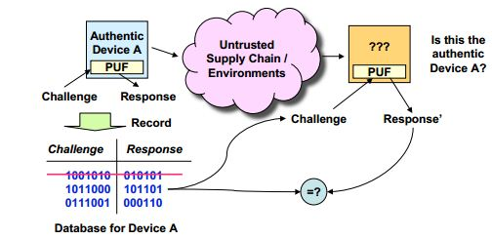
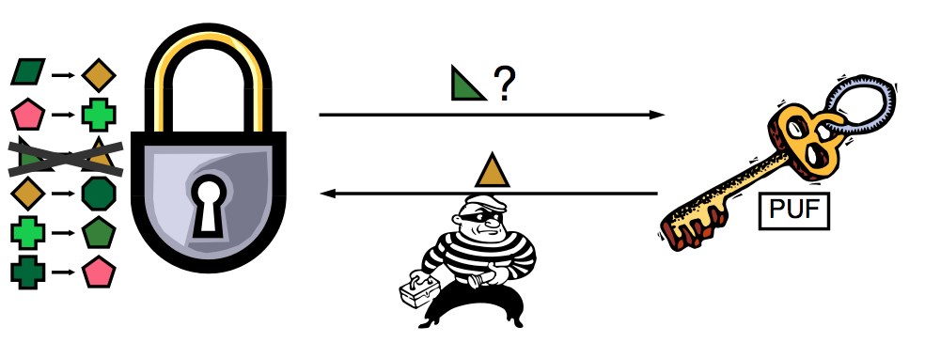
Applications of PUF
1) Low cost authentication

Slide 19
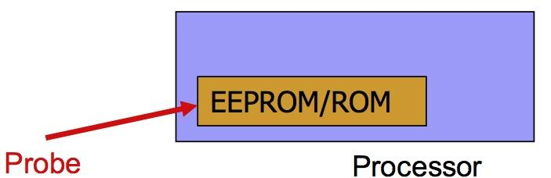
.
Challenges => Store Secrets
Conventional approach to embed secure secrets in IC
      Non-volatile memory(ROM, Fuse, Flash or EEPROM)
      Battery-backed RAM
Non-volatile memory technologies are often vulnerable to invasive and non-invasive attack
Adversaries can physically extract secret keys from EEPROM while processor is off

Slide 20
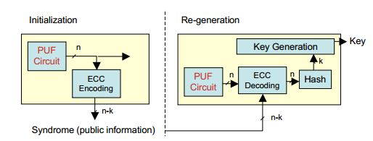
Applications of PUF
2) Cryptographic Key Generator
*ECC=Error Correction Code

Slide 21
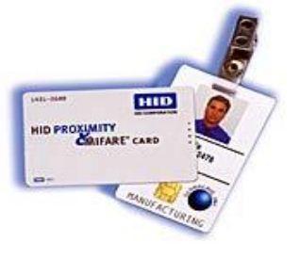
Challenges=>Power and Area
Power and Area are critical
  RFID tag can afford a maximum of 2000 gates for security features
  Passive RFIDs
A good cryptographic primitive should be
lightweight, occupy little area on silicon and
should have very low power consumption.

Slide 22
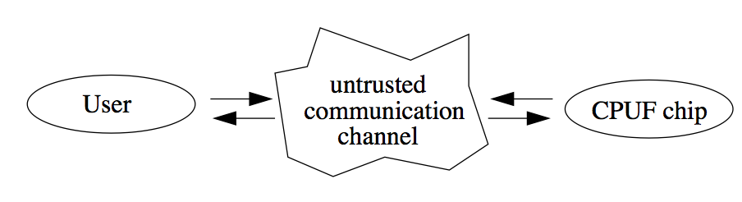
Applications of PUF
3) Software Licensing and Anonymous Computation
  *CPUF=Controlled PUF

Slide 23
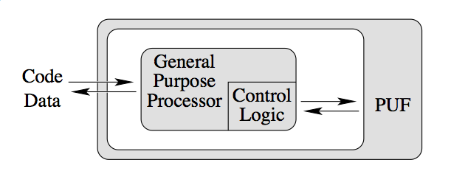
Applications of PUF
3) Software Licensing and Anonymous Computation

Slide 24
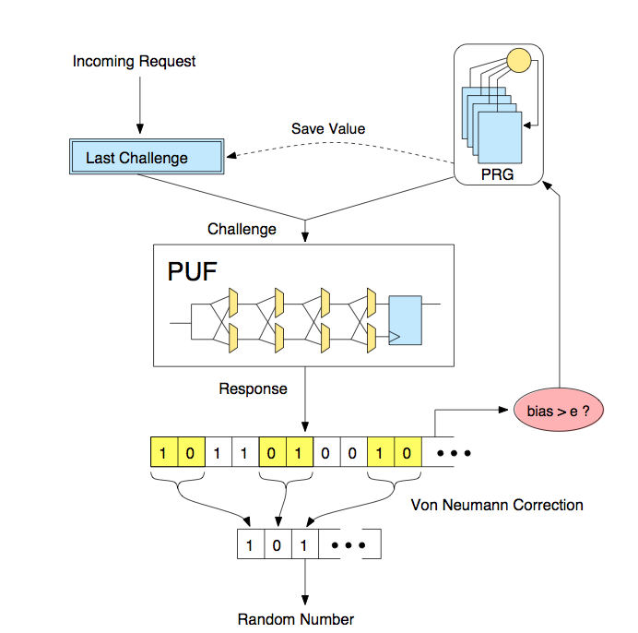
Applications of PUF
4) Entropy source for RNG
0.1% of all challenges do not return a consistent response
These meta-stable challenges generate responses which can vary unpredictably

Slide 25
However…
Security of PUFs is unclear
  Can be modeled sometimes
  Effect of aging
  …
Many PUFs (especially timing based) shown to be in fact clonable (CCS 2010 paper)
  General idea: machine learning based on some challenges allows us to predict other challenges (>99% success)
  Sometimes the effort is big (10s of days)
Still an active research area
  Authenticache (ISCA 2015)
Gap between PUF implementations and models in literature
  Security parameters cannot be determined in practice

