Slide 1

Exploiting modern architectures
Slide credit: some slides from Lucas Davi and others

Slide 2

Introduction
Critical vulnerabilities in modern processors
Read the kernel memory
Bypass security mechanism (ASLR)
Bypass sandboxing
Vulnerability originates in architecture
  Difficult to fix!

Slide 3
Outline
First we will set the table
  Ingredient 1: Side channel and covert channel attacks
  Ingredient 2: Speculation and branch predictor
Meltdown and Spectre
  Spectre (Branch target injection)
  Spectre (Bypassing bound check)
  Meltdown
  What else is out there?
Possible defenses
  Software defenses
  New architectures

Slide 4

Ingredient 1: Covert/Side channels

Slide 5
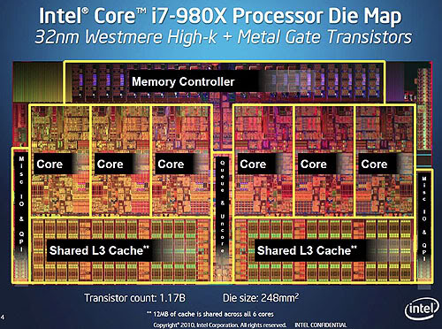
Microarchitecture side channels
Program security relies on isolation
  Process boundary
  Process vs. kernel
  Sandboxing
  Virtual machines, …
Modern processors support multiple programs running at the same time
    Isolation broken at architecture level
  Side channels galore!!
    What one process does can affect others
  What are examples?

Slide 6
Cache Side-Channel Attack
28 1e 4c 24
09 bf 15 82
30 6f 53 d9
a4 49 2d 0e
f2 85 5c 06
6a 91 4e 0c
c4 fc da a8
d5 37 e9 9c
SubBytes
S-Box
Set-associative cache
sets
ways

Slide 7
Flush+Reload Attack
CPU1
CPU2
Victim
Attacker
1- Flush each line in the critical data
2- Victim accesses critical data
3- Reload critical data (measure time)
L1-I
L1-D
L1-I
L1-D
L2
L2
Shared L3
Cache
Evicted
Time
sets
ways

Slide 8
Prime+Probe: L1 Attack
2-way SMT core
1- Prime each cache set
2- Victim accesses critical data
Victim
Attacker
3- Probe each cache set (measure time)
L1-I
L1-D
L2
L1 Cache
Evicted
Time
sets
ways

Slide 9
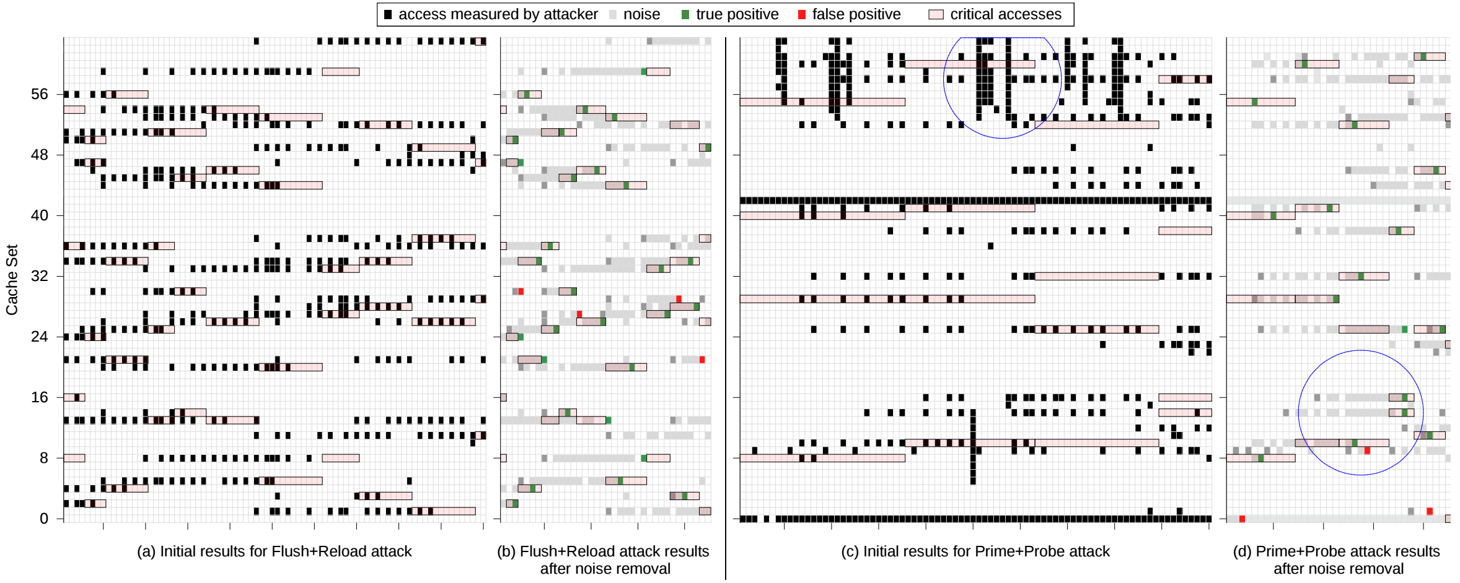
Attack on Critical Table

Slide 10
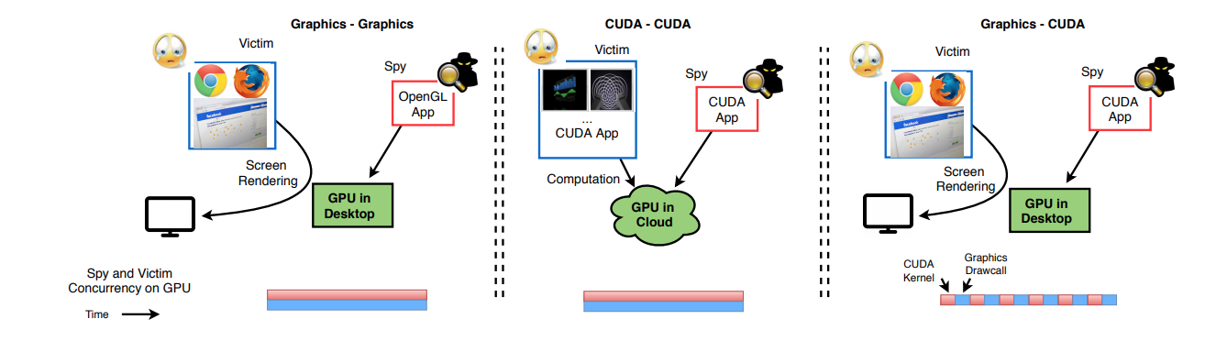
Its not just the CPU

Slide 11
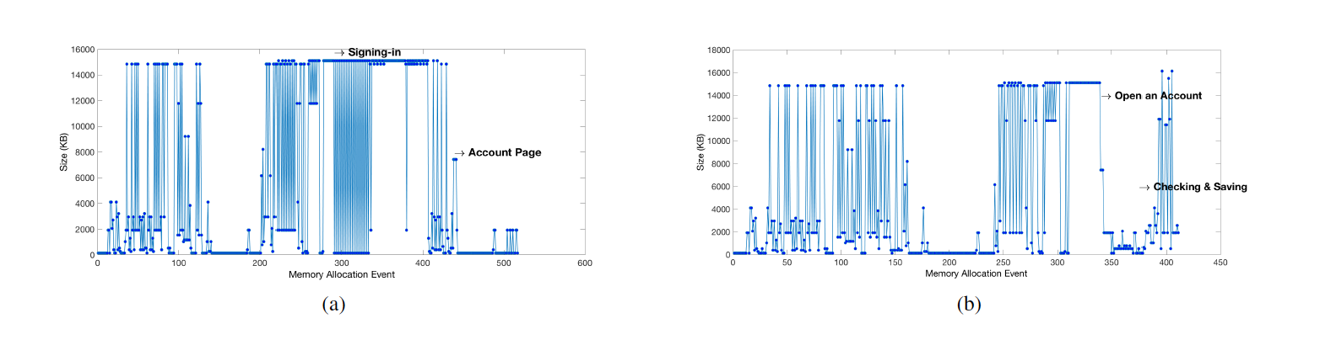
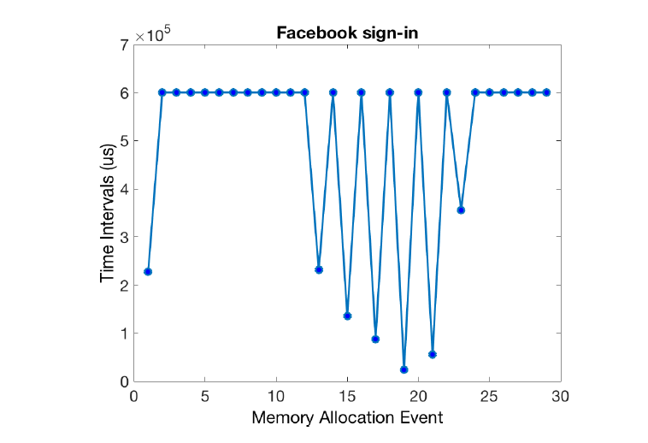
Side and covert channels are everywhere!
Paper under review– vulnerability reported to Nvidia

Slide 12

Ingredient 2: Speculative Execution

Slide 13
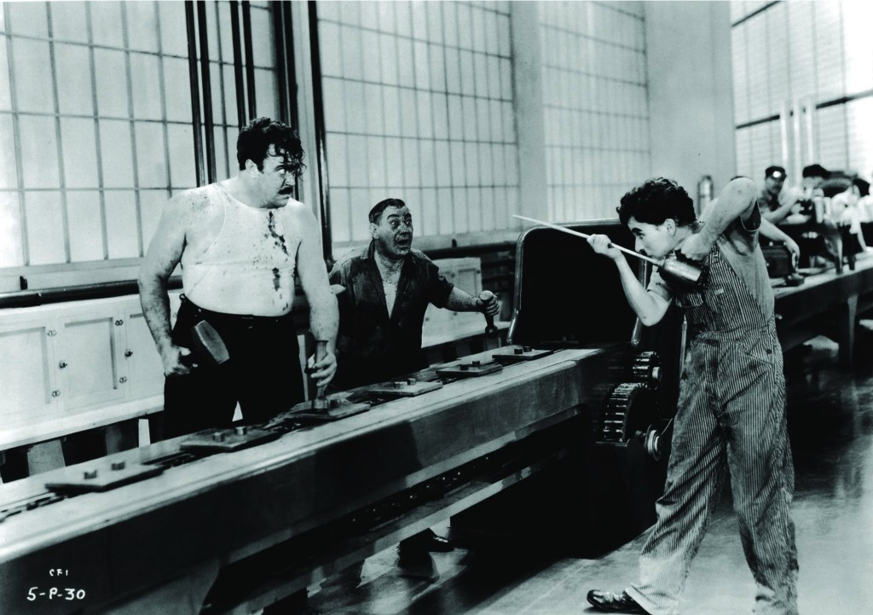
First lets start with pipelining
Reg
Write
Data
Memory
ALU
Reg
Read
Fetch
Notes:
Modern times – available on netflix

Slide 14
Control hazards!

Slide 15
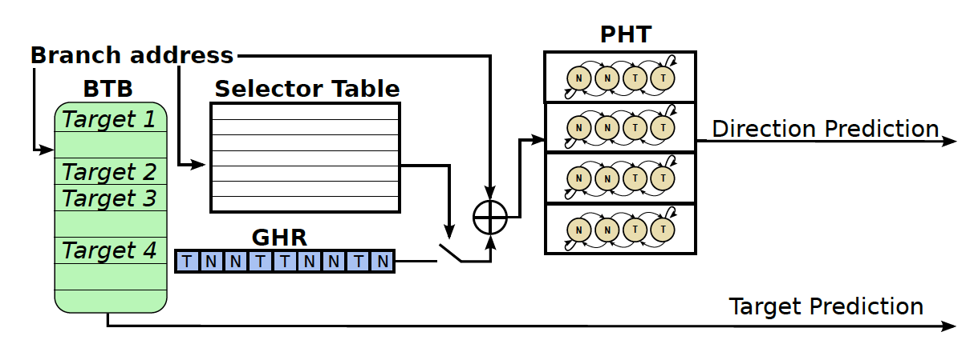
Enter branch predictors

Slide 16

Putting it all together– Attacks!

Slide 17
Some observations about speculation
Speculated instructions can be any old nonsense
  We’ll clean up later
No checks of permissions.
  Permissions not ready to check
  No danger – we will squash instructions if wrong
  Even security extensions do not work
Speculation causes exposure
  Through side channels
  Through physical exposure (e.g., memory bus)

Slide 18
General Idea of all attacks
Fool the processor to speculatively execute some instructions such that:
  The instructions access sensitive data without permission
    (basically a covert transmitter)
  The data is exposed through a side channel
We read it from the side channel → broke isolation
Can read kernel memory; memory out of a sandbox; basically break software isolation based on permissions

Slide 19
Three published variants of attack
Spectre : bounds check bypass (CVE-2017-5753)
Spectre: branch target injection (CVE-2017-5715)
Meltdown: rogue data cache load (CVE-2017-5754)

Slide 20

Spectre:
Variant 1 : bounds check bypass

Slide 21
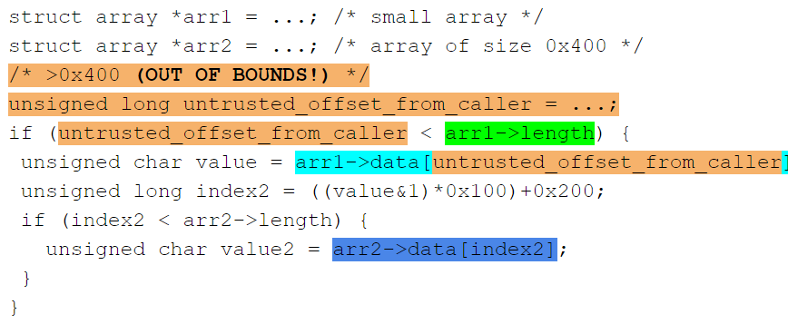
Variant 1: bypassing bound check
Read out of bound memory

Slide 22
Variant 1: bypassing bound check
Assumption:
These value are not cached:
arr1->length
arr2->data[0x200]
arr2->data[0x300]

Slide 23
Variant 1: bypassing bound check
Assumption:
The branch conditions are predicted as true
Speculatively:
  load value = arr1->data[untrusted_offset_from_caller]
  start a load from a data-dependent offset in arr2->data, loading the corresponding cache line into the L1 cache

Slide 24
Variant 1: bypassing bound check
measuring the time required to load arr2->data[0x200] andarr2->data[0x300]
Discloses whether arr1->data[untrusted_offset_from_caller]&1 is 0 or 1

Slide 25
Spectre:
Variant 2 : branch target injection

Slide 26
Jump-over-ASLR: Attack Overview
Use Branch Target Buffer (BTB) to recover random address bits
Two scenarios:
  One user space process attacking another
  User process attacking Kernel ASLR
Attack capabilities:
  Control speculation of another process
  Recover all random bits in Linux Kernel and KVM*
  Recover part of random bits in User Process making brute force attack much faster
* https://github.com/felixwilhelm/mario_baslr/

Slide 27
Branch Target Prediction Mechanism
Branch Target Buffer
Address tag | Target
jmp
A:
A
B
B:
Virtual Address space

Slide 28

User-Level Attack
Victim
Spy
Branch Target Buffer
Address tag | Target
jmp
jmp
A:
A:
A
B
B:
B:
C:
Observation: HIT
Observation: MISPREDICTION

Slide 29
Latencies Observed by the Spy on Haswell Processor

Slide 30
Variant 2: branch target injection background(Branch Target Buffer)
Branch Instruction
Address (Tag)
Branch PC
V
BIA
BTA
Branch Target
Address
Valid Bit
=
Next Fetch PC
Hit?

Slide 31

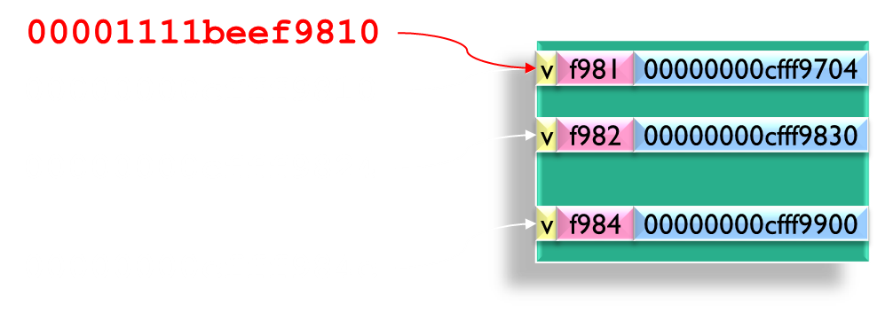
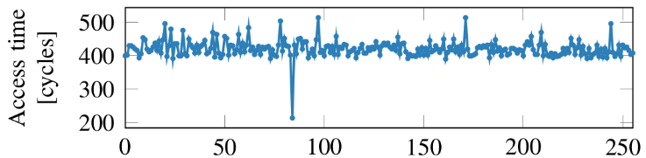
Big Picture
Data Area
1
Adversary knows the binary of the app
Code Area
Victim process
Adversary can inject address of ROP gadget into the BTB
2
Chosen
Payload
4
ROP payload leaks the data through side channel
3
CPU run the ROP payload speculatively

Slide 32

Meltdown:
Variant 3: rogue data cache load

Slide 33
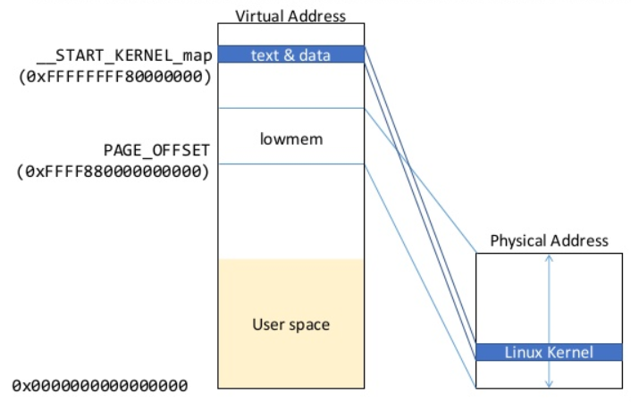
Variant 3: rogue data cache load background

Slide 34
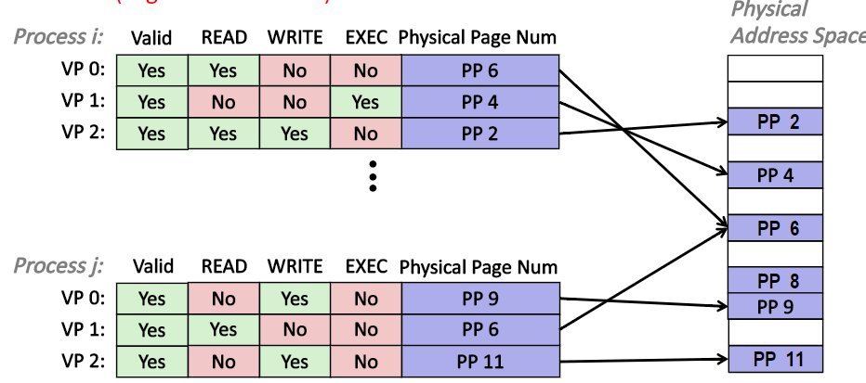
Variant 3: rogue data cache load background

Slide 35
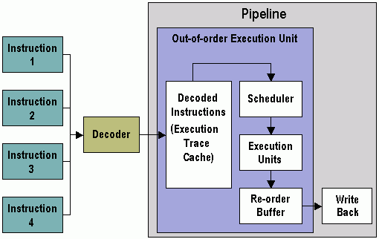
Variant 3: rogue data cache load background
Instruction decoder reads bytes from memory, parse the buffer and output instructions
Map architectural register to physical register
Insert instruction into reservation stations after renaming
Keep track of readiness of source values of an instruction

Slide 36
Variant 3: rogue data cache load background
  When all source values of an instruction are ready, dispatch the instruction to functional unit (FU)
  When a micro op is finished executing the result and exception status are added to the entry in the reorder buffer thus resolving dependencies of other micro ops

Slide 37
Variant 3: rogue data cache load background
  An instruction updates the register alias table (essentially a future file for other instruction in the pipeline) when it completes execution
  An instruction updates the architectural register file when it is the oldest in the machine(oldest in reorder buffer) and has completed execution

Slide 38
Variant 3: rogue data cache load explanation
Idea:
The permission check for accessing an address might not be on the critical path for reading data from memory to a register (permission check could have significant performance impact)
Memory read could make the result of the read available to following instructions immediately
Setting a flag in the reorder buffer that causes an exception to be raised if the permission check fails

Slide 39
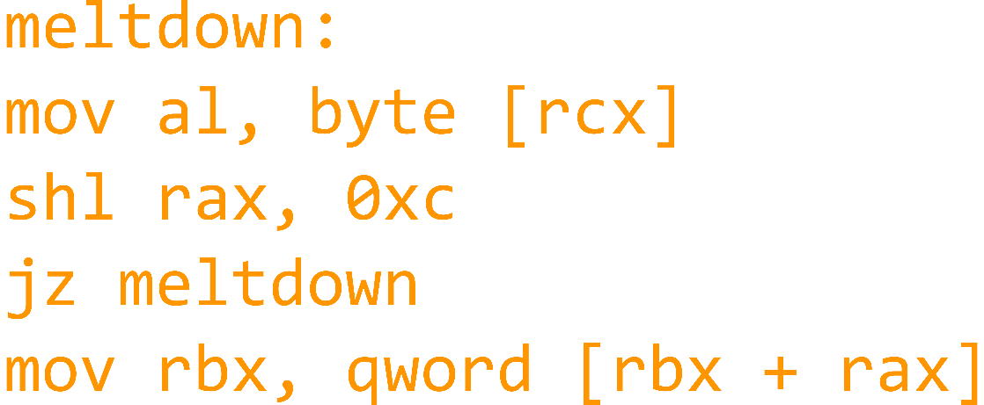
Variant 3: rogue data cache load explanation
Step 1 The content of an attacker-chosen memory location, which is inaccessible to the attacker, is loaded into a register.
Executes instructions in the small time window between the illegal memory access and the raising of the exception
1 rcx = kernel address
2 rbx = prob array
3
4
5
6
7
Notes:
The instruction sequence from step 1 which is executed out of order has to be chosen in a way that it becomes a transient instruction sequence. If this transient instruction sequence is executed before the MOV instruction is retired (i.e., raises the exception), and the transient instruction sequence performed computations based on the secret, it can be utilized to transmit the secret to the attacker

Slide 40
Variant 3: rogue data cache load explanation
Step 2 A transient instruction accesses a cache line based on the secret content of the register
(line 5-7)
1 rcx = kernel address
2 rbx = prob array
3
4
5
6
7
Notes:
The instruction sequence from step 1 which is executed out of order has to be chosen in a way that it becomes a transient instruction sequence. If this transient instruction sequence is executed before the MOV instruction is retired (i.e., raises the exception), and the transient instruction sequence performed computations based on the secret, it can be utilized to transmit the secret to the attacker

Slide 41
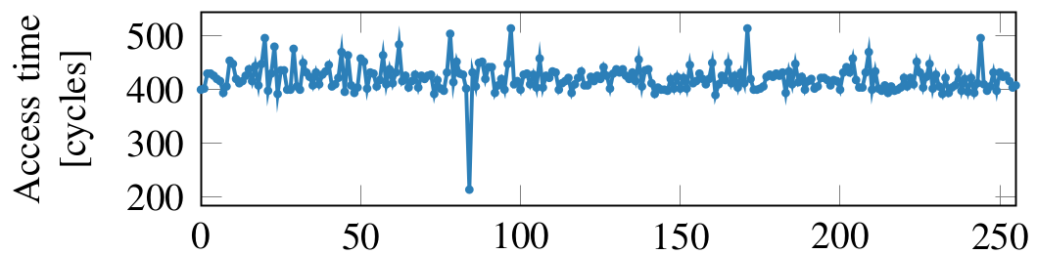
Variant 3: rogue data cache load explanation
1 rcx = kernel address
2 rbx = prob array
3
4
5
6
7
Step 3 The attacker uses Flush+Reload to determine the accessed cache line and hence the secret stored at the chosen memory location.
Notes:
The instruction sequence from step 1 which is executed out of order has to be chosen in a way that it becomes a transient instruction sequence. If this transient instruction sequence is executed before the MOV instruction is retired (i.e., raises the exception), and the transient instruction sequence performed computations based on the secret, it can be utilized to transmit the secret to the attacker

Slide 42

Defenses
(short term/software)

Slide 43
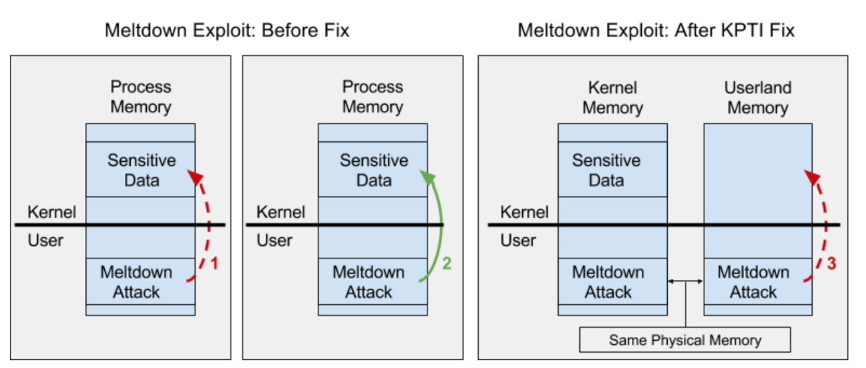
Kernel Page Table Isolation (KPTI)
Key Idea: Separate user space and kernel space
Each application has two sets of pages tables rather than one and switches between them on every kernel-to-user and user-to-kernel transition
Overhead on every system call, interrupt, etc..
Does not work for software sandboxes, or variant 2

Slide 44
Retpoline:(return + trampoline)
Retpoline:(return + trampoline)
Google’s defense against Spectre variant 2
  Variant 2 is super dangerous for the cloud
  Allows one application to disclose information of another
Uses another feature of modern processors called the Return Address Stack
  Instead of predicting the return address through the branch target buffer, we keep the return value on a stack
  When we retrun, we read it from the stack
Replace indirect branches with a return

Slide 45
Retpoline:(return + trampoline)
Subroutine Calls
Background:
P: 0x1000: (start of printf)
1
FFB
0x1000
A: 0xFC34: CALL printf
1
FC3
0x1000
B: 0xFD08: CALL printf
1
FD0
0x1000
C: 0xFFB0: CALL printf
  BTB can easily predict target of calls

Slide 46
Retpoline:(return + trampoline)
Subroutine Returns
Background:
P: 0x1000: ST $RA → [$sp]
0x1B98: LD $tmp ← [$sp]
0x1B9C: RETN $tmp
0
A: 0xFC34: CALL printf
1
1B9
0xFC38
A’:0xFC38: CMP $ret, 0
X
B: 0xFD08: CALL printf
B’:0xFD0C: CMP $ret, 0
  BTB can’t predict return for multiple call sites
  BTB can easily predict target of calls

Slide 47
Retpoline:(return + trampoline)
Background: Return Address Stack (RAS)
Keep track of call stack
A: 0xFC34: CALL printf
FC38
FC38
P: 0x1000: ST $RA → [$sp]
…
BTB
D004
0x1B9C: RETN $tmp
A’:0xFC38: CMP $ret, 0
FC38

Slide 48
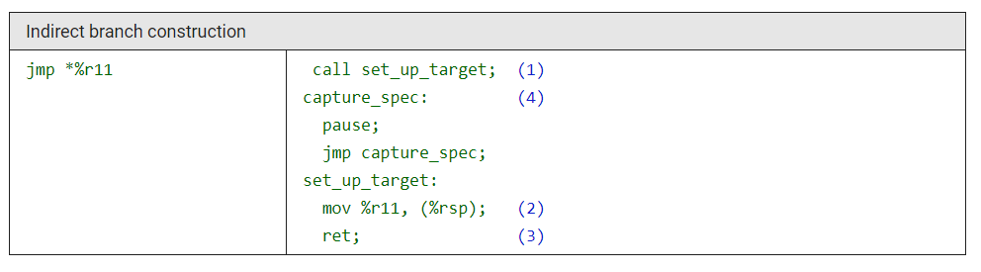
Variant 2: branch target injection
Defenses: Retpoline
Retpoline:(return + trampoline)
Make a direct call to set_up_target.
  Generates distinct stack and RSB entries with a return target of capture_spec.
Notes:
Make a direct call to set_up_target; this is known at compile time and will not trigger speculative target resolution. This generates distinct stack and RSB entries with a return target of capture_spec.

Slide 49
Variant 2: branch target injection
Defenses: Retpoline
Retpoline:(return + trampoline)
2. Modify the on-stack entry generated by (1), to instead direct to %r11.
Notes:
Make a direct call to set_up_target; this is known at compile time and will not trigger speculative target resolution. This generates distinct stack and RSB entries with a return target of capture_spec.

Slide 50
Variant 2: branch target injection
Defenses: Retpoline
Retpoline:(return + trampoline)
3. Return against our original call
Speculative execution consumes the RSB entry generated by (1), and is captured within the pause loop at (4). These instructions are only executed by the speculative path.
Our return is ultimately retired, the on-stack value is used to locate the actual new instruction pointer and the benign results of any speculative execution in the loop at (4) are discarded
Notes:
Make a direct call to set_up_target; this is known at compile time and will not trigger speculative target resolution. This generates distinct stack and RSB entries with a return target of capture_spec.

Slide 51

Thinking ahead – what is next?

Slide 52
Things that make you go hmmm…
Speculation is very old
  Architectures have been vulnerable for over 30 years
  But then only discovered now? Why?
    Suspected for a long time; 1992 paper
    Discovered concurrently by at least 4 teams!
    “things we don’t know we don’t know” – Donald Rumsfled ☺
Offensive security research is important
  Sometimes not considered seriously
What else is out there?
How can we fix it?

Slide 53
New Attacks
Unfortunately, many more variants are appearing
  New side channels: attacks through the L1 cache, and the TLBs
  New applications: Other attacks demonstrated on SGX
Branchscope? Attack on the directional part of the branch predictor
SpectreRSB/ret2spec: use the return stack buffer
SpectrePrime and MeltdownPrime
  New attacks from Princeton/Nvidia using the cache coherence/memory consistency protocol

Slide 54
Principled/comprehensive solutions
One proposal – disable speculation
  Use parallelism instead
  Ugh…back to the dark ages of computer architecture
Keep speculation, but make it safe
  New ways of designing architectures
  SafeSpec (our proposal)
  Poison Ivy (Micro 2016)
  Safe branch predictors:
    Decorrelated/private branch predictors
    Control Flow Integrity based branch predictors

Slide 55
Principled/comprehensive solutions
One proposal – disable speculation
  Use parallelism instead
  Ugh…back to the dark ages of computer architecture
Software patches
  Often address one aspect of the attack (not all variants)
  High overhead: 10%-30% (Netflix reported 800% slowdown for Meltdown patches)
Intel Microcode updates
  Stops speculation where dangerous (problems similar to disable speculation solution)
Future/principled fixes
  Keep speculation, but make it safe: SafeSpec
  Randomization?

Slide 56
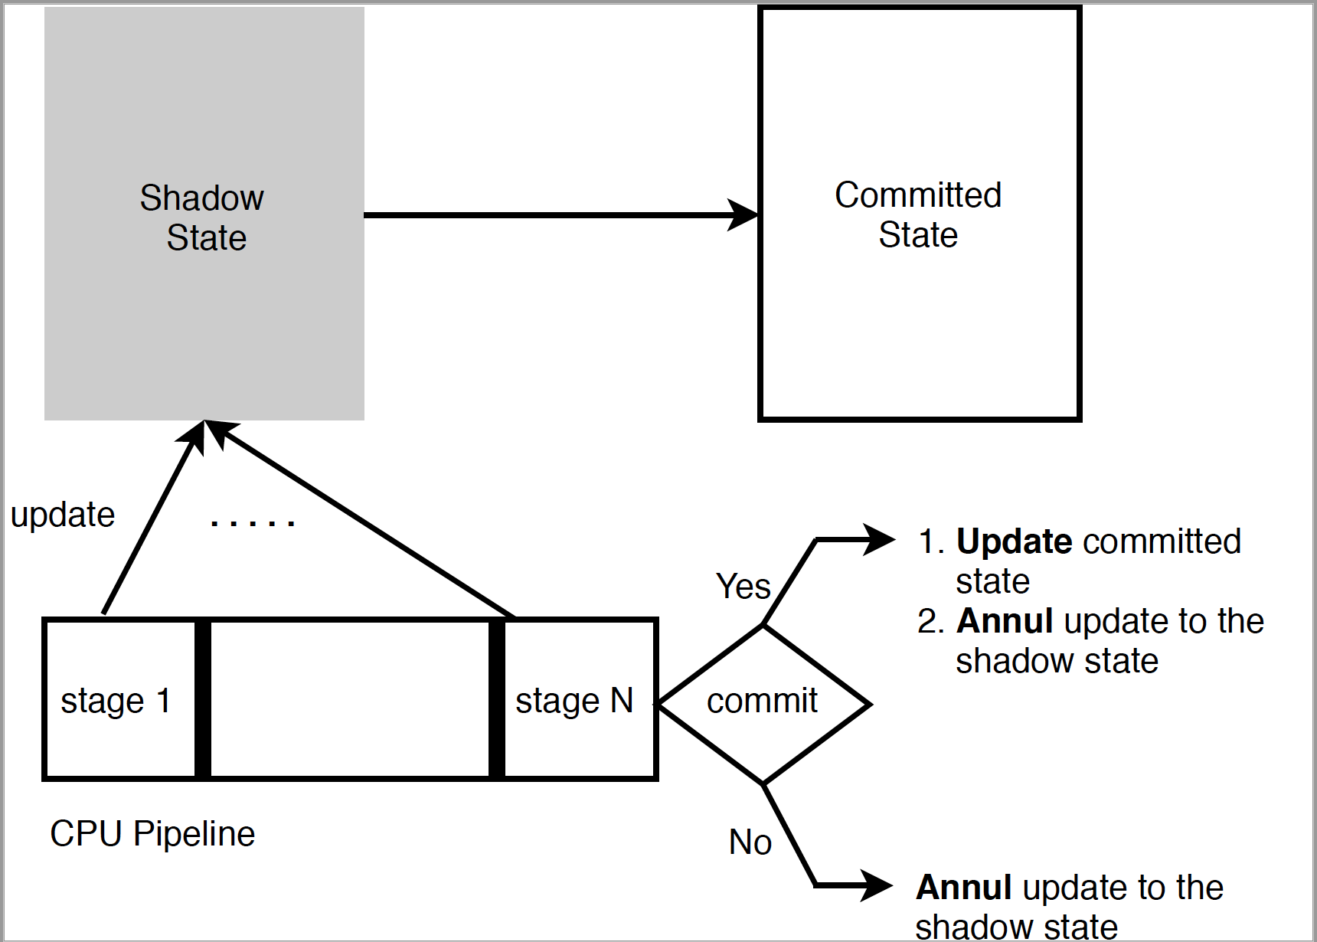
SafeSpec
Use temporary structures (Shadow) to hold any state that is produced speculatively
Notes:
State the limitations

Slide 57
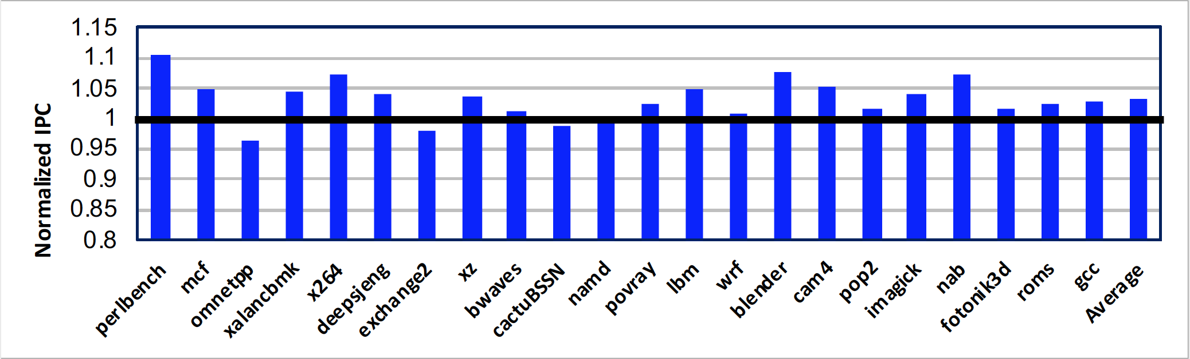
Implementation and Results
Integrated SafeSpec to MARSSx86
Evaluated the performance using SPEC2017

Slide 58
Conclusions/Summary
Security traditionally considered a software problem to be solved in software
…but we see that architectures can be a source of vulnerability
  Architectures must be designed with security in mind
  …but they can also offer security mechanisms for software
Meltdown/Spectre will force a seismic rethinking of how to design architectures
  Will be played out over the next few years…

