Slide 1
Code Reuse Attacks (II)
Slide credits: some slides and figures adapted from David Brumley, AC Chen, and others

Slide 2
Signature-Based Detection
CRAs have a distinctive signature
Gadgets-gadgets-gadgets
Some early work attempted to detect anomalies in the branch predictor
“DROP: Detecting ROP malicious code”
P. Chen et al. ICISS 2009
if (# instructions between returns <= 5) then it is a gadget
if (# consecutive gadgets >= 3) then it is a ROP attack

Slide 3
DROP
Implemented in software
5x slowdown
Can we do better?
Consecutive Gadgets
CRAs
min # gadgets to launch a CRA
S=3
Regular workloads
max tolerable gadget length for CRA
Gadget Length
N=5

Slide 4
Building on DROP
Apply the same idea to
Indirect jumps
Indirect calls
Adjust the thresholds

Slide 5
Extending DROP for JOP
CRAs
Added dispatcher gadgets
Indirect jumps/calls are not that frequent
min # gadgets to launch a CRA
Regular workloads
max tolerable gadget length for CRA

Slide 6
Case of Long Gadgets
Side effects
Overwrite registers/memory locations
May cause exceptions
adc [ebx-0x74EBDBAC], cl
Limited number of registers
One for the dispatcher
One for jumping back to the dispatcher
Only 6 left (in x86)

Slide 7
Gadget Length and State Changes

Slide 8
Defeating DROP
Make the attack pattern less predictable
Perform some unnecessary computation
Without harming attack state
Call a function
Execute many instructions
Return to the same point in the attack
Caller saved registers stay intact
ebx, esi, edi, esp, ebp

Slide 9
Delay Gadgets
atoi()
Dispatcher
Gadget
Functional
Gadget
Delay
Gadget
pop eax
jmp eax
add [ebx], edx
jmp esi
call [ecx-0x56000a00]
add bl, bh
inc ebx
add dh, bh
jmp edi

Slide 10
Summary of DROP Limitations
Implemented in software
5x slowdown
Tight margin for detecting ROP
False positives/negatives
Easily defeated by using delay gadgets

Slide 11
Another proposal: SCRAP
Signature-Based CRA Protection
Detects CRAs with delay gadgets
No false positives for regular workloads
Implemented in hardware
Low overhead
Protects legacy binaries

Slide 12
Attack Signatures
DROP-like Signature Definition:
Symbol | Instruction
w | Indirect Jump
x | Indirect Call
y | Call
z | Return
a | All Other
Up to N instructions
S or more gadgets

Slide 13
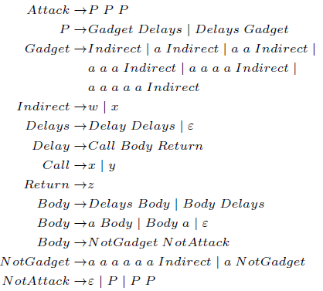
SCRAP Attack Signatures
Signatures with delay gadgets (N=5, S=3):
Symbol | Instruction
w | Indirect Jump
x | Indirect Call
y | Call
z | Return
a | All Other
Attack has 3 parts
Each part has a Gadget and Delays
A Gadget has up to 5 instructions
Delay is a function call
A function call can be a Delay as long as it is not an Attack itself

Slide 14
Example Signatures
Signature | Detected by DROP-like? | Detected by SCRAP?
✔ | ✔
aaawaawaaw
✔ | ✔
awaaxaaaaw
✘ | ✔
awaxaaaaaazaxaw
✘ | ✔
awaxaayaazaaaazaxaw

Slide 15
Pushdown Automata

Slide 16
Simple Implementation
Augment the stack of PDA with Secure Call Stack
Save the PDA state for calls
Restore for returns
Modify for indirect jumps
Commit throttling
Only one stack operation for a commit window
Negligible slowdown
Simplifies the circuitry

Slide 17
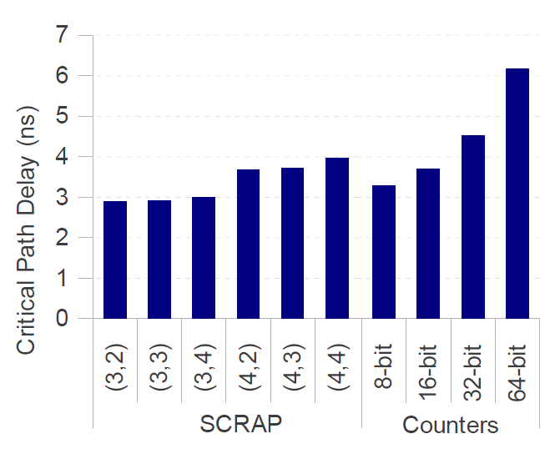
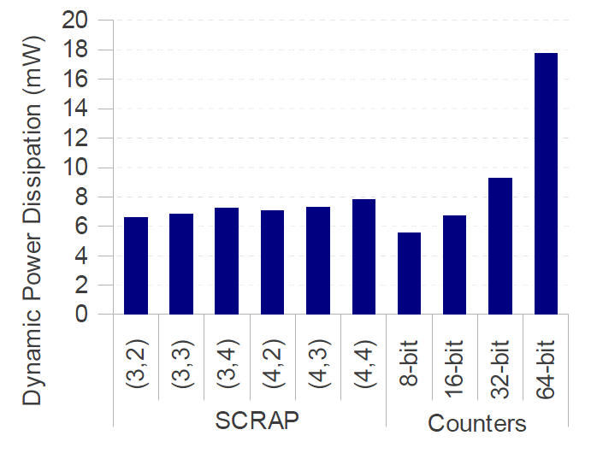
SCRAP Hardware

Slide 18
False Positives for SCRAP
Consecutive Gadgets
CRAs
140 Shell-storm CRA exploits
6
5
4
3
2
1
SPEC 2006 benchmarks
5
6
7
8
9
10
11
12
13
Gadget Length

Slide 19
Performance of SCRAP

Slide 20
Conclusions
Signature-based detection of CRAs is promising
No source code, simple, low-overhead, effective
Naïve approaches can be defeated
Delay gadgets
But is SCRAP really more secure?
Are there other ways to hide?
Paper introduces another detector that tolerates longer gadgets
Becomes harder to avoid false positives
Attacks can be short

Slide 21
Gadget Length
Long gadget means more intermediate instructions

Slide 22
Two threshold SCRAP

Slide 23
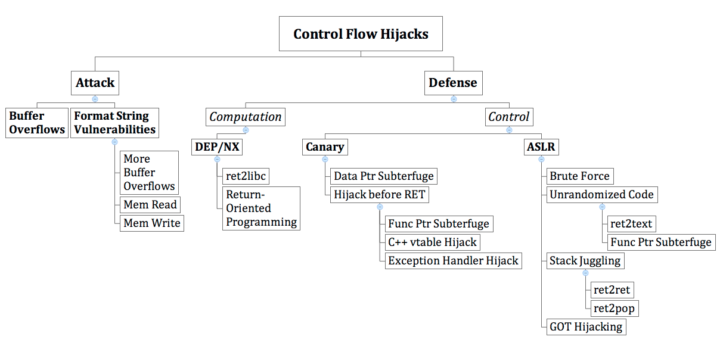
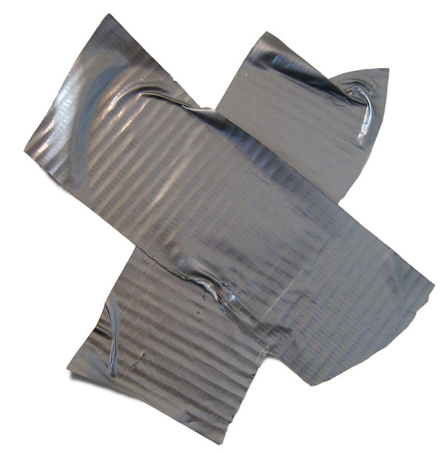
Our story so far…
Unauthorized Control Information Tampering
http://propercourse.blogspot.com/2010/05/i-believe-in-duct-tape.html
Notes:
We have conducted analysis on the 107 CERT advisories from 2000 to 2003.
Our survey of the CERT advisories indicates that UCIT vulnerabilities account for 65% of advisory entries.
http://research.microsoft.com/en-us/um/people/shuochen/papers/ieee-proc.pdf
Journal version of “XKI03” in CFI slides from Princeton.

Slide 24
How to really solve the problem?
Prevent buffer overflows? How? Later
Prevent illegal control flow? Hmm….
Control Flow Integrity (CFI), Abadi et al, CCS 2005
Important paper in security
Control flow: how your program counter changes
Control flow altering instructions: branches, calls, returns, …
CFI: How to specify and preserve legal control flow in a program
How does this help with CRAs?
Discussion: how do we approach this problem?

Slide 25
CFI: Control-Flow Integrity
[Abadi et al.]
Main idea: pre-determine control flow graph (CFG) of an application
Static analysis of source code
Static binary analysis ← CFI
Execution profiling
Explicit specification of security policy
Execution must follow the pre-determined control flow graph

Slide 26
Control Flow Integrity
protects against powerful adversary
with full control over entire data memory
widely-applicable
language-neutral; requires binary only
provably-correct & trustworthy
formal semantics; small verifier
efficient
hmm… 0-45% in experiments; average 16%
Notes:
The box around “data memory” is to highlight we’re going to limit the power of the attacker for memory with instructions.

Slide 27
CFI Adversary Model
CAN
CANNOT
Execute Data
NX takes care of that
Modify Code
text seg usually read-only
Write to %ip
true in x86
Overwrite registers in other contexts
kernel will restore regs
Overwrite any data memory at any time
stack, heap, data segs
Overwrite registers in current context

Slide 28
CFI Overview
Invariant: Execution must follow a path in a control flow graph (CFG) created ahead of run time.
Method:
build CFG statically, e.g., at compile time
instrument (rewrite) binary, e.g., at install time
add IDs and ID checks; maintain ID uniqueness
verify CFI instrumentation at load time
direct jump targets, presence of IDs and ID checks, ID uniqueness
perform ID checks at run time
indirect jumps have matching IDs
“static”
Notes:
source code analysis, or even security automata

Slide 29
CFI: Binary Instrumentation
Use binary rewriting to instrument code with runtime checks
Inserted checks ensure that the execution always stays within the statically determined CFG
Whenever an instruction transfers control, destination must be valid according to the CFG
Goal: prevent injection of arbitrary code and invalid control transfers (e.g., return-to-libc)
Secure even if the attacker has complete control over the thread’s address space

Slide 30
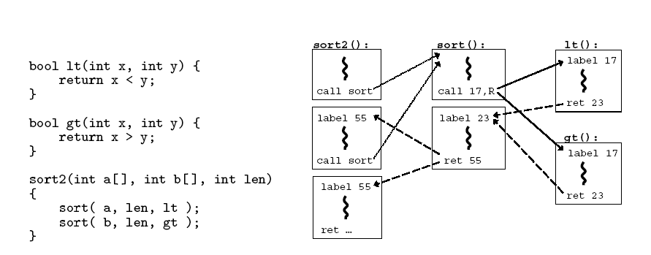
CFG Example

Slide 31
CFI: Control Flow Enforcement
For each control transfer, determine statically its possible destination(s)
Insert a unique bit pattern at every destination
Two destinations are equivalent if CFG contains edges to each from the same source
This is imprecise (why?)
Use same bit pattern for equivalent destinations
Insert binary code that at runtime will check whether the bit pattern of the target instruction matches the pattern of possible destinations

Slide 32
CFI: Example of Instrumentation
Original code
Instrumented code
Abuse an x86 assembly instruction to
insert “12345678” tag into the binary
Jump to the destination only if
the tag is equal to “12345678”

Slide 33
CFI: Preventing Circumvention
Unique IDs
Bit patterns chosen as destination IDs must not appear anywhere else in the code memory except ID checks
Non-writable code
Program should not modify code memory at runtime
What about run-time code generation and self-modification?
Non-executable data
Program should not execute data as if it were code
Enforcement: hardware support + prohibit system calls that change protection state + verification at load-time

Slide 34
Improving CFI Precision
Suppose a call from A goes to C, and a call from B goes to either C, or D (when can this happen?)
CFI will use the same tag for C and D, but this allows an “invalid” call from A to D
Possible solution: duplicate code or inline
Possible solution: multiple tags
Function F is called first from A, then from B; what’s a valid destination for its return?
CFI will use the same tag for both call sites, but this allows F to return to B after being called from A
Solution: shadow call stack

Slide 35
CFI: Security Guarantees
Effective against attacks based on illegitimate control-flow transfer
Stack-based buffer overflow, return-to-libc exploits, pointer subterfuge, code reuse attacks
Does not protect against attacks that do not violate the program’s original CFG
Incorrect arguments to system calls
Substitution of file names
Other data-only attacks

Slide 36
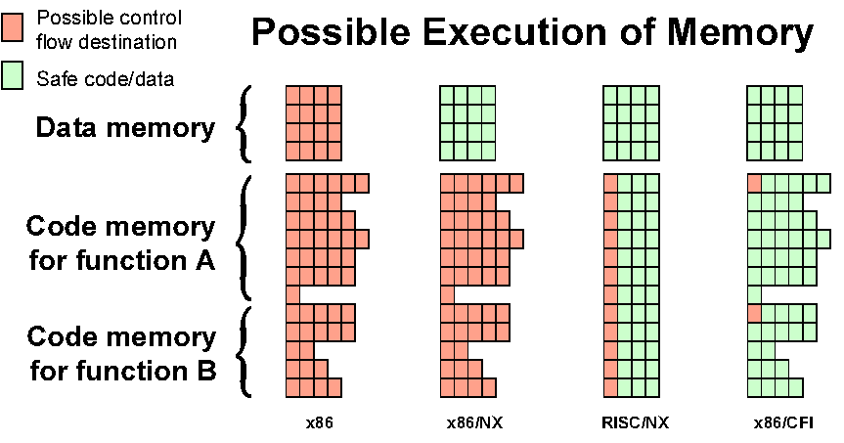
Possible Execution of Memory
[Erlingsson]

Slide 37
Control Flow Integrity
Generate Control Flow Graph
Unique labels for edges
Instrument the code with checks
Each indirect branch checks target for a label
Source
Destination
...
jmp ecx
...
...
mov eax, [esp+4]
...
CFI
instrumentation
...
cmp [ecx], 12345678h
jne error_label
lea ecx, [ecx+4]
jmp ecx
...
...
<data 12345678h>
mov eax, [esp+4]
...
Added instructions

Slide 38
CFI Limitations
Need to construct Control Flow Graph
Sometimes difficult; especially for obfuscated code
No publicly available tools for constructing CFG from binaries
This is changing
Runtime performance overhead due to extra instructions
About 20% for SPEC 2K6 Benchmarks
Problems with dynamic linking
Indirect branches are a headache
Does not handle unintended instructions
Imprecise

Slide 39
Where Do Jump Targets Go?
Typical use of indirect jump instruction
To efficiently implement switch-case statements
Target is in the same function
To support dynamic linking
Target is a function entry point
Key Observation:
Legitimate jump targets ARE NOT in the middle of another function

Slide 40
Branch Regulation
Enforce the following rules:
Returns go to the correct addresses
Jumps target same functions or function entry points
Calls target function entry points
Use hardware checks for enforcement
Low performance overhead (around 2%)
Unintended instructions are handled
No CFG needed
Requires minimal binary annotations
Security shown for common libraries

Slide 41
How Does BR Mitigate JOP Attacks?
0x0000
function1()
<register values>
<C>
<D>
<F>
<E>
popa
jmp esi
xor ecx, ecx
mul ecx
lea ebx, [esp+8] mov al, 11
int 0x80
pop edi
jmp edi
NOT ALLOWED
xor ecx, ecx
jmp esi
Stack frame for vulnerable()
mul ecx
jmp esi
lea ebx, [esp+8]
jmp esi
mov al, 11
int 0x80
malicious return
<B>
Stack frame for main()
function2()
Stack growth
0xFFFF

Slide 42
Implementing Branch Regulation
Use a Secure Call Stack
Annotate function entry points with function size info
Compare jump targets with function bounds and allow if checks pass
Store bounds in secure call stack
Cache a few secure stack entries for performance

Slide 43
Inserting Code Annotations
Symbol Table
...
08048410 g F .text 005a __libc_csu_init
080483e4 g F .text 001c main
080482b8 g F .init 0000 _init
...
Original Code
Annotated Code
080483e4 <main>:
80483e4: push ebp
80483e5: mov ebp, esp
...
80483f9: mov eax, 0
80483fe: leave
80483ff: ret
080483d2 <main>:
80483d2: <annotation> <size=001c>
80483e4: push ebp
80483e5: mov ebp, esp
...
80483f9: mov eax, 0
80483fe: leave
80483ff: ret

Slide 44
Executing Call Instruction
Fetch
Decode
Execute
Commit
<annotation>
call
eax
0098
80482bc
80482bc
.
.
.
8048232: call eax
.
.
.
80482bc: <annotation> 0x98
80482be: push esp
80482C0: …
.
.
.
8048300: jmp ecx
.
.
.
8048354: ret
.
.
.
call eax
(function size)
<annotation> 0098
BR Check
Base | Bound | Return
… | … | …
80482bc | 8048354 | 8048236
… | … | …
Function Bounds Stack
Instruction Cache

Slide 45
Executing Jump Instruction
Fetch
Decode
Execute
Commit
jmp
ecx
0x80483AA
.
.
.
0x8048232: call eax
.
.
.
0x80482BC: <annotation> 0x98
0x80482BE: push esp
0x80482C0: …
.
.
.
0x8048300: jmp ecx
.
.
.
0x8048354: ret
.
.
.
>
>
BR Check
Base | Bound | Return
jmp ecx
0x8048354
… | … | …
0x80482BC| 0x8048354 | 0x8048236
0x80482BC
… | … | …
Function Bounds Stack
Instruction Cache

Slide 46
Executing Return Instruction
Fetch
Decode
Execute
Commit
ret
0x8048236
Return Address
from Stack
.
.
.
0x8048232: call eax
.
.
.
0x80482BC: <annotation> 0x98
0x80482BE: push esp
0x80482C0: …
.
.
.
0x8048300: jmp ecx
.
.
.
0x8048354: ret
.
.
.
=
BR Check
Base | Bound | Return
… | … | …
0x80482BC| 0x8048354 | 0x8048236
0x8048236
ret
… | … | …
Function Bounds Stack
Instruction Cache

Slide 47
Security of Branch Regulation
Effectively reduces the exploitable code base to the current function
An attacker needs to find in same function:
A vulnerability to exploit
Sufficient functional gadgets
Dispatcher gadget
A system call instruction

Slide 48
Number of Vulnerable Functions
Library
libc
libm
libcrypto
libgcrypt
libssl
Total Number of Functions
7775
1077
7991
1135
1017
Functions with Dispatcher Gadget
12
0
3
2
0
Functions with Dispatcher Gadget and System Call
0
0
0
0
0

Slide 49
Unintended Instructions
Mostly garbage instructions
Usually more side effects than intentional
4925
24689

Slide 50
Additional Security Analysis in the Paper
Analysis of available gadgets
Dispatcher gadget discovery algorithms
Analysis of gadget side effects
Gadget length
Impact of unintended gadgets

Slide 51
Increase of Executable Size

Slide 52
Impact of Secure Stack Cache Size

Slide 53
BR Performance with 4-Entry Cache

Slide 54
Another CFI Solution point: CFI Mon
Some solutions try to reuse existing hardware
Use performance monitoring unit on x86
kBouncer: use Last Branch Record (LBR)
CFIMon: use the branch target store to implement a CFI reference monitor

Slide 55
Precision Mode of Intel CPU ---Branch Trace Store (BTS) Mechanism
Record all control transfer precisely into a predefined buffer
jump, call, return, interrupt and exception
also record the addresses of branch source and target
Let a monitor get the trace in a batch
an interrupt will be delivered when the buffer is nearly full
Obtain all the branch information of a running application, help users locate the vulnerabilities
Notes:
To accurately and effectively identify an attack, CFIMon needs precise information of every branch at runtime for detection
since the monitor can obtain
all the branch information of a running application, it
can not only detect security attacks, but also identify the
control flow of the execution of malicious code, thus
help users locate the vulnerabilities

Slide 56
Main Idea
The CFI of an application can be maintained if we can
get a legal set of branch target addresses for every branch
check whether the target address of every branch is within the corresponding legal set at runtime

Slide 57
Branch Classification in X86 ISA ---Direct Branch & Its Target Address
Direct Branch
Direct jump
jnz c2ef0 <__write>
Direct call
callq 34df0 <abort>
Since the code is read-only and cannot be modified during runtime, both the direct jump and direct call are considered safe one
(safe branch) √

Slide 58
Branch Classification in X86 ISA ---Indirect Branch & Its Target Address
(unsafe branch) √
Indirect Branch
Indirect jump
jmpq *%rdx
not possible to gain the whole target address set just by static analysis
Indirect call
callq *%rax
its target address could be obtained by statically scanning the binary code of the application and the libraries it uses
Return
retq
its target address could also be obtained by scanning the binary code.
Dynamic Training
A call can only transfer control to the
start of a function.
In general, the target address of a return has to be the one next to a call
Notes:
A return instruction branches to an address popped from the stack, which could only be determined during
runtime. Since a function maybe be invoked through a function pointer, we cannot know exactly all of its callers. Fortunately, we finds that in most cases, a return follows a call instruction

Slide 59
CFIMon: 2 Phases
Offline phase
build a legal set of target addresses for each branch instruction
Online phase
diagnose possible attacks with legal sets following a number of rules
determine the status of the branch as legal, illegal or suspicious

Slide 60
Offline Analysis --- obtain legal set: ret_set, call_set
Scans the binary of application and dynamic libraries to get
ret_set
contains all addresses of the instructions next to each call
special cases
call_set
contains all addresses of the first instruction of each function
.
.
add(3,4);
printf(“TEST!”);
.
.
int add
(int a, int b){
printf(“1st inst.”);
.
.
}
ret_set
call_set

Slide 61
Online Detection
<source,target>
legal
illegal
special case?
yes
suspicious
no
switch into
different cases
based on <source>
<source> is direct
branch?
yes
no
Consider the state of a branch depending on <target>
<source> is return
<source> is indirect call
<source> is indirect jump
ret_set
call_set
train_set
yes
no
yes
no
yes
no
slide-window
mechanism

Slide 62
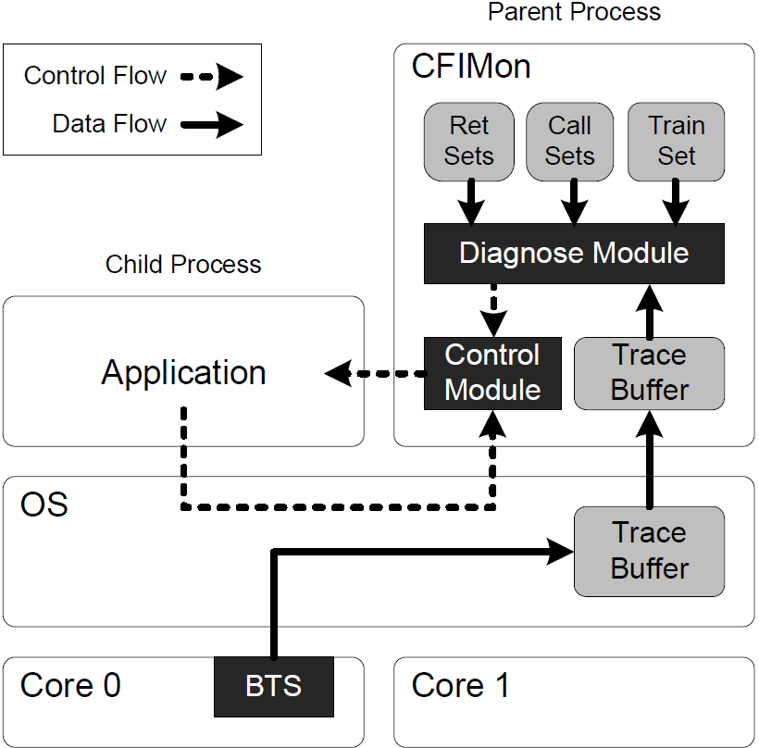
Architecture
A user-level tool with 2 modules
A kernel extension

Slide 63
Slide-Window Mechanism ---For Suspicious Branches
The diagnose module makes a flexible decision depending on the pattern of the branches
maintain a window of the states of recent n branches
apply a rule of tolerating at most m suspicious branches in the recent n ones
i.e., at most m suspicious branches are accepted in recent n branches

Slide 64
Summarizing CFI
Need to construct the CFG
Binary analysis, based on source, based on profiling (CFIMon), etc…
Need to enforce legal control flow
Does not completely solve the problem but makes it much harder
Imprecise and therefore attackable (papers last year and this year show how to construct CRAs that bypass CFI approximations)
More precise but requires significantly more work/information than the two other defense categories.

Slide 65
Discussion/Consolidation
CRAs are an open problem
Almost every solution has weaknesses
Assumptions (spoken or unspoken) typically become the target of the attack
Three general approaches
Moving target
Signature detection
CFI – our first example of a reference monitor
We focused on implementations that had a hardware component
Advantages include: overhead; unintended branches; binary compatibility …

