Slide 1
Code Reuse Attacks (I)
Slide credits: some slides and figures adapted from H. Shacham, V. Pappas, Luca Davi, David Brumley and Nora Sovarel

Slide 2
Administrivia
Summaries
They are due before class (Considered late if handed after class starts)
The point is to be ready for discussion
In the next two weeks, I will assign first round of presentations
Email me preference if you don’t want to get stuck with something you don’t like
Would like very much to make the presentations in the flow of the topics rather than standalone classes

Slide 3
Recall Buffer Overflow and Code Injection Attack
0x0000
main (int argc, char **argv)
{
...
vulnerable(argv[1]);
...
}
vulnerable(char *str1)
{
char str2[100];
strcpy(str2,str1);
return;
}
malicious input
(str2)
str2
xor ecx, ecx
mul ecx
lea ebx, [esp+8]
mov al, 11
int 0x80
Stack frame for vulnerable()
malicious return
return address
Stack frame for main()
Stack growth
0xFFFF

Slide 4
Possible solutions to code injection attacks
We talked about stack canaries, shadow stacks and ASLR
How about Harvard architecture (separate instructions and data memories)?
How about instruction set randomization?
Of course, we also talked about the NX (or W⊕X) bit
A page is either writeable or executable
Two general approaches:
(1) make sure that malicious code cannot be injected, or (2) make sure control flow cannot be hijacked

Slide 5
Aside: Architecture/Hardware solutions
Look up, look down, look back, look forward
Can it be done in software? Even if not quite as good
Remember the strengths and weaknesses of HW
Over-designing for security
How complicated?
Does it touch critical datapath elements?
What is the performance penalty?
How useful?
Does it solve a problem completely? Does it significantly reduce the attack surface?
Other factors
Is it backward compatible? Does it protect legacy binaries?
Does it require major changes to the code base?

Slide 6
Existing Protection from Code Injection Attacks: No Execute Bit (NX)
0x0000
Mark memory pages as
Either WRITABLE
Or EXECUTABLE
But not both
Standard technique in current processors and operating systems
Intel XD bit
AMD XN bit
Windows DEP
Linux PaX
xor ecx, ecx
mul ecx
lea ebx, [esp+8]
mov al, 11
int 0x80
WRITABLE
NOT EXECUTABLE
malicious return
Stack growth
0xFFFF

Slide 7
What Does W⊕X Not Prevent?
Can still corrupt stack …
… or function pointers or critical data on the heap, but that’s not important right now
As long as “saved EIP” points into existing code, W⊕X protection will not block control transfer
This is the basis of return-to-libc exploits
Overwrite saved EIP with address of any library routine, arrange memory to look like arguments
Does not look like a huge threat
Attacker cannot execute arbitrary code
… especially if system() is not available

Slide 8
New Idea: Return-to-libc Attack
ptr to “/bin/sh”
…
argv
argc
return addr
caller’s ebp
buf (64 bytes)
argv[1]
buf
ret transfers control to system, which finds arguments on stack
&system
Overwrite return address with address of libc function
setup fake return address and argument(s)
ret will “call” libc function
No injected code! How did we exploit?
%ebp
%esp

Slide 9
Code Reuse attacks timeline

Slide 10
H. Shacham The Geometry of Innocent Flesh on the Bone: Return-into-libc without Function Calls (on the x86) (CCS 2007)

Slide 11
Next Frontier: Code Reuse Attacks (CRAs)
Key Idea: Reuse existing library code instead of code injection
CRA timeline
Return-into-libc attack (1997)
Borrowed code chunks (2005)
Return Oriented Programming (2007)
Jump Oriented Programming (2010)
Function oriented programming, and others (2013—now)
All bypass NX

Slide 12
Code Reuse Attacks

Slide 13
Chaining RETs for Fun and Profit
[Shacham et al]
Can chain together sequences ending in RET
Krahmer, “x86-64 buffer overflow exploits and the borrowed code chunks exploitation technique” (2005)
What is this good for?
Answer [Shacham et al.]: everything
Turing-complete language
Build “gadgets” for load-store, arithmetic, logic, control flow, system calls
Attack can perform arbitrary computation using no injected code at all!

Slide 14
Return Oriented Programming (ROP)
0x0000
<Address A>
<B>
<D>
<C>
xor ecx, ecx
ret
xor ecx, ecx
mul ecx
lea ebx, [esp+8] mov al, 11
int 0x80
mul ecx
ret
lea ebx, [esp+8]
ret
<Address B>
Stack frame for vulnerable()
mov al, 11
int 0x80
Page marked as EXECUTABLE
<Address C>
malicious return
<A>
Stack frame for main()
<Address D>
Stack growth
0xFFFF

Slide 15
Ordinary Programming
Instruction pointer (EIP) determines which instruction to fetch and execute
Once processor has executed the instruction, it automatically increments EIP to next instruction
Control flow by changing value of EIP

Slide 16
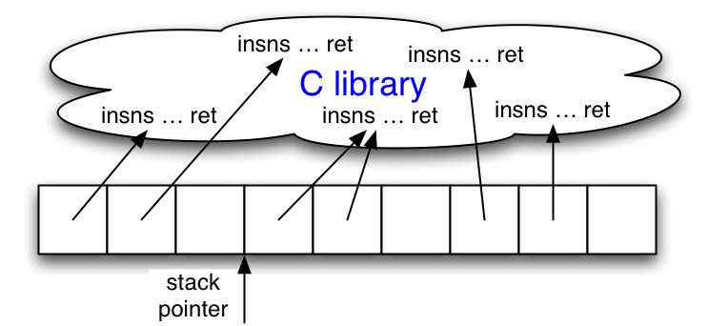
Return-Oriented Programming
Stack pointer (ESP) determines which instruction sequence to fetch and execute
Processor doesn’t automatically increment ESP
But the RET at end of each instruction sequence does

Slide 17
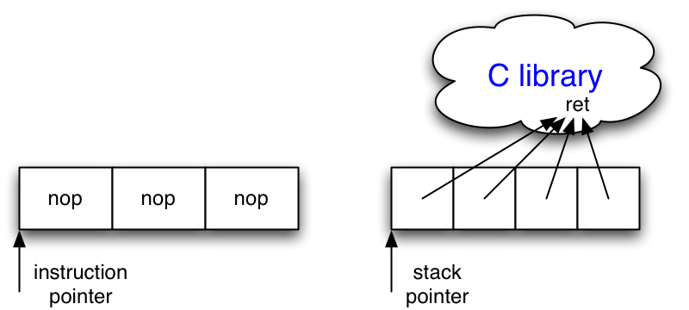
No-ops
No-op instruction does nothing but advance EIP
Return-oriented equivalent
Point to return instruction
Advances ESP
Useful in a NOP sled (what’s that?)

Slide 18
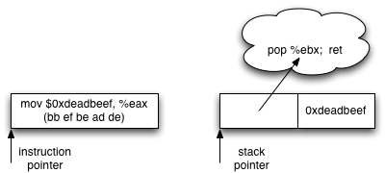
Immediate Constants
Instructions can encode constants
Return-oriented equivalent
Store on the stack
Pop into register to use

Slide 19
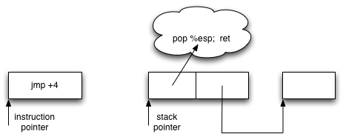
Control Flow
Ordinary programming
(Conditionally) set EIP to new value
Return-oriented equivalent
(Conditionally) set ESP to new value

Slide 20
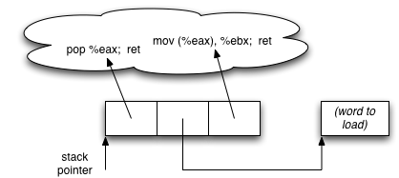
Gadgets: Multi-instruction Sequences
Sometimes more than one instruction sequence needed to encode logical unit
Example: load from memory into register
Load address of source word into EAX
Load memory at (EAX) into EBX

Slide 21
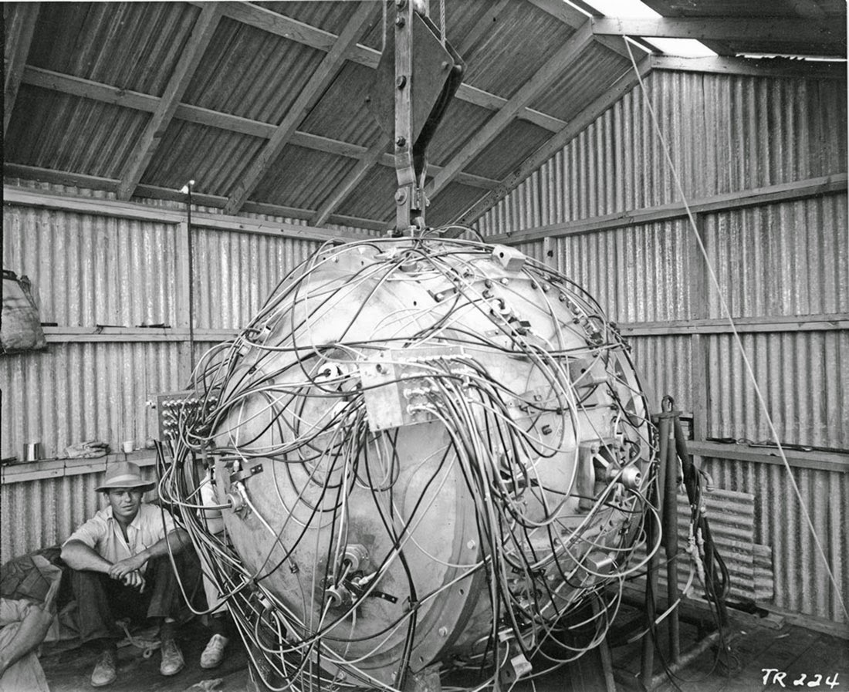
“The Gadget”: July 1945
http://rarehistoricalphotos.com/gadget-first-atomic-bomb/

Slide 22
Gadget Design
Testbed: libc-2.3.5.so, Fedora Core 4
Gadgets built from found code sequences:
Load-store, arithmetic & logic, control flow, syscalls
Found code sequences are challenging to use!
Short; perform a small unit of work
No standard function prologue/epilogue
Haphazard interface, not an ABI
Some convenient instructions not always available

Slide 23
Conditional Jumps
cmp compares operands and sets a number of flags in the EFLAGS register
Luckily, many other ops set EFLAGS as a side effect
jcc jumps when flags satisfy certain conditions
But this causes a change in EIP… not useful (why?)
Need conditional change in stack pointer (ESP)
Strategy:
Move flags to general-purpose register
Compute either delta (if flag is 1) or 0 (if flag is 0)
Perturb ESP by the computed delta

Slide 24
Phase 1: Perform Comparison
neg calculates two’s complement
As a side effect, sets carry flag (CF) if the argument is nonzero
Use this to test for equality
sub is similar, use to test if one number is greater than another

Slide 25
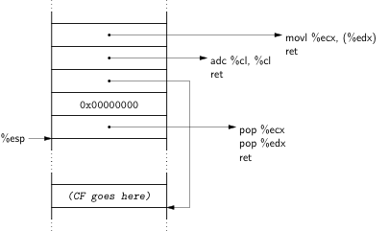
Phase 2: Store 1-or-0 to Memory
❹
❸
❶
❷
❶ Clear ECX
❷ EDX points to destination
❸ adc adds up its operands & the carry flag;
result will be equal to the carry flag (why?)
❹ Store result of adc into destination

Slide 26
Phase 3: Compute Delta-or-Zero
Bitwise AND with delta
(in ESI)
Two’s-complement negation:
0 becomes 0…0;
1 becomes 1…1

Slide 27
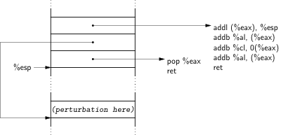
Phase 4: Perturb ESP by Delta

Slide 28
Finding Instruction Sequences
Any instruction sequence ending in RET is useful
Algorithmic problem: recover all sequences of valid instructions from libc that end in a RET
At each RET (C3 byte), look back:
Are preceding i bytes a valid instruction?
Recur from found instructions
Collect found instruction sequences in a trie

Slide 29
Example
Stack
Code
Actions
0xb8800000
0x00000001
0xb8800010
0x00000002
0xb8800020
0xb8800010
0x00400000
0xb8800030
0xb8800000:
pop eax
ret
...
0xb8800010:
pop ebx
ret
...
0xb8800020:
add eax, ebx
ret
...
0xb8800030:
mov [ebx], eax
ret
esp
eax = 1
ebx = 2
eax += ebx
ebx = 0x400000
*ebx = eax
Notes:
Define gadgets. Attackers can use them, may correspond to intended or unintended instruction sequences. Turing complete! Emphasis on invariants/characteristics.

Slide 30
Unintended Instructions
Actual code from ecb_crypt()
c7
45
d4
01
00
00
00
f7
c7
07
00
00
00
0f
95
45
c3
movl $0x00000001, -44(%ebp)
add %dh, %bh
test $0x00000007, %edi
movl $0x0F000000, (%edi)
}
xchg %ebp, %eax
setnzb -61(%ebp)
}
inc %ebp
}
ret

Slide 31
Automating Gadget finding
Galileo algorithm – walk backwards from the return (or indirect branch)
Q – Map gadgets into functional equivalent
Everything is automated using compilers
Demonstrated against many platforms—seems very general

Slide 32
Protecting Against ROP: Discussion
What could we do?
There are several approaches, including some that we have seen.
Take a couple of minutes to come up with one.

Slide 33
Example defense: Secure Call Stack
Semantics of return instruction
ret expects an address pushed by a call
Keep a copy of return addresses in a separate memory space
Secured by OS/Hardware
On each return:
Compare two copies of the return addresses
Generate exception if they mismatch

Slide 34
Example of a Secure Call Stack
0x0000
main (int argc, char **argv)
{
...
vulnerable(argv[1]);
...
}
vulnerable(char *str1)
{
char str2[100];
strcpy(str2,str1);
return;
}
malicious input
str2
≠
Stack frame for vulnerable()
return address
return address
malicious return
Stack frame for main()
Stack growth
0xFFFF

Slide 35
Defeating Secure Call Stacks
Initiating an attack
Overwrite a function pointer,
Overwrite a longjmp buffer,
Exploit a format string vulnerability
Performing an attack
Use indirect jumps instead of returns
Jump Oriented Programming
Need a special gadget to orchestrate control

Slide 36
Dispatcher Gadget/trampoline
Find a gadget that can serve as a trampoline
Find next gadget, jump to it
Gadgets now must end in a jump to trampoline

Slide 37
Jump Oriented Programming
0x0000
<Address A>
Dispatcher Gadget
<Address B>
<register values>
<C>
<D>
<F>
<E>
popa
jmp esi
xor ecx, ecx
mul ecx
lea ebx, [esp+8] mov al, 11
int 0x80
<Address C>
pop edi
jmp edi
xor ecx, ecx
jmp esi
Stack frame for vulnerable()
mul ecx
jmp esi
<Address D>
Page marked as EXECUTABLE
lea ebx, [esp+8]
jmp esi
mov al, 11
int 0x80
<Address E>
malicious return
<B>
Stack frame for main()
<Address F>
Stack growth
0xFFFF

Slide 38
Dispatcher gadget
pop %eax; jmp *(%eax)
Other sequences possible
Much more rare than rets
Trampoline idea – we only need one
Normal gadgets now have to jump back to trampoline
Not that hard to do, but also need indirect branches
What are the implications for defenses?
Those that focus on call-return semantics fail

Slide 39
Hmm….So now what??
Revisit our ROP ideas…
Many break or need to be significantly modified
Rest of today: randomization based defenses

Slide 40
Today – Randomization based defenses
Can we randomize “things” about the program to make it harder to attack?
This class of solutions is called moving-target solution
Idea to make the attack surface change for every instance the attacker is attacking
What can be randomized? Remember ASLR?
Unfortunately, ASLR not that hard to defeat
Only need to see one code pointer
Entropy is low in some implementations
Some side channel attacks possible

Slide 41
In-Place Code Randomization [S&P ’12]
Extend ASLR to a finer-grained level
Applicable on third-party applications
(Practically) Zero performance overhead
Source code (Python):
http://nsl.cs.columbia.edu/projects/orp

Slide 42
Why in-place?
Randomization usually changes the code size
Need to update the control-flow graph (CFG)
But, accurate static disassembly of stripped binaries is hard
Incomplete CFG (data vs. code)
Code resize not an option
Must randomize in-place!

Slide 43
Randomizations
Instruction Substitution
Instruction Reordering
Intra Basic Block
Register Preservation Code
Register Reassignment

Slide 44
Instruction Substitution
add [edx],edi
ret
B0 | 01 | 3A | C3 | 8D | 45 | 80 | 50 | 68
mov al,0x1
cmp al,bl
lea eax,[ebp-0x80]
add [eax],edi
fmul [ebp+0x68508045]
B0 | 01 | 38 | D8 | 8D | 45 | 80 | 50 | 68
mov al,0x1
cmp bl,al
lea eax,[ebp-0x80]
Notes:
Mention that this is part of the original code!

Slide 45
Instruction Reordering (Intra BBL)
8B 41 10 mov eax,[ecx+0x10]
53 push ebx
8B 59 0C mov ebx,[ecx+0xC]
3B C3 cmp eax,ebx
89 41 08 mov [ecx+0x8],eax
7E 4E jle 0x5c
59 push ebx
0C 3B or al,0x3B
C3 ret

Slide 46
Instruction Reordering (Intra BBL)
8B 41 10 mov eax,[ecx+0x10]
53 push ebx
8B 59 0C mov ebx,[ecx+0xC]
3B C3 cmp eax,ebx
89 41 08 mov [ecx+0x8],eax
7E 4E jle 0x5c
41 inc ecx
10 89 41 08 3B C3
adc [ecx-0x3CC4F7BF],cl

Slide 47
Register Preservation Code Reordering
push ebx
push esi
mov ebx,ecx
push edi
mov esi,edx
.
.
.
pop edi
pop esi
pop ebx
ret
push edi
push ebx
push esi
mov ebx,ecx
mov esi,edx
.
.
.
pop esi
pop ebx
pop edi
ret
Prolog
Epilog

Slide 48
Register reassignment
Live regions
function:
push esi
push edi
mov edi,[ebp+0x8]
mov eax,[edi+0x14]
test eax,eax
jz 0x4A80640B
mov ebx,[ebp+0x10]
push ebx
lea ecx,[ebp-0x4]
push ecx
push edi
call eax
...
eax
edi
function:
push esi
push edi
mov eax,[ebp+0x8]
mov edi,[edi+0x14]
test edi,edi
jz 0x4A80640B
mov ebx,[ebp+0x10]
push ebx
lea ecx,[ebp-0x4]
push ecx
push eax
call edi
...

Slide 49
Evaluation
Correctness and performance
Execute Wine’s test suite using randomized versions of Windows DLLs
Randomization coverage
Effectiveness against real-world exploits
Robustness against ROP compilers
Notes:
After explaining wine test, mention that this is where we also measured performance

Slide 50
Randomization Coverage
Dataset: 5,235 PE files (~0.5GB code) from Windows, Firefox, iTunes and Reader

Slide 51
Real-World Exploits
Exploit/Reusable Payload | Unique Gadgets | Modifiable
Adobe Reader v9.3.4 | 11 | 6
Integard Pro v2.2.0 | 16 | 10
Mplayer Lite r33064 | 18 | 7
msvcr71.dll (White Phosphorus) | 14 | 9
msvcr71.dll (Corelan) | 16 | 8
mscorie.dll (White Phosphorus) | 10 | 4
mfc71u.dll (Corelan) | 11 | 6
Modifiable gadgets were not always directly replaceable!

Slide 52
ROP Compilers
Is it possible to create a randomization-resistant payload?
mona.py constructs DEP+ASLR bypassing code
Allocate a WX buffer, copy shellcode and jump
Q is the state-of-the-art ROP compiler [SAB11]
Designed to be robust against small gadget sets

Slide 53
ROP Compilers Results
Non-ASLR Code Base | Mona Orig. Rand. |  | Q Orig. Rand.
Adobe Reader v9.3.4 | ✓ | ✗ | ✓ | ✗
Integard Pro v2.2.0 | ✗ | ✗ | ✓ | ✗
Mplayer Lite r33064 | ✓ | ✗ | ✓ | ✗
msvcr71.dll | ✗ | ✗ | ✓ | ✗
mscorie.dll | ✗ | ✗ | ✗ | ✗
mfc71u.dll | ✓ | ✗ | ✓ | ✗
Both failed to construct payloads from non-randomized code!

Slide 54
This class of solutions –defeated (1)

Slide 55
This class of solutions –defeated (2)

Slide 56
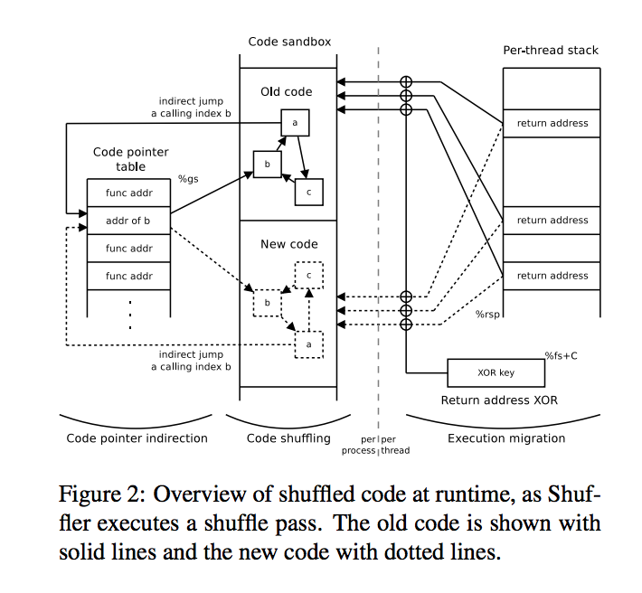
2016—new defenses against JIT ROP
12% overhead with 50msec cycle

Slide 57
Other Randomization ideas? ISR
Encryption Key
Decryption Key
Compile
Load
In memory
Execution
Instruction Set Randomization ~2003
Older idea, can protect against code injection attacks too
What do you think?

Slide 58
Can the key be guessed?
32 bit key => 4,294,967,296 possibilities
32 bit key, guess 16 bits and 16 bits =>
2 * 65,536 = 131,072 possibilities
32 bit key, guess 8 bits at a time =>
4 * 256 = 1,024 possibilities

Slide 59
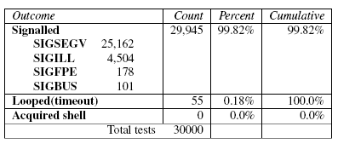
Problems
[Randomized instruction set emulation to disrupt binary code injection attacks, Barrantes & all]

Slide 60
Demonstrated a lovely attack in usenix 2005 (Where’s the FEEB?)
Attacked a multi-threaded network server
Try to guess the return instruction—only 256 possibilities
Unfortunately program crashes if you guess wrong
https://www.usenix.org/legacy/event/sec05/tech/full_papers/sovarel/sovarel.pdf

Slide 61
Leaves the stack compromised when successful
Popped an extra value

Slide 62
Guess jump instruction
2 bytes, so 16K possibilities
But can cause an infinite loop when successful

Slide 63
Conclusions
Moving target defenses are generally a good idea
Can be hardware or software supported
Examples?
However, they can be circumvented sometimes
Low entropy
Disclosure attacks
Fundamental limitation or limitation of current solutions?

