Slide 1
Common Software Attacks EE 260: Architecture/Hardware Support for Security
Slide credits: some slides from Dave O’halloran, Lujo Bauer (CMU) and Dan Boneh (Stanford)

Slide 2
Today
Common attacks frame much of modern computer security
Basic tools in the attacker’s toolkit
We need to understand these attacks to be able to develop solutions for them
Today we discuss common attack vectors on software
Some common defenses as well
General ingredients:
attackers provide input which exploits a vulnerability
Goal is to hijack control so that they can do what they want
Preferably with root permissions; preferably remotely
Common ingredient is data mixes with code (or code pointers)
Data only attacks are possible

Slide 3
I want to start with a philosophical note
Reflections on trusting trust: a short classical paper in security
Shows that can write a compiler that compiles itself and other programs to create trojans from a source that does not have any back doors.
So, we are already assuming a lot when we trust our compilers, operating systems, hardware and vendor applications to be free from insider attacks

Slide 4
Vulnerability by type (1988-2012)
Source: 25 years of vulnerabilities, Younan; based on NVD data

Slide 5
Category 10 (most severe)

Slide 6
Today and most of next time
We’ll start with a quick overview of memory management
Should be review if you had OS
Could be too fast if you have not, but hopefully you can get something
Then we will start looking at some memory exploitations
Buffer overflow
Defenses: software, hardware
Start thinking about hardware strengths
Integer overflow
Format string exploits

Slide 7
IA32 Linux Memory Layout
not drawn to scale
FF
Stack
Stack
Runtime stack (8MB limit)
E. g., local variables
Heap
Dynamically allocated storage
When call malloc(), calloc(), new()
Data
Statically allocated data
E.g., arrays & strings declared in code
Text
Executable machine instructions
Read-only
8MB
Heap
Data
Upper 2 hex digits = 8 bits of address
Text
08
00

Slide 8
Memory Allocation Example
not drawn to scale
FF
Stack
char big_array[1<<24]; /* 16 MB */
char huge_array[1<<28]; /* 256 MB */
int beyond;
char *p1, *p2, *p3, *p4;
int useless() { return 0; }
int main()
{
p1 = malloc(1 <<28); /* 256 MB */
p2 = malloc(1 << 8); /* 256 B */
p3 = malloc(1 <<28); /* 256 MB */
p4 = malloc(1 << 8); /* 256 B */
/* Some print statements ... */
}
Heap
Data
Where does everything go?
Text
08
00

Slide 9
IA32 Example Addresses
not drawn to scale
FF
Stack
address range ~2³²
$esp 0xffffbcd0
p3 0x65586008
p1 0x55585008
p4 0x1904a110
p2 0x1904a008
&p2 0x18049760
&beyond 0x08049744
big_array 0x18049780
huge_array 0x08049760
main() 0x080483c6
useless() 0x08049744
final malloc() 0x006be166
80
Heap
Data
malloc() is dynamically linked
address determined at runtime
Text
08
00

Slide 10
x86-64 Example Addresses
not drawn to scale
00007F
Stack
address range ~2⁴⁷
$rsp 0x00007ffffff8d1f8
p3 0x00002aaabaadd010
p1 0x00002aaaaaadc010
p4 0x0000000011501120
p2 0x0000000011501010
&p2 0x0000000010500a60
&beyond 0x0000000000500a44
big_array 0x0000000010500a80
huge_array 0x0000000000500a50
main() 0x0000000000400510
useless() 0x0000000000400500
final malloc() 0x000000386ae6a170
000030
Heap
Data
malloc() is dynamically linked
address determined at runtime
Text
000000

Slide 11
Page Tables
A page table is an array of page table entries (PTEs) that maps virtual pages to physical pages.
Per-process kernel data structure in DRAM
Physical memory
(DRAM)
Physical page
number or
disk address
Valid
VP 1
PP 0
PTE 0
0
null
VP 2
1
VP 7
VP 4
PP 3
1
0
1
0
null
Virtual memory
(disk)
0
PTE 7
1
VP 1
Memory resident
page table
(DRAM)
VP 2
VP 3
VP 4
VP 6
VP 7

Slide 12
Page Hit
Page hit: reference to VM word that is in physical memory (DRAM cache hit)
Physical memory
(DRAM)
Physical page
number or
disk address
Virtual address
Valid
VP 1
PP 0
PTE 0
0
null
VP 2
1
VP 7
VP 4
PP 3
1
0
1
0
null
Virtual memory
(disk)
0
PTE 7
1
VP 1
Memory resident
page table
(DRAM)
VP 2
VP 3
VP 4
VP 6
VP 7

Slide 13
Page Fault
Page fault: reference to VM word that is not in physical memory (DRAM cache miss)
Physical memory
(DRAM)
Physical page
number or
disk address
Virtual address
Valid
VP 1
PP 0
PTE 0
0
null
VP 2
1
VP 7
VP 4
PP 3
1
0
1
0
null
Virtual memory
(disk)
0
PTE 7
1
VP 1
Memory resident
page table
(DRAM)
VP 2
VP 3
VP 4
VP 6
VP 7

Slide 14
Handling Page Fault
Page miss causes page fault (an exception)
Physical memory
(DRAM)
Physical page
number or
disk address
Virtual address
Valid
VP 1
PP 0
PTE 0
0
null
VP 2
1
VP 7
VP 4
PP 3
1
0
1
0
null
Virtual memory
(disk)
0
PTE 7
1
VP 1
Memory resident
page table
(DRAM)
VP 2
VP 3
VP 4
VP 6
VP 7

Slide 15
Handling Page Fault
Page miss causes page fault (an exception)
Page fault handler selects a victim to be evicted (here VP 4)
Physical memory
(DRAM)
Physical page
number or
disk address
Virtual address
Valid
VP 1
PP 0
PTE 0
0
null
VP 2
1
VP 7
VP 4
PP 3
1
0
1
0
null
Virtual memory
(disk)
0
PTE 7
1
VP 1
Memory resident
page table
(DRAM)
VP 2
VP 3
VP 4
VP 6
VP 7

Slide 16
Handling Page Fault
Page miss causes page fault (an exception)
Page fault handler selects a victim to be evicted (here VP 4)
Physical memory
(DRAM)
Physical page
number or
disk address
Virtual address
Valid
VP 1
PP 0
PTE 0
0
null
VP 2
1
VP 7
VP 3
PP 3
1
1
0
0
null
Virtual memory
(disk)
0
PTE 7
1
VP 1
Memory resident
page table
(DRAM)
VP 2
VP 3
VP 4
VP 6
VP 7

Slide 17
Handling Page Fault
Page miss causes page fault (an exception)
Page fault handler selects a victim to be evicted (here VP 4)
Offending instruction is restarted: page hit!
Physical memory
(DRAM)
Physical page
number or
disk address
Virtual address
Valid
VP 1
PP 0
PTE 0
0
null
VP 2
1
VP 7
VP 3
PP 3
1
1
0
0
null
Virtual memory
(disk)
0
PTE 7
1
VP 1
Memory resident
page table
(DRAM)
VP 2
VP 3
VP 4
VP 6
VP 7

Slide 18
VM as a Tool for Memory Protection
Extend PTEs with permission bits
Page fault handler checks these before remapping
If violated, send process SIGSEGV (segmentation fault)
Physical
Address Space
Process i:
SUP
READ
WRITE
Address
VP 0:
No
Yes
No
PP 6
VP 1:
No
Yes
Yes
PP 4
VP 2:
Yes
Yes
Yes
PP 2
PP 2
•
•
•
PP 4
PP 6
Process j:
SUP
READ
WRITE
Address
PP 8
VP 0:
No
Yes
No
PP 9
PP 9
VP 1:
Yes
Yes
Yes
PP 6
VP 2:
No
Yes
Yes
PP 11
PP 11

Slide 19
Address Translation With a Page Table
Virtual address
Page table base register
(PTBR)
n-1
p
p-1
0
Virtual page number (VPN)
Virtual page offset (VPO)
Page table address
for process
Page table
Valid
Physical page number (PPN)
Valid bit = 0:
page not in memory
(page fault)
m-1
p
p-1
0
Physical page number (PPN)
Physical page offset (PPO)
Physical address

Slide 20
Address Translation: Page Hit
CPU Chip
2
Cache/
Memory
MMU
PTEA
1
PTE
CPU
VA
3
PA
4
Data
5
1) Processor sends virtual address to MMU
2-3) MMU fetches PTE from page table in memory
4) MMU sends physical address to cache/memory
5) Cache/memory sends data word to processor

Slide 21
Address Translation: Page Fault
Exception
Page fault handler
4
CPU Chip
2
Cache/
Memory
Disk
MMU
PTEA
Victim page
1
5
CPU
VA
PTE
7
3
New page
6
1) Processor sends virtual address to MMU
2-3) MMU fetches PTE from page table in memory
4) Valid bit is zero, so MMU triggers page fault exception
5) Handler identifies victim (and, if dirty, pages it out to disk)
6) Handler pages in new page and updates PTE in memory
7) Handler returns to original process, restarting faulting instruction

Slide 22
Integrating VM and Cache
PTE
CPU Chip
PTE
MMU
PTEA
hit
Memory
PTEA
PTEA
miss
PTEA
CPU
VA
PA
PA
PA
miss
PA
hit
Data
L1
cache
Data
VA: virtual address, PA: physical address, PTE: page table entry, PTEA = PTE address

Slide 23
Speeding up Translation with a TLB
Page table entries (PTEs) are cached in L1 like any other memory word
PTEs may be evicted by other data references
PTE hit still requires a small L1 delay
Solution: Translation Lookaside Buffer (TLB)
Small hardware cache in MMU
Maps virtual page numbers to physical page numbers
Contains complete page table entries for small number of pages

Slide 24
TLB Hit
CPU Chip
TLB
2
PTE
VPN
3
Cache/
Memory
1
MMU
CPU
VA
PA
4
Data
5
A TLB hit eliminates a memory access

Slide 25
TLB Miss
CPU Chip
TLB
4
2
PTE
VPN
Cache/
Memory
1
MMU
3
CPU
VA
PTEA
PA
5
Data
6
A TLB miss incurs an additional memory access (the PTE) Fortunately, TLB misses are rare. Why?

Slide 26
Multi-Level Page Tables
Suppose:
4KB (2¹²) page size, 48-bit address space, 8-byte PTE
Problem:
Would need a 512 GB page table!
2⁴⁸ * 2⁻¹² * 2³ = 2³⁹ bytes
Common solution:
Multi-level page tables
Example: 2-level page table
Level 1 table: each PTE points to a page table (always memory resident)
Level 2 table: each PTE points to a page (paged in and out like any other data)
Level 2
Tables
Level 1
Table
...
...

Slide 27
End-to-end Core i7 Address Translation
CPU
32/64
L2, L3, and
main memory
Result
Virtual address (VA)
36
12
VPN
VPO
L1
hit
L1
miss
32
4
TLBT
TLBI
L1 d-cache
(64 sets, 8 lines/set)
TLB
hit
TLB
miss
...
...
L1 TLB (16 sets, 4 entries/set)
9
9
9
9
40
12
40
6
6
VPN1
VPN2
VPN3
VPN4
PPN
PPO
CT
CI
CO
Physical
address
(PA)
CR3
PTE
PTE
PTE
PTE
Page tables

Slide 28
Buffer Overflow Attacks

Slide 29
Internet Worm and IM War
November, 1988
Internet Worm attacks thousands of Internet hosts.
How did it happen?

Slide 30
Internet Worm and IM War
November, 1988
Internet Worm attacks thousands of Internet hosts.
How did it happen?
July, 1999
Microsoft launches MSN Messenger (instant messaging system).
Messenger clients can access popular AOL Instant Messaging Service (AIM) servers
AIM
client
MSN
server
MSN
client
AIM
server
AIM
client

Slide 31
Internet Worm and IM War (cont.)
August 1999
Mysteriously, Messenger clients can no longer access AIM servers.
Microsoft and AOL begin the IM war:
AOL changes server to disallow Messenger clients
Microsoft makes changes to clients to defeat AOL changes.
At least 13 such skirmishes.
How did it happen?
The Internet Worm and AOL/Microsoft War were both based on stack buffer overflow exploits!
many library functions do not check argument sizes.
allows target buffers to overflow.

Slide 32
String Library Code
Implementation of Unix function gets()
No way to specify limit on number of characters to read
Similar problems with other library functions
strcpy, strcat: Copy strings of arbitrary length
scanf, fscanf, sscanf, when given %s conversion specification
/* Get string from stdin */
char *gets(char *dest) { int c = getchar();
char *p = dest;
while (c != EOF && c != '\n') {
*p++ = c;
c = getchar();
}
*p = '\0';
return dest;
}

Slide 33
Vulnerable Buffer Code
/* Echo Line */ void echo() { char buf[4]; /* Way too small! */ gets(buf); puts(buf); }
void call_echo() {
echo();
}
unix>./bufdemo
Type a string:1234567
1234567
unix>./bufdemo
Type a string:12345678
Segmentation Fault
unix>./bufdemo
Type a string:123456789ABC
Segmentation Fault

Slide 34
Buffer Overflow Disassembly
echo:
80485c5: 55 push %ebp
80485c6: 89 e5 mov %esp,%ebp
80485c8: 53 push %ebx
80485c9: 83 ec 14 sub $0x14,%esp
80485cc: 8d 5d f8 lea 0xfffffff8(%ebp),%ebx
80485cf: 89 1c 24 mov %ebx,(%esp)
80485d2: e8 9e ff ff ff call 8048575 <gets>
80485d7: 89 1c 24 mov %ebx,(%esp)
80485da: e8 05 fe ff ff call 80483e4 <puts@plt>
80485df: 83 c4 14 add $0x14,%esp
80485e2: 5b pop %ebx
80485e3: 5d pop %ebp
80485e4: c3 ret
call_echo:
80485eb: e8 d5 ff ff ff call 80485c5 <echo>
80485f0: c9 leave
80485f1: c3 ret

Slide 35
Buffer Overflow Stack
Before call to gets
Stack Frame
for main
/* Echo Line */ void echo() { char buf[4]; /* Way too small! */ gets(buf); puts(buf); }
Return Address
Saved %ebp
%ebp
Stack Frame
for echo
Saved %ebx
[3]
[2]
[1]
[0]
buf
echo:
pushl %ebp # Save %ebp on stack
movl %esp, %ebp
pushl %ebx # Save %ebx
subl $20, %esp # Allocate stack space
leal -8(%ebp),%ebx # Compute buf as %ebp-8
movl %ebx, (%esp) # Push buf on stack
call gets # Call gets
. . .

Slide 36
Buffer Overflow Stack Example
unix> gdb bufdemo
(gdb) break echo
Breakpoint 1 at 0x80485c9
(gdb) run
Breakpoint 1, 0x80485c9 in echo ()
(gdb) print /x $ebp
$1 = 0xffffd678
(gdb) print /x *(unsigned *)$ebp
$2 = 0xffffd688
(gdb) print /x *((unsigned *)$ebp + 1)
$3 = 0x80485f0
Before call to gets
Before call to gets
Stack Frame
for main
Stack Frame
for main
0xffffd688
Return Address
08
04
85
f0
Saved %ebp
ff
ff
d6
88
0xffffd678
Stack Frame
for echo
Saved %ebx
Stack Frame
for echo
Saved %ebx
[3]
[2]
[1]
[0]
buf
xx
xx
xx
xx
buf
80485eb: e8 d5 ff ff ff call 80485c5 <echo>
80485f0: c9 leave

Slide 37
Buffer Overflow Example #1
Before call to gets
Input 1234567
Stack Frame
for main
0xffffd688
Stack Frame
for main
0xffffd688
08
04
85
f0
08
04
85
f0
ff
ff
d6
88
0xffffd678
ff
ff
d6
88
0xffffd678
Stack Frame
for echo
Saved %ebx
Stack Frame
for echo
00
37
36
35
xx
xx
xx
xx
buf
34
33
32
31
buf
Overflow buf, and corrupt %ebx,
but no problem

Slide 38
Buffer Overflow Example #2
Before call to gets
Input 12345678
Stack Frame
for main
0xffffd688
Stack Frame
for main
0xffffd688
08
04
85
f0
08
04
85
f0
ff
ff
d6
88
0xffffd678
ff
ff
d6
00
0xffffd678
Saved %ebx
Stack Frame
for echo
Stack Frame
for echo
38
37
36
35
xx
xx
xx
xx
buf
34
33
32
31
buf
Base pointer corrupted
. . .
80485eb: e8 d5 ff ff ff call 80485c5 <echo>
80485f0: c9 leave # Set %ebp to corrupted value
80485f1: c3 ret

Slide 39
Buffer Overflow Example #3
Before call to gets
Input 123456789
Stack Frame
for main
0xffffd688
Stack Frame
for main
0xffffd688
08
04
85
f0
08
04
85
00
ff
ff
d6
88
0xffffd678
43
42
41
39
0xffffd678
Saved %ebx
Stack Frame
for echo
Stack Frame
for echo
38
37
36
35
xx
xx
xx
xx
buf
34
33
32
31
buf
Return address corrupted
80485eb: e8 d5 ff ff ff call 80485c5 <echo>
80485f0: c9 leave # Desired return point

Slide 40
Malicious Use of Buffer Overflow
Stack after call to gets()
void foo(){
bar();
...
}
foo stack frame
return
address
A
B
pad
int bar() {
char buf[64];
gets(buf);
...
return ...;
}
data written
by gets()
exploit
code
bar stack frame
B
Input string contains byte representation of executable code
Overwrite return address A with address of buffer B
When bar() executes ret, will jump to exploit code

Slide 41
Exploits Based on Buffer Overflows
Buffer overflow bugs allow remote machines to execute arbitrary code on victim machines
Internet worm
Early versions of the finger server (fingerd) used gets() to read the argument sent by the client:
finger naelag@ucr.edu
Worm attacked fingerd server by sending phony argument:
finger “exploit-code padding new-return-address”
exploit code: executed a root shell on the victim machine with a direct TCP connection to the attacker.

Slide 42
Exploits Based on Buffer Overflows
Buffer overflow bugs allow remote machines to execute arbitrary code on victim machines
IM War
AOL exploited existing buffer overflow bug in AIM clients
exploit code: returned 4-byte signature (the bytes at some location in the AIM client) to server.
When Microsoft changed code to match signature, AOL changed signature location.

Slide 43
Date: Wed, 11 Aug 1999 11:30:57 -0700 (PDT)
From: Phil Bucking <philbucking@yahoo.com>
Subject: AOL exploiting buffer overrun bug in their own software!
To: rms@pharlap.com
Mr. Smith,
I am writing you because I have discovered something that I think you
might find interesting because you are an Internet security expert with
experience in this area. I have also tried to contact AOL but received
no response.
I am a developer who has been working on a revolutionary new instant
messaging client that should be released later this year.
...
It appears that the AIM client has a buffer overrun bug. By itself
this might not be the end of the world, as MS surely has had its share.
But AOL is now *exploiting their own buffer overrun bug* to help in
its efforts to block MS Instant Messenger.
....
Since you have significant credibility with the press I hope that you
can use this information to help inform people that behind AOL's
friendly exterior they are nefariously compromising peoples' security.
Sincerely,
Phil Bucking
Founder, Bucking Consulting
philbucking@yahoo.com
AOL exploited their own bug to detect their clients!
Its not a bug, it’s a feature!
http://www.cnn.com/TECH/computing/9908/20/aolbug.idg/index.html
It was later determined that this email originated from within Microsoft!

Slide 44
Code Red Exploit Code
Starts 100 threads running
Spread self
Generate random IP addresses & send attack string
Between 1st & 19th of month
Attack www.whitehouse.gov
Send 98,304 packets; sleep for 4-1/2 hours; repeat
Denial of service attack
Between 21st & 27th of month
Deface server’s home page
After waiting 2 hours

Slide 45
Avoiding Overflow Vulnerability
/* Echo Line */ void echo() { char buf[4]; /* Way too small! */ fgets(buf, 4, stdin); puts(buf); }
Use library routines that limit string lengths
fgets instead of gets
strncpy instead of strcpy
Don’t use scanf with %s conversion specification
Use fgets to read the string
Or use %ns where n is a suitable integer

Slide 46
System-Level Protections
Randomized stack offsets (ASLR)
At start of program, allocate random amount of space on stack
Makes it difficult for hacker to predict beginning of inserted code
unix> gdb bufdemo
(gdb) break echo
(gdb) run
(gdb) print /x $ebp
$1 = 0xffffc638
(gdb) run
(gdb) print /x $ebp
$2 = 0xffffbb08
(gdb) run
(gdb) print /x $ebp
$3 = 0xffffc6a8

Slide 47
Stack Canaries
Idea
Place special value (“canary”) on stack just beyond buffer
Check for corruption before exiting function
GCC Implementation
-fstack-protector
-fstack-protector-all
unix>./bufdemo-protected
Type a string:1234
1234
unix>./bufdemo-protected
Type a string:12345
*** stack smashing detected ***

Slide 48
Protected Buffer Disassembly
echo:
804864d: 55 push %ebp
804864e: 89 e5 mov %esp,%ebp
8048650: 53 push %ebx
8048651: 83 ec 14 sub $0x14,%esp
8048654: 65 a1 14 00 00 00 mov %gs:0x14,%eax
804865a: 89 45 f8 mov %eax,0xfffffff8(%ebp)
804865d: 31 c0 xor %eax,%eax
804865f: 8d 5d f4 lea 0xfffffff4(%ebp),%ebx
8048662: 89 1c 24 mov %ebx,(%esp)
8048665: e8 77 ff ff ff call 80485e1 <gets>
804866a: 89 1c 24 mov %ebx,(%esp)
804866d: e8 ca fd ff ff call 804843c <puts@plt>
8048672: 8b 45 f8 mov 0xfffffff8(%ebp),%eax
8048675: 65 33 05 14 00 00 00 xor %gs:0x14,%eax
804867c: 74 05 je 8048683 <echo+0x36>
804867e: e8 a9 fd ff ff call 804842c <FAIL>
8048683: 83 c4 14 add $0x14,%esp
8048686: 5b pop %ebx
8048687: 5d pop %ebp
8048688: c3 ret

Slide 49
Setting Up Canary
Before call to gets
/* Echo Line */ void echo() { char buf[4]; /* Way too small! */ gets(buf); puts(buf); }
Stack Frame
for main
Return Address
Saved %ebp
%ebp
Stack Frame
for echo
Saved %ebx
Canary
[3]
[2]
[1]
[0]
buf
echo:
. . .
movl %gs:20, %eax # Get canary
movl %eax, -8(%ebp) # Put on stack
xorl %eax, %eax # Erase canary
. . .

Slide 50
Checking Canary
Before call to gets
/* Echo Line */ void echo() { char buf[4]; /* Way too small! */ gets(buf); puts(buf); }
Stack Frame
for main
Return Address
Saved %ebp
%ebp
Stack Frame
for echo
Saved %ebx
Canary
[3]
[2]
[1]
[0]
buf
echo:
. . .
movl -8(%ebp), %eax # Retrieve from stack
xorl %gs:20, %eax # Compare with Canary
je .L24 # Same: skip ahead
call __stack_chk_fail # ERROR
.L24:
. . .

Slide 51
Canary Example
Before call to gets
Input 1234
Stack Frame
for main
Stack Frame
for main
Return Address
Return Address
Saved %ebp
%ebp
Saved %ebp
%ebp
Stack Frame
for echo
Stack Frame
for echo
Saved %ebx
Saved %ebx
03
e3
7d
00
03
e3
7d
00
[3]
[2]
[1]
[0]
buf
34
33
32
31
buf
(gdb) break echo
(gdb) run
(gdb) stepi 3
(gdb) print /x *((unsigned *) $ebp - 2)
$1 = 0x3e37d00
Benign corruption!
(allows programmers to make silent off-by-one errors)

Slide 52
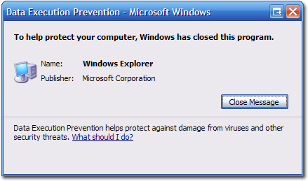
Hardware solution!
Many other solutions have been investigated (compiler, binary rewriting, hardware)
Hardware solution: Nonexecutable code segments
In traditional x86, can mark region of memory as either “read-only” or “writeable”
Can execute anything readable
X86-64 added explicit “execute” permission: the so-called NX bit
If a memory page is writeable, it is not executable
What does this do?

Slide 53
Does not completely solve the problem ☹
Modern software does a lot of just in time compilation
There are also cases where we need code on the stack (primarily interrupt handling)
Even if the above is not true, attackers evolved: Code reuse attacks in a couple of classes.
NX bit can be turned off
Buffer overflows are still extremely dangerous!

Slide 54
Integer Overflow Attacks

Slide 55
Integer overflows
Integers have a fixed precision in computing systems
32-bits (ints or longs); 64-bits long long
Limited precision can lead to bugs
Some arithmetic operations cause overflow: a positive value can turn negative
Signed vs. unsigned comparisons can also cause problems
These bugs are sometimes exploitable
A common pattern: when the integer value is used to check a buffer or control allocation

Slide 56
Example
int catvars (char *buf1, char *buf2, unsigned int len1, unsigned int len2)
{
char mybuf [256];
if((len1 + len2) > 256)
{ /* [3] */ return -1; }
memcpy(mybuf, buf1, len1); /* [4] */
memcpy(mybuf+ len1, buf2, len2);
do_some_stuff (mybuf);
return 0;
}
Problem: if len1 = 0x104 and len2=0xfffffffc then
len1+len2 = 0x100 (or 256) which allows a buffer overflow!

Slide 57
Code Security Example
SUN XDR library
Widely used library for transferring data between machines
void* copy_elements(void *ele_src[], int ele_cnt, size_t ele_size);
ele_src
malloc(ele_cnt * ele_size)

Slide 58
XDR Code
void* copy_elements(void *ele_src[], int ele_cnt, size_t ele_size) {
/*
* Allocate buffer for ele_cnt objects, each of ele_size bytes
* and copy from locations designated by ele_src
*/
void *result = malloc(ele_cnt * ele_size);
if (result == NULL)
/* malloc failed */
return NULL;
void *next = result;
int i;
for (i = 0; i < ele_cnt; i++) {
/* Copy object i to destination */
memcpy(next, ele_src[i], ele_size);
/* Move pointer to next memory region */
next += ele_size;
}
return result;
}

Slide 59
XDR Vulnerability
malloc(ele_cnt * ele_size)
What if:
ele_cnt = 2²⁰ + 1
ele_size = 4096 = 2¹²
Allocation = ??
How can I make this function secure?
Phrack paper has more examples…

Slide 60
Format String attacks
Some figures and examples from presentation by Kevin Du

Slide 61
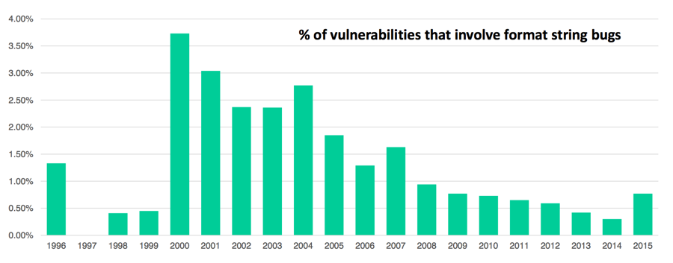
History
First exploit discovered in 2000 (vulnerability known since 1996)
Wu-ftpd 2.*: remote root
Linux rpc.statd: remote root
IRIX telnetd: remote root
BSD chpass: local root

Slide 62
Vulnerable functions
Any function that uses a format string
Format strings are C/C++ strings used in printf and like functions:
“Hello world! My name is %s and I am %d years old”
Note that we are mixing data and control, one of our ingredients
Printing: printf, fprintf, sprintf, vprintf, vfprintf, vsprintf, …
Logging: syslog, err, warn
Doesn’t sound like something dangerous, or is it?

Slide 63
Format function execution
Printf(“Hello World! My name is %s and I am %d years old”, name, age); // note that name is a pointer
From printf, the arguments are on the stack and look like:
…
age
name
…
Where: age is the value of age,
and name is the address of the string
Format function parses the string reading a character at a time. If it is not % it is output to stdio. If % we get the argument from the stack and use it

Slide 64
Problem
Problem occurs when user provides or can change the format string. Consider:
int func (char *user) { fprintf( stdout, user);}
What is possible? Doesn’t look too dangerous
Correct form:
int func (char *user) { fprintf( stdout, “%s”, user);}

Slide 65
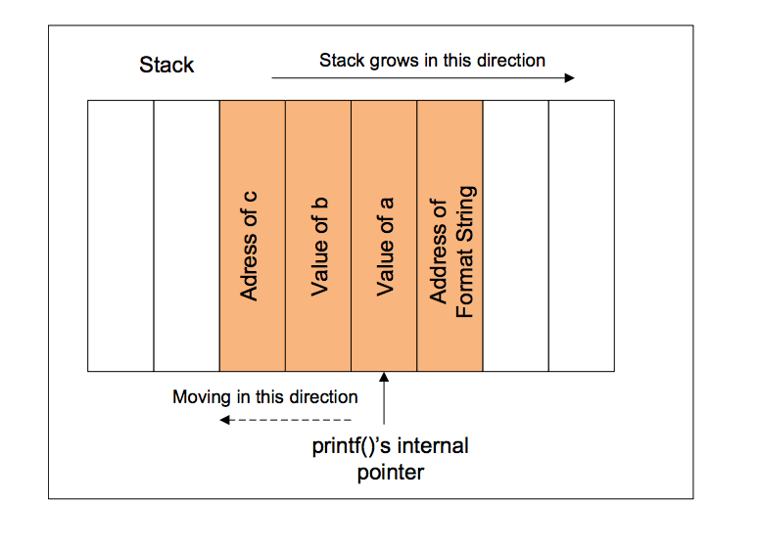
How does printf work?
How can we abuse this?

Slide 66
Format string vulnerabilities
…printf(user)…
What if user provides “%s%s%s%s%s …”
Most likely the program will crash – why?
What if user = “%08x.%08x.%08x.%08x”?
Retrieves 4 32-bit parameters from the stack and displays them as 8-digit padded hexadecimal numbers
How is this useful?

Slide 67
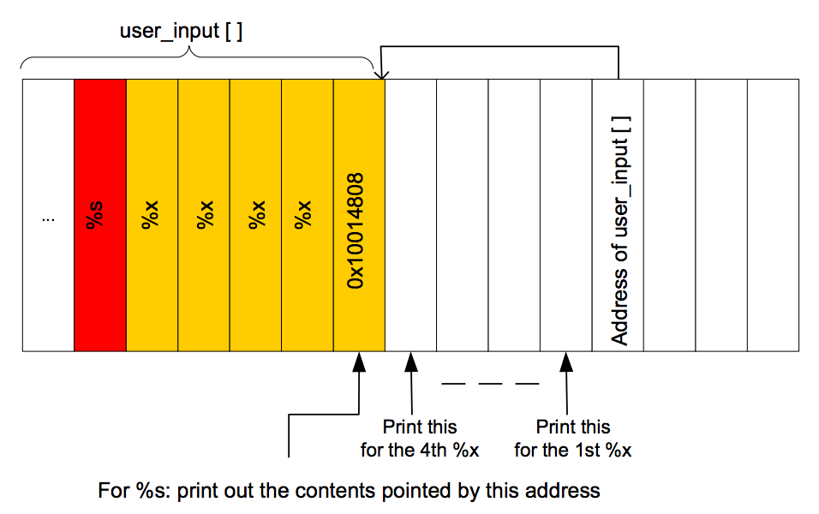
Format strings vulnerabilities
Consider the following user supplied format string:
“\x10\x01\x48\x08 %x %x %x %x %s”
What would this do?

Slide 68
This is not all!
int i;
printf (“123456%n”,&i);
The %n is a little know option in format strings
It writes the count of characters written so far to the screen to the variable i
in this case it would write 6
How is this dangerous?
Think about the previous example

Slide 69
OK, so what to do?
Write better code?
Fix bugs?
Defense mechanisms!
Make systems harder to attack?
What other bugs are out there?

