Slide 1
Firmware Attacks and Security introduction

Slide 2
Firmware attacks
We have focused on software and CPU security, but what about peripheral devices?
They run microcontrols/firmware
  Often this is large and complex
  Can be attacked
  Often they have physical access to the devices not mediated by OS or CPU
Real danger, many published attacks on variety of I/O devices and buses
  E.g., Stuxnet worm

Slide 3
Common attack 1: Data Exfiltration
I/O devices can have DMA access to memory
DMA memory permissions do not go through the page table
  Can access arbitrary memory, recover data, keys etc…
  “Understanding DMA Malware” paper shows how this can be used to launch stealthy attacks
    They implement a keylogger
Defenses?
  IO/MMU and things like Intel Vt-d

Slide 4
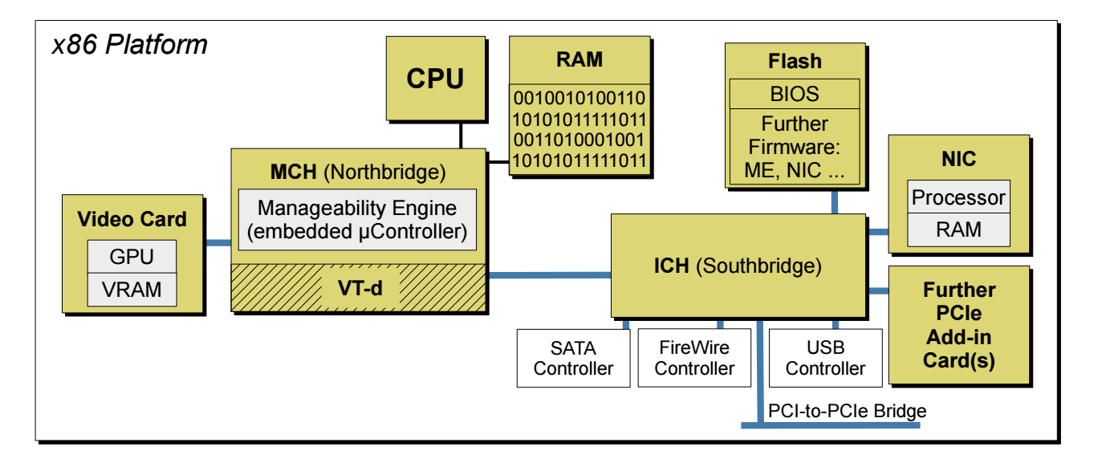
Typical x86 system

Slide 5
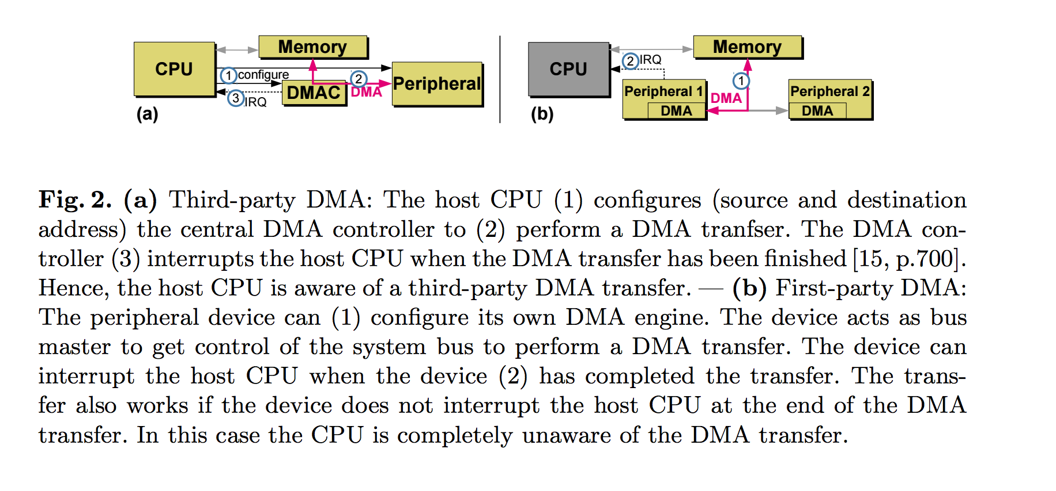
DMA

Slide 6
Intel Virtualization Technology for Directed I/O (Vt-d)
Currently implements:
  I/O device assignment
    Allows administrator to assign I/O device to VMs in any configuration
  DMA Remapping: supports address translation device DMA transfers
  Interrupt remapping: provides VM routing and isolation of device interrupts
  Reliability: record software DMA and interrupt errors that otherwise may corrupt memory and impact isolation
  https://www-ssl.intel.com/content/www/us/en/virtualization/virtualization-technology/intel-virtualization-technology.html?iid=tech_vt+tech

Slide 7
Still can be attacked
Check the “Understanding DMA Malware” paper
  Keylogger through one of the processors on the motherboard
  Had to solve some problems, mostly to do with virtual to physical address mapping and figuring out ASLR
Lesson is firmware/system offers a big attack surface that is difficult to secure

Slide 8
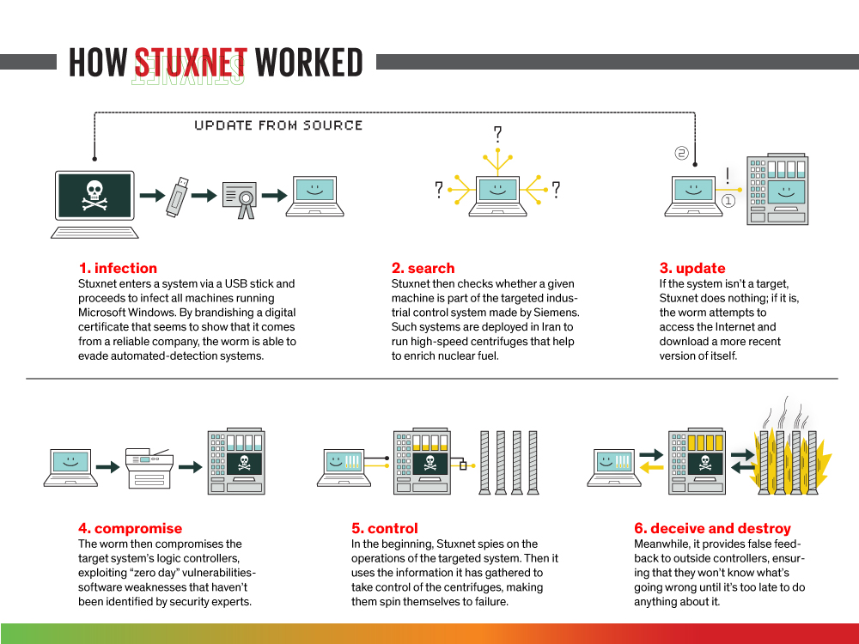
“The Real Story of Stuxnet,” IEEE Spectrum, Feb. 2013

Slide 9
Common attack 2: Bootkits
Multiple pieces of firmware load prior to or during execution of OS
  Attackers with software access (if they are vulnerable and expose interfaces) or physical access can compromise any of them
  Boot process is compromised, anything can be booted
  Could run in a more privileged mode than the OS (e.g., System Management Mode)
  Very old attack: e.g., viruses compromising Master Boot Record
Solution?
  Secure load/attested load using the TPM

Slide 10
Aside: SMM
Feature started in 386SL
  Allows the OS to be interrupted
  Code in the SMM runs at a very high privilege level
  OS has no idea that it is running (undetectable other than timing)
SM-RAM holds SMM state – inaccessible in normal mode
Has some legitimate uses (e.g., emulating hardware)
But has mostly been a haven for rootkits

Slide 11
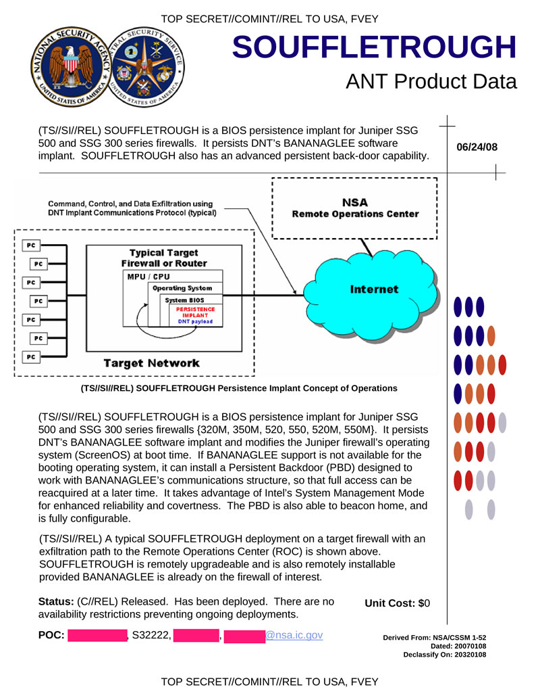
NSA Likes it ☺

Slide 12
Common (?) Attack 3: Backdoors/trojans
Backdoors/trojans installed by the manufacturers
Several reported; prevalence unknown…

Slide 13
Example: Hard drive backdoor
Can exploit firmware (not well written code usually)
Once you exploit it (remotely) you can:
  Make a disk commit suicide
  Or mess with data any way that you want
But can you exfiltrate the data or have it act as a backdoor?
  Yes! NSA was doing that too, but this is based on a research paper
  Linked on website

Slide 14
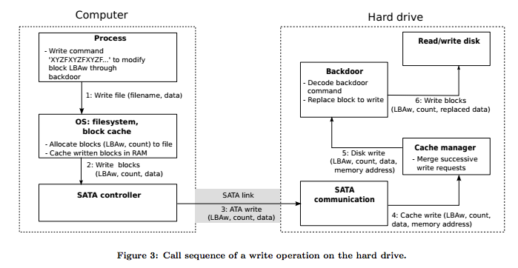

Slide 15
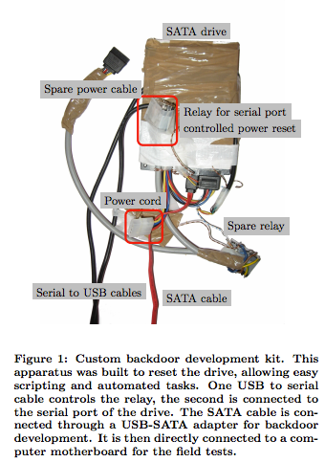
Do not need manufacturer help – reverse engineering kit

Slide 16
Protection and Detection?
Is the problem different from hardware trojans?
  Next class
Firmware integrity verification?
  Yes, unless the firmware comes with the backdoor
  Updates? Sign those too
  Yukun will tell us about Viper
Intrusion detection?
Encryption?

