Slide 1
Reference Monitors/Information Flow Tracking
Slide credits: Raksha presentation based on that original authors

Slide 2
Reference Monitors
A class of analyses that monitors application code to enforce some invariants
What kinds of invariants? We’ve seen at least one
Control Flow Integrity—what was that for?
But there are many other reference monitors that have been proposed – a versatile model
Not just for security
Classical implementation: inlined reference monitor (IRM)
Software only implementation

Slide 3
Inline reference monitors
Software implementation advantages
Flexible in terms of policy
Amenable to compiler optimizations – for example, selectively monitor
Don’t need hardware support
Disadvantages:
Performance tends to be terrible
Coverage
Legacy binaries
…

Slide 4
Today
Look at some reference monitors because
Some that are important and that have had commercial impact
But also, to think about this class of computation in general
Hopefully discover that:
There are many monitors, but they share a common (or at least similar) computation model
Each particular monitor can be implemented in a variety of ways from software only, to hardware only to something in between
With different implications – not just performance
How do we provide hardware support for this class of computation?
How do we think about implementation tradeoffs
Can this be automated?

Slide 5
RAKSHA A Flexible Information Flow Architecture for Software Security
Michael Dalton Hari Kannan Christos Kozyrakis
Computer Systems Laboratory
Stanford University

Slide 6
Motivation
Software security is in a crisis
Far-reaching financial & social implications
Worms now mixing different kinds of attacks
No longer just simple buffer overflows
High-level semantic vulnerabilities now most common threats
SQL Injection, Cross Site Scripting, Directory Traversal, etc
Easy to exploit; often architecture & OS independent
Need a new approach that is
Robust, End-to-end, Practical, Flexible, Fast

Slide 7
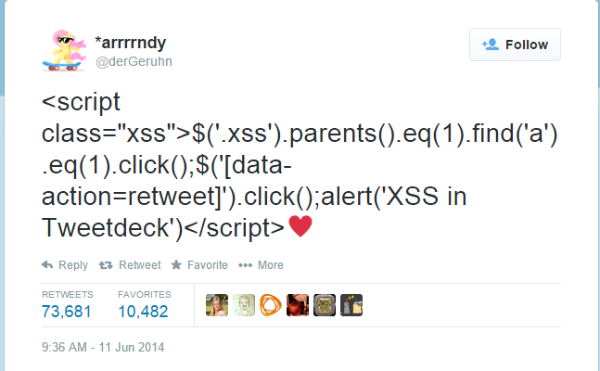
Motivation
High-level semantic vulnerabilities are prevalent in web-based attacks
SQL injection – code inserted into entry field
Cross-Site Scripting (XSS)
Injected website sends malicious code to client
Real-World Examples:
Website database breach
The Wall Street Journal database in July 2014
Twitter worms
statement = "SELECT * FROM users WHERE name ='" + userName + "';"
ERROR!
userName:
‘bob’ OR '1'='1
SELECT * FROM users WHERE name = ‘bob' OR '1'='1';

Slide 8
Dynamic Information Flow Tracking
DIFT tags (taints) data from untrusted sources
Each byte or word of memory, register has a taint bit
Taint status is propagated across instructions
If any source operand is tainted, destination becomes tainted
Trap to OS if tainted data used unsafely
Tainted pointer dereference
Tainted jump address
Tainted code
Can prevent memory corruption on unmodified binaries
Potential: Protect from low-level & high level threats

Slide 9
What is DIFT?
DIFT – Dynamic Information Flow Tracking
Associates a tag with every word of memory
Tag is used to mark tainted data from untrusted sources
Data produced from tainted data is also tainted
Check tag when data is used for potentially unsafe operations (ex. Code Execution)
Detects both low and high-level attacks
userName:
'bob' OR '1'='1
Tag
Data
 | userName=
X | ‘bob’
X | OR
X | ‘1’=‘1
User input
(untrusted)
Tag Check
SECURITY TRAP

Slide 10
Limitations of Current DIFT Systems
Software-based DIFT
On source code (incomplete coverage)
Or transparently through dynamic binary instrumentation
Advantages
Runs on existing hardware
Flexible security policies
Disadvantages
High overhead
Cannot protect O/S
Cannot protect self-modifying binaries
Does not work well with multi-threaded applications

Slide 11
Limitations of Current DIFT Systems
Hardware-based DIFT uses one, fixed security policy
Can only solve one problem (e.g., memory corruption) ⇒ unsafe
High-level attacks cannot be addressed
Cannot adapt to code that violates policy assumptions ⇒ impactical
E.g. glib uses alternate bounds checking instructions (index & 0x00FF)
Vulnerable to attacks that exploit inflexibility of policies
BUT really fast
Hardware security exceptions generate OS traps
Cannot protect OS ⇒ not end-to-end
Cannot combine HW and SW to cover difficult cases ⇒ inflexible
On a trap, just terminate the program…

Slide 12
Raksha (Protection) Overview
Get the best of both worlds
From H/W: fast check and propagation, work with any binary
From S/W: flexible policies, high-level analysis & decisions
Goals
Protect against high-level & low-level attacks
Protect against multiple concurrent attacks
Protect O/S code
At least a major part of it

Slide 13
RAKSHA Overview
Raksha follows the general DIFT model
All state is extended by a 4-bit tag (registers & memory)
4 independent 1-bit states
Operations propagate tags from sources to destinations
Operations check tags to identify security traps
New features
Software-controlled check & propagate policies ⇒ flexibility
Specify policy using check, propagate registers
Fine-grain software control to avoid common pitfalls
Flexibility allows us to catch wide range of bugs
Up to 4 concurrently active policies ⇒ robustness
One policy per tag bit
Provide comprehensive protection against many bugs
Low-overhead, user-level, security traps ⇒ end-to-end, flexibility
Can extend with software; can check operating system

Slide 14
Raksha Architecture and Features

Slide 15
Policy Specification
Up to 4 1-bit policies in parallel
One check & propagate register per active security policy
Policies specified at granularity of primitive operation
Int/FP Arithmetic, Move, Logical, Comparison, Execute
Instructions are decoded into ≥1 primitive operations
Apply rules specified by check/prop regs to each operation
Addresses basic pitfalls of previous designs
Conditional Move is logic and move
Good for CISC

Slide 16
Security Checking Policies
Memory address AND data tainted
Load address is tainted
Store address is tainted
Jump destination is tainted*
Branch condition is tainted*
System call arguments are tainted*
Return address register is tainted
Stack pointer is tainted
Memory address OR data tainted*
Notes:
undesired code is not executed

Slide 17
Policy Specification Registers

Slide 18
Check Policy: LOAD
Load r2,M[r1+offset]
Check Enables
Check source address
If Tagged(r1) then security trap
Check source
If Tagged(M[r1+offset]) then security trap
Both Checks can be running simultaneously
Propagate Enables
Propagate only from source address
Propagate only from source
Propagate both tags
AND or OR mode

Slide 19
Low Overhead Security Traps
On security Trap invoke pre-registered handler
Handler in same address space as code under inspection
Fast switch to S/W
Handler invocation triggers a special “trusted mode”
Trusted mode is orthogonal to user/kernel mode
Untrusted Mode
Transparent tags
Normal Checks and Propagations
Trusted Mode
Visible tags, Tag Access & Manipulation Instructions
No Checks / No Propagations

Slide 20
Low Overhead Security Traps
Benefits
Can check security of (most of the) OS
Reduce the amount of code you really trust
Coupling HW and SW security analysis is practical
Low performance overhead
Drawback: A memory corruption can corrupt the security handler
Solution: A security policy used to protect handler code & data
Handler Code & data are tainted on initialization
Policy does not allow access outside of trusted mode
3 bits remaining…

Slide 21
Tag Granulariity & Storage
Tag granularity
HW maintains per word tag bits
What if SW wants byte or bit granularity for some data?
Maintain in SW using sandboxing & fast user-level traps
Acceptable performance if not common case…
Tag storage
Initial HW ⇒ +4 bits/word in registers, caches, memory
12.5% storage overhead
Multi-granularity tag storage scheme [Suh’04]
Exploit tag similarity to reduce storage overhead
Page-level tags ⇒ cache line-level tags ⇒ word-level tags

Slide 22
Raksha-based LEON3

Slide 23
Raksha Prototype System
Full-featured Linux system
On-line since October 2006…
HW: modified Leon-3 processor
Open-source, Sparc V8 processor, RISC
Single-issue, in-order, 7-stage pipeline
Modified RTL for processor & system
First DIFT system on FPGA

Slide 24
Raksha Software Infrastructure
Goal: run real-world software stack
Running a full-featured Linux 2.6 on Raksha hardware
Custom distribution booting over NFS
Full GNU toolchain + glibc
Over 120 packages total
Set HW policies using preloaded shared libraries
Support enterprise software
SSH
Postgresql
wu-ftpd
Apache
…

Slide 25
Raksha Implementation Summary
Full-system prototype based on LEON 3
Open source processor from Gaisler Research
SPARC V8 compliant
Synthesized on Virtex 2 FPGA board
Parameter | Specification
Pipeline depth | 7 stages
Instruction Cache | 8KB
Data Cache | 32KB
Clock frequency | 20 Mhz
Block RAM utilization | 22%
4 input LUT utilization | 42%
Total increase in gates due to tags | 7.17%

Slide 26
Raksha Implementation Summary
Overhead over original
Logic: 7%
Storage: 12.5%
Clock frequency: none
Application performance
Check/propagate tags ⇒ no slowdown
Overhead depends on SW analysis
Frequency of traps, SW complexity, …
Worst-case example from experiments
Filtering low-level false positives/negatives
Bzip2: +33% with Raksha’s user-level traps
Bzip2: +280% with OS traps
Memory Speed???

Slide 27
Performance Results
Overhead is analysis-dependent
Proportional to exceptions frequency and handler duration
Many analyses are very cheap
Most high-level analyses invoked infrequently
Buffer overflow protection can be most expensive
If software is used to correctly filter false-positives/negatives
AND with 2^{n}-1 is bounds checking
Buffer overflow overhead
Program | Exception | OS trap
gcc | 1.01x | 1.04x
crafty | 1.01x | 1.02x
gzip | 1.31x | 3.60x
bzip2 | 2.99x | 18.80x
vortex | 1.34x | 3.41x

Slide 28
Performance Results

Slide 29
Performance – O/S and S/W traps

Slide 30
H/W Policies for Security Experiments
Concurrent protection using 4 policies
Memory corruption (LL attacks)
Propagate on arithmetic, load/store, logical
Check on tainted pointer/PC use
Trap handler untaints data validated by user code
String tainting (LL & HL attacks)
Propagate on arithmetic, load/store, logical
No checks
System call interposition (HL attacks)
No propagation
Check on system call in untrusted mode
Trap handler invokes proper SW analysis
Sandboxing policy (for trap handler protection)
Handler taints its own code & data
Check on fetch/loads/stores in untrusted mode

Slide 31
Security Experiments
Program | Lang. | Attack | Detected Vulnerability
Traceroute | C | Double Free | Tainted data ptr
Polymorph | C | Buffer Overflow | Tainted Code ptr
Wu-FTPD | C | Format String | Tainted”%n” in vfprintf string
Gzip | C | Directory Traversal | Open tainted dir
Wabbit | PHP | Directory Traversal | Escape Apache root w/ tainted ‘..’
OpenSSH | C | Command Injection | Excve tainted file
ProFTPD | C | SQL Injection | Tainted SQL command
Htdig | C++ | Cross-site Scripting | Tainted <script> tag
PhpSysInfo | PHP | Cross-site Scripting | Tainted <script> tag
Scry | PHP | Cross-site Scripting | Tainted <script> tag
Unmodified Sparc binaries from real-world programs
Basic/net utilities, servers, web apps, search engine
Protection against low-level memory corruptions
Both Control & non-control data attacks
1st DIFT architecture to detect semantic attacks
Without needing to recompile applications
Protection is independent of programming language
Catch suspicious behavior, regardless of language choice

Slide 32
Lessons Learned
HW support for fine-grain tainting is crucial
For both high-level and low-level attacks
Provides fine-grain info to separate legal uses from attacks
Lesson from high-level attacks
Check for attacks at system calls
Provides complete mediation, independent language/library
Lessons from low-level attack
Fixed policies from previous DIFT systems are broken
False positives & negatives even within glibc
Problem: what constitutes validation of tainted data?
Need new SW analysis to couple with HW tainting
Raksha’s flexibility and extensibility are crucial

Slide 33
SIFT: SMT based Information Flow Tracking

Slide 34
Another design point
New ideas (to us):
Parallelize the reference monitor thread
Checking in parallel with execution – what are the implications?
Hardware support for reference monitor generation
Little hardware support for execution
Use normal instructions and a spare SMT hardware context
Some optimizations…

Slide 35
Existing DIFT Schemes and Limitations
Hardware solutions:
Taint propagation with extra busses
Additional checking units
Limitations
intrusive changes to datapath design
Software solutions:
More instructions to propagate and check taint
Limitations
High performance cost
Source code recompilation

Slide 36
Hardware –based DIFT
add r3,r1,r4
WriteBack
t
0
+
data
0
t
r1+r4
data
1
Instruction Decode
r1
data
1
add r3 r1 r4
r0
0
data
1
r4
r1
1
r1
1
r2
1
ALU
0
r3
1
MEM
0
Exception Checking Logic
r1+r4
1
r4
0
r4
0
r5
0
IFQ
0
RF
1
Taint Computation Logic
Existing
DIFT

Slide 37
Software –based DIFT
add r3 r1 r4
add r3 r1 r4
compiler
WriteBack
add r3 r1 r4
shr r2 r5 2
shl r0 r5 1
data
and r2 r2 16
data
and r0 r0 16
Instruction Decode
r0
data
or r0 r2 r0
r1
data
or r5 r5 r0
r2
ALU
r3
00111100
r4
MEM
IFQ
01100000
A small region of memory is used to store taint information of memory
RF
r5 is used for storing taint information of remaining register file
Existing
DIFT

Slide 38
SIFT (SMT-based DIFT)
Execute two threads on SMT processor
Primary thread executes real program
Security thread executes taint tracking instructions
Committed instructions from main thread generate taint checking instruction(s) for security thread
Instruction generation is done in hardware
Taint tracking instructions are stored into a buffer from where they are fed to the second thread context
Threads are synchronized at system calls

Slide 39
Instruction Flow in SIFT

Slide 40
SMT Datapath with SIFT Logic

Slide 41
SIFT Example
add r3 r1 r4
IFQ 1
add r3 r1 r4
WriteBack
0
0
1
1
data
+
r1+r4
1
data
or
1
data
add r3 r1 r4
r1
SIFT Generator
Instruction Decode
r1
r0
0
1
data
ALU
0
1
0
r1
1
r4
r1
r4
r2
1
MEM
1
r3
0
r1+r4
or r3 r1 r4
r4
0
r4
0
r5
0
or r3 r1 r4
RF 1
RF 2
IFQ 2
Shared Resources
Context-1
Context-2
DIFT

Slide 42
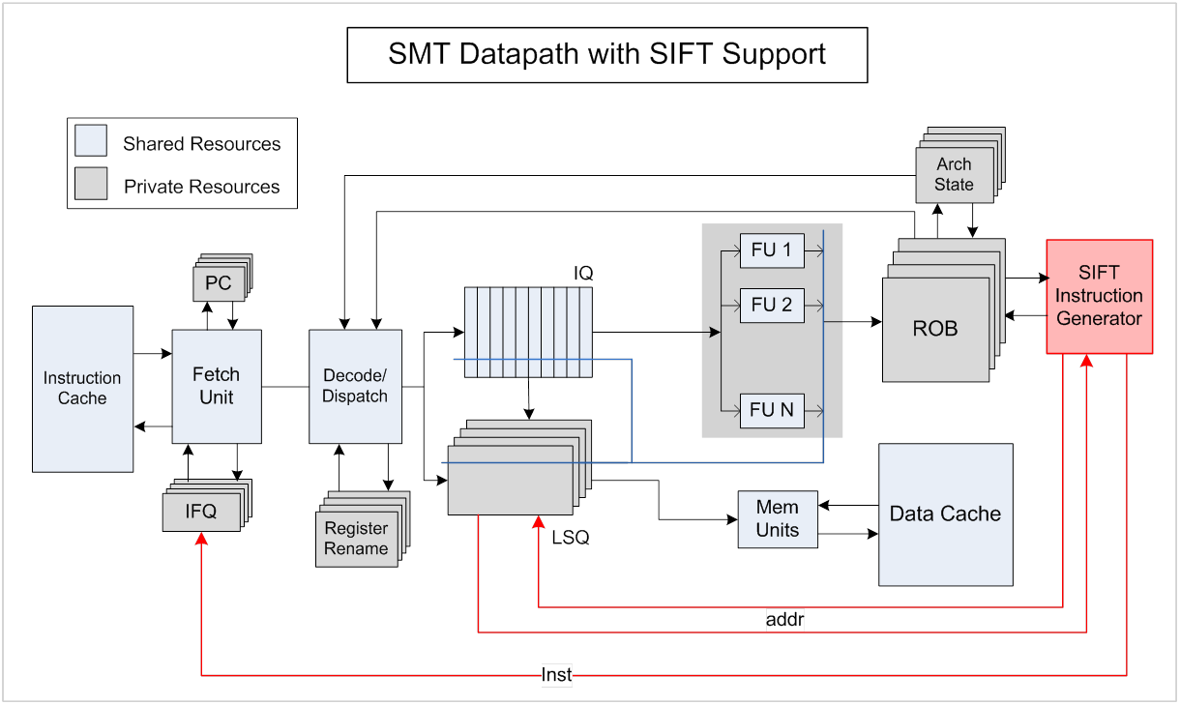
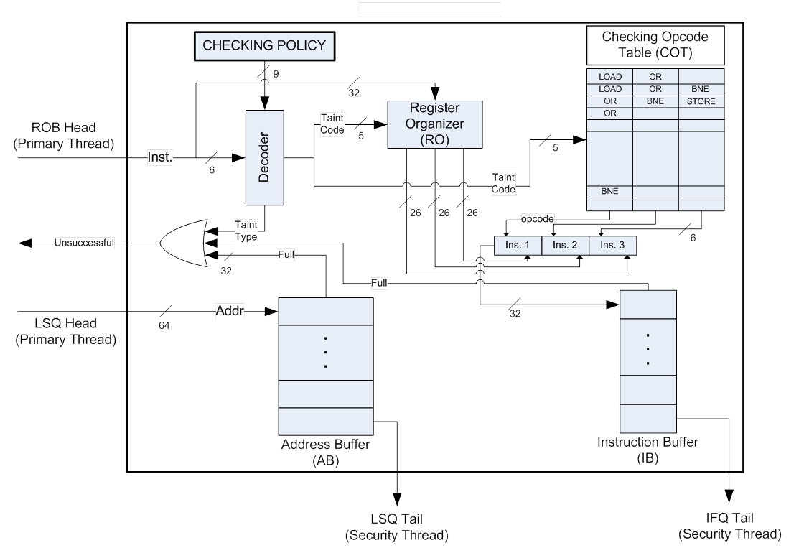
SIFT Instruction Generation Logic
2. Secutiry Instruction Opcodes are read from COT
1. Taint Code Generation
3. Rest of the instructions are taken from Register Organizer and stored Instruction Buffer
4. Load and Store Instruction’s memory addresses are stored in Address Buffer

Slide 43
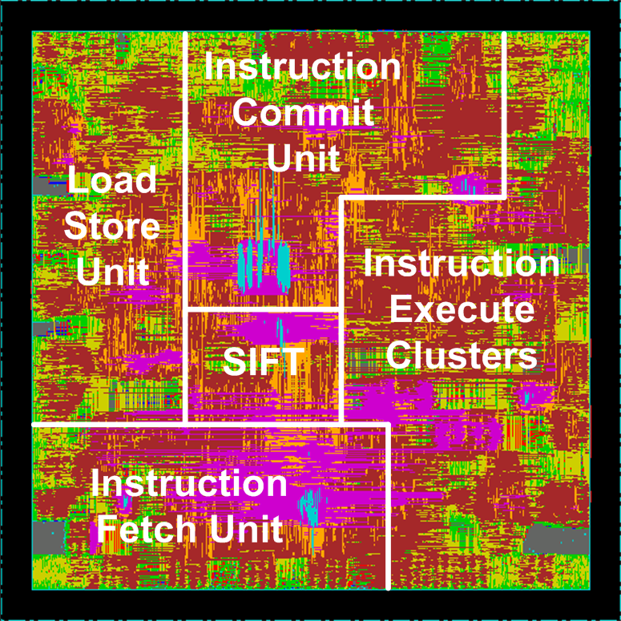
Die Floorplan with SIFT Logic
SUN T1 Open Source Core
IGL synthesized using Synopsys Design Compiler using a TSMC 90nm standard cell library
COT, IB and AB implemented using Cadence Virtuoso
The integrated processor netlist placed and routed using Cadence SoC Encounter
Cost 4.5% of whole processor area

Slide 44
Benefits of Taint Checking with SMT
Software is not involved, transparent to user and applications (although the checking code can also be generated in software)
Hardware instruction generation is faster than software generation
Additional hardware is at the back end of the pipeline, it is not on the critical path
No inter-core communication

Slide 45
Number of Security Instructions per Primary Thread Instruction

Slide 46
SIFT Performance Overhead

Slide 47
SIFT Performance Optimizations
Reduce the number of checking instructions by eliminating the ones that never change the taint state.
Reduce data dependencies in the checker by preloading taint values into its cache once the main program encounters the corresponding address
Reduce the number of security instructions depending on taint state of registers and TLB

Slide 48
Eliminating Checking Instructions
Primary Thread
SIFT Security Thread
SIFT – F Security Thread
lda r0,24176(r0)
xor r9,3,r2
addq r0,r9,r0
ldah r16,8191(r29)
ldq_u r1,0(r0)
lda r16,-26816(r16)
lda r0,1(r0)
lda r18,8(r16)
extqh r1,r0,r1
sra r1,56,r10
bne r2,0x14
and r9,255,r9
stl r3,32(r30)
ldl r2,64(r2)
lda r16,48(r30)
bic r2,255,r2
bis r3,r2,r2
bis r0,r0,r0
bis r9,r9,r2
bis r0,r9,r0
bis r29,r29,r16
ldq_u r1,0(r0)
bis r1,r0,r1
bne r1,0xfffffffffffff080
bis r16,r16,r16
bis r0,r0,r0
bis r16,r16,r18
bis r1,r0,r1
bis r1,r1,r10
bne r2,0xfffffffffffff080
bis r9,r9,r9
bis r3,r30,r3
bne r3,0xfffffffffffff080
stl r3,32(r30)
ldl r2,64(r2)
bis r2,r2,r2
bne r2,0xfffffffffffff080
bis r30,r30,r16
bis r2,r2,r2
bis r3,r2,r2
bis r9,r9,r2
bis r0,r9,r0
bis r29,r29,r16
ldq_u r1,0(r0)
bis r1,r0,r1
bne r1,0xfffffffffffff080
bis r16,r16,r18
bis r1,r0,r1
bis r1,r1,r10
bne r2,0xfffffffffffff080
bis r3,r30,r3
bne r3,0xfffffffffffff080
stl r3,32(r30)
ldl r2,64(r30)
bne r2,0xfffffffffffff080
bis r30,r30,r16
bis r3,r2,r2

Slide 49
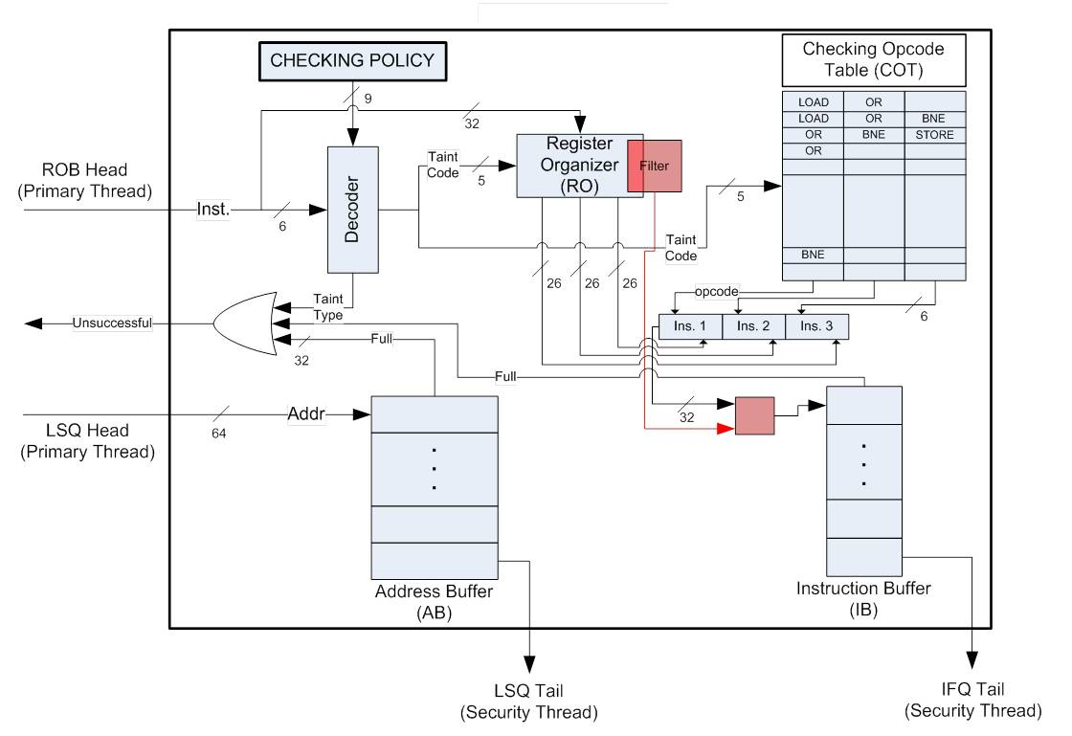
SIFT Logic with Instruction Elimination

Slide 50
Performance Impact of Eliminating Security Instructions

Slide 51
Performance Impact of Cache Prefetching

Slide 52
SIFT Performance on a 8-way Issue Processor

Slide 53
Performance Effect of ISA Support

Slide 54
Performance Effect of Cache Sharing

Slide 55
SIFT-FP with Different Policies
Policy 1 – No Checking only propagation
Policy 2 – Jump Targets, Return Address, Stack Pointer
Policy 3 – Jump Targets, Branch Conditions, System Call Arguments, Memory data and address

Slide 56
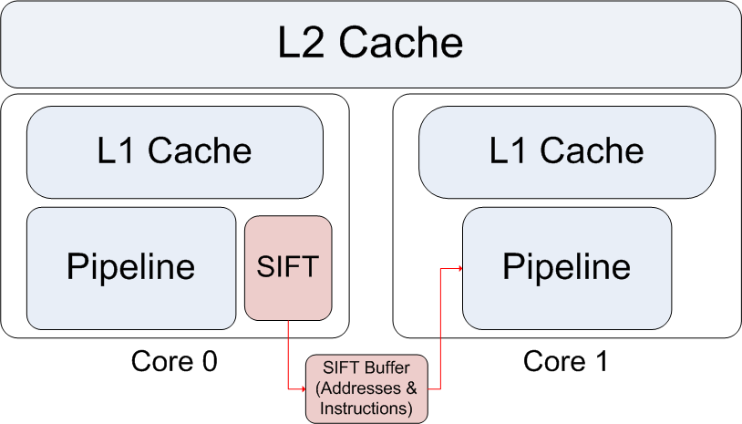
Multicore SIFT

Slide 57
Multicore SIFT Performance

Slide 58
MSIFT with Different Buffer Sizes

Slide 59
Multicore SIFT with Perfect Cache

Slide 60
Discussion
Collapse multiple checking instructions via ISA?
Optimize resource sharing between two threads?
Provide additional execution units for the checker?
Using memory page granularity taint?

Slide 61
General RM Hardware support
Is this a good idea?
What are the benefits
What would it look like? Parallel checking model? Custom Hardware?
How do you retask it for different reference monitors?
Can we benefit from both software optimizations and hardware acceleration?

