Slide 1
Trusted Computing Architecture
Using presentation material from Dan Boneh, Stanford and Eran Tromer

Slide 2
Isolation: summary
Many sandboxing techniques:
  Physical air gap, Virtual air gap (VMMs),
  System call interposition, Software Fault isolation
  Application specific (e.g. Javascript in browser)
Often complete isolation is inappropriate
  Apps need to communicate through regulated interfaces
Hard aspects of sandboxing:
  Specifying policy: what can apps do and not do
  Preventing covert channels

Slide 3
Isolation from OS/VMM harder
Blue pill: originating from BIOS
  Below OS/Hypervisor
Hard to protect if compromise from below
  e.g., if we use permissions or SFI, the OS can simply change them
  Need to root isolation outside the OS
    But, need to be able to let the OS do its job
Conflation of resource management and security role of the OS

Slide 4
Background
TCG consortium. Founded in 1999 as TCPA.
  Main players (promoters): (>200 members)
  AMD, HP, IBM, Infineon, Intel,
  Lenovo, Microsoft, Sun
Goals:
  Hardware protected (encrypted) storage:
    Only “authorized” software can decrypt data
    e.g.: protecting key for decrypting file system
  Secure boot: method to “authorize” software
  Attestation: Prove to remote server what software is running on my machine.

Slide 5
Secure boot
History of BIOS/EFI malware:
  CIH (1998): CIH virus corrupts system BIOS
  Heasman (2007):
    System Management Mode (SMM) “rootkit” via EFI
  Sacco, Ortega (2009): infect BIOS LZH decompressor
    CoreBOOT: generic BIOS flashing tool
Main point: BIOS runs before any defenses (e.g. antivirus)
Proposed defense: lock system configuration (BIOS + OS)
Today: TCG approach
Notes:
SMM: runs privileged code with no interrupts, not even from OS

Slide 6
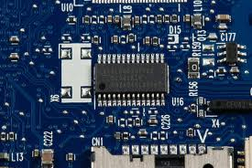
TCG: changes to PC
Extra hardware: TPM
  Trusted Platform Module (TPM) chip
    Single 33MhZ clock.
    Vendors: Atmel, Infineon, National, STMicro, …
    Cost: <$0.3
  Integrated into other chips
    Ethernet controller (Broadcom)
    CPU’s chipset (Intel)
Software changes:
  BIOS, EFI (UEFI)
  OS and Apps
Notes:
7$ for TPM from National Semiconductors (per 1000 units)
Broadcom Ethernet controller with integrated TPM: https://www.broadcom.com/press/release.php?id=700509

Slide 7
TPMs in the real world
TPMs widely available on laptops, desktops
and some servers
Software using TPMs:
  File/disk encryption: BitLocker, IBM, HP, Softex
  Attestation for enterprise login: Cognizance, Wave
  Client-side single sign on: IBM, Utimaco, Wave

Slide 8
TPM Basics
  What the TPM does
  How to use it

Slide 9
Components on TPM chip
Non Volatile
Storage
(> 1280 bytes)
Other
Junk
PCR Registers
(≥16 registers)
LPC
bus
I/O
API calls
Crypto Engine:
RSA, SHA-1, HMAC, RNG
RSA: 1024, 2048 bit modulus
SHA-1: Outputs 20 byte digest

Slide 10
Non-volatile storage
1. Endorsement Key (EK) (2048-bit RSA)
  Created at manufacturing time. Cannot be changed.
  Used for “attestation” (described later)
2. Storage Root Key (SRK) (2048-bit RSA)
  Used for implementing encrypted storage
  Created after running
TPM_TakeOwnership( OwnerPassword, … )
  Can be cleared later with TPM_ForceClear from BIOS
3. OwnerPassword (160 bits) and persistent flags
Private EK, SRK, and OwnerPwd never leave the TPM
Notes:
TPM_ForceClear requires “proof of presence,” namely holding down the Fn key

Slide 11
PCR: the heart of the matter
PCR: Platform Configuration Registers
  Lots of PCR registers on chip (at least 16)
  Register contents: 20-byte SHA-1 digest (+junk)
Updating PCR #n :
  TPM_Extend(n,D): PCR[n] ← SHA-1 ( PCR[n] || D )
  TPM_PcrRead(n): returns value(PCR(n))
PCRs initialized to default value (e.g. 0) at boot time
  TPM can be told to restore PCR values in NVRAM via
  TPM_SaveState and TPM_Startup(ST_STATE)
  for system suspend/resume
Notes:
TPM_SaveState stores PCR values in NV-RAM

Slide 12
Using PCRs: the TCG boot process
BIOS boot block executes
  Calls TPM_Startup (ST_CLEAR) to initialize PCRs to 0
  Calls PCR_Extend( n, <BIOS code> )
  Then loads and runs BIOS post boot code
BIOS executes:
  Calls PCR_Extend( n, <MBR code> )
  Then runs MBR (master boot record), e.g. GRUB.
MBR executes:
  Calls PCR_Extend( n, <OS loader code, config> )
  Then runs OS loader
  … and so on
Notes:
0. During boot TPM receives a TPM_Init signal from LPC bus
1. TMP_Startup: does one of three things: (1) deactivates TPM, (2) resets PCRs, or
(3) restores PCR values from data created with TPM_SaveState --- used for resume
2. TPM_Startup can only be called once after power-up (sets postInitialise flag to True)
3. Note: MBR is GRUB Stage 1

Slide 13
In a diagram
Hardware
BIOS
boot
block
OS
loader
BIOS
MBR
OS
Application
Root of trust in integrity measurement
measuring
TPM
Extend PCR
Root of trust in integrity reporting
After boot, PCRs contain hash chain of booted software
Collision resistance of SHA-1 ensures commitment
Notes:
Single PCR can identify entire platform

Slide 14
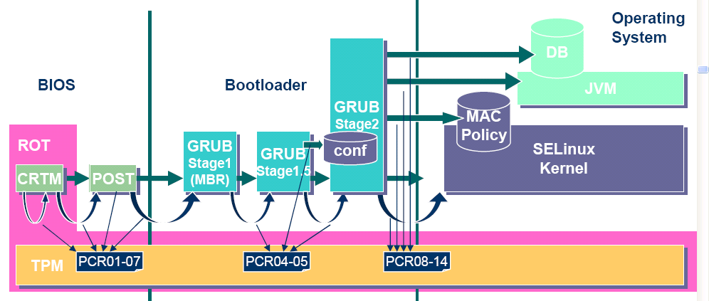
Example: Trusted GRUB (IBM’05)
What PCR # to use and what to measure specified
in GRUB config file

Slide 15
Using PCR values after boot
Application 1: encrypted (a.k.a sealed) storage.
Step 1: TPM_TakeOwnership( OwnerPassword, … )
  Creates 2048-bit RSA Storage Root Key (SRK) on TPM
  Cannot run TPM_TakeOwnership again without OwnerPwd:
    Ownership Enabled Flag ← False
  Done once by IT department or laptop owner.
(optional) Step 2: TPM_CreateWrapKey / TPM_LoadKey
  Create more RSA keys on TPM protected by SRK
  Each key identified by 32-bit keyhandle
Notes:
OwnerPassword can later be used to change owner and remove SRK
SRK key handle ID is 0x40000000

Slide 16
Protected Storage
Main Step: Encrypt data using RSA key on TPM
  TPM_Seal (some) Arguments:
    keyhandle: which TPM key to encrypt with
    KeyAuth: Password for using key `keyhandle’
    PcrValues: PCRs to embed in encrypted blob
    data block: at most 256 bytes (2048 bits)
      Used to encrypt symmetric key (e.g. AES)
  Returns encrypted blob.
Main point: blob can only be decrypted with TPM_Unseal when PCR-reg-vals = PCR-vals in blob.
  TPM_Unseal will fail othrewise
Notes:
TPM_Seal: allows to specify arbitrary PCR values for unseal.

Slide 17
Protected Storage
Embedding PCR values in blob ensures that only
certain apps on certain platform configuration can decrypt data.
  e.g.: Messing with MBR or OS kernel will
  change PCR values.

Slide 18
Sealed storage: applications
Lock software on machine:
  OS and apps sealed with MBR’s PCR.
  Any changes to MBR (to load other OS) will prevent locked software from loading.
  Prevents tampering and reverse engineering
Web server: seal server’s SSL private key
  Goal: only unmodified Apache can access SSL key
  Problem: updates to Apache or Apache config
General problem with software upgrades/patches:
Upgrade process must re-seal all blobs with new PCRs

Slide 19
Security?
Resetting TPM after boot
  Attacker can disable TPM until after boot, then extend PCRs arbitrarily
  (one-byte change to boot block) [Kauer 07]
  Software attack: send TPM_Init on LPC bus allows calling TPM_Startup again (to reset PCRs)
  Simple hardware attack: use a wire to connect TPM reset pin to ground
  Once PCRs are reset, they can be extended to reflect a fake configuration.
Rollback attack on encrypted blobs
  e.g. undo security patches without being noticed.
  Can be mitigated using Data Integrity Regs (DIR)
    Need OwnerPassword to write DIR
Notes:
K’07: Kauer, Usenix Security 2007.
Need owner password to write to DIR. Anyone can read DIR. Stored in NV RAM.

Slide 20
Attestation
Goal: prove to remote party what software is
running on my machine.
Good applications:
  Bank allows money transfer only if customer’s machine runs “up-to-date” OS patches.
  Enterprise allows laptop to connect to its network only if laptop runs “authorized” software
  Quake players can join a Quake network only if their Quake client is unmodified.
DRM:
  MusicStore sells content for authorized players only.

Slide 21
Attestation: how it works
Recall: EK private key on TPM.
  Cert for EK public-key issued by TPM vendor.
Step 1: Create Attestation Identity Key (AIK)
  Involves interaction with a trusted remote issuer to verify EK
  Generated:
  AIK private+public keys, and a certificate signed by issuer
Notes:
TPM can store multiple AIKs (for multiple identities)

Slide 22
Attestation: how it works
Step 2: sign PCR values (after boot)
  Call TPM_Quote (some) Arguments:
    keyhandle: which AIK key to sign with
    KeyAuth: Password for using key `keyhandle’
    PCR List: Which PCRs to sign.
    Challenge: 20-byte challenge from remote server
      Prevents replay of old signatures.
    Userdata: additional data to include in sig.
  Returns signed data and signature.
Notes:
TPM_Quote actually doesn’t take usedata argument. Instead one could do chal = Hash(chal,user-data)

Slide 23
Using attestation
(to establish an SSL tunnel)
Attestation Request (20-byte challenge)
Generate pub/priv key pair
TPM_Quote(AIK, PcrList, chal, pub-key)
Send pub-key and certs
App
Validate:
Certs
PCR vals
Challenge
(SSL) Key Exchange using Cert
OS
Communicate with app using SSL tunnel
TPM
PC
Remote
Server
Attestation must include key-exchange
App must be isolated from rest of system
Notes:
Focus on interactive applications such as Quake and network access control.
For non interactive applications (e.g. music distribution) there is no need for an SSL key exchange since pub-key is quoted.

Slide 24
Better root of trust: “late launch”
Late launch: securely load OS/VMM,
even on a potentially-compromised machine
DRTM – Dynamic Root of Trust Measurement
New CPU instruction:
Intel TXT: SENTER AMD: SKINIT
Atomically does:
  Reset CPU. Reset PCR 17 to 0.
  Load given Secure Loader (SL) code into I-cache
  Extend PCR 17 with SL
  Jump to SL
BIOS boot loader is no longer root of trust
Avoids TPM_Init attack: TPM_Init sets PCR 17 to -1

Slide 25
Trusting the CPU?
Trust the vendor?
System Management Mode (SMM)
  Special execution mode with protected memory, “below” OS and hypervisor
  Survives TXT launch, so compromised BIOS could load a malicious SMM that circumvents TXT.
Intel Management Engine (ME)
  A microcontroller embedded in the processor, “next to” the OS and hypervisor
  Independent of OS security policy.
  Applications: originally, remote administration. Nowadays: EPID (chip-specific keys), Boot Guard (checks signature on boot code), Protected Audio and Video Path, SGX (secure enclaves)
  Trustworthy?
    ME includes its own, potentially vulnerable, custom OS and apps.
    No public documentation of implementation and logic.
    Could be used as an ideal rootkit / trojan horse.
Notes:
Today ME infrastructure runs: PTT (ME-implemented TPM), EPID (ME-rooted
chain of trust for remote attestation), Boot Guard, Protected Audio and Video
Path (PAVP), and SGX.

Slide 26
Security?
Resetting TPM after boot
  Attacker can disable TPM until after boot, then extend PCRs arbitrarily
  (one-byte change to boot block) [Kauer 07]
  Software attack: send TPM_Init on LPC bus allows calling TPM_Startup again (to reset PCRs)
  Simple hardware attack: use a wire to connect TPM reset pin to ground
  Once PCRs are reset, they can be extended to reflect a fake configuration.
Rollback attack on encrypted blobs
  undo security patches
Large trusted base
  Long, complex and potentially vulnerable chain of trust:
  OEM’s drivers, vendor’s peripherals, OS’s vendors.
Notes:
Klauser 07: Kauer, Usenix Security 2007.
Need owner password to write to DIR. Anyone can read DIR. Stored in NV RAM.

Slide 27
Protecting code on an untrusted platform
Can we run sensitive code on a potentially-compromised platform, without rebooting/replacing it?
  Many ways to read and corrupt code!
Secure “enclave” using CPU hardware
  Possible with SENTER/SKINIT but cumbersome (Flicker project)
  Intel Software Guard Extensions (SGX)
  (discussed later)
  ARM TrustZone
Cryptography
  Fully-homomorphic encryption
  Succinct zero-knowledge proofs (SNARKs) and Proof-Carrying Data

Slide 28
SGX
Using presentation material from Intel.

Slide 29
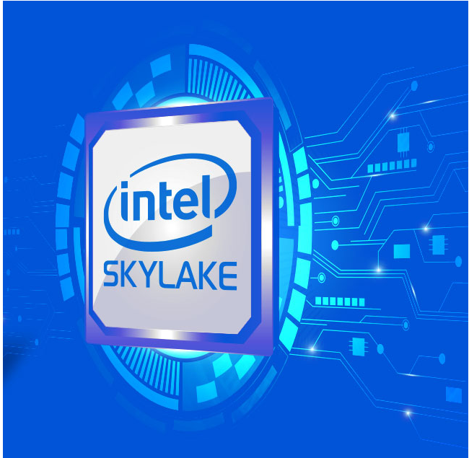
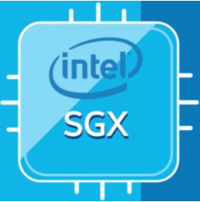
Some slides are courtesy of intel©

Slide 30
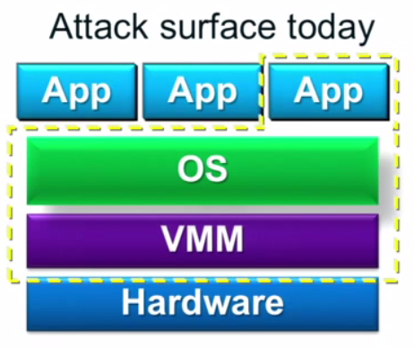
Why SGX?
Software security on commercial CPUs is pursued for many years
SW solutions have limited potential.
Closed HW systems have limited functionality.
Traditional TPMs have large TCB – commonly measure all platform.
TXT overcame some of these by introducing a Dynamic Root of Trust:
Dedicated TCB “mini OS”.
Run only sensitive logic in trusted OS.
Thus, needs to measure only mini OS and sensitive logic app.
But TXT still:
Halts main OS, restarts mini-OS and clears CPU.
Doesn’t support continuous run of trusted and
untrusted apps.
Cumbersome to develop for.
Large TCB - lots of potentially vulnerable SW.
Numerous vulnerabilities - Most Hazardous:
Compromised BIOS can load a malicious SMM that survives TXT launch.
Notes:
A usability wise, TPM shortcoming:
Attesting server, must always know the right PCR values for the platform - according to OS patch updates (for example).
answer was TXT.

Slide 31
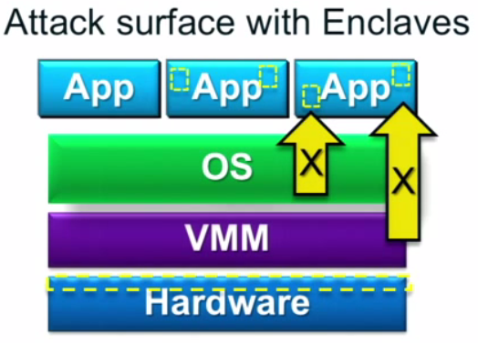
Why SGX?
SGX introduces the ENCALVE:
A protected TEE (Trusted Execution Environment) container.
Shrinks TCB (Trusted Computing Base) to HW and sensitive app logic.
Extends HW TCB on to enclaves in ring-3.
Runs TEE under untrusted OS or VMM.
Supports continuous run of:
  Trusted and untrusted apps.
  Multiple enclaves.
  Multi-threaded enclave.
While maintaining application Integrity and confidentiality.
Notes:
Developers may focus on securing the smaller TCB
Applications run within OS environment
Dev. & Debugged with familiar tools
SMM - System Management Mode
VMM - Virtual Machine Manager

Slide 32
How?
  Dedicated HW
  18 new ISA instructions
  Internal FW data structures
  Tailored cryptographic functions
  Suitable protocols

Slide 33
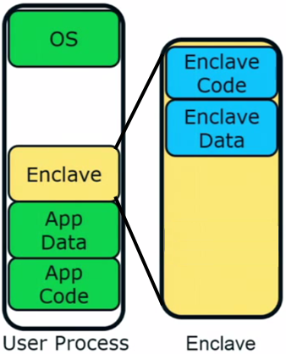
The Enclave – A trusted execution environment embedded in a process
Is part of the application & has full access
to its memory.
Measured and verified by HW on load.
Operation visible only within CPU borders.
Manageable by the OS, e.g:
  CPU time slots
  Paging and memory policy
Secrets are provisioned or acquired only
after enclave initialization.

Slide 34
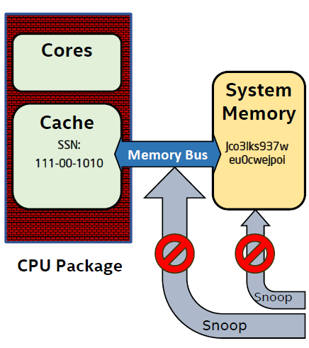
Security Perimeter
Security perimeter is the CPU package boundary.
Data and code unencrypted inside CPU package.
Data and code outside CPU is encrypted and integrity checked.
Single chip TCB avoids inter-chip HW attacks that threaten TPMs.
If the single TCB is the CPU, then
we gain the opportunity for richer semantics by understanding platform state & app code.
MEE
* MME – Memory Management Engine, elaborated shortly.
Notes:
External memory reads and bus snoops see only encrypted data.

Slide 35
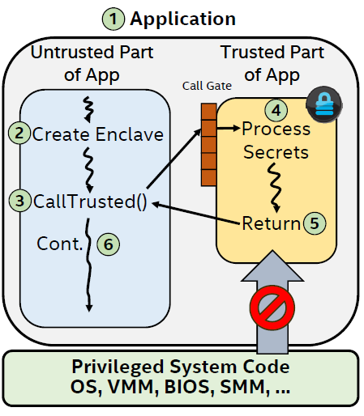
Execution Flow
Enclavize sensitive App parts defines
a partition to trusted and untrusted.
2. App runs & creates enclave in
trusted memory.
3. Trusted function transitions flow to
the enclave.
4. Enclave sees all process data, but
external access to enclave is denied.
5. Trusted function returns.
6. App continues normal execution.

Slide 36




Motivation – Some Usage Examples:
Cloud - Assure customers about the security standard of the “cloud enclave”. Confidential, also from vendors with physical access.
HSM - Implement HSM’s functionality and security such that existing software that supports HSMs can be adapted to using SGX instead.
DRM – On-line content provider that provides content only to authorized players hosting a trusted player enclave.
TOR - A node that could prove to users that it is not backdoored by its own admin and does not keep a log of how connections were routed.
36
Notes:
OS usage - Win10 will enclave LSSAS (no more Mimikatz)
Win10 is the first to support SGX.

Slide 37
Enclave Life Cycle
Virtual Address Space
Physical Address Space

Slide 38
Enclave Life Cycle
Virtual Address Space
Physical Address Space
BIOS setup
System Memory
EPCM
Enclave Page Cache
Invalid
Invalid
Invalid
Invalid Invalid
BIOS reserves memory address range for SGX use.

Slide 39
Enclave Life Cycle
Virtual Address Space
Physical Address Space
Enclave creation
Plaintext Code/Data
Code/Data
System Memory
Enclave
EPCM
Invalid
SECS
Valid, SECS, Range
ECREATE (Range(
Metadata
Enclave
Invalid
Invalid
Page
Cache
Invalid
Invalid
ECREATE - Stores enclave attributes (mode of operation, debug, etc.) in metadata.
Notes:
Metadata page = SECS page

Slide 40
Enclave Life Cycle
Virtual Address Space
Physical Address Space
Enclave creation
Plaintext Code/Data
Code/Data
System Memory
Copy page
Enclave
EPCM
Invalid
SECS
Valid, SECS, Range
ECREATE (Range)
EADD (Copy Page)
Metadata
Invalid
Invalid
Plaintext Coe/Data
Valid, REG,
LA,→SECS
Invalid
EADD – Commits new pages to enclave & updates security metadata.

Slide 41
Enclave Life Cycle
Virtual Address Space
Physical Address Space
Enclave creation
Plaintext Code/Data
Code/Data
System Memory
Enclave
EPCM
Invalid
SECS
Valid, SECS, Range
ECREATE (Range)
EADD (Copy Page)
Metadata
Invalid
Invalid
Plaintext Coe/Data
Valid, REG,
LA,→SECS
Invalid
EADD – Commits code, data or SGX control structure page types.

Slide 42
Enclave Life Cycle
Virtual Address Space
Physical Address Space
Enclave creation
Plaintext Code/Data
Code/Data
System Memory
Enclave
Update PTE
EPCM
Invalid
SECS
Valid, SECS, Range
Metadata
Invalid
ECREATE (Range)
EADD (Copy Page)
Invalid
Plaintext Coe/Data
Valid, REG,
LA,→SECS
Invalid

Slide 43
Enclave Life Cycle
Virtual Address Space
Physical Address Space
Enclave creation
Plaintext Code/Data
Code/Data
System Memory
Enclave
Code/Data
Update PTE
EPCM
Invalid
Metadata
Valid, SECS, Range
Invalid
Valid, REG, LA,→SECS
Valid, REG, LA,→SECS
Invalid
ECREATE (Range)
EADD (Copy Page)
Plaintext
Code/Data Plaintext Code/Data

Slide 44
Enclave Life Cycle
Virtual Address Space
Physical Address Space
Enclave creation
Plaintext Code/Data
Code/Data
System Memory
Enclave
Code/Data
Update PTE
EPCM
Invalid
Metadata
Valid, SECS, Range
Invalid
Valid, REG, LA,→SECS
Valid, REG, LA,→SECS
Invalid
ECREATE (Range)
EADD (Copy Page)
EEXTEND
Plaintext
Code/Data Plaintext Code/Data
EEXTEND - Measures the enclave with SHA256. (detailed shortly)

Slide 45
Enclave Life Cycle
Virtual Address Space
Physical Address Space
Enclave initialization
System Memory
Code/Data
Code/Data
Code/Data
Enclave
Code/Data
Code/Data
EPCM
Invalid
SECS
Valid, SECS, Range
Invalid
Valid, REG, LA,→SECS
Valid, REG, LA,→SECS
Invalid
Metadata
ECREATE (Range)
EADD (Copy Page)
EEXTEND
EINIT
Plaintext
Plaintext
Code/Data
Code/Data
Plaintext
Code/Data
Plaintext
Code/Data
EINIT - Finalizes measurements, validates them & enables enclave’s entry use.

Slide 46
Enclave Life Cycle
Virtual Address Space
Physical Address Space
Enclave active
System Memory
Code/Data
Code/Data
Code/Data
Enclave
Code/Data
Code/Data
EPCM
Invalid
SECS
Valid, SECS, Range
Invalid
Valid, REG, LA,→SECS
Valid, REG, LA,→SECS
Invalid
Metadata
ECREATE (Range)
EADD (Copy Page)
EEXTEND
EINIT
EENTER
Plaintext
Plaintext
Code/Data
Code/Data
Plaintext
Code/Data
Plaintext
Code/Data
EENTER - Verifies enclave entry & sets CPU operation mode to “enclave mode”.

Slide 47
Enclave Life Cycle
Virtual Address Space
Physical Address Space
Enclave active
System Memory
Code/Data
Code/Data
Code/Data
Enclave
Code/Data
Code/Data
EPCM
Invalid
SECS
Valid, SECS, Range
Invalid
Valid, REG, LA,→SECS
Valid, REG, LA,→SECS
Invalid
Metadata
ECREATE (Range)
EADD (Copy Page)
EEXTEND
EINIT
EENTER
Plaintext
Plaintext
Code/Data
Code/Data
Plaintext
Code/Data
Plaintext
Code/Data
Enclave flow is executed using the secured address range, obscured from all other SW.
Notes:
The entire ENCLAVE should appear as a ‘giant instruction’ to the debugger
(if the enclave is not in debug mode)

Slide 48
Enclave Life Cycle
Virtual Address Space
Physical Address Space
Enclave active
System Memory
Code/Data
Code/Data
Code/Data
Enclave
Code/Data
Code/Data
EPCM
Invalid
SECS
Valid, SECS, Range
Invalid
Valid, REG, LA,→SECS
Valid, REG, LA,→SECS
Invalid
Metadata
ECREATE (Range)
EADD (Copy Page)
EEXTEND
EINIT
EENTER
EEXIT
Plaintext
Plaintext
Code/Data
Code/Data
Plaintext
Code/Data
Plaintext
Code/Data
EEXIT – Clears CPU cache & Jumps out of enclave back to OS instruction address.
Notes:
CPU cache – includes: TLB, different SRAM caches, CPU registers, etc..

Slide 49
Enclave Life Cycle
Virtual Address Space
Physical Address Space
Enclave destruction
System Memory
Enclave
EPCM
SECS
Invalid
SECS
ECREATE (Range)
EADD (Copy Page)
EEXTEND
EINIT
EENTER
EEXIT
EREMOVE
Enclave
Invalid
Invalid
Page
Cache
Invalid
Invalid
EREMOVE – Clears enclave’s trusted virtual address range reserved by ECREATE.

Slide 50
Enclave Life Cycle
Virtual Address Space
Physical Address Space
BIOS setup
System Memory
EPCM
Enclave Page Cache
Invalid
Invalid
Invalid
Invalid Invalid

Slide 51
Making use of SGX Enclave
Independent software vendor (ISV) enclave development process.
Identify sensitive parts of application.
Move sensitive logic to enclave project and compile.
  Multi-threaded enclave is supported by creating multiple TCS EPC entries.
Create accompanying enclave certificate (SIGSTRUCT)
  Measure enclave content using SHA-256
  Specify attributes
  Set ISV information
    Product ID
    Security version number – SVN
  Sign with ISV private key.
An enclave is in the clear before instantiation
  Sections of code and data could be encrypted, but their decryption key can’t be pre-installed.
  Secrets come from outside the enclave after it satisfies 3rd part’s trust.
  Subsequent runs use provisioned secrets again.

Slide 52
Enclave creation process
Loads enclave binary into the EPC and establishes identity.
ECREATE
  Finds a free EPC page and makes it the Enclaves SECS
  Stores enclave initial attributes (mode of operation, debug, etc.)
EADD
  Commits information (REG) or TCS as a new enclave EPC entry pages (4KB at a time)
  Creates and updates associated EPCM entry.
EEXTEND
  Measures 256Byte of info. into CryptoLog (thus runs 16 times to measure one page).
EINIT - ensures only measured code has enclave access!
  Gets as input: SIGSTRUCT, EINITTOKEN
    EINITTOKEN is generated using this CPU's Launch key, and contains: MRENCLAVE, MRSIGNER & ATTRIBUTES.
    (These values must match the corresponding values in the SECS)
  Verifies and creates enclave identities:
    Finalizes measurements for MRENCLAVE.
    Validates SIGSTRUCT with enclosed public key
    Uses ISV’s signed SIGSTRUCT to validate MESIGNER and MRENCALVE.
    Checks that no Intel-only bits are set in SIGSTRUCT.ATTRIBUTES unless SIGSTRUCT was signed by Intel.
    Stores these and some other attributes in enclave’s SECS.
  Enables enclave entry (mark as ready to be used)

Slide 53
Enclave Entry and Exit execution
CPU flow control under enclave mode
EENTER
  Gets enclave TCS address as parameter
  Verifies validity of enclave entry point
  Check that TCS is not busy and marked it as “BUSY”.
  Clears any translation remainder in cache (TLS)
  Sets Asynchronous Exit Pointer (AEP) parameter
  Change CPU mode of operation to “enclave mode”.
  If not debug, set HW so the enclave appears as a single instruction.
ERESUME
  AEP will mostly hold the ERESUME inst. address.
EEXIT
  Clear any translation remainder in cache (TLB)
  TCS is marked as “FREE”
  Jumps out of enclave flow back to OS instruction address (stored in RBX)
  Enclave developer is responsible for clearing registers state.

Slide 54
Handling enclave exceptions
AEX – Asynchronous Exit
  Caused by interrupt, exception or fault
  SGX reacts before the OS fault handler takes control.
  All secrets and execution state are stored in enclave’s active SSA frame and replaced to prevent enclave leakage.
  CPU registers are scrapped
  After OS fault treatment, flow will jump to AEP.
SSA – State Save Area entry
  Each TCS maintains a stack of SSA frames
  The SSA frame is pre-defined by the ISV for that thread.

Slide 55










Enclave Measurement
When building an enclave, Intel® SGX generates a cryptographic log of all the build activities
Content: Code, Data, Stack, Heap
Location of each page within the enclave
Security flags being used
Order in which it was built
MRENCLAVE (“Enclave Identity”) is a 256-bit digest of the log
Represents the enclave’s software TCB
Data Chunk1
Chunk 1 MetaData
Data Chunk 2
Chunk 2 MetaData
Data Chunk n
Chunk n MetaData
SHA-256
SHA-256
SHA-256
MRENCLAVE
MRENCLAVE¹
MRENCLAVE²
MRENCLAVE^{n}
Notes:
Resembles TPM digest, where MRENCLAVE^n = PCR_value after extending it with data input.

Slide 56
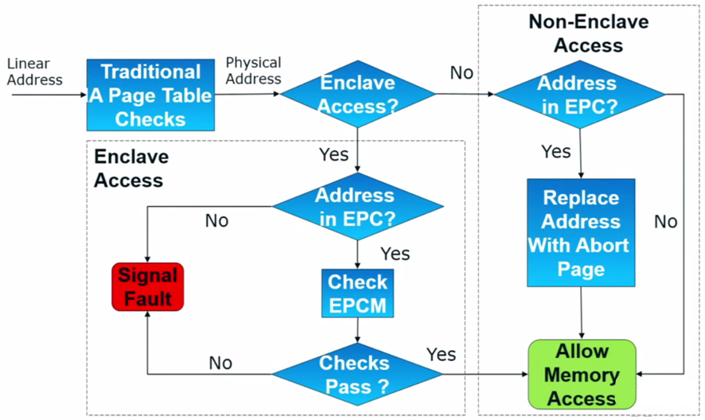
Execution Flow – Access Control

Slide 57
Memory Encryption Engine (MEE)
Resides within the CPU as a Memory Controller extension.
Encrypts, decrypts page swaps and integrity checks them
thus, providing data confidentiality and integrity.
TRNG generates at boot time separate keys for encryption and integrity.
Keys are held in MEE registers, accessible only to HW.
Does not hide the fact that data is written to the DRAM , when it is written, and to which physical address.
Defends system memory from cold boot attacks.
Uses version and counter controls to prevent page replay attack.
Problem – A lot of metadata stored in CPU…

Slide 58
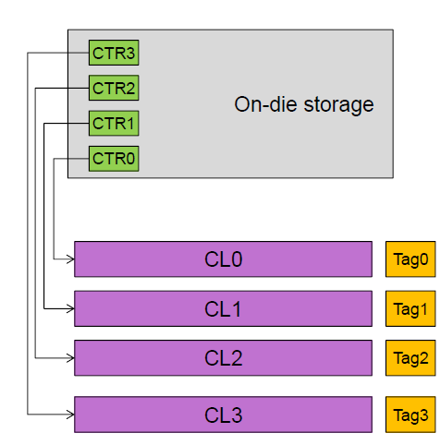
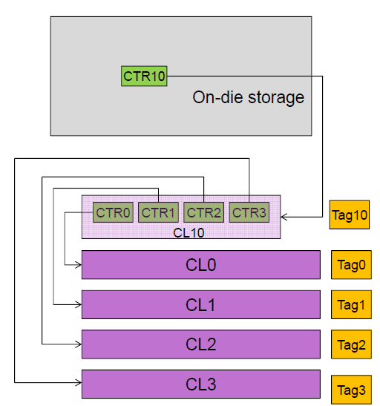
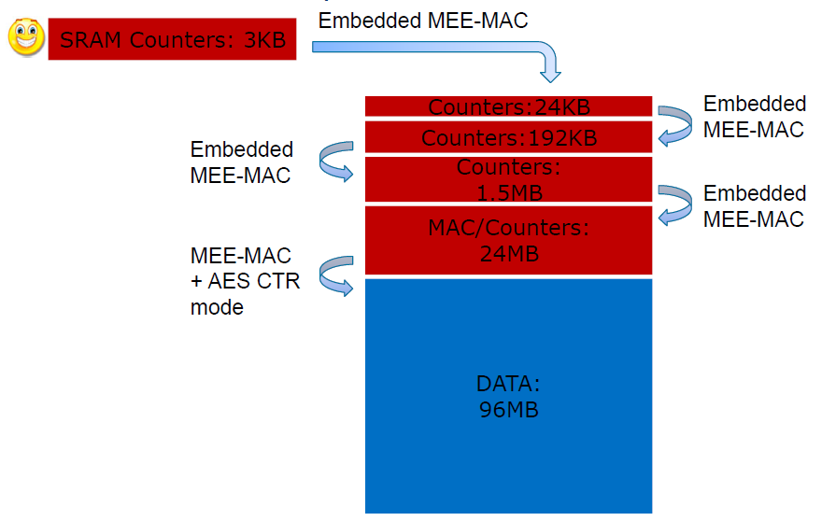
SGX Anti replay attack under HW limitations
Uses version and counter controls to prevent page replay attack.
Keeping this metadata for every evicted page is not scalable in SRAM terms.
How can we “compress” this?
Can be implemented as a merkle-tree.

Slide 59
Halfway recap
Enclave properties as a TEE
SGX Security Perimeter
lifecycle and execution flow
Enclave Measurement
Memory Encryption Engine
Sealing
Attestation
Provisioning
Overview summery
SGX usages
Q&A and open discussion

Slide 60
Sealing
Definition: Cryptographically protecting data when it is stored outside enclave.
Sealing enables enclave to pass data between consecutive runs.
Future enclave instantiation can acquire former provisioned sensitive data.
  (Enclave shouldn’t ship with sensitive data, but be
  provisioned with it after instantiation.)
Newer SVN (security version number) enclave can read older SVN data using a Key Recovery Transformation.
Notes:
:Key Recovery Transformation
Initial key = Choose “key” func form PRF family > F
Derivation String = Output F(“const”)
Derived Key = F(“const”) output, which given no clue about what F was chosen.

Slide 61





Sealing Actors
Sealing Authority – Developer
Enclave ISV that Signs the enclave certificate with its RSA-3072 Private key.
SIGSTRUCT - Enclave certificate.
Sealing Authority Public key (Used by HW to verify Certificate).
Enclave identity aka MRENCLAVE (Used by HW to verify enclave Integrity).
ISV SVN
Other enclave attributes.
Sealing Authority signature
MRSIGNER - Sealing Identity.
Created on enclave initialization.
Accessible only by the TCB.
Used to seal enclave data.
Includes:
sealing authority Public Key hash.
Product ID.
SVN – Security Version Number.
Notes:
Enclave binary is shipped with an accompanying SIGSTRUCT.
SIGSTRUCT is verified on ENCLAVE creation
MRSIGNER is built on ENCLAVE initialization (into MRSIGNER register).
MRSIGNER reflects Sealing Authority identity that signed the enclave’s certificate. (Pub_Key Hash)
Same MRSIGNER can be produced by different MRENCLAVES
TCB = CPU HW & FW.

Slide 62

EGETKEY Instruction
  Key name, Policy, Enclave SVN
Called by an enclave to retrieve
desired key.
Key derivation :
Derived key is enclave and platform
specific.
EGETKEY Instruction
  Intel SGX SVNs
  Device Key
  Owner Epoch
  Key Derivation
Seal Key, Report Key, etc.

Slide 63
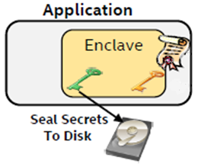
Sealing Process
  Key name, Policy, Enclave SVN
Enclave calls EGETKEY:
Policy options are Enclave or Sealing Identity.
2. Sets sealing key SVN with key
recovery transformation.
3. Seals data with yielded key and ISV chosen encryption
scheme.
4. Writes sealed data to untrusted storage.
EGETKEY Instruction
  Enclave and platform specific key
              Data sealed under: 1. Processor key
              CPU FW SVN
              OwnerEpoch
              Policy choice
Notes:
MRSIGNER is required as input for EGETKEY (as key name) to output the sealing key.
Enclave’s Identity Policy > a key for any instance of this exact enclave. Not future software. (e.g. after a vulnerability is found)
Sealing Identity Policy > a key that is available to enclaves signed by the same Sealing Authority (e.g. new SVN’s).

Slide 64
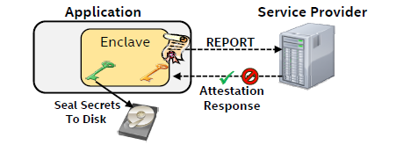
Attestation
SGX support local and remote HW based attestation capabilities.
  Local Attestation
  Allows one enclave to attest its TCB to another enclave on
  the same platform.
  Remote Attestation
  Allows an enclave to attest its TCB to another 3-rd party entity
  outside of the platform.

Slide 65

Local Attestation
Security instructions involved:
“Report”
  Verifier MRENCLAVE, …
  MRENCLAVE, Key name, …
EREPORT Instruction
EGETKEY Instruction
  REPORT (Attestation assertion structure)
  Claimer MRENCLAVE
  Claimer MRSIGNER
  Various addresser attributes
  Developer additional information
  kg
  CMAC tag using verifier key
  (To be Verified by "neighbored" enclave)
  Enclave and platform specific key
Notes:
EGETKEY return the key that is used to cryptographically verify the REPORT (the key is derived from SECS.MRENCALVE).
Same symmetric key:
EGEYKEY returns report key associated with invoking enclave.
EREPORT uses the key to sign the report but doesn't reveal it to invoker.

Slide 66
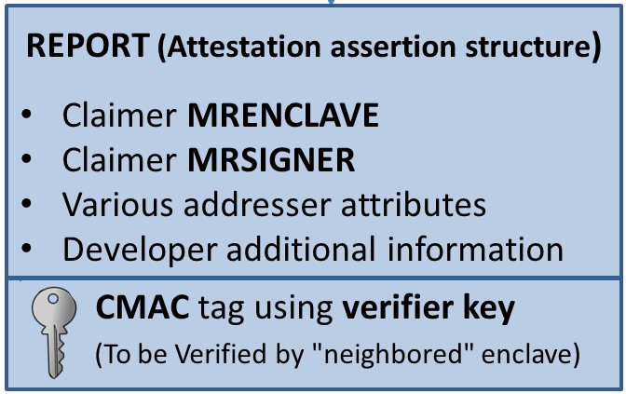
Local Attestation
Protocol flow:
Challenge (B’s MRENCALVE)
Response (REPORT)
Claimer
Verifier
REPORT*
Invokes EREPORT
Invokes EGETKEY
Verifies the REPORT:
  HW (REPORT key)
  SW (response details)
3. Invokes EREPORT
Invokes EGETKEY
Verifies the REPORT :
  HW (REPORT key)
  SW (response details)
* Optional
Notes:
Enclave B **can** then reciprocate by creating a REPORT for enclave A.

Slide 67
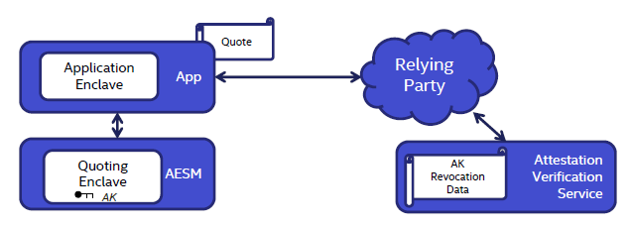
Remote Attestation
SGX uses a Quoting Enclave (QE) to convert LOCAL attestations to REMOTELY verifiable assertion.
QE locally verifies REPORT produced by Application Enclave and signs it as a QUOTE.
QE uses an asymmetric attestation key that reflects the platforms trustworthiness.
App sends Quote to the Relying Party to verify.
Platform
Local attestation
Remote attestation
Notes:
Problem – not same CPU - Remote party can not access it, how can it verify the TCB?
QE replaces the MAC over these REPORTs with a signature created with a device specific (private) asymmetric key.

Slide 68
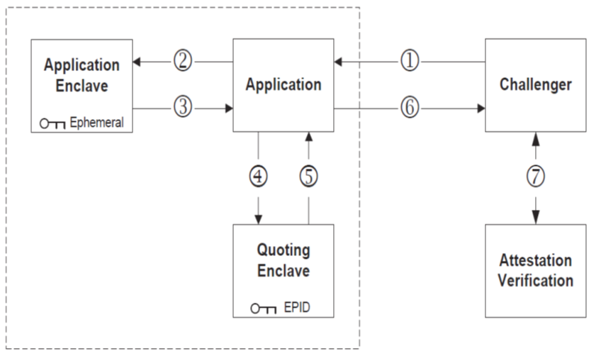

Remote Attestation
Protocol flow:
Challenge
Challenge
QOUTE
Claimer
Verifier
REPORT
Secrets
REPORT
8
QOUTE
QOUTE
Service /
Server run by intel
Verify report
Create Quote
Verify Quote
68
Notes:
Verification service - Public keys and revocation are issued to EPID
verifiers.
Can I fake QOUTEs? >>> EPID keys provide HW based platform identity.

Slide 69
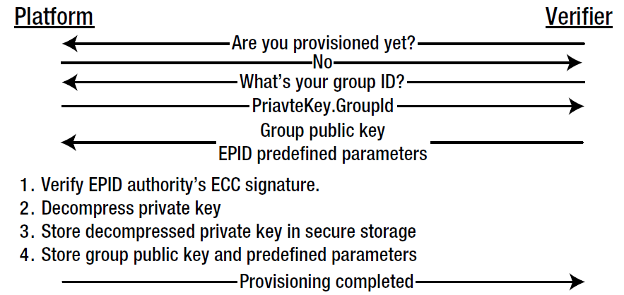
Provisioning the Attestation Key
To save expensive secure fuse space, a unique private key is generated on manufacturing and an unusable shorten form of it is fused on HW.
Group public key and other predefined parameters are sent to the device for it to extract and safely store the functional private key in a secure NVM.
Integrity is checked using hardcoded Intel EPID Authority public key.
Notes:
Provisioned info isn't secret.
Many manufacturers preform provisioning on manufacturing.

Slide 70
Summary
Enclave runs in ring-3 privilege level deriving trust directly from hardware.
Developers may focus on securing a smaller TCB.
Application can support multiple enclaves.
Resources are run & managed by OS, yet protected in face of a compromised OS/VMM.
Provides integrity and confidentiality, also in face of HW DMA attacks.
70

Slide 71
Questions & Open Discussion
Questions ?
What are the limitations of SGX?
Pinpoint the root of trust assumptions.
Techniques that can be implemented to try and breach enclave security.
Are they any drawbacks when utilizing SGX?
Innovative usages of SGX capabilities.
71

