Slide 1
Side channels and covert channels Part II – Other side channels
Slide credits: some slides and figures due to Debdeep Mukhopadhyay and Patrick Schaumont

Slide 2
Recap of discussion of last time
Side channel attacks possible on many shared structures
Co-location sometimes a problem
Defense approaches include
Prevent the leakage
Prevent sharing
Interfere with ability to measure leakage
Decorrelate leakage from critical data
What approach does NoMo, NewCache, RIC use?
Can you think of other defenses?
Solutions are piecewise – can we solve the problem in general?
Discussion at end of class: are these attacks used in practice?
Is security research just empowering attackers?

Slide 3
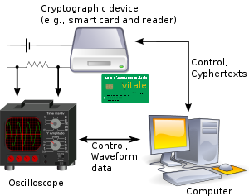
Possible Side Channels
Power
Time
Faults
Electro-Magnetic radiations
Sound
Scan Chains
and may be many more…

Slide 4
Simple Side Channel Analysis (SCA)
makes use of characteristics that are directly visible in one measurement trace.
The secret key needs to have some simple, exploitable relationship with the operations that are visible in the measurement trace.
Typically, vulnerable implementations include key dependent operations (e.g., branching, or key memory access)

Slide 5
Differential Side Channel Analysis
Differences not directly visible in one measurement trace.
Statistical methods have to be applied.
Typically targets one specific intermediate result
A typical approach chooses a selection function
i.e., intermediate result at the beginning or end of crypto algorithm
Result of the selection function depends on the known input/output data and a small number of hypotheses on the key value.
Outcome of selection function is a partitioning of the overall measurement data for each hypothesis used.
For the correct key hypothesis, different statistical properties of the two partitioning sets are expected

Slide 6
Differential Power Analysis
Kocher et al, 1999

Slide 7
Power Attacks (PA)
Differential Power Attacks (DPA) is a popular and difficult threat
Exploit the fact that (dynamic) power consumption of chip is correlated to intermediate results of the algorithm
To measure the circuit power, a small resistor (~50 Ω) is inserted in series with the power or ground input

Slide 8
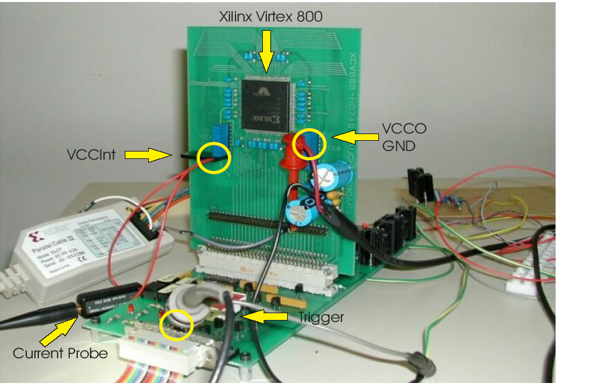
Lab Set Up for Power Analysis
Can sample voltage
differences at around
1GHz with less than
1% error. It also transfers
Data to a PC. Cost around
$400.
Courtesy: Side-Channel Analysis Lab,

Slide 9
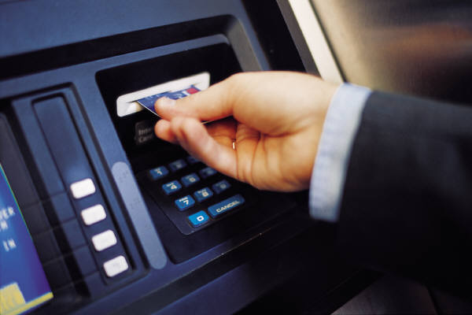
Simple Power Analysis
IC chip
Data input
Terminal
Data output
Power supply
011101101111101110111011101111000001
Measure power consumption
Guess secret information stored on IC chip memory
Power consumption
Secret information
1
0
1
1
0
Notes:
With side channel attacks it is possible to break implementations of cryptosystems even though no mathematical attack is known to solve the underlying problem. With SPA, one power trace is sufficient to reveal the secret.

Slide 10
Simple Power Analysis (SPA)
Directly interprets the power consumption of the device
Looks for the operations taking place and also the key!
Trace: A set of power consumptions across a cryptographic process
1 millisecond operation sampled at 5MHz yield a trace with 5000 points

Slide 11
DES Numerology
DES is a block cipher
64 bit block length
56 bit key length
16 rounds
48 bits of key used each round (subkey)
Each round is simple (for a block cipher)
Security depends primarily on “S-boxes”
Each S-boxes maps 6 bits to 4 bits
Each S-box has a share of 6 bits of the key

Slide 12
L
R
key
32
28
28
expand
shift
shift
32
48
28
28
K_{i}
One
Round
of
DES
⊕
48
48
compress
S-boxes
28
28
32
P box
32
32
⊕
32
L
R
key

Slide 13
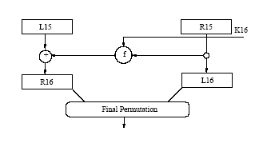
Last Round of DES

Slide 14
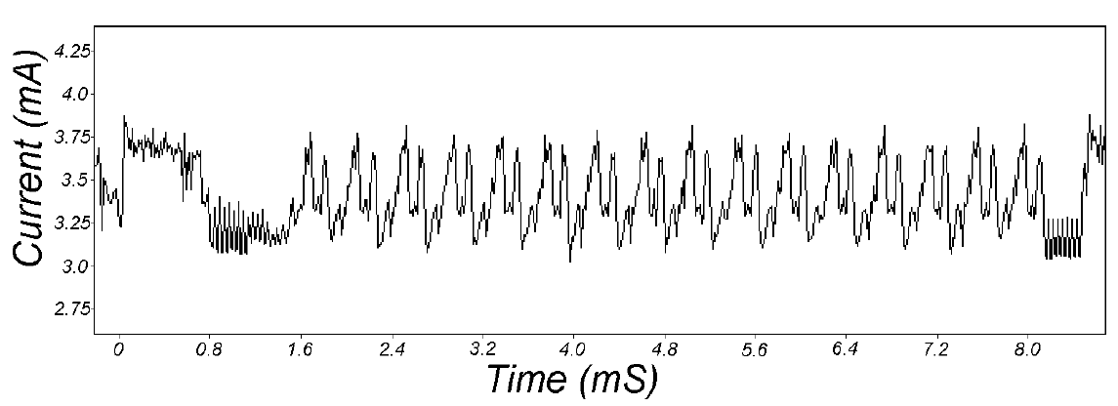
Power Traces of DES
16 Rounds of DES can be easily observed

Slide 15
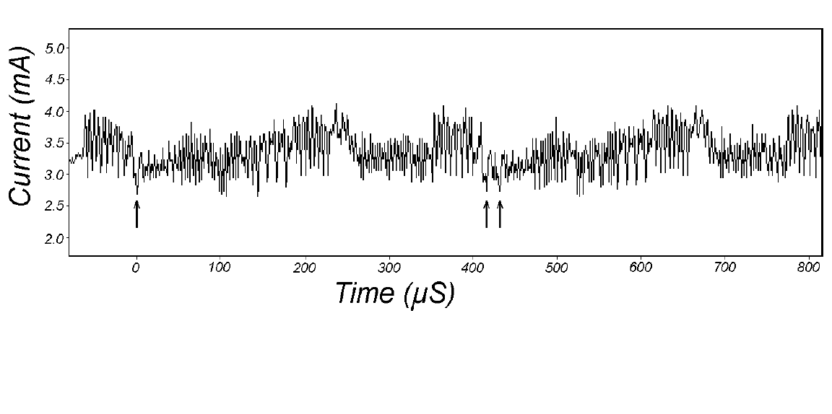
Power Traces for DES
The 28 bit key registers C and D are rotated once in round 2, while twice in
round 3. These conditional branches depending on the key bits
leak critical information.

Slide 16
Zoom in even more
Correspond to a conditional branch

Slide 17
Differential Power Analysis (DPA)

Slide 18
DPA Overview
Introduced by P. Kocher and colleagues
More powerful and more difficult to prevent than SPA
Different power consumption for different state (0 or 1)
Data collection phase and data analysis phase
Procedure
Gather many power consumption curves
Assume a key value
Divide data into two groups(0 and 1 for chosen bit)
Calculate mean value curve of each group
Correct key assumption → not negligible difference

Slide 19
DPA Procedure for DES
1. Make power consumption measurement of about 1000 DES operations, 100000 data points / curve, (Ciphertext_{i}, Curve_{i})
2. Assume a key for a S-box of last round
3. Calculate first S-box first bit output for each plaintext using the assumed key
4. Divide the measurement into 2 groups (output 0 and 1)
5. Calculate the average curve of each group
6. Calculate the difference of two curves
7. Assumed correct key → spikes in the differential curve
8. Repeat 2-7 for other S-boxes
9. Exhaustive search for 8 bits of key

Slide 20
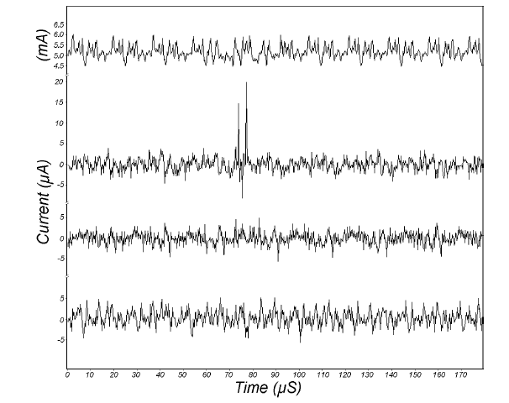
DPA Result Example
Average Power
Consumption
Power Consumption
Differential Curve
With Correct Key Guess
Power Consumption
Differential Curve
With Incorrect Key Guess
Power Consumption
Differential Curve
With Incorrect Key Guess

Slide 21
DPA in details
DPA selection function : D(C,b,K_{s}) is defined as computing the value of the
b^{th} output bit in L in the previous stage, depending upon
C: Ciphertext
K_{S} is the guessed key (6 bits) for the S-Box
Note: If K_{s} is incorrect evaluating D(…) gives the correct bit in half of the cases for each of the ciphertexts.

Slide 22
DPA in details
Attacker obtains m encryption operations and capture power traces, T_{1..m}[1..k], with k sample points each.
An attacker records the m ciphertexts
No knowledge of the plaintext is required

Slide 23
Attacker’s Power Board
Sample Points
T[1][1]
T[1][2]
T[1][k]
C
I
P
H
E
R
T
E
X
T
S
T[2][1]
T[2][2]
T[2][k]
.
.
.
.
T[m][1]
T[m][2]
T[2][k]

Slide 24
The Selection Function D
Attacker knows L16, hence R15
Attacker knows R16
Guess K16 (6 bits)
Compute output of f
Compute the b^{th} bit
of L15
If K₁₆ is wrongly guessed, then the computed value b matches with the correct result half of the time

Slide 25
DPA in details
Attacker now computes a k-sample differential trace Δ_{D}[1..k] by finding the difference between the average of the traces for which D(…) is one and the average for which D(…) is zero.
Principle: If K_{s} is wrongly guessed, D behaves like a random guess.
Thus for a large number of sample points, ΔD[1..k] tends to zero. But
if its correct, the differential will be non-zero and show spikes when
D is correlated with the value being processed.

Slide 26
DPA in details
The correct value of K_{s} can thus be identified from the spikes
After computing the 48 bits, one can perform brute force attack on the remaining 8 bits in the keying material.
Note that noise, measurement errors etc have no effect on this method (as they also are uncorrelated to the data being processed--- just like the wrong guess)…

Slide 27
Countering DPA
Two broad approaches are taken
Make the power consumption of the device independent of the data processed
Detached power supplies
Logic styles with a data independent power consumption
Noise generators
Insertion of random delays
Methods are costly and not in tune with normal CAD methodologies

Slide 28
Fighting DPA with constant-power circuits
The problem: Dynamic power consumption is asymmetrical and dependent on data
V_{cc}
V_{cc}
V_{dd}
V_{dd}
V_{dd}
V_{dd}
The solution:
Consume the same current for all input patterns
Differential Logic:
Use dual rail logic implementation
Makes '0' the same as '1' (hamming-weight independent)
Dynamic Logic:
Use pre-charge phase and evaluate phase
Makes '0->0' the same as '0->1', '1->1', '1->0' (hamming-distance independent)
Notes:
Now how do we combat these correlation attacks ?
They key of the problem here is that power consumption depends on the data pattern produced.
Thus, the solution is to make power consumption independent of the data pattern.
This leads to differential and dynamic logic.

Slide 29
Wave Dynamic Differential Logic
WDDL INPUT
pre
eval
pre
eval
WDDL AND
A
B
A
Q
A
B
A
B
Q
B
Q
clk
Q
A=1
A=1
pre-charge
B=0
B=1
clk
Always a single output transition
evaluate
Notes:
Here are examples of wave dynamic differential logic gates.
The wave comes from the precharge phase, where a wave of precharge values travels through the entire circuit.
A conversion circuit to go from single-ended to differential is shown on the left of the slide.
We need a clock signal to alternate precharge and evaluate phases.
From the timing diagram, we see a constant number of transitions are needed.

Slide 30
Matching interconnect capacitance
WDDL AND
WDDL OR
A
B
A
B
Total capacitance
Output capacitance
Wiring capacitance
Input capacitance
(Cell design)
(Cell design)
Routing
Parallel tracks for constants mutual C
Identical crosstalk cap
Equal via's, segment lengths, .. for constant R
Mismatch causes 2nd order effects !
Notes:
Having matched gates is not enough. We want the differential nets also to drive equal capacitance.
This capacitance consists of the intrinsic cap of each gate, and the wiring cap.
We thus also need to take care of routing.
This is very hard because automatic P&R are not easy to influence.

Slide 31
Countering DPA
Second Approach is to randomize the intermediate results
Based on the principle that the power consumption of the device processing randomized data is uncorrelated to the actual intermediate results
Masking: Can be applied at the algorithm level or at the gate level
Approach studied by

Slide 32
Gate Level Masking
No wires stores a value that is correlated to an intermediate result of the algorithm.
Process of converting an unmasked digital circuit to a masked version can be automated

Slide 33
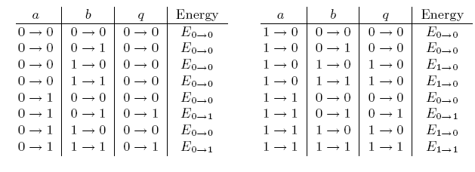
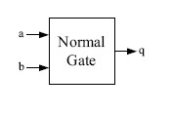
Why are normal gates susceptible to DPA?
Attacker measures large number of power traces
Splits the traces into two groups when q=0 and when q=1 at the end
of the clock cycles.
The expected means are not in general equal, leading to DPA attacks
(as there are spikes in the differential trace)
Here, means of the energies of the groups are:
E(q=0)=(3E_{1->0}+9E_{0->0})/12; E(q=1)=(3E_{0->1}+E_{1->1})/4
Since, E(q=0)≠E(q=1), DPA attack is possible

Slide 34
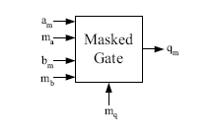
Masked And Gate
There are 4⁵=1024 possible input transmissions that can occur.
It turns out that the expected value of the energy required for the
processing of q=0 and q=1 are identical.
Thus protected against DPA, under the assumption that the CMOS
gates switch only once in one clock cycles.
But we know there are glitches, and so the output of gates swing
a number of times before reaching a steady state. Hence... the
argument continues.

Slide 35
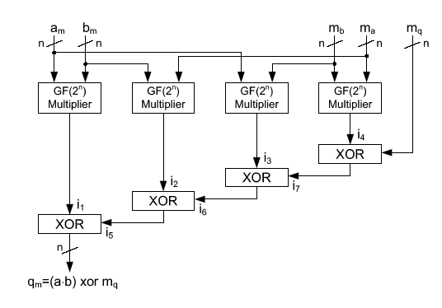
Masked Multiplier
Same Principle may be applied for multiplier circuits.
q_{m}=(a.b)xor m_{q}=(a_{m}xor m_{a}).(b_{m} xor m_{b}) xor m_{q}
=(a_{m}.b_{m}) (xor (b_{m}.m_{a}) (xor (m_{b}.a_{m}) (xor ((m_{a}.m_{b}) xor m_{q}))))

Slide 36
Concluding points on masking
Transitions, T(a_{m}), T(m_{a}), T(b_{m}), T(m_{b}) do not leak
Correlations, ρ(T(i_{j}),a)= ρ(T(i_{j}),b)= ρ(T(i_{j}),c)=0, for j=1 to 4.
So xor gates leak information about unmasked values
Reason is that the xor gates does not change output when both the inputs change value simultaneously or within a small time
Thus the power consumption of the xor gates depend on the time of arrival of the signals i₁ to i₄.
These time delays are related to the unmasked values
Thus the masked circuits are still vulnerable to DPA, because of delays in circuits.

